Slide 1
Statistical Data Analysis
Prof. Dr. Nizamettin AYDIN
naydin@yildiz.edu.tr
http://www.yildiz.edu.tr/~naydin

Slide 2
Examples

Slide 3
Example 1
We have measured the height (in inches) and weight (in pounds) for five newborn babies (shown in the table).
Manually calculate the mean and standard deviation of height and weight; show all the steps.
Table: Height (in inches) and weight (in pounds) for five newborn babies
Observation | Height | Weight
1 | 18 | 7.8
2 | 21 | 9.1
3 | 17 | 8.2
4 | 16 | 6.4
5 | 19 | 8.8

Slide 4
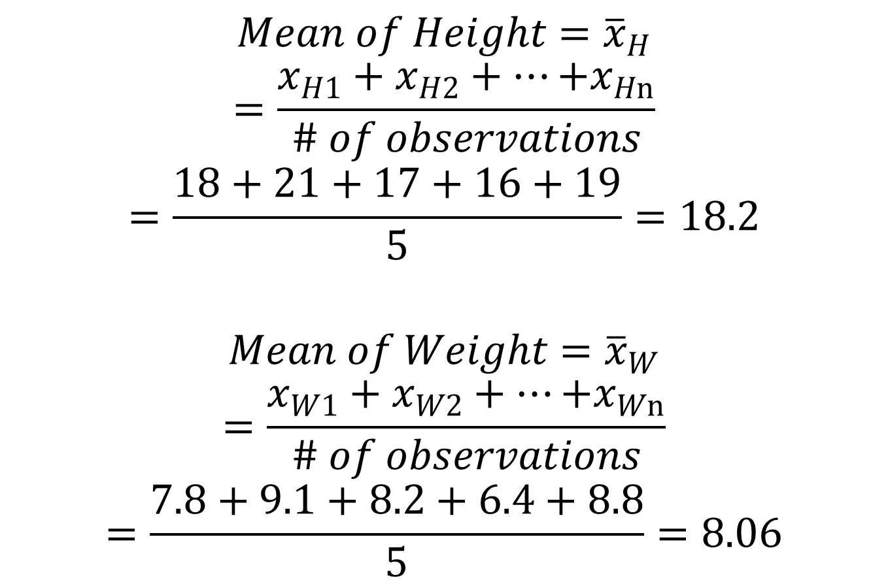
Answer 1
$$Mean of Height={\overline{x}}_{H}$$
$$=\frac{x_{H1}+x_{H2}+…{+x}_{Hn}}{\# of observations}$$
$$=\frac{18+21+17+16+19}{5}=18.2$$
$$Mean of Weight={\overline{x}}_{W}$$
$$=\frac{x_{W1}+x_{W2}+…{+x}_{Wn}}{\# of observations}$$
$$=\frac{7.8+9.1+8.2+6.4+8.8}{5}=8.06$$

Slide 5
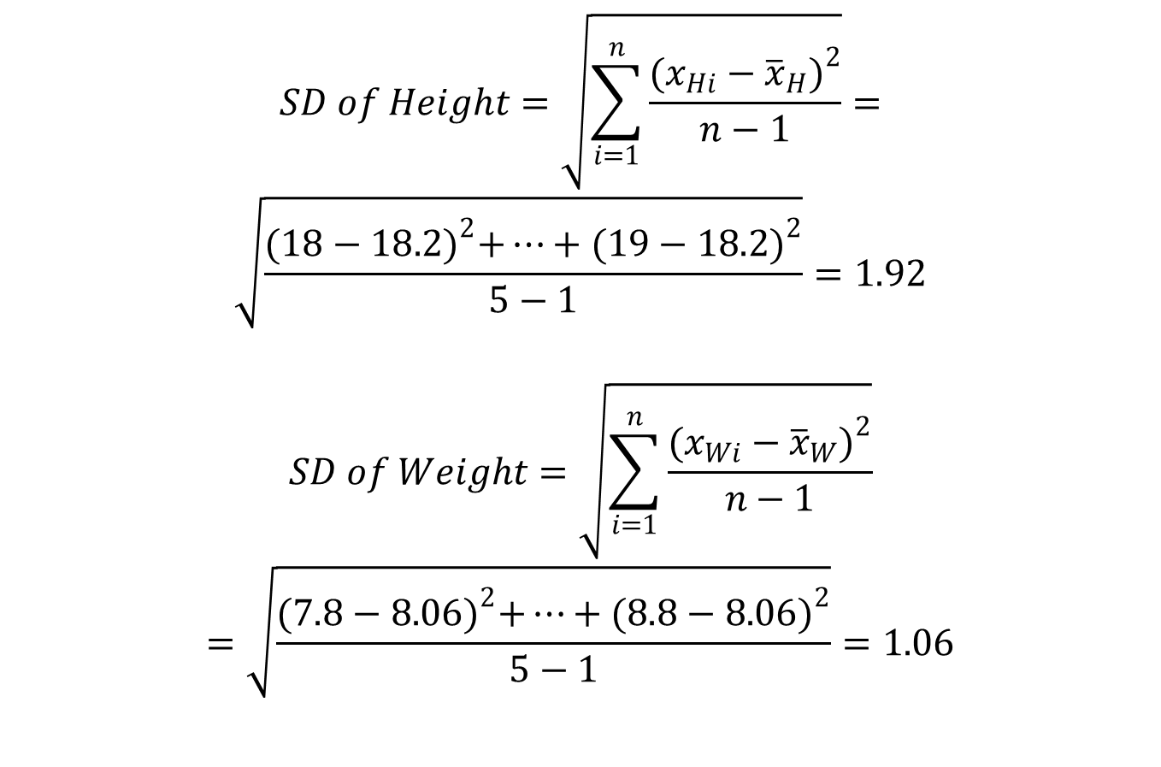
Answer 1
$$SD of Height=\sqrt{\sum_{i=1}^{n}{\frac{{(x_{Hi}−{\overline{x}}_{H})}^{2}}{n−1}}}=$$
$$\sqrt{\frac{{(18−18.2)}^{2}+⋯+{(19−18.2)}^{2}}{5−1}}=1.92$$
$$SD of Weight=\sqrt{\sum_{i=1}^{n}{\frac{{(x_{Wi}−{\overline{x}}_{W})}^{2}}{n−1}}}$$
$$=\sqrt{\frac{{(7.8−8.06)}^{2}+⋯+{(8.8−8.06)}^{2}}{5−1}}=1.06$$

Slide 6
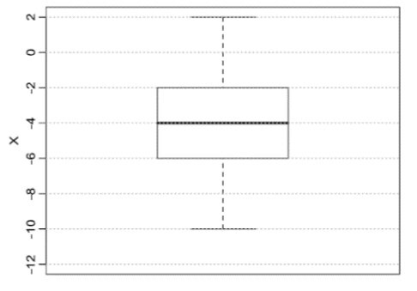
Example 2
Based on the following boxplot, write down the five-number data summary, range and IQR of variable X.
Boxplot of variable X

Slide 7
Answer 2
Five number summary =
  Min = -10,
  Q1 = -6,
  Q2 (median) = -4,
  Q3 = -2,
  Max = 2
Range = Max – Min
  = 2 - (-10) = 12
IQR = Q3 – Q1
  = -2 - (-6) = 4

Slide 8
Example 3
Some values of a row in an image matrix is given as;
  x = {..., 4, 6, 50, 7, 5, 80, 4, 4, 7, 60, 6, 4, 8, 40, 7, 5, ...} .
Inspecting the values in this row reveals that this image is contaminated by impulsive noise (for example 50, 80, …).
Suggest a filtering method to remove this impulsive noise.
What will be the resulting values of the row after applying the filter?

Slide 9
Answer 3
I would suggest to use moving (sliding) median filter,
  as it is a non-linear filter to remove impulsive noise.
  x_{new} = {..., 4, 6, 7, 7, 7, 5, 4, 4, 7, 7, 6, 6, 8, 8, 7, 5, ...}
  x_{old} = {..., 4, 6, 50, 7, 5, 80, 4, 4, 7, 60, 6, 4, 8, 40, 7, 5, ...}

Slide 10
Example 4
A large drug company has 100 potential new prescription drugs under clinical test.
About 20% of all drugs that reach this stage are eventually licensed for sale.
What is the probability that at least 15 of the 100 drugs are eventually licensed?
  Assume that the binomial assumptions are satisfied, and use a normal approximation with continuity correction.

Slide 11
Answer 4
The mean of y
  μ = nθ = 100×0.2 = 20
The standard deviation
  σ = sqrt(nθ(1 − θ)) = sqrt(100×0.2× (1 − 0.2 )) = 4
  The desired probability is that 15 or more drugs are approved.
  Because y =15 is included, the continuity correction is to take the event as y greater than or equal to 14.5.

Slide 12
Continuity Correction Factor
used when a continuous probability distribution is used to approximate a discrete probability distribution.
  For example, when you want to use the normal to approximate a binomial.
According to the Central Limit Theorem, the sample mean of a distribution becomes approximately normal if the sample size is “large enough.”
  For example, the binomial distribution can be approximated with a normal distribution as long as n×p and n×q are both at least 5. Here,
    n = how many items are in your sample,
    p = probability of an event (e.g. 60%),
    q = probability the event doesn’t happen (100% – p).

Slide 13
Continuity Correction Factor
The continuity correction factor accounts for the fact that a normal distribution is continuous, and a binomial is not.
When you use a normal distribution to approximate a binomial distribution, you’re going to have to use a continuity correction factor.
It is as simple as adding or subtracting 0.5 to/from the discrete x-value:
  use the following table to decide whether to add or subtract.
    If P(X=n) use P(n – 0.5 < X < n + 0.5)
    If P(X > n) use P(X > n + 0.5)
    If P(X ≤ n) use P(X < n + 0.5)
    If P (X < n) use P(X < n – 0.5)
    If P(X ≥ n) use P(X > n – 0.5)

Slide 14
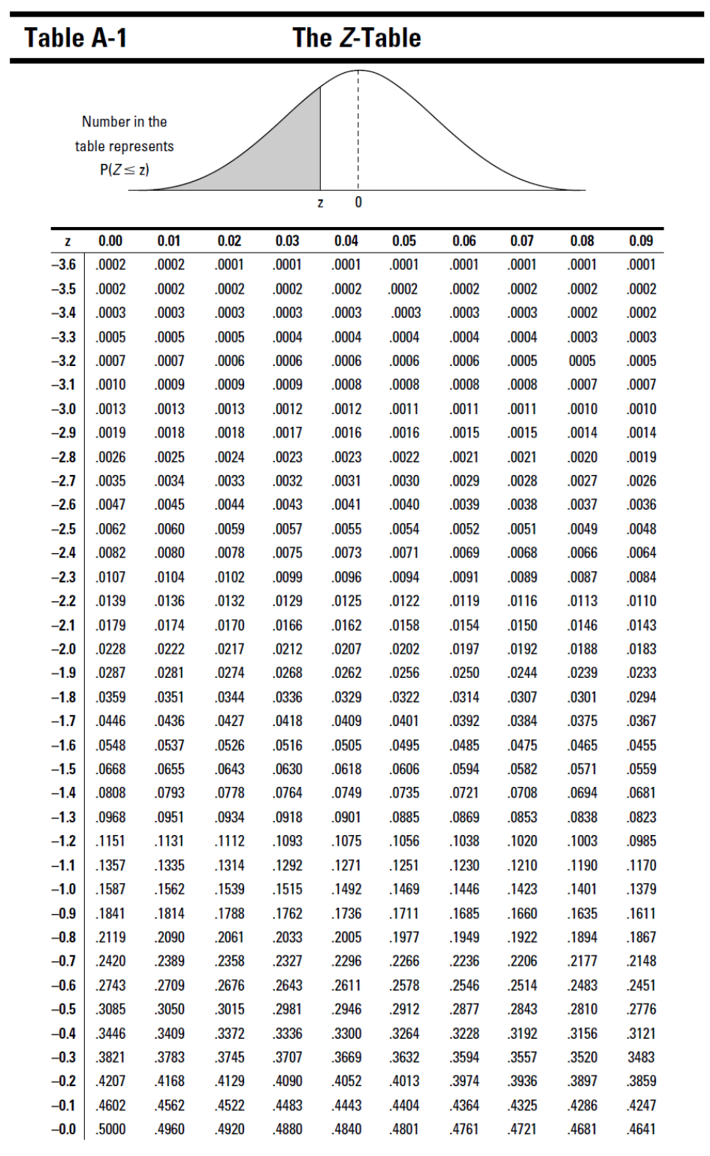
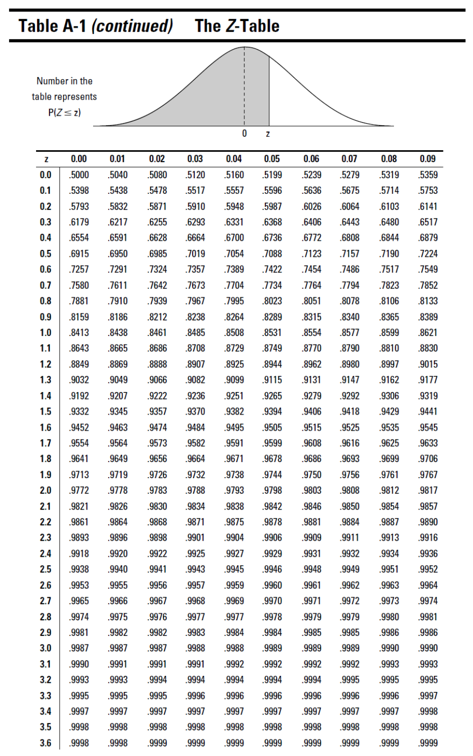

Slide 15
Finding probabilities for Z with the Z-table
To use the Z-table to find probabilities for the standard normal (Z-) distribution
  Go to the row that represents the first digit of your z-value and the first digit after the decimal point.
  Go to the column that represents the second digit after the decimal point of your z-value.
  Intersect the row and column.
This result represents p(Z < z), the probability that the random variable Z is less than the number z (also known as the percentage of z-values that are less than yours).

Slide 16
Finding Probabilities for a Normal Distribution
Draw a picture of the distribution.
Translate the problem into one of the following:
  p(X < a), p(X > b), or p(a < X < b).
  Shade in the area on your picture.
Standardize a (and/or b) to a z-score using the z-formula:
Look up the z-score on the Z-table and find its corresponding probability.
  If you need a “less-than” probability — that is, p(X < a) — you’re done.
  If you want a “greater-than” probability — that is, p(X > b) — find 1- p(X < b) .
If you need a “between-two-values” probability — that is, p(a < X < b) — perform the same steps defined above for b and a, and subtract the results.

Slide 17
Example 5
Suppose that you enter a fishing contest.
The contest takes place in a pond where the fish lengths have a normal distribution with mean μ = 16 cm and standard deviation σ = 4 cm.
  What is the chance of catching fish less than 8 cm?
  Suppose a prize is offered for any fish over 24 cm. What is the chance of winning a prize?
  What is the chance of catching a fish between 16 and 24 cm?

Slide 18
Answer 5
Need to find
  p(X < 8),
  p(X > 24),
  p(16 < X < 24).
First change the x-values to z-values using the z-formula:
  1. chance of catching fish less than 8 cm:
  = 0.0228
  2. chance of winning a prize

Slide 19
Answer 5
  p(Z > 2.00) = 1 – p(Z < 2.00) = 1 – 0.9772 = 0.0228
  3. chance of catching a fish between 16 and 24 cm
    find p(Z < 2.00), which is 0.9772
    find p(Z < 0), which is 0.5000
  p(0 < Z < 2) = 0.9772 - 0.5000 = 0.4772
    The chance of a fish being between 16 and 24 cm is 0.4772

Slide 20
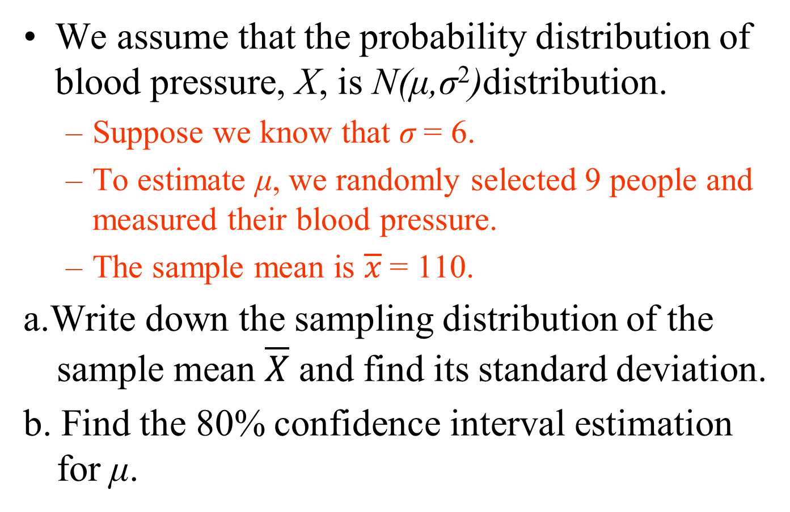
Example 6
We assume that the probability distribution of blood pressure, X, is N(μ,σ²)distribution.
  Suppose we know that σ = 6.
  To estimate μ, we randomly selected 9 people and measured their blood pressure.
  The sample mean is $\overline{x}$ = 110.
a.Write down the sampling distribution of the sample mean $\overline{X}$ and find its standard deviation.
b. Find the 80% confidence interval estimation for μ.

Slide 21
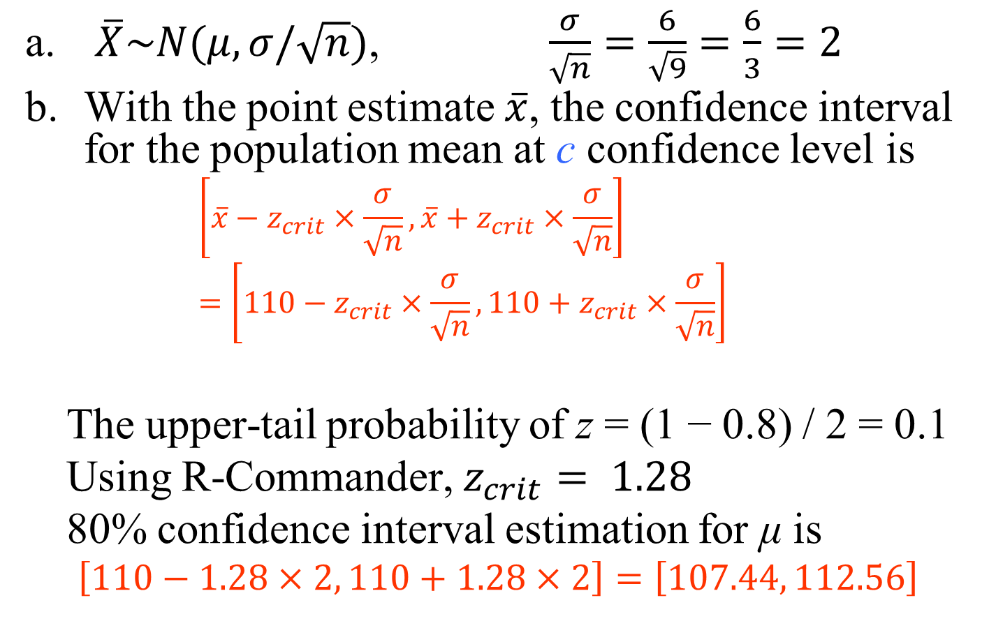
Answer 6
$\overline{X}\sim N(μ,σ/\sqrt{n})$, $\frac{σ}{\sqrt{n}}=\frac{6}{\sqrt{9}}=\frac{6}{3}=2$
With the point estimate $\overline{x}$, the confidence interval for the population mean at c confidence level is
  $$\left[\overline{x}−z_{crit}×\frac{σ}{\sqrt{n}}, \overline{x}+z_{crit}×\frac{σ}{\sqrt{n}}\right]=\left[110−z_{crit}×\frac{σ}{\sqrt{n}}, 110+z_{crit}×\frac{σ}{\sqrt{n}}\right]$$
The upper-tail probability of z = (1 − 0.8) / 2 = 0.1
Using R-Commander, $z_{crit}= 1.28$
80% confidence interval estimation for μ is
  $$\left[110−1.28×2, 110+1.28×2\right]=\left[107.44, 112.56\right]$$

Slide 22
Example 7
For the question in Example 5, suppose that we did not know σ and estimated it using the sample standard deviation s = 6.
  Find the standard error for the sample mean as the estimator of the population mean.
  Find the 80% confidence interval estimation for μ based on this sample.

Slide 23
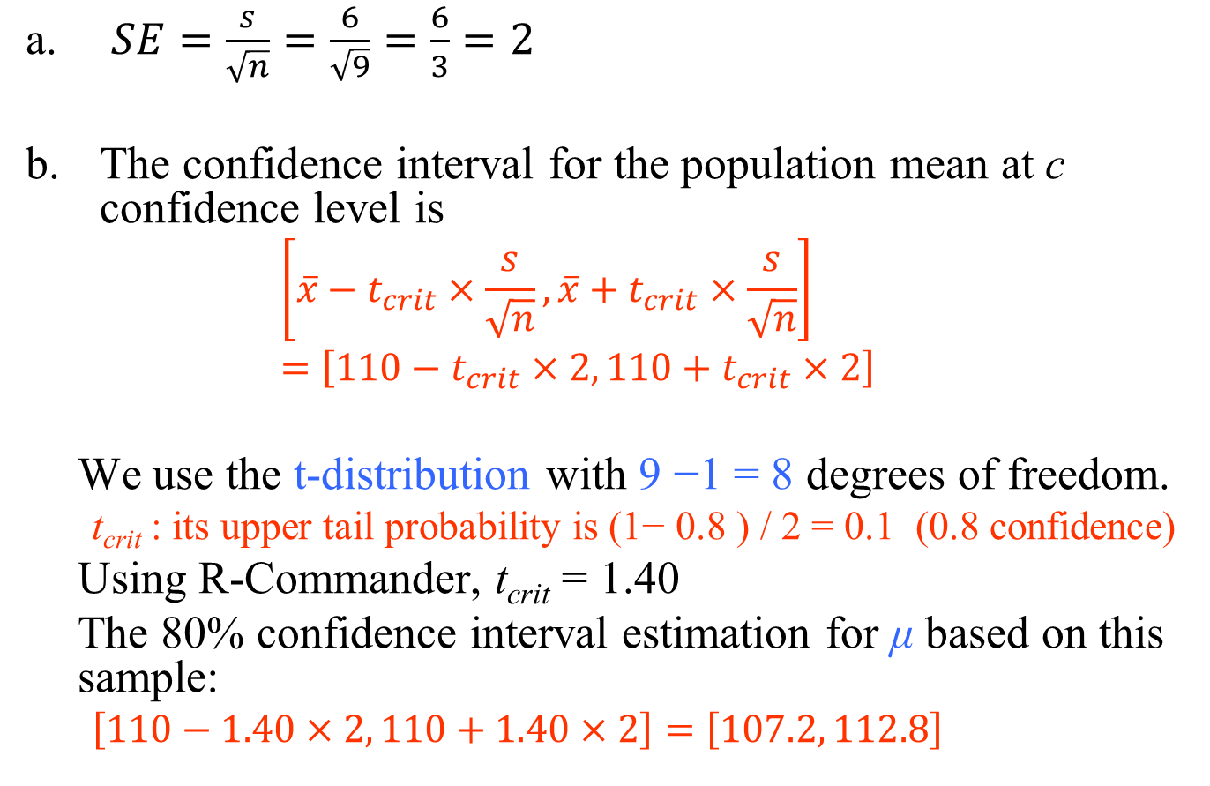
Answer 7
$SE=\frac{s}{\sqrt{n}}=\frac{6}{\sqrt{9}}=\frac{6}{3}=2$
The confidence interval for the population mean at c confidence level is
  $$\left[\overline{x}−t_{crit}×\frac{s}{\sqrt{n}}, \overline{x}+t_{crit}×\frac{s}{\sqrt{n}}\right]=\left[110−t_{crit}×2, 110+t_{crit}×2\right]$$
We use the t-distribution with 9 −1 = 8 degrees of freedom.
  t_{crit} : its upper tail probability is (1− 0.8 ) / 2 = 0.1 (0.8 confidence)
Using R-Commander, t_{crit} = 1.40
The 80% confidence interval estimation for μ based on this sample:
  $\left[110−1.40×2, 110+1.40×2\right]=\left[107.2, 112.8\right]$

Slide 24
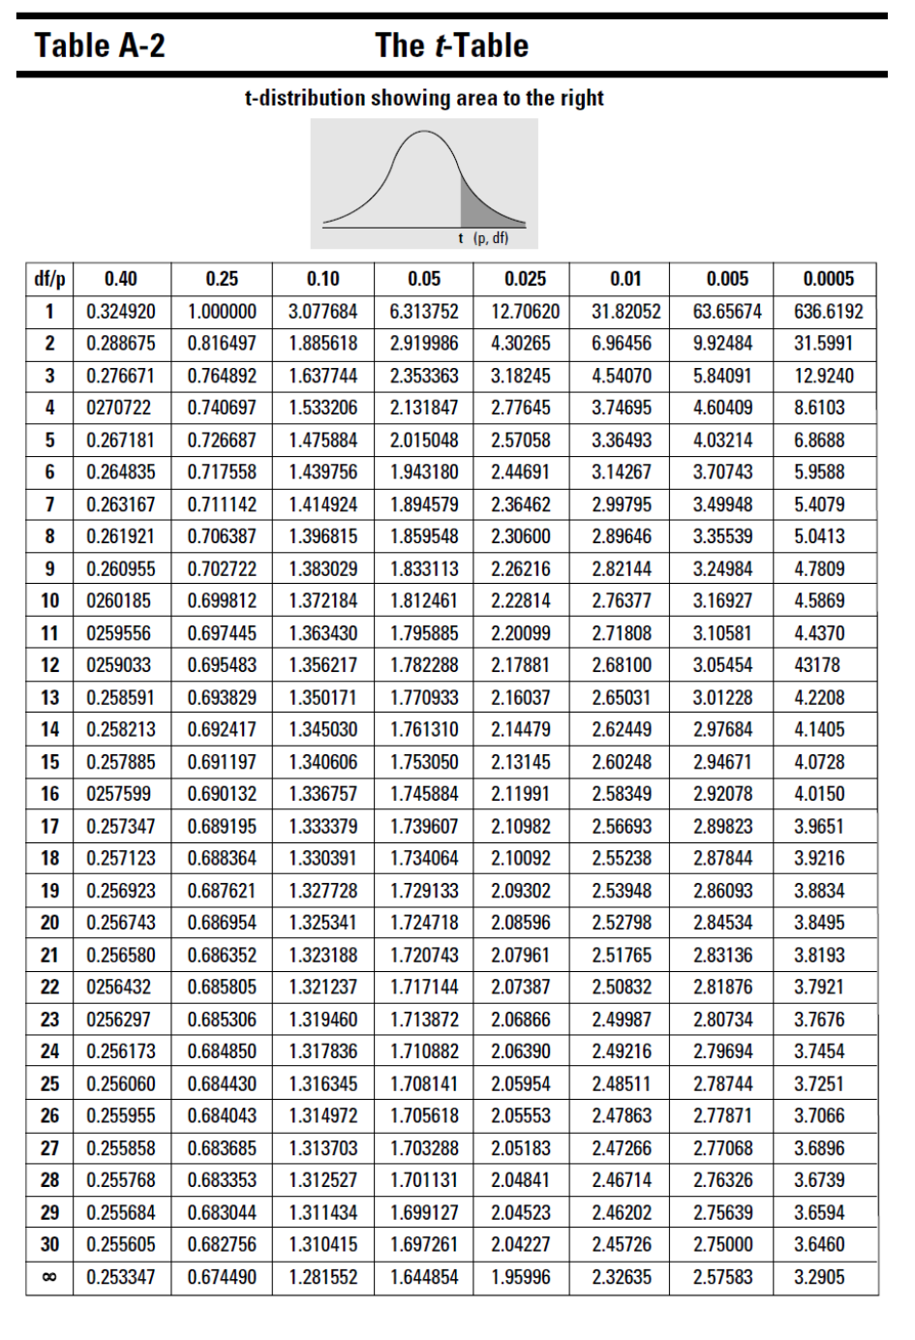

Slide 25
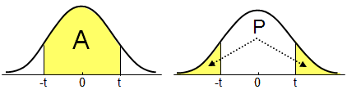

Slide 26
Example 8
A person visits her doctor with concerns about her blood pressure.
  If the systolic blood pressure exceeds 150, the patient is considered to have high blood pressure and medication may be prescribed.
A patient’s blood pressure readings often have a considerable variation during a given day.
Suppose a patient’s systolic blood pressure readings during a given day have a normal distribution with a mean μ = 160 mm mercury and a standard deviation σ = 20 mm.
What is the probability that a single blood pressure measurement will fail to detect that the patient has high blood pressure?
If five blood pressure measurements are taken at various times during the day, what is the probability that the average of the five measurements will be less than 150 and hence fail to indicate that the patient has high blood pressure?
How many measurements would be required in a given day so that there is at most 1% probability of failing to detect that the patient has high blood pressure?

Slide 27
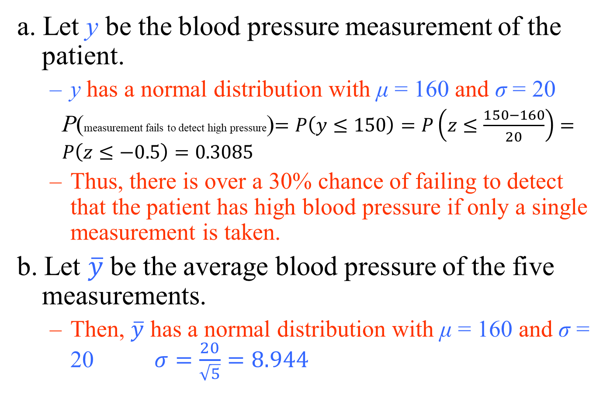
Answer 8
a. Let y be the blood pressure measurement of the patient.
  y has a normal distribution with μ = 160 and σ = 20
P(measurement fails to detect high pressure)$=P\left(y≤150\right)=P\left(z≤\frac{150−160}{20}\right)=P\left(z≤−0.5\right)=0.3085$
  Thus, there is over a 30% chance of failing to detect that the patient has high blood pressure if only a single measurement is taken.
  b. Let $\overline{y}$ be the average blood pressure of the five measurements.
  Then, $\overline{y}$ has a normal distribution with μ = 160 and σ = 20 $σ=\frac{20}{\sqrt{5}}=8.944$

Slide 28
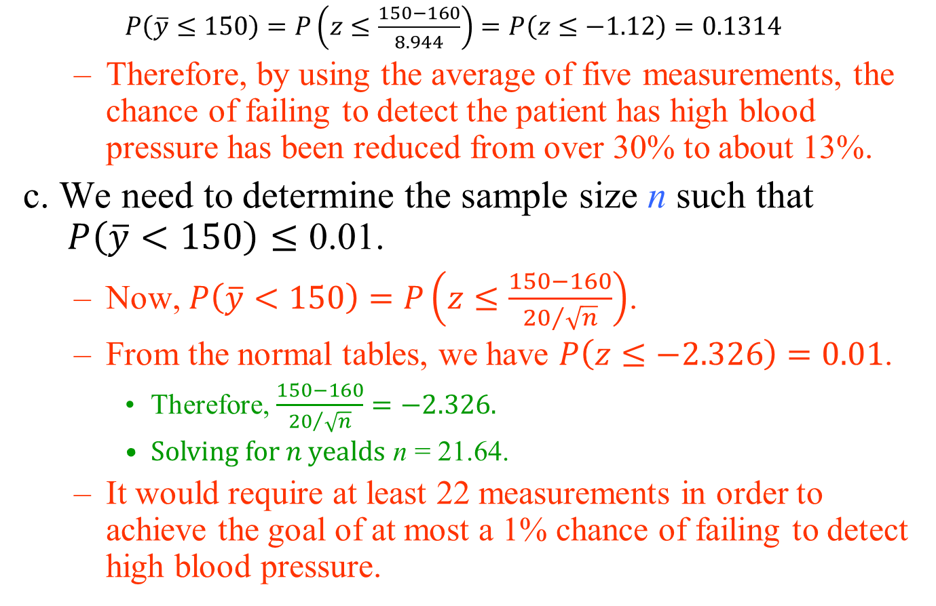
Answer 8
$P\left(\overline{y}≤150\right)=P\left(z≤\frac{150−160}{8.944}\right)=P\left(z≤−1.12\right)=0.1314$
  Therefore, by using the average of five measurements, the chance of failing to detect the patient has high blood pressure has been reduced from over 30% to about 13%.
c. We need to determine the sample size n such that $P\left(\overline{y}<150\right)≤\text{0.01}$.
  Now, $P\left(\overline{y}<150\right)=P\left(z≤\frac{150−160}{{20}/{\sqrt{n}}}\right)$.
  From the normal tables, we have $P\left(z≤−2.326\right)=0.01$.
    Therefore, $\frac{150−160}{{20}/{\sqrt{n}}}=−2.326.$
    $Solving for n yealds$ n = 21.64.
  It would require at least 22 measurements in order to achieve the goal of at most a 1% chance of failing to detect high blood pressure.

Slide 29
Example 9
A company took a random sample of 30 first-year employees and asked them their level of satisfaction with their jobs.
  It found that 80% of those sampled were “very happy” with their employment, ± 3% at a confidence level of 95%.
  The company took this information and reported that 80% of all its employees were very happy with their jobs, ± 3%.
Is that report is correct?

Slide 30
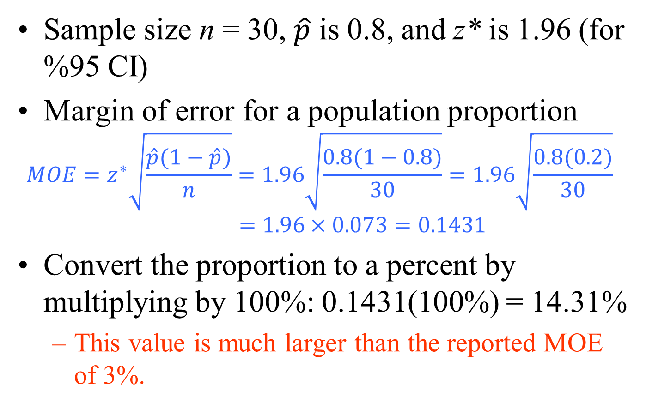
Answer 9
Sample size n = 30, $\hat{p}$ is 0.8, and z* is 1.96 (for %95 CI)
Margin of error for a population proportion
$$MOE=z^{∗}\sqrt{\frac{\hat{p}(1−\hat{p})}{n}}=1.96\sqrt{\frac{0.8(1−0.8)}{30}}=1.96\sqrt{\frac{0.8(0.2)}{30}}$$
$$=1.96×0.073=0.1431$$
Convert the proportion to a percent by multiplying by 100%: 0.1431(100%) = 14.31%
  This value is much larger than the reported MOE of 3%.

Slide 31
Example 10
A poll of 1000 likely voters showed that Candidate Ali had 48% of the vote, and Candidate Veli had 52% of the vote.
The margin of error was ± 3%, and the confidence level was 98%.
Who is most likely to win the election?

Slide 32
Answer 10
The margin of error is used to construct the confidence interval,
  which is a range of likely values for the population parameter
    here, the parameter is the percentage of all voters who would vote for a candidate.
To calculate a confidence interval, you take the result from the sample and add and subtract the margin of error.
In this case,
  the 98% confidence interval for the proportion of all voters for Candidate Ali is 48% plus or minus 3%,
    which is a range of 45% to 51%.

Slide 33
Answer 10
For Candidate Veli,
  the 98% confidence interval is 52% plus or minus 3%,
    which is a range of 49% to 55%.
Both confidence intervals contain possible values above 50%, so either candidate could win;
  therefore, the results are too close to call.

