Slide 1
Statistical Data Analysis
Prof. Dr. Nizamettin AYDIN
naydin@yildiz.edu.tr
http://www.yildiz.edu.tr/~naydin

Slide 2
Examples

Slide 3
Grouped data median
The median for grouped data is slightly more difficult to compute.
Because the actual values of the measurements are unknown, we know that the median occurs in a particular class interval, but we do not know where to locate the median within the interval.
If we assume that the measurements are spread evenly throughout the interval, we get the following result.

Slide 4
Let
  L = lower class limit of the interval that contains the median
  n = total frequency
  cf_{b} = the sum of frequencies (cumulative frequency) for all classes before the median class
  f_{m} = frequency of the class interval containing the median
  w = interval width
Then, for grouped data,
  median = L +(w/f_{m})(0.5n - cf_{b})

Slide 5
Example 1
Considering the following table, compute the median number of ticks per cow for these data.

Slide 8
Let the cumulative relative frequency for class j equal the sum of the relative frequencies for class 1 through class j.
To determine the interval that contains the median, we must find the first interval for which the cumulative relative frequency exceeds 0.50.
This interval is the one containing the median.
For these data, the interval from 28.75 to 31.25 is the first interval for which the cumulative relative frequency exceeds 0.50, as shown in table, Class 6.
So this interval contains the median.

Slide 9
Then
  L = 28.75
  n = 100
  cf_{b} = 47
  f_{m} = 24
  w = 2.5
  median = 28.75 +(2.5/ 24)(0.5 × 100 - 47) = 29.06

Slide 10
Grouped data percentiles
When the data are grouped, for example, the 75th percentile for a set of grouped data would be computed using the following formula.
P = L +(w/f_{p})(0.75n - cf_{b})
where
  P = percentile of interest
  L = lower limit of the class interval that includes the percentile of interest
  n = total frequency
  cf_{b} = cumulative frequency for all class intervals before he percentile class
  f_{p} = frequency of the class interval that includes the percentile of interest
  w = interval width

Slide 11
Example 2
Referring to the tick data Table in previous example, compute the 90th percentile.
Solution
  Because the eighth interval is the first interval for which the cumulative relative frequency exceeds 0.90, we have
    L = 33.75
    n = 100
    cf_{b} = 82
    f₉₀ = 11
    w = 2.5
    P₉₀ = L +(w/f_{p})(0.9n - cf_{b})=33.75+(2.5/11)(0.9×100-82)=35.57

Slide 12
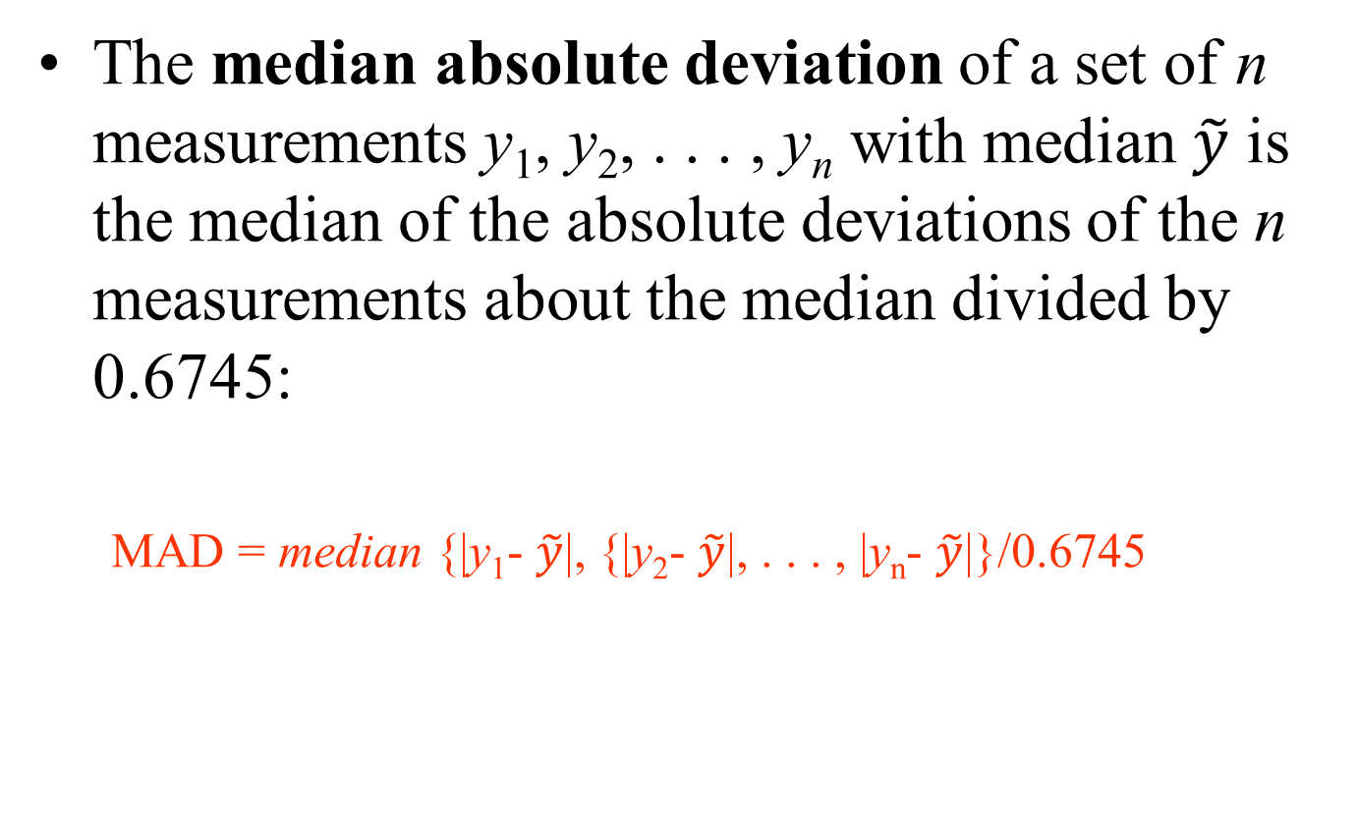
Median Absolute Deviation
The median absolute deviation of a set of n measurements y₁, y₂, . . . , y_{n} with median $\tilde{y}$ is the median of the absolute deviations of the n measurements about the median divided by 0.6745:
  MAD = median {|y₁- $\tilde{y}$|, {|y₂- $\tilde{y}$|, . . . , |y_{n}- $\tilde{y}$|}/0.6745

Slide 13
Median Absolute Deviation
  You may wonder why the median of the absolute deviations is divided by the value 0.6745.
  In a population having a normal distribution with standard deviation σ, the expected value of the absolute deviation about
  the median is 0.6745 σ.
  By dividing the median absolute deviation by 0.6745, the expected value of MAD in a population having a normal distribution is equal to s.
  Thus, the values computed for MAD and the sample standard deviation are also the expected values for data randomly selected from populations that have a normal distribution.

Slide 14
Example 3
A corporation is proposing to select two of its current regional managers as vice presidents. In the history of the company, there has never been a female vice president. The corporation has six male regional managers and four female regional managers. Make the assumption that the 10 regional managers are equally qualified and hence all possible groups of two managers should have the same chance of being selected as the vice presidents.
Now find the probability that both vice presidents are male.

Slide 15
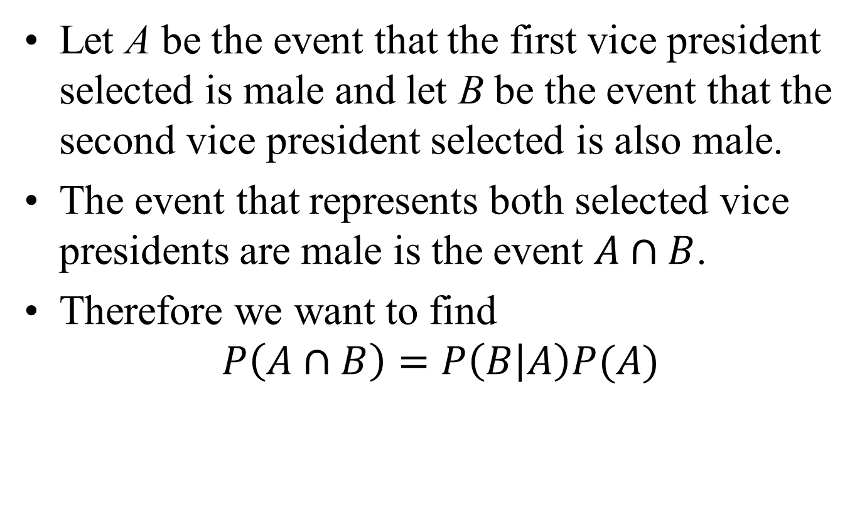
Example 3 - solution
Let A be the event that the first vice president selected is male and let B be the event that the second vice president selected is also male.
The event that represents both selected vice presidents are male is the event $A∩B$.
Therefore we want to find
$$P\left(A∩B\right)=P\left(B | A\right)P(A)$$

Slide 16
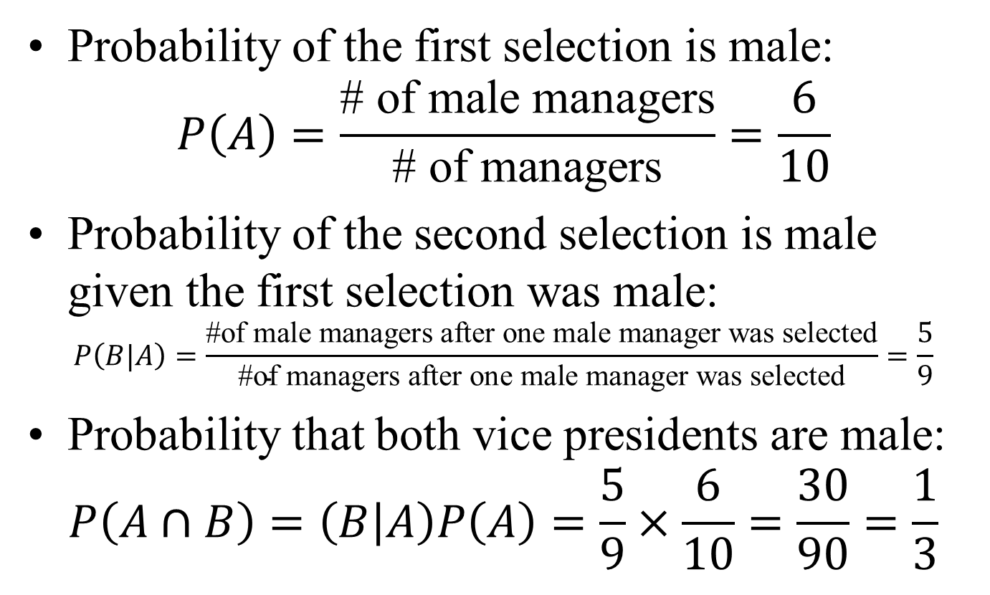
Example 3 - solution
Probability of the first selection is male:
$$P\left(A\right)=\frac{\text{\# }\text{of} \text{male} \text{managers}}{\text{\# }\text{of} \text{managers}}=\frac{6}{10}$$
Probability of the second selection is male given the first selection was male:
$$P\left(B|A\right)=\frac{\text{\#}\text{of} \text{male} \text{managers} \text{after} \text{one} \text{male} \text{manager} \text{was} \text{selected}}{\text{\#}\text{of} \text{managers} \text{after} \text{one} \text{male} \text{manager} \text{was} \text{selected}}=\frac{5}{9}$$
Probability that both vice presidents are male:
$$P\left(A∩B\right)=\left(B | A\right)P\left(A\right)=\frac{5}{9}×\frac{6}{10}=\frac{30}{90}=\frac{1}{3}$$

Slide 17
Example 4
A book club classifies members as heavy, medium, or light purchasers, and separate mailings are prepared for each of these groups.
Overall, 20% of the members are heavy purchasers, 30% medium, and 50% light.
A member is not classified into a group until 18 months after joining the club, but a test is made of the feasibility of using the first 3 months’ purchases to classify members.
The following percentages are obtained from existing records of individuals classified as heavy, medium, or light purchasers
If a member purchases no books in the first 3 months, what is the probability that the member is a light purchaser?

Slide 18
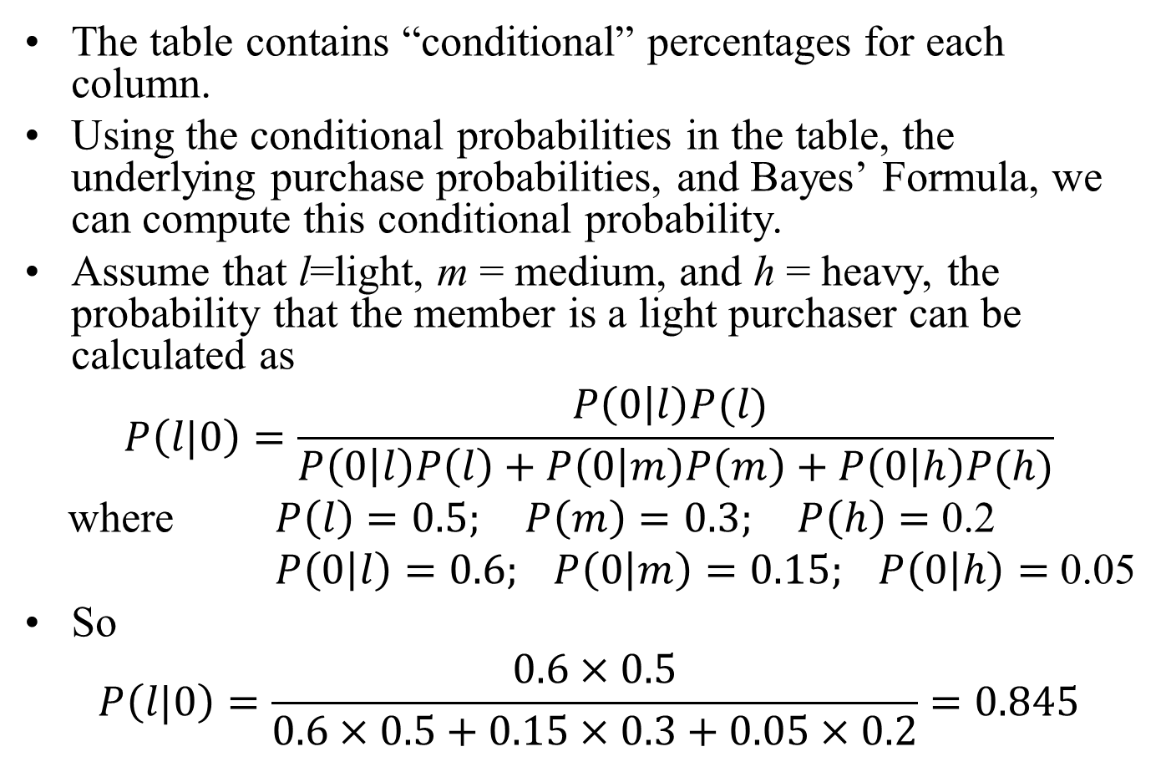
Example 4 - solution
The table contains “conditional” percentages for each column.
Using the conditional probabilities in the table, the underlying purchase probabilities, and Bayes’ Formula, we can compute this conditional probability.
Assume that l=light, m = medium, and h = heavy, the probability that the member is a light purchaser can be calculated as
$$P\left(l|0\right)=\frac{P\left(0 | l\right)P(l) }{P\left(0 | l\right)P\left(l\right)+P\left(0 | m\right)P\left(m\right)+P\left(0 | h\right)P(h)}$$
where $P\left(l\right)=0.5; P\left(m\right)=0.3; P\left(h\right)=$ 0.2
$P\left(0 | l\right)=0.6; P\left(0 | m\right)=0.15; P\left(0 | h\right)=$ 0.05
So
$$P\left(l|0\right)=\frac{0.6×0.5}{0.6×0.5+0.15×0.3+0.05×0.2}=0.845$$

Slide 19
Example 5
A cable TV company is investigating the feasibility of offering a new service in a large city. In order for the proposed new service to be economically viable, it is necessary that at least 50% of their current subscribers add the new service.
A survey of 1,218 customers reveals that 516 would add the new service.
Do you think the company should expend the capital to offer the new service in this city?

Slide 20
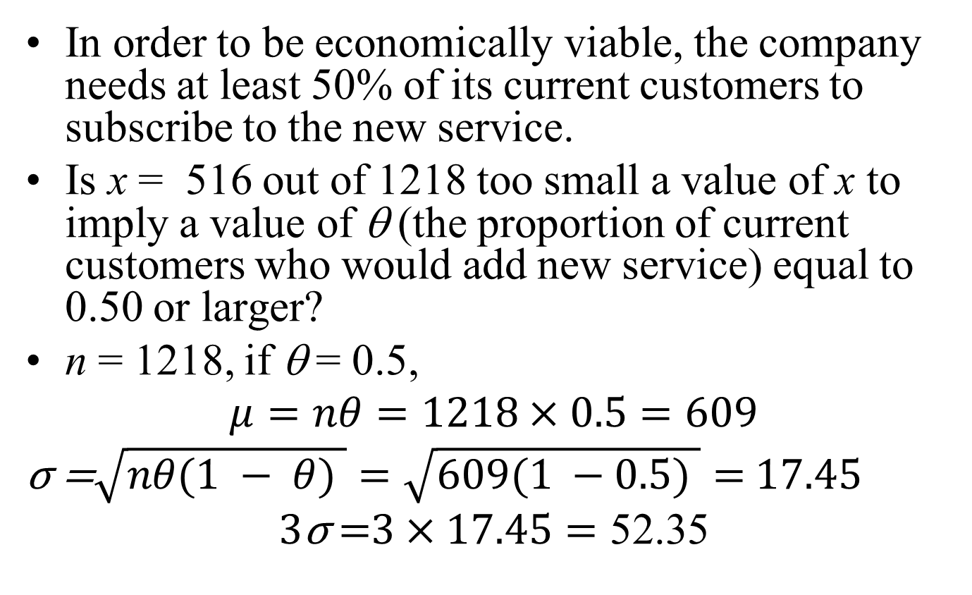
Example 5 - solution
In order to be economically viable, the company needs at least 50% of its current customers to subscribe to the new service.
Is x = 516 out of 1218 too small a value of x to imply a value of θ (the proportion of current customers who would add new service) equal to 0.50 or larger?
n = 1218, if θ = 0.5,
$$μ=nθ=1218×0.5=609$$
$\text{σ}\text{ =}\sqrt{nθ(1 − θ) }=\sqrt{609(1 −0.5) }=$ $17.45$
$$\text{3}\text{σ} \text{=}3×17.45=\text{52.35}$$

Slide 21
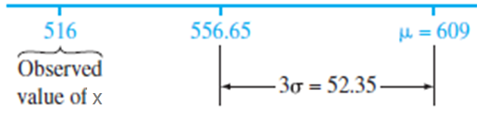
Example 5 - solution
We can see from the figure that x = 516 is more than 3σ, or 52.35, less than μ = 609, the value of μ if θ really equalled 0.5.
Thus the observed number of customers in the sample who would add the new service is much too small if the number of current customers who would not add the service, in fact, is 50% or more of all customers.
Consequently, the company concluded that offering the new service was not a good idea.

Slide 22
Example 6
A person visits her doctor with concerns about her blood pressure. If the systolic blood pressure exceeds 150, the patient is considered to have high blood pressure and medication may be prescribed. A patient’s blood pressure readings often have a considerable variation during a given day. Suppose a patient’s systolic blood pressure readings during a given day have a normal distribution with a mean μ = 160mm mercury and a standard deviation σ = 20 mm.
a. What is the probability that a single blood pressure measurement will fail to detect that the patient has high blood pressure?
b. If five blood pressure measurements are taken at various times during the day, what is the probability that the average of the five measurements will be less than 150 and hence fail to indicate that the patient has high blood pressure?
c. How many measurements would be required in a given day so that there is at most 1% probability of failing to detect that the patient has high blood pressure?

Slide 23
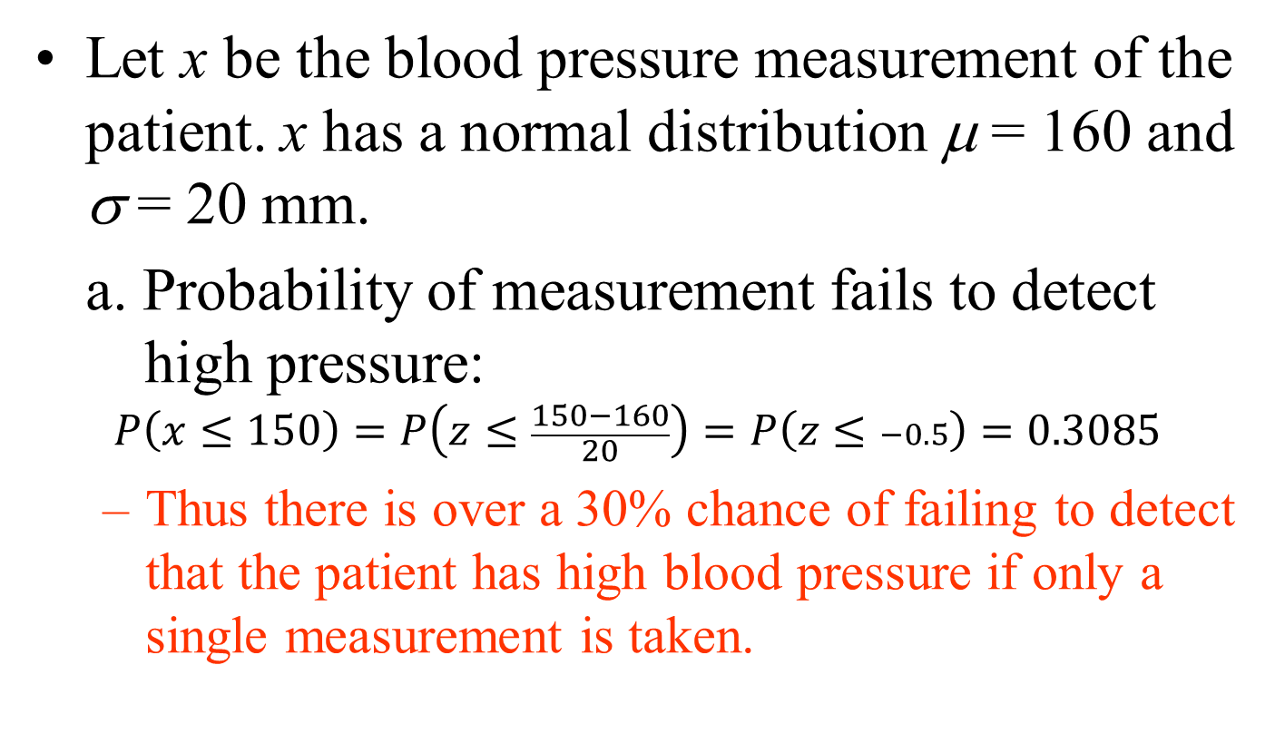
Example 6 - solution
Let x be the blood pressure measurement of the patient. x has a normal distribution μ = 160 and σ = 20 mm.
a. Probability of measurement fails to detect high pressure:
$$P\left(x≤150\right)=P\left(z≤\frac{150−160}{20}\right)=P\left(z≤−0.5\right)=0.3085$$
  Thus there is over a 30% chance of failing to detect that the patient has high blood pressure if only a single measurement is taken.

Slide 24
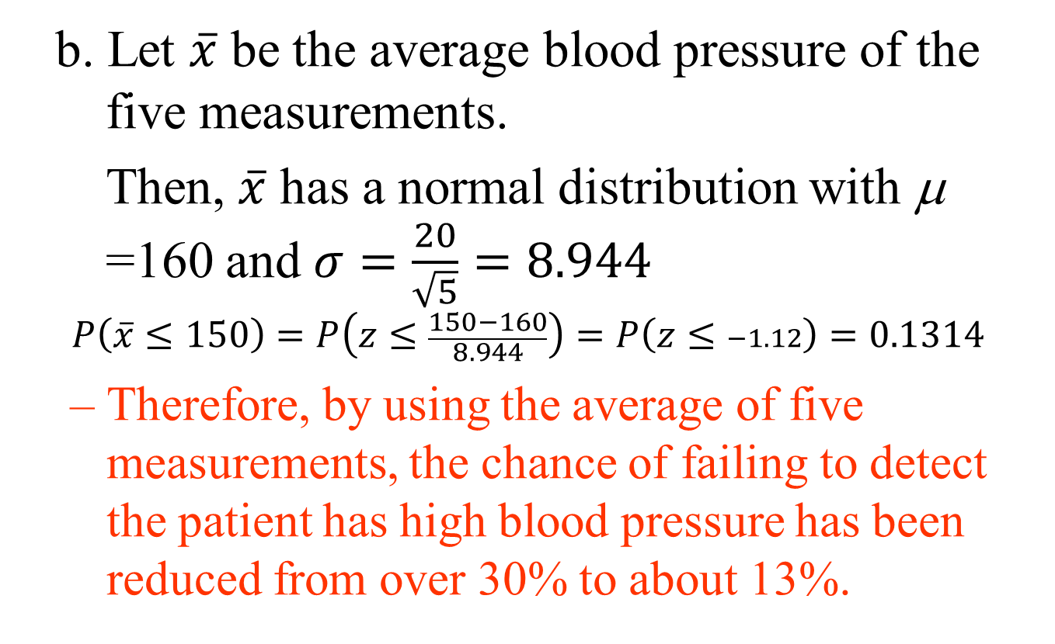
Example 6 - solution
b. Let $\overline{x}$ be the average blood pressure of the five measurements.
Then, $\overline{x}$ has a normal distribution with μ =160 and $σ=\frac{20}{\sqrt{5}}=8.944$
$$P\left(\overline{x}≤150\right)=P\left(z≤\frac{150−160}{8.944}\right)=P\left(z≤−1.12\right)=0.1314$$
  Therefore, by using the average of five measurements, the chance of failing to detect the patient has high blood pressure has been reduced from over 30% to about 13%.

Slide 25
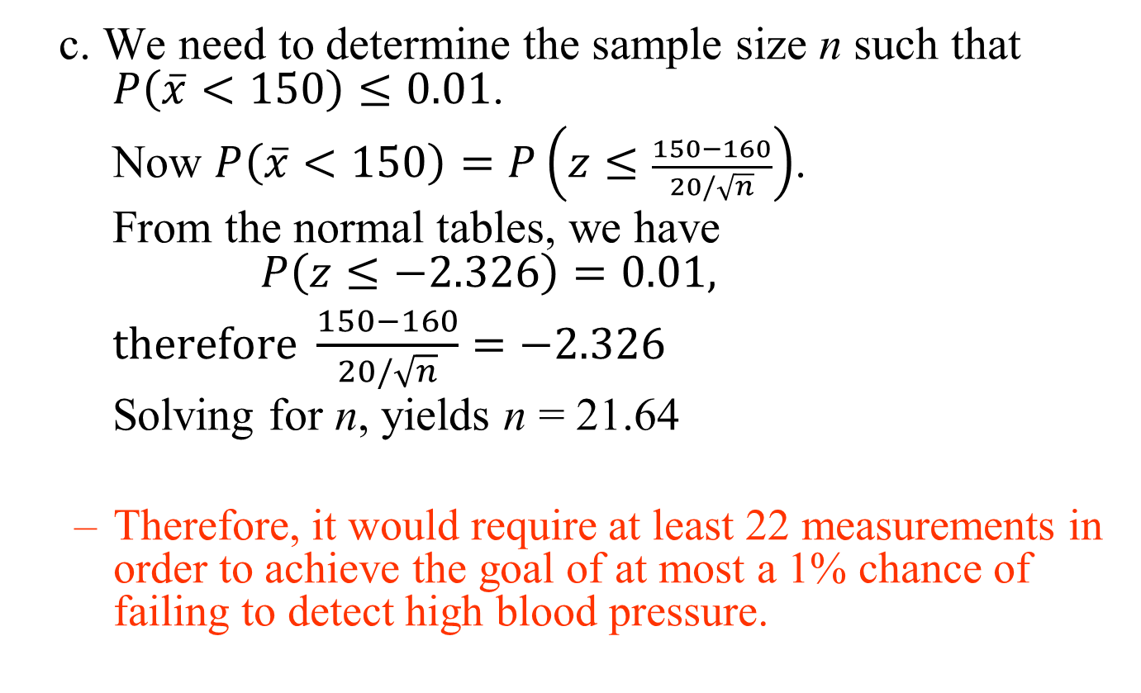
Example 6 - solution
c. We need to determine the sample size n such that $P\left(\overline{x}<150\right)≤0.01$.
Now $P\left(\overline{x}<150\right)=P\left(z≤\frac{150−160}{20/\sqrt{n}}\right)$.
From the normal tables, we have $P\left(z≤−2.326\right)=0.01,$
$therefore \frac{150−160}{20/\sqrt{n}}=−2.326$
Solving for n, yields n = 21.64
  Therefore, it would require at least 22 measurements in order to achieve the goal of at most a 1% chance of failing to detect high blood pressure.

Slide 26
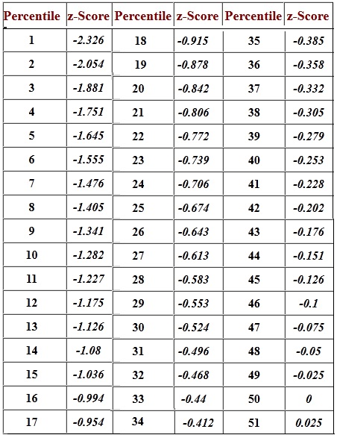

Slide 29
Example 7
Assembly times were measured for a sample of 15 glucose infusion pumps. The mean time to assemble a glucose infusion pump was 15.8 minutes, with a standard deviation of 2.4 minutes. Assuming a relatively symmetric distribution for assembly times,
  a.What percentage of infusion pumps require more than 17 seconds to assemble?
  b. What is the 99% confidence interval for the true mean assembly time (μ)?
  c. What is the 99% confidence interval for mean assembly time if the sample size is 2500?

Slide 30
Example 7 - solution
a.
x = assembly time
What is the Pr (x > 17)?
Pr (x > 17) = Pr (z > (17 − 15.8)/2.4)
= Pr (z > 0.5) = 1 − Pr (z ≤ 0.5)
= 1 − 0.6915) = 0.3085,
or 38.05% of the infusion pumps.

Slide 31
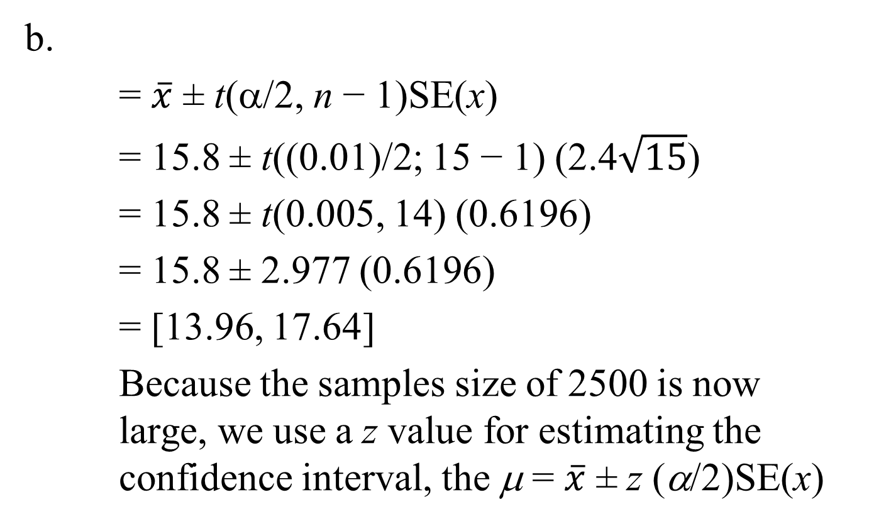
Example 7 - solution
b.
= $\overline{x}$ ± t(α/2, n − 1)SE(x)
= 15.8 ± t((0.01)/2; 15 − 1) (2.4$\sqrt{15}$)
= 15.8 ± t(0.005, 14) (0.6196)
= 15.8 ± 2.977 (0.6196)
= [13.96, 17.64]
Because the samples size of 2500 is now large, we use a z value for estimating the confidence interval, the μ = $\overline{x}$ ± z (α/2)SE(x)

Slide 32

Example 7 - solution
c.
= $\overline{x}$ ± z(α/2)SE(x)
= 15.8 ± z(0.01)/2) (2.4$\sqrt{2500}$)
= 15.8 ± 2.576 (0.048)
= [15.68, 15.92]

