Slide 1
Statistical Data Analysis
Prof. Dr. Nizamettin AYDIN
naydin@yildiz.edu.tr
http://www3.yildiz.edu.tr/~naydin

Slide 2
Introduction to R

Slide 3
The R Project
Environment for statistical computing and graphics
Free software
Associated with simple programming language
Similar to S and S-plus
www.r-project.org

Slide 4
R, S and S-plus
S is an interactive environment for data analysis developed at Bell Laboratories since 1976
1988 - S2: RA Becker, JM Chambers, A Wilks
1992 - S3: JM Chambers, TJ Hastie
1998 - S4: JM Chambers
Exclusively licensed by AT&T/Lucent to Insightful Corporation, Seattle WA.
Product name is “S-plus”.
Implementation languages C, Fortran.

Slide 5
R, S and S-plus
R is initially written by Ross Ihaka and Robert Gentleman at Dep. of Statistics of University of Auckland, New Zealand during 1990s.
GNU General Public License (GPL)
can be used by anyone for any purpose
Open Source
efficient bug tracking and fixing system supported by the user community
http://cm.bell-labs.com/cm/ms/departments/sia/S/history.html

Slide 6
Compiled C vs Interpreted R
C requires a complete program to run
Program is translated into machine code
Can then be executed repeatedly
R can run interactively
Statements converted to machine instructions as they are encountered
This is much more flexible, but also slower
R Programming Language
Interpreted language

Slide 7
R and statistics
Packaging:
a crucial infrastructure to efficiently produce, load and keep consistent software libraries from (many) different sources / authors
Statistics:
most packages deal with statistics and data analysis
State of the art:
many statistical researchers provide their methods as R packages

Slide 8
Tutorials
From R website under “Documentation”
“Manual” is the listing of official R documentation
An Introduction to R
R Language Definition
Writing R Extensions
R Data Import/Export
R Installation and Administration
The R Reference Index

Slide 9
Tutorials
“Contributed” documentation are tutorials and manuals created by R users
Simple R
R for Beginners
Practical Regression and ANOVA Using R
R FAQ
Mailing Lists (listserv)
r-help

Slide 10
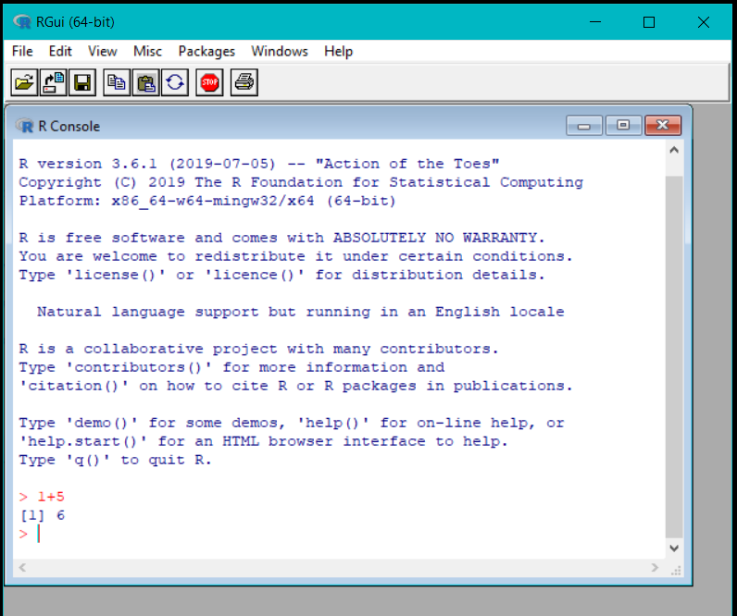
Interactive R
R defaults to an interactive mode
A prompt “>” is presented to users
Each input expression is evaluated…
… and a result returned

Slide 11
R as a Calculator
> 1 + 1 # Simple Arithmetic
[1] 2
> 2 + 3 * 4 # Operator precedence
[1] 14
> 3 ^ 2 # Exponentiation
[1] 9
> exp(1) # Basic mathematical functions are available
[1] 2.718282
> sqrt(10)
[1] 3.162278
> pi # The constant pi is predefined
[1] 3.141593
> 2*pi*6378 # Circumference of earth at equator (in km)
[1] 40074.16

Slide 12
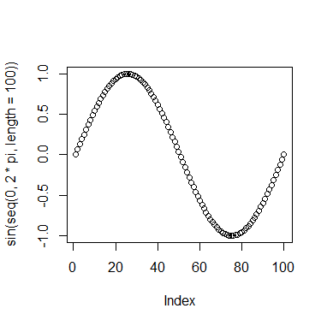
R as a Calculator
> log2(32)
[1] 5
> seq(0, 5, length=6)
[1] 0 1 2 3 4 5
> plot(sin(seq(0, 2*pi, length=100)))

Slide 13
Variables in R
Numeric
Store floating point values
> a = 49
Boolean (T or F)
Values corresponding to True or False
> a = (1+1==3)
> a
[1] FALSE
Strings
Sequences of characters
a = "The dog ate my homework"
> sub("dog","cat",a)
[1] "The cat ate my homework“
Type determined automatically when variable is created with "<-" operator

Slide 14
R as a Smart Calculator
> x <- 1 # Can define variables
> y <- 3 # using "<-" operator to set values
> z <- 4
> x * y * z
[1] 12
> X * Y * Z # Variable names are case sensitive
Error: Object "X" not found
> This.Year <- 2004 # Variable names can include period
> This.Year
[1] 2004

Slide 15
Missing Values
Variables of each data type (numeric, character, logical) can also take the value NA: not available.
NA is not the same as 0
NA is not the same as ""
NA is not the same as FALSE
Any operations (calculations, comparisons) that involve NA may or may not produce NA:
> NA==1
[1] NA
> 1+NA
[1] NA
> max(c(NA, 4, 7))
[1] NA
> max(c(NA, 4, 7), na.rm=T)
[1] 7
> NA | TRUE
[1] TRUE
> NA & TRUE

Slide 16
Functions and Operators
Functions do things with data
“Input”: function arguments (0,1,2,…)
“Output”: function result (exactly one)
Example:
add = function(a,b)
{ result = a+b
return(result) }
Operators:
Short-cut writing for frequently used functions of one or two arguments.
Examples: + - * / ! & | %%

Slide 17
R Vectors
An ordered collection of data of the same type
Created with
c() to concatenate elements or sub-vectors
> a = c(1,2,3)
> a*2
[1] 2 4 6
rep() to repeat elements or patterns
seq() or m:n to generate sequences
Most mathematical functions and operators can be applied to vectors
Without loops!

Slide 18
Defining Vectors
> rep(1,10) # repeats the number 1, 10 times
[1] 1 1 1 1 1 1 1 1 1 1
> seq(2,6) # sequence of integers between 2 and 6
[1] 2 3 4 5 6 # equivalent to 2:6
> seq(4,20,by=4) # Every 4th integer between 4 and 20
[1] 4 8 12 16 20
> x <- c(2,0,0,4) # Creates vector with elements 2,0,0,4
> y <- c(1,9,9,9)
> x + y # Sums elements of two vectors
[1] 3 9 9 13
> x * 4 # Multiplies elements
[1] 8 0 0 16
> sqrt(x) # Function applies to each element
[1] 1.41 0.00 0.00 2.00 # Returns vector

Slide 19
Accessing Vector Elements
Use the [ ] operator to select elements
To select specific elements:
Use index or vector of indexes to identify them
To exclude specific elements:
Negate index or vector of indexes
Alternative:
Use vector of T and F values to select subset of elements

Slide 20
Accessing Vector Elements
> x <- c(2,0,0,4)
> x[1] # Select the first element, equivalent to x[c(1)]
[1] 2
> x[-1] # Exclude the first element
[1] 0 0 4
> x[1] <- 3 ; x
[1] 3 0 0 4
> x[-1] = 5 ; x
[1] 3 5 5 5
> y < 9 # Compares each element, returns result as vector
[1] TRUE FALSE FALSE FALSE
> y[4] = 1
> y < 9
[1] TRUE FALSE FALSE TRUE
> y[y<9] = 2 # Edits elements marked as TRUE in index vector
> y
[1] 2 9 9 2

Slide 21
Matrices and Arrays
matrix: a rectangular table of data of the same type
example:
the expression values for 10000 genes for 30 tissue biopsies: a matrix with 10000 rows and 30 columns.
array: 3-,4-,..dimensional matrix
example:
the red and green foreground and background values for 20000 spots on 120 chips: a 4 x 20000 x 120 (3D) array.

Slide 22
Lists
vector:
an ordered collection of data of the same type.
> a = c(7,5,1)
> a[2]
[1] 5
list:
an ordered collection of data of arbitrary types.
> x = list(ad="ali", yas=30, bekar=F)
Typically, vector elements are accessed by their index (an integer), list elements by their name (a character string).
But both types support both access methods.
the following all retrieve ad:
> x$ad > x["ad"] > x[1] > x[-2:-3]
[1] "ali" [1] "ali" [1] "ali" [1] "ali"

Slide 23
Data Frames
Group a collection of related vectors
Most of the time, when data is loaded, it will be organized in a data frame
It is a rectangular table with rows and columns;
data within each column has the same type (e.g. number, text, logical), but different columns may have different types.
Example:
> a
localization tumorsize progress
XX348 proximal 6.3 FALSE
XX234 distal 8.0 TRUE
XX987 proximal 10.0 FALSE

Slide 24
Setting Up Data Sets
Load from a text file using read.table()
Parameters header, sep, and na.strings control useful options
read.csv() and read.delim() have useful defaults for comma or tab delimited files
Create from scratch using data.frame()
Example:
data.frame(height=c(150,160), weight=(65,72))

Slide 25
Blood Pressure Data Set
HEIGHT WEIGHT WAIST HIP BPSYS BPDIA
172 72 87 94 1 27.5 80
166 91 109 107 172.5 100
174 80 95 101 123 64
176 79 93 100 117 76
166 55 70 94 100 60
163 76 96 99 160 87.5
...
Read into R using:
bp <- read.table(“bp.txt”, header=T, na.strings=c(“x”))

Slide 26
Accessing Data Frames
Multiple ways to retrieve columns…
The following all retrieve weight data:
> bp[“WEIGHT”]
> bp[,2]
> bp$WEIGHT
The following excludes weight data:
> bp[,-2]

Slide 27
Factors
A character string can contain arbitrary text.
Sometimes it is useful to use a limited vocabulary, with a small number of allowed words.
A factor is a variable that can only take such a limited number of values, which are called levels.
> a
[1] Kolon(Rektum) Magen Magen
[4] Magen Magen Retroperitoneal
[7] Magen Magen(retrogastral) Magen
Levels: Kolon(Rektum) Magen Magen(retrogastral) Retroperitoneal

Slide 28
Factors
> class(a)
[1] "factor"
> as.character(a)
[1] "Kolon(Rektum)" "Magen" "Magen"
[4] "Magen" "Magen" "Retroperitoneal"
[7] "Magen" "Magen(retrogastral)" "Magen"
> as.integer(a)
[1] 1 2 2 2 2 4 2 3 2
> as.integer(as.character(a))
[1] NA NA NA NA NA NA NA NA NA NA NA NA
Warning message:
NAs introduced by coercion

Slide 29
Subsetting
Individual elements of a vector, matrix, array or data frame are accessed with "[ ]" by specifying their index, or their name
> a
localisation tumorsize progress
XX348 proximal 6.3 0
XX234 distal 8.0 1
XX987 proximal 10.0 0
> a[3, 2]
[1] 10
> a["XX987", "tumorsize"]
[1] 10
> a["XX987",]
localisation tumorsize progress
XX987 proximal 10 0

Slide 30
Subsetting
> a
localisation tumorsize progress
XX348 proximal 6.3 0
XX234 distal 8.0 1
XX987 proximal 10.0 0
subset rows by a vector of indices
> a[c(1,3),]
localisation tumorsize progress
XX348 proximal 6.3 0
XX987 proximal 10.0 0
subset rows by a logical vector
> a[c(T,F,T),]
localisation tumorsize progress
XX348 proximal 6.3 0
XX987 proximal 10.0 0

Slide 31
Subsetting
> a
localisation tumorsize progress
XX348 proximal 6.3 0
XX234 distal 8.0 1
XX987 proximal 10.0 0
subset a column
> a$localisation
[1] "proximal" "distal" "proximal"
comparison resulting in logical vector
> a$localisation=="proximal"
[1] TRUE FALSE TRUE
subset the selected rows
> a[ a$localisation=="proximal", ]
localisation tumorsize progress
XX348 proximal 6.3 0
XX987 proximal 10.0 0

Slide 32
Common Forms of Data in R
Variables are created as needed
Numeric values
Vectors
Data Frames
Lists
Used some simple functions:
c(), seq(), read.table(), …

Slide 33
Programming Constructs
Grouped Expressions
Control statements
if … else …
for loops
repeat loops
while loops
next, break statements

Slide 34
Grouped Expressions
{expr_1; expr_2; … }
Valid wherever single expression could be used
Return the result of last expression evaluated
Relatively similar to compound statements in C

Slide 35
Branching (if … else …)
if (expr_1) expr_2 else expr_3
The first expression should return a single logical value
Operators && or || may be used
Conditional execution of code
if (logical expression)
{
statements
}
else
{
alternative statements
}
else branch is optional

Slide 36
Example: if … else …
# Standardize observation i
if (sx[i] == "male")
{
z[i] <- (obsrvd[i] - males.mean) / males.sd;
}
else
{
z[i] <- (obsrvd[i] - females.mean) / females.sd;

Slide 37
Loops (for)
When the same or similar tasks need to be performed multiple times; for all elements of a list; for all columns of an array; etc.
for (name in expr_1) expr_2
name is the loop variable
expr_1 is often a sequence
e.g. 1:20
e.g. seq(1, 20, by = 2)

Slide 38
Example: for
# Sample M random pairings in a set of N objects
for (i in 1:M)
{
# As shown, the sample function returns a
single
# element in the interval 1:N
p = sample(N, 1)
q = sample(N, 1)
# Additional processing as needed…
ProcessPair(p, q);
}

Slide 39
repeat
repeat expr
Continually evaluate expression
Loop must be terminated with break statement

Slide 40
Example: repeat
# Sample with replacement from a set of N objects
# until the number 615 is sampled twice
M <- matches <- 0
repeat
{
# Keep track of total connections sampled
M <- M + 1
# Sample a new connection
p = sample(N, 1)
# Increment matches whenever we sample 615
if (p == 615)
matches <- matches + 1;
# Stop after 2 matches
if (matches == 2)
break;
}

Slide 41
while
while (expr_1) expr_2
While expr_1 is false, repeatedly evaluate expr_2
break and next statements can be used within the loop

Slide 42
Example: while
# Sample with replacement from a set of N objects
# until 615 and 815 are sampled consecutively
match <- false
while (match == false)
{
# sample a new element
p = sample(N, 1)
# if not 615, then goto next iteration
if (p != 615)
next;
# Sample another element
q = sample(N, 1)
# Check if we are done
if (q != 815)
match = true;
}

Slide 43
Example: for and while
for (i in 1:10)
{
print(i*i)
}
i=1
while (i<=10)
{
print(i*i)
i = i+1
}

Slide 44
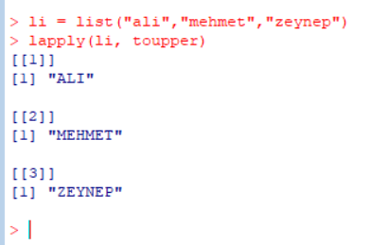
lapply, sapply, apply
When the same or similar tasks need to be performed multiple times for all elements of a list or for all columns of an array.
May be easier and faster than “for” loops
lapply( li, fct )
To each element of the list li, the function fct is applied.
The result is a list whose elements are the individual fct results.
> li = list("ali","mehmet","zeynep")
> lapply(li, toupper)
[[1]]
[1] "ALİ"
[[2]]
[1] "MEHMET"
[[3]]
[1] "ZEYNEP"

Slide 45
lapply, sapply, apply
sapply( li, fct )
Like lapply, but tries to simplify the result, by converting it into a vector or array of appropriate size
> li = list("ali","mehmet","zeynep")
> sapply(li, toupper)
[1] "ALİ" "MEHMET" "ZEYNEP«
> fct = function(x) { return(c(x, x*x, x*x*x)) }
> sapply(1:5, fct)
[,1] [,2] [,3] [,4] [,5]
[1,] 1 2 3 4 5
[2,] 1 4 9 16 25
[3,] 1 8 27 64 125

Slide 46
lapply, sapply, apply
apply( arr, margin, fct )
Applies the function fct along some dimensions of the array arr, according to margin, and returns a vector or array of the appropriate size.
> x
[,1] [,2] [,3]
[1,] 5 7 0
[2,] 7 9 8
[3,] 4 6 7
[4,] 6 3 5
> apply(x, 1, sum)
[1] 12 24 17 14
> apply(x, 2, sum)
[1] 22 25 20

Slide 47
Functions in R
Easy to create your own functions in R
As tasks become complex, it is a good idea to organize code into functions that perform defined tasks
In R, it is good practice to give default values to function arguments
Functions can be defined as
name <- function(arg1, arg2, …)
expression
Arguments can be assigned default values:
arg_name = expression
Return value is the last evaluated expression or can be set explicitly with return()

Slide 48
Defining Functions
> square <- function(x = 10) x * x
> square()
[1] 100
> square(2)
[1] 4
> intsum <- function(from=1, to=10)
{
sum <- 0
for (i in from:to)
sum <- sum + i
sum
}
> intsum(3) # Evaluates sum from 3 to 10 …
[1] 52
> intsum(to = 3) # Evaluates sum from 1 to 3 …
[1] 6

Slide 49
Some notes on functions …
You can print the arguments for a function using args() command
> args(intsum)
function (from = 1, to = 10)
You can print the contents of a function by typing only its name, without the ()
You can edit a function using
> my.func <- edit(my.old.func)

Slide 50
Debugging Functions
Toggle debugging for a function with debug() / undebug() command
With debugging enabled, R steps through function line by line
Use print() to inspect variables along the way
Press <enter> to proceed to next line
> debug(intsum)
> intsum(10)

Slide 51
Useful R Functions - Random Generation
In contrast to many C implementations, R generates pretty good random numbers
set.seed(seed) can be used to select a specific sequence of random numbers
sample(x, size, replace = FALSE) generates a sample of size elements from x.
If x is a single number, sample is from 1:x

Slide 52
Useful R Functions - Random Generation
Samples from Uniform distribution
runif(n, min = 1, max = 1)
Samples from Binomial distribution
rbinom(n, size, prob)
Samples from Normal distribution
rnorm(n, mean = 0, sd = 1)
Samples from Exponential distribution
rexp(n, rate = 1)
Samples from T-distribution
rt(n, df)
And others!
􀁺 rexp(n, rate = 1)

Slide 53
R Help System
R has a built-in help system with useful information and examples
help() provides general help
help(plot) will explain the plot function
help.search("histogram") will search for topics that include the word histogram
example(plot) will provide examples for the plot function

Slide 54
Input / Output
Use sink(file) to redirect output to a file
Use sink() to restore screen output
Use print() or cat() to generate output inside functions
Use source(file) to read input from a file

Slide 55
Basic Utility Functions
length() returns the number of elements
mean() returns the sample mean
median() returns the sample median
range() returns the largest and smallest values
unique() removes duplicate elements
summary() calculates descriptive statistics
diff() takes difference between consecutive elements
rev() reverses elements

Slide 56
Managing Workspaces
As you generate functions and variables, these are added to your current workspace
Use ls() to list workspace contents
Use rm() to delete variables or functions
When you quit, with the q() function, you can save the current workspace for later use

