Slide 1
Statistical Data Analysis
Prof. Dr. Nizamettin AYDIN
naydin@yildiz.edu.tr
http://www3.yildiz.edu.tr/~naydin

Slide 2
Regression Analysis

Slide 3
Regression Analysis
The modeling of the relationship between a response variable and a set of explanatory variables is one of the most widely used of all statistical techniques.
  We refer to this type of modeling as regression analysis.
A regression model provides the user with a functional relationship between the response variable and explanatory variables that allows the user to determine which of the explanatory variables have an effect on the response.
  The regression model allows the user to explore what happens to the response variable for specified changes in the explanatory variables.
    {For example, financial officers must predict future cash flows based on specified values of interest rates, raw material costs, salary increases, and so on}

Slide 4
Regression Analysis
The basic idea of regression analysis is to obtain a model for the functional relationship between a response variable (often referred to as the dependent variable) and one or more explanatory variables (often referred to as the independent variables).
Regression models have a number of uses:
  The model provides a description of the major features of the data set.
    In some cases, a subset of the explanatory variables will not affect the response variable, and, hence, the researcher will not have to measure or control any of these variables in future studies.
      This may result in significant savings in future studies or experiments.

Slide 5
Regression Analysis
  The equation relating the response variable to the explanatory variables produced from the regression analysis provides estimates of the response variable for values of the explanatory variables not observed in the study.
    For example, a clinical trial is designed to study the response of a subject to various dose levels of a new drug.
    Because of time and budgetary constraints, only a limited number of dose levels are used in the study.
      The regression equation will provide estimates of the subjects’ response for dose levels not included in the study.
  In business applications, the prediction of future sales of a product is crucial to production planning.
    If the data provide a model that has a good fit in relating current sales to sales in previous months, prediction of sales in future months is possible.

Slide 6
Regression Analysis
  In some applications of regression analysis, the researcher is seeking a model that can accurately estimate the values of a variable that is difficult or expensive to measure using explanatory variables that are inexpensive to measure and obtain.
    If such a model is obtained, then in future applications it is possible to avoid having to obtain the values of the expensive variable by measuring the values of the inexpensive variables and using the regression equation to estimate the values of the expensive variable.
      For example, a physical fitness center wants to determine the physical well-being of its new clients.
      Maximal oxygen uptake is recognized as the single best measure of cardiorespiratory fitness, but its measurement is expensive.
      Therefore, the director of the fitness center would want a model that provides accurate estimates of maximal oxygen uptake using easily measured variables such as weight, age, heart rate after a 1-mile walk, time needed to walk 1 mile, and so on.

Slide 7
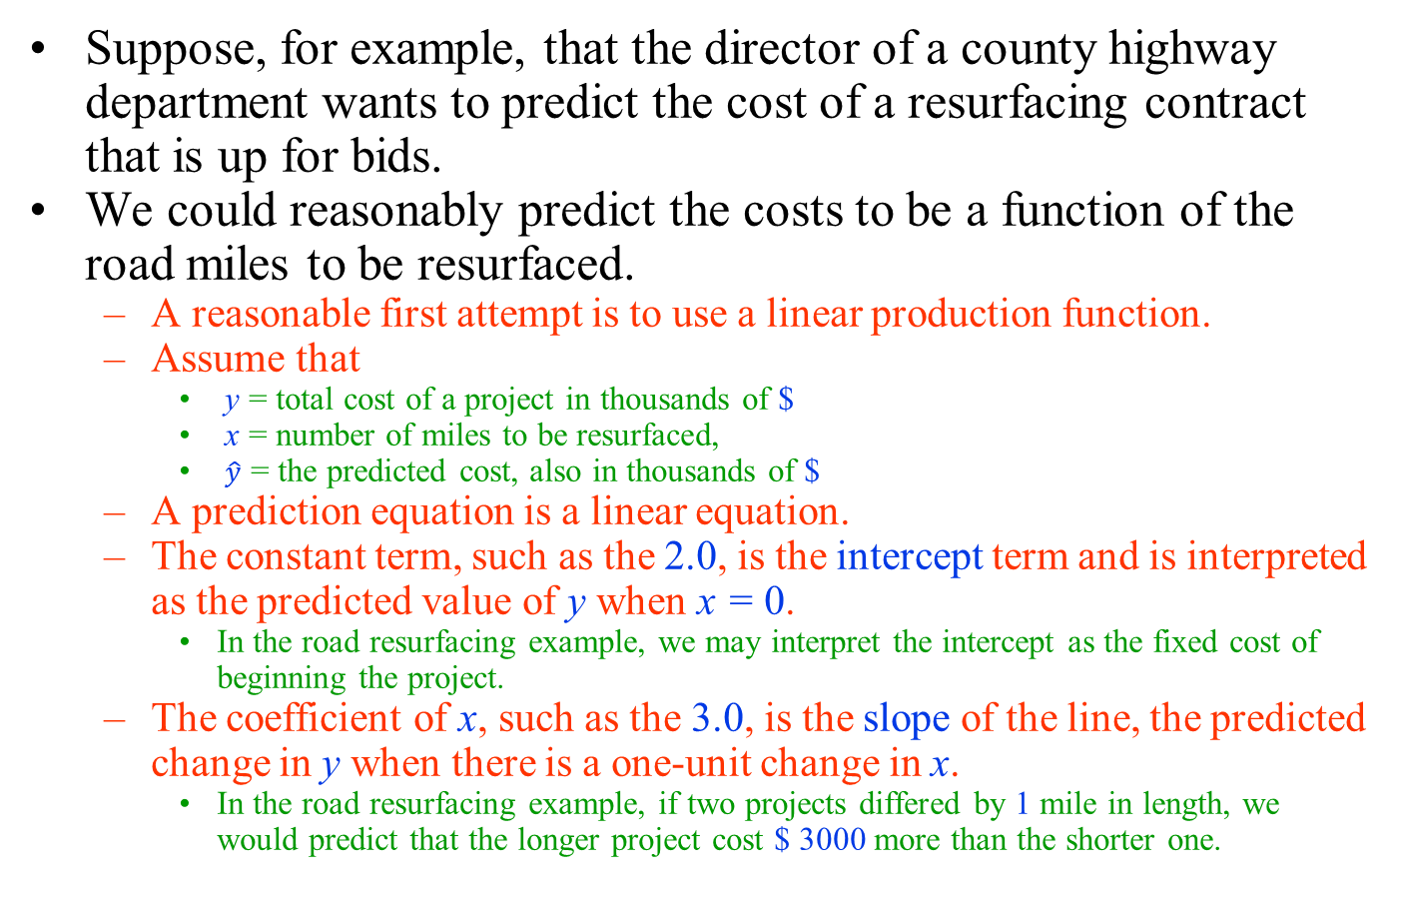
Regression Analysis
Suppose, for example, that the director of a county highway department wants to predict the cost of a resurfacing contract that is up for bids.
We could reasonably predict the costs to be a function of the road miles to be resurfaced.
  A reasonable first attempt is to use a linear production function.
  Assume that
    y = total cost of a project in thousands of $
    x = number of miles to be resurfaced,
    $\hat{y}$ = the predicted cost, also in thousands of $
  A prediction equation is a linear equation.
  The constant term, such as the 2.0, is the intercept term and is interpreted as the predicted value of y when x = 0.
    In the road resurfacing example, we may interpret the intercept as the fixed cost of beginning the project.
  The coefficient of x, such as the 3.0, is the slope of the line, the predicted change in y when there is a one-unit change in x.
    In the road resurfacing example, if two projects differed by 1 mile in length, we would predict that the longer project cost $ 3000 more than the shorter one.

Slide 8
Regression Analysis
After this soft introduction, we now discuss linear regression models for either testing a hypothesis regarding the relationship between one or more explanatory variables and a response variable, or predicting unknown values of the response variable using one or more predictors.
  We use X to denote explanatory variables and Y to denote response variables.
We start by focusing on problems where the explanatory variable is binary.
  As before, the binary variable X can be either 0 or 1.
We then continue our discussion for situations where the explanatory variable is numerical.

Slide 9
Linear Regression Models with One Binary Explanatory Variable
Suppose that we want to investigate the relationship between sodium chloride (salt) consumption (low vs. high consumption) and blood pressure among elderly people (e.g., above 65 years old).
  We take a random sample of 25 people from this population and find that 15 of them keep a low sodium chloride diet (less than 6 grams of salt per day) and 10 of them keep a high sodium chloride diet (more than 6 grams of salt per day)
The next figure shows the dot plot along with sample means, shown as black circles, for each group.
We connect the two sample means to show the overall pattern for how blood pressure changes from one group to another.

Slide 10
Linear Regression Models with One Binary Explanatory Variable
The dot plot for systolic blood pressure for 25 elderly people (left panel),
  where 15 people follow a low sodium chloride diet (X = 0), and 10 people follow a high sodium chloride diet (X = 1)
The dot plot for systolic blood pressure for 25 elderly people (right panel).
  Here, the sample means among the low and high sodium chloride diet groups are shown as black circles.
  A straight line connects the sample means.
  The line intercepts the vertical axis at a = 133.17 and has slope b = 6.25

Slide 11
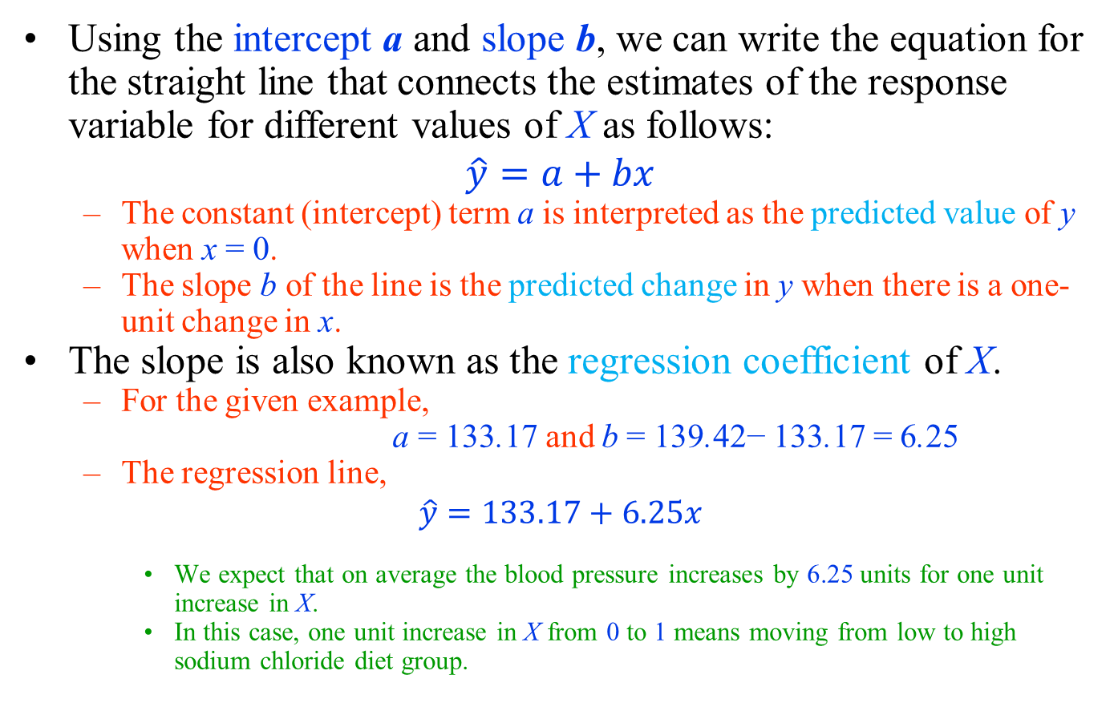
Linear Regression Models with One Binary Explanatory Variable
Using the intercept a and slope b, we can write the equation for the straight line that connects the estimates of the response variable for different values of X as follows:
$$\hat{y}=a+bx$$
  The constant (intercept) term a is interpreted as the predicted value of y when x = 0.
  The slope b of the line is the predicted change in y when there is a one-unit change in x.
The slope is also known as the regression coefficient of X.
  For the given example,
  a = 133.17 and b = 139.42− 133.17 = 6.25
  The regression line,
$$\hat{y}=133.17+6.25x$$
    We expect that on average the blood pressure increases by 6.25 units for one unit increase in X.
    In this case, one unit increase in X from 0 to 1 means moving from low to high sodium chloride diet group.

Slide 12
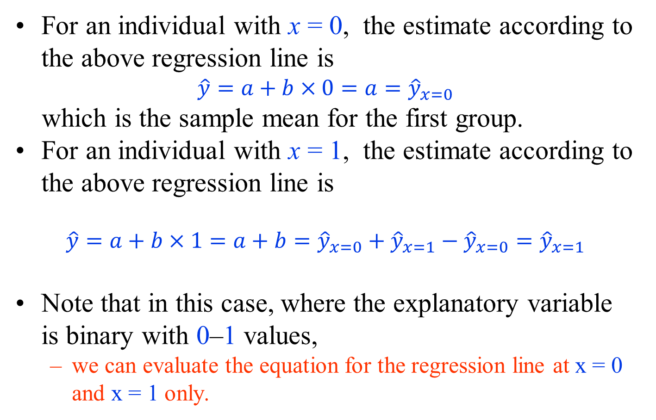
Linear Regression Models with One Binary Explanatory Variable
For an individual with x = 0, the estimate according to the above regression line is
$$\hat{y}=a+b×0=a={\hat{y}}_{x=0}$$
which is the sample mean for the first group.
For an individual with x = 1, the estimate according to the above regression line is
$$\hat{y}=a+b×1=a+b={\hat{y}}_{x=0}+{\hat{y}}_{x=1}−{\hat{y}}_{x=0}={\hat{y}}_{x=1}$$
Note that in this case, where the explanatory variable is binary with 0–1 values,
  we can evaluate the equation for the regression line at x = 0 and x = 1 only.

Slide 13
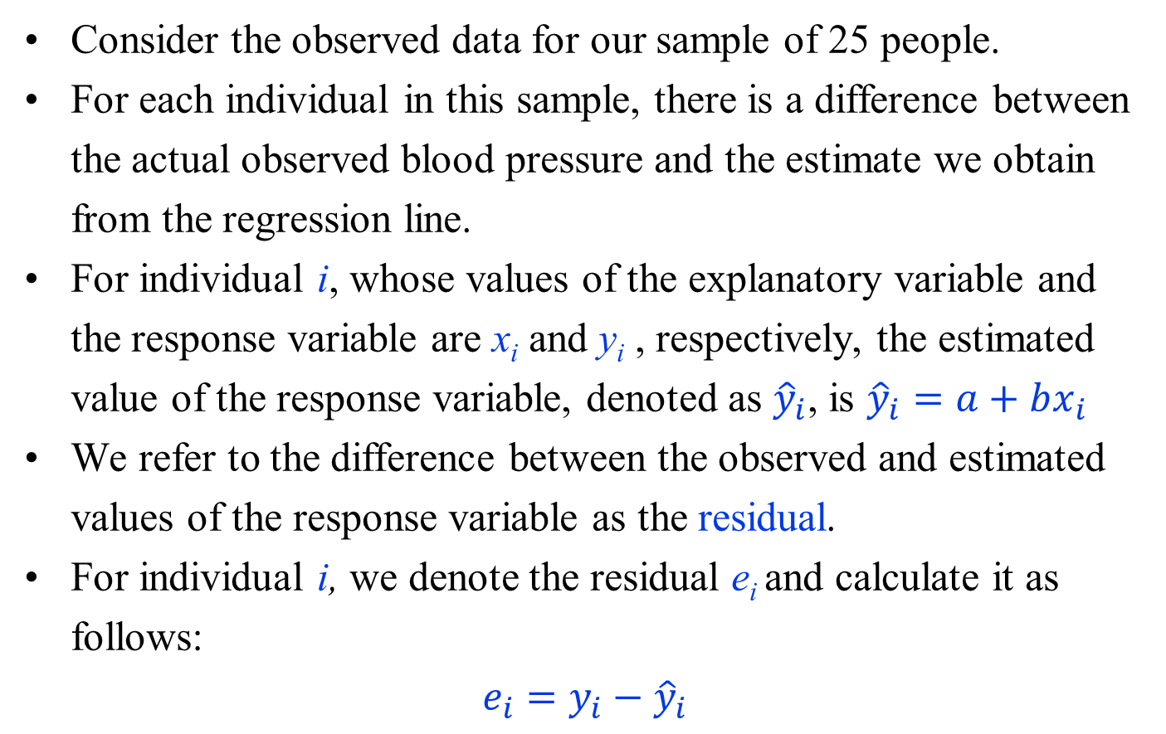
Linear Regression Models with One Binary Explanatory Variable
Consider the observed data for our sample of 25 people.
For each individual in this sample, there is a difference between the actual observed blood pressure and the estimate we obtain from the regression line.
For individual i, whose values of the explanatory variable and the response variable are x_{i} and y_{i} , respectively, the estimated value of the response variable, denoted as ${\hat{y}}_{i}$, is ${\hat{y}}_{i}=a+bx_{i}$
We refer to the difference between the observed and estimated values of the response variable as the residual.
For individual i, we denote the residual e_{i} and calculate it as follows:
$$e_{i}=y_{i}−{\hat{y}}_{i}$$

Slide 14
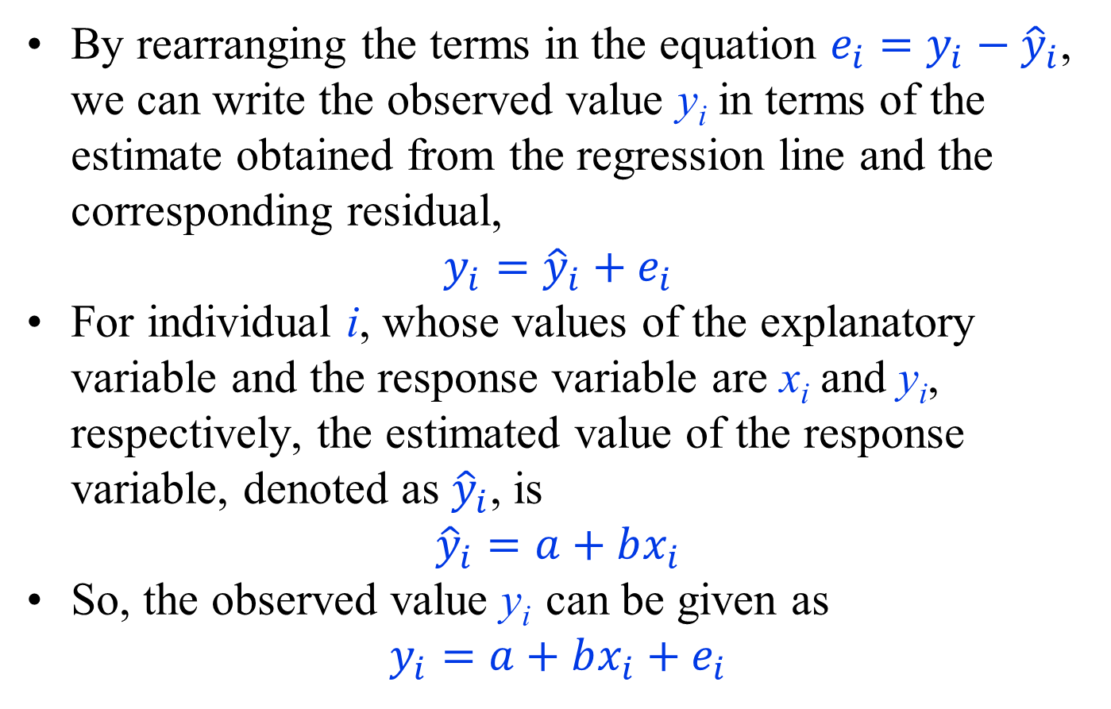
Linear Regression Models with One Binary Explanatory Variable
By rearranging the terms in the equation $e_{i}=y_{i}−{\hat{y}}_{i}$, we can write the observed value y_{i} in terms of the estimate obtained from the regression line and the corresponding residual,
$$y_{i}={\hat{y}}_{i}{+ e}_{i}$$
For individual i, whose values of the explanatory variable and the response variable are x_{i} and y_{i}, respectively, the estimated value of the response variable, denoted as ${\hat{y}}_{i}$, is
$${\hat{y}}_{i}=a+bx_{i}$$
So, the observed value y_{i} can be given as
$$y_{i}=a+bx_{i}{+ e}_{i}$$

Slide 15
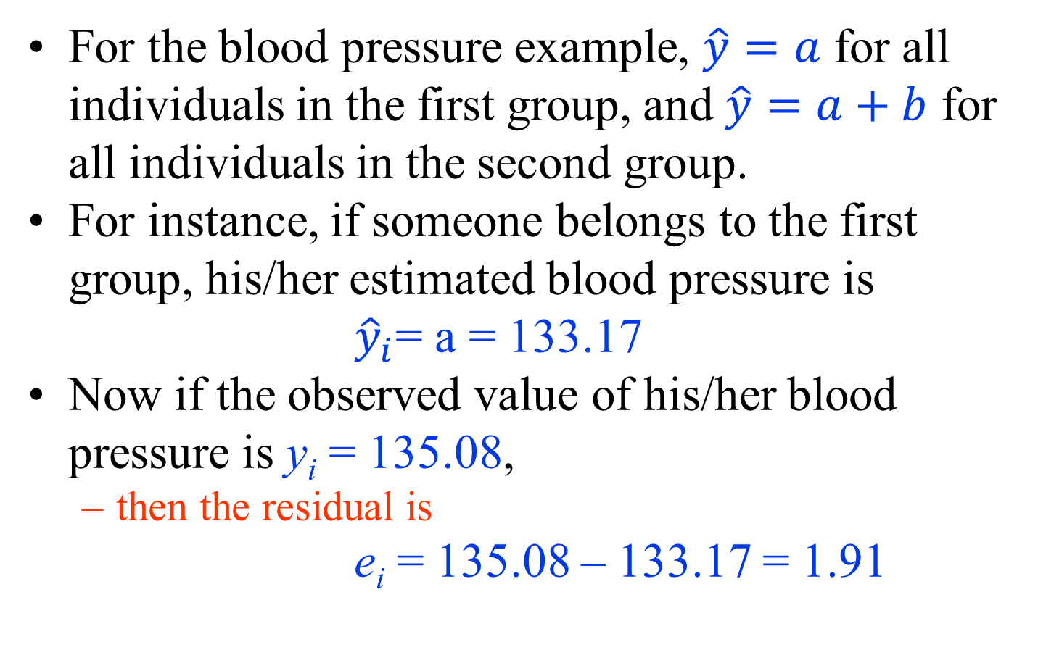
Linear Regression Models with One Binary Explanatory Variable
For the blood pressure example, $\hat{y}=a$ for all individuals in the first group, and $\hat{y}=a+b$ for all individuals in the second group.
For instance, if someone belongs to the first group, his/her estimated blood pressure is
${\hat{y}}_{i}$= a = 133.17
Now if the observed value of his/her blood pressure is y_{i} = 135.08,
  then the residual is
e_{i} = 135.08 – 133.17 = 1.91

Slide 16
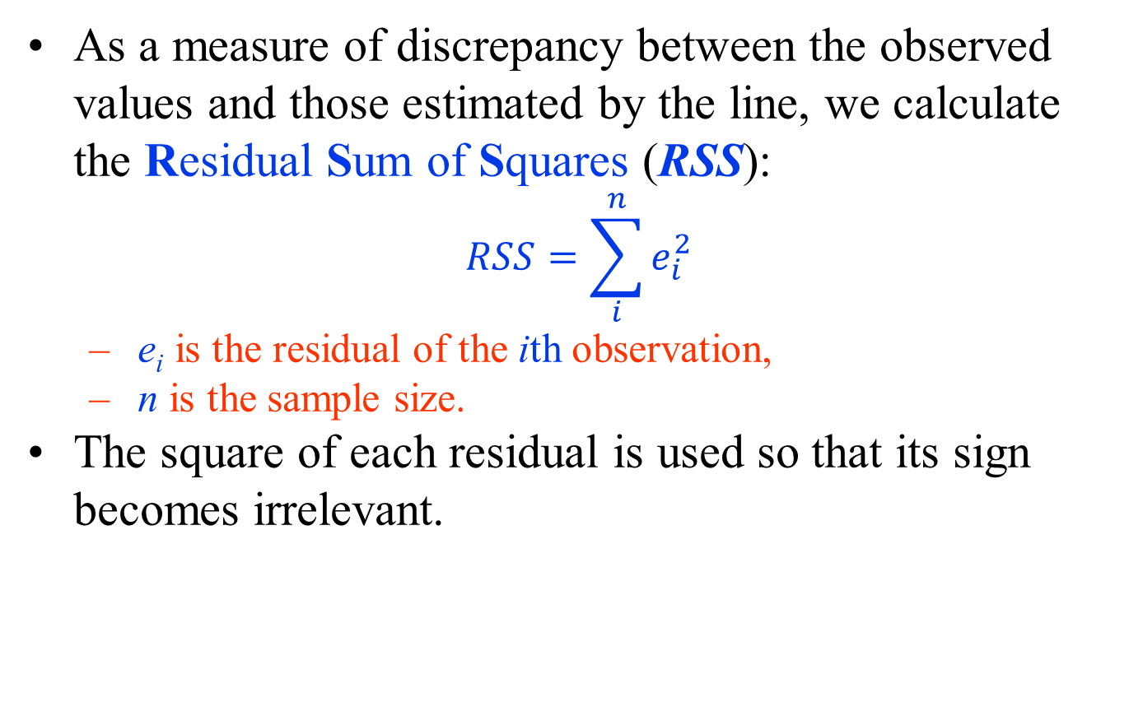
Residual sum of squares
As a measure of discrepancy between the observed values and those estimated by the line, we calculate the Residual Sum of Squares (RSS):
$$RSS=\sum_{i}^{n}{e_{i}^{2}}$$
  e_{i} is the residual of the ith observation,
  n is the sample size.
The square of each residual is used so that its sign becomes irrelevant.

Slide 17
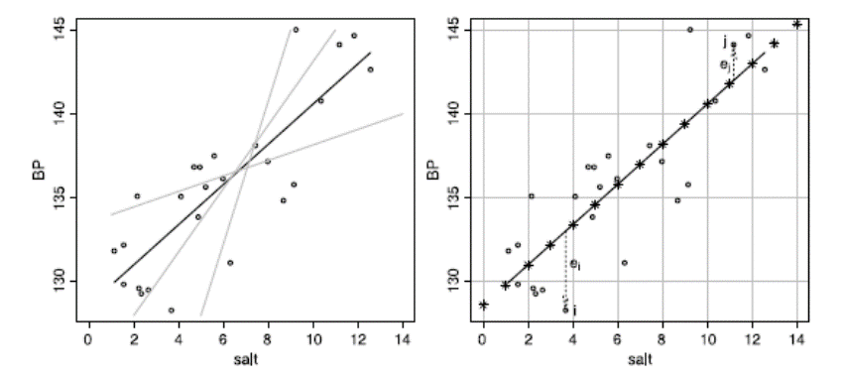
One Numerical Explanatory Variable
We now discuss simple linear regression models (i.e., linear regression with only one explanatory variable), where the explanatory variable is numerical.
Left panel: Scatterplot of blood pressure by daily sodium chloride intake along with some candidate lines for capturing the overall relationship between the two variables.
  The black line is the least-squares regression line.
Right panel: The least-squares regression line for the relationship between blood pressure and sodium chloride intake.
  The vertical arrows show the residuals for two observations.
  The stars are the estimated blood pressure for daily sodium chloride intakes from 0 to 14 grams

Slide 18
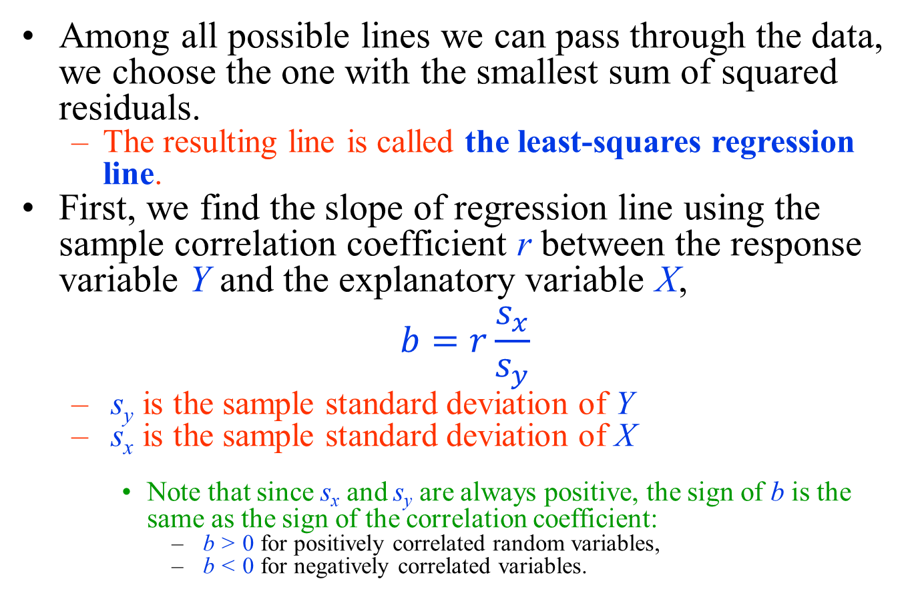
One Numerical Explanatory Variable
Among all possible lines we can pass through the data, we choose the one with the smallest sum of squared residuals.
  The resulting line is called the least-squares regression line.
First, we find the slope of regression line using the sample correlation coefficient r between the response variable Y and the explanatory variable X,
$$b=r\frac{s_{x}}{s_{y}}$$
  s_{y} is the sample standard deviation of Y
  s_{x} is the sample standard deviation of X
    Note that since s_{x} and s_{y} are always positive, the sign of b is the same as the sign of the correlation coefficient:
      b > 0 for positively correlated random variables,
      b < 0 for negatively correlated variables.

Slide 19
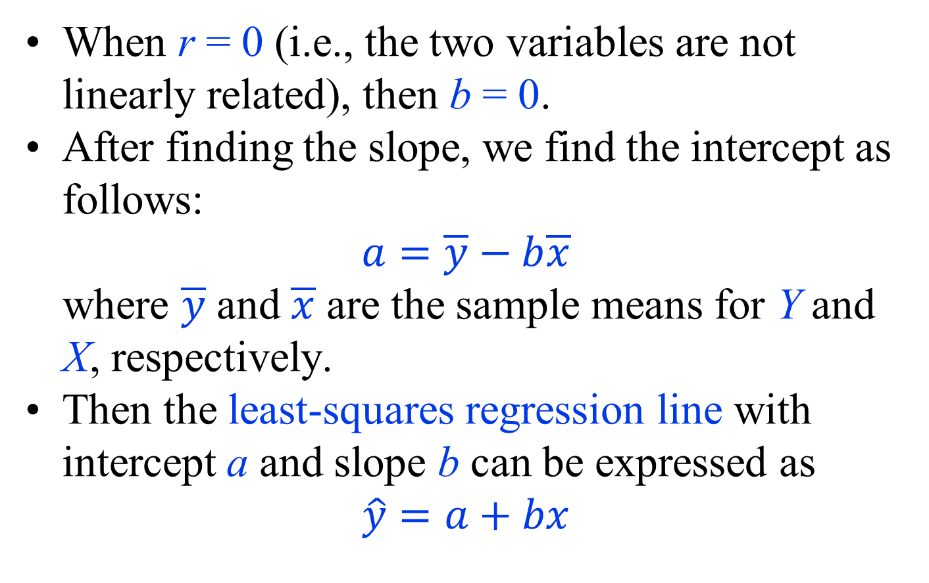
One Numerical Explanatory Variable
When r = 0 (i.e., the two variables are not linearly related), then b = 0.
After finding the slope, we find the intercept as follows:
$$a=\overline{y}−b\overline{x}$$
where $\overline{y}$ and $\overline{x}$ are the sample means for Y and X, respectively.
Then the least-squares regression line with intercept a and slope b can be expressed as
$$\hat{y}=a+bx$$

Slide 20
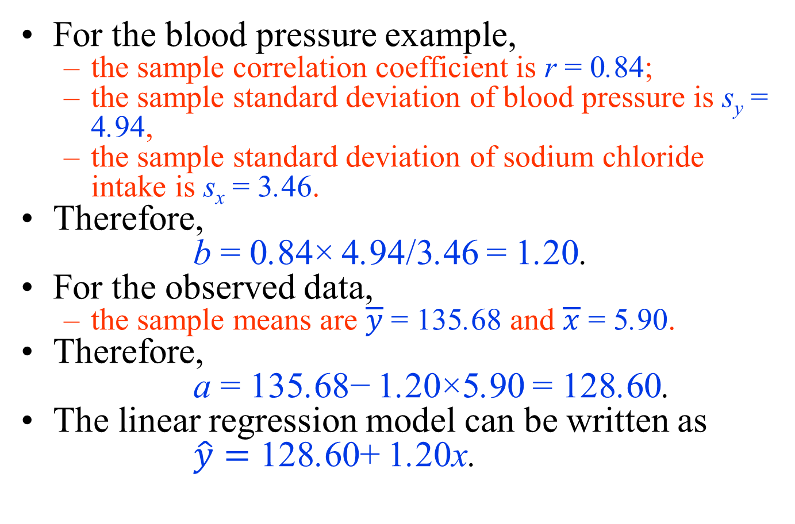
Example
For the blood pressure example,
  the sample correlation coefficient is r = 0.84;
  the sample standard deviation of blood pressure is s_{y} = 4.94,
  the sample standard deviation of sodium chloride intake is s_{x} = 3.46.
Therefore,
b = 0.84× 4.94/3.46 = 1.20.
For the observed data,
  the sample means are $\overline{y}$ = 135.68 and $\overline{x}$ = 5.90.
Therefore,
a = 135.68− 1.20×5.90 = 128.60.
The linear regression model can be written as
$\hat{y}=$ 128.60+ 1.20x.

Slide 21
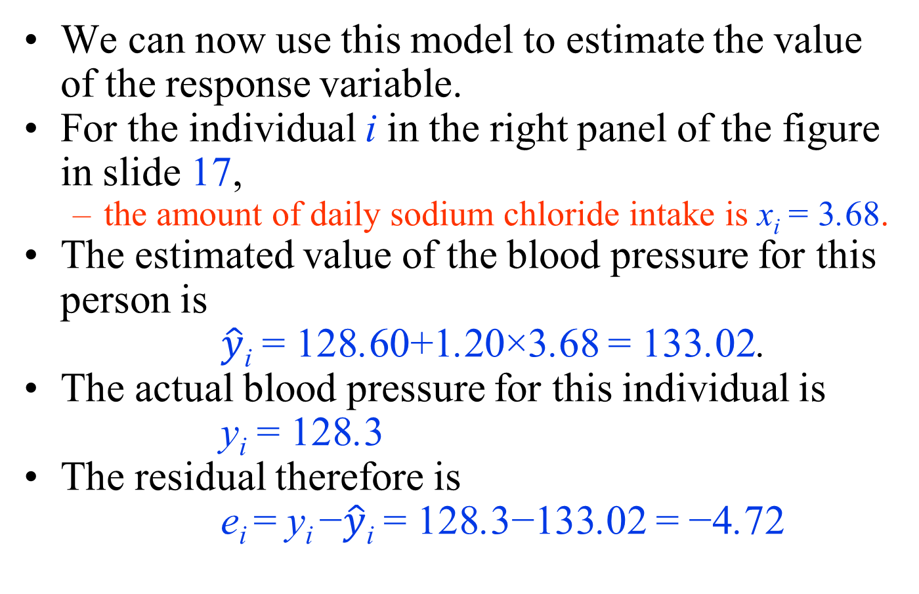
Example
We can now use this model to estimate the value of the response variable.
For the individual i in the right panel of the figure in slide 17,
  the amount of daily sodium chloride intake is x_{i} = 3.68.
The estimated value of the blood pressure for this person is
$\hat{y}$_{i} = 128.60+1.20×3.68 = 133.02.
The actual blood pressure for this individual is
y_{i} = 128.3
The residual therefore is
e_{i} = y_{i} −$\hat{y}$_{i} = 128.3−133.02 = −4.72

Slide 22
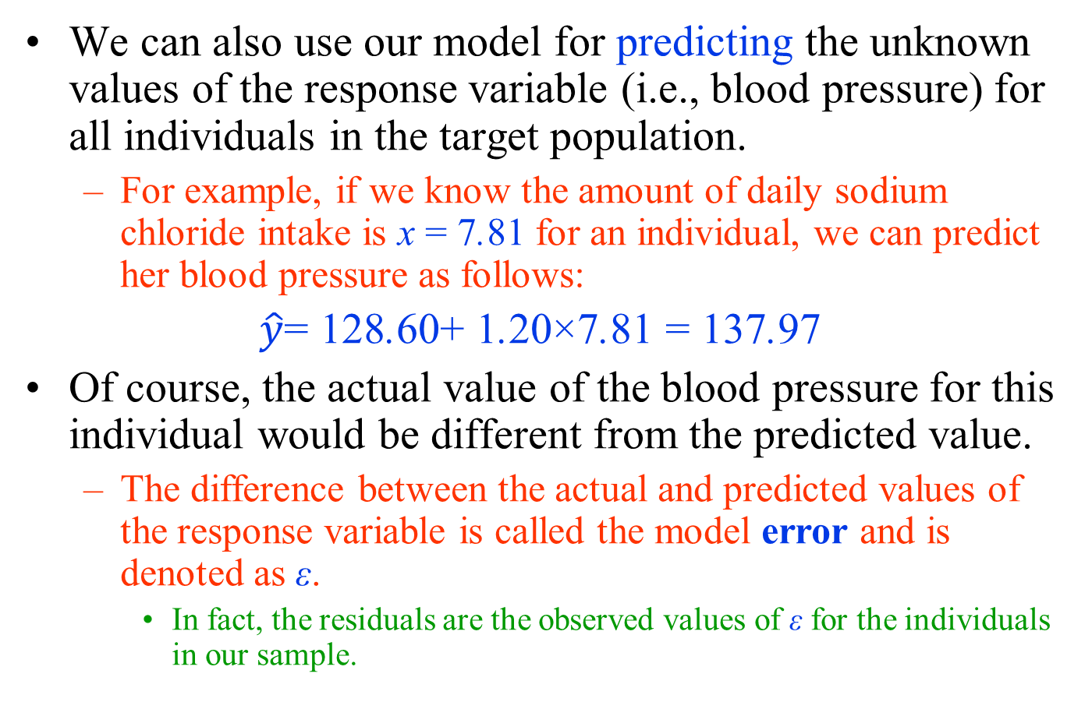
Example
We can also use our model for predicting the unknown values of the response variable (i.e., blood pressure) for all individuals in the target population.
  For example, if we know the amount of daily sodium chloride intake is x = 7.81 for an individual, we can predict her blood pressure as follows:
$\hat{y}$= 128.60+ 1.20×7.81 = 137.97
Of course, the actual value of the blood pressure for this individual would be different from the predicted value.
  The difference between the actual and predicted values of the response variable is called the model error and is denoted as ε.
    In fact, the residuals are the observed values of ε for the individuals in our sample.

Slide 23
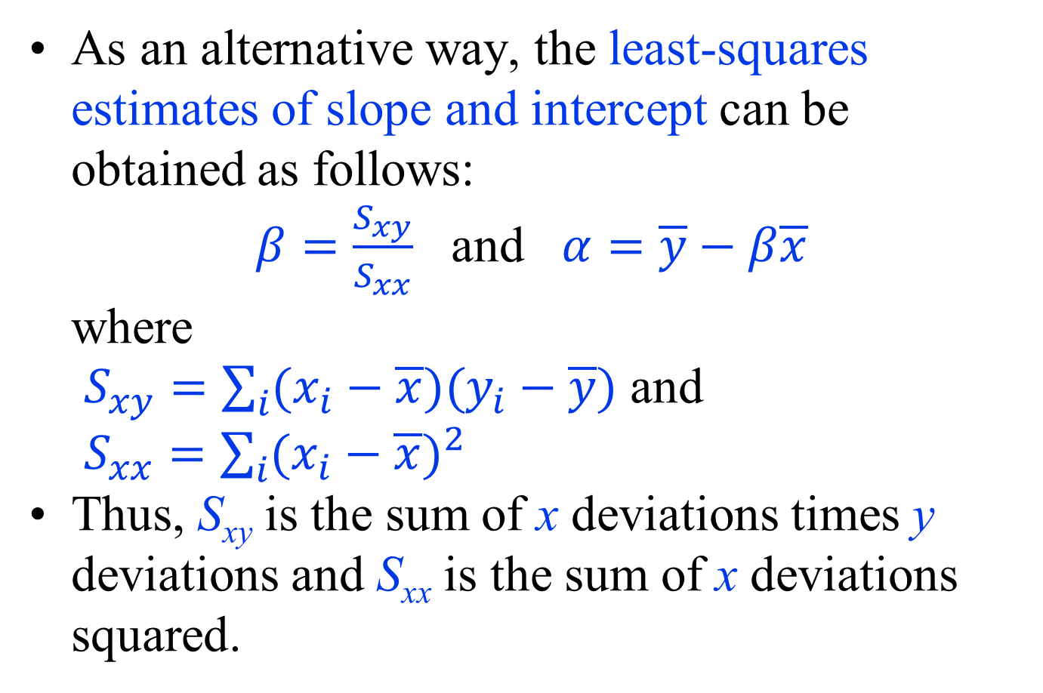
Estimating model parameters
As an alternative way, the least-squares estimates of slope and intercept can be obtained as follows:
$β=\frac{S_{xy}}{S_{xx}}$ and $α=\overline{y}−β\overline{x}$
where
$S_{xy}=\sum_{i}{(x_{i}−\overline{x})(y_{i}−\overline{y})}$ and
$S_{xx}=\sum_{i}{(x_{i}−\overline{x})^{2}}$
Thus, S_{xy} is the sum of x deviations times y deviations and S_{xx} is the sum of x deviations squared.

Slide 24
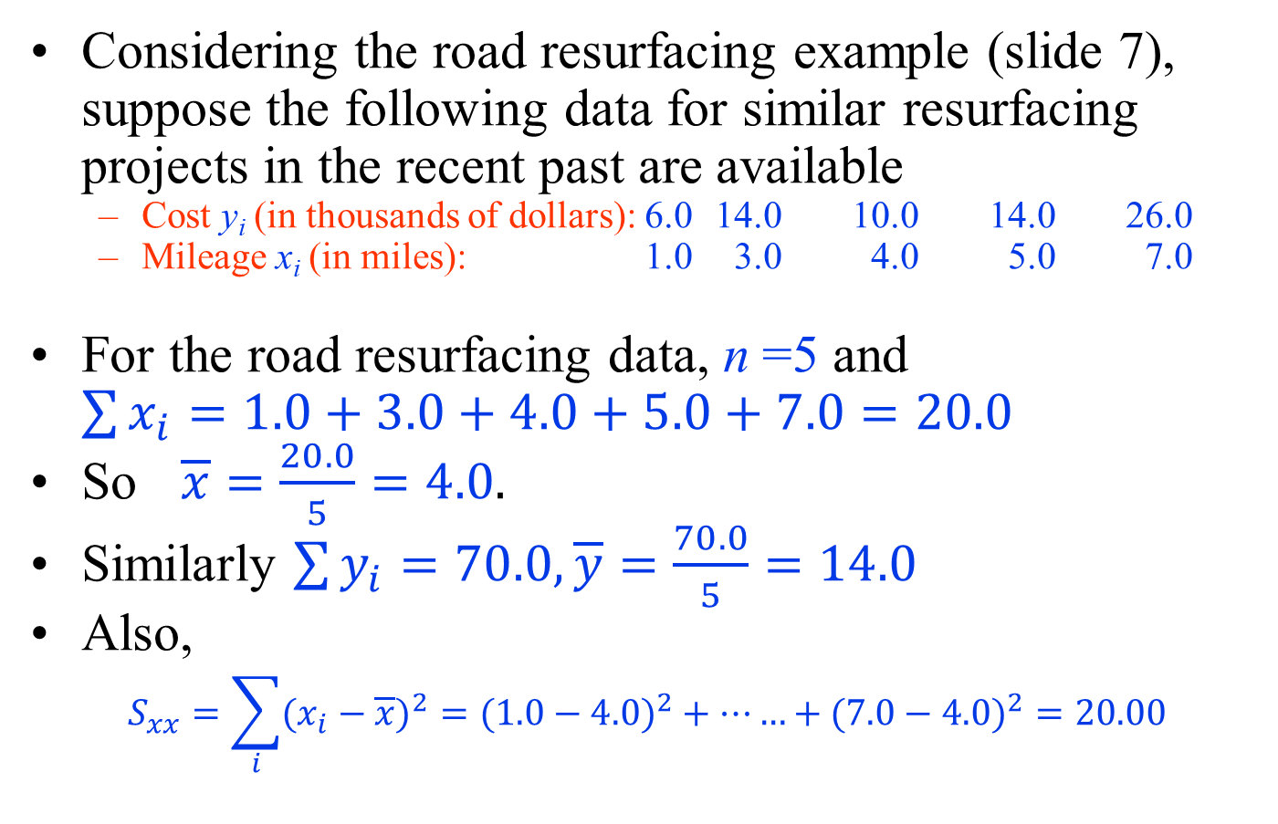
Example
Considering the road resurfacing example (slide 7), suppose the following data for similar resurfacing projects in the recent past are available
  Cost y_{i} (in thousands of dollars): 6.0 14.0 10.0 14.0 26.0
  Mileage x_{i} (in miles): 1.0 3.0 4.0 5.0 7.0
For the road resurfacing data, n =5 and $\sum{x_{i}=1.0+3.0+4.0+5.0+7.0=20.0}$
So $\overline{x}=\frac{20.0}{5}=4.0.$
Similarly $\sum{y_{i}=70.0, \overline{y}=\frac{70.0}{5}=14.0}$
Also,
$$S_{xx}=\sum_{i}{(x_{i}−\overline{x})^{2}}=(1.0−4.0)^{2}+……+(7.0−4.0)^{2}=20.00$$

Slide 25
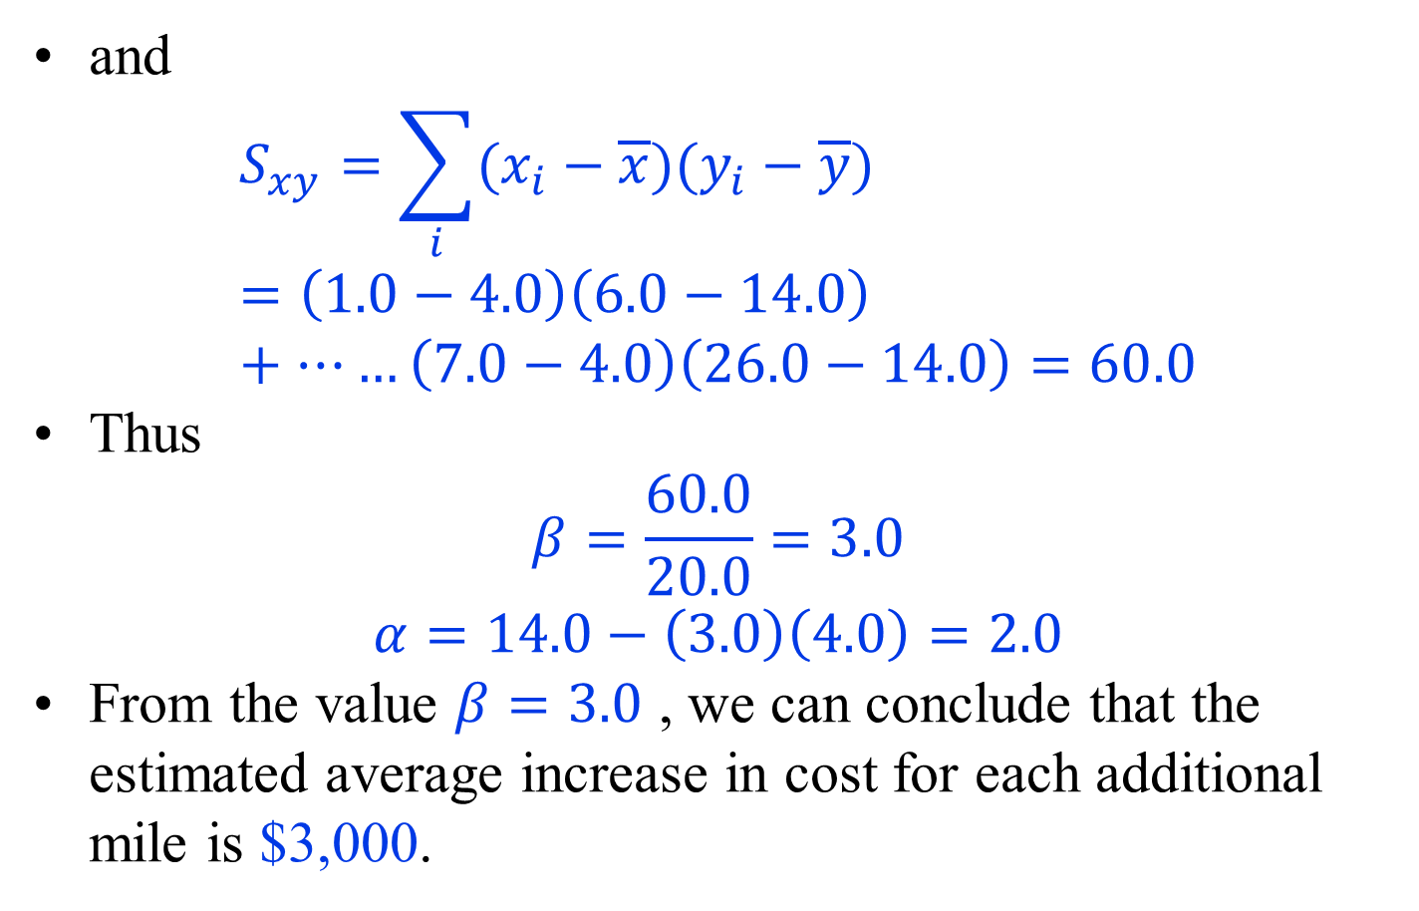
Example
and
$$S_{xy}=\sum_{i}{(x_{i}−\overline{x})(y_{i}−\overline{y})}=\left(1.0−4.0\right)\left(6.0−14.0\right)+……\left(7.0−4.0\right)\left(26.0−14.0\right)=60.0$$
Thus
$$β=\frac{60.0}{20.0}=3.0$$
$$α=14.0−\left(3.0\right)\left(4.0\right)=2.0$$
From the value $β=3.0$ , we can conclude that the estimated average increase in cost for each additional mile is $3,000.

Slide 26
Example
Deviations from the least-squares line from the mean

Slide 27
The linear relationship
The linear relationship between Y and X in the entire population can be presented in a similar form,
Y = α +βX +ε
  where α is the intercept, and β is the slope of the regression line , ε is called the error term, representing the difference between the estimated and the actual values of Y in the population.
  We refer to the above equation as the linear regression model.
  We refer to α and β as the regression parameters.
    More specifically, β is called the regression coefficient for the explanatory variable.
The process of finding the regression parameters is called fitting a regression model to the data.

Slide 28
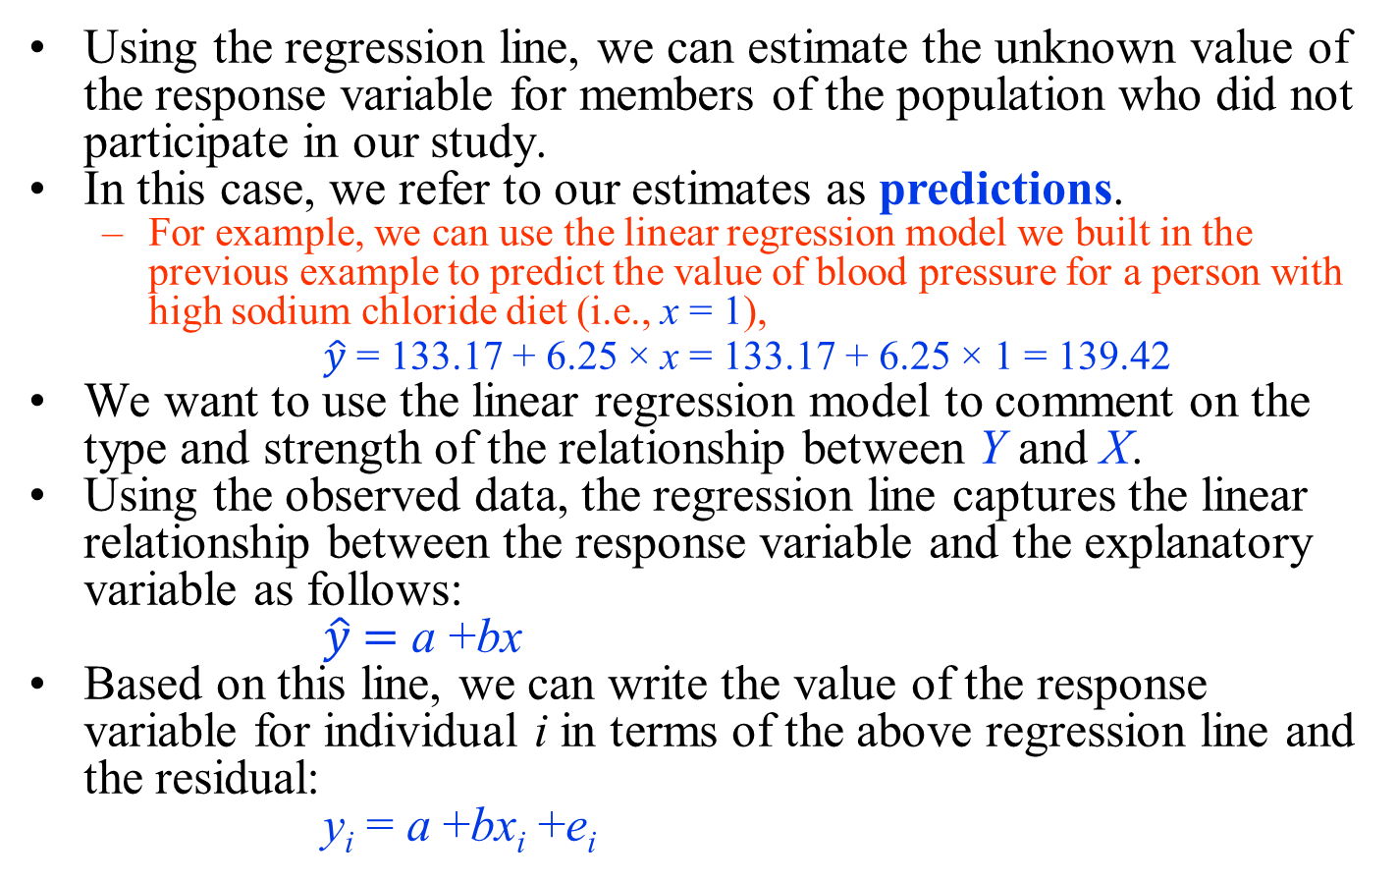
Statistical Inference Using Simple Linear Regression Models
Using the regression line, we can estimate the unknown value of the response variable for members of the population who did not participate in our study.
In this case, we refer to our estimates as predictions.
  For example, we can use the linear regression model we built in the previous example to predict the value of blood pressure for a person with high sodium chloride diet (i.e., x = 1),
$\hat{y}$ = 133.17 + 6.25 × x = 133.17 + 6.25 × 1 = 139.42
We want to use the linear regression model to comment on the type and strength of the relationship between Y and X.
Using the observed data, the regression line captures the linear relationship between the response variable and the explanatory variable as follows:
$\hat{y} \text{=} \text{a} \text{+}\text{bx}$
Based on this line, we can write the value of the response variable for individual i in terms of the above regression line and the residual:
y_{i} = a +bx_{i} +e_{i}

Slide 29
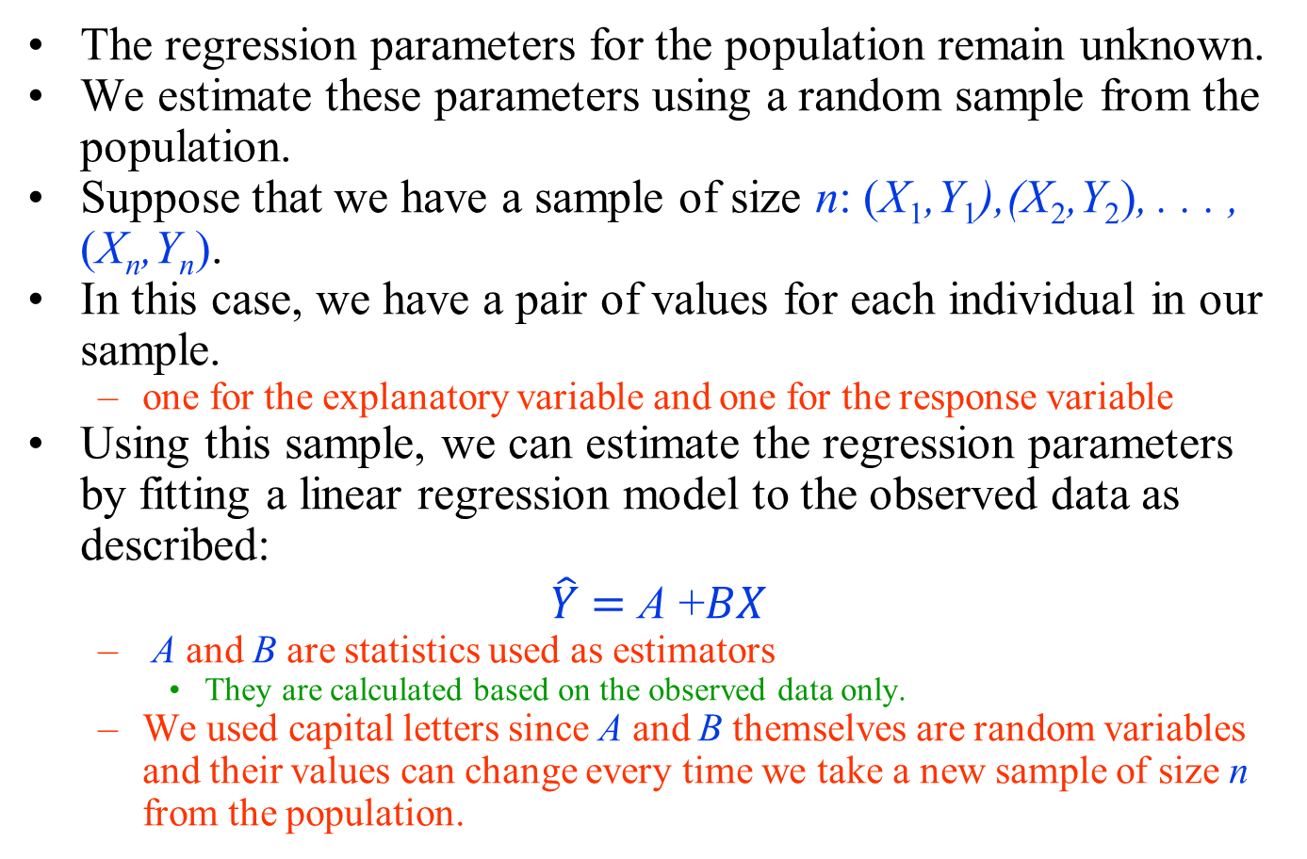
Statistical inference using regression models
The regression parameters for the population remain unknown.
We estimate these parameters using a random sample from the population.
Suppose that we have a sample of size n: (X₁,Y₁),(X₂,Y₂), . . . , (X_{n},Y_{n}).
In this case, we have a pair of values for each individual in our sample.
  one for the explanatory variable and one for the response variable
Using this sample, we can estimate the regression parameters by fitting a linear regression model to the observed data as described:
$$\hat{Y}\text{ =} \text{A} \text{+}BX$$
  A and B are statistics used as estimators
    They are calculated based on the observed data only.
  We used capital letters since A and B themselves are random variables and their values can change every time we take a new sample of size n from the population.

Slide 30
Statistical inference using regression models
The point estimates do not reflect our uncertainty;
  we always remain uncertain about the actual values of α and β, and our estimates for these parameters can change when we take a different sample from the population.
Therefore, we use the point estimates a and b obtained from the observed data along with the sampling distribution of the estimators A and B to find confidence interval estimates for α and β.
  This is similar to what we had for the population mean.
Because the slope parameter β has a central role in capturing the linear relationship between Y and X, we need to find its confidence intervals.
  Similar approach can be used for the intercept α.

Slide 31
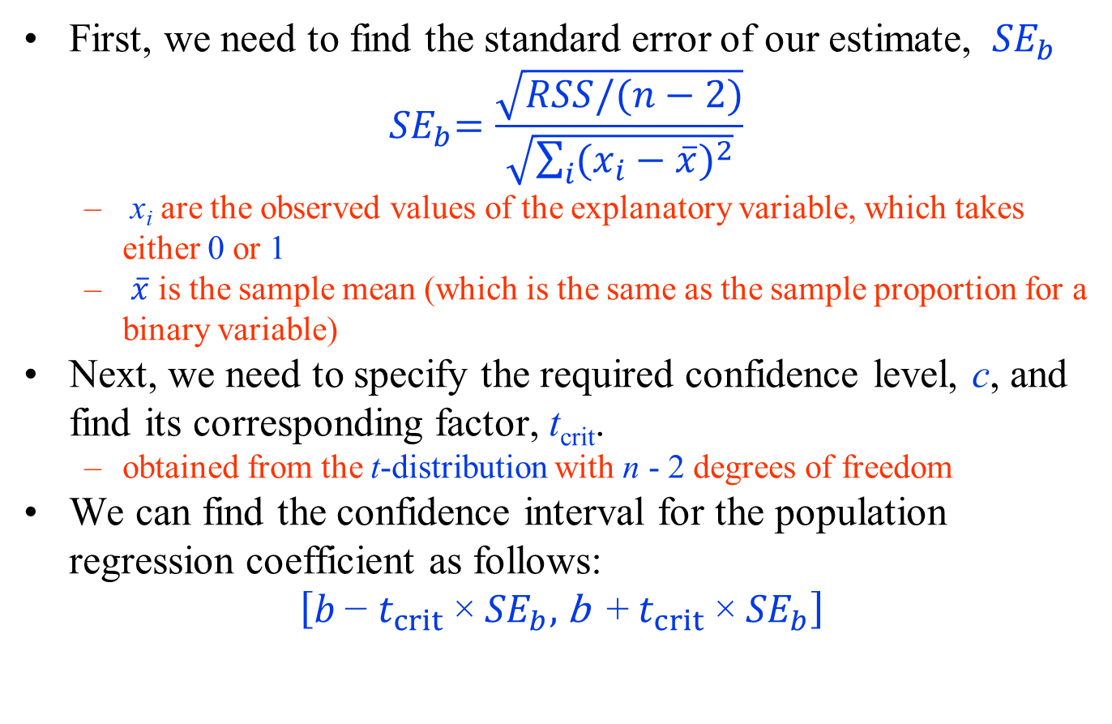
Confidence Interval for Regression Coefficients
First, we need to find the standard error of our estimate, ${ SE}_{b}$
$${ SE}_{b}=\frac{\sqrt{RSS/(n−2)}}{\sqrt{\sum_{i}{{(x_{i}−\overline{x})}^{2}}}}$$
  x_{i} are the observed values of the explanatory variable, which takes either 0 or 1
  $\overline{x}$ is the sample mean (which is the same as the sample proportion for a binary variable)
Next, we need to specify the required confidence level, c, and find its corresponding factor, t_{crit}.
  obtained from the t-distribution with n - 2 degrees of freedom
We can find the confidence interval for the population regression coefficient as follows:
$$\left[b \text{−} t_{crit} \text{×}{ SE}_{b}\text{, }\text{b} \text{+}{ t}_{crit} \text{×}{ SE}_{b}\right]$$

Slide 32
Confidence Interval for Regression Coefficients
For the blood pressure example,
  the sample size is n = 25.
Therefore, we use the t-distribution with 25 − 2 = 23 degrees of freedom.
If we set the confidence level to 0.95,
  then t_{crit} = 2.07,
    which is obtained from the t-distribution with 23 degrees of freedom by setting the upper tail probability to (1−0.95)/2 = 0.025.
Therefore,
  the 95% confidence interval for β is
[6.25−2.07×1.59, 6.25+ 2.07×1.59] = [2.96, 9.55]
    by moving from the low sodium chloride diet to high sodium chloride diet, the expected (average) amount of increase in blood pressure is estimated to be somewhere between 2.96 and 9.55 units

Slide 33
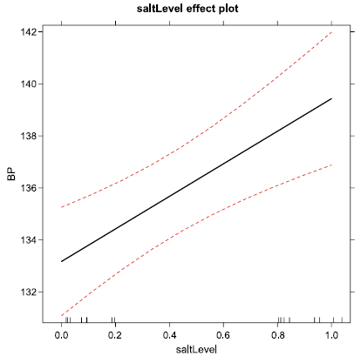
Confidence Interval for Regression Coefficients
Least-squares regression line (solid line) and its 95% confidence interval (dashed curves) for the relationship between blood pressure and sodium chloride intake level

Slide 34
Hypothesis Testing with Simple Linear Regression Models
Linear regression models can be used for testing hypotheses regarding possible linear relationship between the response variable and the explanatory variable.
  For this, the regression coefficient β, its estimator B, and its point estimate b play a central role.
For linear regression models with a binary explanatory variable, we found the regression line by connecting the sample means of the two groups.
  In these models, the slope b is the difference between the two sample means. Similarly, the regression coefficient β captures the difference between the population means for the two groups.
If the response variable is not related to the binary explanatory variable, the two population means are the same, and the slope of the regression line for the whole population will be zero.
  That is, the null hypothesis stating no relationship between the two variable can be written as H₀ : β = 0.

Slide 35
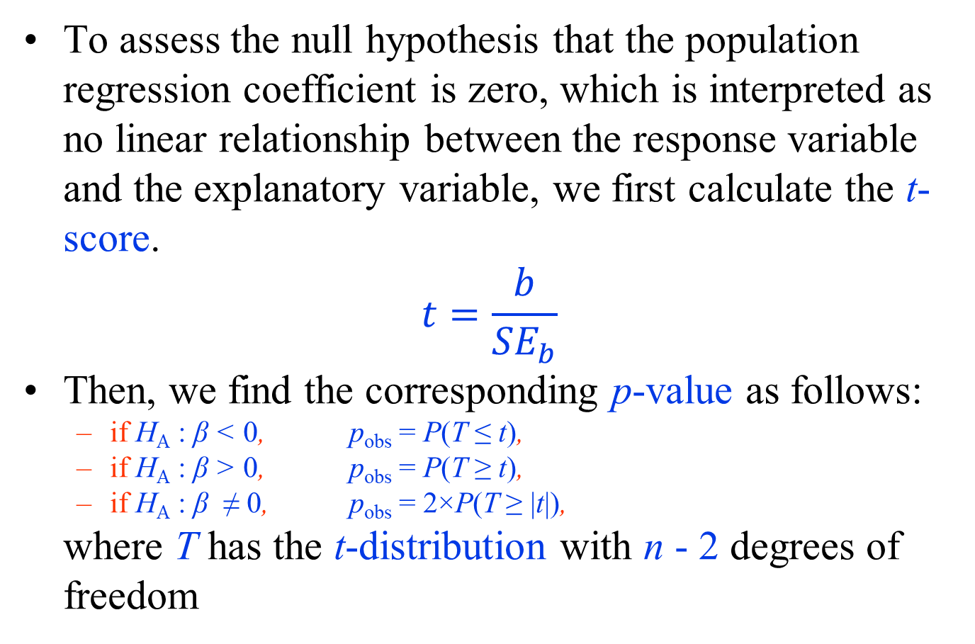
Hypothesis Testing with Simple Linear Regression Models
To assess the null hypothesis that the population regression coefficient is zero, which is interpreted as no linear relationship between the response variable and the explanatory variable, we first calculate the t-score.
$$t=\frac{b}{{SE}_{b}}$$
Then, we find the corresponding p-value as follows:
  if H_{A} : β < 0, p_{obs} = P(T ≤ t),
  if H_{A} : β > 0, p_{obs} = P(T ≥ t),
  if H_{A} : β ≠ 0, p_{obs} = 2×P(T ≥ |t|),
where T has the t-distribution with n - 2 degrees of freedom

Slide 36
Hypothesis Testing with Simple Linear Regression Models
In the blood pressure example,
  the estimate of the regression coefficient was b = 6.25,
  the standard error was SE_{b} = 1.59.
Therefore,
t = b / SE_{b} = 6.25 / 1.59 = 3.93.
If H_{A} : β ≠ 0 (which is the common form of the alternative hypothesis),
  we find the p-value by calculating the upper tail probability of |3.93| = 3.93 from the t-distribution with 25 − 2 = 23 degrees of freedom and multiplying the result by 2.
For this example,
p_{obs} = 2×0.00033 = 0.00066.
Because p_{obs} for this example is quite small and below any commonly used confidence level (e.g., 0.01, 0.05, 0.1), we can reject the null hypothesis and conclude that blood pressure is related to sodium chloride diet level.

Slide 37

Example
Data from a sample of 10 pharmacies are used to examine the relation between prescription sales volume and percentage of prescription ingredients purchased directly from the supplier.
The sample data are shown in the following table
a. Find the least-squares estimates for the regression line $\hat{y}=α+βx$
b. Predict sales volume for a pharmacy that purchases 15% of its prescription ingredients directly from the supplier.
c. Plot the (x, y) data and the prediction equation $\hat{y}=α+βx$
d. Interpret the value of β in the context of the problem.

Slide 38
Example
a. Least-squares estimates

Slide 39
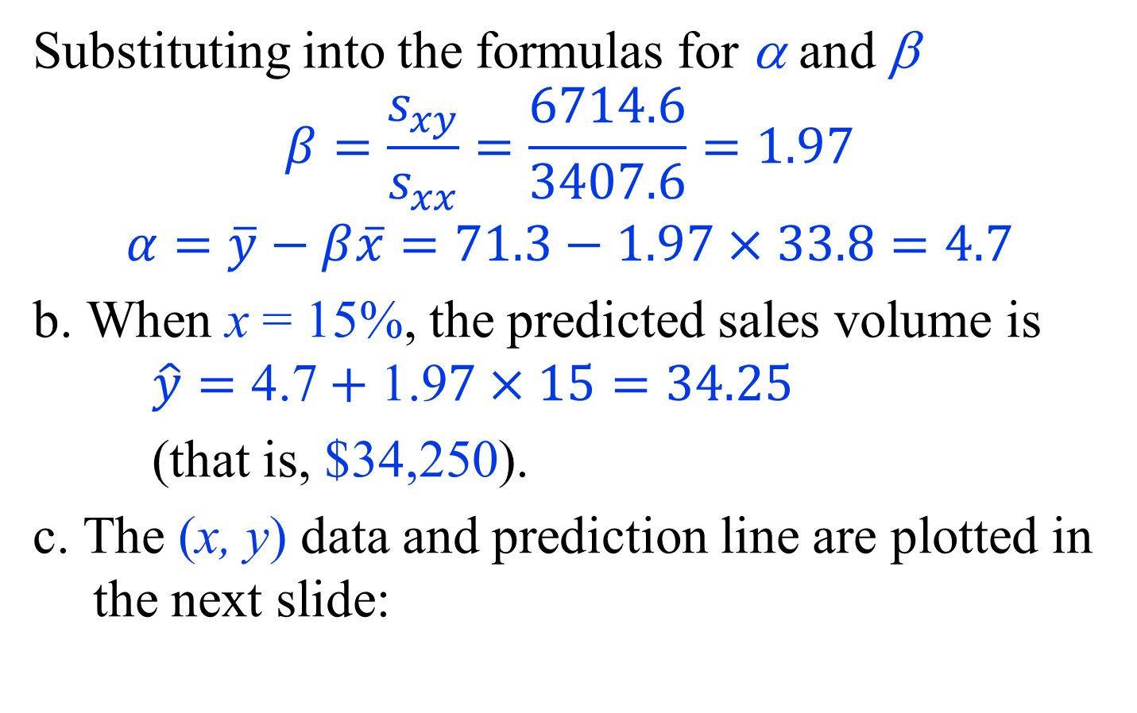
Example
Substituting into the formulas for α and β
$$β=\frac{s_{xy}}{s_{xx}}=\frac{6714.6}{3407.6}=1.97$$
$$α=\overline{y}−β\overline{x}=71.3−1.97×33.8=4.7$$
b. When x = 15%, the predicted sales volume is $\hat{y}=\text{4.7}+\text{1.9}7×15=34.25$
(that is, $34,250).
c. The (x, y) data and prediction line are plotted in the next slide:

Slide 40
Example
d. From β = 1.97, we conclude that if a pharmacy would increase by 1% the percentage of ingredients
purchased directly, then the estimated increase in average sales volume would be $1,970.

Slide 41
Goodnes of Fit
14.12.20
Recall that the RSS quantifies the discrepancy between the observed data and the regression line used to represent the data:
  the higher RSS, the higher discrepancy.
  can be interpreted as the
    unexplained variation in the response variable using the regression model
    lack of fit of the linear regression model
In contrast, R² is a measure of goodness of fit
  measures how well the regression model represents the observed data and explains the variation in the response variable.
    value of R² is between 0 and 1
    the better the model fits the data, the higher its R² is.

Slide 42
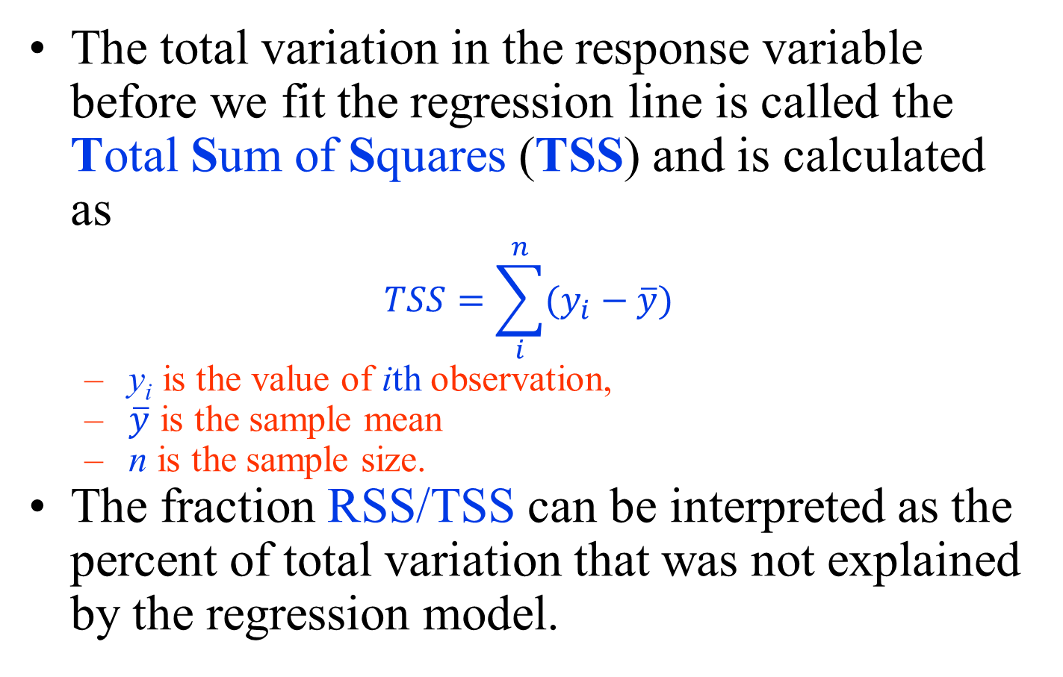
Goodnes of Fit
The total variation in the response variable before we fit the regression line is called the Total Sum of Squares (TSS) and is calculated as
$$TSS=\sum_{i}^{n}{(y_{i}−\overline{y})}$$
  y_{i} is the value of ith observation,
  $\overline{y}$ is the sample mean
  n is the sample size.
The fraction RSS/TSS can be interpreted as the percent of total variation that was not explained by the regression model.

Slide 43
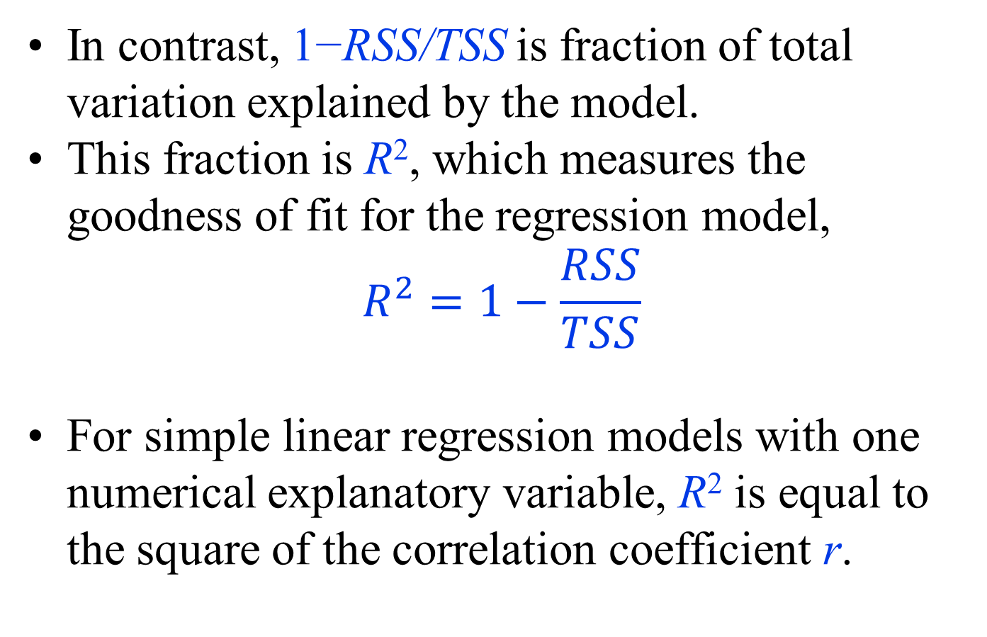
Goodnes of Fit
In contrast, 1−RSS/TSS is fraction of total variation explained by the model.
This fraction is R², which measures the goodness of fit for the regression model,
$$R^{2}=1−\frac{RSS}{TSS}$$
For simple linear regression models with one numerical explanatory variable, R² is equal to the square of the correlation coefficient r.

Slide 44
Goodnes of Fit
R² provided by R-Commander (highlighted) for the linear regression model with blood pressure as the response variable and daily sodium chloride intake as the explanatory variable.
For this model, R² = 0.70.
  70% of the total variation in blood pressure can be explained by the daily amount of sodium chloride a person consumes.
  30% of the total variation cannot be explained by this model and is regarded as random.
The sample correlation coefficient between blood pressure and daily sodium chloride intake is r = 0.84.
Therefore, the R² = (0.84)² = 0.70.
Notes:
While R² provides useful information about the fit of the regression model, one should be cautious about overstating its importance.
Having a large R² only means that the model provides estimates close to the observed values for individuals in our sample.
This may or may not translate to better predictions for other individuals that are not included in our sample.
Moreover, even when the value of R² is small, the model could still be useful for predicting unknown values of the response variable, especially when we consider the alternative option of not using the model (and the explanatory variable) for prediction.

Slide 45
Model Assumptions and Diagnostics
Statistical inference using linear regression models is based on several assumptions:
  Linearity
  Independence
  Constant Variance and Normality
Violating these assumptions could lead to wrong conclusions.

Slide 46
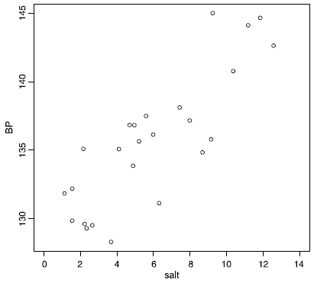
Model Assumptions - Linearity
The relationship between the explanatory variable X and the response variable Y is linear
appropriateness of this assumption can be visually evaluated using the scatterplot
When this assumption does not hold, we might still be able to use linear regression models after transforming the original variables.
  logarithm (usually for the response variable),
  square root, and square (usually for predictors).

Slide 47
Model Assumptions - Independence
a reasonable assumption if
  simple random sampling is used to select individuals that are not related to each other
  multiple observations are not obtained from the same individual.
However, we sometimes sample
  related subjects in groups
  unrelated subjects, but obtain multiple measurements of the response variable for each subject.
For such data, regression models taking the dependencies among observations into account should be used.
  When multiple observations are obtained over time, a class of statistical models called longitudinal models is used.

Slide 48
Model Assumptions - Constant Variance and Normality
Using linear regression models also involves some assumptions regarding the probability distribution of the response variable Y, which is the main random variable in regression analysis.
It is expected that the variation of the actual values of the response variable around the regression line remains the same regardless of the value of the explanatory variable.
  This is called the constant variance assumption, which is also known as the homoscedasticity assumption.
    Heteroscedasticity refers to situations where the constant variance assumption is violated.
To check the validity of these assumptions, the residuals e that are observed values of the random variable ε is examined .

Slide 49
Model Assumptions - Constant Variance and Normality
To illustrate how we check the assumptions regarding ε, we use the blood pressure example with daily amount of sodium chloride intake as the explanatory variable.
In R-Commander, make sure RegModel.2 is the active model, then click
  Models→Graphs Basic diagnostic plots
This creates several model diagnostic plots shown in the next slide.
When the constant variance assumption does not hold, we can sometimes stabilize the variance using simple transformations of the response variable so the variance becomes approximately constant.
  For example, instead of Y , we could use sqrt(Y) or log(Y) in the regression model.

Slide 50
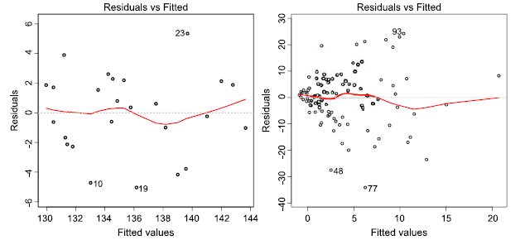
Model Assumptions - Constant Variance and Normality
Left panel: The residual plot for the blood pressure example (with daily amount of sodium chloride intake as the explanatory variable) to assess the assumptions of linear regression models related to the error term. Here, the scatter plot of residuals vs. the estimated (fitted) values is shown. The horizontal axis represents the regression line. The solid line on the plot shows the overall pattern of the residuals. The plot shows that the residuals are scattered randomly around the horizontal dashed line at zero without any detectable pattern.
Right panel: An illustrative example, where the constant variance assumption is violated. Here, the residuals become more dispersed around the horizontal line as we move from small to large fitted values

Slide 51
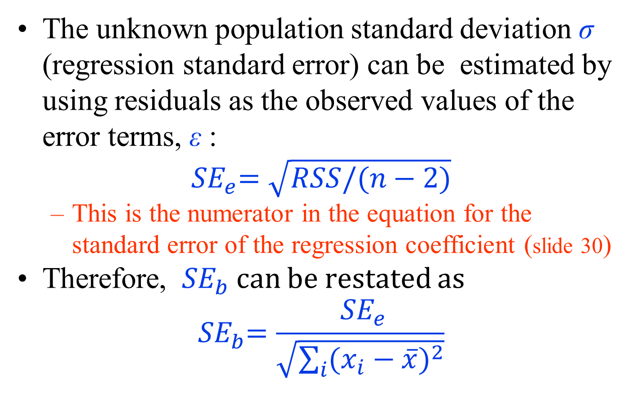
Regression Standard Error (𝑆𝐸_{𝑒})
The unknown population standard deviation σ (regression standard error) can be estimated by using residuals as the observed values of the error terms, ε :
$${ SE}_{e}=\sqrt{RSS/(n−2)}$$
  This is the numerator in the equation for the standard error of the regression coefficient (slide 30)
Therefore, ${ SE}_{b}$ can be restated as
$${ SE}_{b}=\frac{{ SE}_{e}}{\sqrt{\sum_{i}{{(x_{i}−\overline{x})}^{2}}}}$$

Slide 52
Multiple Linear Regression
In most cases, we are interested in the relationship between the response variable and multiple explanatory variables.
If our objective is to predict unknown values of the response variable, we might be able to improve prediction accuracy by including multiple predictors in the linear regression model.
Models with multiple explanatory variables or predictors are called multiple linear regression models.

Slide 53
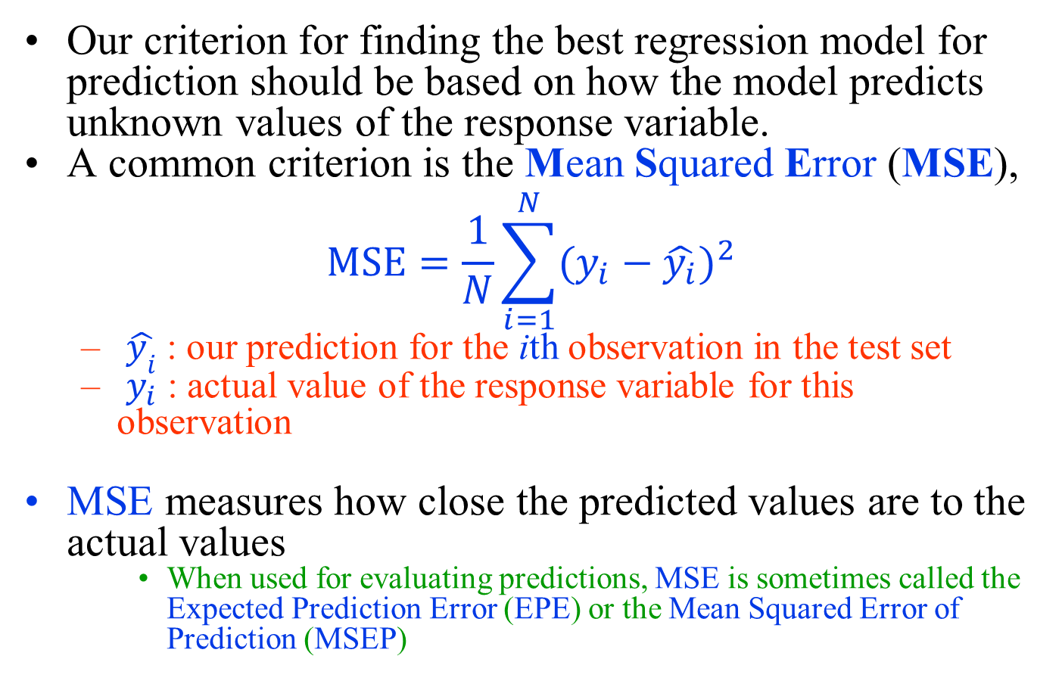
Multiple Linear Regression
Our criterion for finding the best regression model for prediction should be based on how the model predicts unknown values of the response variable.
A common criterion is the Mean Squared Error (MSE),
$$MSE=\frac{1}{N}\sum_{i=1}^{N}{{(y_{i}−\hat{y_{i}})}^{2}}$$
  $\hat{y_{i}}$ : our prediction for the ith observation in the test set
  $y_{i}$ : actual value of the response variable for this observation
MSE measures how close the predicted values are to the actual values
    When used for evaluating predictions, MSE is sometimes called the Expected Prediction Error (EPE) or the Mean Squared Error of Prediction (MSEP)

Slide 54
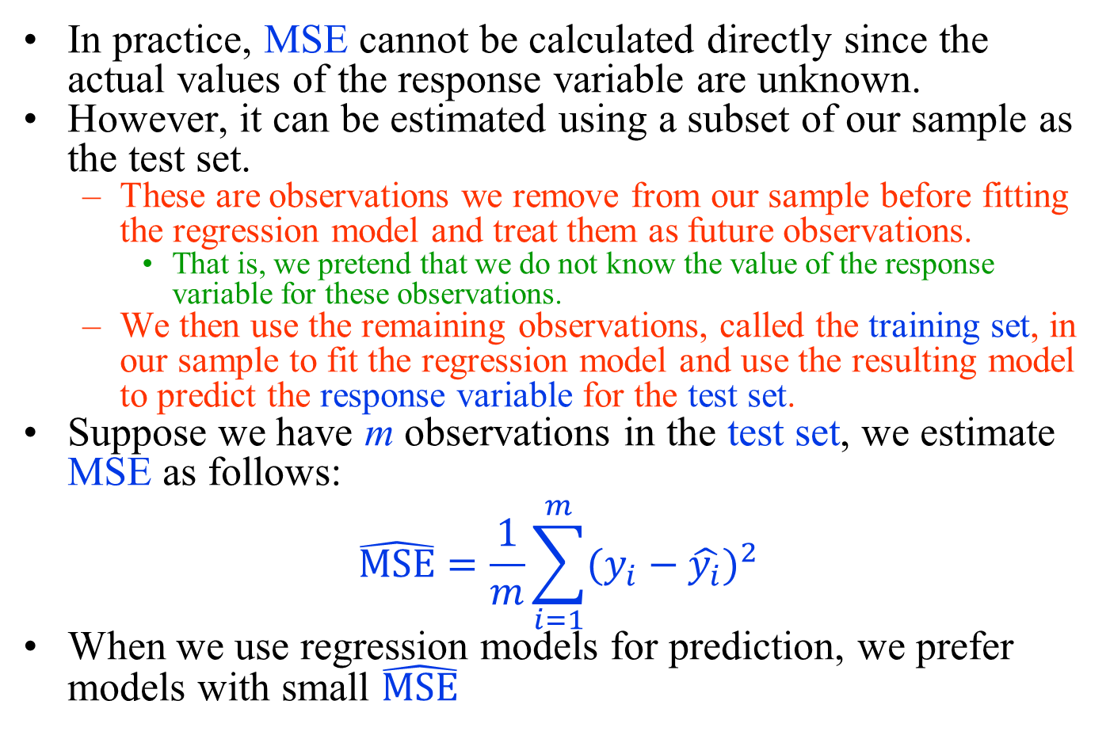
Multiple Linear Regression
In practice, MSE cannot be calculated directly since the actual values of the response variable are unknown.
However, it can be estimated using a subset of our sample as the test set.
  These are observations we remove from our sample before fitting the regression model and treat them as future observations.
    That is, we pretend that we do not know the value of the response variable for these observations.
  We then use the remaining observations, called the training set, in our sample to fit the regression model and use the resulting model to predict the response variable for the test set.
Suppose we have m observations in the test set, we estimate MSE as follows:
$$\hat{MSE}=\frac{1}{m}\sum_{i=1}^{m}{{(y_{i}−\hat{y_{i}})}^{2}}$$
When we use regression models for prediction, we prefer models with small $\hat{MSE}$

Slide 55
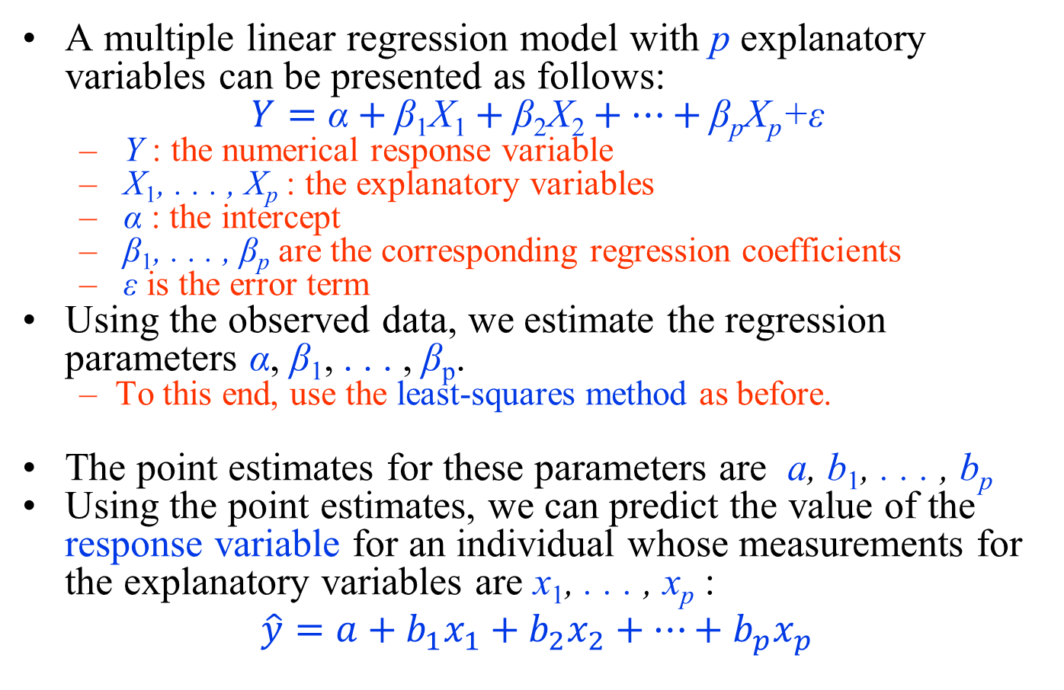
Multiple Linear Regression
A multiple linear regression model with p explanatory variables can be presented as follows:
$$Y=\text{α}+\text{β}\text{1}\text{X}\text{1}+\text{β}\text{2}\text{X}\text{2}+…+\text{β}\text{p}\text{X}\text{p}\text{+}\text{ε}$$
  Y : the numerical response variable
  X₁, . . . , X_{p} : the explanatory variables
  α : the intercept
  β₁, . . . , β_{p} are the corresponding regression coefficients
  ε is the error term
Using the observed data, we estimate the regression parameters α, β₁, . . . , β_{p}.
  To this end, use the least-squares method as before.
The point estimates for these parameters are a, b₁, . . . , b_{p}
Using the point estimates, we can predict the value of the response variable for an individual whose measurements for the explanatory variables are x₁, . . . , x_{p} :
$$\hat{y}=a+b_{1}x_{1}+b_{2}x_{2}+…+b_{p}x_{p}$$

Slide 56
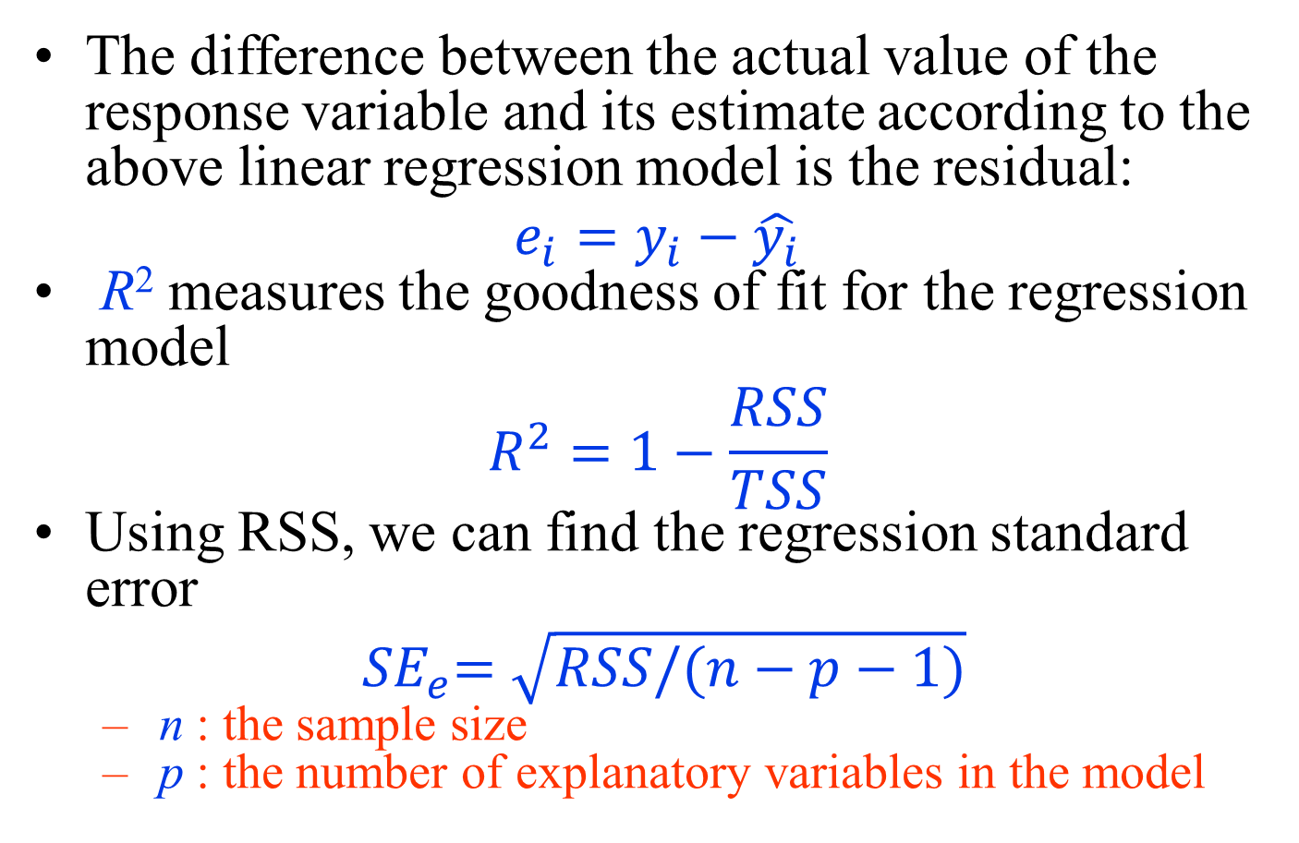
Multiple Linear Regression
The difference between the actual value of the response variable and its estimate according to the above linear regression model is the residual:
$$e_{i}=y_{i}−\hat{y_{i}}$$
R² measures the goodness of fit for the regression model
$$R^{2}=1−\frac{RSS}{TSS}$$
Using RSS, we can find the regression standard error
$${ SE}_{e}=\sqrt{RSS/(n−p−1)}$$
  n : the sample size
  p : the number of explanatory variables in the model

Slide 57
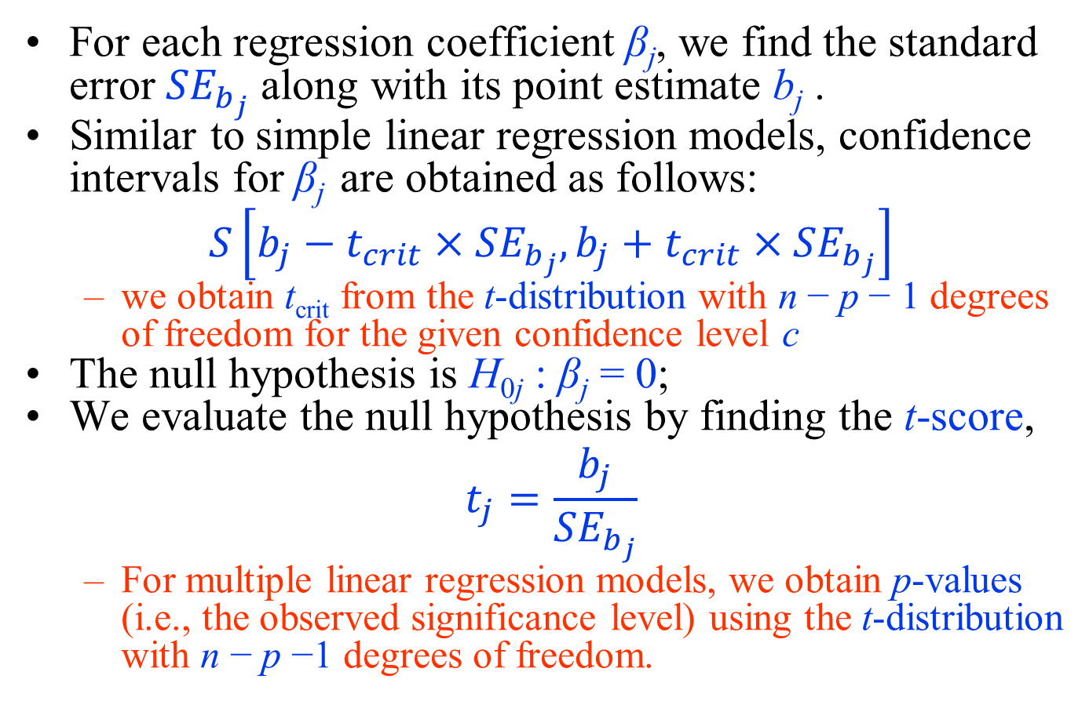
Multiple Linear Regression
For each regression coefficient β_{j}, we find the standard error ${SE}_{b_{j}}$ along with its point estimate b_{j} .
Similar to simple linear regression models, confidence intervals for β_{j} are obtained as follows:
$$S\left[b_{j}−t_{crit}×{SE}_{b_{j}},b_{j}+t_{crit}×{SE}_{b_{j}}\right]$$
  we obtain t_{crit} from the t-distribution with n − p − 1 degrees of freedom for the given confidence level c
The null hypothesis is H_{0j} : β_{j} = 0;
We evaluate the null hypothesis by finding the t-score,
$$t_{j}=\frac{b_{j}}{{SE}_{b_{j}}}$$
  For multiple linear regression models, we obtain p-values (i.e., the observed significance level) using the t-distribution with n − p −1 degrees of freedom.

Slide 58
Multiple Linear Regression
As an example, R-Commander can be used to estimate the parameters of multiple linear regression models and use them to perform statistical inference.
  For the birthweight example, make sure birthwt is the active data set, then click Statistics → Fit models → Linear model.
  Then under Model Formula, enter bwt ∼ age + smoke
  By doing so, we specify the following multiple linear regression model:
    bwt = α + β₁age +β₂smoke + ε

Slide 59
Linear regression models with interaction terms
The usual assumption in multiple linear regression models is that the effects are additive
If we believe that the effects are not additive (i.e., the effect of one explanatory variable X₁ on the response variable depends on the value of another explanatory variable X₂ in the model), we can still use linear regression models by including a new variable X₃ = X₁X₂,
Y = α + β₁X₁ +β₂X₂ +β₁₂X₁X₂ + ε
  X₁X₂ : the interaction term.
  β₁ and β₂ : the main effects,
  β₁₂ : the interaction effect.

Slide 60
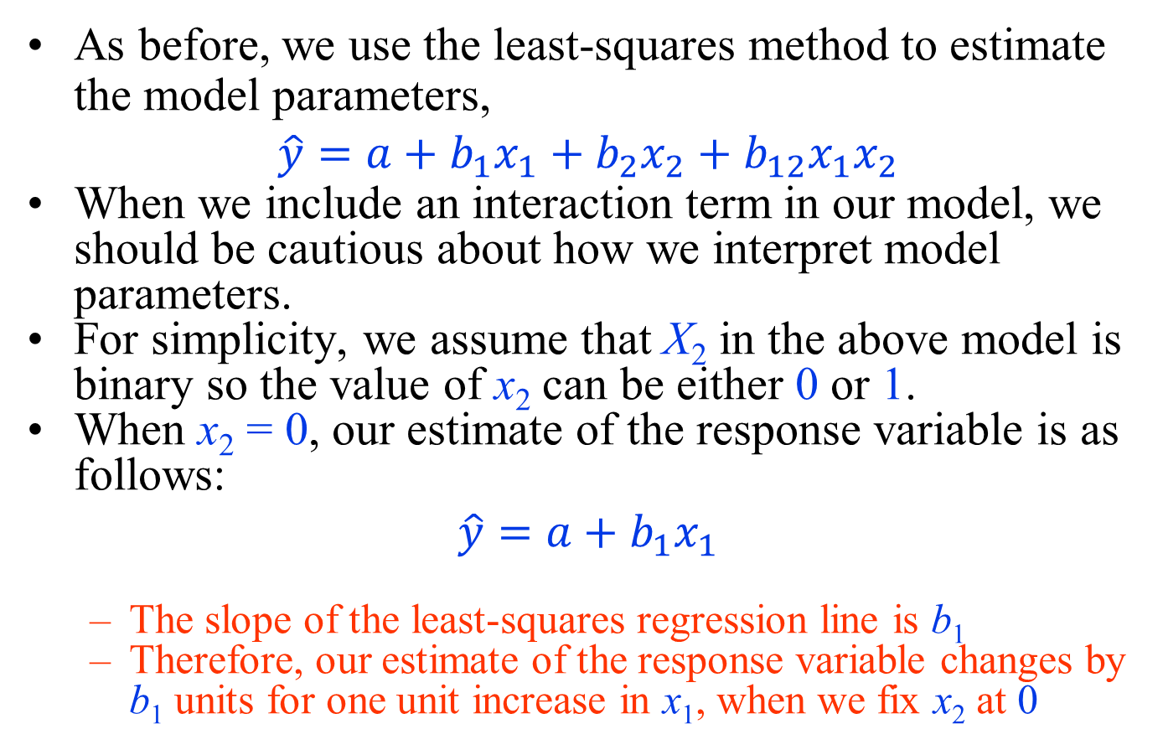
Linear regression models with interaction terms
As before, we use the least-squares method to estimate the model parameters,
$$\hat{y}=a+b_{1}x_{1}+b_{2}x_{2}+b_{12}x_{1}x_{2}$$
When we include an interaction term in our model, we should be cautious about how we interpret model parameters.
For simplicity, we assume that X₂ in the above model is binary so the value of x₂ can be either 0 or 1.
When x₂ = 0, our estimate of the response variable is as follows:
$$\hat{y}=a+b_{1}x_{1}$$
  The slope of the least-squares regression line is b₁
  Therefore, our estimate of the response variable changes by b₁ units for one unit increase in x₁, when we fix x₂ at 0

Slide 61
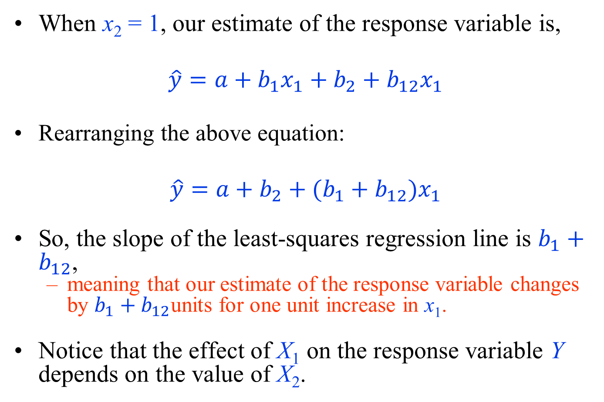
Linear regression models with interaction terms
When x₂ = 1, our estimate of the response variable is,
$$\hat{y}=a+b_{1}x_{1}+b_{2}+b_{12}x_{1}$$
Rearranging the above equation:
$$\hat{y}=a+{b_{2}+(b}_{1}+b_{12})x_{1}$$
So, the slope of the least-squares regression line is $b_{1}+b_{12}$,
  meaning that our estimate of the response variable changes by $b_{1}+b_{12}$units for one unit increase in x₁.
Notice that the effect of X₁ on the response variable Y depends on the value of X₂.

Slide 62
Linear Regression Models in R
As an example, let us model the relationship between percent body fat, siri, and height, using a simple linear regression model.
  install the mfp package using the install.packages() function,
  load it into R using the library() function,
  make the data bodyfat available for analysis using the data() function:
    > install.packages("mfp", dependencies = TRUE)
    > library(mfp)
    > data(bodyfat)
We set the dependencies to TRUE to install other packages that are related to mfp along with it.

Slide 63
Linear Regression Models in R
  To fit the least-squares regression model, use the lm() function:
    > fit <- lm(siri ~ height, data = bodyfat)
      1st argument of the function is the formula of the form of response ∼ explanatory variable.
      The second argument specifies the data set.
  The fit object now stores all the output from the linear regression model.
  Type fit to get the estimates of regression parameters (α , β):
    > fit
    Call:
    lm(formula = siri height, data = bodyfat)
    Coefficients:
    (Intercept) height
    33.4945 -0.2045

Slide 64
Linear Regression Models in R
  Using the summary() function, we can obtain the output similar to what Rcommander provides:
    > summary(fit)
      Call:
      lm(formula = siri height, data = bodyfat)
      Residuals:
      Min 1Q Median 3Q Max
      -19.5902 -6.7124 0.3966 6.0716 27.0919
      Coefficients:
      Estimate Std. Error t value Pr(>|t|)
      (Intercept) 33.4945 10.1096 3.313 0.00106 **
      height -0.2045 0.1439 -1.421 0.15664
      ---
      Signif. codes: 0 ’***’ 0.001 ’**’ 0.01 ’*’ 0.05 ’.’
      0.1 ’ ’ 1
      Residual standard error: 8.352 on 250 degrees
      of freedom Multiple R-squared: 0.008009,
      Adjusted R-squared: 0.004041
      F-statistic: 2.019 on 1 and 250 DF, p-value: 0.1566

Slide 65
Linear Regression Models in R
  With the names() function, we can view all the information contained in the fit object:
    > names(fit)
      [1] "coefficients" "residuals"
      [3] "effects" "rank"
      [5] "fitted.values" "assign"
      [7] "qr" "df.residual"
      [9] "xlevels" "call"
      [11] "terms" "model"
  Now we can use the $ operator to access information.
    For instance, suppose that we wanted the point estimates of α and β:
    > fit$coefficients
      (Intercept) height
      33.4944938 -0.2044753

Slide 66
Linear Regression Models in R
  The estimated response values for all people in our sample are stored in the fitted.values object within fit.
    Suppose that we wanted the estimates for the first 5 people:
    > fit$fitted.values[1:5]
      1 2 3 4 5
      19.64129 18.72115 19.94800 18.72115 18.92563
  The differences between actual and estimated response values are stored in the residuals object within fit.
    The following command returns the residuals of the first 5 people:
    > fit$residuals[1:5]
      1 2 3 4 5
      -7.341291 -12.621152 5.351996 -8.321152 9.774373

Slide 67
Linear Regression Models in R
  Adding the least-squares line to the scatterplot is easy with the abline() function:
    > plot(bodyfat$height, bodyfat$siri,
      + main = "Scatterplot for Percent Body Fat
      by Height",
      + xlab = "Height", ylab = "Percent Body Fat")
      > abline(fit)
  By default, abline() draws a solid line.
  We can set the line type to dashed line by using the option lty=2. The lty defines the line type.
  In general, the abline() function can be used to add a straight line to an existing plot.
    Before using abline, you first need to create a plot .

Slide 68
Linear Regression Models in R
  We can also fit a multiple linear regression model to the bodyfat data using abdomen circumference and height as explanatory variables.
  we use the lm() function, but now we include both explanatory variables on the right-hand side of the formula.
  We separate the explanatory variables with plus signs:
    > multReg <- lm(siri ~ height + abdomen, data = bodyfat)
    > summary(multReg)
      Call:
      lm(formula = siri height + abdomen, data = bodyfat)
      Residuals:
      Min 1Q Median 3Q Max
      -18.8513 -3.4825 -0.0156 3.0949 11.1633

Slide 69
Linear Regression Models in R
    Coefficients:
    Estimate Std. Error t value Pr(>|t|)
    (Intercept) -14.31075 6.04265 -2.368 0.0186 *
    height -0.37053 0.08122 -4.562 7.95e-06 ***
    abdomen 1.64707 0.07074 23.283 < 2e-16 ***
    ---
    Signif. codes: 0 ’***’ 0.001 ’**’ 0.01 ’*’
    0.05 ’.’ 0.1 ’ ’ 1
    Residual standard error: 4.695 on 249 degrees
    of freedom Multiple R-squared: 0.6878,
    Adjusted R-squared: 0.6853
    F-statistic: 274.2 on 2 and 249 DF, p-value: < 2.2e-16
To include the interaction term between height and abdomen in the model,
  we can specify the regression model as siri ∼ height * abdomen.
In this case, R includes the main effects of the two variables automatically.

