Slide 1
Statistical Data Analysis
Prof. Dr. Nizamettin AYDIN
naydin@yildiz.edu.tr
http://www3.yildiz.edu.tr/~naydin

Slide 2
ANALYSIS OF
CATEGORICAL VARIABLES

Slide 3
ANALYSIS OF CATEGORICAL VARIABLES
Pearson’s χ² (chi-squared) test is used to test hypotheses regarding the distribution of a categorical variable or the relationship between two categorical variables.
Pearson’s χ² test uses a test statistic, which we denote as Q, to measure the discrepancy between the observed data and what we expect to observe under the null hypothesis.
Higher levels of discrepancy between data and H₀ results in higher values of Q.
We use q to denote the observed value of Q based on a specific sample of observed data.

Slide 4
Pearson’s χ² Test for One Categorical Variable
Let us denote the binary variable of interest as X, based on which we can divide the population into two groups depending on whether X = 1 or X = 0.
Further, suppose that the null hypothesis H₀ states that the probability of group 1 is μ₀₁ and the probability of group 2 is μ₀₂.
Here μ₀₂ = 1 − μ₀₁.
If the null hypothesis is true, we expect that, out of n randomly selected individuals, E₁ = nμ₀₁ belong to the first group, and E₂ = n(1 − μ₀₁) belong to the second group.
We refer to E₁ and E₂ as the expected frequencies under the null.
We refer to the observed number of people in each group as the observed frequencies and denote them O₁ and O₂ for group 1 and group 2, respectively.

Slide 5
Pearson’s χ² Test for One Categorical Variable
Pearson’s χ2 test measures the discrepancy between the observed data and the null hypothesis based on the difference between the observed and expected frequencies as follows:
$$Q=\frac{(O_{1}−E_{1})^{2}}{E_{1}}+\frac{(O_{2}−E_{2})^{2}}{E_{2}}$$
The value of Q will be zero only when the observed data matches our expectation under the null exactly.
When there is some discrepancy between the data and the null hypothesis, Q becomes greater than zero.
The higher discrepancy between our data and what is expected under H₀, the larger Q and therefore the stronger the evidence against H₀.

Slide 6
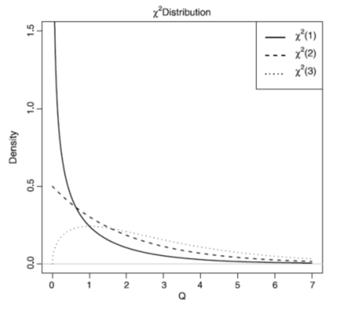
Pearson’s χ² Test for One Categorical Variable
If the null hypothesis is true, then the approximate distribution of Q is χ².
Like the t-distribution, the χ²-distribution is commonly used for hypothesis testing and denoted χ²(df ).
The plot of the pdf for a χ²-distribution with various degrees of freedom
The observed significance level p_{obs} is calculated using the χ²-distribution with 1 degree of freedom.
This corresponds to the upper tail probability of q from the χ²(1) distribution.

Slide 7
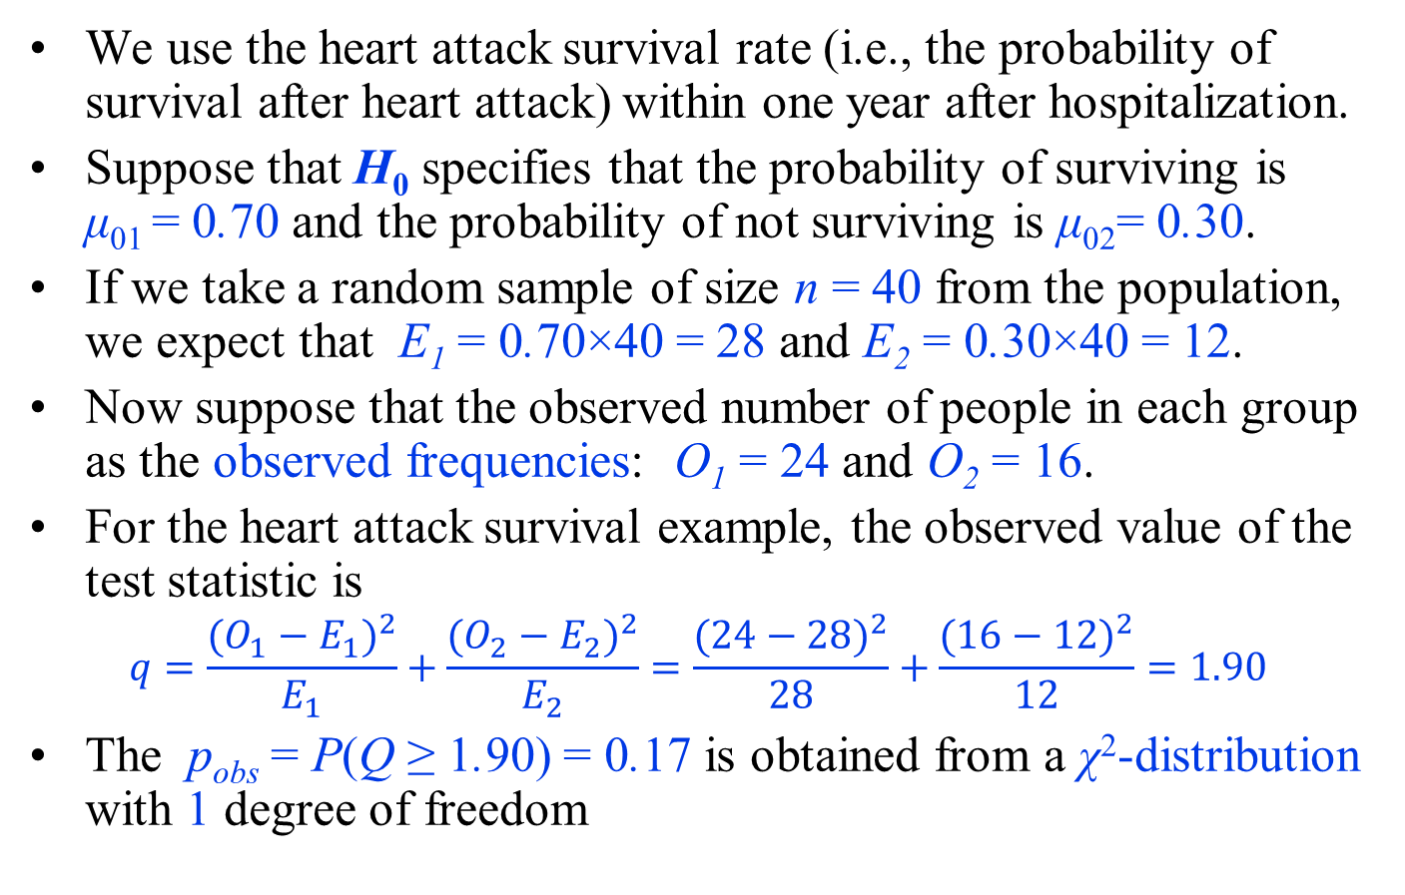
Example
We use the heart attack survival rate (i.e., the probability of survival after heart attack) within one year after hospitalization.
Suppose that H₀ specifies that the probability of surviving is μ₀₁ = 0.70 and the probability of not surviving is μ₀₂= 0.30.
If we take a random sample of size n = 40 from the population, we expect that E₁ = 0.70×40 = 28 and E₂ = 0.30×40 = 12.
Now suppose that the observed number of people in each group as the observed frequencies: O₁ = 24 and O₂ = 16.
For the heart attack survival example, the observed value of the test statistic is
$$q=\frac{(O_{1}−E_{1})^{2}}{E_{1}}+\frac{(O_{2}−E_{2})^{2}}{E_{2}}=\frac{(24−28)^{2}}{28}+\frac{(16−12)^{2}}{12}=1.90$$
The p_{obs} = P(Q ≥ 1.90) = 0.17 is obtained from a χ²-distribution with 1 degree of freedom

Slide 8
Example
The sampling distribution for Q under the null hypothesis: Q∼ χ²(1).
The p-value is the upper tail probability of observing values as extreme or more extreme than q = 1.90
Therefore, the results are not statistically significant, and we cannot reject the null hypothesis at commonly used significance levels (e.g., 0.01, 0.05, and 0.1).
In this case, we believe that the difference between observed and expected frequencies could be due to chance alone.

Slide 9
Categorical Variables with Multiple Categories
Pearson’s χ² test can be generalized to situations where the categorical random variable can take more than two values.
In general, for a categorical random variable with k possible categories, we calculate the test statistic Q as
$$Q=\sum_{i=1}^{k}{\frac{(O_{i}−E_{i})^{2}}{E_{i}}} ,$$
The approximate distribution of Q is χ2 with the degrees of freedom equal to df = k − 1.
Therefore, to find p_{obs}, we calculate the upper tail probability of q (the observed value of Q) from the χ²(k −1) distribution.

Slide 10
Example
Suppose that we monitor heart attack patients for one year and divide them into three groups:
patients who did not have another heart attack and survived,
patients who had another heart attack and survived,
patients who did not survive.
Suppose that μ₀₁ = 0.5, μ₀₂ = 0.2, and μ₀₃ = 0.3.
The expected frequencies of each category for a sample of n = 40:
E₁ = 0.5×40 = 20, E₂ = 0.2×40 = 8, E₃ = 0.3×40 = 12.
This time, suppose that the actual observed frequencies based on a sample of size n = 40 for the three groups are
O₁ = 13, O₂ = 11, O₃ = 16.

Slide 11
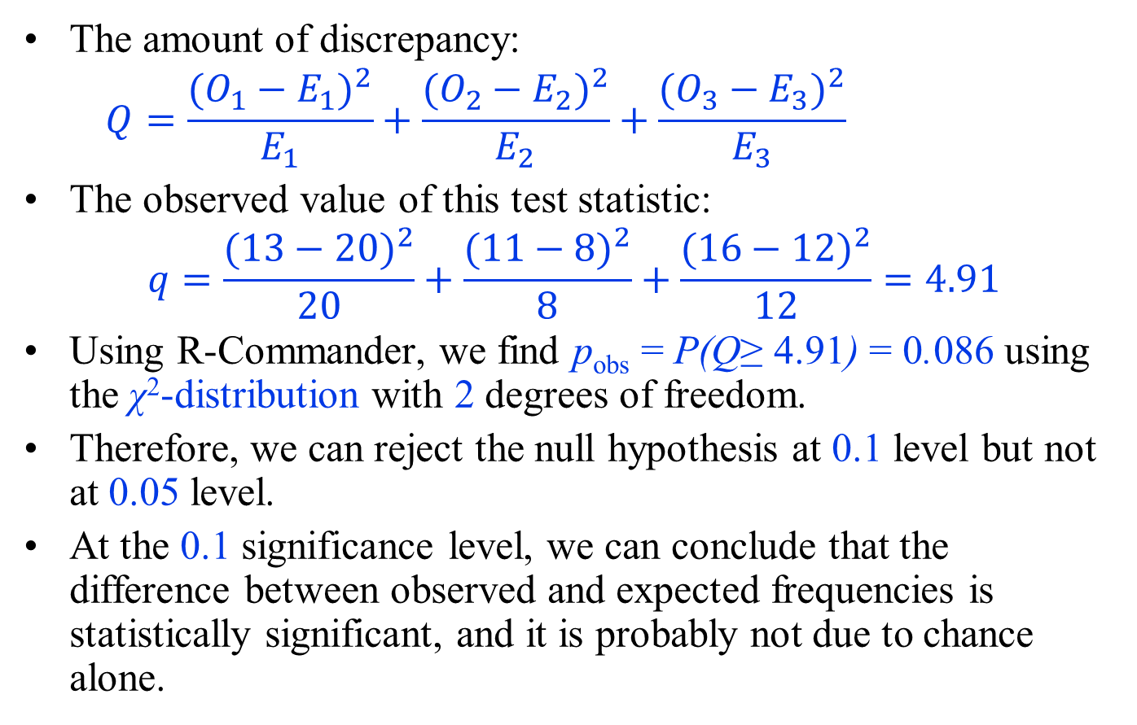
Example
The amount of discrepancy:
$$Q=\frac{(O_{1}−E_{1})^{2}}{E_{1}}+\frac{(O_{2}−E_{2})^{2}}{E_{2}}+\frac{(O_{3}−E_{3})^{2}}{E_{3}}$$
The observed value of this test statistic:
$$q=\frac{(13−20)^{2}}{20}+\frac{(11−8)^{2}}{8}+\frac{(16−12)^{2}}{12}=4.91$$
Using R-Commander, we find p_{obs} = P(Q≥ 4.91) = 0.086 using the χ²-distribution with 2 degrees of freedom.
Therefore, we can reject the null hypothesis at 0.1 level but not at 0.05 level.
At the 0.1 significance level, we can conclude that the difference between observed and expected frequencies is statistically significant, and it is probably not due to chance alone.

Slide 12
Pearson’s χ² Test of Independence
We now discuss the application of Pearson’s χ² test for evaluating a hypothesis regarding possible relationship between two categorical variables.
More specifically, we measure the difference between the observed frequencies and expected frequencies under the null.
The null hypothesis in this case states that the two categorical random variables are independent.
For two independent random variables, the joint probability is equal to the product of their individual probabilities.
In what follows, we use this rule to find the expected frequencies.

Slide 13
Pearson’s χ² Test of Independence
We use the following general form of Pearson’s χ² test, which summarizes the differences between the expected frequencies (under the null hypothesis) and the observed frequencies over all cells of the contingency table:
$$Q=\sum_{i}{\sum_{j}{\frac{(O_{ij}−E_{ij})^{2}}{E_{ij}}}}$$
where O_{ij} and E_{ij} are the observed and expected values in the ith row and jth column of the contingency table.
The double sum simply means that we add the individual measures of discrepancies for cells by going through all cells in the contingency table.

Slide 14
Pearson’s χ² Test of Independence
As before, higher values of Q provide stronger evidence against H₀.
For I × J contingency tables (i.e., I rows and J columns), the Q statistic has approximately the χ²-distribution with (I −1)×(J −1) degrees of freedom under the null.
Therefore, we can calculate the observed significance level by finding the upper tail probability of the observed value for Q, which we denote as q, based on the χ²-distribution with (I −1)×(J −1) degrees of freedom.

Slide 15
Example 1
The probability that the mother is smoker (i.e., smoke =1) and the baby has low birthweight (i.e., low =1) is the product of smoker and low-birthweight probabilities.
For the baby weight example, we can summarize the observed and expected frequencies in the contingency tables.
 | Observed frequency |  |  |  | Expected frequency
 | Normal | Low |  |  | Normal | Low
Nonsmoking | 86 | 29 |  | Nonsmoking | 79.1 | 35.9
Smoking | 44 | 30 |  | Smoking | 50.9 | 23.1

Slide 16
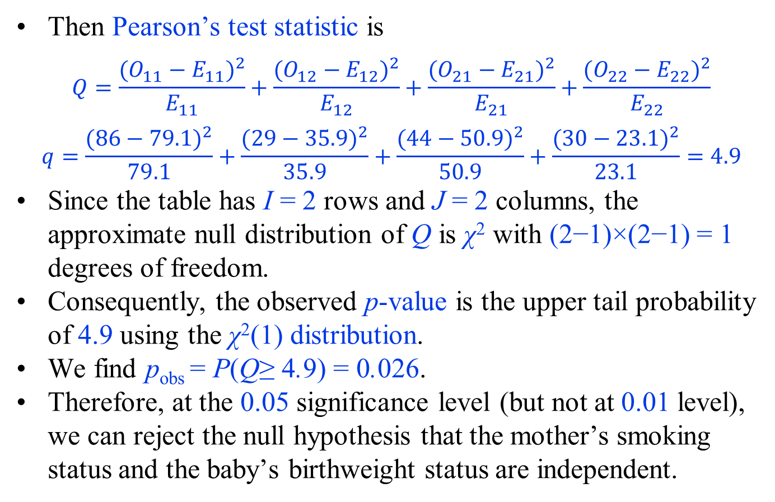
Example 1
Then Pearson’s test statistic is
$$Q=\frac{(O_{11}−E_{11})^{2}}{E_{11}}+\frac{(O_{12}−E_{12})^{2}}{E_{12}}+\frac{(O_{21}−E_{21})^{2}}{E_{21}}+\frac{(O_{22}−E_{22})^{2}}{E_{22}}$$
$$q=\frac{(86−79.1)^{2}}{79.1}+\frac{(29−35.9)^{2}}{35.9}+\frac{(44−50.9)^{2}}{50.9}+\frac{(30−23.1)^{2}}{23.1}=4.9$$
Since the table has I = 2 rows and J = 2 columns, the approximate null distribution of Q is χ² with (2−1)×(2−1) = 1 degrees of freedom.
Consequently, the observed p-value is the upper tail probability of 4.9 using the χ²(1) distribution.
We find p_{obs} = P(Q≥ 4.9) = 0.026.
Therefore, at the 0.05 significance level (but not at 0.01 level), we can reject the null hypothesis that the mother’s smoking status and the baby’s birthweight status are independent.

Slide 17
Example 2
Suppose that we would like to investigate whether the race of mothers is related to the risk of having babies with low birthweight.
The race variable can take three values: 1 for white, 2 for African-American, and 3 for others.
As before, the low variable can take 2 possible values: 1 for babies with birthweight less than 2.5 kg and 0 for other babies.
Therefore, all possible combinations of race and low can be presented by a 3 × 2 contingency table.
The following Table provides the observed frequency of each cell and the expected frequency of each cell if the null hypothesis is true.

Slide 18
Example 2
 | Observed frequency |  |  |  | Expected frequency
Groups | Normal (low=0) | Low (low=1) |  | Groups | Normal (low=0) | Low (low=1)
1 | 73 | 23 |  | 1 | 66 | 30
2 | 15 | 11 |  | 2 | 18 | 8
3 | 42 | 23 |  | 3 | 46 | 21
For example, there are 73 babies in the first row and first column.
This is the number of babies in the intersection of race = 1 (mother is white) and low = 0 (having a baby with normal birthweight).
If the null hypothesis is true, the expected number of babies in this cell would have been 66.

Slide 19
Example 2
The observed value of the test statistic Q is obtaned as q = 5.0 using the following equations.
$$Q=\frac{(O_{11}−E_{11})^{2}}{E_{11}}+\frac{(O_{12}−E_{12})^{2}}{E_{12}}+\frac{(O_{21}−E_{21})^{2}}{E_{21}}+\frac{(O_{22}−E_{22})^{2}}{E_{22}}+\frac{(O_{31}−E_{31})^{2}}{E_{31}}+\frac{(O_{32}−E_{32})^{2}}{E_{32}}$$
The distribution of Q under the null hypothesis is χ² with
(3 − 1) × (2 −1) = 2 degrees of freedom.
To find the corresponding p-value, we need to find the probability of observing values as or more extreme than 5.0.
This is the upper-tail probability of 5 from the χ²(2) distribution: p_{obs} = P(Q≥ 5).
The value of p_{obs} is 0.08.
We can reject the null hypothesis at 0.1 level but not at 0.05 level.
At 0.05 level, the relationship between the two variables (i.e., race of mothers and birthweight status) is not statistically significant.

