Slide 1
Statistical Data Analysis
Prof. Dr. Nizamettin AYDIN
naydin@yildiz.edu.tr
http://www3.yildiz.edu.tr/~naydin

Slide 2
Statistical Inference for the Relationship
Between Two Variables

Slide 3
Relationship Between a Numerical Variable and a Binary Variable
In general, we can denote the means of the two groups as µ₁ and µ₂.
The null hypothesis indicates that the population means are equal, H₀ : µ₁ = µ₂.
In contrast, the alternative hypothesis is one the following:
if H_{A} : μ₁ > μ₂, if we believe the mean for group 1 is greater than the mean for group 2.
if H_{A} : μ₁ < μ₂, if we believe the mean for group 1 is less than the mean for group 2.
if H_{A} : μ₁ ≠ μ₂, if we believe the means are different but we do not specify which one is greater.
We can also express these hypotheses in terms of the difference in the means:
H_{A} : µ₁ - µ₂ > 0, H_{A} : µ₁ - µ₂ < 0, or H_{A} : µ₁ - µ₂ ≠ 0
Then the corresponding null hypothesis is that there is no difference in the population means, H₀ : µ₁ - µ₂ = 0

Slide 4
Relationship Between a Numerical Variable and a Binary Variable
Previously, we used the sample mean $\overline{X}$ to perform statistical inference regarding the population mean µ.
To evaluate our hypothesis regarding the difference between two means, µ₁ - µ₂, it is reasonable to choose the difference between the sample means, $\overline{X}$₁ - $\overline{X}$₂, as our statistic.
We use µ₁₂ to denote the difference between the population means µ₁ and µ₂, and use $\overline{X}$₁₂ to denote the difference between the sample means $\overline{X}$₁ and $\overline{X}$₂:
µ₁₂ ₌ µ₁ ₋ µ₂ $\overline{X}$₁₂ = $\overline{X}$₁ - $\overline{X}$₂

Slide 5
Relationship Between a Numerical Variable and a Binary Variable
By the Central Limit Theorem,
$$\overline{X}1 \sim N\left(μ_{1},\frac{σ_{1}^{2}}{n_{1}}\right) , \overline{X}2 \sim N\left(μ_{2},\frac{σ_{2}^{2}}{n_{2}}\right)$$
where n₁ and n₂ are the number of observations.
Therefore,
$$\overline{X}12 \sim N\left(μ_{1}−μ_{2},\frac{σ_{1}^{2}}{n_{1}}+\frac{σ_{2}^{2}}{n_{2}}\right)$$
We can rewrite this as
$\overline{X}12 \sim N\left(μ_{12},{SD}_{12}^{2}\right)$ where ${SD}_{12}=\sqrt{\frac{σ_{1}^{2}}{n_{1}}+\frac{σ_{2}^{2}}{n_{2}}}$

Slide 6
Relationship Between a Numerical Variable and a Binary Variable
We want to test our hypothesis that H_{A} : µ₁₂ ≠ 0 (i.e., the difference between the two means is not zero) against the null hypothesis that H₀ : µ₁₂ = 0.
To use $\overline{X}$₁₂ as a test statistic, we need to find its sampling distribution under the null hypothesis (i.e., its null distribution).
If the null hypothesis is true, then µ₁₂ = 0.
Therefore, the null distribution of $\overline{X}$₁₂ is
$$\overline{X}12 \sim N\left(0,{SD}_{12}^{2}\right)$$
As before, however, it is more common to standardize the test statistic by subtracting its mean (under the null) and dividing the result by its standard deviation.
$$Z=\frac{\overline{X}12}{{SD}_{12}}$$
where Z is called the z-statistic, and it has the standard normal distribution: Z ∼ N(0, 1).

Slide 7
Two-sample z-test
To test the null hypothesis H₀ : µ₁₂ = 0, we determine the z-score,
$$z=\frac{\overline{x}12}{{SD}_{12}}$$
Then, depending on the alternative hypothesis, we can calculate the p-value, which is the observed significance level, as:
if H_{A} : μ₁₂ > 0, p_{obs} = P(Z ≥ z),
if H_{A} : μ₁₂ < 0, p_{obs} = P(Z ≤ z),
if H_{A} : μ₁₂ ≠ 0, p_{obs} = 2×P(Z ≥ |z|),
The above tail probabilities are obtained from the standard normal distribution.

Slide 8
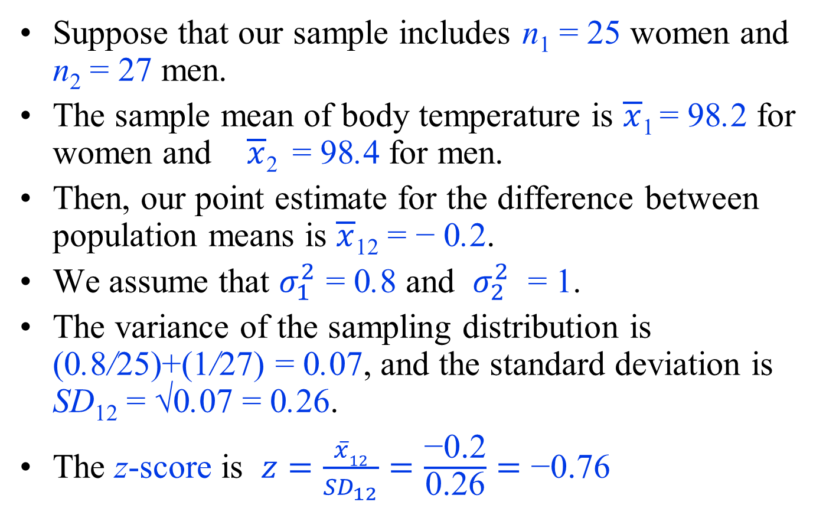
Example
Suppose that our sample includes n₁ = 25 women and n₂ = 27 men.
The sample mean of body temperature is $\overline{x}$₁ = 98.2 for women and $\overline{x}$₂ = 98.4 for men.
Then, our point estimate for the difference between population means is $\overline{x}$₁₂ = − 0.2.
We assume that $σ_{1}^{2}$ = 0.8 and $σ_{2}^{2}$ = 1.
The variance of the sampling distribution is (0.8/25)+(1/27) = 0.07, and the standard deviation is SD₁₂ = √0.07 = 0.26.
The z-score is $z=\frac{\overline{x}12}{{SD}_{12}}=\frac{\text{−0.2}}{\text{0.26}}=\text{−0.76}$

Slide 9
Example
H_{A} : μ₁₂ ≠ 0 and z = −0.76.
Therefore, p_{obs} = 2P(Z ≥ |−0.76|) = 2×0.22 = 0.44.
For the body temperature example, p_{obs} = 0.44 is greater than the commonly used significance levels (e.g., 0.01, 0.05, and 0.1).
Therefore, the test result is not statistically significant, and we cannot reject the null hypothesis (which states that the population means for the two groups are the same) at these levels.
That is, any observed difference could be due to chance alone.

Slide 10
Two-Sample t-test
In practice, SD₁₂ is not known since σ₁ and σ₂ are unknown.
As before, we can use the sample variances $S_{1}^{2}$ and $S_{2}^{2}$ to estimate ${\text{σ}}_{1}^{2}$ and ${\text{σ}}_{2}^{2}$, and take this additional source of uncertainty into account by using t -distributions instead of the standard normal distribution.
We use $s_{1}^{2}$ and $s_{2}^{2}$ (point estimates for population variances ${\text{σ}}_{1}^{2}$ and ${\text{σ}}_{2}^{2}$) to estimate the standard deviation,
$${SE}_{12}=\sqrt{\frac{s_{1}^{2}}{n_{1}}+\frac{s_{2}^{2}}{n_{2}}}$$
where SE₁₂ is the standard error of $\overline{X}$₁₂ .
Then, instead of the standard normal distribution, we need to use t-distributions to find p-values.
For this, we can use R or R-Commander.

Slide 11
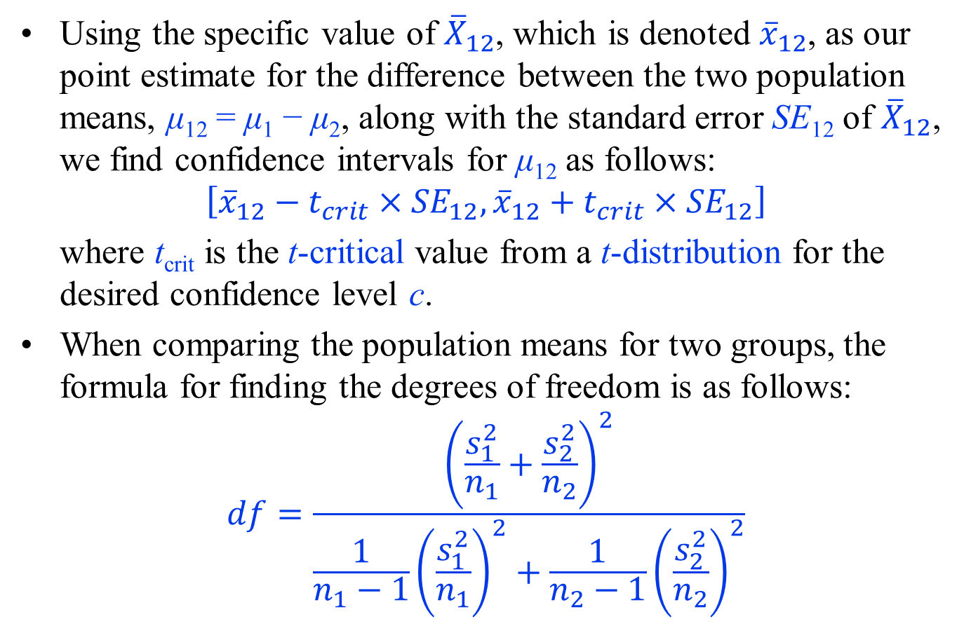
Two-Sample t-test
Using the specific value of ${\overline{X}}_{12}$, which is denoted ${\overline{x}}_{12}$, as our point estimate for the difference between the two population means, μ₁₂ = μ₁ − μ₂, along with the standard error SE₁₂ of ${\overline{X}}_{12}$, we find confidence intervals for μ₁₂ as follows:
$$\left[{\overline{x}}_{12}−t_{crit}×{SE}_{12},{\overline{x}}_{12}+t_{crit}×{SE}_{12}\right]$$
where t_{crit} is the t-critical value from a t-distribution for the desired confidence level c.
When comparing the population means for two groups, the formula for finding the degrees of freedom is as follows:
$$df=\frac{{\left(\frac{s_{1}^{2}}{n_{1}}+\frac{s_{2}^{2}}{n_{2}}\right)}^{2}}{{\frac{1}{n_{1}−1}\left(\frac{s_{1}^{2}}{n_{1}}\right)}^{2}+\frac{1}{n_{2}−1}{\left(\frac{s_{2}^{2}}{n_{2}}\right)}^{2}}$$

Slide 12
Two-Sample t-test
For testing a hypothesis regarding μ₁₂ = μ₁ −μ₂ when the population variances are unknown,
we follow similar steps as above,
but we use SE₁₂ instead of SD₁₂ and use the following t -statistic instead of the z-statistic to account for the additional source of uncertainty involved in estimating the population variances:
$$T=\frac{\overline{X}12}{\sqrt{\frac{S_{1}^{2}}{n_{1}}+\frac{S_{2}^{2}}{n_{2}}}}$$
where $\overline{X}$₁₂= $\overline{X}$₁− $\overline{X}$₂ as before.

Slide 13
Two-Sample t-test
Using the observed data, we obtain $\overline{x}$₁₂= $\overline{x}$₁− $\overline{x}$₂ as the observed value of $\overline{X}12$.
We also use the observed data to obtain s₁ and s₂ as the observed values of sample variances.
Then, we calculate the observed value of the test statistic T as follows:
$$t=\frac{\overline{x}12}{\sqrt{\frac{s_{1}^{2}}{n_{1}}+\frac{s_{2}^{2}}{n_{2}}}}=\frac{\overline{x}12}{{SE}_{12}}$$
which is called the t -score.
Depending on the alternative hypothesis, we calculate p_{obs} as
if H_{A} : μ₁₂ > 0, p_{obs} = P(T ≥ t),
if H_{A} : μ₁₂ < 0, p_{obs} = P(T ≤ t),
if H_{A} : μ₁₂ ≠ 0, p_{obs} = 2×P(T ≥ |t|),
where T has a t -distribution with the degrees of freedom obtained as above

Slide 14
Example
For the body temperature example, suppose that the sample variances based on our sample of n₁ = 25 women and n₂ = 27 men are $s_{1}^{2}$= 1.1 and $s_{2}^{2}$= 1.2, respectively.
The standard error of $\overline{X}$₁₂ is
$${SE}_{12}=\sqrt{\frac{s_{1}^{2}}{n_{1}}+\frac{s_{2}^{2}}{n_{2}}}=\sqrt{\frac{1.1}{25}+\frac{1.2}{27}}=0.3$$
Degrees of freedom is
$df=\frac{{\left(\frac{s_{1}^{2}}{n_{1}}+\frac{s_{2}^{2}}{n_{2}}\right)}^{2}}{{\frac{1}{n_{1}−1}\left(\frac{s_{1}^{2}}{n_{1}}\right)}^{2}+\frac{1}{n_{2}−1}{\left(\frac{s_{2}^{2}}{n_{2}}\right)}^{2}}=\frac{{\left(\frac{1.1}{25}+\frac{1.2}{27}\right)}^{2}}{{\frac{1}{26−1}\left(\frac{1.1}{25}\right)}^{2}+\frac{1}{27−1}{\left(\frac{1.2}{27}\right)}^{2}}=49.9$

Slide 15
Example
To find the corresponding t_{crit}, we follow similar steps as before.
Suppose that we are interested in 95% confidence interval for μ₁₂.
We find t_{crit} from the t–distribution with df = 49.9 degrees of freedom.
In R-Commander,
click Distributions → t distribution → t quantiles.
Then enter (1 − 0.95)/2 = 0.025 for Probabilities, 49.9 for Degrees of freedom, and check the option Upper tail.
The corresponding t-critical value is 2.01.

Slide 16
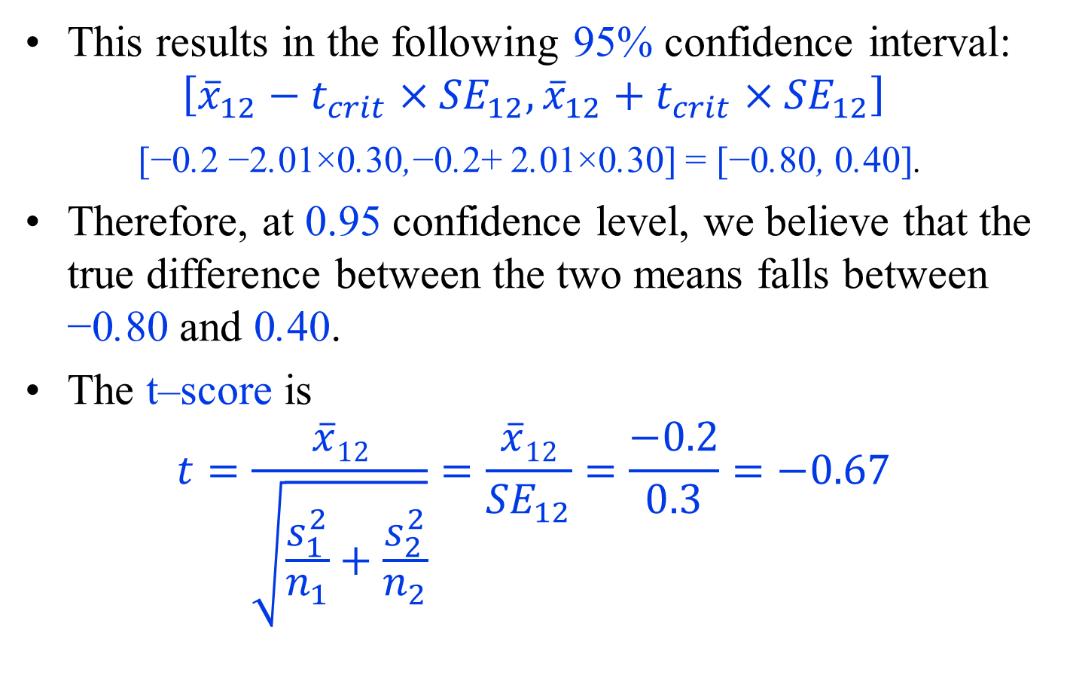
Example
This results in the following 95% confidence interval:
$$\left[{\overline{x}}_{12}−t_{crit}×{SE}_{12},{\overline{x}}_{12}+t_{crit}×{SE}_{12}\right]$$
[−0.2 −2.01×0.30,−0.2+ 2.01×0.30] = [−0.80, 0.40].
Therefore, at 0.95 confidence level, we believe that the true difference between the two means falls between −0.80 and 0.40.
The t–score is
$$t=\frac{\overline{x}12}{\sqrt{\frac{s_{1}^{2}}{n_{1}}+\frac{s_{2}^{2}}{n_{2}}}}=\frac{\overline{x}12}{{SE}_{12}}=\frac{−0.2}{0.3}=−0.67$$

Slide 17
Example
The alternative hypothesis is H_{A} : μ₁₂ ≠ 0.
Using the t-distribution with df = 49.9 degrees of freedom, the upper tail probability of |−0.67| = 0.67 is P(T >0.67) = 0.25.
The observed significance level is p_{obs} = 2×0.25 = 0.50, which is considered to be large (compared to commonly used significance levels).
Therefore, the result is not statistically significant, and we cannot reject the null hypothesis,
which indicates that the two populations (men and women) have the same mean body temperature.

