Slide 1
Statistical Data Analysis
Prof. Dr. Nizamettin AYDIN
naydin@yildiz.edu.tr
http://www3.yildiz.edu.tr/~naydin

Slide 2
Hypothesis Testing

Slide 3
Hypothesis
A hypothesis (plural: hypotheses):
  a testable statement about the relationship between two or more variables or a proposed explanation for some observed phenomenon.
In a scientific experiment or study, the hypothesis is a brief summation of the researcher's prediction of the study's findings, which may be supported or not by the outcome.
Hypothesis testing is the core of the scientific method.

Slide 4
Hypothesis
Scientific method
  an approach to seeking knowledge that involves forming and testing a hypothesis.
  used to answer questions in a wide variety of disciplines outside of science, including business.
  provides a logical, systematic way to answer questions and removes subjectivity by requiring each answer to be authenticated with objective evidence that can be reproduced.
  often carried out in a linear manner, but the approach can also be cyclical, because once a conclusion has been reached, it often raises more questions.
Goal of scientific method is to gather data that will validate or invalidate a cause and effect relationship.

Slide 5
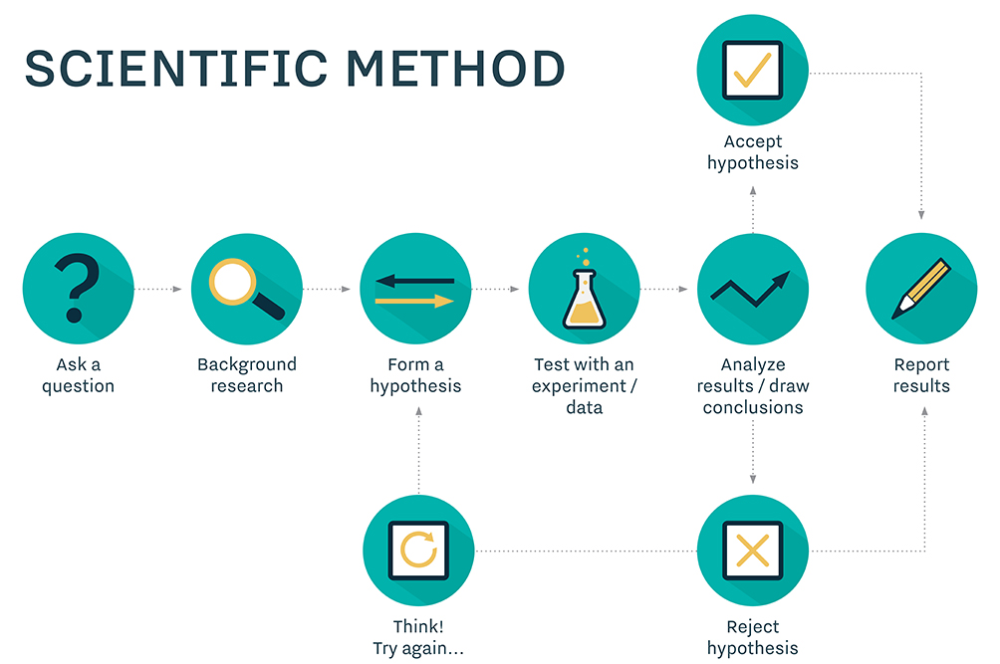
Hypothesis

Slide 6
Hypothesis
In general, many scientific investigations start by expressing a hypothesis.
To evaluate hypotheses, we rely on
  estimators,
  their sampling distributions,
  their specific values
from observed data.
For example,
  Mackowiak et al.* hypothesized that the average normal (i.e., for healthy people) body temperature is less than the widely accepted value of 98.6°F.
  If we denote the population mean of normal body temperature as μ, then we can express this hypothesis as μ<98.6.
*Mackowiak, P.A., Wasserman, S.S., Levine, M.M.: A critical appraisal of 98.6°F, the upper limit of the normal body temperature, and other legacies of Carl Reinhold AugustWunderlich. JAMA 268, 1578–1580 (1992)

Slide 7
Null and Alternative hypotheses
The null hypothesis
  usually reflects the “status quo" or “nothing of interest".
  denoted as H₀
The alternative hypothesis
  the hypothesis we are investigating through a scientific study
  denoted as H_{A}
Consider the body temperature example, where we want to examine the null hypothesis H₀ : µ = 98.6 against the alternative hypothesis H_{A} : µ < 98.6.
The procedure for evaluating a hypothesis is called hypothesis testing, and it rises in many scientific problems.
  For hypothesis testing, we focus on the null hypothesis since it tends to be simpler.
  To this end, we examine the evidence that the observed data provide against the null hypothesis H₀.
    If the evidence against H₀ is strong, we reject H₀.
    If not, we state that the evidence provided by the data is not strong enough to reject H₀, and we fail to reject it.

Slide 8
Null and Alternative hypotheses
With respect to our decision regarding the null hypothesis H₀, we might make two types of errors:
  Type I error:
    we reject H₀ when it is true and should not be rejected.
  Type II error:
    we fail to reject H₀ when it is false and should be rejected.
We denote the probability of making type I error as α and the probability of making type II error as β.
 | Actual Validity of H₀
Decision Made |  | H₀ is true | H₀ is false
 | Accept H₀ | True Negative | False Negative (Type II Error)
 | Reject H₀ | False Positive (Type I Error) | True Positive

Slide 9
Null and alternative hypotheses
Now suppose that we have a hypothesis testing procedure that fails to reject the null hypothesis when it should be rejected with probability β.
  This means that our test correctly rejects the null hypothesis with probability 1 − β.
    Note that the two events are complementary.
  We refer to this probability (i.e., 1 − β) as the power of the test.
In practice, it is common to first agree on a tolerable type I error rate α, such as 0.01, 0.05, and 0.1.
Then try to find a test procedure with the highest power among all reasonable testing procedures.

Slide 10
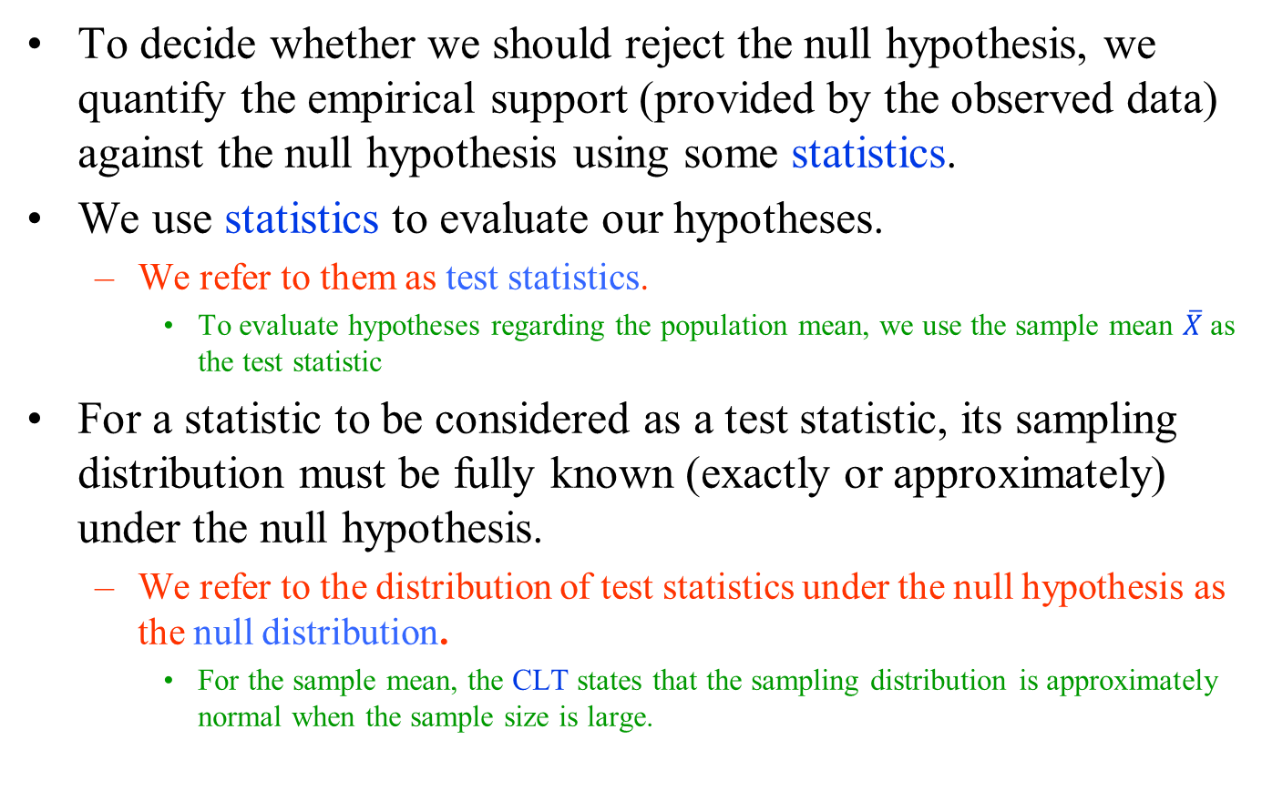
Hypothesis testing for the population mean
To decide whether we should reject the null hypothesis, we quantify the empirical support (provided by the observed data) against the null hypothesis using some statistics.
We use statistics to evaluate our hypotheses.
  We refer to them as test statistics.
    To evaluate hypotheses regarding the population mean, we use the sample mean $\overline{X}$ as the test statistic
For a statistic to be considered as a test statistic, its sampling distribution must be fully known (exactly or approximately) under the null hypothesis.
  We refer to the distribution of test statistics under the null hypothesis as the null distribution.
    For the sample mean, the CLT states that the sampling distribution is approximately normal when the sample size is large.

Slide 11
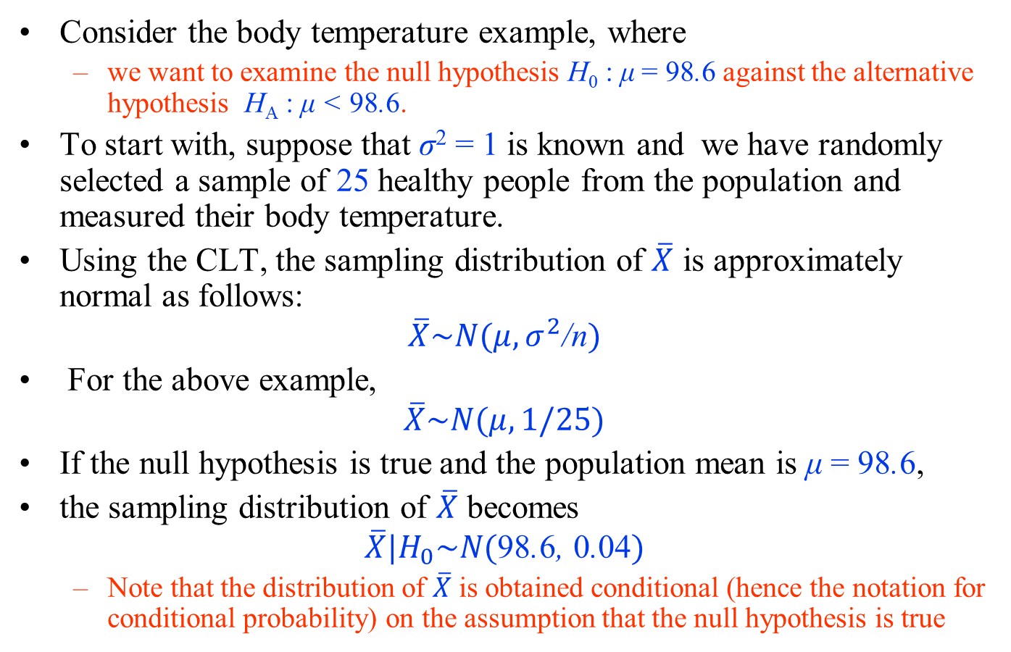
Hypothesis testing for the population mean
Consider the body temperature example, where
  we want to examine the null hypothesis H₀ : μ = 98.6 against the alternative hypothesis H_{A} : μ < 98.6.
To start with, suppose that σ² = 1 is known and we have randomly selected a sample of 25 healthy people from the population and measured their body temperature.
Using the CLT, the sampling distribution of $\overline{X}$ is approximately normal as follows:
$$\overline{X}\sim N(μ, σ^{2}\text{/}\text{n})$$
For the above example,
$$\overline{X}\sim N(μ, 1/25)$$
If the null hypothesis is true and the population mean is μ = 98.6,
the sampling distribution of $\overline{X}$ becomes
$$\overline{X}|H_{0}\sim N(\text{98}\text{.}\text{6}\text{, }\text{0}\text{.}\text{04})$$
  Note that the distribution of $\overline{X}$ is obtained conditional (hence the notation for conditional probability) on the assumption that the null hypothesis is true

Slide 12
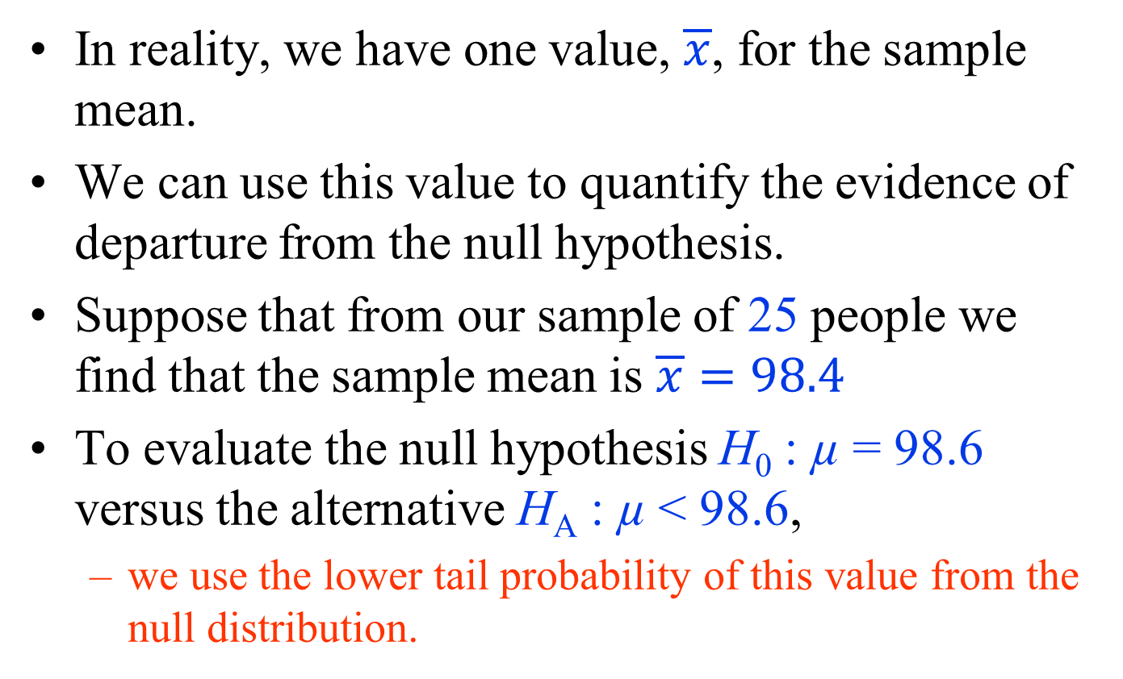
Hypothesis testing for the population mean
In reality, we have one value, $\overline{x}$, for the sample mean.
We can use this value to quantify the evidence of departure from the null hypothesis.
Suppose that from our sample of 25 people we find that the sample mean is $\overline{x}=98.4$
To evaluate the null hypothesis H₀ : µ = 98.6 versus the alternative H_{A} : µ < 98.6,
  we use the lower tail probability of this value from the null distribution.

Slide 13

Hypothesis testing for the population mean
For the normal body temperature example, examining the hypotheses H₀ : µ = 98.6 versus the alternative H_{A} : µ < 98.6.
Left panel: The shaded area shows the lower-tail probability of the observed sample mean, $\overline{x}=98.4$.
  This is the observed significance level, p-value, which is denoted as p_{obs}.
Right panel: After standardizing, the p-value corresponds to the lower tail probability of z = −1 based on the standard normal distribution

Slide 14
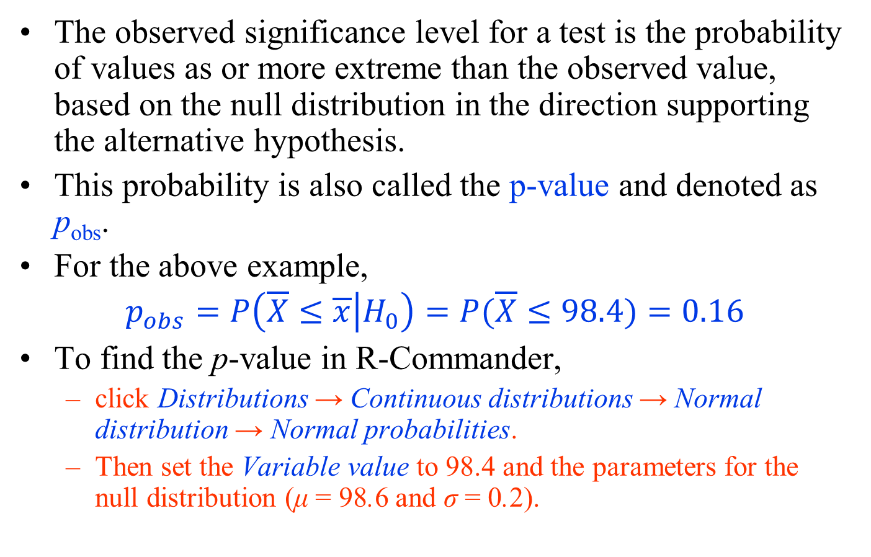
Observed significance level
The observed significance level for a test is the probability of values as or more extreme than the observed value, based on the null distribution in the direction supporting the alternative hypothesis.
This probability is also called the p-value and denoted as p_{obs}.
For the above example,
$$p_{obs}=P\left(\overline{X}≤\overline{x} | H_{0}\right)=P(\overline{X}≤98.4)=0.16$$
To find the p-value in R-Commander,
  click Distributions → Continuous distributions → Normal distribution → Normal probabilities.
  Then set the Variable value to 98.4 and the parameters for the null distribution (μ = 98.6 and σ = 0.2).

Slide 15
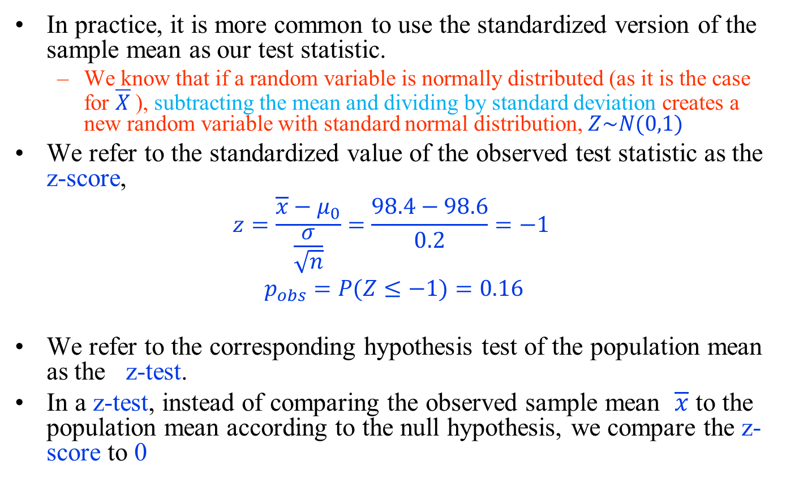
z-Tests of the Population Mean
In practice, it is more common to use the standardized version of the sample mean as our test statistic.
  We know that if a random variable is normally distributed (as it is the case for $\overline{X}$), subtracting the mean and dividing by standard deviation creates a new random variable with standard normal distribution, $Z\sim N(0,1)$
We refer to the standardized value of the observed test statistic as the z-score,
$$z=\frac{\overline{x}−μ_{0}}{\frac{σ}{\sqrt{n}}}=\frac{98.4−98.6}{0.2}=−1$$
$$p_{obs}=P(Z≤−1)=0.16$$
We refer to the corresponding hypothesis test of the population mean as the z-test.
In a z-test, instead of comparing the observed sample mean $\overline{x}$ to the population mean according to the null hypothesis, we compare the z-score to 0

Slide 16
Interpretation of p-value
The p-value is the conditional probability of extreme values (as or more extreme than what has been observed) of the test statistic assuming that the null hypothesis is true.
  When the p-value is small, say 0.01 for example, it is rare to find values as extreme as what we have observed (or more so).
As the p-value increases, it indicates that there is a good chance to find more extreme values (for the test statistic) than what has been observed.
  Then, we would be more reluctant to reject the null hypothesis.
The common significance levels are 0.01, 0.05, and 0.1.

Slide 17
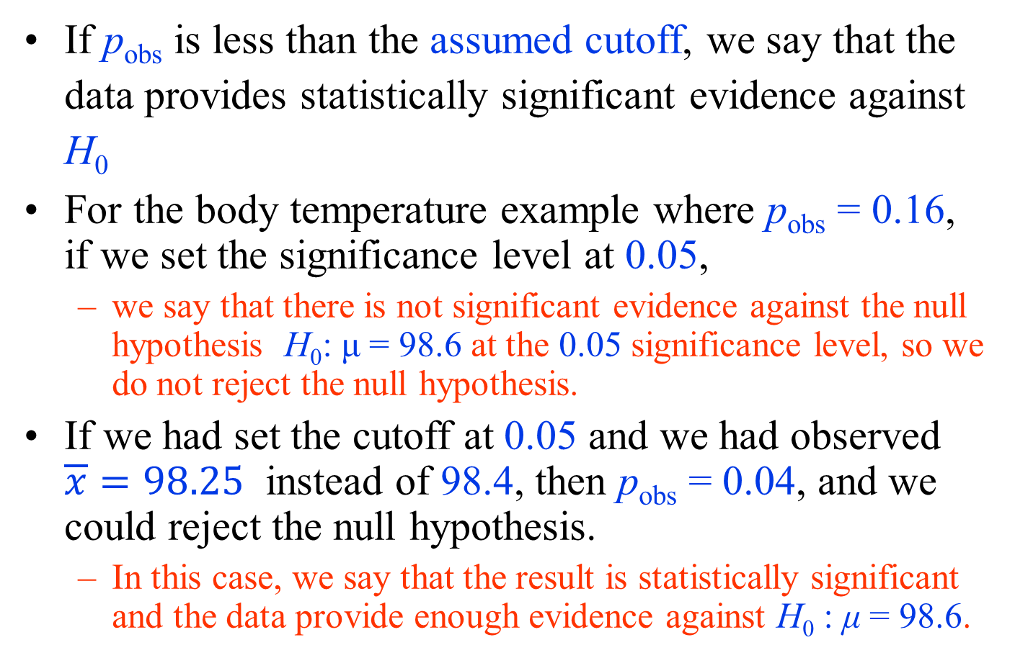
Interpretation of p-value
If p_{obs} is less than the assumed cutoff, we say that the data provides statistically significant evidence against H₀
For the body temperature example where p_{obs} = 0.16, if we set the significance level at 0.05,
  we say that there is not significant evidence against the null hypothesis H₀: μ = 98.6 at the 0.05 significance level, so we do not reject the null hypothesis.
If we had set the cutoff at 0.05 and we had observed $\overline{x}=98.25$ instead of 98.4, then p_{obs} = 0.04, and we could reject the null hypothesis.
  In this case, we say that the result is statistically significant and the data provide enough evidence against H₀ : μ = 98.6.

Slide 18
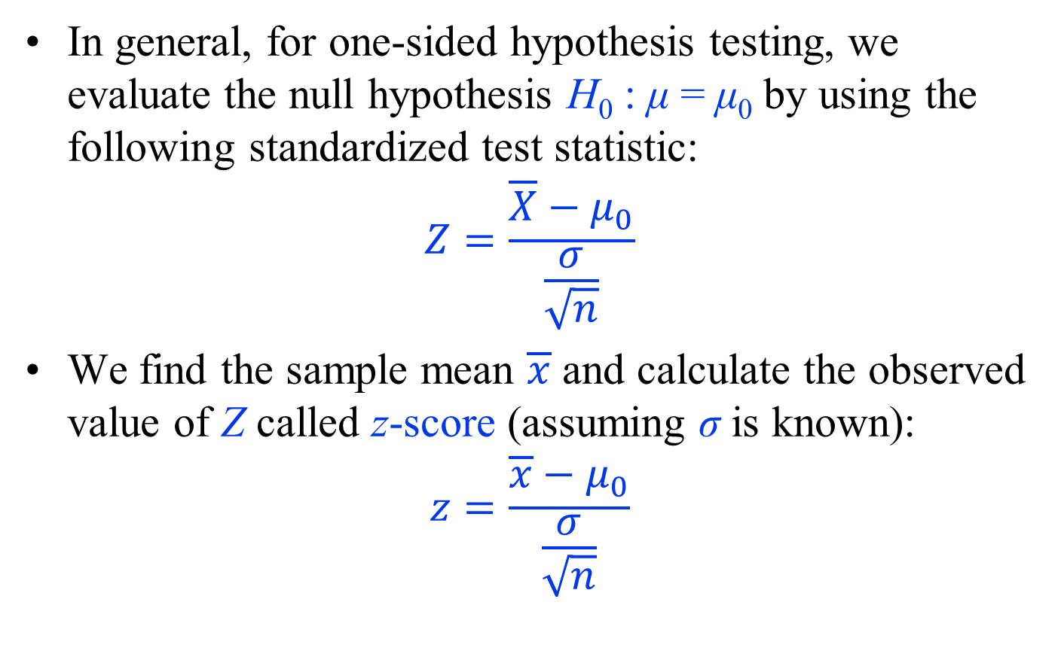
One-Sided Hypothesis Testing
In general, for one-sided hypothesis testing, we evaluate the null hypothesis H₀ : μ = μ₀ by using the following standardized test statistic:
$$Z=\frac{\overline{X}−μ_{0}}{\frac{σ}{\sqrt{n}}}$$
We find the sample mean $\overline{x}$ and calculate the observed value of Z called z-score (assuming σ is known):
$$z=\frac{\overline{x}−μ_{0}}{\frac{σ}{\sqrt{n}}}$$

Slide 19
One-Sided Hypothesis Testing
We then use the standard normal distribution to find the p-value.
  If the alternative hypothesis regarding the population mean is H_{A} : μ < μ₀,
    we use the standard normal distribution to find lower tail probability of the z-score: P(Z ≤ z).
  If the alternative hypothesis regarding the population mean is H_{A} : μ > μ₀,
    we use P(Z ≥ z) instead.
The resulting probability, p_{obs}, is the observed significance level, which can be compared to several significance levels such as 0.01, 0.05, and 0.1.

Slide 20
One-Sided Hypothesis Testing
In some situations, we might hypothesize that the population mean is greater than a specific value and express our hypothesis as H_{A} :μ>μ₀.
Our null hypothesis is still H₀ : μ = μ₀.
This is also a one-sided test since the departure from the null is still in one direction: toward values larger than μ₀.
For example,
  suppose that we have observed that many Pima Indian women suffer from diabetes.
  We know that obesity and diabetes are related; we might therefore hypothesize that this population is obese on average, where obesity is defined as BMI higher than 30.
  If we denote the population mean of BMI for Pima Indian women, we can then express our hypothesis as μ>30.
  In this case, the null hypothesis is H₀ : μ = 30; that is, μ₀ = 30.

Slide 21
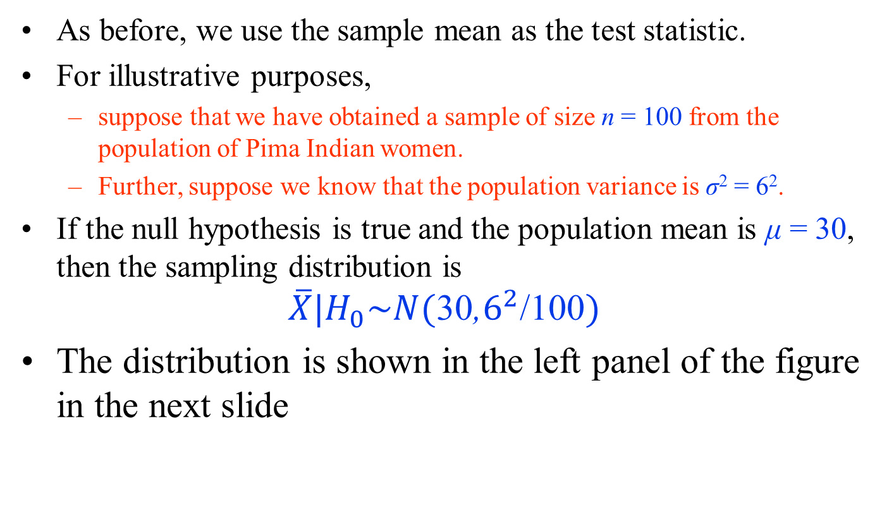
One-Sided Hypothesis Testing
As before, we use the sample mean as the test statistic.
For illustrative purposes,
  suppose that we have obtained a sample of size n = 100 from the population of Pima Indian women.
  Further, suppose we know that the population variance is σ² = 6².
If the null hypothesis is true and the population mean is μ = 30, then the sampling distribution is
$$\overline{X}|H_{0}\sim N(\text{30}\text{,}6^{2}\text{/}\text{100})$$
The distribution is shown in the left panel of the figure in the next slide

Slide 22
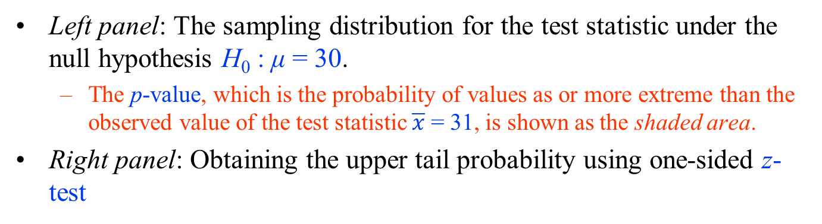
One-Sided Hypothesis Testing
Left panel: The sampling distribution for the test statistic under the null hypothesis H₀ : μ = 30.
  The p-value, which is the probability of values as or more extreme than the observed value of the test statistic $\overline{x}$ = 31, is shown as the shaded area.
Right panel: Obtaining the upper tail probability using one-sided z-test

Slide 23
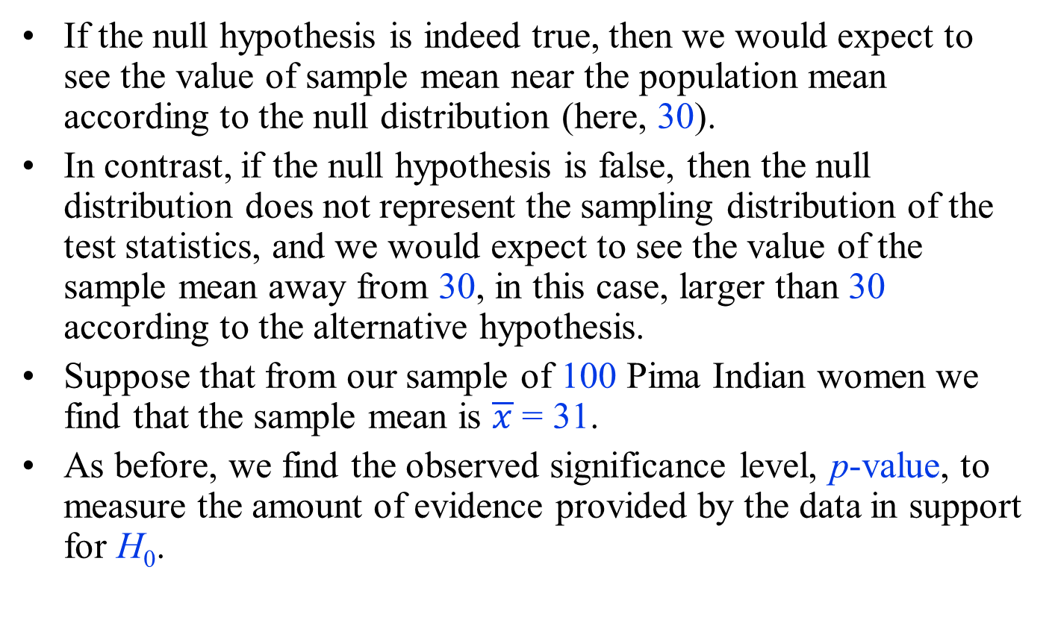
One-Sided Hypothesis Testing
If the null hypothesis is indeed true, then we would expect to see the value of sample mean near the population mean according to the null distribution (here, 30).
In contrast, if the null hypothesis is false, then the null distribution does not represent the sampling distribution of the test statistics, and we would expect to see the value of the sample mean away from 30, in this case, larger than 30 according to the alternative hypothesis.
Suppose that from our sample of 100 Pima Indian women we find that the sample mean is $\overline{x}$ = 31.
As before, we find the observed significance level, p-value, to measure the amount of evidence provided by the data in support for H₀.

Slide 24
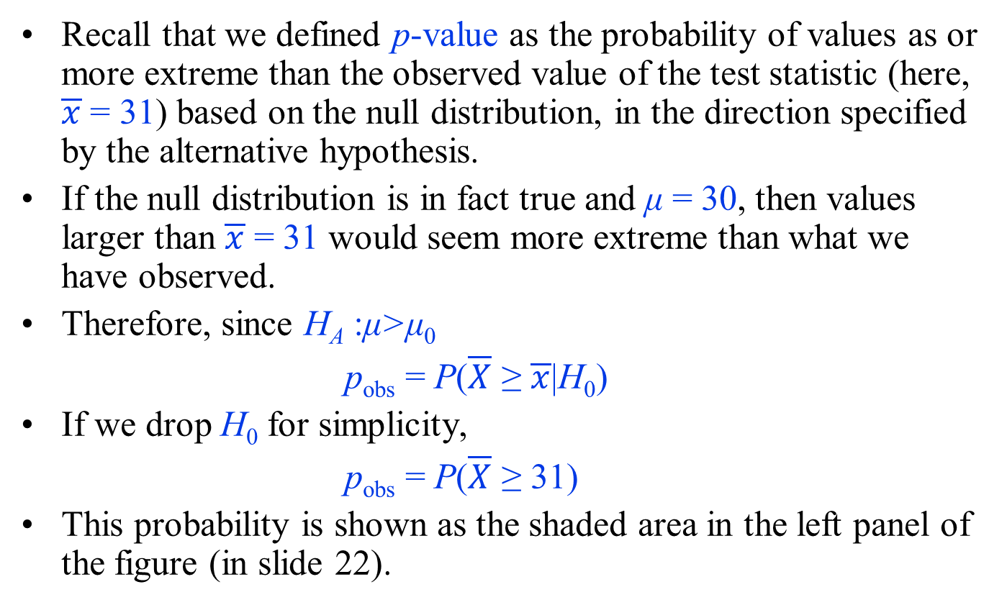
One-Sided Hypothesis Testing
Recall that we defined p-value as the probability of values as or more extreme than the observed value of the test statistic (here, $\overline{x}$ = 31) based on the null distribution, in the direction specified by the alternative hypothesis.
If the null distribution is in fact true and μ = 30, then values larger than $\overline{x}$ = 31 would seem more extreme than what we have observed.
Therefore, since H_{A} :μ>μ₀
p_{obs} = P($\overline{X}$ ≥ $\overline{x}$|H₀)
If we drop H₀ for simplicity,
p_{obs} = P($\overline{X}$ ≥ 31)
This probability is shown as the shaded area in the left panel of the figure (in slide 22).

Slide 25
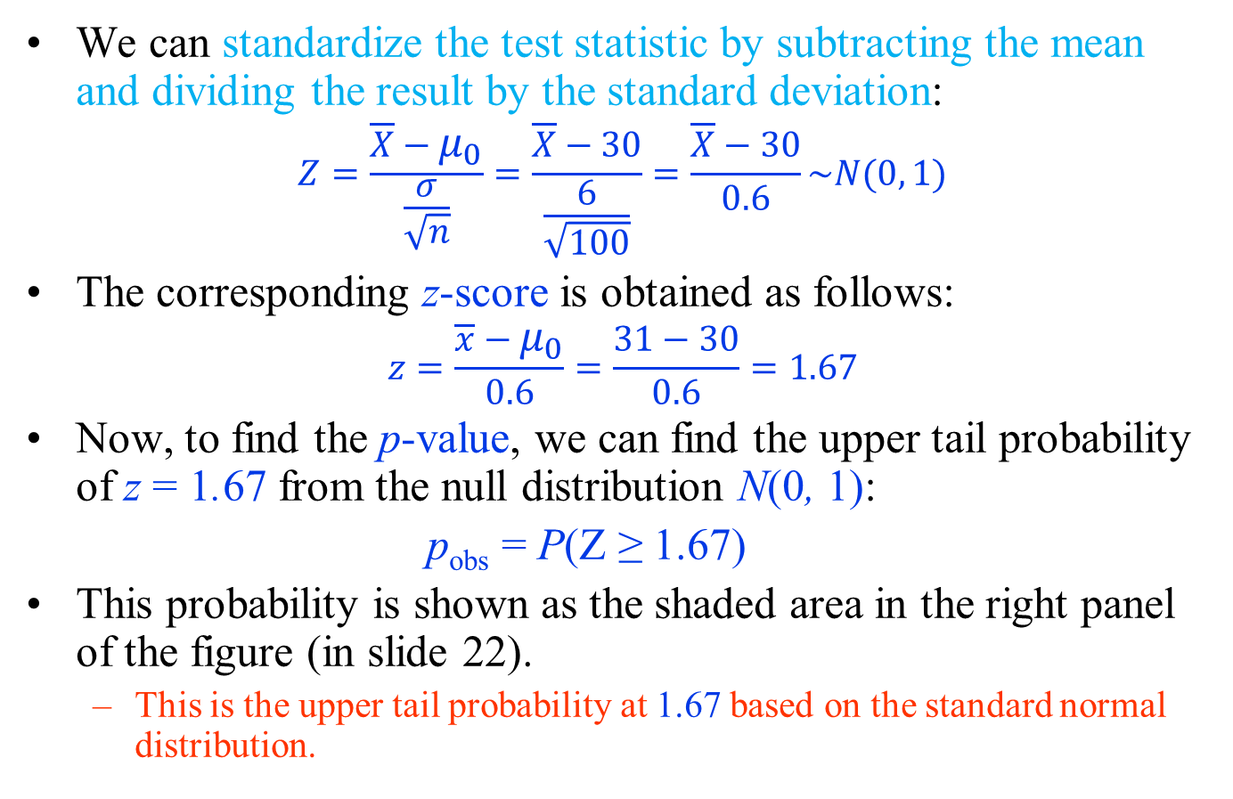
One-Sided Hypothesis Testing
We can standardize the test statistic by subtracting the mean and dividing the result by the standard deviation:
$$Z=\frac{\overline{X}−μ_{0}}{\frac{σ}{\sqrt{n}}}=\frac{\overline{X}−30}{\frac{6}{\sqrt{100}}}=\frac{\overline{X}−30}{0.6}\sim N(0, 1)$$
The corresponding z-score is obtained as follows:
$$z=\frac{\overline{x}−μ_{0}}{0.6}=\frac{31−30}{0.6}=1.67$$
Now, to find the p-value, we can find the upper tail probability of z = 1.67 from the null distribution N(0, 1):
p_{obs} = P(Z ≥ 1.67)
This probability is shown as the shaded area in the right panel of the figure (in slide 22).
  This is the upper tail probability at 1.67 based on the standard normal distribution.

Slide 26
One-Sided Hypothesis Testing
The upper tail probability is by convention P(Z >1.67).
However, for continuous random variables, P(Z > 1.67) = P(Z ≥ 1.67) since the probability of any specific value (here, 1.67) is zero.
For this example, p_{obs} = 0.048.
We can reject the null hypothesis at 0.05 level but not at 0.01 level.
At 0.05 level, we can conclude that the population mean of BMI for Pima Indian women is higher than 30 and the difference is statistically significant.

Slide 27
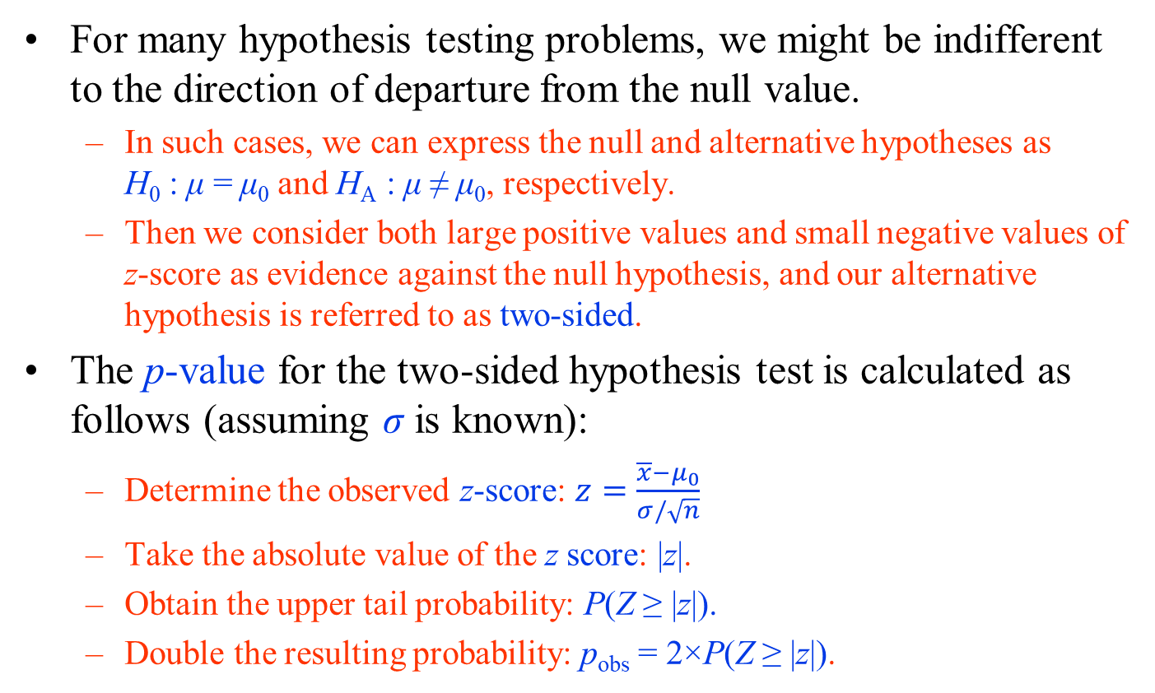
Two-Sided Hypothesis Testing
For many hypothesis testing problems, we might be indifferent to the direction of departure from the null value.
  In such cases, we can express the null and alternative hypotheses as H₀ : μ = μ₀ and H_{A} : μ ≠ μ₀, respectively.
  Then we consider both large positive values and small negative values of z-score as evidence against the null hypothesis, and our alternative hypothesis is referred to as two-sided.
The p-value for the two-sided hypothesis test is calculated as follows (assuming σ is known):
  Determine the observed z-score: $z=\frac{\overline{x}−μ_{0}}{σ/\sqrt{n}}$
  Take the absolute value of the z score: |z|.
  Obtain the upper tail probability: P(Z ≥ |z|).
  Double the resulting probability: p_{obs} = 2×P(Z ≥ |z|).

Slide 28
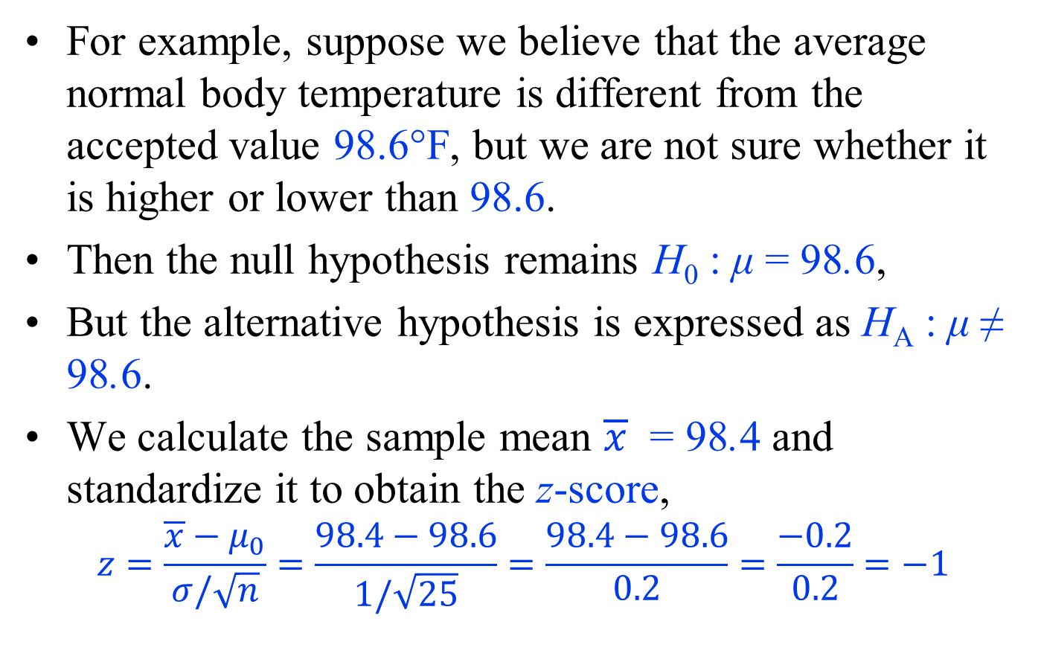
Two-Sided Hypothesis Testing
For example, suppose we believe that the average normal body temperature is different from the accepted value 98.6°F, but we are not sure whether it is higher or lower than 98.6.
Then the null hypothesis remains H₀ : μ = 98.6,
But the alternative hypothesis is expressed as H_{A} : μ ≠ 98.6.
We calculate the sample mean $\overline{x}$ = 98.4 and standardize it to obtain the z-score,
$$z=\frac{\overline{x}−μ_{0}}{σ/\sqrt{n}}=\frac{98.4−98.6}{1/\sqrt{25}}=\frac{98.4−98.6}{0.2}=\frac{−0.2}{0.2}=−1$$

Slide 29
Two-Sided Hypothesis Testing
The p-value is still calculated as the probability of values as or more extreme than the observed z-score.
  However, in this case, extreme values are those whose distance from 0 is more than the distance of −1 from zero.
    These are values that are either less than −1 or greater than 1.
Therefore, to find the observed significance level, we need to add the probabilities for Z ≤ −1 and Z ≥ 1:
p_{obs} = P(Z ≤ ˗1) + P(Z ≥ 1)
This probability is equal to the shaded area in the following figure

Slide 30
Two-Sided Hypothesis Testing
Illustrating the
p-value for a two-sided
hypothesis test of average
normal body temperature,
where H₀ : μ = 98.6 and
H_{A} : μ ≠ 98.6.
After standardizing,
p_{obs} = P(Z ≤−1)+P(Z ≥ 1) = 2×0.16 = 0.32
The p-value is greater than typical significance levels such as 0.01, 0.05, and 0.1, so we cannot reject it at these levels.
Therefore, we conclude that the observed difference is not statistically significant, and could be due to chance alone.

Slide 31
Hypothesis testing using t-tests
So far, we have assumed that the population variance σ² is known.
  In reality, σ² is almost always unknown, and we need to estimate it from the data.
As before, we estimate σ² using the sample variance S².
Similar to our approach for finding confidence intervals, we account for this additional source of uncertainty by using the t-distribution with n-1 degrees of freedom instead of the standard normal distribution.
  The hypothesis testing procedure is then called the t-test.

Slide 32
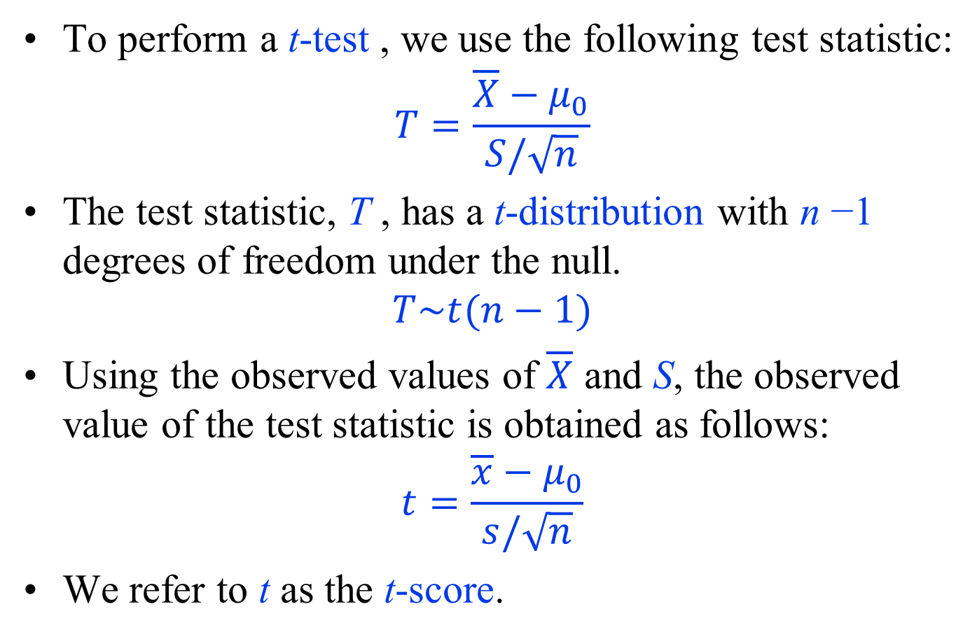
Hypothesis testing using t-tests
To perform a t-test , we use the following test statistic:
$$T=\frac{\overline{X}−μ_{0}}{S/\sqrt{n}}$$
The test statistic, T , has a t-distribution with n −1 degrees of freedom under the null.
$$T\sim t(n−1)$$
Using the observed values of $\overline{X}$ and S, the observed value of the test statistic is obtained as follows:
$$t=\frac{\overline{x}−μ_{0}}{s/\sqrt{n}}$$
We refer to t as the t-score.

Slide 33
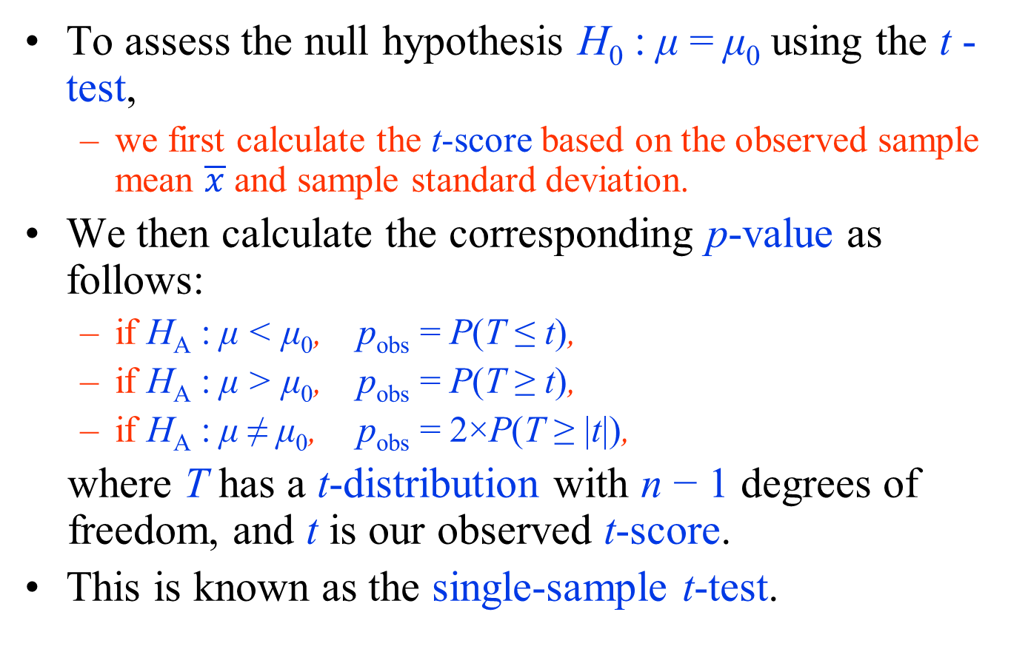
Hypothesis testing using t-tests
To assess the null hypothesis H₀ : μ = μ₀ using the t -test,
  we first calculate the t-score based on the observed sample mean $\overline{x}$ and sample standard deviation.
We then calculate the corresponding p-value as follows:
  if H_{A} : μ < μ₀, p_{obs} = P(T ≤ t),
  if H_{A} : μ > μ₀, p_{obs} = P(T ≥ t),
  if H_{A} : μ ≠ μ₀, p_{obs} = 2×P(T ≥ |t|),
where T has a t-distribution with n − 1 degrees of freedom, and t is our observed t-score.
This is known as the single-sample t-test.

Slide 34
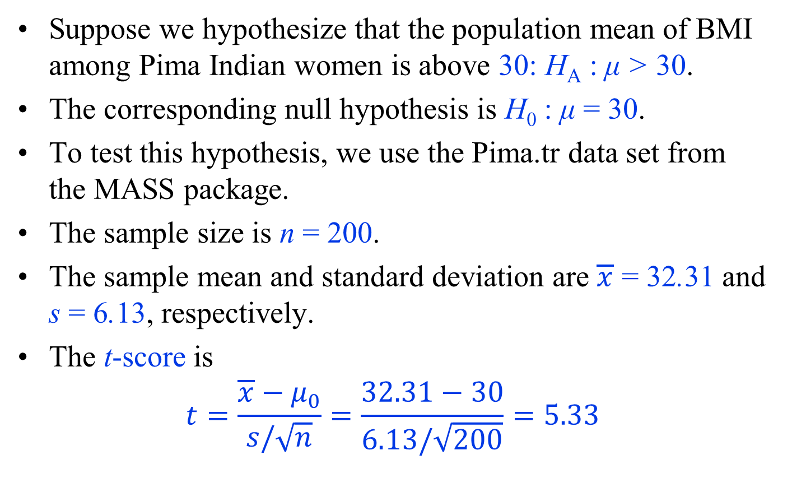
Hypothesis testing using t-tests - example
Suppose we hypothesize that the population mean of BMI among Pima Indian women is above 30: H_{A} : μ > 30.
The corresponding null hypothesis is H₀ : μ = 30.
To test this hypothesis, we use the Pima.tr data set from the MASS package.
The sample size is n = 200.
The sample mean and standard deviation are $\overline{x}$ = 32.31 and s = 6.13, respectively.
The t-score is
$$t=\frac{\overline{x}−μ_{0}}{s/\sqrt{n}}=\frac{32.31−30}{6.13/\sqrt{200}}=5.33$$

Slide 35
Hypothesis testing using t-tests - example
For the above example, p_{obs} = P(T ≥ 5.33), which we obtain from the t-distribution with 200 − 1 = 199 degrees of freedom.
To obtain this probability in R-Commander,
  click Distributions → Continuous Distributions → t distribution → t probabilities.
  Then enter 5.33 for Variable value and 199 for Degrees of freedom, and select Upper tail.
  The resulting probability is 1.33×10⁻⁰⁷.
At any reasonable significance level, there is strong evidence to reject the null hypothesis and conclude that the population mean of BMI among Pima Indian women is in fact greater than 30.
  Therefore, on average, the population is obese.

Slide 36
Hypothesis testing for population proportion
For a binary random variable X with possible values 0 and 1, we are typically interested in evaluating hypotheses regarding the population proportion of the outcome of interest, denoted as X = 1.
As discussed before, the population proportion is the same as the population mean for such binary variables.
So we follow the same procedure as described above.
More specifıcally, we use the z-test for hypothesis testing.
Note that we do not use t-test, because for binary random variable, population variance is σ² = µ(1 - µ).

Slide 37
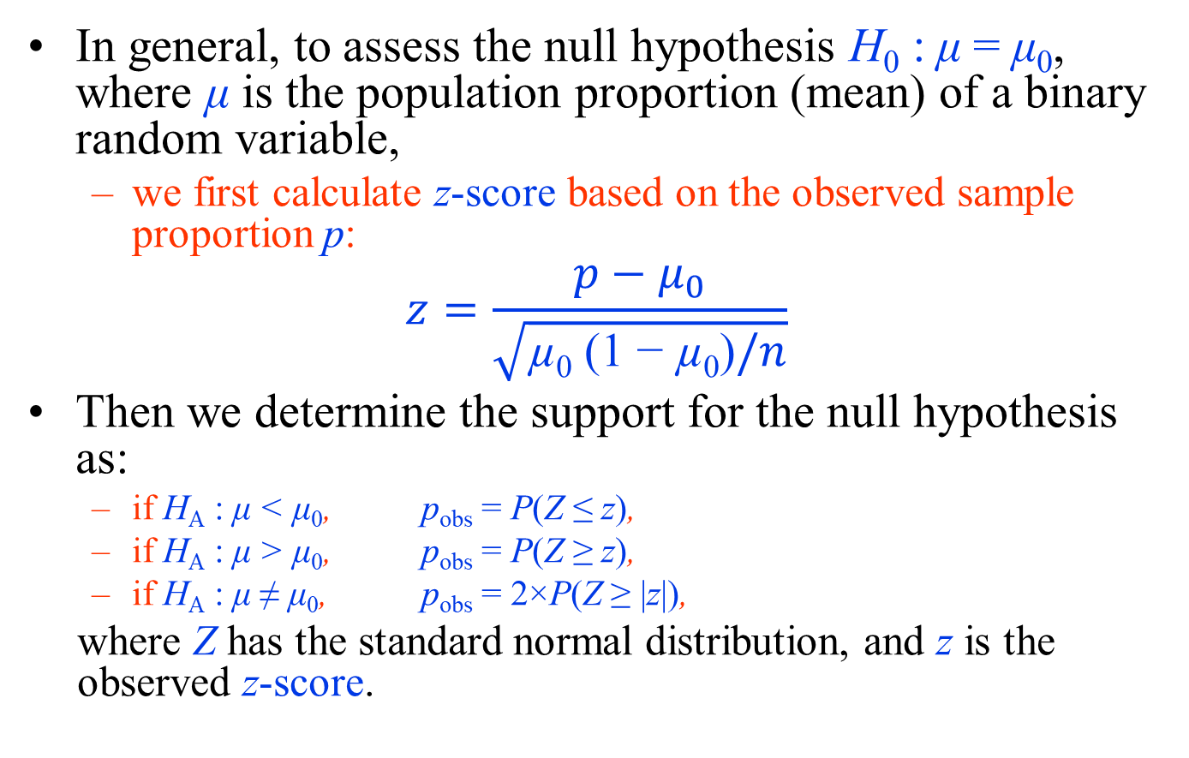
Hypothesis testing for population proportion
In general, to assess the null hypothesis H₀ : μ = μ₀, where μ is the population proportion (mean) of a binary random variable,
  we first calculate z-score based on the observed sample proportion p:
$$z=\frac{p−μ_{0}}{\sqrt{\text{µ}\text{0}\text{ (1 − }\text{µ}\text{0}\text{)}/n}}$$
Then we determine the support for the null hypothesis as:
  if H_{A} : μ < μ₀, p_{obs} = P(Z ≤ z),
  if H_{A} : μ > μ₀, p_{obs} = P(Z ≥ z),
  if H_{A} : μ ≠ μ₀, p_{obs} = 2×P(Z ≥ |z|),
where Z has the standard normal distribution, and z is the observed z-score.

Slide 38
Hypothesis testing for population proportion
Consider the Melanoma dataset available from the MASS package.
Suppose that we hypothesize that less than 50% of cases ulcerate: μ < 0.5.
Then the null hypothesis can be expressed as H₀ : μ = 0.5.
Using the Melanoma data set, we can test the above null hypothesis.
The number of observations in this data set is n = 205, of which 90 patients had ulceration.
Therefore,
p = 90/205 = 0.44

Slide 39
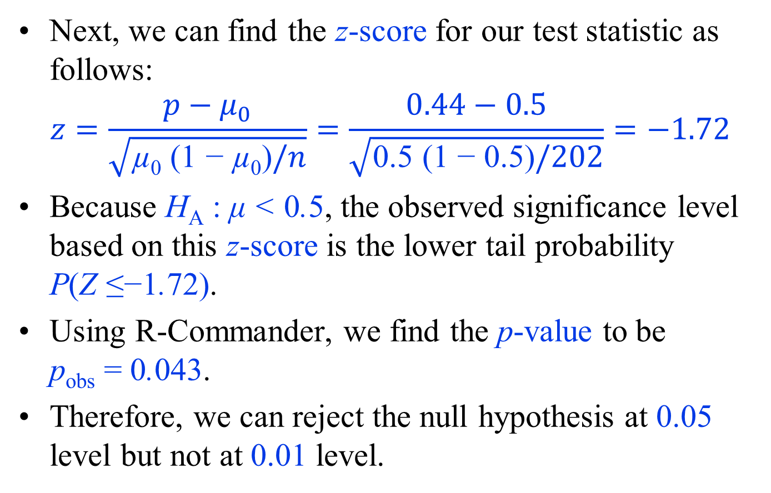
Hypothesis testing for population proportion
Next, we can find the z-score for our test statistic as follows:
$$z=\frac{p−μ_{0}}{\sqrt{\text{µ}\text{0}\text{ (1 − }\text{µ}\text{0}\text{)}/n}}=\frac{0.44−0.5}{\sqrt{\text{0.5}\text{ (1 − }\text{0.5}\text{)}/202}}=−1.72$$
Because H_{A} : μ < 0.5, the observed significance level based on this z-score is the lower tail probability P(Z ≤−1.72).
Using R-Commander, we find the p-value to be p_{obs} = 0.043.
Therefore, we can reject the null hypothesis at 0.05 level but not at 0.01 level.

Slide 40
Test of Normality
Visual inspection of the distribution may be used for assessing normality, although this approach is usually unreliable and does not guarantee that the distribution is normal.
  The frequency distribution (histogram),
  stem-and-leaf plot,
  boxplot,
  P-P plot (probability-probability plot),
  Q-Q plot (quantile-quantile plot)
  are used for checking normality visually

Slide 41
Test of Normality
The appropriateness of the normality assumption can be evaluated formally using a testing procedure such as
  Kolmogorov-Smirnov (K-S) test
  Lilliefors corrected K-S test
  Shapiro-Wilk test
  Anderson-Darling test
  Cramer-von Mises test
  D’Agostino skewness test
  Anscombe-Glynn kurtosis test
  D’Agostino-Pearson omnibus test
  the Jarque-Bera test

Slide 42
Test of Normality - Example
More specifically, this test evaluates the null hypothesis that the distribution of the random variable is normal.
As usual, we then either reject this hypothesis and conclude that the normality assumption is not appropriate, or fail to reject it and conclude that there is no strong evidence of deviation from normality.
Suppose we assume that the bmi variable in Pima.tr has normal distribution.

Slide 43
Test of Normality - Example
To evaluate this assumption, In R-Commander,
  click Statistics → Summaries → Test of normality and chose Shapiro-Wilk,
  then select the bmi.
The p-value for this test is 0.25.
Therefore, we do not reject the null hypothesis (which states that the distribution is normal) and conclude that the deviation of the distribution from normality is not statistically significant.

Slide 44
Test of Normality - Example
For comparison, repeat the above steps to test the normality assumption for the age variable in the Pima.tr data set.
Using the Shapiro–Wilk test, the p-value is 1.853 × 10⁻¹², which is very small.
Therefore, we can comfortably reject the null hypothesis and conclude that the deviation from normality is statistically significant.

Slide 45
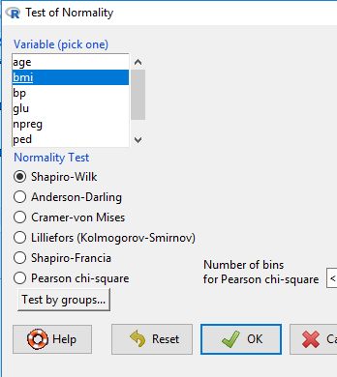
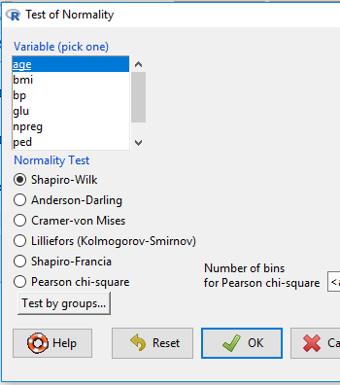


Test of Normality - Example

Slide 46
Hypothesis Testing with R Programming
To perform the z-test in R, use the function pnorm()
For the body temperature example discussed earlier, the z-score was −1.
  For the one-sided hypothesis of the form H₀ :μ<μ₀, we find the lower tail probability of −1 as follows:
> pnorm(-1, mean = 0, sd = 1, lower.tail = TRUE)
[1] 0. 1586553
For the BMI example, z-score was 1.67.
  For the one-sided hypothesis of the form H₀ :μ>μ₀, we need to find the upper tail probability of 1.67 as follows:
> pnorm(1.67, mean = 0, sd = 1, lower.tail = FALSE)
[1] 0.04745968

Slide 47
Hypothesis Testing with R Programming
When σ² is unknown and we need to use the data to estimate it separately, we use the t-test to evaluate hypotheses regarding the mean of a normal distribution.
For the BMI example discussed earlier, the t-score was t = 5.33.
  For the one-sided hypothesis of the form H₀ :μ>μ₀, we find the upper tail probability of 5.33 from a t distribution with n−1 degrees of freedom, where n = 200 in this example.
  We use the pt() function:
> pt(5.33, df = 199, lower.tail = FALSE)
[1] 0.0000001324778

