Slide 1
Statistical Data Analysis
Prof. Dr. Nizamettin AYDIN
naydin@yildiz.edu.tr
http://www3.yildiz.edu.tr/~naydin

Slide 2
Data Exploration

Slide 3
Data Visualization and Summary Statistics
Preliminary steps before analysis:
  defining the scientific question we try to answer,
  selecting a set of representative members from the population of interest
  collecting data (either through observational studies or randomized experiments),
Analysis usually begins with data exploration.
  We start by focusing on data exploration techniques for one variable at a time.

Slide 4
Data Visualization and Summary Statistics
Objective is
  to develop a high-level understanding of the data,
  learn about the possible values for each characteristic,
  find out how a characteristic varies among individuals in our sample.
Basicaly, we want to learn about the distribution of variables.
  Recall that for a variable, the distribution shows
    the possible values,
    the chance of observing those values,
    how often we expect to see them in a random sample from the population.

Slide 5
Data Visualization and Summary Statistics
Example of an ECG recording
R-R interval is defined as the time interval between successive R waves of the QRS complex,

Slide 6
Data Visualization and Summary Statistics
A normally functioning heart exhibits considerable variability in beat-to-beat intervals.
  variability reflects the body’s continual effort to maintain homeostasis
    so that the body may continue to perform its most essential functions and supply the body with the oxygen and nutrients required to function normally.
It has been demonstrated through biomedical research that there is a loss of heart rate variability associated with some diseases,
  such as diabetes and ischemic heart disease.

Slide 7
Data Visualization and Summary Statistics
Researchers seek to determine
  if this difference in variability between normal subjects and subjects with heart disease is significant
    meaning, it is due to some underlying change in biology and not simply a result of chance
  whether it might be used to predict the progression of the disease.
One will note that the probability model changes as a consequence of changes in the underlying biological function or process.

Slide 8
Data Visualization and Summary Statistics
To make sound decisions in the context of the uncertainty with some level of confidence,
  we need to assume some probability models for the populations from which the samples have been collected.
Once we have assumed an underlying model,
  we can select the appropriate statistical tests for comparing two or more populations
  then we can use these tests to draw conclusions about our hypotheses for which we collected the data in the first place

Slide 9
Data Visualization and Summary Statistics
The data exploration methods allow us to reduce the amount of information so that we can focus on the key aspects of the data.
We do this by using data visualization techniques and summary statistics.
The visualization techniques and summary statistics we use for a variable depend on its type
  Recall that we can classify them into two general groups:
    Numerical (quantitative) variables
      discrete, continuous
    Categorical variables
      nominal, ordinal

Slide 10
Graphical summarization of data
Before blindly applying the statistical analysis, it is always good to look at the raw data,
  usually in a graphical form,
  and then use graphical methods to summarize the data in an easy to interpret format.
  A Picture is worth a thousand word
The types of graphical displays that are most frequently used by engineers
  scatterplots, time series, box-and-whisker plots, and histograms.

Slide 11
Data Visualization and Summary Statistics
As a computational tool, R will be used.
  RStudio is an IDE for R.
    It is available in two formats:
      RStudio Desktop is a regular desktop application
      RStudio Server runs on a remote server and allows accessing RStudio using a web browser.
  R-Commander can also be used
    It allows us to do basic statistical analysis without necessarily learning the programing language of R.
First, you must download and install R
  Go to http://www.r-project.org/
  Click on the download R link
  Then select a location closest to you.
  Click on your operating system

Slide 12
Data Visualization and Summary Statistics
You can download R-Commander from the command line by following these steps:
  Once you have installed R, open it by double-clicking on the icon.
  A window called “R Console” will open.
  Make sure you have a working internet connection. Then, at the prompt (the > symbol), type the following command exactly and then press enter :
    > install.packages("Rcmdr", dependencies = TRUE)
  R may respond by asking you to select a mirror site and listing them in a pop-up box. Choose a nearby location.
  Depending on your connection speed, the installation may take awhile.
If R is not already open, open it by clicking on its icon.
To open R-Commander, at the prompt enter the following command
  > library(Rcmdr)

Slide 13
What is R?
a language and environment for statistical computing and graphics
provides a wide variety of statistical (linear and non linear modeling, classical statistical tests, time-series analysis, classification, clustering, ...) and graphical techniques, and is highly extensible
available as Free Software under the terms of the Free Software Foundation's GNU General Public License in source code form.
compiles and runs on a wide variety of UNIX platforms and similar systems, Windows and MacOS.

Slide 14
The R environment
R is an integrated suite of software facilities for data manipulation, calculation and graphical display.
It includes
  an effective data handling and storage facility,
  a suite of operators for calculations on arrays, in particular matrices,
  a large, coherent, integrated collection of intermediate tools for data analysis,
  graphical facilities for data analysis and display either on-screen or on hardcopy,
  a well-developed, simple and effective programming language which includes conditionals, loops, user-defined recursive functions and input and output facilities.

Slide 15
Data Visualization and Summary Statistics
You can download R-Commander from the command line by following these steps:
  Once you have installed R, open it by double-clicking on the icon.
  A window called “R Console” will open.
  Make sure you have a working internet connection. Then, at the prompt (the > symbol), type the following command exactly and then press enter :
    > install.packages("Rcmdr", dependencies = TRUE)
  R may respond by asking you to select a mirror site and listing them in a pop-up box. Choose a nearby location.
  Depending on your connection speed, the installation may take awhile.
If R is not already open, open it by clicking on its icon.
To open R-Commander, at the prompt enter the following command
  > library(Rcmdr)

Slide 16
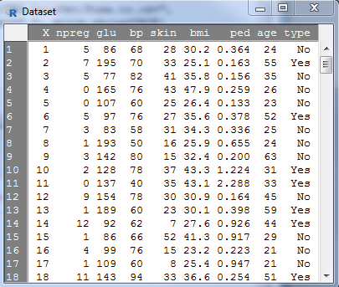
Data Visualization and Summary Statistics
Example Data set : Pima.tr

Slide 17
Data Visualization and Summary Statistics
Example Data set : Pima.tr
  Pima Indians Diabetes Data Set
  Attribute Information:
    npreg: Number of times pregnant.
    glu: Plasma glucose concentration a 2 hours in an oral glucose tolerance test.
    bp: Diastolic blood pressure (mm Hg) .
    skin: Triceps skin fold thickness (mm).
    bmi: Body mass index (weight in kg/(height in m)^2).
    ped: Diabetes pedigree function.
    age: Age in years.
    type: Class variable (disease status)
      Yes for diabetic, No for nondiabetic

Slide 18
Data Visualization and Summary Statistics
Categorical variables are either nominal or ordinal, depending on the extent of information the numerical coding provides.
For nominal variables, the numbers are simply labels, which are chosen arbitrarily.
  Therefore, they do not provide any information.
The type variable in Pima.tr is nominal.
For ordinal variables, although the numbers do not have their usual meaning, they preserve a rank ordering.
  Therefore, they provide information about the ordering of categories.

Slide 19
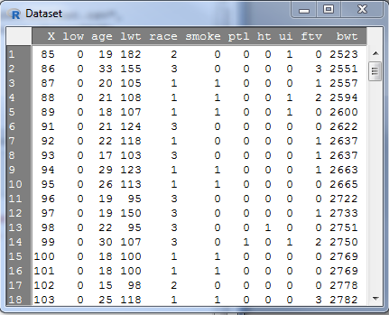
Data Visualization and Summary Statistics
Example Data set : birthwt

Slide 20
Data Visualization and Summary Statistics
Example Data set : birthwt
  the birth weight of 189 newborn babies along with some characteristics
  Attribute Information:
    low: indicator of birth weight less than 2.5 kg (0 = normal birth weight, 1 = low birth weight).
    age: mother’s age in years.
    lwt: mother’s weight in pounds at last menstrual period.
    race: mother’s race (1 = white, 2 = African-American, 3 = other).
    smoke: smoking status during pregnancy (0 = not smoking, 1 = smoking).
    ptl: number of previous premature labors.
    ht: history of hypertension (0 = no, 1 = yes).
    ui: presence of uterine irritability (0 = no, 1 = yes).
    ftv: number of physician visits during the first trimester.
    bwt: birth weight in grams.

Slide 21
Data Visualization and Summary Statistics
In the birthwt data set, variables age, lwt, ptl, ftv, and bwt are numerical variables.
  Among these variables, ptl and ftv are count variables.
  The variables low, race, smoke, ht, and ui are all categorical.
Note that all categorical variables are coded with numerical values.
In these situations, R and R-Commander cannot automatically recognize them as categorical variables.
  In fact, they are considered as numerical variables by default.
Therefore, we need to convert them to categorical variables.
  To do this, make sure birthwt is the active data set, then
  click on
    Data→ Manage variables in active data set → Convert numeric variables to factors

Slide 22
Data Visualization and Summary Statistics
Many data set can be downloaded from the following site:
https://vincentarelbundock.github.io/Rdatasets/datasets.html

Slide 23
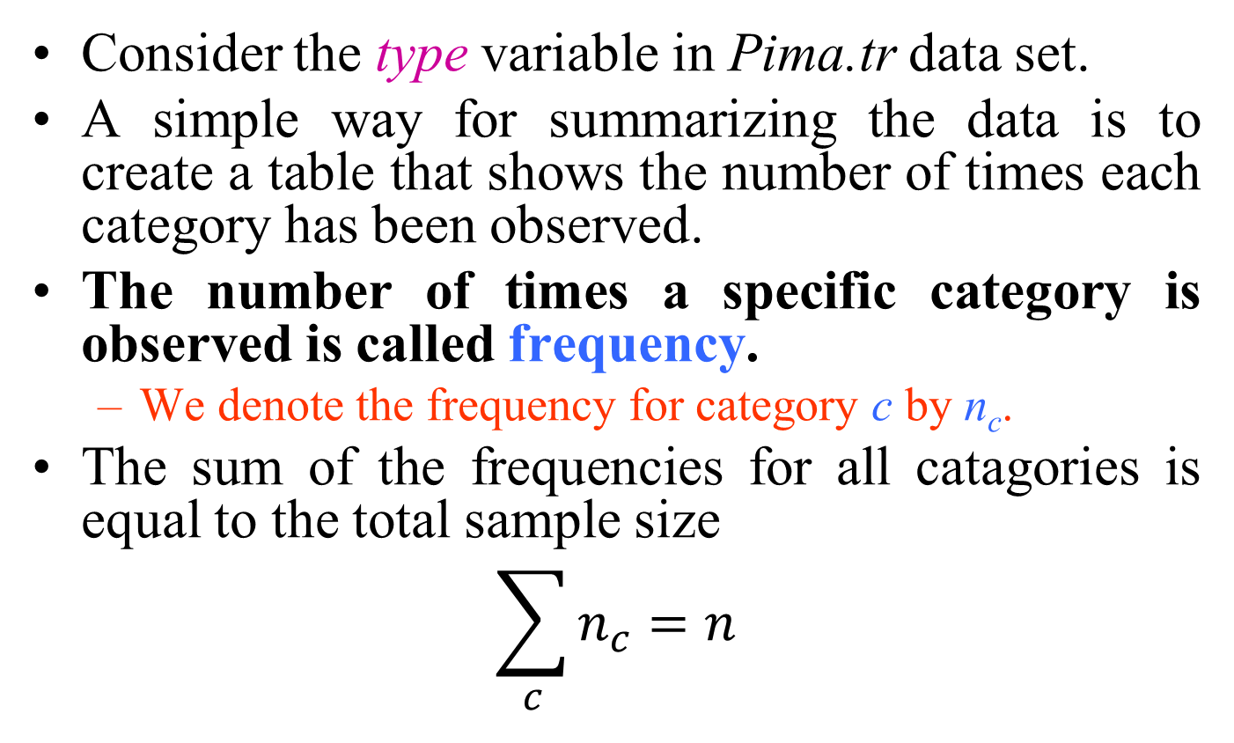
Exploring Categorical Variables
Consider the type variable in Pima.tr data set.
A simple way for summarizing the data is to create a table that shows the number of times each category has been observed.
The number of times a specific category is observed is called frequency.
  We denote the frequency for category c by n_{c}.
The sum of the frequencies for all catagories is equal to the total sample size
$$\sum_{c}{n_{c}=n}$$

Slide 24
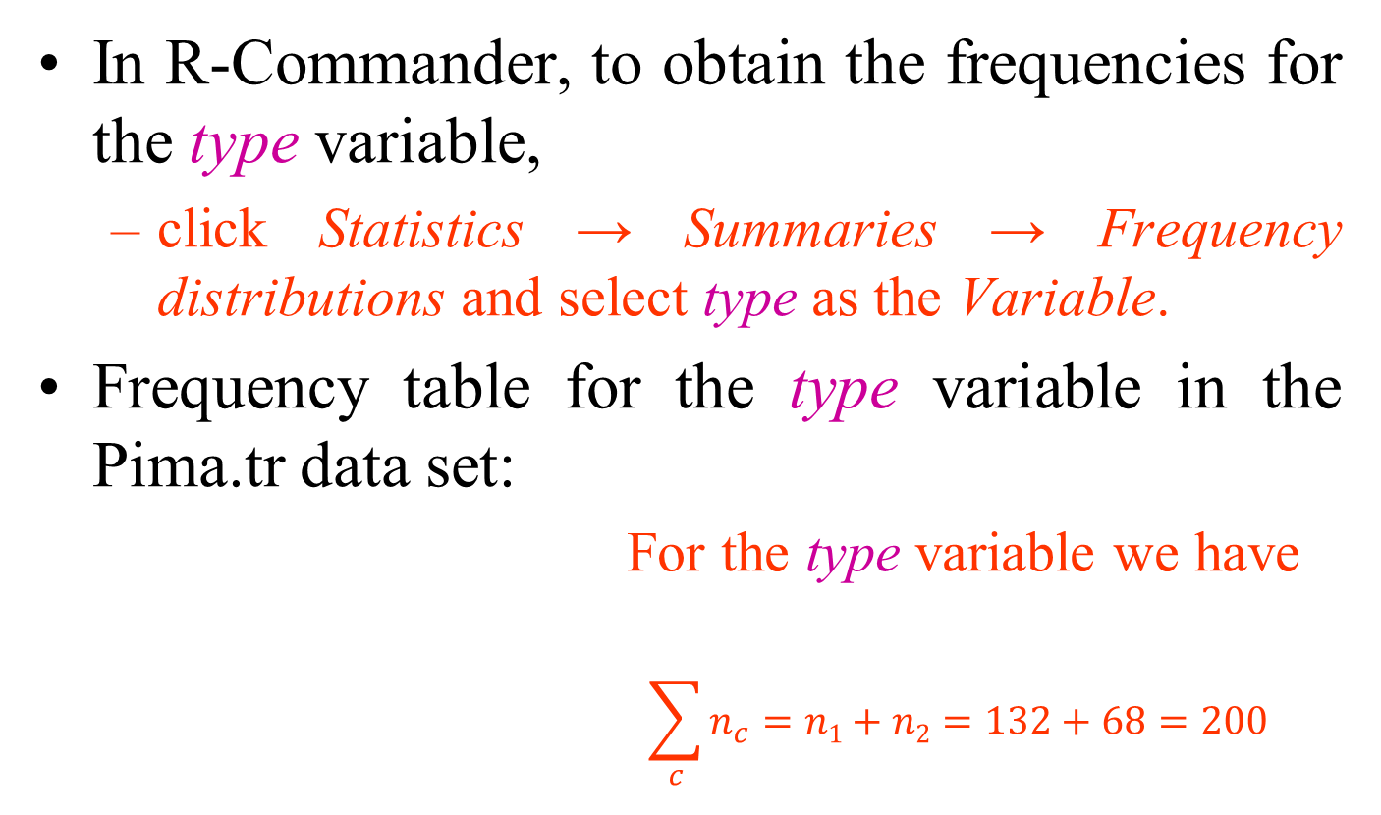
Exploring Categorical Variables
In R-Commander, to obtain the frequencies for the type variable,
  click Statistics → Summaries → Frequency distributions and select type as the Variable.
Frequency table for the type variable in the Pima.tr data set:
  For the type variable we have
  $$\sum_{c}{n_{c}=n1+n2=132+68=200}$$
Type | Frequency
No Yes Total | 132 68 200

Slide 25
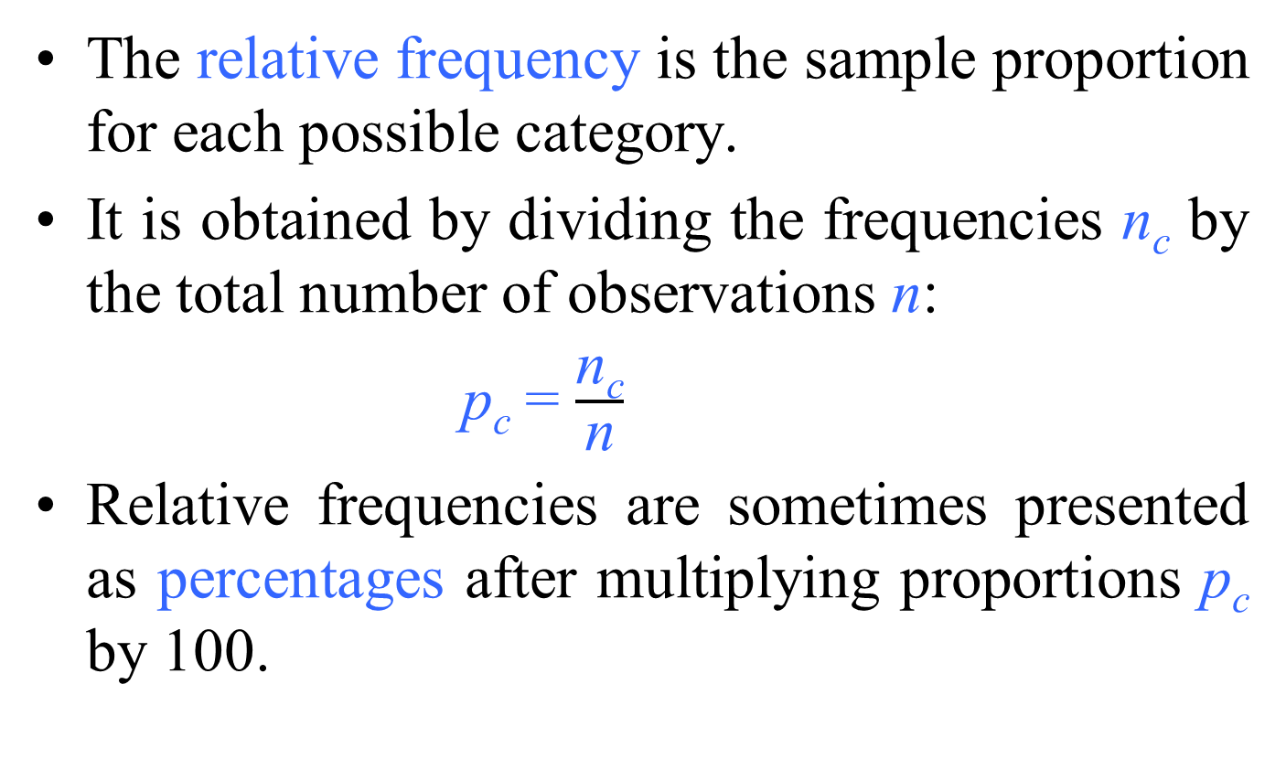
Relative Frequency and Percentage
The relative frequency is the sample proportion for each possible category.
It is obtained by dividing the frequencies n_{c} by the total number of observations n:
p_{c} = $\frac{\text{n}\text{c}}{\text{n}}$
Relative frequencies are sometimes presented as percentages after multiplying proportions p_{c} by 100.

Slide 26
Relative Frequency and Percentage
Consider the race variable in the birthwt data set.
  The frequencies are n₁ = 96, n₂ = 26, and n₃ = 67 for “White”, “African-American”, and “Other” categories, respectively.
  The sum of these frequencies is equal to the sample size n = 189.
The relative frequencies and percentages for the race variable in birthwt data set are
  p₁ = 96/189 = 0.508 = 50.8%,
  p₂ = 26/189 = 0.138 = 13.8%,
  p₃ = 67/189 = 0.354 = 35.4%.
Therefore, 50.8% of the women in the sample were white, 13.8% were African-American, and the remaining 35.4% were from other races.

Slide 27
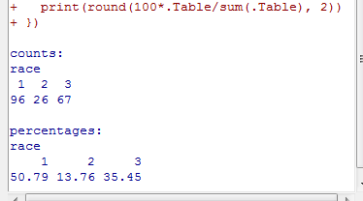
Relative Frequency and Percentage
In R-Commander, make sure birthwt is the active data set,
  then click
    Statistics → Summaries → Frequency distributions, and select race as the Variable.
The frequencies and percentages
are given in the Output window.
For race, the category “1” (i.e.,
white women) has the highest
frequency.
In this case, we say that the mode of the variable race is “1”.
For a categorical variable, the mode is the most common value,
  i.e., the value with the highest frequency.

Slide 28
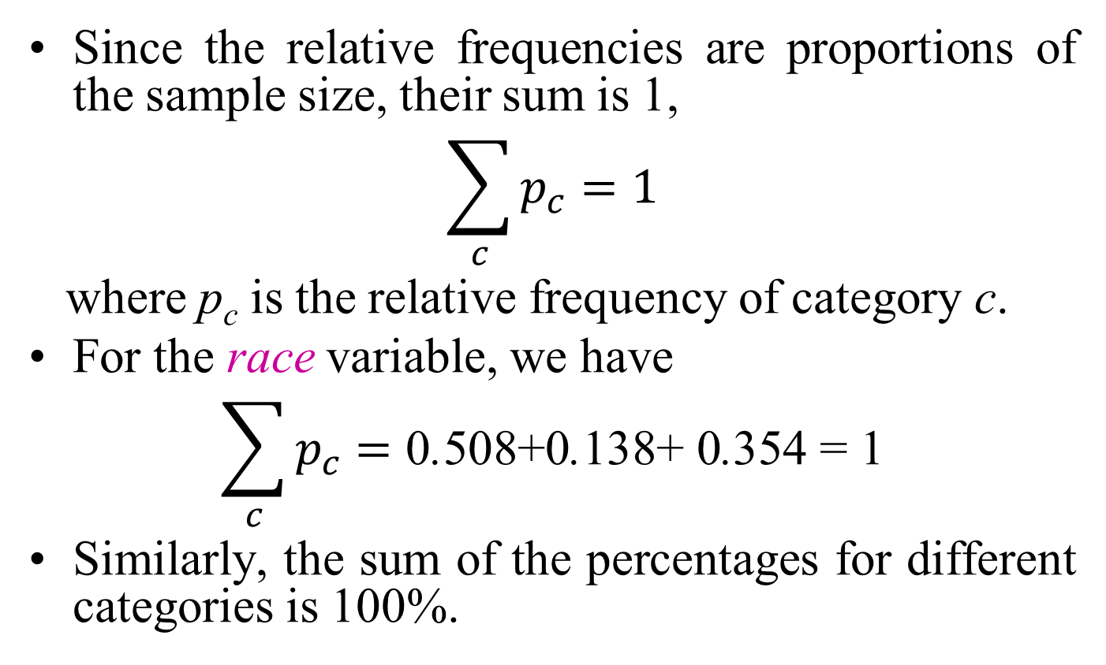
Relative Frequency and Percentage
Since the relative frequencies are proportions of the sample size, their sum is 1,
$$\sum_{c}{p_{c}=1}$$
where p_{c} is the relative frequency of category c.
For the race variable, we have
$$\sum_{c}{p_{c}=\text{0}\text{.}\text{508+0}\text{.}\text{138+ 0}\text{.}\text{354 = 1}}$$
Similarly, the sum of the percentages for different categories is 100%.

Slide 29
Bar Graph
For categorical variables, bar graphs are one of the simplest ways of visualizing the data.
Using a bar graph, we can visualize the possible values (categories) a categorical variable can take,
  as well as the number of times each category has been observed in our sample.
The height of each bar in this graph shows the number of times the corresponding category has been observed.
  {Create a bar graph for type by clicking Graphs→Bar graph and then selecting type as the Variable.}

Slide 30
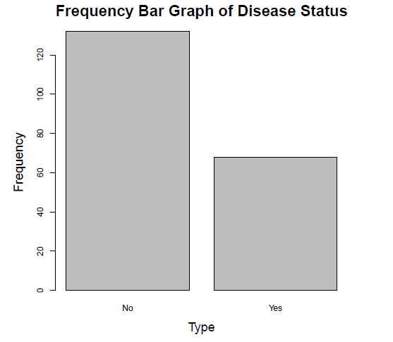
Bar graphs and frequencies
Frequency table for the type variable in the Pima.tr data set
Type | Frequency
No Yes Total | 132 68 200
Bar graph for the type variable
Overall, bar graphs show us how the observed values of a categorical variable in our sample are distributed

Slide 31
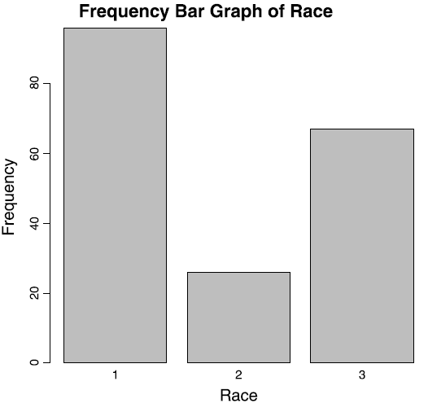
Bar graphs and frequencies
Frequency table for the race variable in the birthwt data set
Race | Frequency | Relative frequency
White | 96 | 0.508
African-American | 26 | 0.138
Other | 67 | 0.354
Total | 189 | 1
Bar graph for mother’s race in the birthwt data set,
where 1, 2, and 3 represent the categories “white”, “African-American”, and “other”, respectively

Slide 32
Bar Graph
Checklist for evaluating bar graphs:
  Check the units on the y-axis.
    Make sure they are evenly spaced.
  Be aware of the scale of the bar graph (the units in which bar heights are represented).
    Using a smaller scale you can make differences look more dramatic.
      (for example, each half inch of height representing 10 units versus 50)
  In the case where the bars represent percents and not counts, make sure to ask for the total number of individuals summarized by the bar graph if it is not listed.

Slide 33
Pie chart
A pie chart takes categorical data and shows the percentage of individuals that fall into each category.
The sum of all the slices of the pie should be 100% or close to it (with a bit of round-off error).
Because a pie chart is a circle, categories can easily be compared and contrasted to one another.

Slide 34
Pie chart
An example:
  The Florida lottery uses a pie chart to report where the money goes when a lottery ticket is purchased.

Slide 35
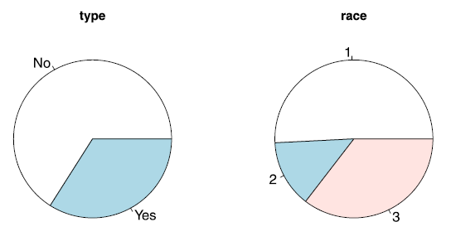
Pie chart
We can use a pie chart to visualize the relative frequencies of different categories for a categorical variable.
In a pie chart, the area of a circle is divided into sectors, each representing one of the possible categories of the variable.
The area of each sector c is proportional to its frequency.
To create pie charts in R-Commander, click Graphs→Pie chart.
Pie charts for the type variable from Pima.tr and the race variable from birthwt, where 1, 2, and 3 represent the categories “white”, “African-American”, and “other”, respectively

Slide 36
Pie chart
To evaluate a pie chart for statistical correctness:
  Check to be sure the percentages add up to 100% or close to it
    any round-off error should be very small
  Beware of slices of the pie called “other” that are larger than many of the other slices.
    This shows a lack of detail in the information gathered.
  A pie chart only shows the percentage in each group, not the number in each group.
    Always ask for or look for a report of the total size of the data set.

Slide 37
Time Charts (line graphs)
a data display whose main point is to examine trends over time.
Typically a time chart has
  some unit of time on the horizontal axis
    (year, day, month, and so on)
  a measured quantity on the vertical axis
    (average income, birth rate, total sales, etc.).
At each time period, the amount is shown as a dot, and the dots connect to form the time chart.

Slide 38
Time Charts (line graphs)
Average hourly wage for production workers, 1947–1998

Slide 39
Time Charts (line graphs)
A time chart can present information in a misleading way, for example
  charting the number of crimes over time, rather than the crime rate (crimes per capita).
    Because the population size of a city changes over time, crime rate is the appropriate measure.
Make sure you understand what statistics are being presented and examine them for fairness and appropriateness.

Slide 40
Time Charts (line graphs)
Checklist for evaluating time charts:
  Examine the scale on the vertical (quantity) axis as well as the horizontal (timeline) axis;
    results can be made to look more or less dramatic than they actually are simply by changing the scale.
  Take into account the units used in the chart and be sure they are appropriate for comparison over time
    (for example, are dollar amounts adjusted for inflation?).
  Watch for gaps in the timeline on a time chart.
    Connecting the dots across a short period of time is better than connecting across a long time.

Slide 41
Further reading on visualization of categorical data
  http://www.sciencedirect.com/science/book/9780122990458
  http://www.datavis.ca/books/vcd/vcdstory.pdf
  http://citeseerx.ist.psu.edu/viewdoc/download?doi=10.1.1.140.599&rep=rep1&type=pdf
  https://www.jstatsoft.org/article/view/v053i07/v53i07.pdf
  http://vis.berkeley.edu/courses/cs294-10-fa08/wiki/images/9/99/Seth-FinalPaper.pdf

Slide 42
Exploring Numerical Variables
For numerical variables, we are especially interested in two key aspects of the distribution:
  its location
    refers to the central tendency of values, that is, the point around which most values are gathered.
  its spread
    refers to the dispersion of possible values, that is, how scattered the values are around the location.

Slide 43
Histograms
defined as a frequency distribution commonly used to visualize numerical variables.
A histogram is similar to a bar graph after the values of the variable are grouped (binned) into a finite number of nonoverlapping intervals (bins), usually of equal width.
Given N samples or measurements, x_{i} ranging from X_{min} to X_{max}, the samples are binned into bins
Typically, the number of bins is on the order of 7–14, depending on the nature of the data.
  In addition, we typically expect to have at least three samples per bin.
    Sturgess’rule may also be used to estimate the number of bins and is given by k = 1 + 3.3 log(n).
      where k is the number of bins and n is the number of samples.

Slide 44
Histograms
One bin of a histogram plot
The bin is defined by
  a lower bound,
  a midpoint,
  an upper bound

Slide 45
Histograms
constructed by plotting the number of samples in each bin.
  horizontal axis,
    the sample value,
  the vertical axis,
    the number of occurrences of samples falling within a bin
Next slide illustrates a histogram for 1000 samples drawn from a normal distribution with mean (μ) = 0 and standard deviation (σ) = 1.0.

Slide 46
Histograms

Slide 47
Histograms
Two useful measures in describing a histogram:
  the absolute frequency in one or more bins
    f_{i} = absolute frequency in ith bin
  the relative frequency in one or more bins
    f_{i} /n = relative frequency in ith bin,
      where n is the total number of samples being summarized in the histogram
The histogram can exhibit several shapes
  symmetric, skewed, or bimodal.

Slide 48
Histograms - example
As a running example, consider a numerical variable, X, for which three sets (samples) of observations denoted as Sample 1, Sample 2, and Sample 3 have been collected.
Dot plots for these three sets of observations:
Observations in Sample 1 are gathered around 2,
Observations in Sample 2 and Sample 3 are gathered around 4.
Observations in Sample 3 are more dispersed compared to those in Sample 1 and Sample 2

Slide 49
Histograms - example
Histograms of the three samples.

Slide 50
Histograms - example
The following table shows the number of live births in Colorado by age of mother for selected years from 1975–2000.
The numerical variable age is broken down into categories of 5-year groupings.

Slide 51
Histograms - example
Relative frequency histograms comparing 1975 and 2000
You can see more older mothers in 2000 than in 1975.

Slide 52
Histograms
The bar height for each interval could be set to its relative frequency p_{c} = n_{c}/n, or the percentage p_{c} x100, of observations that fall into that interval.
For histograms, however, it is more common to use the density instead of the relative frequency or percentage.
  The density is the relative frequency for a unit interval.
    It is obtained by dividing the relative frequency by the interval width:
f_{c} = p_{c}/w_{c}
      Here, p_{c} = n_{c}/n is the relative frequency with n_{c} as the frequency of interval c and n as the total sample size.
      The width of interval c is denoted w_{c} .
To create the density histogram in R-Commander, click Graphs → Histogram, select a variable, and choose Densities for the Axis Scaling.

Slide 53
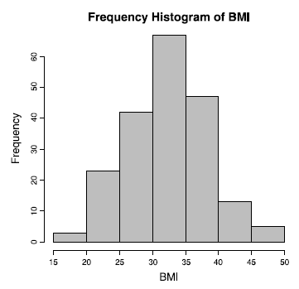
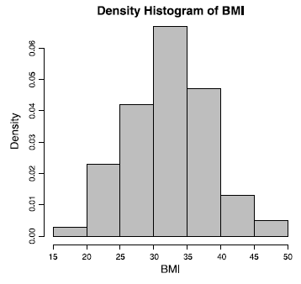
Histograms
The frequency histogram for the numerical variable bmi in the Pima.tr data set.
The height of the rectangles represent the frequency of the interval and sum to the total sample size n.
Here, the values of the variable are divided into seven bins
The density histogram for bmi from the Pima.tr data set.
Here, the scale on the y-axis is density (not frequency).
Once again, the values of bmi are divided into seven bins of width w = 5

Slide 54
Histograms
Assuming the frequency histogram for variable bmi, let us calculate the density of the interval [30, 35], which is the 4th interval.
  There are n₄ = 67 observations in this interval.
  Therefore, the relative frequency is p₄ = 67/200 = 0.335.
  The interval width is w₄ = 5.
  The density for this interval is therefore f₄ = 0.335/5 = 0.067
To create the density histogram for bmi in R-Commander, click
  Graphs → Histogram, select bmi as the Variable, and choose Densities for the Axis Scaling

Slide 55
Histograms
The height of each bar in density histogram shows the density of the corresponding interval (as opposed to its frequency).
For each interval c, the area of the corresponding bar in the density histogram is calculated as follows (hight×width):
  a_{c} = f_{c} × w_{c} = (p_{c} / w_{c}) × w_{c} = p_{c}
Therefore, the area of each bar (rectangle) is the relative frequency for the corresponding interval.
  Since the sum of relative frequencies is 1, the total area of bars in a density histogram is 1.

Slide 56
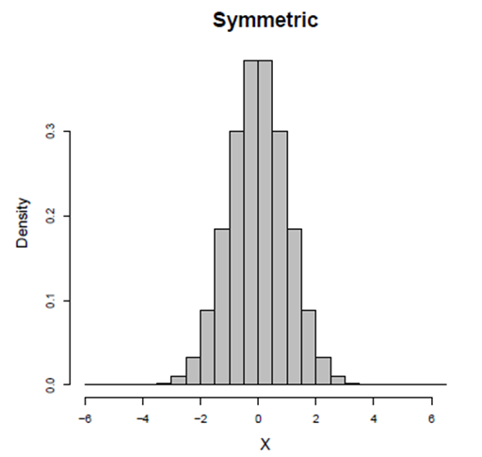
Histograms
When creating a histogram, it is important to choose an appropriate value for w (Number of Bins) .
Besides the location and spread of a distribution, the shape of a histogram also shows us how the observed values spread around the location.
We say the following histogram is symmetric around its location (here, zero) since the densities are the [almost] same for any two intervals that are equally distant from the center.

Slide 57
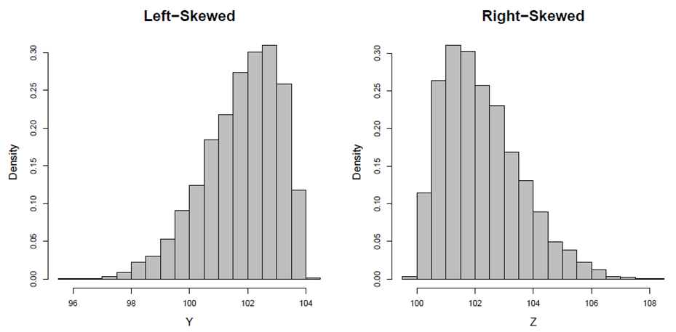
Histograms
In many situations, we find that a histogram is stretched to the left or right.
We call such histograms skewed.
  More specifically, we call them left-skewed if they are stretched to the left, or right-skewed if they are stretched to the right.

Slide 58
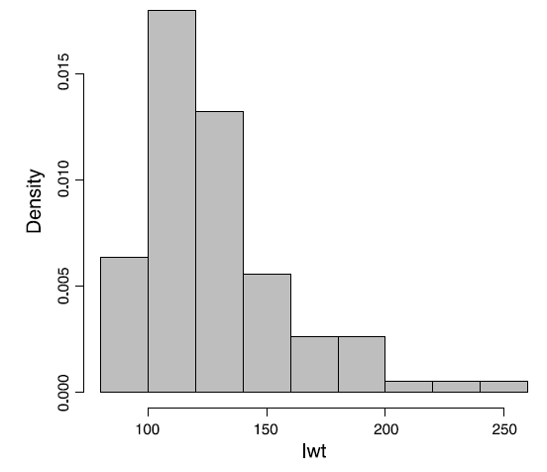
Histograms
As an example, histogram of variable lwt in the birthwt data set is right-skewed

Slide 59
Histograms
The histograms in previous slides, whether symmetric or skewed, have one thing in common
  they all have one peak (or mode).
We call such histograms (and their corresponding distributions) unimodal.
Sometimes histograms have multiple modes.
  The bimodal histogram appears to be a combination of two unimodal histograms.
    Indeed, in many situations bimodal histograms (and multimodal histograms in general) indicate that the underlying population is not homogeneous and may include two (or more in case of multimodal histograms) subpopulations.

Slide 60
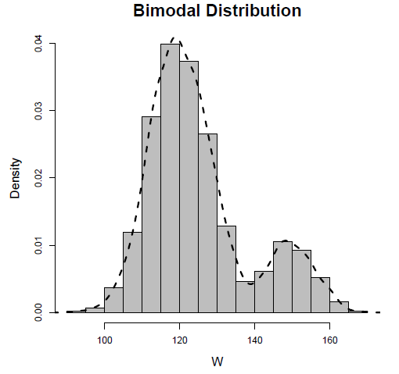
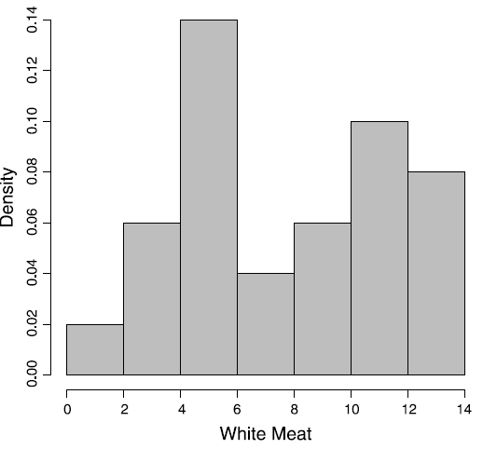
Histograms
Histogram of a bimodal distribution
A smooth curve is superimposed so that the two peaks are more evident
Histogram of protein consumption in 25 European countries for white meat in Protein data set.
The histogram is bimodal, which indicates that the sample might be comprised of two subgroups

Slide 61
Histograms
The histogram is important because it serves as
  a rough estimate of the true probability density function or
  probability distribution of the underlying random process from which the samples are being collected.
The probability density function or probability distribution is a function that quantifies the probability of a random event, x, occurring.
  When the underlying random event is discrete in nature, we refer to the probability density function as the probability mass function

Slide 62
Histograms
The probability density function for a discrete random variable (probability mass function).
In this case, the random variable is the value of a toss of a single dice.
  Note that each of the six possible outcomes has a probability of occurrence of 1 of 6.
This probability density function is also known as a uniform probability distribution.

Slide 63
Histograms
Histograms representing the outcomes of experiments in which a single dice is tossed 50 and 2000 times, respectively
  Note that as the sample size increases, the histogram approaches the true probability distribution (uniform probability distribution)

Slide 64
Histograms
Engineers are trying to make decisions about populations or processes to which they have limited access.
Thus, they design experiments and collect samples that they think will fairly represent the underlying population or process.
Regardless of what type of statistical analysis will result from the investigation or study, all statistical analysis should follow the same general approach:
  Measure a limited number of representative samples from a larger population.
  Estimate the true statistics of larger population from the sample statistics.

Slide 65
Histograms
Once the researcher has estimated the sample statistics from the sample population,
  he or she will try to draw conclusions about the larger (true) population.
The most important question to ask when reviewing the statistics and conclusions drawn from the sample population is
  how well the sample population represents the larger, underlying population.

Slide 66
Histograms
Checklist for evaluating a histogram:
  Examine the scale used for the vertical axis and beware of results that appear exaggerated or played down through the use of inappropriate scales.
  Check out the units on the vertical axis to see whether the histogram reports frequencies (numbers) or relative frequencies (percentages), and then take this into account when evaluating the information.
  Look at the scale used for the groupings of the numerical variable (on the horizontal axis).
    If the range for each group is very small, the data may look overly volatile.
    If the ranges are very large, the data may appear to be smoother than they really are.

Slide 67
Measures of Central Tendency
Histograms are useful for visualizing numerical data and identifying their location and spread.
However, we typically use descriptive or summary statistics for more precise specification of the
  central tendency
  dispersion
  of observed values.

Slide 68
Measures of Central Tendency
A central tendency is a central or typical value for a probability distribution.
  also called a center or location of the distribution.
Measures of central tendency are often called averages.
There are several measures that reflect the central tendency
  sample mean,
  sample median,
  sample mode.

Slide 69
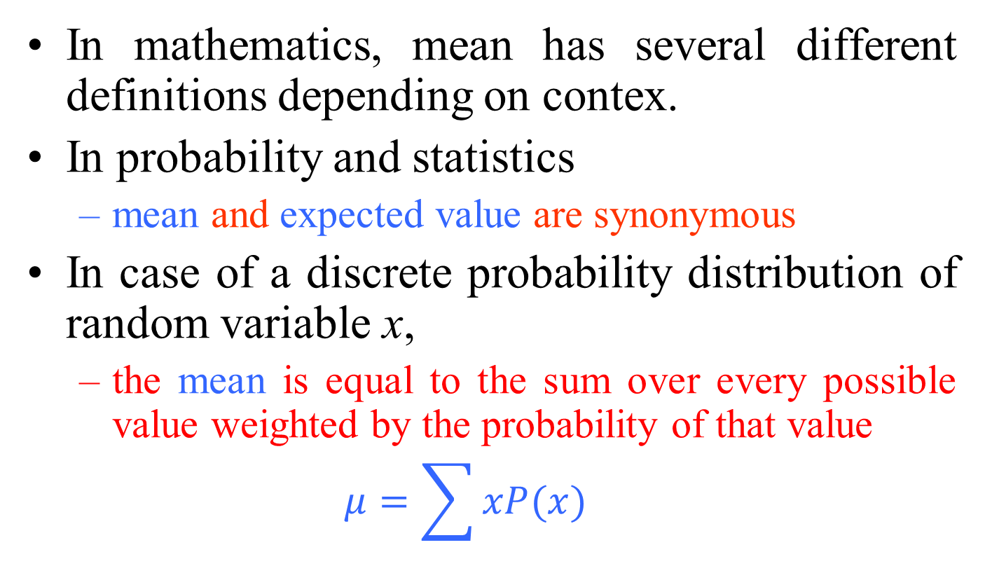
Mean
In mathematics, mean has several different definitions depending on contex.
In probability and statistics
  mean and expected value are synonymous
  In case of a discrete probability distribution of random variable x,
  the mean is equal to the sum over every possible value weighted by the probability of that value
  $$μ=\sum{xP(x)}$$

Slide 70
Mean
For a data set, the terms
  arithmetic mean,
  mathematical expectation,
  sometimes average
  are used synonymously to refer to a central value of a discrete set of numbers
  specifically, the sum of the values divided by the number of values.
If the data set were based on a series of observations obtained by sampling from a statistical population,
  the arithmetic mean is termed as the sample mean to distinguish it from the population mean

Slide 71
Mean
Outside of probability and statistics, a wide range of other notions of mean are often used in geometry and analysis:
  Pythagorean means
    Arithmetic mean, Geometric mean, Harmonic mean
  Generalized means
    Power mean,
      a.k.a generalized mean, Hölder mean, mean of degree (or order or power) p
    ƒ-mean
  Weighted arithmetic mean
  Truncated mean
  Interquartile mean
  Fréchet mean
  …

Slide 72
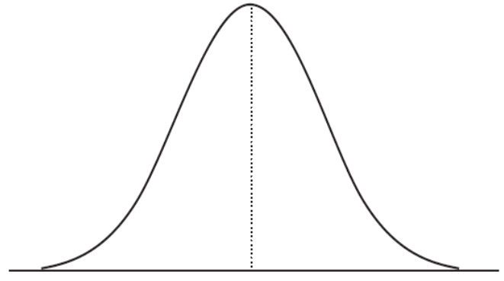

Mean
Arithmetic mean (or simply mean) of a sample $x_{1}$, $x_{2}$…, $x_{n}$, usually denoted by $\overline{x}$
$$\overline{x}=\frac{x_{1}+x_{2}+…{+x}_{n}}{n}$$
It is used when the spread of the data is fairly similar on each side of the mid point
  when the data are “normally distributed”.
    If a value is a lot smaller or larger than the others, “skewing” the data, the mean will then not give a good picture of the typical value.

Slide 73
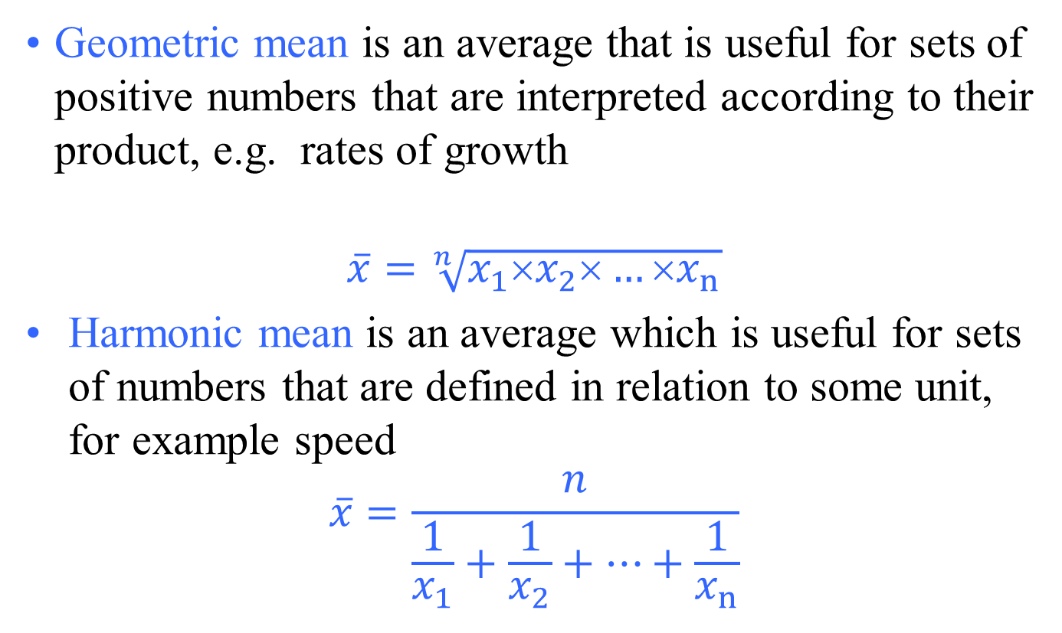
Mean
                Geometric mean is an average that is useful for sets of positive numbers that are interpreted according to their product, e.g. rates of growth
                $$\overline{x}=\sqrt[n]{x_{1}×x_{2}×…{×x}_{n}}$$
Harmonic mean is an average which is useful for sets of numbers that are defined in relation to some unit, for example speed
$$\overline{x}=\frac{n}{\frac{1}{x_{1}}+\frac{1}{x_{2}}+…+\frac{1}{x_{n}}}$$

Slide 74
Mean
The relationship between Arithmetic mean, Geometric mean, and Harmonic mean:
  Arithmetic mean × Harmonic mean = Geometric mean²
Arithmetic mean, Geometric mean, and Harmonic mean satisfy the following inequalities:
  Arithmetic mean ≥ Geometric mean ≥ Harmonic mean
    Equality holds if and only if all the elements of the given sample are equal
The arithmetic mean is best used in situations where:
  the data are not skewed (no extreme outliers)
  the individual data points are not dependent on each other
The geometric mean should be used whenever the data are inter-related
The harmonic mean is best to use when there is:
  A large population where the majority of the values are distributed uniformly but where there are a few outliers with significantly higher values

Slide 75
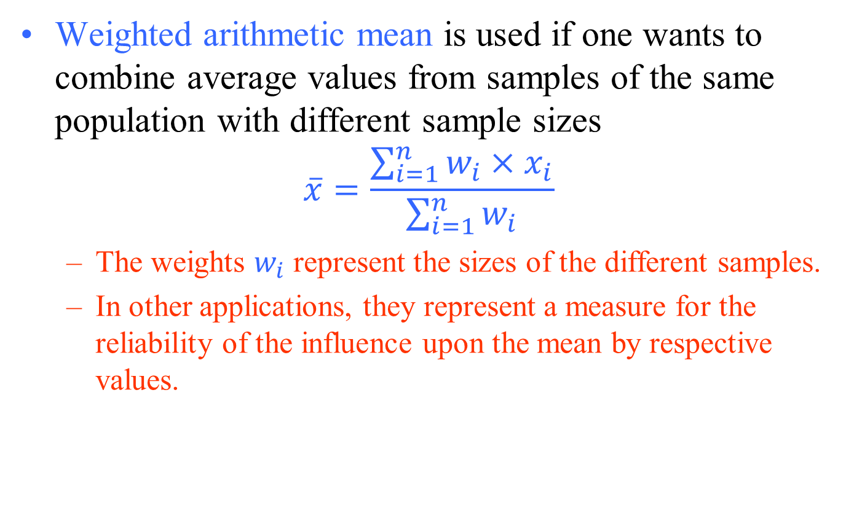
Mean
Weighted arithmetic mean is used if one wants to combine average values from samples of the same population with different sample sizes
$$\overline{x}=\frac{\sum_{i=1}^{n}{w_{i}}{×x}_{i}}{\sum_{i=1}^{n}{w_{i}}}$$
  The weights $w_{i}$ represent the sizes of the different samples.
  In other applications, they represent a measure for the reliability of the influence upon the mean by respective values.

Slide 76
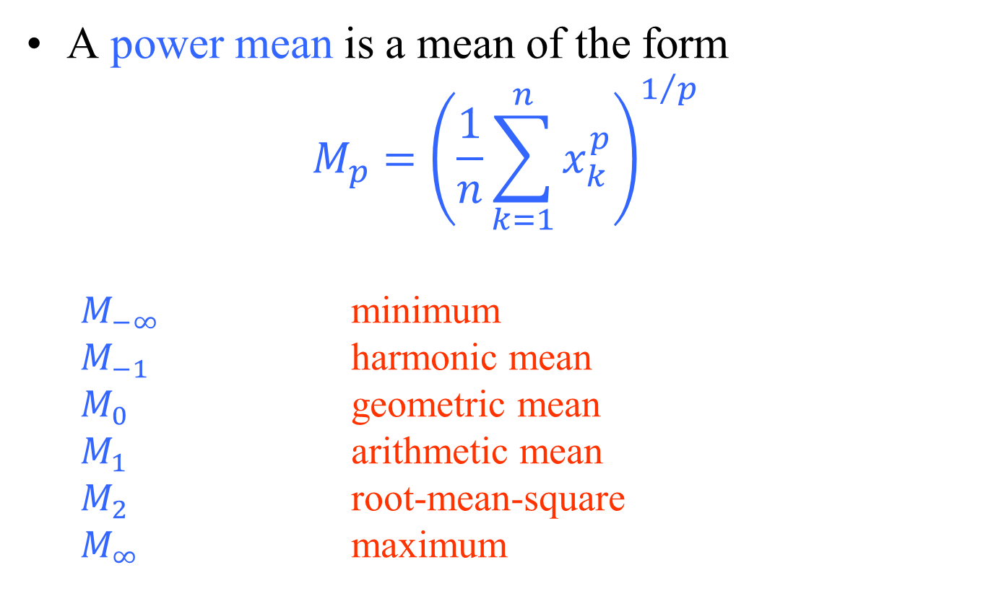
Mean
A power mean is a mean of the form
$$M_{p}={\left(\frac{1}{n}\sum_{k=1}^{n}{x_{k}^{p}}\right)}^{1/p}$$
  $M_{−∞}$ minimum
  $M_{−1}$ harmonic mean
  $M_{0}$ geometric mean
  $M_{1}$ arithmetic mean
  $M_{2}$ root-mean-square
  $M_{∞}$ maximum

Slide 77
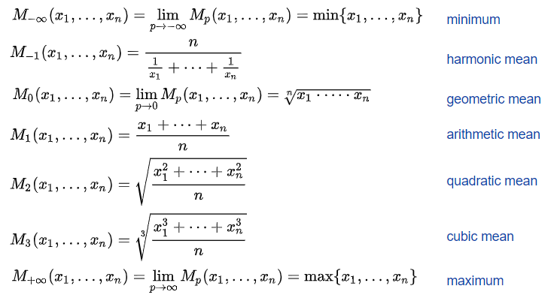
Mean

Slide 78
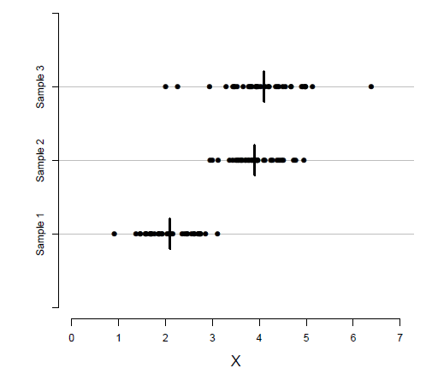
Sample Mean
Plotting the three samples along with their means (short vertical lines)
For Sample 1, Sample 2, and Sample 3, the means are 2.1, 3.9, and 4.1, respectively.

Slide 79

Sample Mean
Sample mean is sensitive to very large or very small values, which might be outliers (unusual values).
For instance, suppose that we have measured the resting heart rate (in beats per minute) for five people.
In this case, the sample mean is 79.8, which seems to be a good representative of the data.
Now suppose that the heart rate for the first individual is recorded as 47 instead of 74.
Now, the sample mean does not capture the central tendency.

Slide 80
Median
Sometimes known as the mid-point.
  It is used to represent the average when the data are not symmetrical (skewed distribution)
    The median value of a group of observations or samples, x_{i}, is the middle observation when samples, x_{i}, are listed in descending order.
Note that if the number of samples, n, is odd, the median will be the middle observation.
If the sample size, n, is even, then the median equals the average of two middle observations.
Compared with the sample mean, the sample median is less susceptible to outliers.

Slide 81

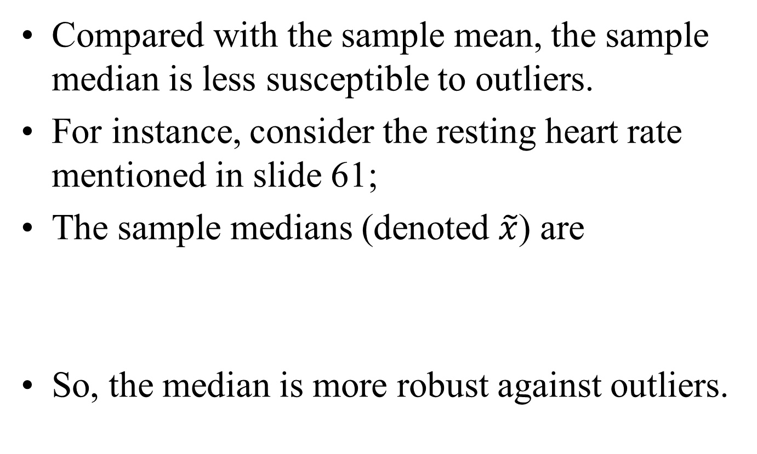
Median
Compared with the sample mean, the sample median is less susceptible to outliers.
For instance, consider the resting heart rate mentioned in slide 61;
The sample medians (denoted $\tilde{x}$) are
So, the median is more robust against outliers.

Slide 82
Median
The median may be given with its inter-quartile range (IQR).
The 1st quartile point has the 1⁄4 of the data below it
The 3rd quartile point has the 3⁄4 of the sample below it
The IQR contains the middle 1⁄2 of the sample
This can be shown in a “box and whisker” plot.

Slide 83
Median (example)
A dietician measured the energy intake over 24 hours of 50 patients on a variety of wards. One ward had two patients that were “nil by mouth”. The median was 12.2 megajoules, IQR 9.9 to 13.6. The lowest intake was 0, the highest was 16.7.
This distribution is represented by the box and whisker plot below.
Box and whisker plot of energy intake of 50 patients over 24 hours.
The ends of the whiskers represent the maximum and minimum values, excluding extreme results like those of the two “nil by mouth” patients.

Slide 84
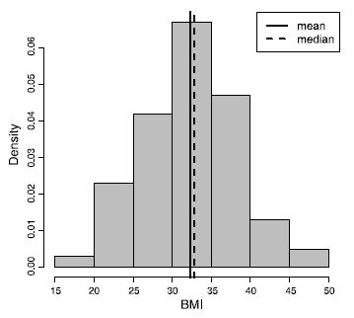
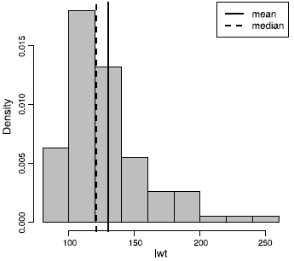
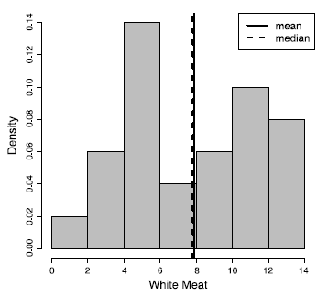
Sample Mean and Median
Histogram of bmi.
in the Pima.tr data set.
Histogram of lwt.
in the birthwt data set.
Histogram of WhiteMeat
in the Protein data set.
The mean and median are nearly equal since the histogram is Symmetric.
The mean is shifted to the right of the median. Because the histogram is skewed to the right.
Neither mean nor median is a good measurement for central tendency since the histogram is bimodal.

Slide 85
Mode
the most common of a set of events
  used when we need a label for the most frequently occurring event
    Example: An eye clinic sister noted the eye colour of 100 consecutive patients. The results are shown below
Graph of eye colour of patients attending an eye clinic.
In this case the mode is brown, the commonest eye colour.

Slide 86
Mode
You may see reference to a bi-modal distribution.
  Generally when this is mentioned in papers it is as a concept rather than from calculating the actual values,
    e.g. “The data appear to follow a bi-modal distribution”.
Graph of ages of patients with asthma in a practice
  The arrows point to the modes at ages 10–19 and 60–69.
Bi-modal data may suggest that two populations are present that are mixed together,
  so an average is not a suitable measure for the distribution.

Slide 87
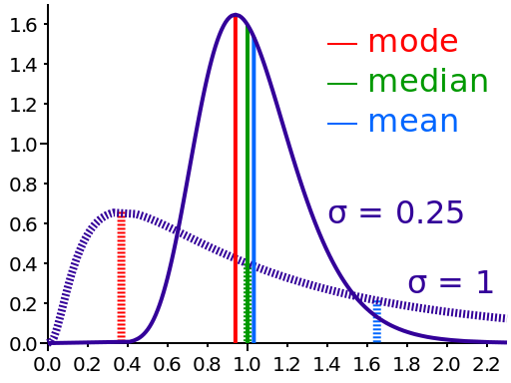
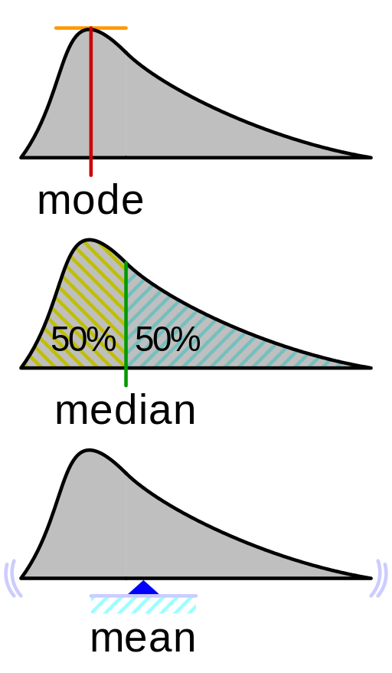
Mean, Median, Mode
Comparison of the arithmetic mean, median and mode of two skewed (log-normal) distributions.
Geometric visualisation of the mode, median and mean of an arbitrary probability density function.

Slide 88
An applicaton of mean: moving AVERAGE filter
Highlights trends in a signal (smoothing)
k: pozitif integer, w_{j}: weights, Σ w_{j} =1
Algorithm for the 1st order MA filter
for n=1:N
y(n)=0.5*(x(n)+x(n+1));
end
Example (2 point moving AVERAGE filter)
x=(x₁, x₂ , x₃ , x₄ , x₅ , x₆ , x₇ , x₈ , …)
y=([x₁+x₂]/2, [x₂+x₃]/2, [x₃+x₄ ]/2, …)

Slide 89
Complementary procedure: moving DIFFERENCE filter
Removes trends from a signal (sharpening)
1st order differencing
  Dy_{t} = y_{t} - y_{t-1}
Higher order differences (2nd order)
  D²y_{t} = D(Dy_{t}) = Dy_{t} - Dy_{t-1}= y_{t} - 2y_{t-1} + y_{t-2}
Example (1st order moving DIFFERENCE filter)
x=(x₁, x₂ , x₃ , x₄ , x₅ , x₆ , x₇ , x₈ , …)
y=([x₂-x₁], [x₃-x₂], [x₄-x₃ ], …)

Slide 90
Moving median filtering
Useful in impulsive noise removal (image processing, sliding median filtering)
Example:
  3 point moving median filtering
x=(x₁, x₂ , x₃ , x₄ , x₅ , x₆ , x₇ , x₈ , …)
y=(med[x₁,x₂,x₃], med[x₂,x₃,x₄], med[x₃,x₄,x₅], …)
  If a window with even number of samples are selected median is average of two mid-point samples

Slide 91
Measures of Variability
When summarizing the variability of a population or process, we typically ask,
  “How far from the center (sample mean) do the samples (data) lie?”
To answer this question, we typically use the following estimates that represent the spread of the sample data:
  sample variance,
  sample standard deviation.
  interquartile ranges,

Slide 92
Variance and standard deviation
Consider Sample 2 and Sample 3.
The two samples have similar locations, but Sample 3 is more dispersed than Sample 2.
The deviations (differences) of observations from the center (e.g., mean) tend to be larger in Sample 3 compared to Sample 2.

Slide 93
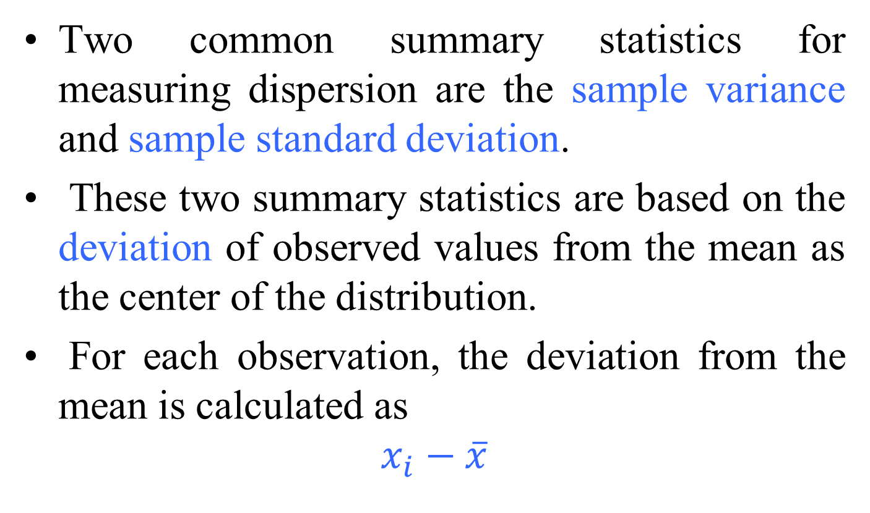
Variance and standard deviation
Two common summary statistics for measuring dispersion are the sample variance and sample standard deviation.
These two summary statistics are based on the deviation of observed values from the mean as the center of the distribution.
For each observation, the deviation from the mean is calculated as
$$x_{i}−\overline{x}$$

Slide 94


Variance and standard deviation
The sample variance is a common measure of dispersion based on the squared deviations.
The square root of the variance is called the sample standard deviation.

Slide 95
Measures of Variability
Standard deviation (SD) is used for data which are “normally distributed”,
  to provide information on how much the data vary around their mean.
  SD indicates how much a set of values is spread around the average.
    A range of one SD above and below the mean (abbreviated to ± 1 SD) includes 68.2% of the values.
    ± 2 SD includes 95.4% of the data.
    ± 3 SD includes 99.7%.

Slide 96
Measures of Variability
Example 1:
Let us say that a group of patients enrolling for a trial had a normal distribution for weight. The mean weight of the patients was 80 kg. For this group, the SD was calculated to be 5 kg.
normal distribution of weights of patients enrolling in a trial with mean 80 kg, SD 5 kg.
1 SD below the average is 80 – 5 = 75 kg.
1 SD above the average is 80 + 5 = 85 kg.
± 1 SD will include 68.2% of the subjects, so 68.2% of patients will weigh between 75 and 85 kg.
95.4% will weigh between 70 and 90 kg (± 2 SD).
99.7% of patients will weigh between 65 and 95 kg (± 3 SD)

Slide 97
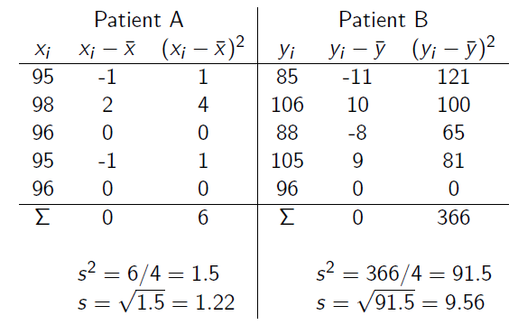
Variance and standard deviation
Example 2

Slide 98
Variance and standard deviation
some properties that can help you when interpreting a standard deviation:
  The standard deviation can never be a negative number.
  The smallest possible value for the standard deviation is 0
    (when every number in the data set is exactly the same).
  Standard deviation is affected by outliers, as it’s based on distance from the mean, which is affected by outliers.
  The standard deviation has the same units as the original data, while variance is in square units.

Slide 99
Measures of Variability
It is important to note that for normal distributions (symmetrical histograms),
  sample mean and sample deviation are the only parameters needed to describe the statistics of the underlying phenomenon.
Thus, if one were to compare two or more normally distributed populations,
  one only needs to test the equivalence of the means and variances of those populations.

Slide 100
Quantile
comes from the word quantity
A quantile is where a sample is divided into equal-sized, adjacent, subgroups
  (quantile is also called a fractile)
It can also refer to dividing a probability distribution into areas of equal probability
Quartiles are also quantiles;
  they divide the distribution into four equal parts.
Percentiles are quantiles;
  they divide a distribution into 100 equal parts
Deciles are quantiles;
  they divide a distribution into 10 equal parts.

Slide 101
Percentiles
the most common way to report relative standing of a number within a data set
A percentile is the percentage of individuals in the data set who are below where your particular number is located.
  For example,
  if your exam score is at the 90th percentile, that means
    90% of the people taking the exam with you scored lower than you did
    10 percent scored higher than you did

Slide 102
Percentiles
Steps to calculate the k^{th} percentile (where k is any number between 1 and one 100):
  1. Order all the numbers in the data set from smallest to largest.
  2. Multiply k percent times the total number of numbers, n.
  3a.If your result from Step 2 is a whole number, go to Step 4.
  If the result from Step 2 is not a whole number, round it up to the nearest whole number and go to Step 3b.

Slide 103
Percentiles
  3b.Count the numbers in your data set from left to right (from the smallest to the largest number) until you reach the value from Step 3a.
  This corresponding number in your data set is the k^{th} percentile.
  4. Count the numbers in your data set from left to right until you reach that whole number.
  The k^{th} percentile is the average of that corresponding number in your data set and the next number in your data set.

Slide 104
Percentiles - example
Suppose 25 test scores, in order from lowest to highest:
  43, 54, 56, 61, 62, 66, 68, 69, 69, 70, 71, 72, 77, 78, 79, 85, 87, 88, 89, 93, 95, 96, 98, 99, 99.
To find the 90th percentile for these scores
  multiply 90% by the total number of scores,
    90% × 25 = 0.90 × 25 = 22.5 (step 2).
    This is not a whole number;
  Step 3a says round up to the nearest whole number, 23, then go to step 3b

Slide 105
Percentiles - example
  Counting from left to right
    you go until you find the 23rd number in the data set.
  That number is 98,
    which is the 90th percentile for this data set.
To find the 20th percentile,
  take 0.20 ∗ 25 = 5;
    this is a whole number so proceed to Step 4, which tells us the 20th percentile is the average of the 5th and 6th numbers in the ordered data set (62 and 66).
  20th percentile then becomes (66 + 62) / 2 = 64
The median is the 50th percentile,
  the point in the data where 50% of the data fall below that point and 50% fall above it.
    The median for the test scores example is the 13th number, 77.

Slide 106
Percentiles
A percentile is not a percent;
  a percentile is a number that is a certain percentage of the way through the data set,
    when the data set is ordered.
Suppose your score on the GRE was reported to be the 80th percentile.
  This does not mean you scored 80% of the questions correctly.
  It means that 80% of the students’ scores were lower than yours, and 20% of the students’ scores were higher than yours.

Slide 107
Quartile
For sampled data, the median is also known as
  the 2nd quartile, Q2.
Given Q2, we can find the 1st quartile, Q1,
  by simply taking the median value of those samples that lie below the 2nd quartile.
We can find the 3d quartile, Q3,
  by taking the median value of those samples that lie above the 2nd quartile.
Quartiles can also be found in terms of percentiles:
  1st quartile is 25th percentile
  2nd quartile is 50th percentile
  3rd quartile is 75th percentile

Slide 108
Quartile
Considering the following (25) test scores
  43, 54, 56, 61, 62, 66, 68, 69, 69, 70, 71, 72, 77, 78, 79, 85, 87, 88, 89, 93, 95, 96, 98, 99, 99
Q1 (25th percentile)
  0.25 * 25 = 6.25 ➔ (round up) ➔ 7 Q1 = 68
Q2 (50th percentile)
  0.50 * 25 = 12.5 ➔ (round up) ➔ 13 Q2 = 77
Q1 (75th percentile)
  0.75 * 25 = 18.75 ➔ (round up) ➔ 19 Q3 = 89

Slide 109
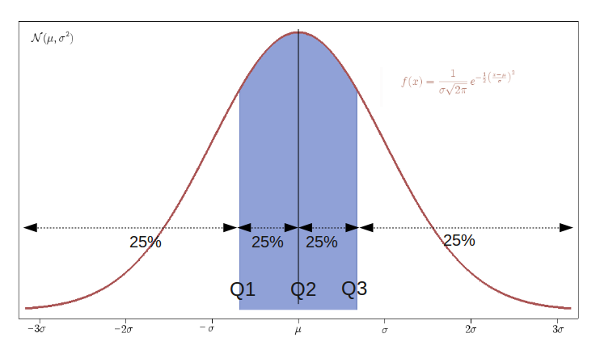
Measures of Variability

Slide 110
Five-number summary
The minimum (min), which is the smallest value of the variable in our sample, is in fact the 0 quantile.
On the other hand, the maximum (max), which is the largest value of the variable in our sample, is the 1 quantile.
The minimum and maximum along with quartiles (Q1, Q2, and Q3) are known as five-number summary.
These are usually presented in the increasing order:
  min, 1st quartile, median, 3rd quartile, max
  min, 25th percentile, median, 75th percentile, max
This way, the five-number summary provides
  0, 0.25, 0.50, 0.75, and 1 quantiles

Slide 111
Five-number summary
The five-number summary can be used to derive two measures of dispersion:
  the range
    the difference between the maximum observed value and the minimum observed value.
  the interquartile range (IQR)
    the difference between the third quartile (Q3) and the first quartile (Q1).
    IQR = Q3 - Q1

Slide 112
Measures of Variability – example 1
As an illustration, we have the following samples:
  99, 99, 56, 61, 62, 66, 68, 98, 69, 70, 71, 72, 77, 78, 79, 85, 87, 88, 89, 93, 95, 96, 69, 54, 43
list these samples in ascending order,
  43, 54, 56, 61, 62, 66, 68, 69, 69, 70, 71, 72, 77, 78, 79, 85, 87, 88, 89, 93, 95, 96, 98, 99, 99
  the median value (Q2) for these samples is 77 (13th sample).
The 1st quartile, Q1, can be found by taking the median of the following samples,
  43, 54, 56, 61, 62, 66, 68, 69, 69, 70, 71, 72, 77
  which is 68
The 3rd quartile, Q3, may be found by taking the median value of the following samples:
  77, 78, 79, 85, 87, 88, 89, 93, 95, 96, 98, 99, 99
  which is 89.
Thus, the interquartile range, (Q1 = 68; Q2 = 77; Q3 = 89)
Q3 − Q1 = 89 − 68 = 21

Slide 113
Measures of Variability – example 1
Using percentiles;
  list the samples in ascending order,
  43, 54, 56, 61, 62, 66, 68, 69, 69, 70, 71, 72, 77, 78, 79, 85, 87, 88, 89, 93, 95, 96, 98, 99, 99
Q1 (25th percentile)
  0.25 * 25 = 6.25 ➔ (round up) ➔ 7 Q1 = 68
Q2 (50th percentile)
  0.50 * 25 = 12.5 ➔ (round up) ➔ 13 Q2 = 77
Q1 (75th percentile)
  0.75 * 25 = 18.75 ➔ (round up) ➔ 19 Q3 = 89
In this case, the interquartile range, (Q1 = 68; Q2 = 77; Q3 = 89)
Q3 − Q1 = 89 − 68 = 21

Slide 114
Measures of Variability – example 1
Alternative calculation;
  Use the following formula to estimate the ith observation:
  i^{th} observation = q (n + 1)
  where q is the quantile, n is the number of items in a data set
list the samples in ascending order;
  43, 54, 56, 61, 62, 66, 68, 69, 69, 70, 71, 72, 77, 78, 79, 85, 87, 88, 89, 93, 95, 96, 98, 99, 9
Q1 (25th percentile)
  0.25 * (25 +1) = 6. 5 ➔ (round down) ➔ 6 Q1 = 66
Q2 (50th percentile)
  0.50 * (25 +1) = 13 ➔ 13 Q2 = 77
Q1 (75th percentile)
  0.75 * (25 +1) = 19.5 ➔ (round down) ➔ 19 Q3 = 89
In this case, the interquartile range, (Q1 = 66; Q2 = 77; Q3 = 89)
Q3 − Q1 = 89 − 66 = 23

Slide 115
Measures of Variability – example 2
As an illustration, we have the following samples:
  1, 3, 3, 2, 5, 1, 1, 4, 3, 2.
list these samples in descending order,
  5, 4, 3, 3, 3, 2, 2, 1, 1, 1
  the median value (Q2) for these samples is 2.5
The 1st quartile, Q1, can be found by taking the median of the following samples,
  2.5, 2, 2, 1, 1, 1
  which is 1.5
The 3rd quartile, Q3, may be found by taking the median value of the following samples:
  5, 4, 3, 3, 3, 2.5
  which is 3.
Thus, the interquartile range, (Q1 = 1.5; Q2 = 2.5; Q3 = 3)
Q3 − Q1 = 3 − 1.5 = 1.5

Slide 116
Measures of Variability – example 2
Using percentiles;
  list the samples in ascending order,
  1, 1, 1, 2, 2, 3, 3, 3, 4, 5
Q1 (25th percentile)
  0.25 *10 = 2.5 ➔ (round up) ➔ 3 Q1 = 1
Q2 (50th percentile)
  0.50 *10 = 5 ➔ 5 Q2 = (2+3)/2 = 2.5
Q1 (75th percentile)
  0.75 *10 = 7.5 ➔ (round up) ➔ 8 Q3 = 3
In this case, the interquartile range, (Q1 = 1; Q2 = 2.5; Q3 = 3)
Q3 − Q1 = 3 − 1 = 2

Slide 117
Measures of Variability – example 2
Alternative calculation;
  Use the following formula to estimate the i^{th} observation:
  i^{th} observation = q (n + 1)
  where q is the quantile, n is the number of items in a data set
list the samples in ascending order; 1, 1, 1, 2, 2, 3, 3, 3, 4, 5
Q1 (25th percentile)
  0.25 * (10 +1) = 2.75 ➔ (round down) ➔ 2 Q1 = 1
Q2 (50th percentile)
  0.50 * (10 +1) = 5.5 ➔ (round down) ➔ 5 Q2 = 2
Q1 (75th percentile)
  0.75 * (10 +1) = 8.25 ➔ (round down) ➔ 8 Q3 = 3
In this case, the interquartile range, (Q1 = 1; Q2 = 2; Q3 = 3)
Q3 − Q1 = 3 − 1 = 2

Slide 118
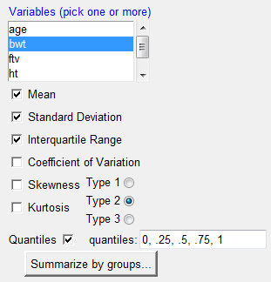

Five-number summary
We can use R-Commander to obtain the five-number summary along with mean and standard deviation.
Make sure birthwt is the active data set.
  Click Statistics → Summaries → Numerical summaries.
  Now select bwt.
    Make sure Mean, Standard Deviation, Interquantile and Quantiles are checked.
  The resulting summary statistics are:

Slide 119
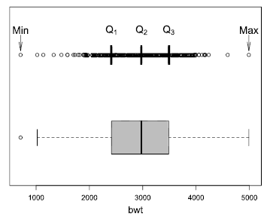
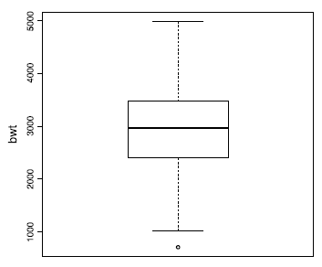
Boxplot
To visualize the five-number summary, the range and the IQR,
  we often use a boxplot
    a.k.a. box and whisker plot
Very often, boxplots are drawn vertically.
To create a boxplot for bwt in R-Commander,
  make sure birthwt is the active dataset,
  click Graphs → Boxplot, and select bwt.

Slide 120
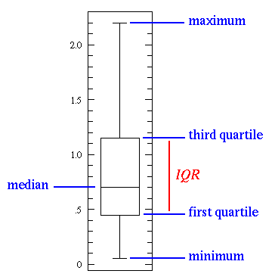
Boxplot
This simplest possible box plot displays the full range of variation (from min to max), the likely range of variation (the IQR), and a typical value (the median).
Not uncommonly real datasets will display surprisingly high maximums or surprisingly low minimums called outliers.
John Tukey has provided a precise definition for two types of outliers:
  Outliers are either 3×IQR or more above the third quartile or 3×IQR or more below the first quartile.
  Suspected outliers are slightly more central versions of outliers:
    either 1.5×IQR or more above the third quartile
      (Q3 + 1.5 x IQR)
    or 1.5×IQR or more below the first quartile
      (Q1-1.5 x IQR)

Slide 121
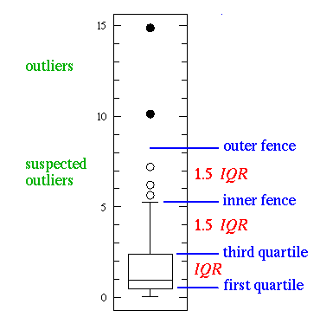
Boxplot
If either type of outlier is present
  the whisker on the appropriate side is taken to 1.5×IQR from the quartile (the "inner fence") rather than the max or min,
individual outlying data points are displayed as
  unfilled circles for suspected outliers
  or filled circles for outliers.
The "outer fence" is 3×IQR from the quartile.

Slide 122
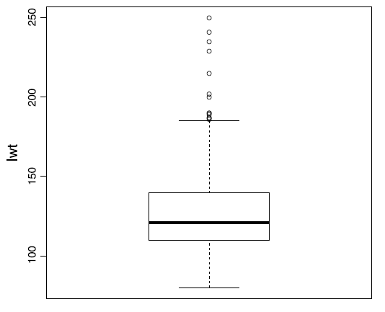
Boxplot
Vertical boxplot of lwt.
This plot reveals that the variable lwt is right-skewed and there are several possible outliers,
  whose values are beyond the whisker on the top of the box

Slide 123
Data Preprocessing
We refer to data in their original form (i.e., collected by researchers) as the raw data.
Before using the original data for analysis, we should thoroughly check them for missing values and possible outliers.
We refer to the process of preparing the raw data for analysis as data preprocessing.
The data set we have been using so far (Pima.tr) was obtained after removing these observations from Pima.tr2.

Slide 124
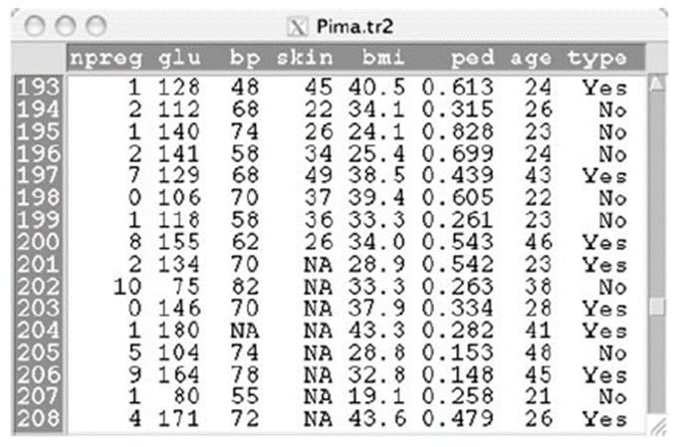
Missing Data
Here, missing values are denoted NA (Not Available)
In general, it is up to the researcher to decide whether to remove the observations with missing values or impute (guess) the missing values in order to keep the observations.
To remove all observations with missing values
  click Data → Active data set → Remove cases with missing data.
To remove individual observations,
  click Data→Active data set → Remove row(s) from active data and enter the row numbers for observations you want to remove.

Slide 125
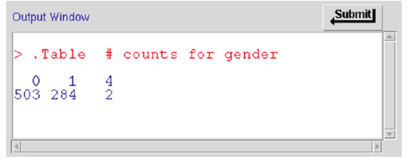
Outliers
Sometimes, an observed value of a variable is suspicious since it does not follow the overall patterns presented by the rest of the data.
  We refer to such observations as outliers.
For analyzing such data, we could use statistical methods that are more robust against outliers (e.g., median, IQR).
Frequency table for gender from the AsthmaLOS data set.
The value of gender for two observations are entered as “4”, while gender can only take 0 or 1

Slide 126
Data Set AsthmaLOS
los: length of stay in hospital (in days).
hospital.id: hospital ID.
insurer: the insurer, which is either 0 or 1.
age: the age of the patient.
gender: the gender of the patient; 1 for female, and 0 for male.
race: the race of the patient; 1 for white, 2 for Hispanic, 3 for African-American, 4 for Asian/Pacific Islander, 5 for others.
bed.size: the number of beds in the hospital; 1 means 1 to 99, 2 means 100 to 249, 3 means 250 to 400, 4 means 401 to 650.
owner.type: the hospital owner; 1 for public, 2 for private.
complication: if there were any treatment complication; 0 means there were no complications, 1 means there were some complications.

Slide 127
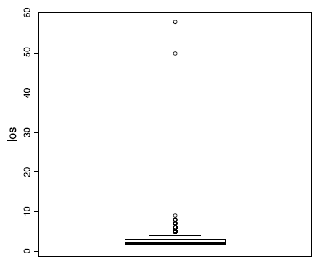
The boxplot of los with two extremely large values

Slide 128
Data Transformation
We rely on data transformation techniques (i.e., applying a function to the variable)
  to reduce the influence of extreme values in our analysis.
Two of the most commonly used transformation functions for this purpose are
  logarithm
  square root.
To use log-transformation,
  click Data→ Manage variables in active data set → Compute new variable.
  Under New variable name, enter log.lwt, and under Expression to compute, enter log(lwt)

Slide 129
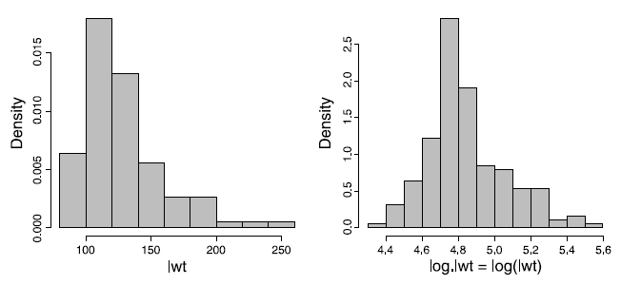
Data Transformation
Left panel: Histogram of variable lwt in the birthwt data set.
Right panel: Histogram of log-transformation of variable lwt

Slide 130
Data Transformation
The reasons for data transformation:
  to make the distribution of the data normal,
    this fulfills one of the assumptions of conducting a parametric means comparison.
  to create more informative graphs of the data,
  better outlier identification (or getting outliers in line)
  increasing the sensitivity of statistical tests

Slide 131
Data Transformation
A data transformation is defined to be a process in which the measurements on the original scale are systematically converted to a new scale of measurement.
Transformations involve applying a mathematical function to each data point.
A transformation is needed when the data is excessively skewed positively or negatively.

Slide 132
Some data transformations

Slide 133
Data Transformation
The figure below suggests the type of transformation that can be applied depending upon the degree of skewness.
Positively skewed data
Negatively skewed data

Slide 134
Data Transformation
Logarithms:
  Growth rates are often exponential and log transforms will often normalize them.
  Log transforms are particularly appropriate if the variance increases with the mean.
Reciprocal:
  If a log transform does not normalize your data you could try a reciprocal (1/x) transformation.
    This is often used for enzyme reaction rate data.

Slide 135
Data Transformation
Square root:
  used when the data are counts, e.g. blood cells on a haemocytometer or woodlice in a garden.
    Carrying out a square root transform will convert data with a Poisson distribution to a normal distribution.
Arcsine:
  a.k.a. the angular transformation
  especially useful for percentages and proportions which are not normally distributed.

Slide 136
Data Transformation
Tabachnick and Fidell (2007) and Howell (2007) suggest to use the following guidelines when transforming data:
If your data distribution is… Try this transformation method
Moderately positive skewness Square-Root
NEWX = SQRT(X)
Substantially positive skewness Logarithmic (Log 10)
NEWX = LG10(X)
Substantially positive skewness Logarithmic (Log 10)
(with zero values) NEWX = LG10(X + C)
Moderately negative skewness Square-Root
NEWX = SQRT(K – X)
Substantially negative skewness Logarithmic (Log 10)
NEWX = LG10(K – X)
    C = a constant added to each score so that the smallest score is 1.
    K = a constant from which each score is subtracted
Howell, D. C. (2007). Statistical methods for psychology (6th ed.). Belmont, CA: Thomson Wadsworth.
Tabachnick, B. G., & Fidell, L. S. (2007). Using multivariate statistics (5th ed.). Boston: Allyn and Bacon

Slide 137
Creating New Variable
We can create a new variable based on two or more existing variables.
Consider the bodyfat data set, which includes weight and height.
To create BMI,
  click Data → Manage variables in active data set → Compute new variable.
  Under New variable name, enter BMI, and under Expression to compute, enter
    (weight * 703)/(height^2)

Slide 138
Creating a new variable BMI based on weight and height for each person in the bodyfat data set

Slide 139
Creating New Variable
This will create a new variable called BMI.
We can now investigate the linear relationship between this variable and percent body fat by calculating their sample correlation coefficient.
Pearson’s correlation coefficient between siri and BMI is 0.72,
  which indicates a strong positive linear relationship as expected.

Slide 140
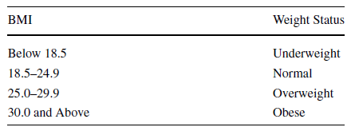
Creating Catagories for Numerical Variables
This could help us to see the patterns more clearly and identify relationships more easily.
Histograms are created by dividing the range of a numerical variable into intervals.
Instead of using arbitrary intervals, we might prefer to group the values in a meaningful way.
Standard weight status based on BMI according to CDC (Centers for Disease Control and Prevention)

Slide 141
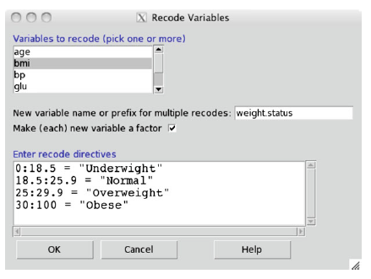
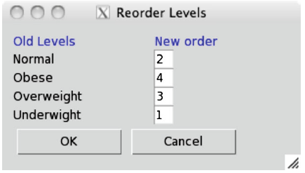
Creating Catagories for Numerical Variables
In R-Commander, let us divide subjects based on their bmi (from the Pima.tr) into four groups:
  Underweight, Normal, Overweight, and Obese.
  Click Data → Manage variables in active data set → Recode variables.
To specify the order of categories in R-Commander,
  click Data → Manage variables in active data set → Reorder factor levels. Then select weight.status.

Slide 142
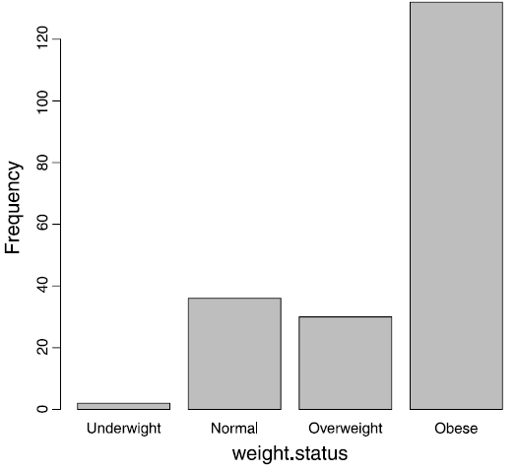
Creating Catagories for Numerical Variables
The bar graph for bmi after converting the numerical variable to a categorical variable

Slide 143
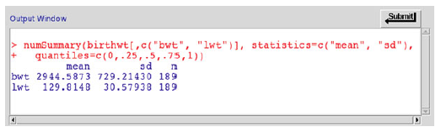
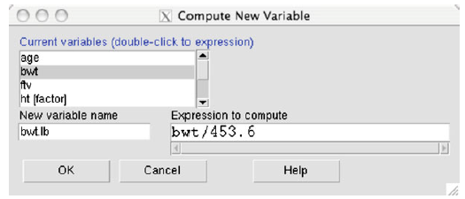

Creating Catagories for Numerical Variables
Summary statistics for bwt and lwt from the birthwt data set
Creating a new variable bwt.lb (birth weight in pounds) and obtaining its summary statistics
Creating a new variable bwt.lb (birth weight in pounds) and obtaining its summary statistics

Slide 144

Coefficient of Variation
In general, the coefficient of variation is used to compare variables in terms of their dispersion when the means are substantially different
  possibly as the result of having different measurement units.
To quantify dispersion independently from units, we use the coefficient of variation,
  which is the standard deviation divided by the sample mean
    assuming that the mean is a positive number:
$$CV=\frac{s}{\overline{x}}$$

Slide 145
Coefficient of Variation
The coefficient of variation
  for bwt (birth weight in grams) is
    729.2/ 2944.6 = 0.25
  for bwt.lb (birth weight in pounds) is
    1.6/6.5 = 0.25.
  for lwt (weight in pounds) is
    30.6/129.8 = 0.24
Comparing this coefficient of variation suggests that the two variables have roughly the same dispersion in terms of CV.

Slide 146


Scaling and Shifting Variables
In general, when we multiply the observed values of a variable by a constant a, its mean, standard deviation, and variance are multiplied by a, |a|, and a², respectively.
  That is, if y = ax, then
    $\overline{y}$=a$\overline{x}$, $s_{y}$=$\left|a\right|s_{x},$ $s_{y}^{2}$=$a^{2}s_{x}^{2}$
The coefficient of variation is not affected.

Slide 147


Scaling and Shifting Variables
If we shift the observed values by b, i.e., y = x + b, then
  $\overline{y}$=$\overline{x}+b$, $s_{y}$=$s_{x},$ $s_{y}^{2}$=$s_{x}^{2}$
If we multiply the observed values by the constant a and then add the constant b to the result, i.e., y = ax +b, then
  $\overline{y}$=$a\overline{x}+b$, $s_{y}$=$\left|a\right|s_{x},$ $s_{y}^{2}$=${a^{2}s}_{x}^{2}$
the coefficient of variation will change. If y = ax +b (assuming a >0 and b = 0), then

Slide 148


Variable Standardization
Variable standardization is a common linear transformation,
  where we subtract the sample mean $\overline{x}$ from the observed values and divide the result by the sample standard deviation s,
    in order to shift the mean to zero and make the standard deviation 1:
Using such transformation is especially common in regression analysis and clustering.
Subtracting $\overline{x}$ from the observations shifts the sample mean to zero.
  This, however, does not change the standard deviation.
Dividing by s, on the other hand, changes the sample standard deviation to 1

Slide 149
Data Exploration with R Programming
Load Pima.tr data set, which is available from MASS package
  > library(MASS)
  > data(Pima.tr)
  > data("Pima.tr") is also valid
The head() function shows only the first part of the data set.
  > head(Pima.tr)
Use the help() function to view description on the data available in the package
  > help(Pima.tr)
Use table() function to obtain the frequencies for the catagorical variable
  > type.freq <- table(Pima.tr$type)
  > type.freq
    No Yes
    68
  Note that the $ symbol is being used to access the type variable in the Pima.tr data set.

Slide 150
Data Exploration with R Programming
Now, use the type.freq table to create the bar graph.
  > barplot(type.freq, xlab = "Type", ylab = "Frequency", main = "Frequency Bar Graph of Type")
The first parameter to the barplot() function is the frequency table. The options xlab and ylab label the x and n axes, respectively. Likewise, the main option puts a title on the plot.
The relative frequency can be calculated as
> n <- sum(type.freq)
> type.rel.freq <- type.freq/n
> round(type.rel.freq, 2)
> round(type.rel.freq, 2) * 100

Slide 151
Data Exploration with R Programming
If the levels of a categorical variable in the data set is coded as numbers, we need to convert the type of variable to factor using the factor() function, so that R recognizes it as categorical.
You can use the function is.factor() to examine whether a variable is a factor.
  > data(birthwt)
  > is.factor(birthwt$smoke)
  [1] FALSE
  > birthwt$smoke <- factor(birthwt$smoke)
  > is.factor(birthwt$smoke)
  [1] TRUE
  > table(birthwt$smoke)
  0 1
  115 74

Slide 152
Data Exploration with R Programming
To create a frequency histogram for age, use the hist() function with the freq option set to “TRUE” (which is the default):
  > hist(Pima.tr$age, freq = TRUE, xlab = "Age", ylab = "Frequency", col = "grey", main = "Frequency Histogram of Age")
Then create a density histogram of age by setting the freq option to “FALSE”:
  > hist(Pima.tr$age, freq = FALSE,xlab = "Age", ylab = "Density", col = "grey", main = "Density Histogram of Age")

Slide 153
Data Exploration with R Programming
We can obtain the mean and median of numerical data with the mean() and median() functions.
Find these statistics for numerical variables in Pima.tr:
  > mean(Pima.tr$npreg)
  [1] 3.57
  > median(Pima.tr$bmi)
  [1] 32.8
The quantile() function with the probs option returns the specified quantiles:
  > quantile(Pima.tr$bmi, probs = c(0.1, 0.25, 0.5, 0.9))
  10% 25% 50% 90%
  24.200 27.575 32.800 39.400
The five-number summary along with the mean can simply be obtained with the summary() function:
  > summary(Pima.tr$bmi)
  Min. 1st Qu. Median Mean 3rd Qu. Max.
  18.20 27.58 32.80 32.31 36.50 47.90

Slide 154
Data Exploration with R Programming
We can present the five-number summary visually with a boxplot:
  > boxplot(Pima.tr$bmi, ylab = "BMI")
While the default is to create vertical boxplots, we can also create horizontal boxplots by specifying the horizontal option to true:
  > boxplot(Pima.tr$bmi, ylab = "BMI", horizontal = TRUE)
Find the interquartile range (IQR) with the IQR() function:
  > IQR(Pima.tr$bmi)
  [1] 8.925
The smallest and largest observations can be obtained with the range() function
    the functions min() and max() could also be applied):
  > minMax <- range(Pima.tr$bmi)
  > minMax
  [1] 18.2 47.9

Slide 155
Data Exploration with R Programming
The variance and standard deviation are also easily calculated with var() and sd():
  > var(Pima.tr$bmi)
  [1] 37.5795
  > sd(Pima.tr$bmi)
  [1] 6.130212

Slide 156
Data Exploration with R Programming
Creating Categories for Numerical Variables:
  To create a categorical variable weight.status based on the bmi variable in Pima.tr, we can go through each observation one by one and assign each observation to one of the four categories:
    “Underweight”,
    “Normal”,
    “Overweight”,
    “Obese”.
  To do this, we can use loops and conditional statements
  First, we start by creating an empty vector of size 200 within the Pima.tr data frame:
    > Pima.tr$weight.status <- rep(NA, 200)

Slide 157
Data Exploration with R Programming
  Next, we set the values of weight.status for all observations by using ifelse() statements within a for() loop:
    > for (i in 1:200) {
    if (Pima.tr$bmi[i] < 18.5) {
    Pima.tr$weight.status[i] <- "Underweight"
    }
    else if (Pima.tr$bmi[i] >= 18.5 &
    Pima.tr$bmi[i] < 24.9) {
    Pima.tr$weight.status[i] <- "Normal"
    }
    else if (Pima.tr$bmi[i] >= 24.9 &
    Pima.tr$bmi[i] < 29.9) {
    Pima.tr$weight.status[i] <- "Overweight"
    }
    else {
    Pima.tr$weight.status[i] <- "Obese"
    }
    }

Slide 158

Data Exploration with R Programming
  Here, the loop counter goes from 1 to 200.
  Use the head() function to view the result:
    > head(Pima.tr)

Slide 159
Data Exploration with R Programming
Before using the newly created variable weight.status in statistical analysis, its type should be converted to factor.
  > Pima.tr$weight.status <- factor(Pima.tr$weight.status)
While the above code makes weight.status a factor variable, it does not take into account the ordering of levels.
The levels are ordered alphabetically and can be examined using the levels() function:
  > levels(Pima.tr$weight.status)
  [1] "Normal" "Obese"
  [3] "Overweight" "Underweight"

Slide 160
Data Exploration with R Programming
The right ordering can be provided when the factor() function is used to convert the variable:
  > Pima.tr$weight.status <- factor(Pima.tr$weight.status, levels = c("Underweight", "Normal", "Overweight", "Obese"))
  > levels(Pima.tr$weight.status)
  [1] "Underweight" "Normal"
  [3] "Overweight" "Obese"

Slide 161
Handling Missing Data in R
To find missing values of a variable,
  the is.na() function can be used
    It returns “TRUE” when the value is missing and “FALSE” otherwise,
  Consider the Pima.tr2 data set from the MASS library
    the Pima.tr data set is obtained from Pima.tr2 by removing observations with missing values):
      > data(Pima.tr2)
      > is.na(Pima.tr2$bp)
To obtain the indices of observations whose values are missing, we can use the which() function along with the is.na() function.
  > which(is.na(Pima.tr2$bp))

Slide 162
Handling Missing Data in R
The complete.cases() function returns a logical vector indicating which cases (observations) in the data set are complete
  > complete.cases(Pima.tr2)
To remove cases with missing values, the na.omit() function can be used:
  > Pima.complete <- na.omit(Pima.tr2)
    Here, the newly created Pima.complete data set includes only the complete cases from Pima.tr2.

