Slide 1
Mesleki İngilizce - Technical English
II
Prof. Dr. Nizamettin AYDIN
naydin@yildiz.edu.tr
http://www.yildiz.edu.tr/~naydin

Slide 2
Notes:
  In the slides,
    texts enclosed by curly parenthesis, {…}, are examples.
    texts enclosed by square parenthesis, […], are explanations related to examples.

Slide 3
Networks
Learning Objectives
  to acquire basic vocabulary related to network concepts
  to become familiar with different technologies
  to understanding, the limits, capabilities, and benefits of specific network hardware
Sub-areas covered
  Computer networks
  Internet

Slide 4
Networks
Keywords
  Connection
    In networking, a connection refers to pieces of related information that are transferred through a network
  Packet
    A packet is the most basic unit that is transferred over a network.
    When communicating over a network, packets are the envelopes that carry your data from one end point to the other
  Network Interface
    A network interface can refer to any kind of software interface to networking hardware

Slide 5
Networks
Keywords
  LAN
    stands for "local area network".
    refers to a network or a portion of a network that is not publicly accessible to the greater internet
  WAN
    stands for "wide area network".
    means a network that is much more extensive than a LAN.
  Protocol
    a set of rules and standards that basically define a language that devices can use to communicate.
    There are a great number of protocols in use extensively in networking, and they are often implemented in different layers.

Slide 6
Networks
Keywords
  Bandwidth
    the amount of data that can be carried from one point to another in a given time period
  Topology
    The physical layout of a network
  Cryptography
    the study of encryption and decryption.

Slide 7
Networks
Reading text
Pre-reading questions
  What is a protocol?
  Which device forwards packets between networks by processing the routing information included in the packet?
  What is called the physical or logical arrangement of network?
  Which data communication system spans states, countries, or the whole world?
Notes:
The article provides information about the creation and history of a well-known computer worm called ‘ILOVEYOU’. The first section contains its basic description and explains the features of the worm that made it effective. The following sections describe how the worm spread and the effect it had worldwide. The article gives information about the author of the worm and the man who wrote the software that
repaired the damage it caused. This is followed by a section on how the ‘ILOVEYOU’ worm affects computers. The text ends with brief information about the legal measures against the author of the worm.

Slide 8
Networks-Introduction
Comparing a data network to a living organism,
  the hardware provides the skeleton or basic infrastructure upon which the nervous system is built.
Similarly, a few hundred meters of cable running through the walls of a laboratory is necessary
  but insufficient to constitute a network.
  Rather, the data pulsing through cables or other media in a coordinated fashion define a network.

Slide 9
Networks-Introduction
This coordination is provided by electronics that
  connect workstations and shared computer peripherals with the networks
  amplify, route, filter, block, and translate data.
An informatics researcher should have a basic understanding of the limits, capabilities, and benefits of specific network hardware,
  to be able to converse intelligently with hardware vendors
  to direct the management of an information services provider.

Slide 10
Networks-Introduction
The Internet was a natural successor to the cold war projects in the 1950s and early 1960s
The modern Internet was the unintended outcome of two early complex systems:
  the ARPANET (Advanced Research Project Agency Network)
  the SAGE system (semiautomatic ground environment),
    developed for the military in the early 1950s and 1960s, respectively.

Slide 11
Networks-Introduction
SAGE was the national air defense system comprised of
  an elaborate, ad hoc network of incompatible command and control computers,
  early warning radar systems,
  weather centers,
  air traffic control centers,
  ships,
  planes,
  weapons systems.

Slide 12
Networks-Introduction
The communications network component of the SAGE system was comprehensive and extended beyond the border of the U.S. and included ships and aircraft.
It was primarily a military system,
  with a civil defense link as its only tie with civilian communications system.
In the 1950s and 1960s, federally funded researchers at academic institutions explored ways to manage the growing store of digital data amid the increasingly complex network of computers and networks.
One development was hypertext,
  a cross-referencing scheme,
    where a word in one document is linked to a word in the same or a different document.

Slide 13
Networks-Introduction
Around the time the ARPANET was born, a number of academic researchers began experimenting with computer-based systems that used hypertext.
  For example, in the early 1970s, a team at Carnegie-Mellon University developed ZOG,
    a hypertext-based system that was eventually installed on a U.S. aircraft carrier.
ZOG was a reference application that provided the crew with online documentation that was richly cross-linked to improve speed and efficiency of locating data relevant to operating shipboard equipment.

Slide 14
Networks-Introduction
In addition to applications for the military, a variety of commercial, hypertext-based document management systems were spun out of academia and commercial laboratories,
  such as the Owl Guide hypertext program from the University of Kent, England, and
  the Notecards system from Xerox PARC in California.
Both of these systems were essentially stand-alone equivalents of a modern Web browser,
  but based on proprietary document formats with content limited to what could be stored on a hard drive or local area network (LAN).
In this circuitous way, out of the quest for national security through an indestructible communications network,
  the modern Internet was born.

Slide 15
Networks-Example
Microarray Laboratory Network

Slide 16
Networks-Example
The computers in a typical microarray laboratory present a mixture of
  data formats,
  operating systems,
  processing capabilities.
The network in this example (a wired and wireless local area network) supports
  the microarray laboratory processes,
    from experimental design and array fabrication to expression analysis and publishing of results.

Slide 17
Networks
A network architecture should be examined from the perspective of:
  Geographical scope
  Underlying model or models used to implement the network
  Signal transmission technology
  Bandwidth or speed
  Physical layout or topology
  Protocol or standards used to define how signals are handled by the network
  Ownership or funding source involved in network development
  Hardware, including
    cables, wires, and other media used to provide the information conduit from one device to the next
  Content carried by the network

Slide 18
Networks
Network Taxonomy

Slide 19
Networks
There are multiple networking Technologies:
  Personal Area Network (PAN)
  Local Area Network (LAN)
  Metropolitan Area Network (MAN)
  Wide Area Network (WAN)
  Storage Area Network (SAN)
  Enterprise private network (EPN)
  Virtual private network (VPN)
  Global Area Network (GAN)
  Wireless Local Area Network (WLAN)
  Controller Area Network (CAN)
  Internet Area Network (IAN)

Slide 20
Networks
Geographical Scope
The geographical extent of a network is significant because it affects
  bandwidth,
  security,
  response time,
  the type of computing possible.
    For example, it is only because of the high-speed Internet backbone that real-time teleconferencing and model sharing are possible on a worldwide basis.

Slide 21
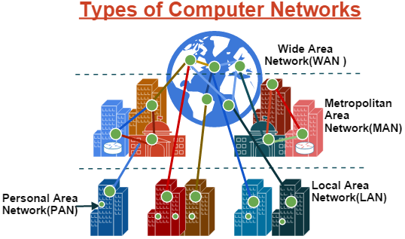
Networks
Informatics R&D incorporates network resources on worldwide (WAN), institution-wide (MAN), and laboratory-wide (LAN and PAN) levels.

Slide 22
Networks
PAN
  personal area network
a computer network used for communication among computer devices,
  including telephones, personal digital assistants, …
limited to the immediate proximity of the user, or about a 10-meter radius,
If PAN is constructed using wireless technology,
  known as wireless personal area network (WPAN)

Slide 23
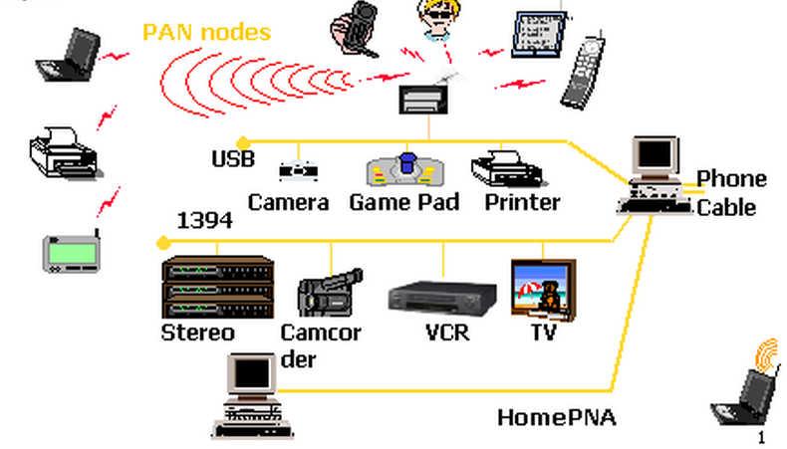
Networks
PAN

Slide 24
Networks
LAN
  local area network
a network that is restricted to smaller physical areas
  extend to about 100-meters from a central server, or a single floor in a typical research building.
    e.g. a local office, school, or house.
Approximately all current LANs whether wired or wireless are based on Ethernet.
Data transfer speeds can extend to
  10.0 Mbps (Ethernet network)
  1.0 Gbps (Gigabit ethernet)
  Coaxial cable and CAT 5 cables are normally used for connection.

Slide 25
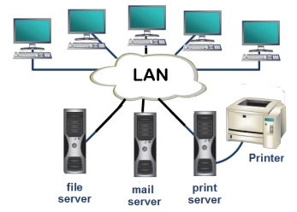
Networks
LAN

Slide 26
Networks
MAN
  Metropolitan Area Network
take over where LANs leave off,
  covering entire buildings and extending tens of kilometers.
typically implemented with digital subscriber line (DSL), cable modem, and fixed wireless technologies.
Several LANs are often connected to make a MAN.
  When this configuration is used for a college campus, it is referred to as a campus area network (CAN).

Slide 27
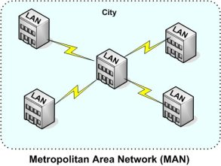
Networks
MAN

Slide 28
Networks
WAN
  Wide Area Network
connects computers together over large physical distances,
  such as entire country or entire world
typically composed of a combination of
  terrestrial fixed satellite systems, coaxial cable, and fiber optical cable.
The public switched telephone network and the Internet are examples of WANs.

Slide 29
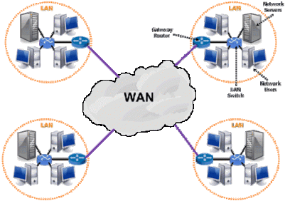
Networks
WAN

Slide 30
Networks
SAN
  Storage area network
connects servers directly to devices to store data
moves storage resources off the common user network and reorganizes them into an independent, high-performance network.
  So, each server is allowed to access shared storage.
    This can involve Fibre-channel connection, similar to Ethernet, to handle high-performance disk storage for application.

Slide 31
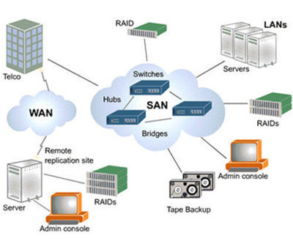
Networks
SAN

Slide 32
Networks
EPN
  Enterprise Private Network
a computer network built to share computer resources among different sites
  such as production sites, offices and shops of a business
Some of the advantages of an EPN:
  The messages are secure because they are encrypted.
  They are cost effective and scalable.
  They help to centralize IT resources.
  They enable business continuity.

Slide 33
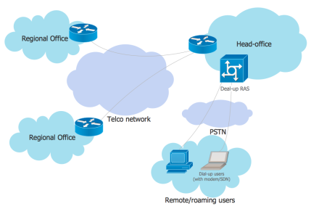
Networks
EPN

Slide 34
Networks
VPN
  Virtual Private Network
an extended private network which spreads over the internet.
Users can send and receive data across shared or public networks.
It uses public wires
  usually the internet to connect to a private network
    usually a company’s private network.
The benefit of a secure VPN is its level of security to the connected systems,
  whereas the other network infrastructure alone can not provide it.

Slide 35
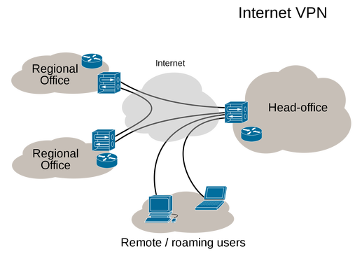
Networks
VPN

Slide 36
Networks
GAN
  Global Area Network
a network composed of different interconnected networks that cover an unlimited geographical area.
  The term is loosely synonymous with Internet,
    which is considered a global area network.
    BGAN
  Broadband Global Area Network
    a mobile communications system created to transmit broadband wireless voice and data communications almost anywhere on the earth's surface.
  The system, developed by Immarsat, Inc., consists of a constellation of geostationary satellites working in conjunction with portable, lightweight, surface-based terminals about the size of a laptop.

Slide 37
Networks
WLAN
  Wireless Local Area Network
a wireless computer network that links two or more devices using a wireless distribution method within a limited area
  such as a home, school, computer laboratory, or office building.
sometimes called a local area wireless network (LAWN)
The IEEE 802.11 group of standards specify the technologies for WLANs

Slide 38
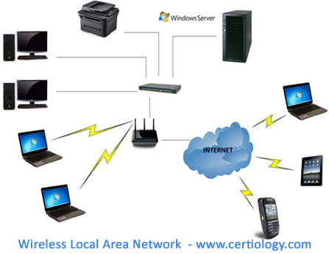
Networks
WLAN

Slide 39
Networks
CAN
  Controller Area Network
a serial bus network of microcontrollers that connects devices, sensors and actuators in a system or sub-system for real-time control applications.
  Bosch originally developed the CAN in 1985 for in-vehicle networks
Lifts and escalators use embedded CAN networks
  Hospitals use the CANopen protocol to link lift devices, such as panels, controllers, doors, and light barriers, to each other and control them.

Slide 40
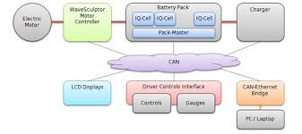
Networks
CAN

Slide 41
Networks
IAN
  Internet Area Network
a concept for a communications network that connects voice and data end-points within a cloud environment over IP,
  replacing an existing LAN, WAN or the public switched telephone network (PSTN).
Cloud based IT & Communications interface

Slide 42
Communications Models
In the traditional client-server model, a server provides data to one or more clients.
In contrast, in a peer-to-peer network, every computer acts as a server and client to other computers on the network.
  As such, a particular computer might function as a server one moment and as a client the next
The simplest type of computer network to construct in a small workgroup is a peer-to-peer network.

Slide 43
Communications Models

Slide 44
Communications Models
The disadvantages of the peer-to-peer model
  Uneven use of resources,
    the workstations with the most relevant content are accessed more often than workstations with less frequently accessed content.
      The result is decreased performance for computational tasks of the frequently accessed workstations.
  Data management is more challenging.
    Everyone in the workgroup must perform tasks such as archiving and updating antiviral utilities, for example.

Slide 45
Communications Models
A client-server model employs a central server to provide programs and data files that can be accessed by client workstations on the network.
An advantage of this model is that
  the network operating system running on the server provides for security, tiered access privileges, and no degradation of individual workstation performance
    because files are accessed from the server.
In addition, the data and programs on the central server can be more easily and consistently archived, backed up, accessed, and shared.

Slide 46
Transmissions Technology
Switched Communications
  A fixed, continuous bi-directional connection is established between the message source and recipient.

Slide 47
Transmissions Technology
Packet Communications
  Multiple, virtual communications channels are established by breaking up messages into small packets and reassembling them at the destination

Slide 48
Protocols
Network protocols
  formal standards and policies comprised of rules, procedures and formats that define communication between two or more devices over a network.
  govern the end-to-end processes of timely, secure and managed data or network communication.
The key standards organizations that define or suggest network protocols:
  the Open Systems Interconnection (OSI) group,
  the Institute of Electrical and Electronics Engineers (IEEE),
  the Consultative Committee on International Telegraphy and Telephony
  International Telecommunications Union-Telecommunications Sector
  the American National Standards Institute (ANSI),
  the Exchange Carriers Standards Association (ECSA),
  the Alliance for Telecommunications Industry Solutions (ATIS)
OSI, begun by the International Organization for Standardization in the late 1970s, defines high-level communications architectures, including the OSI Reference Model

Slide 49
Protocols
The OSI Reference Model
  OSI defines the communications process into seven different categories that deal with communications and network access.
Layer Name Focus
7 Application Semantics
6 Presentation Syntax
5 Session Dialog coordination
4 Transport Reliable data transfer
3 Network Routing and relaying
2 Data Link Technology-specific transfer
1 Physical Physical connections
The IEEE develops standards for the entire computing industry, including wired and wireless networks
  these standards define specific low-level functionality, such as operating frequency, bandwidth, message format, signal voltage, and connector style for computer networks.
    For example, the IEEE-802.3 10BaseT standard defines Ethernet over ordinary twisted pair cable

Slide 50
Key Network Protocols
The most important IEEE standards in biomedical informatics:
Standard Description
IEEE 488 Computer to electronic instrument communications; also known as GPIB and HPIB
IEEE-802 LAN and MAN standards
IEEE-802.3 Ethernet; the most common LAN specification
IEEE-802.3 10Base-T Ethernet over twisted pair cable
IEEE-802.11 Wireless LANs
IEEE-802.11a 5 GHz, 54 Mbps wireless LAN; shorter range than 2.4 GHz systems, higher bandwidth, and more channels than WiFi
IEEE-802.11b 2.4 GHz, 11 Mbps wireless LAN; the most common, most mature; limited channels, also known as WiFi

Slide 51
Key Network Protocols
Standard Description
IEEE-802.11e 2.4 GHz, 11 Mbps wireless LAN; enhanced quality of service
IEEE-802.11g 2.4 GHz, 22 Mbps wireless LAN; higher- bandwidth version of 802.11b, limited channels
IEEE-802.11i 2.4 GHz, 11 Mbps wireless LAN; enhanced security
CCITT/ITU-T ISDN Digital communications over standard phone lines
CCITT/ITU-T X.25 Switched packet communications
ANSI FDDI High-speed (200 Mbps) fiber backbone LAN
ECSA SONET Very high-speed (10 Gbps) optical network standard
DARPA TCP/IP The protocol of the Internet

Slide 52
Bandwidth
There are three frequently used definitions of bandwidth in the context of Information Technology:
In computer networks,
  bandwidth is data transfer rate,
    the amount of data that can be carried from one point to another in a given time period (usually a second).
  Network bandwidth is usually expressed in bits per second (bps);
    modern networks typically have speeds measured in the millions of bits per second
      (megabits per second (Mbps)
    or billions of bits per second
      gigabits per second (Gbps)
  Different applications require different bandwidths.
    An instant messaging conversation might take less than 1000 bits per second (bps);
    A voice over IP (VoIP) conversation requires 56 kilobits per second (Kbps) to sound smooth and clear.
    Standard definition video (480p) works at 1 megabit per second (Mbps), but HD video (720p) wants around 4 Mbps, and HDX (1080p), more than 7 Mbps.

Slide 53
Bandwidth
In signal processing/communication,
  Bandwidth is the range of frequencies
    the difference between the highest frequency signal component and the lowest frequency signal component
    bandwidth is measured in hertz (cycles per second).
    This is the original meaning of bandwidth,
      although it is now used primarily in discussions about cellular networks and the spectrum of frequencies that operators license from various governments for use in mobile services.
  In business,
  bandwidth is a synonym for capacity or ability.
      In this sense, it refers to having time or staffing available to tackle something

Slide 54
Bandwidth
Network Bandwidth
Gigabit Ethernet, Fast Ethernet, and Ethernet provide a tiered network system that provides a compromise between system data throughput, cost, and maintenance.

Slide 55
Topology
The physical layout of a network
  a function of the practical constraints imposed by
    the environment,
    the protocols that must be supported,
    the cost of installation.
The most common protocols used with LANs, Ethernet and token ring, assume a bus and ring topology, respectively.
The star topology is often used as a hub to connect several networks and in wireless networks,
  where multiple devices connect via radio frequency, it links to a central wireless access point or wireless hub.

Slide 56
Topology
Bus topology:
  A network topology in which all nodes (stations) are connected together by a single bus.
Mesh topology:
  A network topology in which there are at least two nodes with two or more paths between them.
Ring topology:
  A network topology in which every node has exactly two branches connected to it.
Star topology:
  A network topology in which peripheral nodes are connected to a central node, which rebroadcasts all transmissions received from any peripheral node to all peripheral nodes on the network, including the originating node.

Slide 57
Topology
Fully connected (Mesh) topology:
  A network topology in which there is a direct path between any two nodes.
  In a fully connected network with n nodes, there are n(n-1)/2 direct paths.
Tree topology:
  A network topology that resembles an interconnection of star networks in that individual peripheral nodes are required to transmit to and receive from one other node only, toward a central node, and are not required to act as repeaters or regenerators.
Hybrid topology:
  A combination of any two or more network topologies.

Slide 58
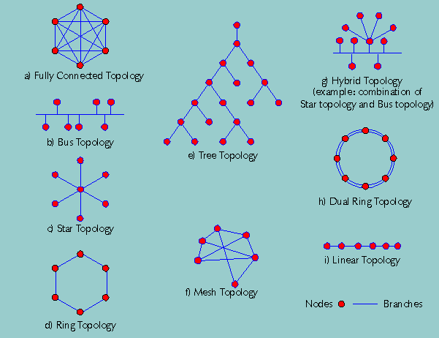
Topology

Slide 59
Hardware - Media
The most common media are
  coaxial cable,
  twisted pair wiring,
  fiber optics,
  the ether (for wireless networks)
Media Characteristics are reflected by
  bandwidth,
  cost,
  security,
  flexibility,
  range

Slide 60
Hardware - Media
Media Characteristics
In this example, ether refers to wireless LAN signals

Slide 61
Hardware - Media
Coaxial Cable
  popular as a medium for LANs
  inexpensive and provides the greatest flexibility in installation
  the center conductor is shielded by a copper or aluminum mesh or foil,
  provides a relatively secure connection and a high bandwidth.
  However,
    it's possible for someone with a sensitive receiver and antenna to remotely pick up signals traveling through coaxial cable, amplify them, and decode the digital stream

Slide 62
Hardware - Media
Fiber
  the most popular media used in networks,
  glass fiber provides
    the greatest bandwidth,
    highest level of security,
    greatest range,
    resistance to electrical noise.
  Although fiber provides a working range of up to several kilometers with standard electronics,
    it's less flexible to install compared to copper cable.
    For example, unlike twisted pair or coaxial cable, fiber can't be snaked through very tight turns because the glass fiber is more fragile than the others
  From a security perspective, fiber is the superior medium because there is no radio frequency signal that can be intercepted by a nearby receiver

Slide 63
Hardware - Media
Twisted Pair
  the wiring used in virtually every office and residence for telephone communications,
    is a comprise between cost, bandwidth, security, and availability.
  more affordable than coaxial cable or fiber,
    but the bandwidth isn't as great, and security is a much greater concern.
  When used with radio frequency network signals,
    twisted pair cables don't perfectly cancel out the signals traversing the two wires, but act as antennas.
    As a result, not only are signals in the cable more readily intercepted, but the twisted pair cable is more susceptible to electrical noise in the environment.

Slide 64
Hardware - Media
Power Line Cable
  a low-cost, low-bandwidth solution to networking.
  Although it may be suitable for exchanging text-only e-mails and other small files, the limitations of the medium prevent it from being a serious network medium for biomedical informatics applications.
  It may be a viable as part of a redundant backup network system.
  Ether
  provides the greatest flexibility,
    but also presents the greatest security risk.
  Typical internal installations for wireless LANs are limited to the same floor in a building.
  However, within that space, users may have complete mobility with laptops or desktop workstations that are frequently moved.
  Optical LANs, based on infrared (IR) links are line-of-sight only, and are limited to a single work area.

Slide 65
Hardware - Media
Radio frequency communications are also commonly used between buildings, in the form of microwave links.
These links tend to be line-of-sight and limited to perhaps ~50 km, depending on terrain and buildings that may interfere with line-of-sight communications.
Unlike the radio frequency technology used with LANs, the bandwidth of these links is on the same order as coaxial cable.
Similarly, radio frequency satellite links that extend thousands of kms support high-bandwidth transmission rates comparable to that provided by coaxial cable and fiber media.

Slide 66
Hardware - Media
The type of media used for Internet access depends
  primarily on the types of service available,
  secondarily on the bandwidth, security, and cost constraints.
The choice of media that can be used to support an internal LAN is more a function of
  cost,
  bandwidth requirements,
  security,
  ease of installation,
  type of existing wiring, if any.

Slide 67
Network Electronics
The media running from office to office and across the country become a useful communications channel with the addition of electronics
  capable of sending and receiving signals through the media.
These electronics serve a variety of functions:
  Generating signals destined for a recipient somewhere in the network
  Coordinating signals through media in order to minimize interference
  Amplifying and conditioning signals so that they can continue error-free to their destination

Slide 68
Network Electronics
  Blocking signals from certain paths to minimize interference in those paths
  Routing signals down the quickest or least-expensive route from source to destination
  Translating signals originally designed to work with one protocol so that they are compatible with networks designed to support other protocols
  Connecting different networks
  Monitoring the status of the network, including the functioning of network electronics and the amount of data on segments of the network

Slide 69
Network Electronics
Several of the network devices
Device Application
Bridge Connects multiple network segments and forwards data between them
Content Filter Prevents access of restricted external Web content
Firewall Prevents unauthorized users from accessing the network
Gateway Links two networks that use different protocols
Hub Provides a central connection point for a network configured in a star topology
Modem Connects a workstation or LAN to an outside workstation or network, such as the Internet
Monitor Monitors activity on the network by node and by network segment

Slide 70
Network Electronics
Device Application
Router Sends data transmissions only to the portion of a network meant to receive them
Satellite Transmits signals from a server in orbit
Server Supplies files and applications to clients
Switch Selects network paths at high speeds
UPS Provides uninterruptible power for network electronics, especially servers
Wireless Hub Provides mobile, cable-free access to servers, shared resources, and the Internet from anywhere within range of the hub
Wireless Modem Allows workstations and laptops to communicate with a wireless hub (access point)

Slide 71
Network Electronics
Network Hardware
The physical architecture shown here may support a markedly different logical architecture.

Slide 72
Contents
Networks are sometimes defined by the nature of the content they carry.
  For example,
    Some networks capable of sustained high-bandwidth connections are dedicated to video and other multimedia, whereas others are limited to text.
Networks may also be relegated to database or equipment communications.
  The former is especially prominent in bioinformatics, in the form of storage area networks.
    These networks, typically based on fiber optics, are maintained for highspeed communications between disk arrays and computers involved in sequencing and other applications that require almost constant access to data stored on high-speed hard drives.

Slide 73
Security
Network security is an increasingly important factor in informatics
  because of the central role that online databases, applications, and groupware such as e-mail play in the day-to-day operation.
Opening an intranet to the outside world through username and password protected restricted access may be the basis for collaboration as well as a weak point in the security of the organization.

Slide 74
Security
Although it may be practically impossible to maintain security from professional industrial spies,
  a variety of steps can be taken to minimize the threat posed by modestly computer-savvy activists and the most common non-directed security threats.
These steps include
  using antiviral utilities,
  controlling access through the use of advanced user-authentication technologies,
  firewalls,
  low-level encryption technologies.

Slide 75
Security
Antiviral Utilities
The risk of virus infection can be minimized by installing virus-scanning software on servers and locally on workstations.
The downside to this often-unavoidable precaution is decreased performance of the computers running antiviral programs, as well as the maintenance of the virus-detection software to insure that the latest virus definitions are installed.

Slide 76
Security
Authentication
The most often used method of securing access to a network is to verify that users are who they say they are.
However, simple username and password protection at the firewall and server levels can be defeated by someone
  who either can guess or otherwise has access to the username and password information.

Slide 77
Security
A more secure option is to use a synchronized, pseudorandom number generator for passwords.
  In this scheme, two identical pseudorandom number generators, one running on a credit card–sized computer and one running on a secure server, generate identical number sequences that appear to be random to an observer.
More sophisticated methods of user authentication involve biometrics, the automated recognition of fingerprint, voice, retina, or facial features.

Slide 78
Security
Firewalls
stand-alone devices or programs running on a server that block unauthorized access to a network.
Dedicated hardware firewalls are more secure than a software-only solution,
  but are also considerably more expensive.
Firewalls are commonly used in conjunction with proxy servers to mirror servers inside a firewall,
  thereby intercepting requests and data originally intended for an internal server.
In this way, outside users can access copies of some subset of the data on the system without ever having direct access to the data.
  This practice provides an additional layer of security against hackers.

Slide 79
Security
Encryption
the process of making a message unintelligible to all but the intended recipient
one of the primary means of ensuring the security of messages sent through the Internet and even in the same building.
also one of the greatest concerns—and limitations—of network professionals.
Although cryptography predates computers by several millennia, no one has yet devised a system that can't be defeated, given enough time and resources.
  Every form of encryption has tradeoffs of security versus processing and management overhead, and different forms of encryption are used in different applications

Slide 80
Security
Encryption Standards
Standard Description
AES Advanced Encryption Standard—Eventual replacement for DES, based on 128-bit encryption.
DES Data Encryption Standard—Used by the government, based on 64-bit encryption.
IDEA International Data Encryption Algorithm—Used by the banking industry, developed by the Swiss Federal Institute of Technology, 128-bit encryption.
PGP Pretty Good Privacy—Popular on the Internet, effective, free, simple to use.
RSA Rivest-Shamir-Adelman System—Popular in business and government.
S-HTTP Secure Hypertext Transfer Protocol—For transmitting individual messages over the Internet.
SSL Secure Sockets Layer—Developed by Netscape Communications Corp. for the Internet.

Slide 81
Security
Process
More important than the specific encryption algorithm or user-authentication technology used is the process of implementing a security strategy.
  For example, the best firewall, proxy server, and user authentication system is valueless if a researcher has a habit of losing his secure ID card.
  Similarly, a wireless hub capable of supporting the latest security standards is vulnerable to attack if the person who configures the hub doesn't take the time to enable the security features.
  Similarly, a researcher who leaves her username and passwords on a Post-It Note stuck to her monitor provides a security hole for everyone from the janitorial staff to a visitor who happens to walk past her office.

Slide 82
Ownership
Networks are often characterized by the way they are funded.
Private networks are owned and managed by private corporations.
  For example, many of the major pharmaceutical corporations have internal bioinformatics R&D groups that manage workflow and data with the help of privately owned and highly secure networks.
These private networks may be completely isolated, connect to the Internet through a secure firewall, or communicate with academic and commercial collaborators through dedicated, secure lines.
Private networks may also be open to researchers and other companies—for a fee.

Slide 83
Ownership
Public networks such as the Internet and the public telephone network are at least partially funded by public coffers.
They are also freely open to anyone who is capable of paying for their services.
Cooperative networks are supported and managed by their users.
  One of the best known cooperative networks was BITNET (Because It's Time Network), started by universities in the early 1980s.
  Before it was replaced by NSFNET (National Science Foundation Network) in the early 1990s, it connected about 3,000 mainframe computers at universities in the U.S., Canada, South America, Europe, Asia, and Australia.

Slide 84
Implementation
The major steps in the implementation process:
Create a Requirements Specification.
  This document includes a high-level description of the tasks to be supported by the network,
    such as routing sequencing data from sequencing machines to analysis workstations and data warehouses,
      as well as the desired response times and storage capacities.
    For example, the requirements specification document may stipulate the need to support 35 workstations, provide access to storage in excess of 1 terabyte with an access time of less than 50 milliseconds, with tiered password protection, and secure, high-speed access to the Internet.

Slide 85
Implementation
Create a Functional Specifications Document
  that defines, in detail, how the high-level needs outlined in the requirements specification will be met.
    This document quantifies many of the qualitative terms in the requirements specification to the degree that anyone competent in information sciences can determine exactly what equipment, personnel, and costs will be associated with the project.
Select Hardware.
  Assuming the functional specifications document is complete, the next step is selecting network, workstation electronics, and media.
    Often the functional specifications document is authored with particular hardware and software in mind, which further simplifies the selection process.

Slide 86
Implementation
Select Software.
  This step of the implementation process involves selecting the network operating system, as well as database publishing software and tools such as PHP, XML, CGI, Java, or JavaScript editors and runtime systems.
Select Utility.
  Software and hardware utilities, such as network monitors and antiviral utilities, should be defined during the design process, not as an afterthought.

Slide 87
Implementation
Select Internet Access Service.
  Most larger institutions have high-speed Internet access available throughout their offices.
    However, bandwidth requirements may necessitate alternate Internet services,
      such as supplementing a corporate-wide cable modem service with a high-speed dedicated line, satellite link, or high-speed microwave link.

Slide 88
Management
After a network is established, it must be managed to realize its full potential.
Network management issues include
  making provision for disaster recovery,
  load balancing,
  bandwidth management,
  maintaining network security.
For example, disaster recovery plans and support for inevitable network electronics and media failure should consider
  fire, electrical disturbances, power outages, or intentional destruction.

Slide 89
Management
Part of disaster recovery planning includes
  securing redundant systems,
    such as running extra cables when installing a wired network
  installing a bank of 56K dial-up modems available for Internet access in the event that the high-speed Internet connection fails.
Perhaps the greatest management challenge is maintaining adequate security.
  This task entails monitoring the Internet on a daily basis
    to check for word of new viruses or security holes in the operating system, and installing the appropriate software patches and utilities to address the new threats.

Slide 91
Grammar revision
Comprise, can be used with the parts that make up something as the subject:
  {Oil and coal comprise 70% of the nation’s exports.}
Compose
Compose of is even more formal than consist of and comprise.
Compose of is only used in the passive voice:
  {Muscle is composed of different types of protein.}

Slide 92
Grammar revision
Comparison and contrast
Example: Comparison of digital and conventional cameras
Note how we can compare and contrast these types of cameras
FEATURE | DIGITAL | CONVENTIONAL
lens | ✓ | ✓
viewfinder | ✓ | ✓
requires chemical processing | x | ✓
film | x | ✓
transfer images directly to PC | ✓ | x
can delete unsatisfactory images | ✓ | x

Slide 93
Grammar revision
Comparing features which are similar:
  {Both cameras have lenses.}
  {Like the conventional camera, the digital camera has a viewfinder.}
  Contrasting features which are different:
  {The conventional camera requires chemical processing whereas the digital camera does not.}
  {The conventional camera uses film unlike the digital camera.}

Slide 94
Grammar revision
  {With a digital camera you can transfer images directly to a PC but with a conventional camera you need to use a scanner.}
  {With digital cameras you can delete unsatisfactory images; however with conventional cameras you cannot.}

