Slide 1
Introduction to Bioinformatics
Prof. Dr. Nizamettin AYDIN
Introduction to Statistics
naydin@yildiz.edu.tr
http://www3.yildiz.edu.tr/~naydin

Slide 2
Data analysis – “The Concept”
Approach to de-synthesizing data, informational, and/or factual elements to answer research questions
Method of putting together facts and figures to solve research problems
Systematic process of utilizing data to address research questions
Breaking down research issues through utilizing controlled data and factual information

Slide 3
Categories of data analysis
  Narrative (e.g. laws, arts)
  Descriptive (e.g. social sciences)
  Statistical/mathematical (pure/applied sciences)
  Audio-Optical (e.g. telecommunication)
  Others
Most research analyses adopt the first three
The second and third are most popular in pure, applied, and social sciences

Slide 4
Statistical Methods
Something to do with “statistics”
  Statistics
    meaningful quantities about a sample of objects, things, persons, events, phenomena, etc.
    Widely used in many fields (social sciences, engineering, etc.)
    Simple to complex issues. E.g.
      correlation
      anova
      manova
      regression
      econometric modelling
Two main categories:
  Descriptive statistics
  Inferential statistics

Slide 5
Descriptive statistics
Use sample information to explain/make abstraction of population “phenomena”
Common “phenomena”:
  Association
  Tendency
  Causal relationship
  Trend,
  Pattern,
  Dispersion,
  Range
Used in non-parametric analysis
  e.g. chi-square, t-test, 2-way anova

Slide 6
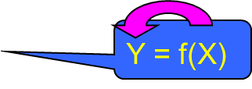
Inferential statistics
Using sample statistics to infer some phenomena of population parameters
Common phenomena: cause-and-effect
  One-way relationship
  Multi-directional relationship
  Recursive
Use parametric analysis
Y1 = f(Y2, X, e1)
Y2 = f(Y1, Z, e2)
Y1 = f(X, e1)
Y2 = f(Y1, Z, e2)

Slide 7
Which one to use?
Nature of research
  Descriptive in nature?
  Attempts to infer, predict, find cause-and-effect, influence, relationship?
  Is it both?
Research design (including variables involved)
  E.g. outputs/results expected
    research issue
    research questions
    research hypotheses

Slide 8
How to avoid mistakes - Useful tips
Crystalize the research problem
  operability of it!
Read literature on data analysis techniques
Evaluate various techniques that can do similar things with respect to research problem
Know what a technique does and what it doesn’t
Consult people, esp. supervisor
Pilot-run the data and evaluate results

Slide 9
Principles of analysis…
Goal of an analysis is to…
  explain cause-and-effect phenomena
  relate research with real-world event
  predict/forecast the real-world phenomena based on research
  find answers to a particular problem
  make conclusions about real-world event based on the problem
  learn a lesson from the problem

Slide 10
…Principles of analysis…
Data cannot talk
An analysis contains some aspects of scientific reasoning/argument:
  Define
  Interpret
  Evaluate
  Illustrate
  Discuss
  Explain
  Clarify
  Compare
  Contrast

Slide 11
…Principles of analysis…
An analysis must have four elements:
  Data/information (what)
  Scientific reasoning/argument
    what? who? where? how? what happens?
  Finding
    what results?
  Lesson/conclusion
    so what? so how? therefore, …

Slide 12
…Principles of data analysis…
Basic guide to data analysis:
  Analyze, not narrate
  Go back to research flowchart
  Break down into research objectives and research questions
  Identify phenomena to be investigated
  Visualize the expected answers
  Validate the answers with data
  Do not tell something not supported by data

Slide 13
…Principles of data analysis
When analyzing:
  Be objective
  Be accurate
  Be true
Separate facts and opinion
Avoid “wrong” reasoning/argument.
  E.g. mistakes in interpretation.

Slide 14
Description of samples and populations
Statistics is about making statements about a population from data observed from a representative sample of the population.
A population
  a collection of subjects whose properties are to be analyzed.
  contains all subjects of interest.
A sample
  a part of the population of interest
  a subset selected by some means from the population.

Slide 15
Description of samples and populations
A parameter
  a numerical value that describes a characteristic of a population
A statistic
  a numerical measurement that describes a characteristic of a sample
We use a statistic to infer something about a parameter.

Slide 16
Data exploration
After collecting data, the next step towards statistical inference and decision making is to perform data exploration,
  which involves visualizing and summarizing the data.
    The objective of data visualization is to obtain a high level understanding of the sample and their observed (measured) characteristics.
To make the data more manageable, we need to further reduce the amount of information in some meaningful ways so that we can focus on the key aspects of the data.
  Summary statistics are used for this purpose.

Slide 17
Data exploration
Using data exploration techniques, we can learn about the distribution of a variable.
  The distribution of a variable tells us
    the possible values it can take,
    the chance of observing those values,
    how often we expect to see them in a random sample from the population.
Through data exploration, we might detect previously unknown patterns and relationships that are worth further investigation.
  We can also identify possible data issues, such as unexpected or unusual measurements, known as outliers.

Slide 18
Statistical inference
We collect data on a sample from the population in order to learn about the whole population.
  {For example, Mackowiak, et al. (1992) measure the normal body temperature for 148 people to learn about the normal body temperature for the entire population.
    In this case, we say we are estimating the unknown population average.
      However, the characteristics and relationships in the whole population remain unknown.
    Therefore, there is always some uncertainty associated with our estimations.}

Slide 19
Statistical inference
The mathematical tool to address uncertainty in Statistics
  probability.
The process of using the data to draw conclusions about the whole population, while acknowledging the extent of our uncertainty about our findings, is called statistical inference.
  The knowledge we acquire from data through statistical inference allows us to make decisions with respect to the scientific problem that motivated our study and our data analysis.

Slide 20
Data types
The type(s) of data collected in a study determine
  the type of statistical analysis that can be used
  which hypotheses can be tested
  which model we can use for prediction.
Broadly speaking, data can be classified into two major types:
  categorical
  quantitative

Slide 21
Categorical data
Categorical data can be grouped into categories based on some qualitative trait.
The resulting data are merely labels or categories,
  {examples include
    gender (male and female)
    ethnicity (e.g., Caucasian, Asian, African)}
We can further sub-classify categorical data into two types:
  nominal
  ordinal

Slide 22
Categorical data
Nominal data
  When there is no natural ordering of the categories we call the data nominal.
    {Hair color is an example of nominal data}
Ordinal data
  When the categories may be ordered, the data are called ordinal variables.
    {Categorical variables that judge pain (e.g., none, little, heavy) or income (low-level income, middle-level income, or high-level income) are examples of ordinal variables.}

Slide 23
Quantitative data
Quantitative data are numerical measurements where
  the numbers are associated with a scale measure rather than just being simple labels.
Quantitative data fall in two categories:
  discrete
  continuous

Slide 24
Quantitative data
Discrete quantitative data
  numeric data variables that have a finite or countable number of possible values.
    When data represent counts, they are discrete.
      {Examples include household size or the number of kittens in a litter.}
Continuous quantitative data
  The real numbers are continuous with no gaps;
    physically measurable quantities like length, volume, time, mass, etc., are generally considered continuous.

Slide 25
Categorical vs Quantitative data
Categorical data are typically summarized using frequencies or proportions of observations in each category
Quantitative data typically are summarized using averages or means.

Slide 26
Describing Data
Once data are collected, the next step is to summarize it all to get a handle on the big picture.
Statisticians describe data in two major ways:
  with pictures
    that is, charts and graphs
  with numbers,
    called descriptive statistics.

Slide 27
Charts and graphs
Data are summarized in a visual way using charts and/or graphs
  Some of the basic graphs used include pie charts and bar charts
  Some data are numerical
  Data representing counts or measurements need a different type of graph that either keeps track of the numbers themselves or groups them into numerical groupings.
    One major type of graph that is used to graph numerical data is a histogram.

Slide 28
Descriptive statistics
Numbers that describe a data set in terms of its important features
  Categorical data are typically summarized using
    the number of individuals in each group (the frequency)
    the percentage of individuals in each group (the relative frequency)
  Numerical data represent measurements or counts, where the actual numbers have meaning
    more features can be summarized
      measures of center
      measures of spread
      measures of the relationship between two variables
    Some descriptive statistics are better than others,
    some are more appropriate than others

Slide 29
Data Visualization and Summary Statistics
Preliminary steps before analysis:
  defining the scientific question we try to answer,
  selecting a set of representative members from the population of interest
  collecting data (either through observational studies or randomized experiments),
Analysis usually begins with data exploration.
  We start by focusing on data exploration techniques for one variable at a time.

Slide 30
Data Visualization and Summary Statistics
Objective is
  to develop a high-level understanding of the data,
  learn about the possible values for each characteristic,
  find out how a characteristic varies among individuals in our sample.
Basicaly, we want to learn about the distribution of variables.
  Recall that for a variable, the distribution shows
    the possible values,
    the chance of observing those values,
    how often we expect to see them in a random sample from the population.

Slide 31
Data Visualization and Summary Statistics
The data exploration methods allow us to reduce the amount of information so that we can focus on the key aspects of the data.
We do this by using data visualization techniques and summary statistics.
The visualization techniques and summary statistics we use for a variable depend on its type
  Recall that we can classify them into two general groups:
    Numerical (quantitative) variables
      discrete, continuous
    Categorical variables
      nominal, ordinal

Slide 32
Graphical summarization of data
Before blindly applying the statistical analysis, it is always good to look at the raw data,
  usually in a graphical form,
  and then use graphical methods to summarize the data in an easy to interpret format.
  A Picture is worth a thousand word
The types of graphical displays that are most frequently used by engineers
  scatterplots, time series, box-and-whisker plots, and histograms.

Slide 33
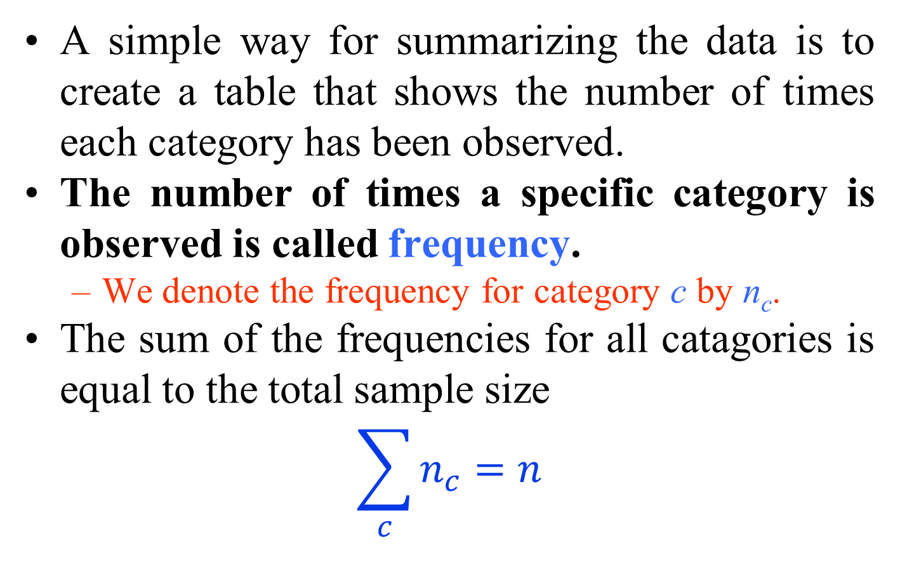
Exploring Categorical Variables
A simple way for summarizing the data is to create a table that shows the number of times each category has been observed.
The number of times a specific category is observed is called frequency.
  We denote the frequency for category c by n_{c}.
The sum of the frequencies for all catagories is equal to the total sample size
$$\sum_{c}{n_{c}=n}$$

Slide 34
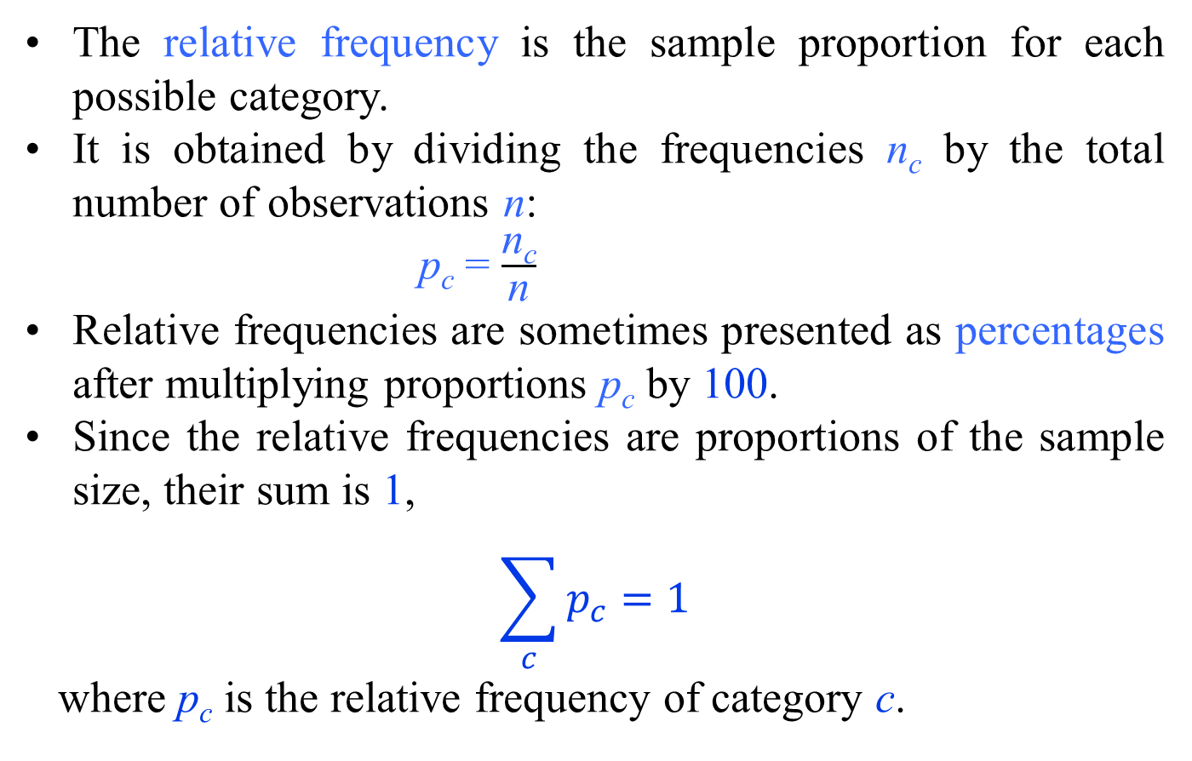
Relative Frequency and Percentage
The relative frequency is the sample proportion for each possible category.
It is obtained by dividing the frequencies n_{c} by the total number of observations n:
p_{c} = $\frac{\text{n}\text{c}}{\text{n}}$
Relative frequencies are sometimes presented as percentages after multiplying proportions p_{c} by 100.
Since the relative frequencies are proportions of the sample size, their sum is 1,
$$\sum_{c}{p_{c}=1}$$
where p_{c} is the relative frequency of category c.

Slide 35
Exploring Numerical Variables
For numerical variables, we are especially interested in two key aspects of the distribution:
  its location
    refers to the central tendency of values, that is, the point around which most values are gathered.
  its spread
    refers to the dispersion of possible values, that is, how scattered the values are around the location.

Slide 36
Histograms
defined as a frequency distribution commonly used to visualize numerical variables.
A histogram is similar to a bar graph after the values of the variable are grouped (binned) into a finite number of nonoverlapping intervals (bins), usually of equal width.
Given N samples or measurements, x_{i} ranging from X_{min} to X_{max}, the samples are binned into bins
Typically, the number of bins is on the order of 7–14, depending on the nature of the data.
  In addition, we typically expect to have at least 3 samples per bin.
    Sturgess’rule may also be used to estimate the number of bins and is given by k = 1 + 3.3 log(n).
      where k is the number of bins and n is the number of samples.

Slide 37
Histograms
One bin of a histogram plot
The bin is defined by
  a lower bound,
  a midpoint,
  an upper bound

Slide 38
Histograms
constructed by plotting the number of samples in each bin.
  horizontal axis,
    the sample value,
  the vertical axis,
    the number of occurrences of samples falling within a bin
Next slide illustrates a histogram for 1000 samples drawn from a normal distribution with mean (μ) = 0 and standard deviation (σ) = 1.0.

Slide 39
Histograms

Slide 40
Histograms
Two useful measures in describing a histogram:
  the absolute frequency in one or more bins
    f_{i} = absolute frequency in ith bin
  the relative frequency in one or more bins
    f_{i} /n = relative frequency in ith bin,
      where n is the total number of samples being summarized in the histogram
The histogram can exhibit several shapes
  symmetric, skewed, or bimodal.

Slide 41
Histograms
The bar height for each interval could be set to its relative frequency p_{c}= n_{c}/n, or the percentage p_{c}×100, of observations that fall into that interval.
For histograms, however, it is more common to use the density instead of the relative frequency or percentage.
  The density is the relative frequency for a unit interval.
    It is obtained by dividing the relative frequency by the interval width:
f_{c} = p_{c}/w_{c}
      Here, p_{c}= n_{c}/n is the relative frequency with n_{c} as the frequency of interval c and n as the total sample size.
      The width of interval c is denoted w_{c} .

Slide 42
Histograms
The height of each bar in density histogram shows the density of the corresponding interval (as opposed to its frequency).
For each interval c, the area of the corresponding bar in the density histogram is calculated as follows (hight×width):
  a_{c} = f_{c} × w_{c} = (p_{c} / w_{c}) × w_{c} = p_{c}
Therefore, the area of each bar (rectangle) is the relative frequency for the corresponding interval.
  Since the sum of relative frequencies is 1, the total area of bars in a density histogram is 1.

Slide 43
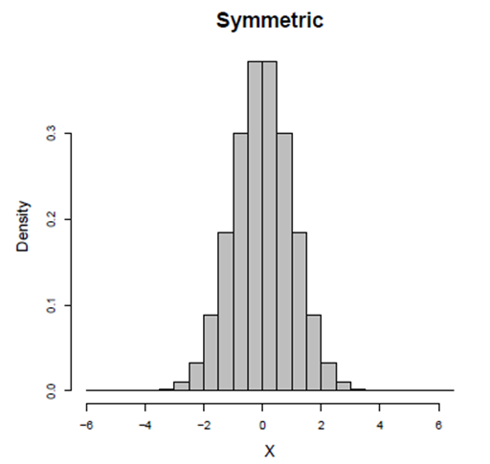
Histograms
When creating a histogram, it is important to choose an appropriate value for w (Number of Bins) .
Besides the location and spread of a distribution, the shape of a histogram also shows us how the observed values spread around the location.
We say the following histogram is symmetric around its location (here, zero) since the densities are the [almost] same for any two intervals that are equally distant from the center.

Slide 44
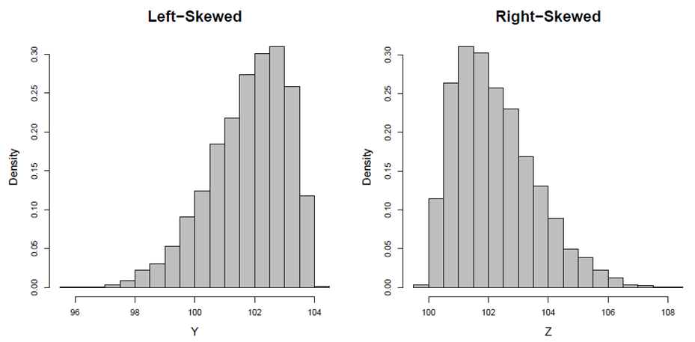
Histograms
In many situations, we find that a histogram is stretched to the left or right.
We call such histograms skewed.
  More specifically, we call them left-skewed if they are stretched to the left, or right-skewed if they are stretched to the right.

Slide 45
Histograms
The histograms in previous slides, whether symmetric or skewed, have one thing in common
  they all have one peak (or mode).
We call such histograms (and their corresponding distributions) unimodal.
Sometimes histograms have multiple modes.
  The bimodal histogram appears to be a combination of two unimodal histograms.
    Indeed, in many situations bimodal histograms (and multimodal histograms in general) indicate that the underlying population is not homogeneous and may include two (or more in case of multimodal histograms) subpopulations.

Slide 46
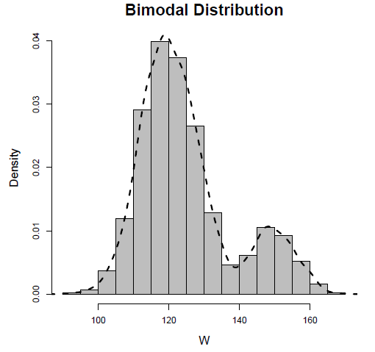
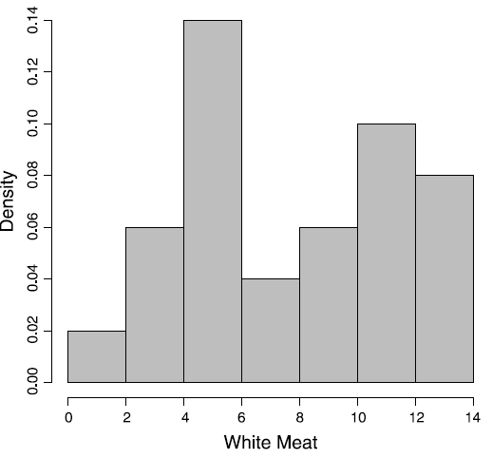
Histograms
Histogram of a bimodal distribution
A smooth curve is superimposed so that the two peaks are more evident
Histogram of protein consumption in 25 European countries for white meat in Protein data set.
The histogram is bimodal, which indicates that the sample might be comprised of two subgroups

Slide 47
Histograms
The histogram is important because it serves as
  a rough estimate of the true probability density function or
  probability distribution of the underlying random process from which the samples are being collected.
The probability density function or probability distribution is a function that quantifies the probability of a random event, x, occurring.
  When the underlying random event is discrete in nature, we refer to the probability density function as the probability mass function

Slide 48
Measures of Central Tendency
Histograms are useful for visualizing numerical data and identifying their location and spread.
However, we typically use descriptive or summary statistics for more precise specification of the
  central tendency
  dispersion
  of observed values.

Slide 49
Measures of Central Tendency
A central tendency is a central or typical value for a probability distribution.
  also called a center or location of the distribution.
Measures of central tendency are often called averages.
There are several measures that reflect the central tendency
  sample mean,
  sample median,
  sample mode.

Slide 50
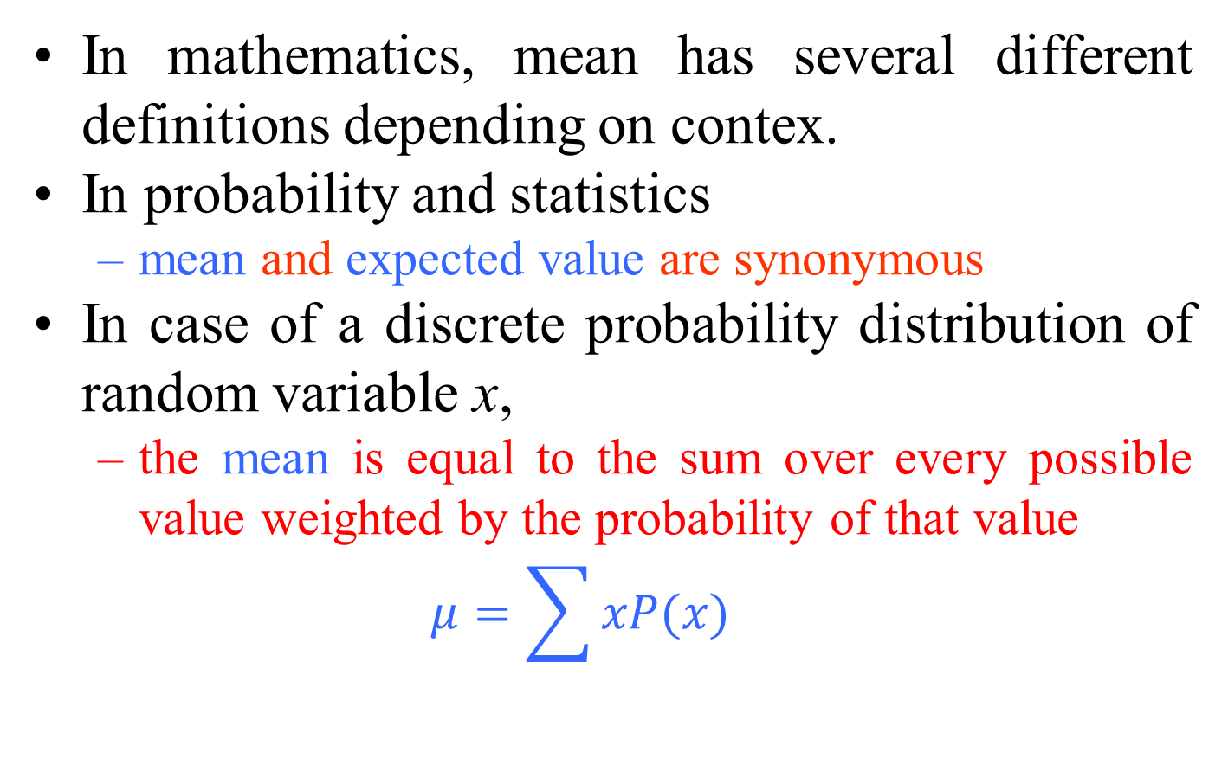
Mean
In mathematics, mean has several different definitions depending on contex.
In probability and statistics
  mean and expected value are synonymous
  In case of a discrete probability distribution of random variable x,
  the mean is equal to the sum over every possible value weighted by the probability of that value
  $$μ=\sum{xP(x)}$$

Slide 51
Mean
For a data set, the terms
  arithmetic mean,
  mathematical expectation,
  sometimes average
  are used synonymously to refer to a central value of a discrete set of numbers
  specifically, the sum of the values divided by the number of values.
If the data set were based on a series of observations obtained by sampling from a statistical population,
  the arithmetic mean is termed as the sample mean to distinguish it from the population mean

Slide 52
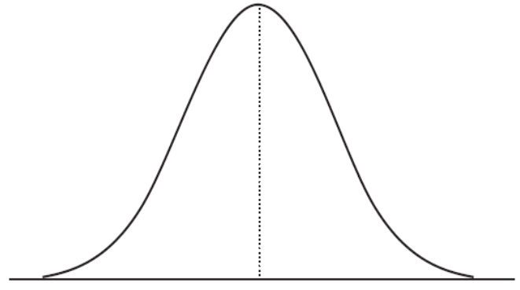
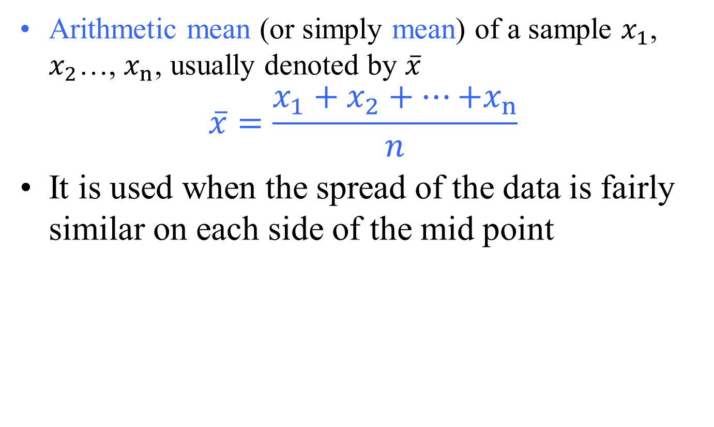
Mean
Arithmetic mean (or simply mean) of a sample $x_{1}$, $x_{2}$…, $x_{n}$, usually denoted by $\overline{x}$
$$\overline{x}=\frac{x_{1}+x_{2}+…{+x}_{n}}{n}$$
It is used when the spread of the data is fairly similar on each side of the mid point
  when the data are “normally distributed”.
    If a value is a lot smaller or larger than the others, “skewing” the data, the mean will then not give a good picture of the typical value.

Slide 53
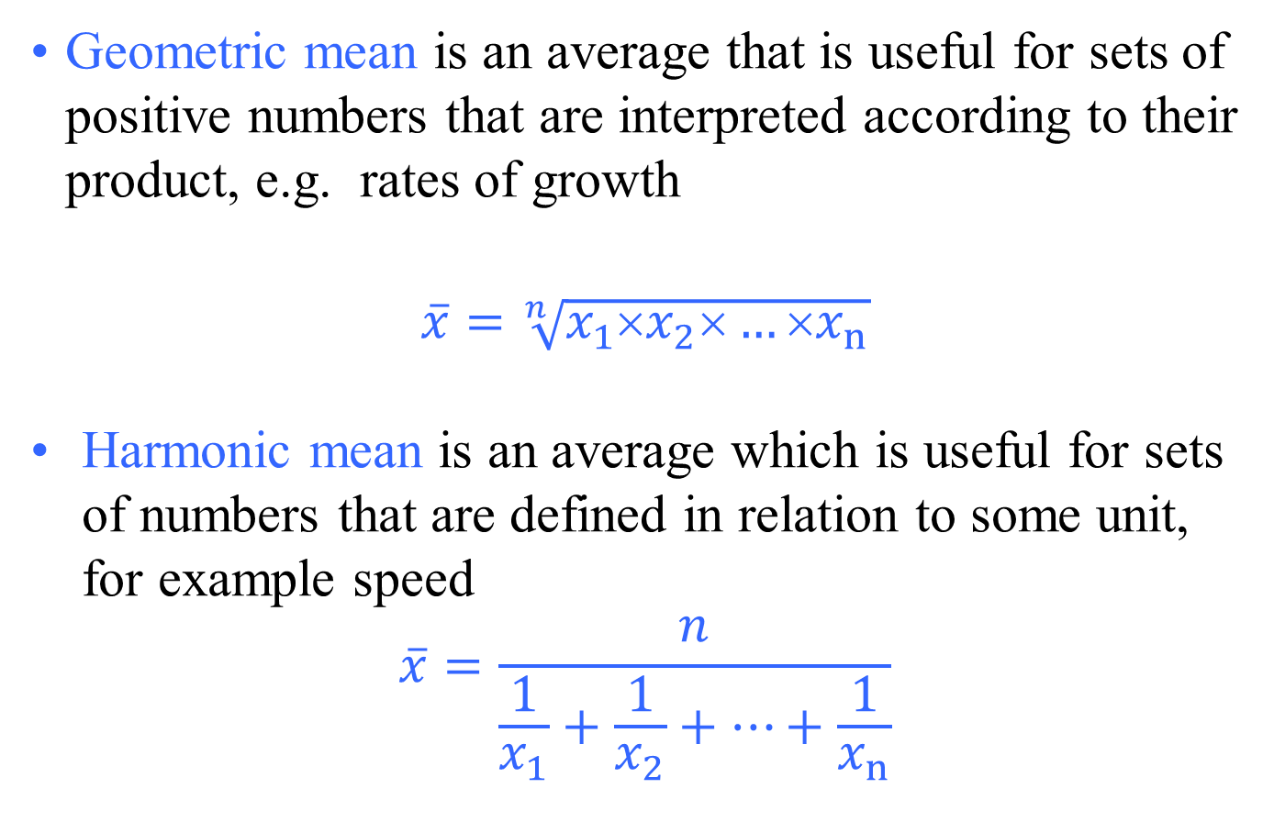
Mean
                Geometric mean is an average that is useful for sets of positive numbers that are interpreted according to their product, e.g. rates of growth
                $$\overline{x}=\sqrt[n]{x_{1}×x_{2}×…{×x}_{n}}$$
Harmonic mean is an average which is useful for sets of numbers that are defined in relation to some unit, for example speed
$$\overline{x}=\frac{n}{\frac{1}{x_{1}}+\frac{1}{x_{2}}+…+\frac{1}{x_{n}}}$$

Slide 54
Mean
The relationship between Arithmetic mean, Geometric mean, and Harmonic mean:
  Arithmetic mean × Harmonic mean = Geometric mean²
Arithmetic mean, Geometric mean, and Harmonic mean satisfy the following inequalities:
  Arithmetic mean ≥ Geometric mean ≥ Harmonic mean
    Equality holds if and only if all the elements of the given sample are equal
The arithmetic mean is best used in situations where:
  the data are not skewed (no extreme outliers)
  the individual data points are not dependent on each other
The geometric mean should be used whenever the data are inter-related
The harmonic mean is best to use when there is:
  A large population where the majority of the values are distributed uniformly but where there are a few outliers with significantly higher values

Slide 55
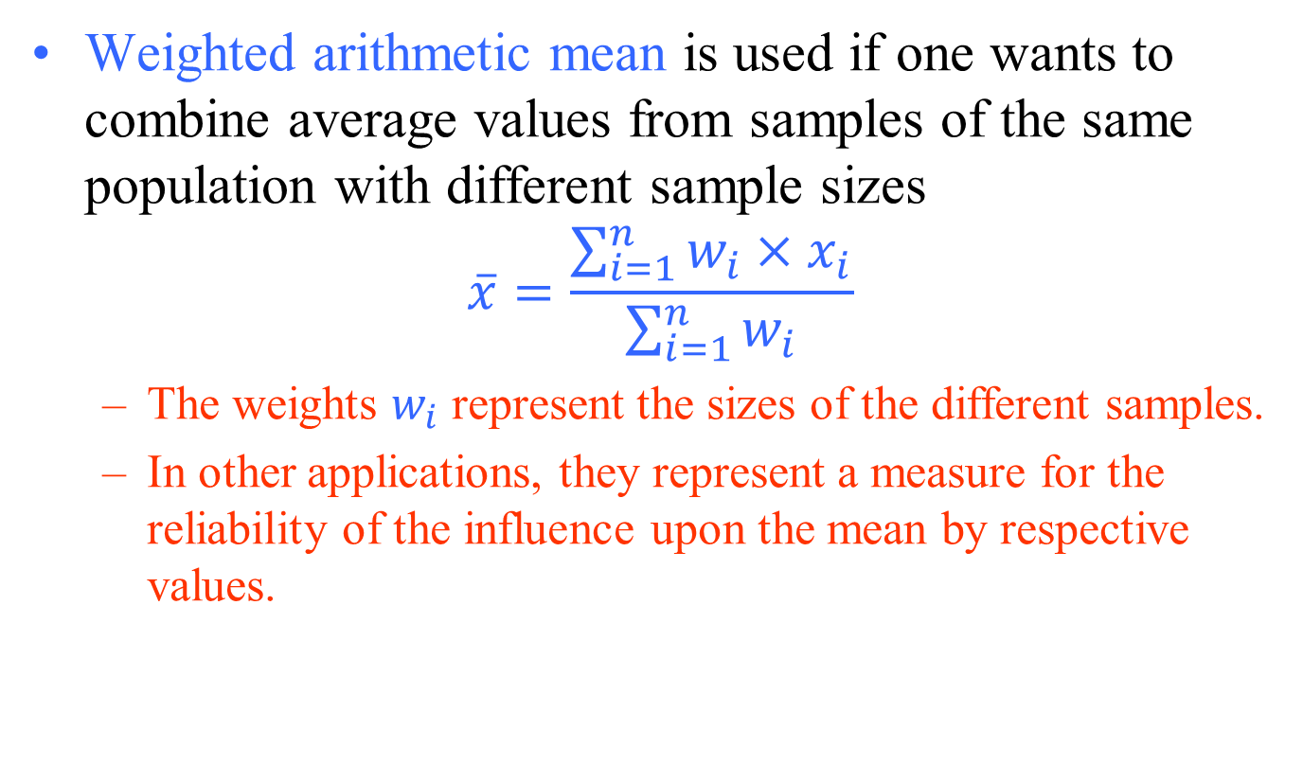
Mean
Weighted arithmetic mean is used if one wants to combine average values from samples of the same population with different sample sizes
$$\overline{x}=\frac{\sum_{i=1}^{n}{w_{i}}{×x}_{i}}{\sum_{i=1}^{n}{w_{i}}}$$
  The weights $w_{i}$ represent the sizes of the different samples.
  In other applications, they represent a measure for the reliability of the influence upon the mean by respective values.

Slide 56
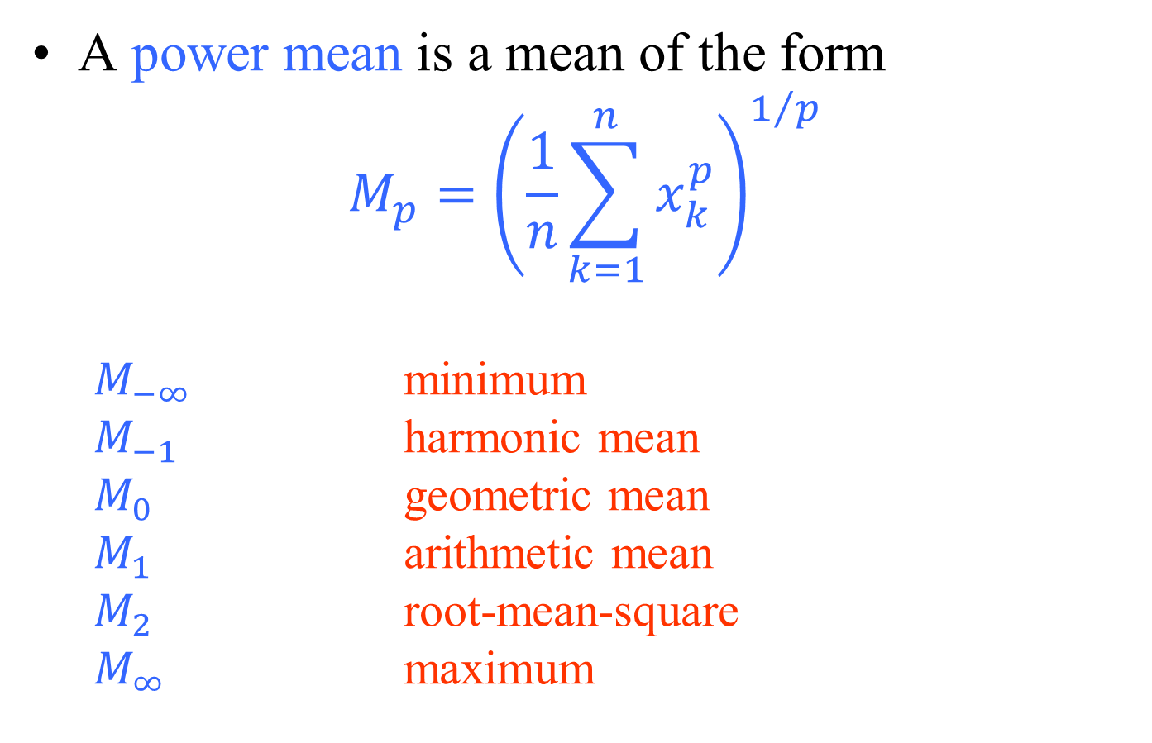
Mean
A power mean is a mean of the form
$$M_{p}={\left(\frac{1}{n}\sum_{k=1}^{n}{x_{k}^{p}}\right)}^{1/p}$$
  $M_{−∞}$ minimum
  $M_{−1}$ harmonic mean
  $M_{0}$ geometric mean
  $M_{1}$ arithmetic mean
  $M_{2}$ root-mean-square
  $M_{∞}$ maximum

Slide 57
Median
Sometimes known as the mid-point.
  It is used to represent the average when the data are not symmetrical (skewed distribution)
    The median value of a group of observations or samples, x_{i}, is the middle observation when samples, x_{i}, are listed in descending order.
Note that if the number of samples, n, is odd, the median will be the middle observation.
If the sample size, n, is even, then the median equals the average of two middle observations.
Compared with the sample mean, the sample median is less susceptible to outliers.

Slide 58
Median
The median may be given with its inter-quartile range (IQR).
The 1st quartile point has the 1⁄4 of the data below it
The 3rd quartile point has the 3⁄4 of the sample below it
The IQR contains the middle 1⁄2 of the sample
This can be shown in a “box and whisker” plot.

Slide 59
Mode
the most common of a set of events
  used when we need a label for the most frequently occurring event
    Example: An eye clinic sister noted the eye colour of 100 consecutive patients. The results are shown below
Graph of eye colour of patients attending an eye clinic.
In this case the mode is brown, the commonest eye colour.

Slide 60
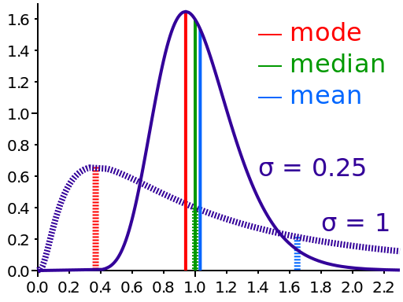
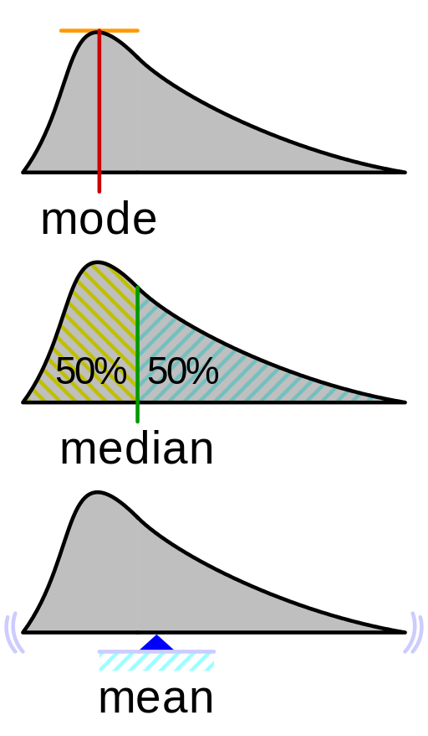
Mean, Median, Mode
Comparison of the arithmetic mean, median and mode of two skewed (log-normal) distributions.
Geometric visualisation of the mode, median and mean of an arbitrary probability density function.

Slide 61
Measures of Variability
When summarizing the variability of a population or process, we typically ask,
  “How far from the center (sample mean) do the samples (data) lie?”
To answer this question, we typically use the following estimates that represent the spread of the sample data:
  sample variance,
  sample standard deviation.
  interquartile ranges,

Slide 62
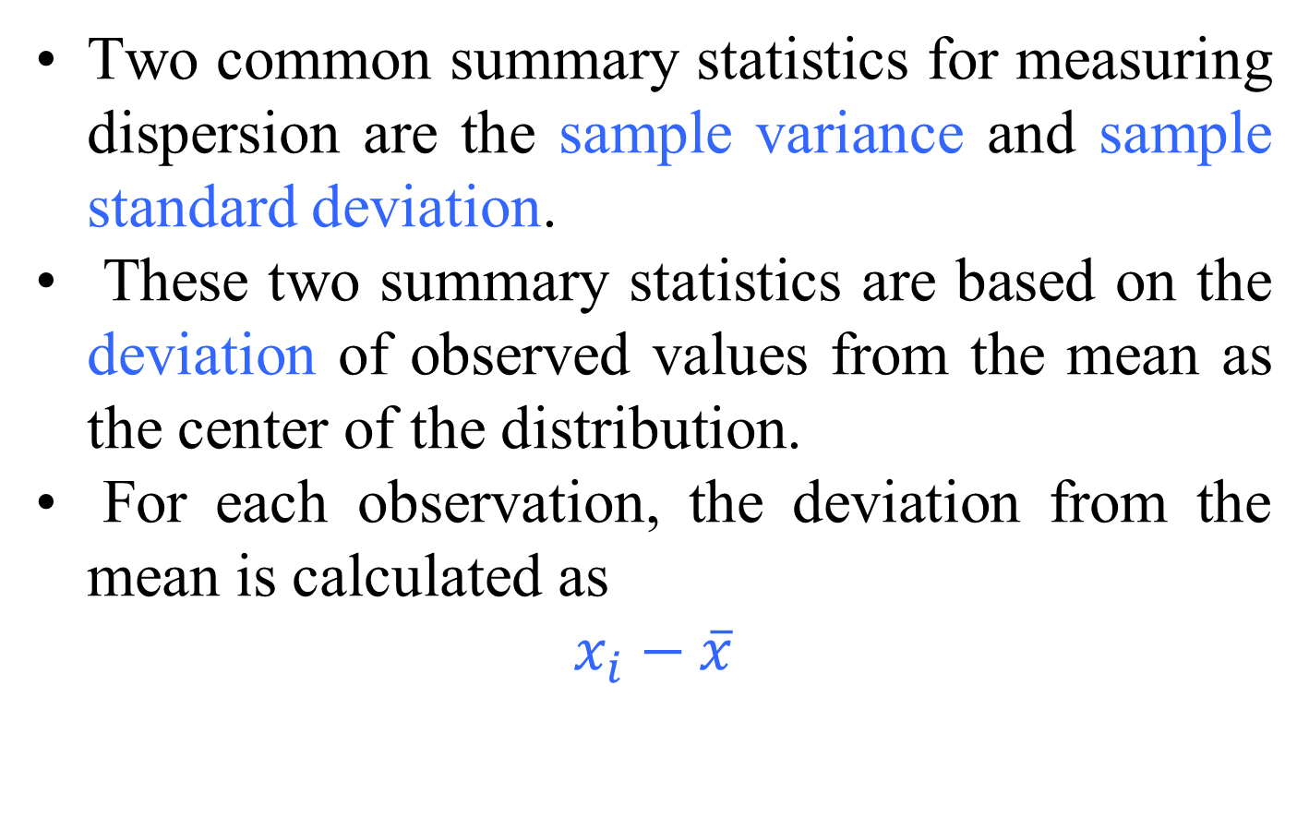
Variance and standard deviation
Two common summary statistics for measuring dispersion are the sample variance and sample standard deviation.
These two summary statistics are based on the deviation of observed values from the mean as the center of the distribution.
For each observation, the deviation from the mean is calculated as
$$x_{i}−\overline{x}$$

Slide 63


Variance and standard deviation
The sample variance is a common measure of dispersion based on the squared deviations.
The square root of the variance is called the sample standard deviation.

Slide 64
Measures of Variability
Standard deviation (SD) is used for data which are “normally distributed”,
  to provide information on how much the data vary around their mean.
  SD indicates how much a set of values is spread around the average.
    A range of one SD above and below the mean (abbreviated to ± 1 SD) includes 68.2% of the values.
    ± 2 SD includes 95.4% of the data.
    ± 3 SD includes 99.7%.

Slide 65
Variance and standard deviation
Some properties that can help you when interpreting a standard deviation:
  The standard deviation can never be a negative number.
  The smallest possible value for the standard deviation is 0
    (when every number in the data set is exactly the same).
  Standard deviation is affected by outliers, as it’s based on distance from the mean, which is affected by outliers.
  The standard deviation has the same units as the original data, while variance is in square units.

Slide 66
Measures of Variability
It is important to note that for normal distributions (symmetrical histograms),
  sample mean and sample deviation are the only parameters needed to describe the statistics of the underlying phenomenon.
Thus, if one were to compare two or more normally distributed populations,
  one only needs to test the equivalence of the means and variances of those populations.

Slide 67
Quantile
comes from the word quantity
A quantile is where a sample is divided into equal-sized, adjacent, subgroups
  (quantile is also called a fractile)
It can also refer to dividing a probability distribution into areas of equal probability
Quartiles are also quantiles;
  they divide the distribution into 4 equal parts.
Percentiles are quantiles;
  they divide a distribution into 100 equal parts
Deciles are quantiles;
  they divide a distribution into 10 equal parts.

Slide 68
Percentiles
the most common way to report relative standing of a number within a data set
A percentile is the percentage of individuals in the data set who are below where your particular number is located.
  For example,
  if your exam score is at the 90th percentile, that means
    90% of the people taking the exam with you scored lower than you did
    10 percent scored higher than you did

Slide 69
Quartile
For sampled data, the median is also known as
  the 2nd quartile, Q2.
Given Q2, we can find the 1st quartile, Q1,
  by simply taking the median value of those samples that lie below the 2nd quartile.
We can find the 3d quartile, Q3,
  by taking the median value of those samples that lie above the 2nd quartile.
Quartiles can also be found in terms of percentiles:
  1st quartile is 25th percentile
  2nd quartile is 50th percentile
  3rd quartile is 75th percentile

Slide 70
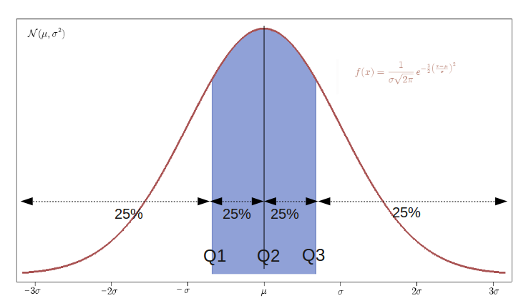
Measures of Variability

Slide 71
Five-number summary
The minimum (min), which is the smallest value of the variable in our sample, is in fact the 0 quantile.
On the other hand, the maximum (max), which is the largest value of the variable in our sample, is the 1 quantile.
The minimum and maximum along with quartiles (Q1, Q2, and Q3) are known as five-number summary.
These are usually presented in the increasing order:
  min, 1st quartile, median, 3rd quartile, max
  min, 25th percentile, median, 75th percentile, max
This way, the five-number summary provides
  0, 0.25, 0.50, 0.75, and 1 quantiles

Slide 72
Five-number summary
The five-number summary can be used to derive two measures of dispersion:
  the range
    the difference between the maximum observed value and the minimum observed value.
  the interquartile range (IQR)
    the difference between the third quartile (Q3) and the first quartile (Q1).
    IQR = Q3 - Q1

Slide 73
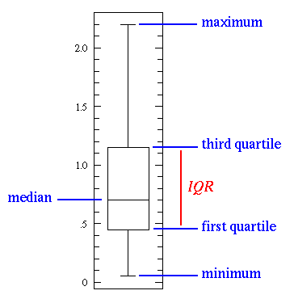
Boxplot
This simplest possible box plot displays the full range of variation (from min to max), the likely range of variation (the IQR), and a typical value (the median).
Not uncommonly real datasets will display surprisingly high maximums or surprisingly low minimums called outliers.
  John Tukey has provided a precise definition for two types of outliers:
    3×IQR or more above the Q3 => (Q3 + 3 x IQR)
    3×IQR or more below the Q1 => (Q1 - 3 x IQR)
  Suspected outliers are slightly more central versions of outliers:
    1.5×IQR or more above the Q3 => (Q3 + 1.5 x IQR)
    1.5×IQR or more below the Q1 => (Q1 - 1.5 x IQR)

Slide 74
Data Transformation
We rely on data transformation techniques
  to reduce the influence of extreme values in our analysis.
The reasons for data transformation:
  to make the distribution of the data normal,
  to create more informative graphs of the data,
  better outlier identification
  increasing the sensitivity of statistical tests
Two of the most common transformation functions for this purpose are
  logarithm
  square root.

Slide 75
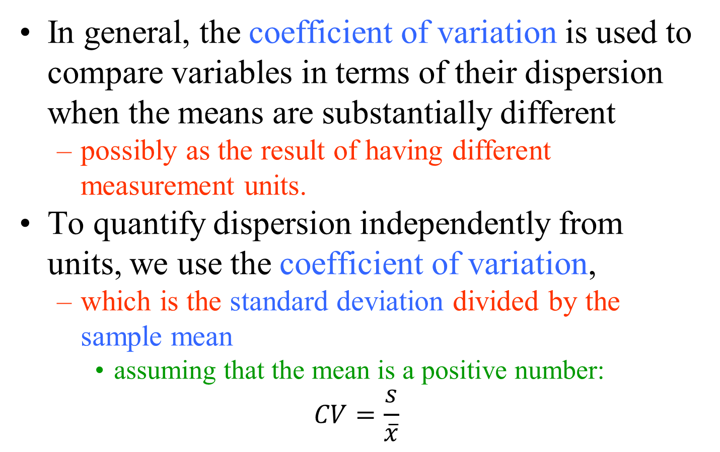
Coefficient of Variation
In general, the coefficient of variation is used to compare variables in terms of their dispersion when the means are substantially different
  possibly as the result of having different measurement units.
To quantify dispersion independently from units, we use the coefficient of variation,
  which is the standard deviation divided by the sample mean
    assuming that the mean is a positive number:
$$CV=\frac{s}{\overline{x}}$$

Slide 76

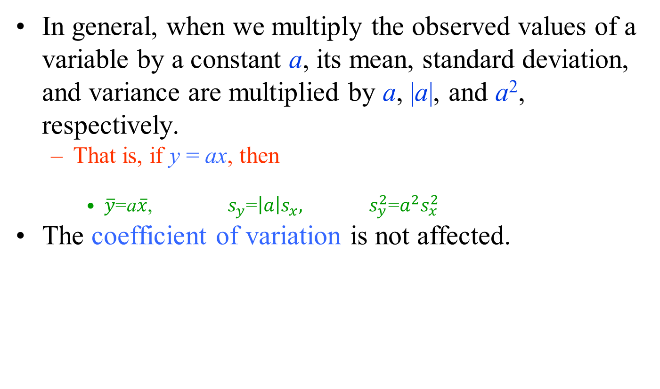
Scaling and Shifting Variables
In general, when we multiply the observed values of a variable by a constant a, its mean, standard deviation, and variance are multiplied by a, |a|, and a², respectively.
  That is, if y = ax, then
    $\overline{y}$=a$\overline{x}$, $s_{y}$=$\left|a\right|s_{x},$ $s_{y}^{2}$=$a^{2}s_{x}^{2}$
The coefficient of variation is not affected.

Slide 77

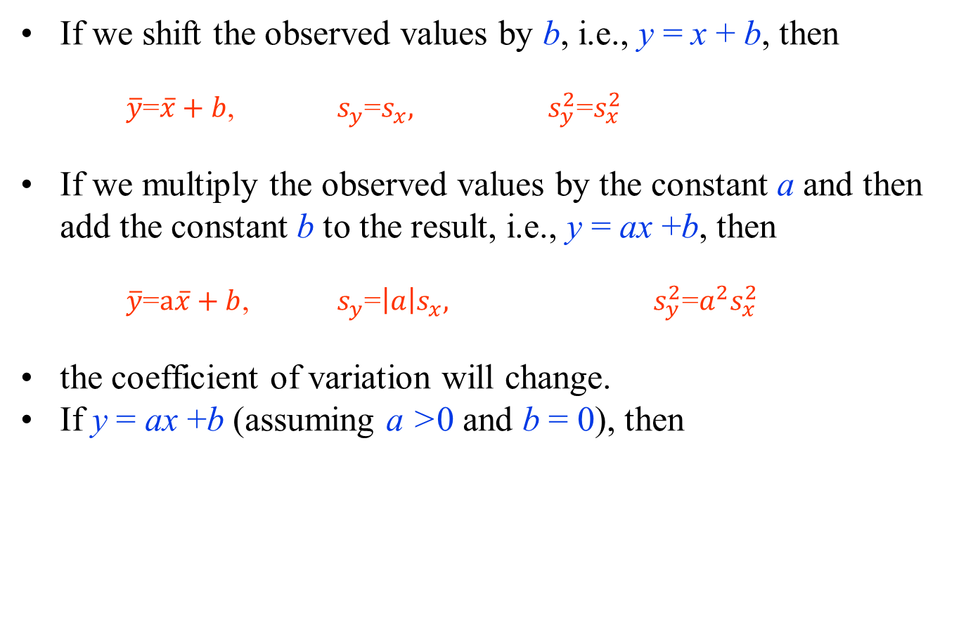
Scaling and Shifting Variables
If we shift the observed values by b, i.e., y = x + b, then
  $\overline{y}$=$\overline{x}+b$, $s_{y}$=$s_{x},$ $s_{y}^{2}$=$s_{x}^{2}$
If we multiply the observed values by the constant a and then add the constant b to the result, i.e., y = ax +b, then
  $\overline{y}$=$a\overline{x}+b$, $s_{y}$=$\left|a\right|s_{x},$ $s_{y}^{2}$=${a^{2}s}_{x}^{2}$
the coefficient of variation will change.
If y = ax +b (assuming a >0 and b = 0), then

Slide 78

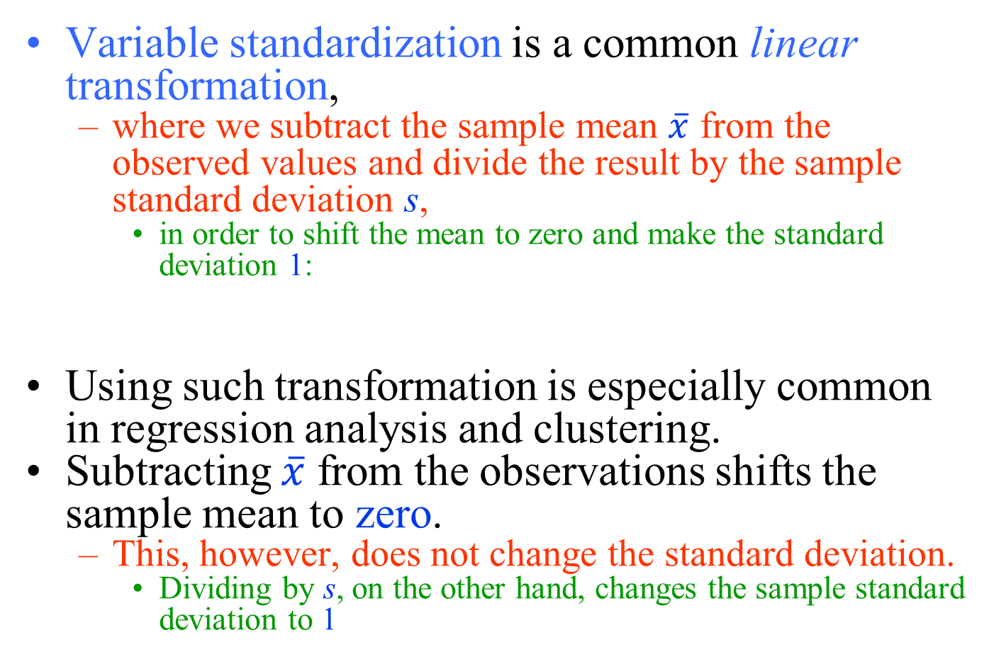
Variable Standardization
Variable standardization is a common linear transformation,
  where we subtract the sample mean $\overline{x}$ from the observed values and divide the result by the sample standard deviation s,
    in order to shift the mean to zero and make the standard deviation 1:
Using such transformation is especially common in regression analysis and clustering.
Subtracting $\overline{x}$ from the observations shifts the sample mean to zero.
  This, however, does not change the standard deviation.
    Dividing by s, on the other hand, changes the sample standard deviation to 1

Slide 79
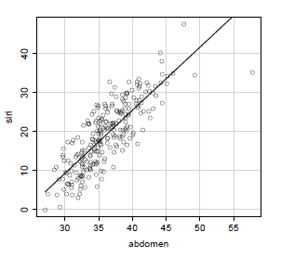
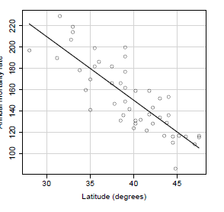
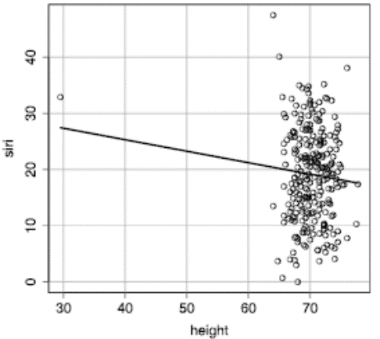
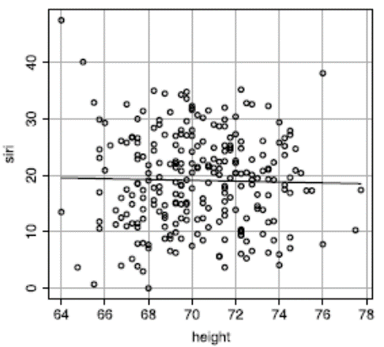
Exploring Relationships
Two numerical variables
  Scatterplot Matrix
    The relationship is simply an association and should not be regarded as causation since the data come from an observational study

Slide 80

Exploring Relationships
Two numerical variables
  Correlation
    To quantify the strength and direction of a linear relationship between two numerical variables
      Considering a set of observed pairs of values, (x₁, y₁), (x₂, y₂), . . . , (x_{n}, y_{n}), for a sample of n observations Pearson's correlation coefficient, r , can be used as a summary statistic
      s_{x} and s_{y} denote the sample standard deviations
    The values of r are always between -1 and +1.
    The relationship is strong when r approaches -1 or +1.
    The sign of r shows the direction (negative or positive) of the linear relationship.

Slide 81
Exploring Relationships
Two numerical variables
  Cross-correlation
    Is a measure of similarities of two signals
  Auto-correlation
    when x(n) = y(n)
  Algorithm for Cross/Auto-correlation
for k=1:K+N-1
for n=1:N
r(k)=r(k)+x(n)*y(k+n-1);
end
end

Slide 82


Exploring Relationships
Two numerical variables
  Sample Covariance
    If the standard deviations are removed from the denominator in Pearson’s correlation coefficient, the statistic is called the sample covariance,
    Therefore

Slide 83
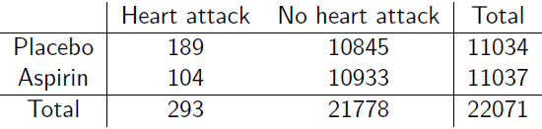
Exploring Relationships
Two categorical variables
  contingency tables
    used to summarize the relationship between several categorical variables.
    a special type of frequency distribution table, where two variables are shown simultaneously.
    sample proportion can be calculated
      proportion of people suffered from a heart attack in the placebo group p₁ = 189/11034 = 0.0171
      proportion of people suffered from heart attack in the aspirin group p₂ = 104/11037 = 0.0094

Slide 84

Exploring Relationships
Two categorical variables
  One way of measuring the strength of the relationship is to calculate the difference of proportions, p₂-p₁.
    In the example, p₂-p₁ = -0.0077
      proportion of people suffered from heart attack reduces by 0.0077 in the aspirin group compared to the placebo group, or
  Another common summary statistic for comparing sample proportions is the relative proportion, p₂/p₁
    If p₂ = p₁ , p₂/p₁= 1, which is interpreted as no relationship between the two categorical variables

Slide 85

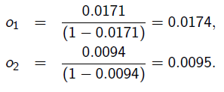

Exploring Relationships
Two categorical variables
  It is more common to compare the sample odds
      where p is the sample proportion for the event of interest
    The odds of a heart attack in the placebo group, o₁, and in the aspirin group, o₂, are
  We usually compare the sample odds using the sample odds ratio
    If OR = 1, no relationship between
    Values of RO away from 1, indicate strong relationship

Slide 86
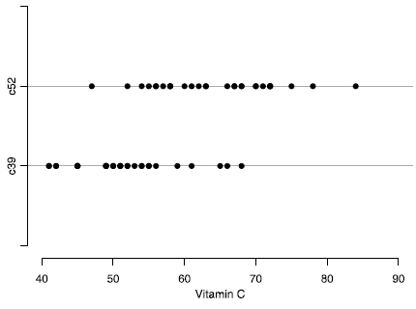
Exploring Relationships
Numerical and Categorical Variables
  dot plots (a.k.a. strip chart)
    The dot plots of ascorbic acid (one form of vitamin C) content (numerical) by cultivar (categorical).

Slide 87
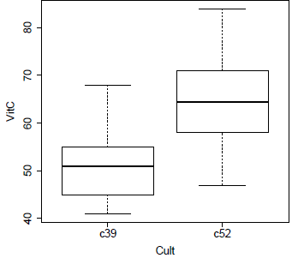
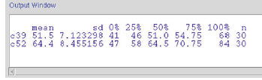
Exploring Relationships
Numerical and Categorical Variables
  boxplots of the numerical variable for different values of the categorical variable
    This plot suggests that vitamin C content tends to be higher in the c52 group compared to the c39 group.
      This is indicative of a possible relationship between these two variables.
        Summary statistics of vitamin C content by cultivar from the cabbages data set

Slide 88
Probability as a Measure of Uncertainty
Plots and summary statistics are used to learn about the distribution of variables and to investigate their relationships.
  However, we always remain uncertain about the true distributions and relationships in the population since we almost never have access to all of its members.
  Furthermore, our findings based on the observed sample can change if different samples from the population were obtained.
Therefore, when we generalize our findings from a sample to the whole population, we should explicitly specify the extent of our uncertainty.
  We use probability as a measure of uncertainty.

Slide 89
Probability as a Measure of Uncertainty
A phenomenon is called random if its outcome (value) cannot be determined with certainty before it occurs.
The collection of all possible outcomes S is called the sample space.
To each possible outcome in the sample space, we assign a probability P,
  which represents how certain we are about the occurrence of the corresponding outcome.
For an outcome o, we denote the probability as P(o), where 0 ≤ P(o) ≤ 1.
The total probability of all outcomes in the sample space is always 1

Slide 90
Probability as a Measure of Uncertainty
An event is a subset of the sample space S.
We denote the probability of event E as P(E).
  The probability of an event is the sum of the probabilities for all individual outcomes included in that event.
For any event E, we deﬁne its complement, E^{c}, as the set of all outcomes that are in the sample space S but not in E.
The probability of the complement event is
P(E^{c}) = 1− P(E)

Slide 91

Probability as a Measure of Uncertainty
The odds of an event shows how much more certain we are that the event occurs than we are that it does not occur.
  For event E, we calculate the odds as follows:
For two events E₁ and E₂ in a sample space S, we deﬁne their union E₁ ∪ E₂ as the set of all outcomes that are at least in one of the events.
For two events E₁ and E₂ in a sample space S, we deﬁne their intersection E₁ ∩ E₂ as the set of outcomes that are in both events.

Slide 92
Probability as a Measure of Uncertainty
We refer to the probability of the intersection of two events, P(E₁ ∩ E₂), as their joint probability.
In contrast, we refer to probabilities P(E₁) and P(E₂) as the marginal probabilities of events E₁ and E₂.
For any two events E₁ and E₂, we have
  P(E₁ ∪ E₂) = P(E₁) + P(E₂) − P(E₁ ∩ E₂)
Two events are called disjoint or mutually exclusive if they never occur together

Slide 93

Probability as a Measure of Uncertainty
The conditional probability, denoted P(E₁|E₂), is
  The probability of event E₁ given that another event E₂ has occurred. (P(E₂) ≠ 0)
  Two events E₁ and E₂ are independent if our knowledge of the occurrence of one event does not change the probability of occurrence of the other event.
If events E₁, E₂ , ..., E_{n} are independent:
  P(E₁ ∩ E₂ ∩ ... ∩ E₂) = P(E₁) × P(E₂) × ... × P(E_{n})

Slide 94


Probability as a Measure of Uncertainty
According to Bayes’ theorem or Bayes’ rule
  for two events E₁ and E₂, the following equation shows the relationship between P(E₂|E₁) and P(E₁|E₂):
The general form of Bayes’ theorem

Slide 95
Interpretation of Probability as the Relative Frequency
The random phenomena can be observed repeatedly.
  These repeated experiments or observations are called trials.
For such random phenomena, the probability of an event can be interpreted in terms of the relative frequency.
The above interpretation of probability requires two important assumptions.
  We assume that the probability of events does not change from one trial to another.
  We also assume that the outcome of one trial does not affect the outcome of another trial.

Slide 96
Gaussian Distribution…
The spread (distribution) of data may be rectangular, skewed, Gaussian, or other.
The Gaussian distribution is given by
where μ is the true mean and σ is the true standard deviation of a very large number of measurements.

Slide 97
…Gaussian Distribution
For the normal distribution, 68% of the data lies within ±1 SD.
By measuring samples and averaging, we obtain the estimated mean , which has a smaller standard deviation s_{x}.
α is the tail probability that x_{s} does not differ from μ by more than δ.

Slide 98
Poisson Probability…
The Poisson probability density function is another type of distribution.
  It can describe, among other things, the probability of radioactive decay events, cells flowing through a counter, or the incidence of light photons.
The probability that a particular number of events K will occur in a measurement (or during a time) having an average number of events m is
The standard deviation of the Poisson distribution is

Slide 99
…Poisson Probability
A typical Poisson distribution for m = 3.

Slide 100
Parameter Estimation
The objective of statistics is to make inferences about a population based on information contained in a sample.
Populations are characterized by numerical descriptive measures called parameters.
Typical population parameters are the mean μ, the median M, the standard deviation σ, and a proportion π.
Most inferential problems can be formulated as an inference about one or more parameters of a population.

Slide 101
Parameter Estimation
Methods for making inferences about parameters fall into one of two categories:
  estimate the value of the population parameter of interest
  test a hypothesis about the value of the parameter
These two methods of statistical inference involve different procedures, and they answer two different questions about the parameter.
  In estimating a population parameter, we are answering the question
    “What is the value of the population parameter?”
  In testing a hypothesis, we are seeking an answer to the question
    “Does the population parameter satisfy a specified condition? ”

Slide 102
Parameter Estimation
Estimation refers to the process of guessing the unknown value of a parameter (e.g., population mean) using the observed data.
For this, an estimator, which is a statistic, is used.
  A statistic is a function of the observed data only.
Sometimes we only provide a single value as our estimate.
  This is called point estimation.
    Point estimates do not reflect our uncertainty when estimating a parameter.
    We always remain uncertain regarding the true value of the parameter when we estimate it using a sample from the population.
To address this issue, we can present our estimates in terms of a range of possible values.
  This is called interval estimation.

Slide 103
Hypothesis Testing
A hypothesis (plural: hypotheses),
  a testable statement about the relationship between two or more variables
  a proposed explanation for some observed phenomenon.
In a scientific experiment or study, the hypothesis is
  a brief summation of the researcher's prediction of the study's findings, which may be supported or not by the outcome.
Hypothesis testing is the core of the scientific method.

Slide 104
Scientific method
an approach to seeking knowledge that involves forming and testing a hypothesis.
used to answer questions in a wide variety of disciplines outside of science, including business.
provides a logical, systematic way to answer questions and removes subjectivity by requiring each answer to be authenticated with objective evidence that can be reproduced.
Goal of scientific method is to gather data that will validate or invalidate a cause and effect relationship.
  often carried out in a linear manner, but the approach can also be cyclical, because once a conclusion has been reached, it often raises more questions.

Slide 105
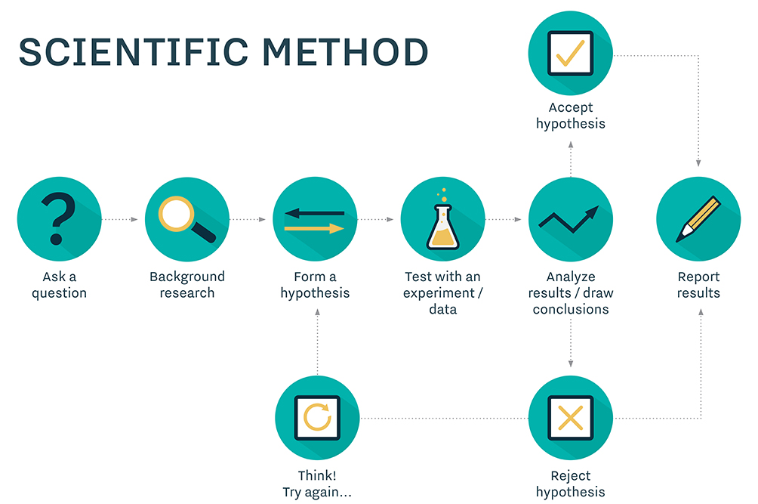
Scientific method

Slide 106
Hypothesis
In general, many scientific investigations start by expressing a hypothesis.
To evaluate hypotheses, we rely on
  estimators,
  their sampling distributions,
  their specific values
from observed data.
For example,
  Mackowiak et al.* hypothesized that the average normal (i.e., for healthy people) body temperature is less than the widely accepted value of 98.6°F.
  If we denote the population mean of normal body temperature as μ, then we can express this hypothesis as μ<98.6.
*Mackowiak, P.A., Wasserman, S.S., Levine, M.M.: A critical appraisal of 98.6°F, the upper limit of the normal body temperature, and other legacies of Carl Reinhold AugustWunderlich. JAMA 268, 1578–1580 (1992)

Slide 107
Null and Alternative hypotheses
The null hypothesis usually reflects the “status quo" or “nothing of interest".
In contrast, we refer to our hypothesis (i.e., the hypothesis we are investigating through a scientific study) as the alternative hypothesis and denote it as H_{A}.
The procedure for evaluating a hypothesis is called hypothesis testing, and it rises in many scientific problems.
For hypothesis testing, we focus on the null hypothesis since it tends to be simpler.
To this end, we examine the evidence that the observed data provide against the null hypothesis H₀.
  If the evidence against H₀ is strong, we reject H₀.
  If not, we state that the evidence provided by the data is not strong enough to reject H₀, and we fail to reject it.

Slide 108
Null and Alternative hypotheses
With respect to our decision regarding the null hypothesis H₀, we might make two types of errors:
  Type I error:
    we reject H₀ when it is true and should not be rejected.
  Type II error:
    we fail to reject H₀ when it is false and should be rejected.
We denote the probability of making type I error as α and the probability of making type II error as β.
 | Actual Validity of H₀
Decision Made |  | H₀ is true | H₀ is false
 | Accept H₀ | True Negative | False Negative (Type II Error)
 | Reject H₀ | False Positive (Type I Error) | True Positive

Slide 109
Null and alternative hypotheses
Now suppose that we have a hypothesis testing procedure that fails to reject the null hypothesis when it should be rejected with probability β.
  This means that our test correctly rejects the null hypothesis with probability 1 − β.
    Note that the two events are complementary.
  We refer to this probability (i.e., 1 − β) as the power of the test.
In practice, it is common to first agree on a tolerable type I error rate α, such as 0.01, 0.05, and 0.1.
Then try to find a test procedure with the highest power among all reasonable testing procedures.

Slide 110
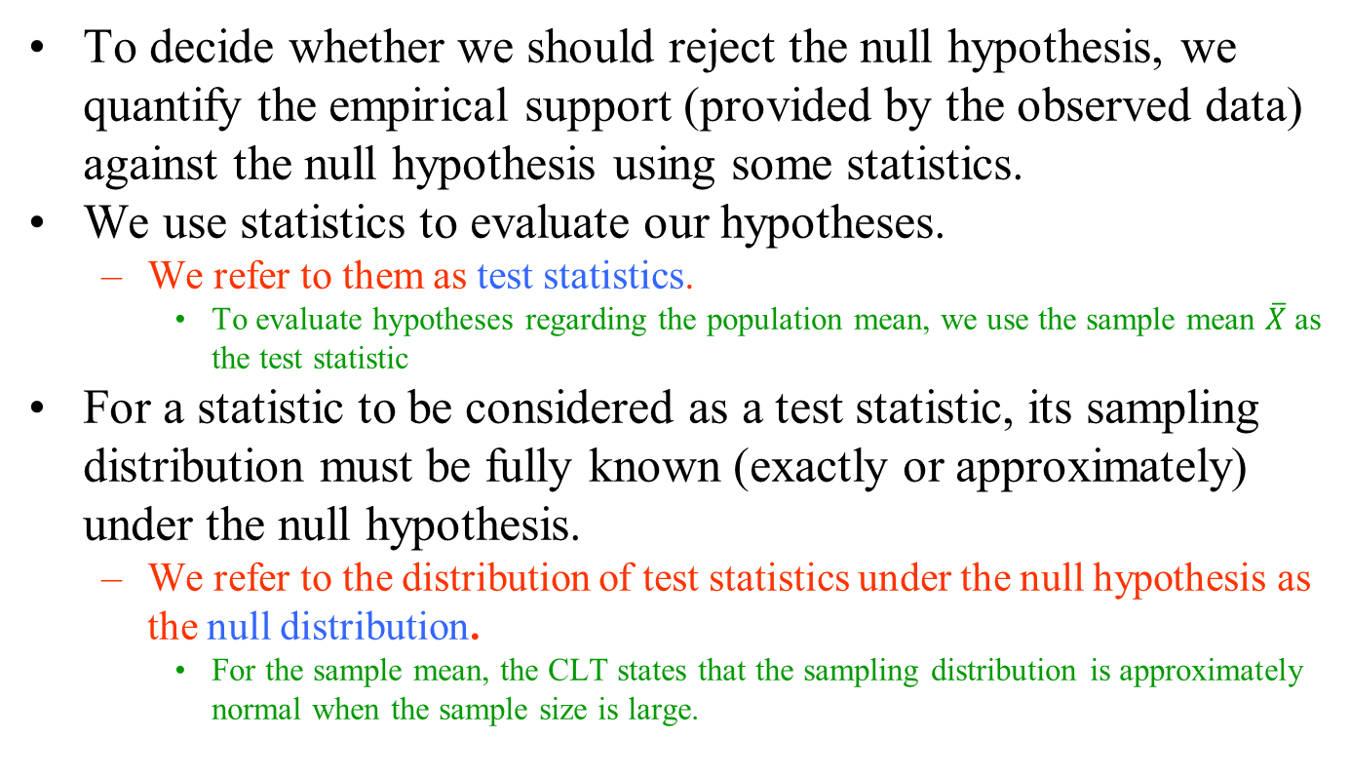
Hypothesis testing for the population mean
To decide whether we should reject the null hypothesis, we quantify the empirical support (provided by the observed data) against the null hypothesis using some statistics.
We use statistics to evaluate our hypotheses.
  We refer to them as test statistics.
    To evaluate hypotheses regarding the population mean, we use the sample mean $\overline{X}$ as the test statistic
For a statistic to be considered as a test statistic, its sampling distribution must be fully known (exactly or approximately) under the null hypothesis.
  We refer to the distribution of test statistics under the null hypothesis as the null distribution.
    For the sample mean, the CLT states that the sampling distribution is approximately normal when the sample size is large.

Slide 111
Regression Analysis
The modeling of the relationship between a response variable and a set of explanatory variables is one of the most widely used of all statistical techniques.
  We refer to this type of modeling as regression analysis.
A regression model provides the user with a functional relationship between the response variable and explanatory variables that allows the user to determine which of the explanatory variables have an effect on the response.
  The regression model allows the user to explore what happens to the response variable for specified changes in the explanatory variables.

Slide 112
Regression Analysis
The basic idea of regression analysis is to obtain a model for the functional relationship between a response variable (often referred to as the dependent variable) and one or more explanatory variables (often referred to as the independent variables).
Regression models have a number of uses:
  The model provides a description of the major features of the data set.
    In some cases, a subset of the explanatory variables will not affect the response variable, and, hence, the researcher will not have to measure or control any of these variables in future studies.
      This may result in significant savings in future studies or experiments.

Slide 113
Regression Analysis
  The equation relating the response variable to the explanatory variables produced from the regression analysis provides estimates of the response variable for values of the explanatory variables not observed in the study.
    For example, a clinical trial is designed to study the response of a subject to various dose levels of a new drug.
    Because of time and budgetary constraints, only a limited number of dose levels are used in the study.
      The regression equation will provide estimates of the subjects’ response for dose levels not included in the study.
  In business applications, the prediction of future sales of a product is crucial to production planning.
    If the data provide a model that has a good fit in relating current sales to sales in previous months, prediction of sales in future months is possible.

Slide 114
The linear relationship
The linear relationship between Y and X in the entire population can be presented in a similar form,
Y = α +βX +ε
where α is the intercept, and β is the slope of the regression line , ε is called the error term, representing the difference between the estimated and the actual values of Y in the population.
We refer to the above equation as the linear regression model.
  We refer to α and β as the regression parameters.
  More specifically, β is called the regression coefficient for the explanatory variable.
  The process of finding the regression parameters is called fitting a regression model to the data.

Slide 115
Supervised learning
Linear regression models are used to predict the unknown values of the response variable.
  In these models, the response variable has a central role;
    the model building process is guided by explaining the variation of the response variable or predicting its values.
  Therefore, building regression models is known as supervised learning.

Slide 116
Unsupervised learning
Building statistical models to identify the underlying structure of data is known as unsupervised learning.
  An important class of unsupervised learning is clustering,
    which is commonly used to identify subgroups within a population.
In general, cluster analysis refers to the methods that attempt to divide the data into subgroups such that
  the observations within the same group are more similar compared to the observations in different groups.

Slide 117
Distance Measure
The core concept in any cluster analysis is the notion of similarity and dissimilarity.
  It is common to quantify the degree of dissimilarity based on a distance measure,
    which is usually defined for a pair of observations.
The most commonly used distance measure is the squared distance,
d_{ij} = (x_{i} −x_{j} )²,
  where d_{ij} refers to the distance between observations i and j , x_{i} is the value of random variable X for observation i, and x_{j} is the value for observation j.

Slide 118
Similarity and Dissimilarity
Similarity
  is a numerical measure of how alike two data objects are
  is higher when objects are more alike
  often falls in the range [0,1]
Dissimilarity
  is a numerical measure of how two data objects are different
  is lower when objects are more alike
    Minimum dissimilarity is often 0
    Upper limit varies
Proximity refers to a similarity or dissimilarity

Slide 119
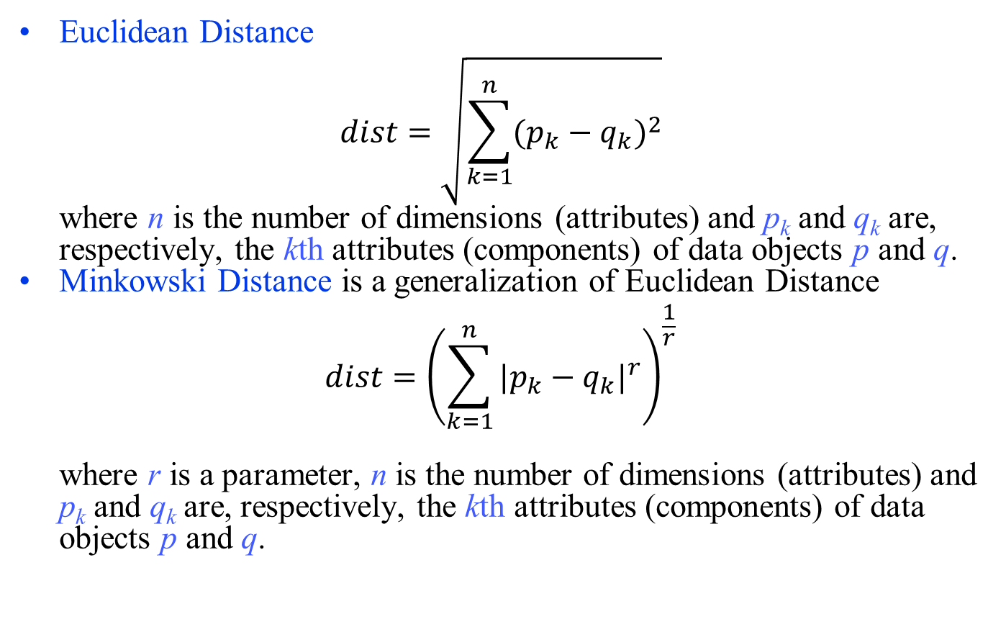
Distance
Euclidean Distance
$$dist=\sqrt{\sum_{k=1}^{n}{{(p_{k}−q_{k})}^{2}}}$$
where n is the number of dimensions (attributes) and p_{k} and q_{k} are, respectively, the kth attributes (components) of data objects p and q.
Minkowski Distance is a generalization of Euclidean Distance
$$dist={\left(\sum_{k=1}^{n}{{|p_{k}−q_{k}|}^{r}}\right)}^{\frac{1}{r}}$$
where r is a parameter, n is the number of dimensions (attributes) and p_{k} and q_{k} are, respectively, the kth attributes (components) of data objects p and q.

Slide 120
Distance
In Minkowski Distance,
  if r = 1 dist is City block (Manhattan, taxicab, L1 norm) distance
  if r = 2 dist is Euclidean distance
  if r = ∞ dist is “supremum” (Lmax norm, L∞ norm) distance
In general, if we measure p random variables X₁, . . . , X_{p}, the squared distance between two observations i and j in our sample is
d_{ij} = (x_{i1} −x_{j1})² +・ ・ ・+(x_{ip} −x_{jp})²
This measure of dissimilarity is called the squared Euclidean distance

Slide 121
K-means Clustering
K-means clustering is a simple algorithm that uses the squared Euclidean distance as its measure of dissimilarity.
After randomly partitioning the observations into K groups and finding the center or centroid of each cluster, the K-means algorithm finds the best clusters by iteratively repeating the following steps
  For each observation, find its squared Euclidean distance to all K centers, and assign it to the cluster with the smallest distance.
  After regrouping all the observations into K clusters, recalculate the K centers.
These steps are applied until the clusters do not change
  i.e., the centers remain the same after each iteration.

Slide 122
K-means Clustering
An example of visualizing the results of K-means clustering with a scatterplot
The three clusters are represented by circles, triangles, and crosses.

Slide 123
Hierarchical Clustering
There are two potential problems with the K-means clustering algorithm.
  It is a flat clustering method.
  We need to specify the number of clusters K a priori.
An alternative approach that avoids these issues is hierarchical clustering.
The result of this method is a dendrogram (a tree).
  The root of the dendrogram is its highest level and contains all n observations.
  The leaves of the tree are its lowest level and are each a unique observation.

Slide 124
Hierarchical Clustering
There are two general algorithms for hierarchical clustering:
  Divisive (top-down):
    We start at the top of the tree, where all observations are grouped in a single cluster.
    Then we divide the cluster into two new clusters that are most dissimilar.
      Now we have two clusters.
    We continue splitting existing clusters until every observation is its own cluster.

Slide 125
Hierarchical Clustering
  Agglomerative (bottom-up):
    We start at the bottom of the tree, where every observation is a cluster
      i.e., there are n clusters.
    Then we merge two of the clusters with the smallest degree of dissimilarity
      i.e., the two most similar clusters.
      Now we have n − 1 clusters.
    We continue merging clusters until we have only one cluster (the root) that includes all observations.

Slide 126
Hierarchical Clustering
We can use one of the following methods to calculate the overall distance between two clusters
  Single linkage clustering uses the minimum d_{ij} among all possible pairs as the distance between the two clusters.
  Complete linkage clustering uses the maximum d_{ij} as the distance between the two clusters.
  Average linkage clustering uses the average d_{ij} over all possible pairs as the distance between the two clusters.
  Centroid linkage clustering finds the centroids of the two clusters and uses the distance between the centroids as the distance between the two clusters.

Slide 127
Hierarchical Clustering
The following figure illustrates the difference between the single linkage method, the complete linkage method, and the centroid linkage method to determine the distance d_{ij} between the two clusters shown as circles and squares.
Note that the dotted line connects the centers (as opposed to observations) of the two clusters.
There are of course other ways for defining the distance between two clusters.
However, the above measures are the most commonly used.

