Slide 1
Introduction to Bioinformatics
Prof. Dr. Nizamettin AYDIN
Phylogenetics
naydin@yildiz.edu.tr
http://www3.yildiz.edu.tr/~naydin

Slide 2
What is Molecular Phylogenetics…
Phylogenetics
  the study of evolutionary relationships in organisms,
  one part of the larger field of systematics, which also includes taxonomy.
    The term taxonomy connotes the process and methodology for the naming and classification of organisms.
The systematics
  the branch of biology that deals with classification and nomenclature; taxonomy

Slide 3
…What is Molecular Phylogenetics…
The context of evolutionary biology is phylogeny,
  the connections between all groups of organisms as understood by ancestor/descendant relationships.
The molecular mechanisms of organisms studied strongly suggests that all organisms on earth have a common ancestor.
  Thus, the species are related to each other by the virtue of having evolved from the same common ancestor.
Such a relationship of species is called phylogeny and it’s graphical representation is called a phylogenetic tree.

Slide 4
…What is Molecular Phylogenetics
Example:
  relationship among species
crocodiles
primates
rodents
birds
birds
lizards
crocodiles
snakes
marsupials
rodents
snakes
primates
lizards
marsupials

Slide 5
Etymology
phyl-(or phylo-)
  Latin, from Greek, from phylē, phylon.
    tribes, races or phyla
    phyla
  a direct line of descent within a group
genetics (genetic + -ics)
  From Greek genetikos from genesis (origin)
    laws of origination (1872)
    study of heredity (from 1891)
phylogeny
  the evolutionary history of a kind of organism
  the evolution of a genetically related group of organisms
  phylogenetics
  a branch of science that deals with phylogeny

Slide 6
A Brief History of Molecular Phylogenetics
1900s
  Immunochemical studies
    cross-reactions stronger for closely related organisms
      Nuttall (1902) - apes are closest relatives to humans!
1960s - 1970s
  Protein sequencing methods, electrophoresis, DNA hybridization and Polymerase Chain Reaction (PCR) contributed to a boom in molecular phylogeny
late 1970s to present
  Discoveries using molecular phylogeny
    Endosymbiosis - Margulis, 1978
    Divergence of phyla and kingdom - Woese, 1987
    Many Tree of Life projects completed or underway

Slide 7
Molecular data vs. Morphology/Physiology
Strictly heritable entities
Data is unambiguous
Regular & predictable evolution
Quantitative analyses
Ease of homology assessment
Relationship of distantly related organisms can be inferred
Abundant and easily generated with PCR and sequencing
Can be influenced by environmental factors
Ambiguous modifiers: “reduced”, “slightly elongated”, “somewhat flattened”
Unpredictable evolution
Qualitative argumentation
Homology difficult to assess
Only close relationships can be confidently inferred
Problems when working with micro-organisms and where visible morphology is lacking

Slide 8
Phylogenetic concepts: Interpreting a Phylogeny
Physical position in tree is not meaningful
Swiveling can only be done at the nodes
Only tree structure matters
Sequence A
Sequence B
Sequence C
Sequence D
Sequence E
Present
Time

Slide 9
Phylogenetic concepts: Interpreting a Phylogeny
Physical position in tree is not meaningful
Swiveling can only be done at the nodes
Only tree structure matters
Sequence A
Sequence B
Sequence E
Sequence D
Sequence C
Present
Time

Slide 10
Tree Terminology
Relationships are illustrated by a phylogenetic tree / dendrogram
  Combination of Greek dendro/tree and gramma/drawing
  A dendrogram is a tree diagram
    frequently used to illustrate the arrangement of the clusters produced by hierarchical clustering.
  Dendrograms are often used in computational biology
    to illustrate the clustering of genes or samples, sometimes on top of heatmaps.

Slide 11
Tree Terminology
A cladogram is a type of phylogenetic tree that only shows tree topology
  the shape indicating relatedness.
    It shows that, say, humans are more closely related to chimpanzees than to gorillas,
      but not the time or genetic distance between the species.
  Combination of Greek clados/branch and gramma/drawing
    topology
      the branching structure of the tree

Slide 12
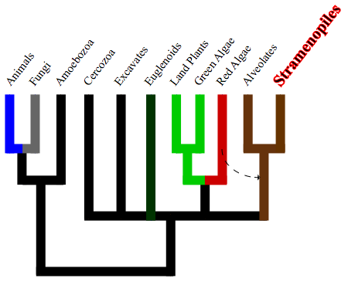
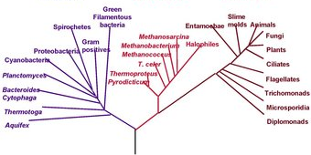
Tree Terminology
The branching pattern is called the tree’s topology
Trees can be represented in several forms:
Rectangular cladogram
Slanted cladogram

Slide 13
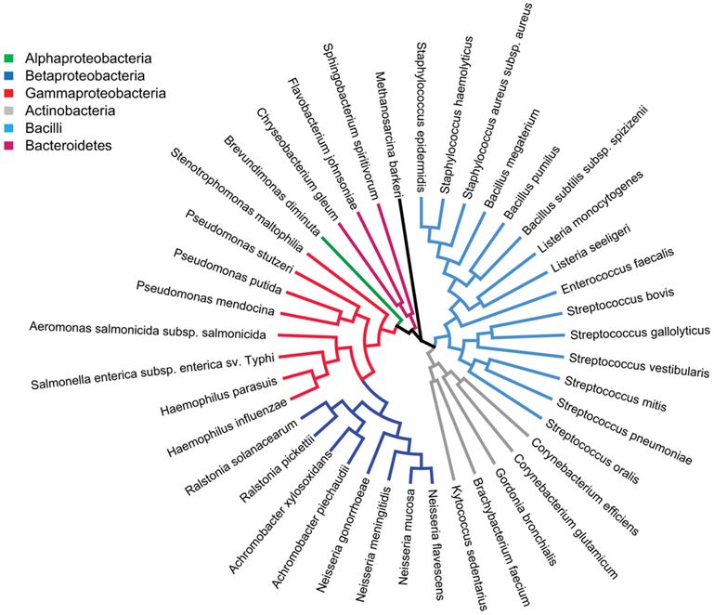
Tree Terminology
Circular cladogram

Slide 14
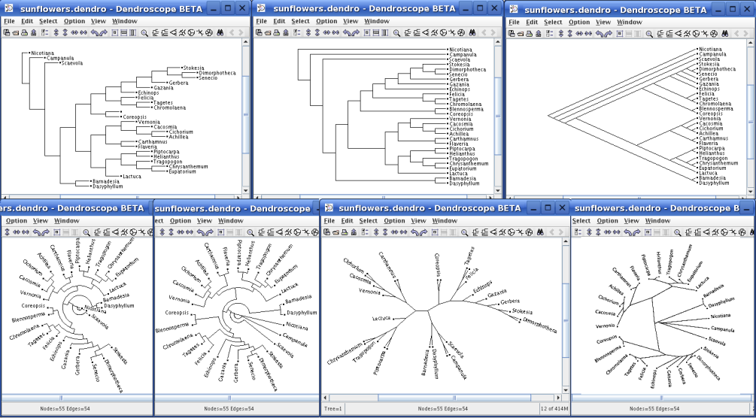
Same tree - seven different views
Rectangular Phylogram, Rectangular Cladogram, Slanted Cladogram, Circular Phylogram, Circular Cladogram, Radial Phylogram and Radial Cladogram

Slide 15
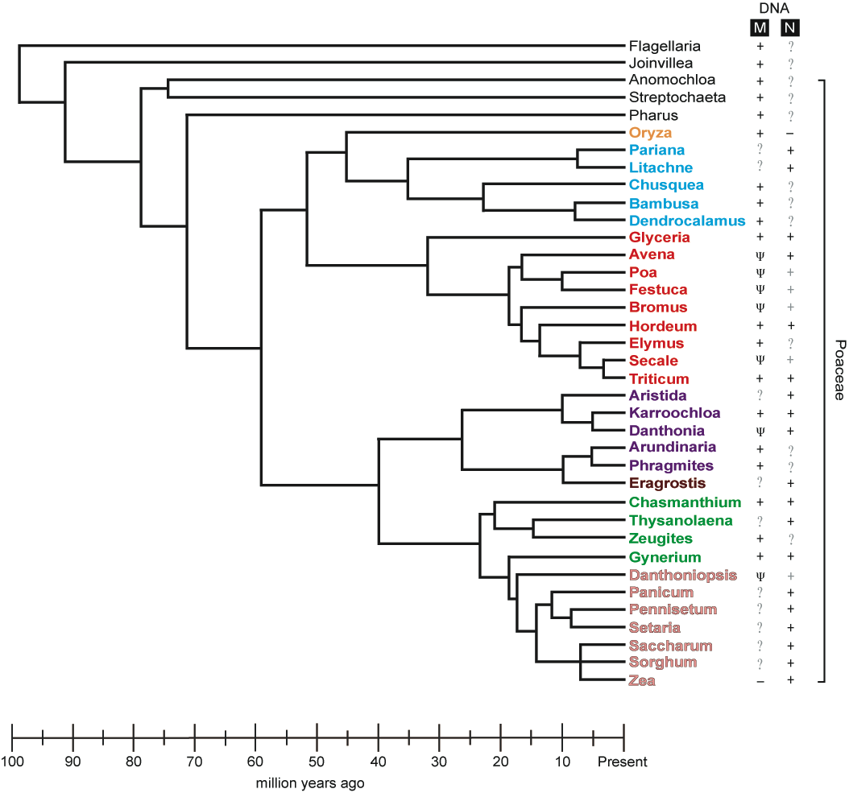
Tree Terminology
Operational taxonomic units (OTU) / Taxa
Internal nodes
A
B
C
Terminal nodes
D
Sisters
Root
E
F
Branches
Polytomy

Slide 16
Tree Terminology
Rooted trees
Unrooted trees
A
D
B
B
A
E
C
D
Root
E
F
C
F
Rooted trees:
  has a root that denotes common ancestry
Unrooted trees:
  Only specifies the degree of kinship among taxa but not the evolutionary path
  Taxon, plural taxa. (taxonomy): Any group or rank in a biological classification into which related organisms are classified.

Slide 17
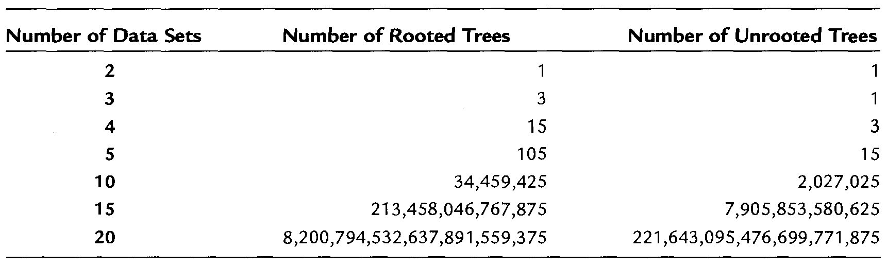


Number of trees
The number of rooted trees for n species:
The number of unrooted trees for n species:
$$\frac{\left(2n−3\right)!}{2^{n−2}\left(n−2\right)!}$$
$$\frac{\left(2n−5\right)!}{2^{n−3}\left(n−3\right)!}$$
Number of possible rooted and unrooted trees that can describe the possible relationships among fairly small numbers of data sets.

Slide 18
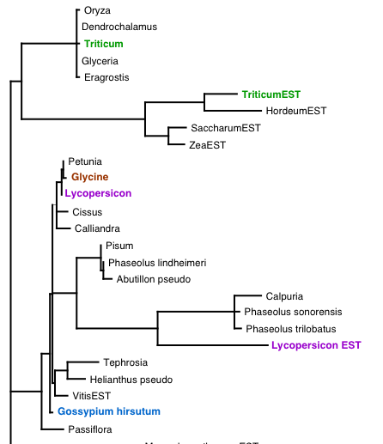
Tree Terminology
Scaled trees:
  Branch lengths are proportional to the number of nucleotide/amino acid changes that occurred on that branch (usually a scale is included).
  In the best of cases, scaled trees are also additive, meaning that
  the physical length of the branches connecting any two nodes is an accurate representation of their accumulated differences.

Slide 19
Tree Terminology
Unscaled trees:
  Branch lengths are not proportional to the number of nucleotide/amino acid changes
    usually used to illustrate evolutionary relationships only.
  line up all terminal nodes and convey only their relative kinship without making any representation regarding the number of changes that separate
A
B
C
D
E
F

Slide 20
Tree Terminology
Monophyletic groups
Paraphyletic groups
Saturnite 1
Jupiterian 32
Saturnite 2
Jupiterian 5
Saturnite 3
Jupiterian 67
Martian 1
Human 11
Martian 3
Jupiterian 8
Martian 2
Human 3
Monophyletic groups:
  All taxa within the group are derived from a single common ancestor and members form a natural clade.
Paraphyletic groups:
  The common ancestor is shared by other taxon in the group and members do not form a natural clade.

Slide 21
Gene vs. Species Trees
Gene tree
  a phylogenetic tree based on the divergence observed within a single homologous gene.
    Such trees may represent the evolutionary history of a gene but not necessarily that of the species in which it is found.
Species trees
  best obtained from analyses that use data from multiple genes.
    For example, a study on the evolution of plant species used more than 100 different genes to generate a species tree for plants.

Slide 22
Character and Distance Data
The molecular data used to generate phylogenetic trees fall into one of two categories:
  Characters
    a well-defined feature that can exist in a limited number of different states
  Distances
    a measure of the overall, pairwise difference between two data sets
Both DNA and protein sequences are examples of data that describe a set of discrete character states.

Slide 23
Methods in Phylogenetic Reconstruction
Distance Based Methods
  calculate pairwise distances between sequences, and group sequences that are most similar.
  This approach has potential for computational simplicity and therefore speed
Character Based Methods (Maximum parsimony)
  assumes that shared characters in different entities result from common descent.
  Groups are built on the basis of such shared characters, and the simplest explanation for the evolution of characters is taken to be the correct, or most parsimonious one.
Probabilistic Methods (Maximum likelihood)
  compute the probability that a data set fits a tree derived from that data set, given a specified model of sequence evolution.

Slide 24
Comparison of Methods
Distance
Maximum parsimony
Maximum likelihood
Uses only pairwise distances
Minimizes distance between nearest neighbors
Very fast
Easily trapped in local optima
Good for generating tentative tree, or choosing among multiple trees
Uses only shared derived characters
Minimizes total distance
Slow
Assumptions fail when evolution is rapid
Best option when tractable (<30 taxa, homoplasy rare)
Uses all data
Maximizes tree likelihood given specific parameter values
Very slow
Highly dependent on assumed evolution model
Good for very small data sets and for testing trees built using other methods

Slide 25
Methods in Phylogenetic Reconstruction
Distance Based Methods
  Using a sequence alignment, pairwise distances/dissimilarities are calculated
  Creates a distance/dissimilarity matrix
  A phylogenetic tree is calculated with clustering algorithms, using the distance matrix.
  Examples of clustering algorithms include
    Unweighted Pair Group Method using Arithmetic averages (UPGMA)
    Neighbor Joining clustering.
A
A
A
B
B
B
C
C
D

Slide 26
UPGMA
Unweighted-Pair-Group Method with Arithmetic mean (UPGMA)
  Oldest and simplest distance matrix method
  Originally proposed in the early 1960s to help with the evolutionary analysis of morphological characters,
  requires data that can be condensed to a measure of genetic distance between all pairs of taxa being considered.
  requires a distance matrix such as one that might be created for a group of 4 taxa called A, B, C, and D.

Slide 27
UPGMA
Assume that the pairwise distances between each of the taxa are given in the following matrix:
  d_{AB} : distance between species A and B
  d_{AC} : distance between species A and C
  …
Species | A | B | C
B | d_{AB} | - | -
C | d_{AC} | d_{BC} | -
D | d_{AD} | d_{BD} | d_{CD}

Slide 28
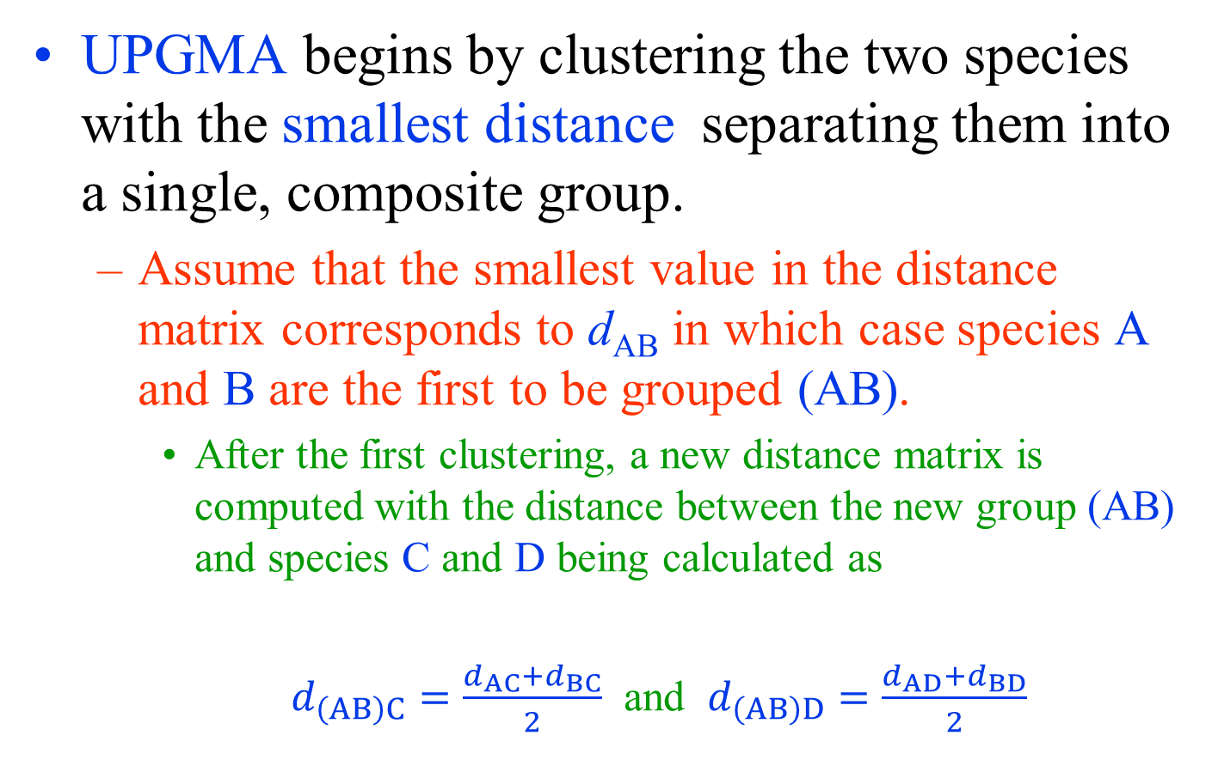
UPGMA
UPGMA begins by clustering the two species with the smallest distance separating them into a single, composite group.
  Assume that the smallest value in the distance matrix corresponds to d_{AB} in which case species A and B are the first to be grouped (AB).
    After the first clustering, a new distance matrix is computed with the distance between the new group (AB) and species C and D being calculated as
    $d_{\left(AB\right)C}=\frac{d_{AC}{+d}_{BC}}{2}$ and $d_{\left(AB\right)D}=\frac{d_{AD}{+d}_{BD}}{2}$

Slide 29
UPGMA
The species separated by the smallest distance in the new matrix are then clustered to make another new composite species.
The process is repeated until all species have been grouped.
  If scaled branch lengths are to be used on the tree to represent the evolutionary distance between species, branch points are positioned at a distance halfway between each of the species being grouped
    i.e., at d_{AB}/2 for the first clustering

Slide 30
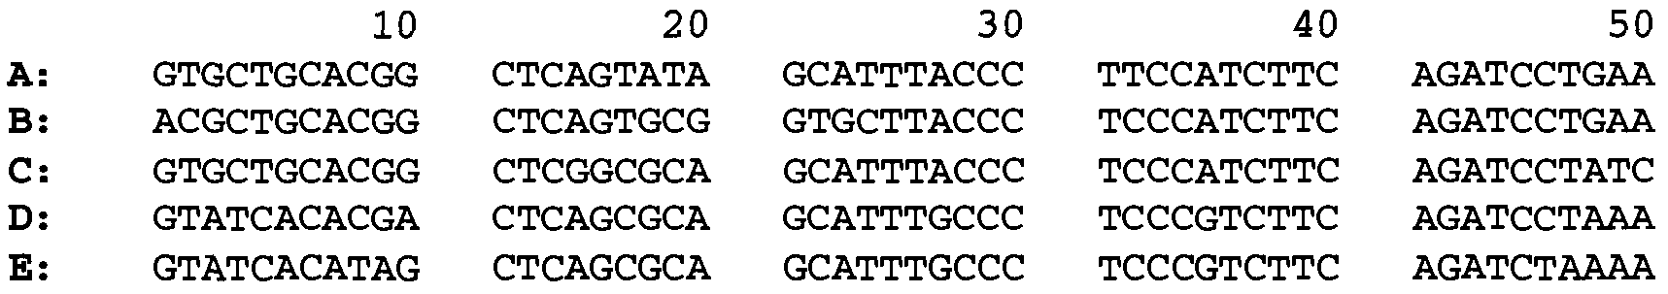
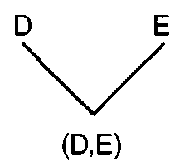
UPGMA - example
Consider the following alignment between five different DNA sequences
Pairwise distance matrix
  Smallest distance:
    d_{DE} , so
      Species D and species E are grouped
Species | A | B | C | D
B | 9 | - | - | -
C | 8 | 11 | - | -
D | 12 | 15 | 10 | -
E | 15 | 18 | 13 | 5

Slide 31
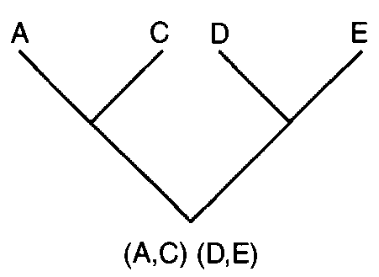
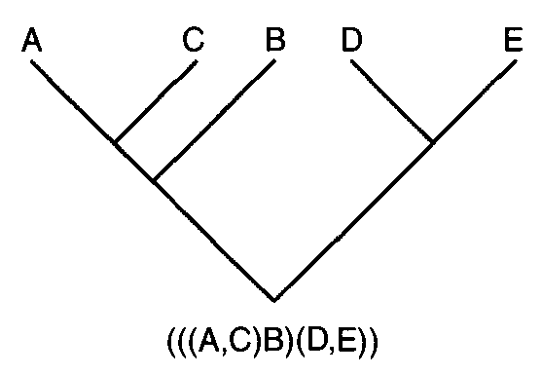
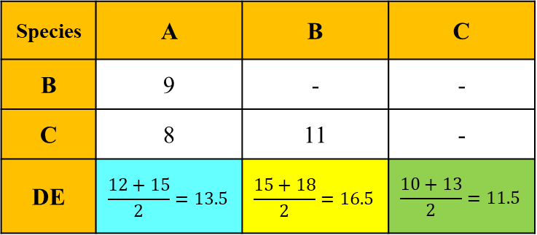
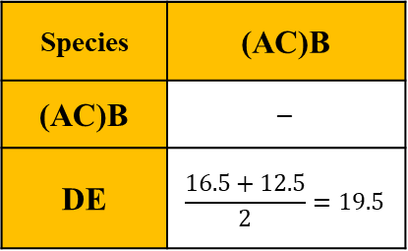
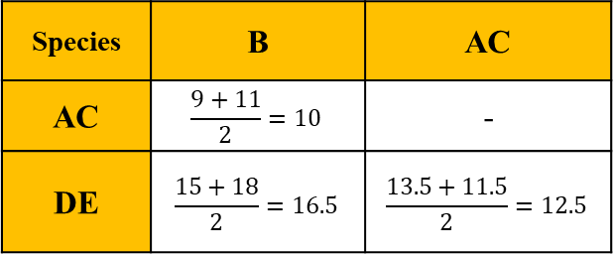
UPGMA - example
Species | A | B | C | D
B | 9 | - | - | -
C | 8 | 11 | - | -
D | 12 | 15 | 10 | -
E | 15 | 18 | 13 | 5
Species | A | B | C
B | 9 | - | -
C | 8 | 11 | -
DE | $$\frac{12+15}{2}=13.5$$ | $$\frac{15+18}{2}=16.5$$ | $$\frac{10+13}{2}=11.5$$
Species | B | AC
AC | $$\frac{9+11}{2}=10$$ | -
DE | $$\frac{15+18}{2}=16.5$$ | $$\frac{13.5+11.5}{2}=12.5$$
Species | (AC)B
(AC)B | $$−$$
DE | $$\frac{16.5+12.5}{2}=19.5$$

Slide 32
Estimation of Branch Lengths
Tree describes the relatedness of sequences
It is possible for the topology of phylogenetic trees to convey information about
  the relative degree to which sequences have diverged.
  Scaled trees that convey that information, often referred to as cladograms,
    the length of branches correspond to the inferred amount of time that the sequences have been accumulating substitutions independently.

Slide 33
Estimation of Branch Lengths
The relative length of each branch in a cladogram can be calculated using the information in a distance matrix.
  In the example, the d_{DE} is 5,
    the pair of branches connecting each of those species to their common ancestor should each be d_{DE} /2 or 2.5 units long on a tree with scaled branch lengths.
  A and C should be connected to their common ancestor by branches that are d_{AC}/2 or 4 units long,
  The branch point between (AC) and (DE) should be connected to (AC) and (DE) by branches that are both d_{(AC)(DE)}/2 or 6.25 units long,

Slide 34
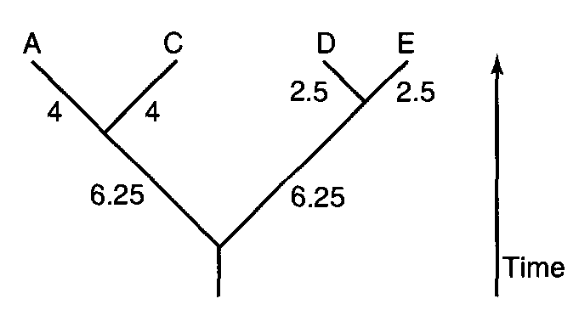
Estimation of Branch Lengths
A scaled tree showing the branch lengths separating four of the species depicted in slide 30.
Branch lengths are shown next to each branch.
Branches are also drawn to scale to reflect the amount of differences between all species.
This very simple approach to estimating branch lengths actually allows UPGMA to intrinsically generate rooted phylogenetic trees.

Slide 35
Estimation of Branch Lengths
Determining branch lengths for a scaled tree is only slightly more complicated
  when it cannot be assumed that evolutionary rates are the same for all lineages.
The simplest tree whose branch lengths might have some meaningful information is one with just three species (A, B, C) and one branch point, such as the one shown.
On such a tree, the length of each of the three branches can be represented by a single letter (a, b, and c) for which we know the following must be true:
  d_{AB} = a + b ; d_{BC} = b + c ; d_{AC} = a + c
A
a
C
c
B
b

Slide 36
Estimation of Branch Lengths
Phylogeny reconstruction for 3 sequences
  There is a single tree topology
  The branch lengths (a, b, c) :
  a + b = d_{AB}
  b + c = d_{BC}
  a + c = d_{AC}
Input:
  d_{AB}, d_{BC} and d_{AC} (pairwise distances)
Output:
  a = (d_{AB} + d_{AC} – d_{BC}) / 2
  b = (d_{AB} + d_{BC} – d_{AC}) / 2
  c = (d_{AC} + d_{BC} – d_{AB}) / 2
 | A | B | C
A | - | a+b | a+c
B | - | - | b+c
C | - | - | -
A
a
C
c
B
b

Slide 37
Estimation of Branch Lengths - example
Distance matrix of 3 sequences and unrooted tree
  distance from A to B = a + b = 22 (1)
  distance from A to C = a + c = 39 (2)
  distance from B to C = b + c = 41 (3)
subtracting (3) from (2) yields:
  b + c – (a + c) = b – a = 41 – 39 = 2 (4)
 | A | B | C
A | -- | 22 | 39
B | -- | -- | 41
C | -- | -- | --
A
a
C
c
B
b

Slide 38
Estimation of Branch Lengths - example
adding (1) and (4) yields
  a + b + b – a = 2b = 22 + 2 = 24
  2b = 24
  b = 24 / 2 = 12
so
  a + b = a + 12 = 22;
  a = 22 – 12 = 10
  finally
  a + c = 10 + c = 39;
  c = 39 – 10 = 29
A
10
C
29
12
B

Slide 39
Neighbor's Relation Method
Popular variant of the UPGMA method
emphasizes pairing species in such a way that
  a tree is created with the smallest possible branch lengths overall.
On any unrooted tree, pairs of species that are separated from each other by just one internal node are said to be neighbors.

Slide 40
Neighbor's Relation Method
The topology of a phylogenetic tree such as the one shown below gives rise to some useful algebraic relationships between neighbors.
If the tree above is a true tree for which additivity holds, then the following should be true:
  d_{AC} + d_{BD} = d_{AD} + d_{BC} = a + b + c + d + 2e = d_{AB} + d_{CD} + 2e
  where a, b, c, and d are the lengths of the terminal branches and e is the length of the single central branch.
Species | A | B | C
B | d_{AB} | - | -
C | d_{AC} | d_{BC} | -
D | d_{AD} | d_{BD} | d_{CD}
A
C
a
c
e
Species | A | B | C
B | a+b | - | -
C | a+e+c | b+e+c | -
D | a+e+d | b+e+d | c+d
b
d
B
D

Slide 41
Neighbor's Relation Method
The following conditions, known together as the four-point condition, will also be true:
d_{AB} + d_{CD} < d_{AC} + d_{BD} ; d_{AB} + d_{CD} < d_{AD} + d_{BC}
It is in this way that a neighborliness approach considers all possible pairwise arrangements of four species and determines which arrangement satisfies the four-point condition.
  An important assumption of the four-point condition is that branch lengths on a phylogenetic tree should be additive and, while it is not especially sensitive to departures from that assumption, data sets that are not additive can cause this method to generate a tree with an incorrect topology.

Slide 42
Neighbor's Relation Method - example
Consider the alignment:
A ACGCGTTGGGCGATGGCAAC
B ACGCGTTGGGCGACGGTAAT
C ACGCATTGAATGATGATAAT
D ACACATTGAGTGATAATAAT
The distances between these sequences can be shown as a table:
 | A | B | C | D
A | - | 3 | 7 | 8
B | - | - | 6 | 7
C | - | - | - | 3
D | - | - | - | -

Slide 43
Estimation of Branch Lengths - example
Using this information, an unrooted tree showing the relationship between these sequences can be drawn:
 | A | B | C | D
A | - | 3 | 7 | 8
B | - | - | 6 | 7
C | - | - | - | 3
D | - | - | - | -
A
C
2
1
4
1
2
B
D

Slide 44
Neighbor-Joining Methods
A variant of neighborliness
an agglomerative technique, and so operates using iteration,
  building the tree from the bottom-up
Start with a star-like tree with all species coming off a single central node regardless of their number.
Neighbors are then sequentially found that minimize the total length of the branches on the tree.

Slide 45
Neighbor-Joining Methods
The input is an n×n dissimilarity/distance matrix d.
In the first iteration,
  the n leaves are all in their own clusters;
In subsequent iterations,
  each cluster is a set of leaves,
    but the clusters are disjoint.
At the beginning of each iteration, the taxa are partitioned into clusters, and for each cluster we have a rooted tree that is leaf-labelled by the elements in the cluster.

Slide 46
Neighbor-Joining Methods
During the iteration, a pair of clusters is selected to be made siblings;
  this results in the trees for the two clusters being merged into a larger rooted tree by making their roots siblings.
When there are only three subtrees, then the three subtrees are merged into a tree on all the taxa by adding a new node, r, and making the roots of the three subtrees adjacent to r.
Note that this description suggests that neighbor joining produces a rooted tree.
  However, after the tree is produced, the root is ignored, so that neighbor joining actually returns an unrooted tree.

Slide 47
Neighbor-Joining Methods
The neighbor-joining method: a new method for reconstructing phylogenetic trees. (1987). Molecular Biology and Evolution. doi:10.1093/oxfordjournals.molbev.a040454

Slide 48
Character-Based Methods of Phylogenetics
The concept of parsimony is at the very heart of all character-based methods of phylogenetic reconstruction.
  Parsimonious: someone who was especially careful with the spending of their money.
In a biological sense, parsimony is used to describe
  the process of attaching preference to one evolutionary pathway over another on the basis of which pathway requires the invocation of the smallest number of mutational events.

Slide 49
Character-Based Methods of Phylogenetics
Phylogenetic trees represent theoretical models that depict the evolutionary history of 3 or more sequences.
The two premises that underlie biological parsimony are quite simple:
  Mutations are exceedingly rare events
  The more unlikely events a model invokes, the less likely the model is to be correct.
As a result, the relationship that requires the fewest number of mutations to explain the current state of the sequences being considered is the relationship that is most likely to be correct.

Slide 50
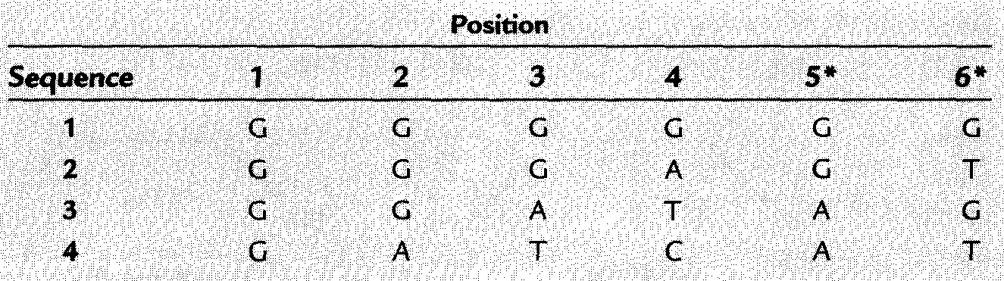
Character-Based Methods of Phylogenetics
Informative and Uninformative Sites
The short four-way multiple sequence alignment shown above contains positions that fall into two categories in terms of their information content for a parsimony analysis:
  those that have information (are informative)
  those that do not (are uninformative).
The relationship between four sequences can be described by only three different unrooted trees

Slide 51
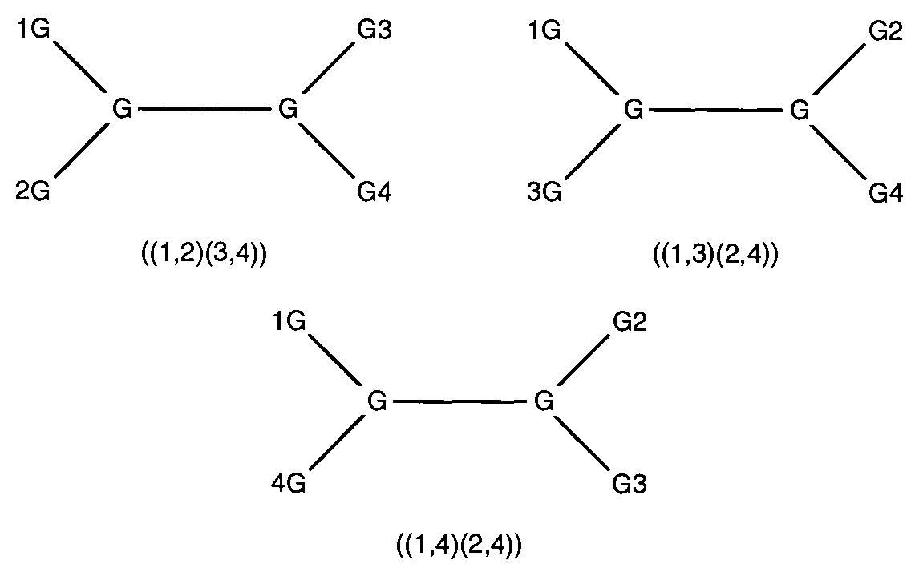
Character-Based Methods of Phylogenetics
Position 1: All 4 sequences have the same character (a "G") and the position is therefore said to be invariant.
  Invariant sites are clearly uninformative because each of the three possible trees that describe the relationship of the four sequences invokes exactly the same number of mutations (0)

Slide 52
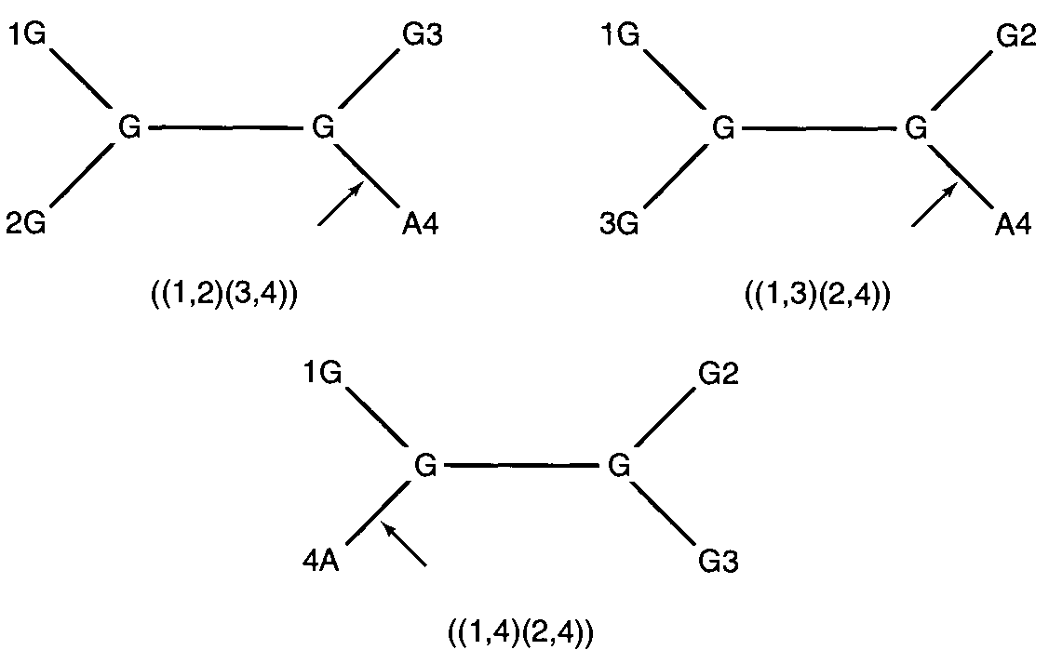
Character-Based Methods of Phylogenetics
Position 2: Uninformative from a parsimony perspective because one mutation occurs in all three of the possible trees.

Slide 53
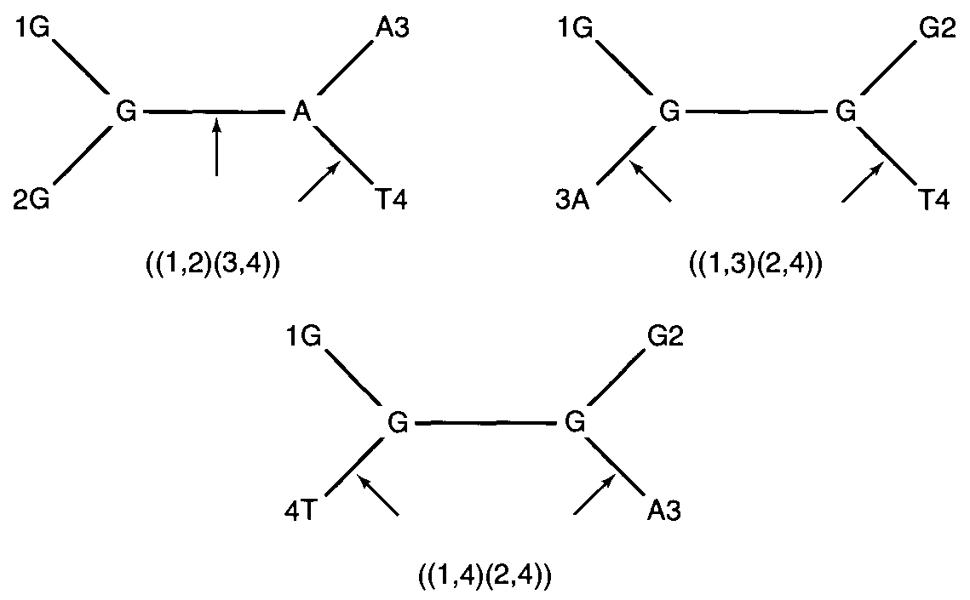
Character-Based Methods of Phylogenetics
Position 3: Uninformative because all three trees require two mutations

Slide 54
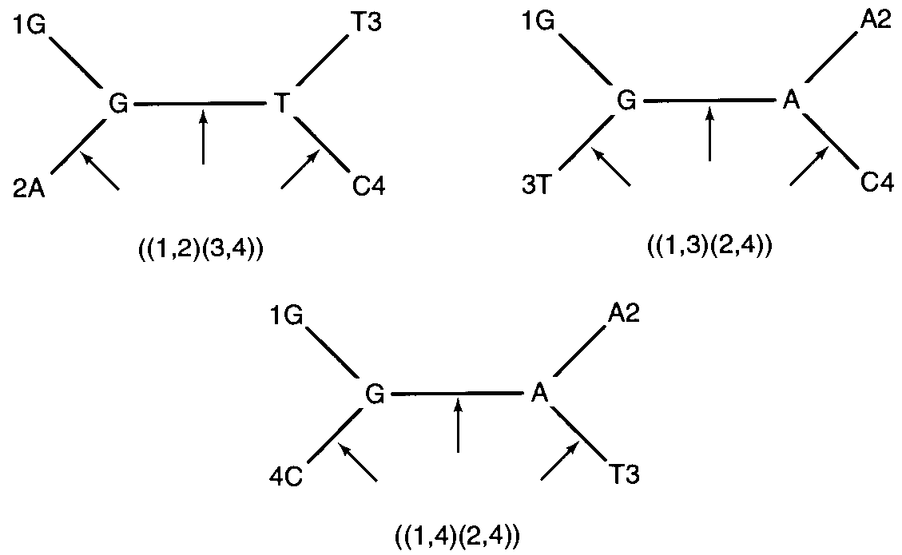
Character-Based Methods of Phylogenetics
Position 4: Uninformative because all three trees require three mutations.

Slide 55
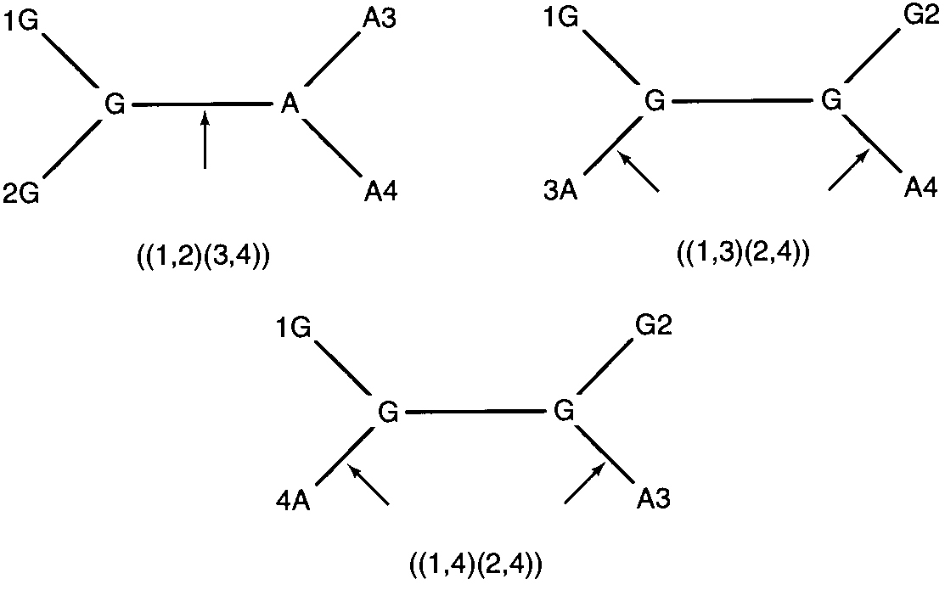
Character-Based Methods of Phylogenetics
Position 5: Informative because one of the three trees invokes only one mutation and the other two alternative trees both require two mutations

Slide 56
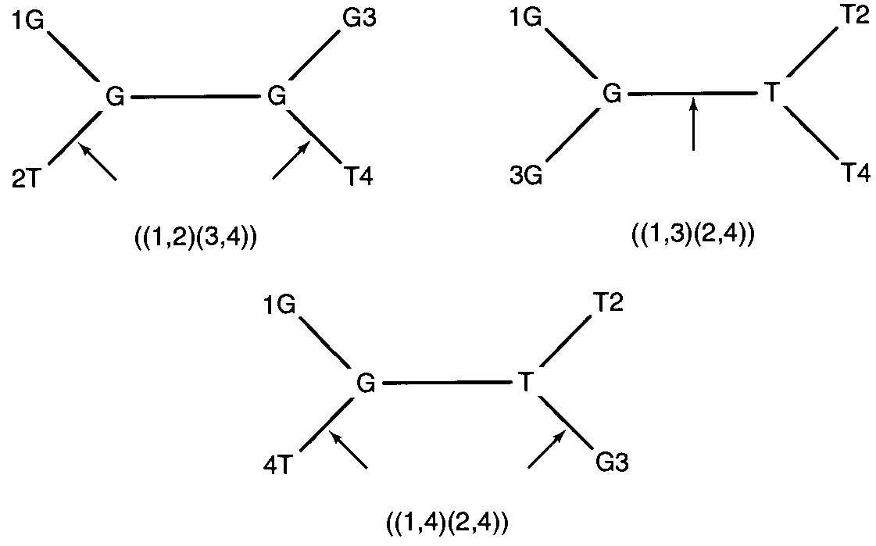
Character-Based Methods of Phylogenetics
Position 6: Informative because one of the three trees invokes only one mutation and the other two alternative trees both require two mutations

Slide 57
Character-Based Methods of Phylogenetics
In general, for a position to be informative regardless of how many sequences are aligned,
  it has to have at least two different nucleotides
  each of these nucleotides has to be present at least twice.
All parsimony programs begin by applying this fairly simple rule to the data set being analyzed.
Notice that 4 of the 6 positions being considered in the alignment shown in slide 50 are simply discarded and not considered any further in a parsimony analysis.
  All of those sites would have contributed to the pairwise similarity scores used by a distance-based approach, and this difference alone can generate substantial differences in the conclusions reached by both types of approaches.

Slide 58
Character-Based Methods of Phylogenetics
Once uninformative sites have been identified and discarded, implementation of the parsimony approach in its simplest form can be straightforward.
Every possible tree is considered individually for each informative site.
A running tally is maintained for each tree that keeps track of the minimum number of substitutions required for each position.
After all informative sites have been considered, the tree (or trees) that needs to invoke the smallest total number of substitutions is labeled the most parsimonious.
    https://paup.phylosolutions.com/

Slide 59
Character-Based Methods of Phylogenetics
Maximum Parsimony
  All possible trees are determined for each position of the sequence alignment
  Each tree is given a score based on the number of evolutionary step needed to produce said tree
  The most parsimonious tree is the one that has the fewest evolutionary changes for all sequences to be derived from a common ancestor
  Usually several equally parsimonious trees result from a single run.

Slide 60
Maximum parsimony: exhaustive stepwise addition
B
C
Step 1
A
B
D
B
D
C
B
C
C
D
Step 2
A
A
A
E
D
E
D
D
B
B
B
E
C
C
C
…………………
A
A
A
Step 3

Slide 61
Maximum Parsimony - example
Maximum parsimony methods predict the evolutionary tree that minimizes the number of steps required to generate the observed variation in the sequences.
  First, a multiple sequence alignment must first be obtained.
For each aligned position, phylogenetic trees that require the smallest number of evolutionary changes to produce the observed sequence changes are identified.

Slide 62
Maximum Parsimony - example
This continues for each position in the alignment.
Those trees that produce the smallest number of changes overall for all sequence positions are identified.
  This is a rather time consuming algorithm that only works well if the sequences have a strong sequence similarity.

Slide 63
Maximum Parsimony - example
The left tree is preferred over the right tree.
AAA
1
AAA
AAA
AGA
AAA
1
AAA
2
1
1
1
AAA
AGA
AGA
GGA
AAG
GGA
AAG
AAA
Total #substitutions = 3
Total #substitutions = 4

Slide 64

Maximum Parsimony - example
Assuming we have 4 sequences
  There are 3 possible trees:
The optimal tree is obtained by adding the number of changes at each informative site for each tree, and picking the tree requiring the least total number of changes.
For a large number of sequences the number of trees to examine becomes so large that it might not be possible to examine all possible trees.

Slide 65
Maximum Parsimony - example
Consider the following sequences
S1 C A C C C C T T
S2 A A C C C C A T
S3 C A C T G C T T
S4 A A C T G C T A
(S1,S2),(S3,S4) 2 0 0 1 1 0 1 1 6
(S1,S3),(S2,S4) 1 0 0 2 2 0 1 1 7
(S1,S4),(S2,S3) 2 0 0 2 2 0 1 1 7
√

Slide 66
Maximum Parsimony - example
S1 C A C C C C T T
S2 A A C C C C A T
S3 C A C T G C T T
S4 A A C T G C T A
(S1,S2),(S3,S4) 2 0 0 1 1 0 1 1 6 √
(S1,S3),(S2,S4) 1 0 0 2 2 0 1 1 7
S1
C
C
S3
S1
C
A
S2
C
A
C
A
S2
A
C
mutation=2
(S1,S2), (S3, S4)
C
mutation=1
(S1,S3), (S2, S4)
A
A
S4
S3
A
S4

Slide 67
Methods in Phylogenetic Reconstruction
Maximum Likelihood
  Creates all possible trees like Maximum Parsimony method
  But instead of retaining trees with shortest evolutionary steps,
    employs a model of evolution whereby different rates of transition/transversion ratios can be used
  Each tree generated is calculated for the probability that it reflects each position of the sequence data
  Calculation is repeated for all nucleotide sites
  Finally, the tree with the best probability is shown as the maximum likelihood tree
    usually only a single tree remains
  It is a more realistic tree estimation because it does not assume equal transition-transversion ratio for all branches.

Slide 68
Tree Confidence
All phylogenetic trees represent hypotheses regarding the evolutionary history of the sequences that make up a data set.
Like any good hypothesis, it is reasonable to ask two questions about how well it describes the underlying data:
  How much confidence can be attached to the overall tree and its component parts (branches)?
  How much more likely is one tree to be correct than a particular or randomly chosen alternative tree?
  To address these two questions, a powerful resampling technique called bootstrapping has become the predominant favorite for addressing the first question, and a simple parametric comparison of two trees is typical of those used to address the second.

Slide 69
Bootstrapping
  Bootstrap analysis is a kind of statistical analysis to test the reliability of certain branches in the evolutionary tree.
  In statistics, it is any test or metric that relies on random sampling with replacement.
  It falls in the broader class of resampling methods.
  It involves resampling one's own data, with replacement, to create a series of bootstrap samples of the same size as the original data.
  In the case of nucleic acid (amino acid) sequences, the resampled data are the nucleotides (amino acids) of a sequence while the statistical significance of a specific cluster is given by the fraction of trees, based on the resampled data, containing that cluster.

Slide 70
Bootstrapping
Bootstrap tests allow for a rough quantification of those confidence levels.
The basic approach of a bootstrap test is straightforward:
A subset of the original data is drawn (with replacement) from the original data set and a tree is inferred from this new data set,
  as illustrated in the next slide

Slide 71
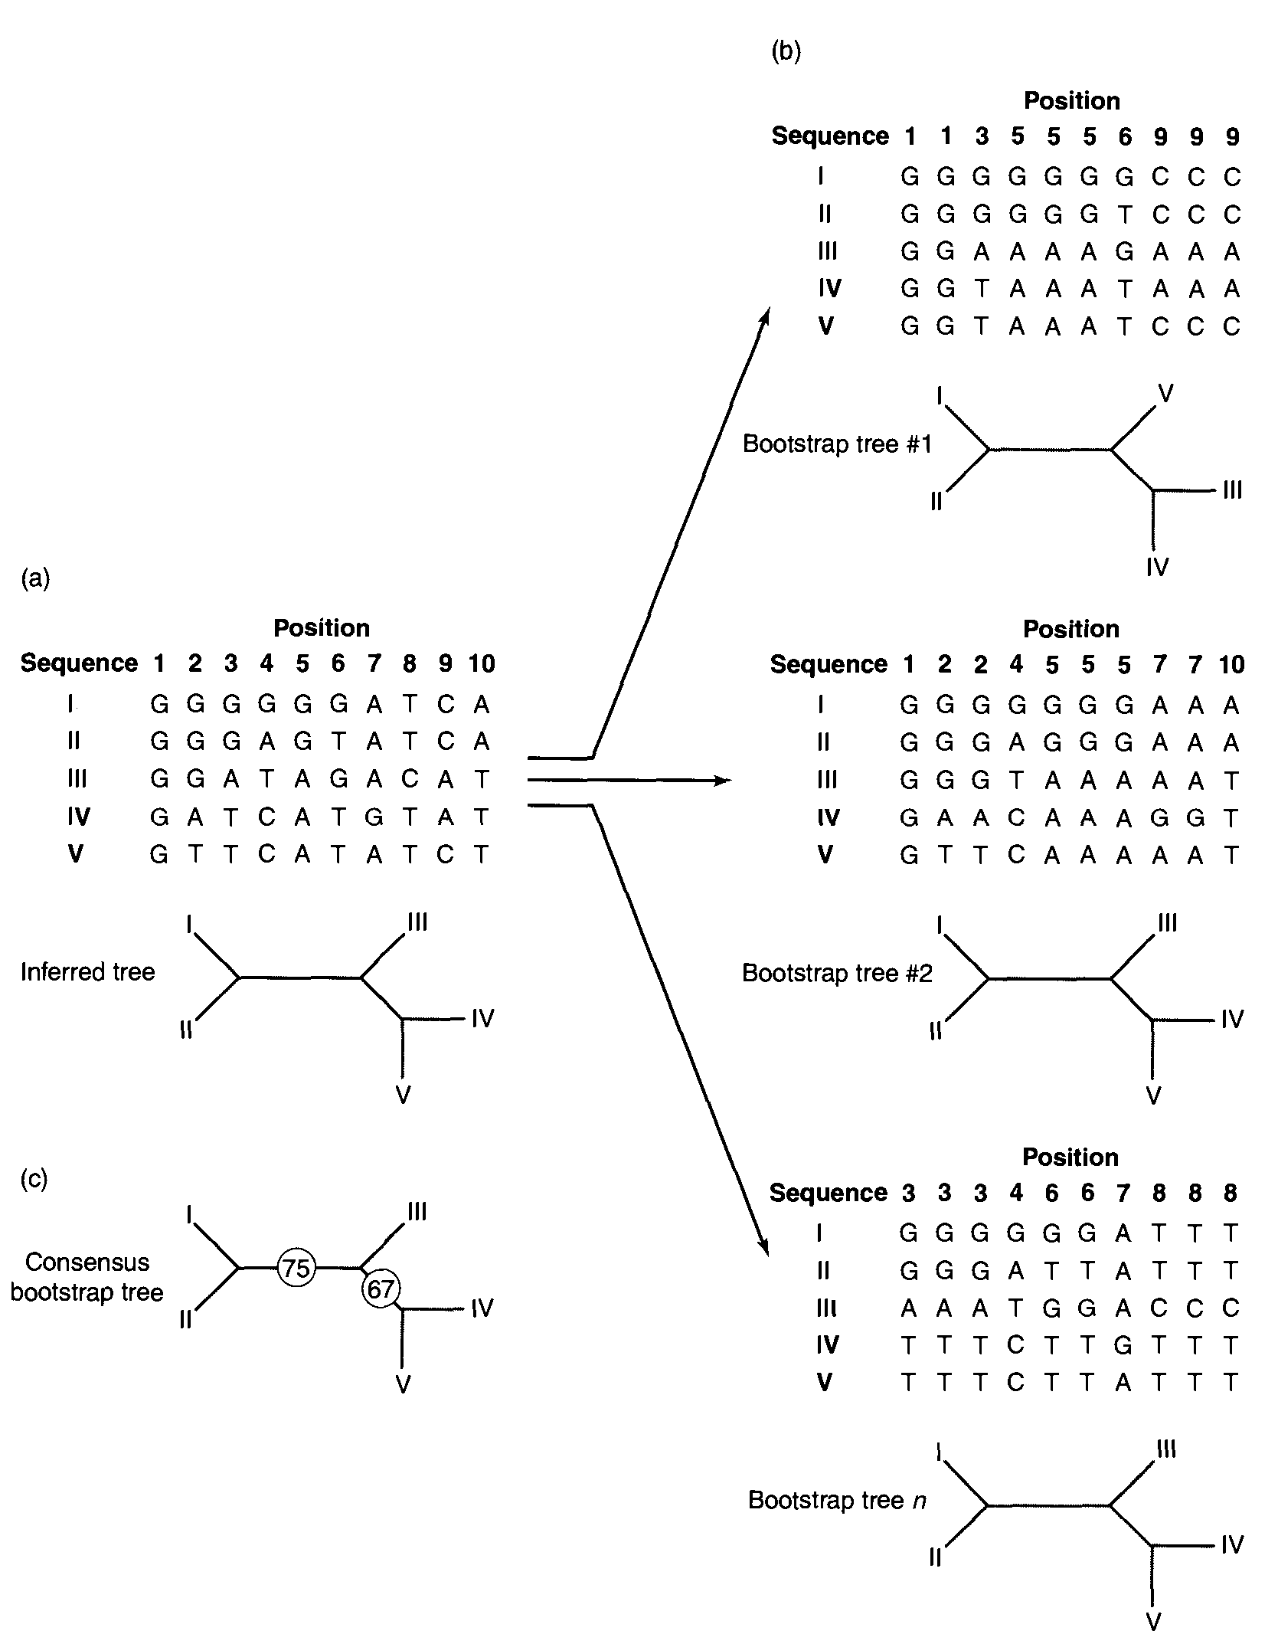
Bootstrapping
Illustration of a boostrap test for a data set that is 10 characters long (positions: 1 through 10) and five sequences (I through V) deep.
The original data set and its most parsimonious tree (a).
A random number generator chooses 10 times from the original 10 positions and creates the three resampled data sets with their corresponding trees (b).
A consensus tree (c) for the three resampled data sets is shown with circled values indicating the fraction of bootstrapped trees that support the clustering of sequences I and II and sequences IV and V.

Slide 72
Bootstrapping
Computational method to estimate the confidence level of a certain phylogenetic tree.
Pseudo sample 1
001122234556667
Sample
rat GGAAGGGGCTTTTTA
human GGTTGGGGCTTTTTA
turtle GGTTGGGCCCCTTTA
fruitfly CCTTCCCGCCCTTTT
oak AATTCCCGCTTCCCT
duckweed AATTCCCCCTTCCCC
0123456789
rat GAGGCTTATC
human GTGGCTTATC
turtle GTGCCCTATG
fruitfly CTCGCCTTTG
oak ATCGCTCTTG
duckweed ATCCCTCCGG
Pseudo sample 2
445556777888899
rat CCTTTTAAATTTTCC
human CCTTTTAAATTTTCC
turtle CCCCCTAAATTTTGG
fruitfly CCCCCTTTTTTTTGG
oak CCTTTCTTTTTTTGG
duckweed CCTTTCCCCGGGGGG
rat
human
turtle
fruit fly
oak
duckweed
Inferred tree
Many more replicates (between 100 - 1000)

Slide 73
Bootstrap values
100
rat
65
human
turtle
0
fruit fly
55
oak
duckweed
Values are in percentages
Conventional practice:
  only values 60-100% are shown

Slide 74
Parametric Tests
The underlying principle of parsimony suggests that the tree that invokes the smallest number of substitutions is the one that is most likely to depict the true relationship between the sequences.
A common question is "How much more likely is the most parsimonious tree than a particular alternative that has previously been put forward to describe the relationship between these taxa?"

Slide 75
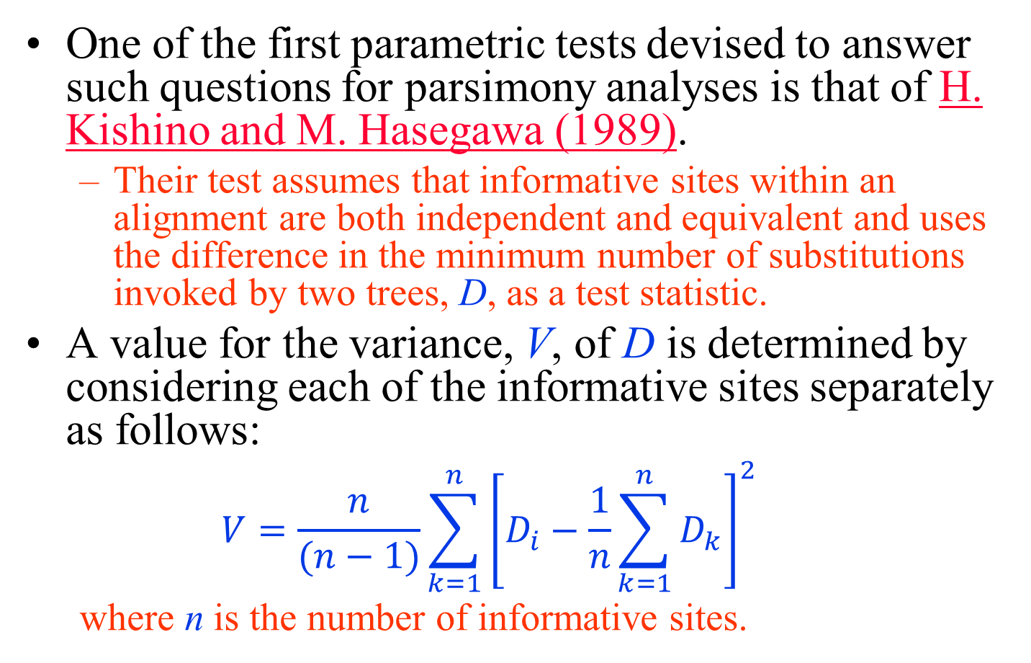
Parametric Tests
One of the first parametric tests devised to answer such questions for parsimony analyses is that of H. Kishino and M. Hasegawa (1989).
  Their test assumes that informative sites within an alignment are both independent and equivalent and uses the difference in the minimum number of substitutions invoked by two trees, D, as a test statistic.
A value for the variance, V, of D is determined by considering each of the informative sites separately as follows:
  $$V=\frac{n}{(n−1)}\sum_{k=1}^{n}{{\left[D_{i}−\frac{1}{n}\sum_{k=1}^{n}{D_{k}}\right]}^{2}}$$
  where n is the number of informative sites.

Slide 76
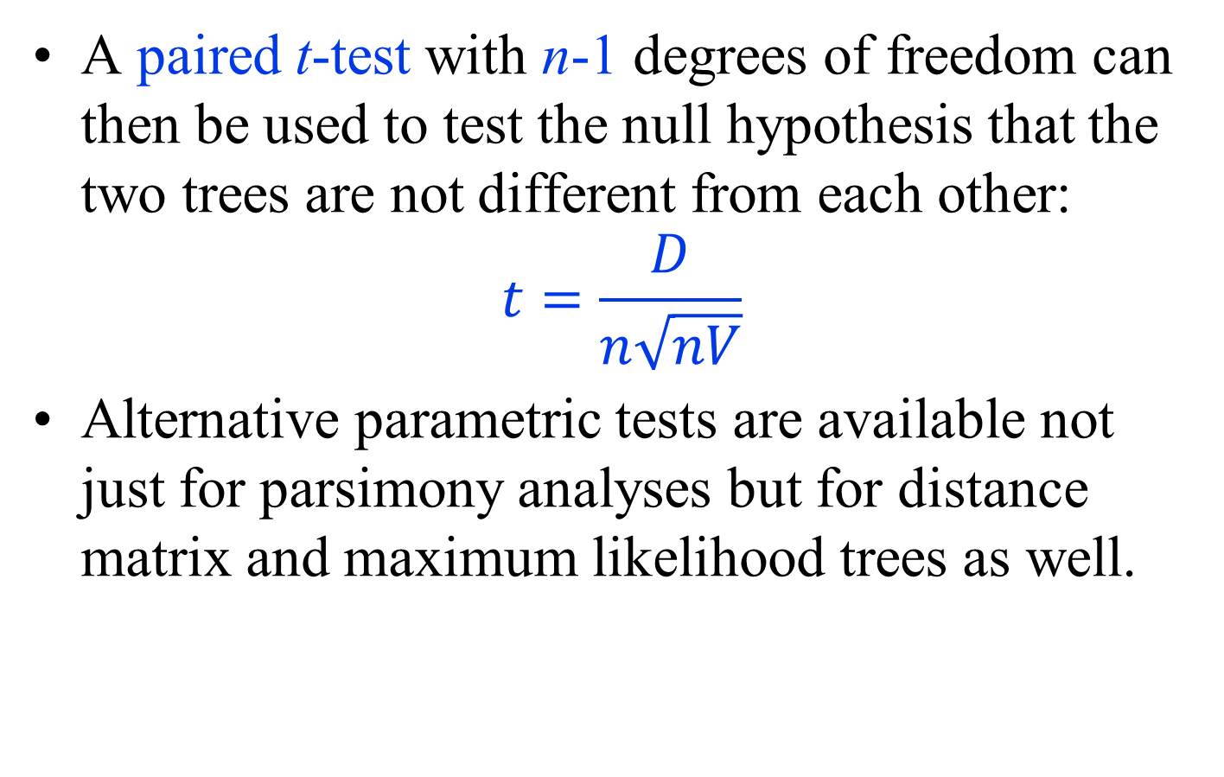
Parametric Tests
A paired t-test with n-1 degrees of freedom can then be used to test the null hypothesis that the two trees are not different from each other:
$$t=\frac{D}{n\sqrt{nV}}$$
Alternative parametric tests are available not just for parsimony analyses but for distance matrix and maximum likelihood trees as well.

Slide 77
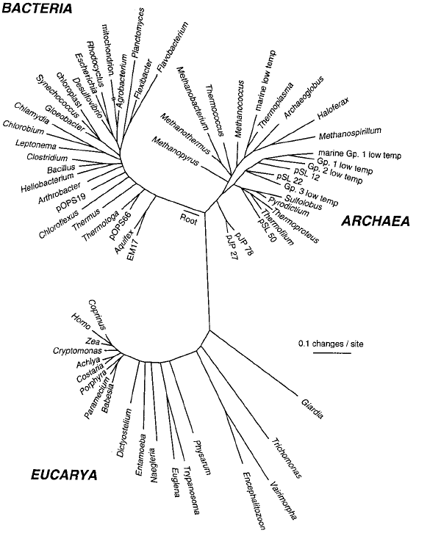
Some Discoveries Made Using Molecular Phylogenetics
Universal Tree of Life
  Using rRNA sequences
  Able to study the relationships of uncultivated organisms, obtained from a hot spring in Yellowstone National Park

Slide 78
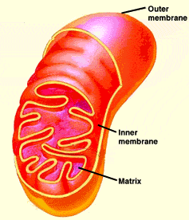
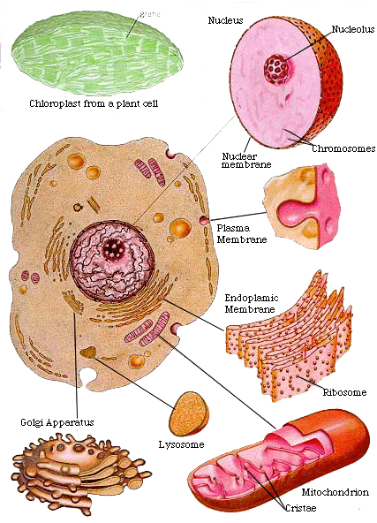
Some Discoveries Made Using Molecular Phylogenetics
Endosymbiosis: Origin of the Mitochondrion and Chloroplast
Mitochondria and chloroplasts are derived from the α-purple bacteria and the cyanobacteria respectively, via separate endosymbiotic events.
α-Purple Bacteria
Other bacteria
Chloroplasts
Mitochondria
Root
Cyanobacteria
Eukaryotes
Archaea

Slide 79
Some Discoveries Made Using Molecular Phylogenetics
Relationships within species: HIV subtypes
A
Rwanda
Ivory Coast
B
Italy
Uganda
U.S.
U.S.
India
Rwanda
U.K.
C
Ethiopia
Uganda
S. Africa
D
Uganda
Tanzania
Netherlands
F
Russia
G
Romania
Taiwan
Cameroon
Brazil
Netherlands

Slide 80
Problems and Errors in Phylogenetic Reconstruction
Inherent strengths and weaknesses in different tree-making methodologies.
More is better
  Errors in inferred phylogeny may be caused by small data sets and/or limited sampling.
Unsuitable sequences
  those undergoing rapid nucleotide changes or slow to zero changes overtime may skew phylogenetic estimations

Slide 81
Problems and Errors in Phylogenetic Reconstruction
Mutations:
  Duplications, inversions, insertions, deletions etc. can give inaccurate signals
Genomic hotspots:
  small regions of rapid evolution are not easily detected
Homoplasy:
  nucleotide changes that are similar but occurred independently in separate lineages are mistakenly assumed as inherited changes
Sample contamination / mislabeling:
  always a possibility when working with large data sets

