Slide 1
Introduction to Bioinformatics
Pairwise Sequence Alignment
Prof. Dr. Nizamettin AYDIN
naydin@yildiz.edu.tr
http://www3.yildiz.edu.tr/~naydin

Slide 2
Outline
Introduction to sequence alignment
pair wise sequence alignment
  The Dot Matrix
  Scoring Matrices
  Gap Penalties
  Dynamic Programming

Slide 3
Introduction to sequence alignment
In molecular biology, a common question is to ask whether or not two sequences are related.
The most common way to tell whether or not they are related is to compare them to one another to see if they are similar.
Question:
  Are two sequences related?
Compare the two sequences,
  see if they are similar

Slide 4
Sequence Alignment
Sequence Alignment
  the identification of residue-residue correspondences.
It is the basic tool of bioinformatics.
Example:
  pear and tear
Similar words, different meanings

Slide 5
Biological Sequences
Similar biological sequences tend to be related
Information:
  Functional
  Structural
  Evolutionary
Common mistake:
  sequence similarity is not homology!
Homologous sequences:
  derived from a common ancestor

Slide 6
Relation of sequences
Homologs:
  similar sequences in 2 different organisms derived from a common ancestor sequence.
Orthologs:
  Similar sequences in 2 different organisms that have arisen due to a speciation event. Functionality Retained.
Paralogs:
  Similar sequences within a single organism that have arisen due to a gene duplication event.
Xenologs:
  similar sequences that have arisen out of horizontal transfer events (symbiosis, viruses, etc)

Slide 7
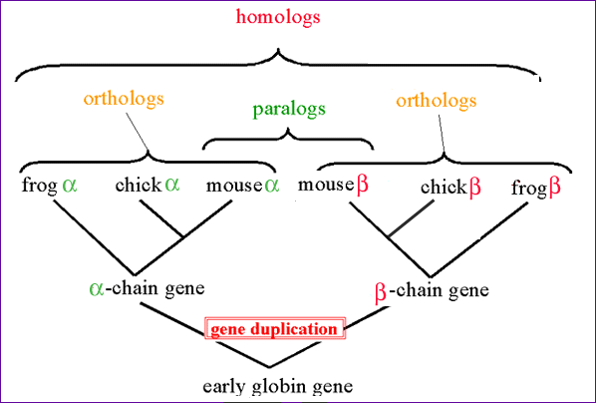
Relation of sequences
Image Source: http://www.ncbi.nlm.nih.gov/Education/BLASTinfo/Orthology.html

Slide 8
Use Protein Sequences for Similarity Searches
DNA sequences tend to be less informative than protein sequences
DNA bases vs. 20 amino acids - less chance similarity
Similarity of AAs can be scored
  # of mutations, chemical similarity, PAM matrix
  Protein databanks are much smaller than DNA databanks
  less random matches.
Similarity is determined by pairwise alignment of different sequences

Slide 9
Pairwise Alignment
The alignment of two sequences (DNA or protein) is a relatively straightforward computational problem.
There are lots of possible alignments.
Two sequences can always be aligned.
Sequence alignments have to be scored.
Often there is more than one solution with the same score.

Slide 10
Sequence Alignment
The concept
An alignment is a mutual arrangement of two sequences.
  Pairwise sequence alignment
It exhibits where the two sequences are similar, and where they differ.
An optimal alignment is one that exhibits the most correspondences, and the least differences.
Sequences that are similar probably have the same function

Slide 11
Sequence Alignment
Terms of sequence comparison
Sequence identity
  exactly the same Amino Acid or Nucleotide in the same position
Sequence similarity
  substitutions with similar chemical properties
Sequence homology
  general term that indicates evolutionary relatedness among sequences
  sequences are homologous if they are derived from a common ancestral sequence

Slide 12
Sequence Alignment
Things to consider:
to find the best alignment one needs to examine all possible alignments
to reflect the quality of the possible alignments one needs to score them
there can be different alignments with the same highest score
variations in the scoring scheme may change the ranking of alignments

Slide 13
Sequence Alignment
Evolution:
Ancestral sequence: ABCD
ACCD (B C) ABD (C ø)
ACCD or ACCD Pairwise Alignment
AB─D A─BD
mutation deletion
true alignment

Slide 14
Sequence Alignment
A protein sequence alignment
MSTGAVLIY--TSILIKECHAMPAGNE-----
---GGILLFHRTHELIKESHAMANDEGGSNNS
* * * **** ***
A DNA sequence alignment
attcgttggcaaatcgcccctatccggccttaa
att---tggcggatcg-cctctacgggcc----
*** **** **** ** ******

Slide 15
Hamming or edit distance
Simplest method in determining sequence similarity is to determine the edit distance between two sequences
If we take the example of pear and tear, how similar are these two words?
An alignment of these two is as follows:
P E A R
| | |
T E A R

Slide 16
Hamming Distance
Minimum number of letters by which two words differ
Calculated by summing number of mismatches
Hamming Distance between PEAR and TEAR is 1

Slide 17
Gapped Alignments
With biological sequences, it is often necessary to align two sequences that are of
  different lengths,
  that have regions that have been inserted or deleted over time.
Thus, the notion of gaps needs to be introduced.
  gaps denoted by ‘-’
Consider the words alignment and ligament.
  One alignment of these two words is as follows:
A L I G N M E N T
| | | | | | |
- L I G A M E N T

Slide 18
Possible Residue Alignments
An alignment can produce one of the following:
  a match between two characters
  a mismatch between two characters
    also called a substitution or mutation
  a gap in the first sequence
    which can be thought of as the deletion of a character in the first sequence
  a gap in the second sequence
    which can be thought of as the insertion of a character in the first sequence

Slide 19
Alignments
Consider the following two nucleic acid sequences:
  ACGGACT and ATCGGATCT.
The followings are two valid alignments:
A – C – G G – A C T
| | | | |
A T C G G A T _ C T
A T C G G A T C T
| | | | | |
A – C G G – A C T
Which alignment is the better alignment?

Slide 20
Alignment Scoring Scheme
One way to judge this is to assign
  a + score for each match,
  a - score for each mismatch,
  a - score for each insertion/deletion (indels).
Possible scoring scheme:
match: +2 mismatch: -1 indel: –2
  Alignment 1:
    5 * 2 – 1(1) – 4(2) = 10 – 1 – 8 = 1
  Alignment 2:
    6 * 2 – 1(1) – 2 (2) = 12 – 1 – 4 = 7
    Using the above scoring scheme, the 2nd alignment is a better alignment,
  since it produces a higher alignment score.

Slide 21
Alignment Methods
Visual
Brute Force
Dynamic Programming
Word-Based (k tuple)

Slide 22
Visual Alignments (Dot Plots)
One of basic techniques for determining the alignment between two sequences is by using a visual alignment known as dot plots.
Matrix
  Rows:
    Characters in one sequence
  Columns:
    Characters in second sequence
Filling
  Loop through each row;
    if character in row-column match, fill in the cell
  Continue until all cells have been examined

Slide 23
The Dot Matrix
established in 1970 by A.J. Gibbs and G.A.McIntyre
method for comparing two amino acid or nucleotide sequences
A G C T A G G A
each sequence builds one axis of
the grid
one puts a dot, at the intersection
of same letters appearing in both
sequences
scan the graph for a series of dots
  reveals similarity
  or a string of same characters
longer sequences can also be
compared on a single page, by
using smaller dots
G
A
C
T
A
G
G
C

Slide 24
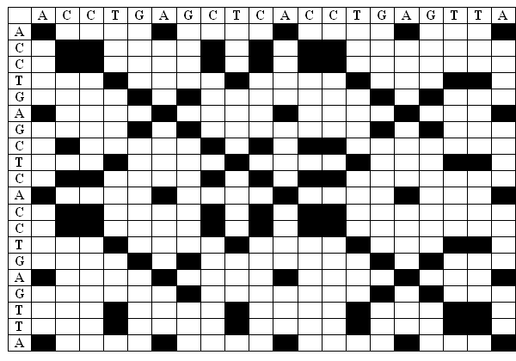
Example Dot Plot

Slide 25
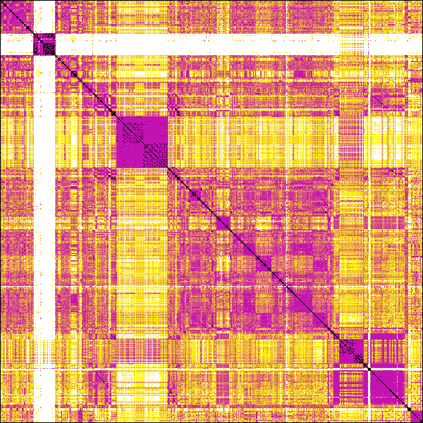
An entire software module of a telecommunications switch; about two million lines of C
Darker areas indicate regions with a lot of matches
  a high degree of similarity
Lighter areas indicate regions with few matches
  a low degree of similarity
Dark areas along the main diagonal indicate sub-modules.
Dark areas off the main diagonal indicate a degree of similarity between sub-modules.
The largest dark squares are formed by redundancies in initializations of signal-tables and finite-state machines.

Slide 26
Information within Dot Plots
Dot plots are useful as a first-level filter for determining an alignment between two sequences.
  It reveals the presence of insertions or deletions
Comparing a single sequence to itself can reveal the presence of a repeat of a subsequence
  Inverted repeats = reverse complement
    Used to determine folding of RNA molecules
Self comparison can reveal several features:
  similarity between chromosomes
  tandem genes
  repeated domains in a protein sequence
  regions of low sequence complexity (same characters are often repeated)

Slide 27
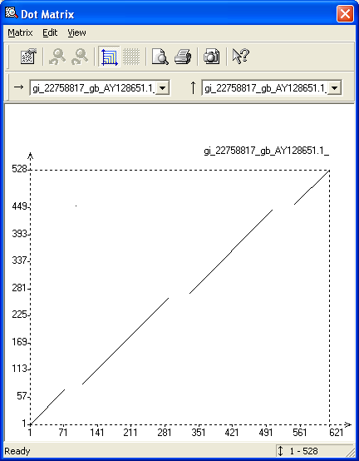
Insertions/Deletions
Regions containing insertions/deletions can be readily determined.
One potential application is to determine the number of coding regions (exons) contained within a processed mRNA.

Slide 28
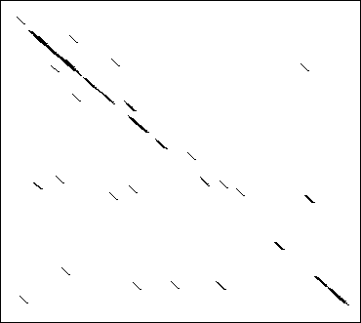
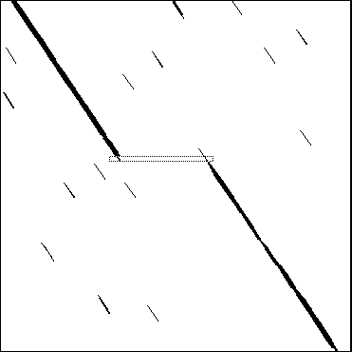
Insertions/Deletions
Two similar, but not identical, sequences
An indel (insertion or deletion):

Slide 29
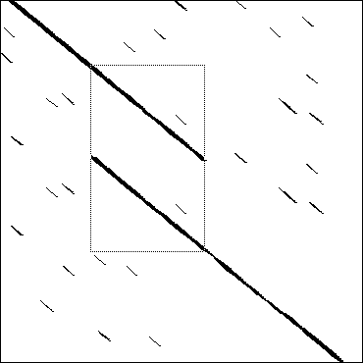
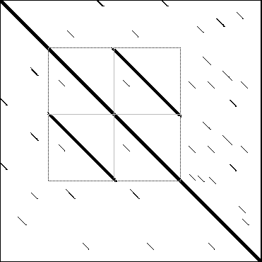
Duplication
A tandem duplication:
Self-dotplot of
a tandem duplication:

Slide 30
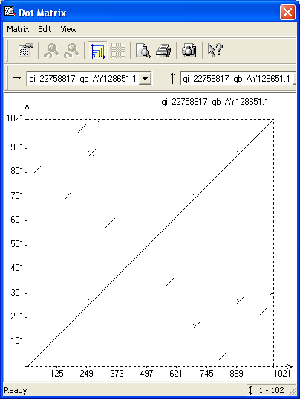
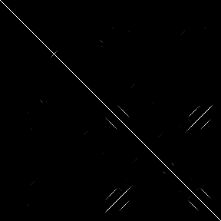
Repeats/Inverted Repeats

Slide 31
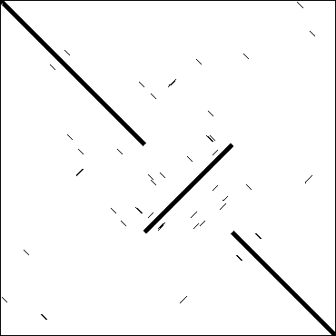
Repeats/Inverted Repeats
An inversion:
Self dot plot with repeats:

Slide 32
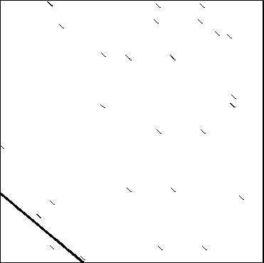
The Dot Matrix
Joining sequences:

Slide 33
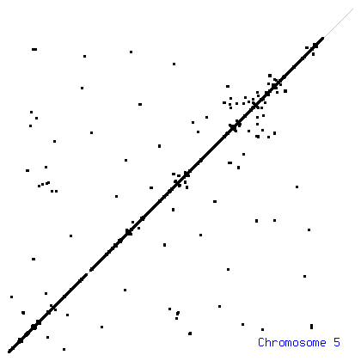
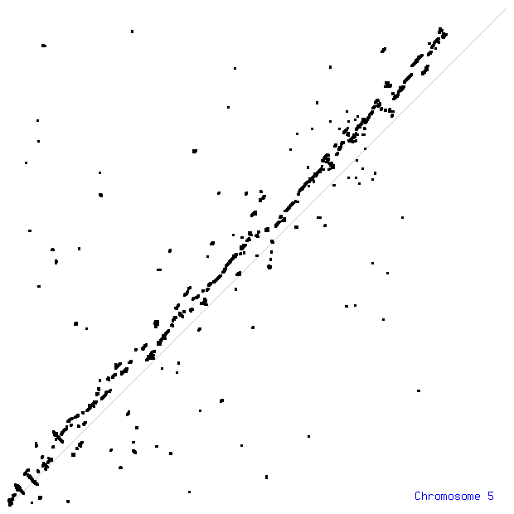
Comparing Genome Assemblies
Dot plots can also be used in order to compare two different assemblies of the same sequence.
Below are three dotplots of various chromosomes.
The 1st shows two separate assemblies of human chromosome 5 compared against each other.
The 2nd shows one assembly of chromosome 5 compared against itself, indicating the presence of repetitive regions.
The 3rd shows chromosome Y compared against itself, indicating the presence of inverted repeats.

Slide 35

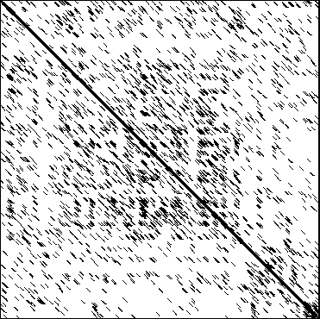
Noise in Dot Plots
The very stringent, self-dotplot:
The non-stringent self-dotplot:
Stringency is the quality or state of being stringent.
stringent: marked by rigor, strictness, or severity especially with regard to rule or standard
Stringency is a situation in which a law, test, etc. is extremely severe or limiting and must be obeyed

Slide 36
Noise in Dot Plots
Nucleic Acids (DNA, RNA)
  1 out of 4 bases matches at random
To filter out random matches,
  sliding windows are used
  Percentage of bases matching in the window is set as threshold
    A dot is printed only if a minimal number of matches occur
Rule of thumb:
  larger windows for DNAs (only 4 bases, more random matches)
  typical window size is 15 and stringency of 10

Slide 37
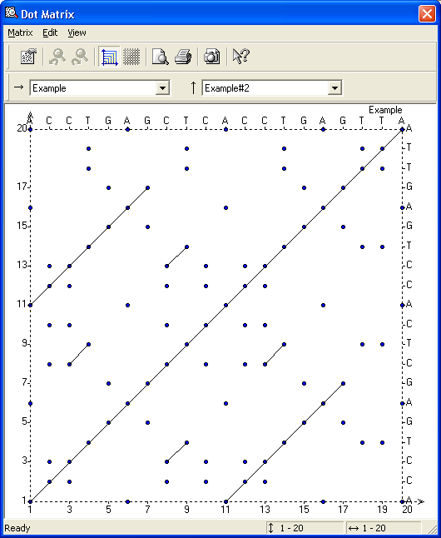
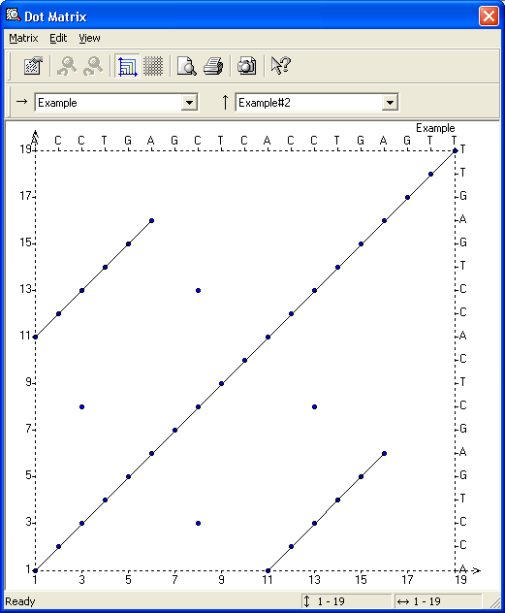
Reduction of Dot Plot Noise
Self alignment of ACCTGAGCTCACCTGAGTTA

Slide 38
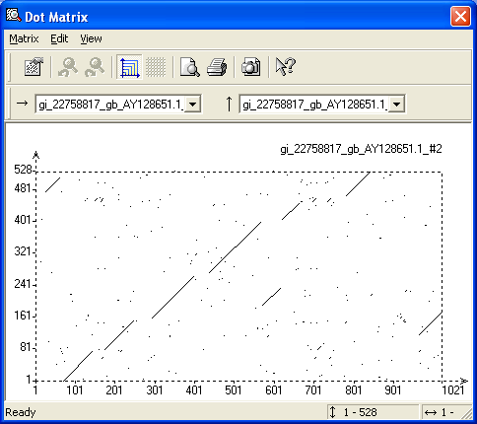
Available Dot Plot Programs
Vector NTI software package (under AlignX)

Slide 39
Available Dot Plot Programs
Vector NTI software package (under AlignX)
GCG software package:
Compare http://www.hku.hk/bruhk/gcgdoc/compare.html
DotPlot+ http://www.hku.hk/bruhk/gcgdoc/dotplot.html
http://www.isrec.isb-sib.ch/java/dotlet/Dotlet.html
http://bioweb.pasteur.fr/cgi-bin/seqanal/dottup.pl
Dotter (http://www.cgr.ki.se/cgr/groups/sonnhammer/Dotter.html)

Slide 40

Available Dot Plot Programs

Slide 41
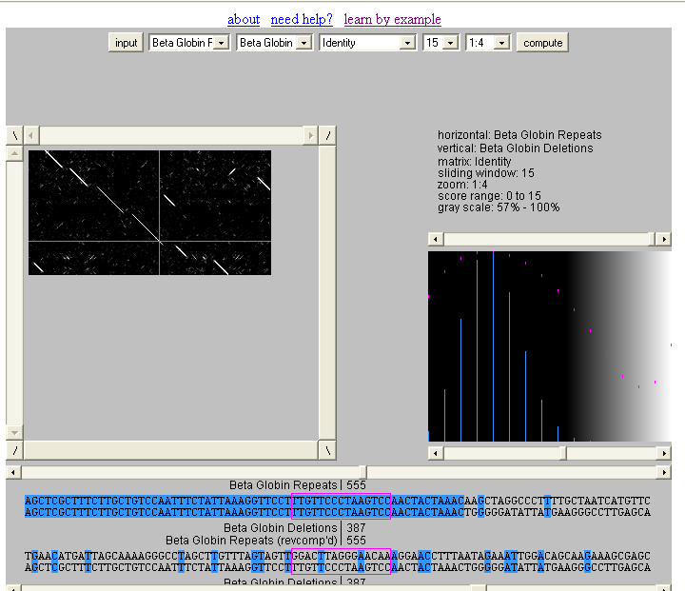
Available Dot Plot Programs
Dotlet (Java Applet) http://www.isrec.isb-sib.ch/java/dotlet/Dotlet.html

Slide 42
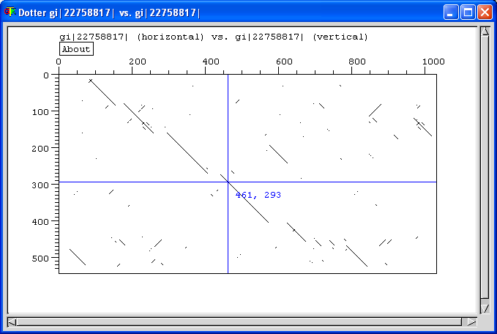
Available Dot Plot Programs
Dotter (http://www.cgr.ki.se/cgr/groups/sonnhammer/Dotter.html)

Slide 43
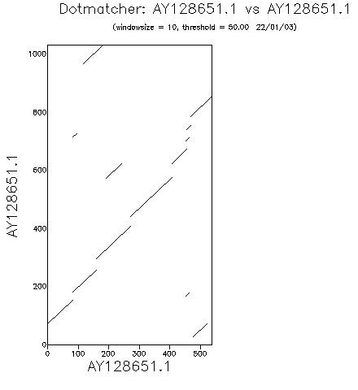
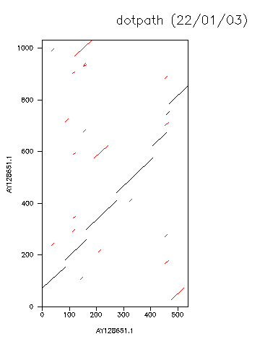
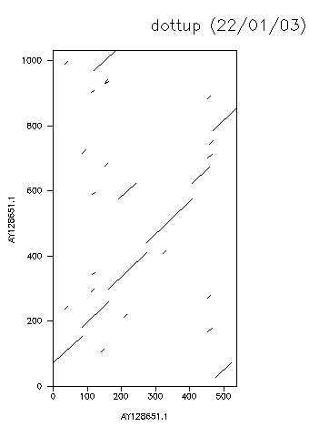
Available Dot Plot Programs
EMBOSS DotMatcher, DotPath,DotUp

Slide 44
The Dot Plot (Dot Matrix)
When to use the Dot Plot method?
  unless the sequences are known to be very much alike
limits of the Dot Matrix
  doesn’t readily resolve similarity that is interrupted by insertion or deletions
  Difficult to find the best possible alignment (optimal alignment)
  most computer programs don’t show an actual alignment

Slide 45
Dot Plot References
Gibbs, A. J. & McIntyre, G. A. (1970).
The diagram method for comparing sequences. its use with amino acid and nucleotide sequences.
Eur. J. Biochem. 16, 1-11.
Staden, R. (1982).
An interactive graphics program for comparing and aligning nucleic-acid and amino-acid sequences.
Nucl. Acid. Res. 10 (9), 2951-2961.

Slide 46
Next step
We must define quantitative measures of sequence similarity and difference!
  Hamming distance:
    # of positions with mismatching characters
  Levenshtein (or edit) distance:
    # of operations required to change one string into the other (deletion, insertion, substitution)
AGTC
CGTA
Hamming distance = 2
AG-TCC
CGCTCA
Levenshtein distance = 3

Slide 47
Scoring
+1 for a match -1 for a mismatch?
should gaps be allowed?
  if yes how should they be scored?
what is the best algorithm for finding the optimal alignment of two sequences?
is the produced alignment significant?

Slide 48
Determining Optimal Alignment
Two sequences: X and Y
  |X| = m; |Y| = n
  Allowing gaps, |X| = |Y| = m+n
Brute Force
Dynamic Programming

Slide 49
Brute Force
Determine all possible subsequences for X and Y
  2^{m+n} subsequences for X, 2^{m+n} for Y!
Alignment comparisons
  2^{m+n} * 2^{m+n} = 2^{(2(m+n))} = 4^{m+n} comparisons
Quickly becomes impractical

Slide 50
Dynamic Programming
Used in Computer Science
Solve optimization problems by dividing the problem into independent subproblems
Sequence alignment has optimal substructure property
  Subproblem: alignment of prefixes of two sequences
  Each subproblem is computed once and stored in a matrix

Slide 51
Dynamic Programming
Optimal score:
  built upon optimal alignment computed to that point
Aligns two sequences beginning at ends, attempting to align all possible pairs of characters

Slide 52
Dynamic Programming
Scoring scheme for matches, mismatches, gaps
Highest set of scores defines optimal alignment between sequences
Match score: DNA – exact match; Amino Acids – mutation probabilities
Guaranteed to provide optimal alignment given:
  Two sequences
  Scoring scheme

Slide 53
Steps in Dynamic Programming
• Initialization
• Matrix Fill (scoring)
• Traceback (alignment)
DP Example:
Sequence #1: GAATTCAGTTA; M = 11
Sequence #2: GGATCGA; N = 7
• s(a_{i}b_{j}) = +5 if a_{i} = b_{j} (match score)
• s(a_{i}b_{j}) = -3 if a_{i}≠b_{j} (mismatch score)
• w = -4 (gap penalty)

Slide 54
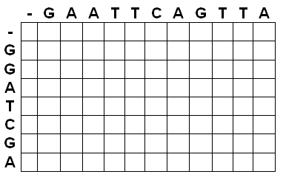
View of the DP Matrix
M+1 rows, N+1 columns

Slide 55
Global Alignment (Needleman-Wunsch)
Attempts to align all residues of two sequences
INITIALIZATION: First row and first column set
S_{i,0} = w * i
S_{0,j} = w * j

Slide 56
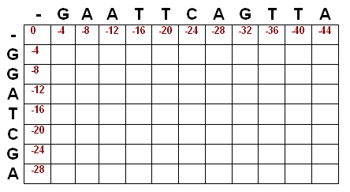
Initialized Matrix(Needleman-Wunsch)

Slide 57
Matrix Fill (Global Alignment)
S_{i,j} = MAXIMUM[
S_{i-1, j-1} + s(a_{i,}b_{j}) (match/mismatch in the diagonal),
S_{i,j-1} + w (gap in sequence #1),
S_{i-1,j} + w (gap in sequence #2)
]

Slide 58
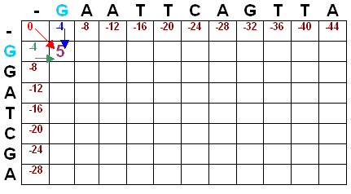
Matrix Fill (Global Alignment)
S_{1,1} = MAX[S_{0,0} + 5, S_{1,0} - 4, S_{0,1} - 4] = MAX[5, -8, -8]

Slide 59
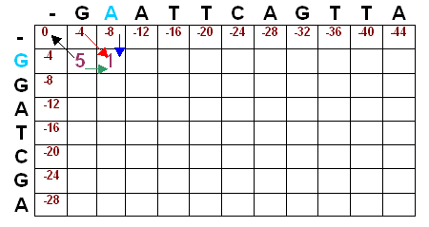
Matrix Fill (Global Alignment)
S_{1,2} = MAX[S_{0,1} -3, S_{1,1} - 4, S_{0,2} - 4] = MAX[-4 - 3, 5 – 4, -8 – 4] = MAX[-7, 1, -12] = 1

Slide 60
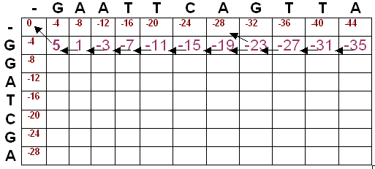
Matrix Fill (Global Alignment)

Slide 61
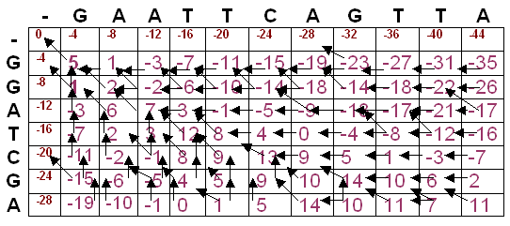
Filled Matrix (Global Alignment)

Slide 62
Trace Back (Global Alignment)
maximum global alignment score = 11 (value in the lower right hand cell).
Traceback begins in position S_{M,N}; i.e. the position where both sequences are globally aligned.
At each cell, we look to see where we move next according to the pointers.

Slide 63
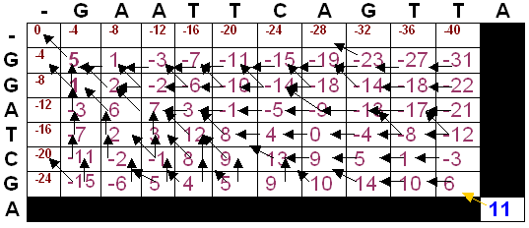
Trace Back (Global Alignment)

Slide 64
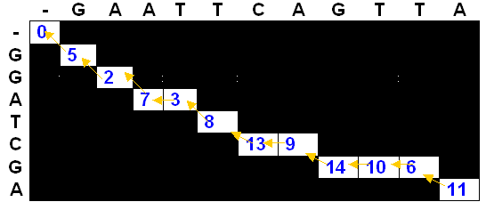
Global Trace Back
G A A T T C A G T T A
| | | | | |
G G A – T C – G - — A

Slide 66
Checking Alignment Score
G A A T T C A G T T A
| | | | | |
G G A – T C – G - — A
+ - + - + + - + - - +
5 3 5 4 5 5 4 5 4 4 5
5 – 3 + 5 – 4 + 5 + 5 – 4 + 5 – 4 – 4 + 5 = 11✓

Slide 67
Local Alignment
Smith-Waterman: obtain highest scoring local match between two sequences
Requires 2 modifications:
  Negative scores for mismatches
  When a value in the score matrix becomes negative, reset it to zero (begin of new alignment)

Slide 68
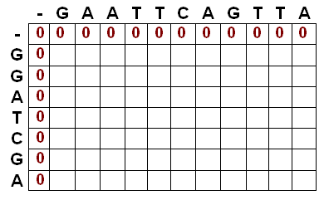
Local Alignment Initialization
Values in row 0 and column 0 set to 0.

Slide 69
Matrix Fill (Local Alignment)
S_{i,j} = MAXIMUM [
S_{i-1, j-1} + s(a_{i,}b_{j}) (match/mismatch in the diagonal),
S_{i,j-1} + w (gap in sequence #1),
S_{i-1,j} + w (gap in sequence #2),
0 ]

Slide 70
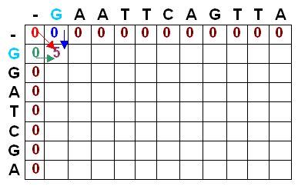
Matrix Fill (Local Alignment)
S_{1,1} = MAX[S_{0,0} + 5, S_{1,0} - 4, S_{0,1} – 4,0] = MAX[5, -4, -4, 0] = 5

Slide 71
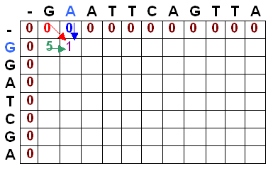
Matrix Fill (Local Alignment)
S_{1,2} = MAX[S_{0,1} -3, S_{1,1} - 4, S_{0,2} – 4, 0] = MAX[0 - 3, 5 – 4, 0 – 4, 0] = MAX[-3, 1, -4, 0] = 1

Slide 72
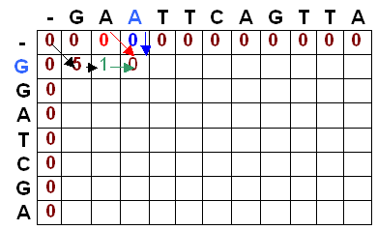
Matrix Fill (Local Alignment)
S_{1,3} = MAX[S_{0,2} -3, S_{1,2} - 4, S_{0,3} – 4, 0] = MAX[0 - 3, 1 – 4, 0 – 4, 0] =
MAX[-3, -3, -4, 0] = 0

Slide 73
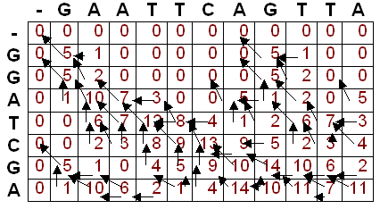
Filled Matrix (Local Alignment)

Slide 74
Trace Back (Local Alignment)
maximum local alignment score for the two sequences is 14
found by locating the highest values in the score matrix
14 is found in two separate cells, indicating multiple alignments producing the maximal alignment score

Slide 75
Trace Back (Local Alignment)
Traceback begins in the position with the highest value.
At each cell, we look to see where we move next according to the pointers
When a cell is reached where there is not a pointer to a previous cell, we have reached the beginning of the alignment

Slide 76
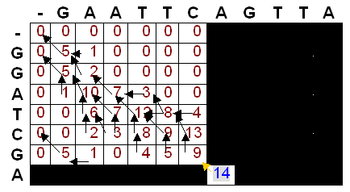
Trace Back (Local Alignment)

Slide 77
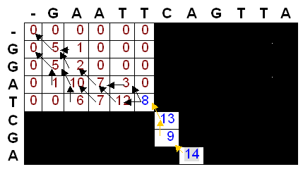
Trace Back (Local Alignment)

Slide 78
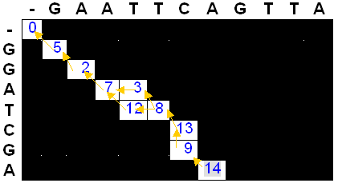
Trace Back (Local Alignment)

Slide 79
Maximum Local Alignment
G A A T T C - A
| | | | |
G G A T – C G A
+ - + + - + - +
5 3 5 5 4 5 4 5
G A A T T C - A
| | | | |
G G A – T C G A
+ - + - + + - +
5 3 5 4 5 5 4 5

Slide 81
Overlap Alignment
Consider the following problem:
Find the most significant overlap between two sequences?
Possible overlap relations:
a.
b.
Difference from local alignment:
Here we require alignment between the endpoints of the two sequences.

Slide 82
Overlap Alignment
Initialization: S_{i,0} = 0 , S_{0,j} = 0
Recurrence: as in global alignment
S_{i,j} = MAXIMUM [
S_{i-1, j-1} + s(a_{i,}b_{j}) (match/mismatch in the diagonal),
S_{i,j-1} + w (gap in sequence #1),
S_{i-1,j} + w (gap in sequence #2) ]
Score: maximum value at the bottom line and rightmost line
global
local
overlap

Slide 83
Overlap Alignment - example
PAWHEAE
HEAGAWGHEE
Scoring scheme :
Match: +4
Mismatch: -1
Gap penalty: -5

Slide 84
Overlap Alignment
PAWHEAE
HEAGAWGHEE
Scoring scheme :
Match: +4
Mismatch: -1
Gap penalty: -5

Slide 85
Overlap Alignment
PAWHEAE
HEAGAWGHEE
Scoring scheme:
Match: +4
Mismatch: -1
Gap penalty: -5

Slide 86
Overlap Alignment
The best overlap is:
P | A | W | H | E | A | E | - | - | - | - | - | -
- | - | - | H | E | A | G | A | W | G | H | E | E
Pay attention!
A different scoring scheme could yield a different result, such as:
Scoring scheme :
Match: +4
Mismatch: -1
Gap penalty: -2
- | - | - | P | A | W | - | H | E | A | E
H | E | A | G | A | W | G | H | E | E | -

Slide 87
Sequence Alignment Variants
Global alignment (The Needelman-Wunsch Algorithm)
  Initialization: S_{i,0} = i*w, S_{0,j} = j*w
  Score: S_{i,j} = MAX [S_{i-1, j-1} + s(a_{i,}b_{j}), S_{i,j-1} + w, S_{i-1,j} + w]
Local alignment (The Smith-Waterman Algorithm)
  Initialization: S_{i,0} = 0, S_{0,j} = 0
  Score: S_{i,j} = MAX [S_{i-1, j-1} + s(a_{i,}b_{j}), S_{i,j-1} + w, S_{i-1,j} + w, 0]
Overlap alignment
  Initialization: S_{i,0} = 0, S_{0,j} = 0
  Score: S_{i,j} = MAX [S_{i-1, j-1} + s(a_{i,}b_{j}), S_{i,j-1} + w, S_{i-1,j} + w]

Slide 88
Scoring Matrices
match/mismatch score
  Not bad for similar sequences
  Does not show distantly related sequences
Likelihood matrix
  Scores residues dependent upon likelihood substitution is found in nature
  More applicable for amino acid sequences

Slide 89
Parameters of Sequence Alignment
Scoring Systems:
Each symbol pairing is assigned a numerical value, based on a symbol comparison table.
Gap Penalties:
Opening: The cost to introduce a gap
Extension: The cost to elongate a gap

Slide 90
DNA Scoring Systems -very simple
Sequence 1
Sequence 2
actaccagttcatttgatacttctcaaa
taccattaccgtgttaactgaaaggacttaaagact
A G C T
A 1 0 0 0
G 0 1 0 0
C 0 0 1 0
T 0 0 0 1
Match: 1
Mismatch: 0
Score = 5

Slide 91
Protein Scoring Systems
Sequence 1
Sequence 2
PTHPLASKTQILPEDLASEDLTI
T:G = -2
T:T = 5
Score = 48
PTHPLAGERAIGLARLAEEDFGM
Scoring
matrix
C S T P A G N D . .
C 9
S -1 4
T -1 1 5
P -3 -1 -1 7
A 0 1 0 -1 4
G -3 0 -2 -2 0 6
N -3 1 0 -2 -2 0 5
D -3 0 -1 -1 -2 -1 1 6
.
.
A scoring matrix is a table of values that describe the probability of a residue pair occurring in alignment.

Slide 92
Protein Scoring Systems
Amino acids have different biochemical and physical properties
that influence their relative replaceability in evolution.
tiny
P
aliphatic
C
small
S+S
G
I
A
G
S
V
C
N
L
SH
T
D
hydrophobic
M
Y
K
E
F
Q
W
H
R
positive
aromatic
polar
charged

Slide 93
Protein Scoring Systems
Scoring matrices reflect:
– # of mutations to convert one to another
– chemical similarity
– observed mutation frequencies
Log odds matrices:
– the values are logarithms of probability ratios
of the probability of an aligned pair to
the probability of a random alignment.
Widely used scoring matrices:
  PAM
  BLOSUM

Slide 94
PAM matrices
(Percent Accepted Mutations)
Derived from global alignments of protein families . Family members share at least 85% identity (Dayhoff et al., 1978).
Construction of phylogenetic tree and ancestral sequences of each protein family
Computation of number of replacements for each pair of amino acids

Slide 95
PAM matrices
The numbers of replacements were used to compute a so-called PAM-1 matrix.
The PAM-1 matrix reflects an average change of 1% of all amino acid positions.
PAM matrices for larger evolutionary distances can be extrapolated from the PAM-1 matrix by multiplication.
PAM250 = 250 mutations per 100 residues.
Greater numbers mean bigger evolutionary distance
  .

Slide 96
PAM 250
A R N D C Q E G H I L K M F P S T W Y V B Z
A 2 -2 0 0 -2 0 0 1 -1 -1 -2 -1 -1 -3 1 1 1 -6 -3 0 2 1
R -2 6 0 -1 -4 1 -1 -3 2 -2 -3 3 0 -4 0 0 -1 2 -4 -2 1 2
N 0 0 2 2 -4 1 1 0 2 -2 -3 1 -2 -3 0 1 0 -4 -2 -2 4 3
D 0 -1 2 4 -5 2 3 1 1 -2 -4 0 -3 -6 -1 0 0 -7 -4 -2 5 4
C -2 -4 -4 -5 12 -5 -5 -3 -3 -2 -6 -5 -5 -4 -3 0 -2 -8 0 -2 -3 -4
Q 0 1 1 2 -5 4 2 -1 3 -2 -2 1 -1 -5 0 -1 -1 -5 -4 -2 3 5
E 0 -1 1 3 -5 2 4 0 1 -2 -3 0 -2 -5 -1 0 0 -7 -4 -2 4 5
G 1 -3 0 1 -3 -1 0 5 -2 -3 -4 -2 -3 -5 0 1 0 -7 -5 -1 2 1
H -1 2 2 1 -3 3 1 -2 6 -2 -2 0 -2 -2 0 -1 -1 -3 0 -2 3 3
I -1 -2 -2 -2 -2 -2 -2 -3 -2 5 2 -2 2 1 -2 -1 0 -5 -1 4 -1 -1
L -2 -3 -3 -4 -6 -2 -3 -4 -2 2 6 -3 4 2 -3 -3 -2 -2 -1 2 -2 -1
K -1 3 1 0 -5 1 0 -2 0 -2 -3 5 0 -5 -1 0 0 -3 -4 -2 2 2
M -1 0 -2 -3 -5 -1 -2 -3 -2 2 4 0 6 0 -2 -2 -1 -4 -2 2 -1 0
F -3 -4 -3 -6 -4 -5 -5 -5 -2 1 2 -5 0 9 -5 -3 -3 0 7 -1 -3 -4
P 1 0 0 -1 -3 0 -1 0 0 -2 -3 -1 -2 -5 6 1 0 -6 -5 -1 1 1
S 1 0 1 0 0 -1 0 1 -1 -1 -3 0 -2 -3 1 2 1 -2 -3 -1 2 1
T 1 -1 0 0 -2 -1 0 0 -1 0 -2 0 -1 -3 0 1 3 -5 -3 0 2 1
W -6 2 -4 -7 -8 -5 -7 -7 -3 -5 -2 -3 -4 0 -6 -2 -5 17 0 -6 -4 -4
Y -3 -4 -2 -4 0 -4 -4 -5 0 -1 -1 -4 -2 7 -5 -3 -3 0 10 -2 -2 -3
V 0 -2 -2 -2 -2 -2 -2 -1 -2 4 2 -2 2 -1 -1 -1 0 -6 -2 4 0 0
B 2 1 4 5 -3 3 4 2 3 -1 -2 2 -1 -3 1 2 2 -4 -2 0 6 5
Z 1 2 3 4 -4 5 5 1 3 -1 -1 2 0 -4 1 1 1 -4 -3 0 5 6
C
W
W
-8
17
A value of 0 indicates the frequency of alignment is random
log(freq(observed)/freq(expected))

Slide 97
Amino Acid
Frequency
1978 1991
L 0.085 0.091
A 0.087 0.077
G 0.089 0.074
S 0.070 0.069
V 0.065 0.066
E 0.050 0.062
T 0.058 0.059
K 0.081 0.059
I 0.037 0.053
D 0.047 0.052
R 0.041 0.051
P 0.051 0.051
N 0.040 0.043
Q 0.038 0.041
F 0.040 0.040
Y 0.030 0.032
M 0.015 0.024
H 0.034 0.023
C 0.033 0.020
W 0.010 0.014
freq(expected) = f(AA_{i})*f(AA_{j})

Slide 98
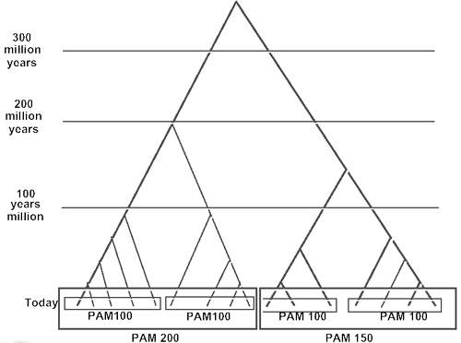
Use Different PAM’s for
Different Evolutionary Distances
(Adapted from D Brutlag, Stanford)

Slide 99
BLOSUM
(Blocks Substitution Matrix)
Derived from alignments of domains of distantly related
proteins (Henikoff & Henikoff,1992).
Occurrences of each amino acid pair
in each column of each block alignment
is counted.
The numbers derived from all blocks were
used to compute the BLOSUM matrices.
A
A
C
E
C
A
A
C
E
C
A - C = 4
A - E = 2
C - E = 2
A - A = 1
C - C = 1

Slide 100
BLOSUM
(Blocks Substitution Matrix)
Sequences within blocks are clustered according to their level of identity.
Clusters are counted as a single sequence.
Different BLOSUM matrices differ in the percentage of sequence identity used in clustering.
The number in the matrix name (e.g. 62 in BLOSUM62) refers to the percentage of sequence identity used to build the matrix.
Greater numbers mean smaller evolutionary distance.

Slide 101
TIPS on choosing a scoring matrix
Generally, BLOSUM matrices perform better than PAM matrices for local similarity searches (Henikoff & Henikoff, 1993).
When comparing closely related proteins one should use lower PAM or higher BLOSUM matrices,
For distantly related proteins higher PAM or lower BLOSUM matrices.
For database searching the commonly used matrix is BLOSUM62.

Slide 102
Nucleic Acid Scoring Scheme
Transition mutation (more common)
  purine purine A G
  pyrimidine pyrimidine T C
Transversion mutation
  purine pyrimidine A, G T, C
 | A | G | T | C
A | 20 | 10 | 5 | 5
G | 10 | 20 | 5 | 5
T | 5 | 5 | 20 | 10
C | 5 | 5 | 10 | 20

Slide 103
Amino acid exchange matrices
Amino acids are not equal:
Some are easily substituted because they have similar:
  physico-chemical properties
  structure
Some mutations between amino acids occur more often due to similar codons
The two above observations give us ways to define substitution matrices

Slide 104
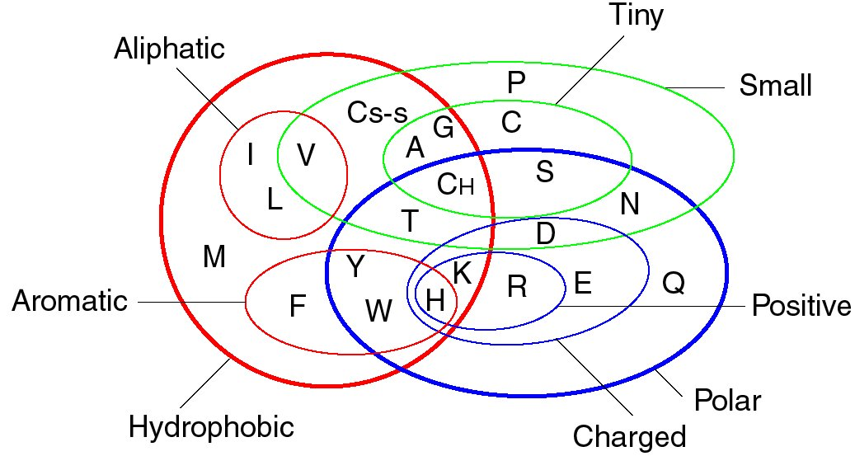
Properties of Amino Acids
Sequence similarity
substitutions with similar chemical properties

Slide 105
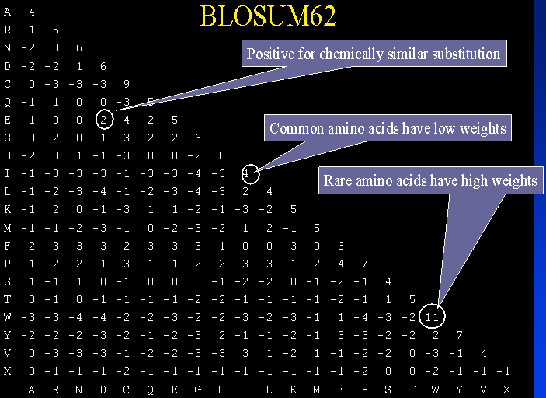
Scoring Matrices
table of values that describe the probability of a residue pair occurring in an alignment
the values are logarithms of ratios of two probabilities
  probability of random occurrence of an amino acid (diagonal)
  probability of meaningful occurrence of a pair of residues

Slide 106
Scoring Matrices
Widely used matrices
PAM (Percent Accepted Mutation) / MDM (Mutation Data Matrix ) / Dayhoff
  Derived from global alignments of closely related sequences.
  Matrices for greater evolutionary distances are extrapolated from those for lesser ones.
  The number with the matrix (PAM40, PAM100) refers to the evolutionary distance; greater numbers are greater distances.
  PAM-1 corresponds to about 1 million years of evolution
  for distant (global) alignments, Blosum50, Gonnet, or (still) PAM250
BLOSUM (Blocks Substitution Matrix)
  Derived from local, ungapped alignments of distantly related sequences
  All matrices are directly calculated; no extrapolations are used
  The number after the matrix (BLOSUM62) refers to the minimum percent identity of the blocks used to construct the matrix; greater numbers are lesser distances.
  The BLOSUM series of matrices generally perform better than PAM matrices for local similarity searches.
  For local alignment, Blosum 62 is often superior
Structure-based matrices
Specialized Matrices

Slide 107
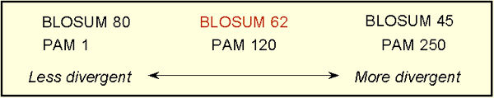
Scoring Matrices
The relationship between BLOSUM and PAM substitution matrices
BLOSUM matrices with higher numbers and PAM matrices with low numbers are designed for comparisons of closely related sequences.
BLOSUM matrices with low numbers and PAM matrices with high numbers are designed for comparisons of distantly related proteins.
http://www.ncbi.nlm.nih.gov/Education/BLASTinfo/Scoring2.html

Slide 108
Percent Accepted Mutation (PAM or Dayhoff) Matrices
Studied by Margaret Dayhoff
Amino acid substitutions
  Alignment of common protein sequences
  1572 amino acid substitutions
  71 groups of protein, 85% similar
“Accepted” mutations – do not negatively affect a protein’s fitness
Similar sequences organized into phylogenetic trees
Number of amino acid changes counted
Relative mutabilities evaluated
20 x 20 amino acid substitution matrix calculated

Slide 109
Percent Accepted Mutation (PAM or Dayhoff) Matrices
PAM 1: 1 accepted mutation event per 100 amino acids; PAM 250: 250 mutation events per 100 …
PAM 1 matrix can be multiplied by itself N times to give transition matrices for sequences that have undergone N mutations
PAM 250: 20% similar; PAM 120: 40%; PAM 80: 50%; PAM 60: 60%

Slide 110
PAM1 matrix
normalized probabilities multiplied by 10000
Ala Arg Asn Asp Cys Gln Glu Gly His Ile Leu Lys Met Phe Pro Ser Thr Trp Tyr Val
A R N D C Q E G H I L K M F P S T W Y V
A 9867 2 9 10 3 8 17 21 2 6 4 2 6 2 22 35 32 0 2 18
R 1 9913 1 0 1 10 0 0 10 3 1 19 4 1 4 6 1 8 0 1
N 4 1 9822 36 0 4 6 6 21 3 1 13 0 1 2 20 9 1 4 1
D 6 0 42 9859 0 6 53 6 4 1 0 3 0 0 1 5 3 0 0 1
C 1 1 0 0 9973 0 0 0 1 1 0 0 0 0 1 5 1 0 3 2
Q 3 9 4 5 0 9876 27 1 23 1 3 6 4 0 6 2 2 0 0 1
E 10 0 7 56 0 35 9865 4 2 3 1 4 1 0 3 4 2 0 1 2
G 21 1 12 11 1 3 7 9935 1 0 1 2 1 1 3 21 3 0 0 5
H 1 8 18 3 1 20 1 0 9912 0 1 1 0 2 3 1 1 1 4 1
I 2 2 3 1 2 1 2 0 0 9872 9 2 12 7 0 1 7 0 1 33
L 3 1 3 0 0 6 1 1 4 22 9947 2 45 13 3 1 3 4 2 15
K 2 37 25 6 0 12 7 2 2 4 1 9926 20 0 3 8 11 0 1 1
M 1 1 0 0 0 2 0 0 0 5 8 4 9874 1 0 1 2 0 0 4
F 1 1 1 0 0 0 0 1 2 8 6 0 4 9946 0 2 1 3 28 0
P 13 5 2 1 1 8 3 2 5 1 2 2 1 1 9926 12 4 0 0 2
S 28 11 34 7 11 4 6 16 2 2 1 7 4 3 17 9840 38 5 2 2
T 22 2 13 4 1 3 2 2 1 11 2 8 6 1 5 32 9871 0 2 9
W 0 2 0 0 0 0 0 0 0 0 0 0 0 1 0 1 0 9976 1 0
Y 1 0 3 0 3 0 1 0 4 1 1 0 0 21 0 1 1 2 9945 1
V 13 2 1 1 3 2 2 3 3 57 11 1 17 1 3 2 10 0 2 9901

Slide 111
Log Odds Matrices
PAM matrices converted to log-odds matrix
  Calculate odds ratio for each substitution
    Taking scores in previous matrix
    Divide by frequency of amino acid
  Convert ratio to log10 and multiply by 10
  Take average of log odds ratio for converting A to B and converting B to A
  Result: Symmetric matrix
  EXAMPLE: Mount pp. 80-81

Slide 112
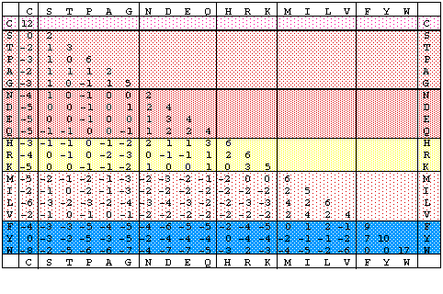
PAM250 Log odds matrix

Slide 113
Blocks Amino Acid Substitution Matrices (BLOSUM)
Larger set of sequences considered
Sequences organized into signature blocks
Consensus sequence formed
  60% identical: BLOSUM 60
  80% identical: BLOSUM 80

Slide 114
DNA Mutations
In addition to using a match/mismatch scoring scheme for DNA sequences, nucleotide mutation matrices can be constructed as well. These matrices are based upon two different models of nucleotide evolution: the first, the Jukes-Cantor model, assumes there are uniform mutation rates among nucleotides, while the second, the Kimura model, assumes that there are two separate mutation rates: one for transitions (where the structure of purine/pyrimidine stays the same), and one for transversions. Generally, the rate of transitions is thought to be higher than the rate of transversions.
A
G
PURINES: A, G
PYRIMIDINES C, T
Transitions: A↔G; C↔T
Transversions: A↔C, A↔T,
C↔G, G↔T
C
T

Slide 115
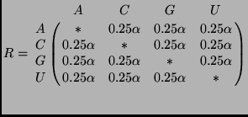

Nucleic Acid Scoring Matrices
Two mutation models:
  Jukes-Cantor Model of evolution: α = common rate of base substitution
  Kimura Model of Evolution: α = rate of transitions; β = rate of transversions
    Transitions
    Transversions

Slide 116
Nucleotide substitution matrices with the equivalent distance of 1 PAM
A. Model of uniform mutation rates among nucleotides.
A G T C
A 0.99
G 0.00333 0.99
T 0.00333 0.00333 0.99
C 0.00333 0.00333 0.00333 0.99
B. Model of 3-fold higher transitions than transversions.
A G T C
A 0.99
G 0.006 0.99
T 0.002 0.002 0.99
C 0.002 0.002 0.006 0.99

Slide 117
Nucleotide substitution matrices with the equivalent distance of 1 PAM
A. Model of uniform mutation rates among nucleotides.
A G T C
A 2
G -6 2
T -6 -6 2
C -6 -6 -6 2
B. Model of 3-fold higher transitions than transversions.
A G T C
A 2
G -5 2
T -7 -7 2
C -7 -7 -5 2

Slide 118
Linear vs. Affine Gaps
The scoring matrices used to this point assume a linear gap penalty where each gap is given the same penalty score.
However, over evolutionary time, it is more likely that a contiguous block of residues has become inserted/deleted in a certain region (for example, it is more likely to have 1 gap of length k than k gaps of length 1).
Therefore, a better scoring scheme to use is an initial higher penalty for opening a gap, and a smaller penalty for extending the gap.

Slide 119
Linear vs. Affine Gaps
Gaps have been modeled as linear
More likely contiguous block of residues inserted or deleted
  1 gap of length k rather than k gaps of length 1
Scoring scheme should penalize new gaps more

Slide 120
Affine Gap Penalty
w_{x} = g + r(x-1)
w_{x} : total gap penalty; g: gap open penalty; r: gap extend penalty; x: gap length
gap penalty chosen relative to score matrix
  Gaps not excluded
  Gaps not over included
  Typical Values: g = -12; r = -4

Slide 121
Affine Gap Penalty and Dynamic Programming
M_{i, j} = max { D_{i - 1, j - 1} + subst(A_{i}, B_{j}) ,
M_{i - 1, j - 1} + subst(A_{i}, B_{j}) ,
I_{i - 1, j - 1} + subst(A_{i}, B_{j}) }
D_{i, j} = max { D_{i , j - 1} – extend, M_{i , j - 1} - open }
I_{i, j} = max { M_{i-1 , j} – open, I_{i-1 , j} - extend }
where M is the match matrix, D is delete matrix, and I is insert matrix

Slide 122
Drawbacks to DP Approaches
Dynamic programming approaches are guaranteed to give the optimal alignment between two sequences given a scoring scheme.
However, the two main drawbacks to DP approaches is that they are compute and memory intensive, in the cases discussed to this point taking at least O(n²) space, between O(n²) and O(n³) time.
Linear space algorithms have been used in order to deal with one drawback to dynamic programming. The basic idea is to concentrate only on those areas of the matrix more likely to contain the maximum alignment. The most well-known of these linear space algorithms is the Myers-Miller algorithm. Compute intensive

Slide 123
Alternative DP approaches
Linear space algorithms Myers-Miller
Bounded Dynamic Programming
Ewan Birney’s Dynamite Package
  Automatic generation of DP code

Slide 124
Assessing Significance of Alignment
When two sequences of length m and n are not obviously similar but show an alignment, it becomes necessary to assess the significance of the alignment. The alignment of scores of random sequences has been shown to follow a Gumbel extreme value distribution.

Slide 125
Significance of Alignment
Determine probability of alignment occurring at random
  Sequence 1: length m
  Sequence 2: length n
Random sequences:
  When two sequences of length m and n are not obviously similar but show an alignment, it becomes necessary to assess the significance of the alignment.
  The alignment of scores of random sequences has been shown to follow a Gumbel extreme value distribution.

Slide 126
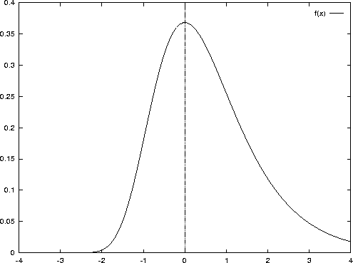
Gumbel Extreme Value Distribution
http://roso.epfl.ch/mbi/papers/discretechoice/node11.html
http://mathworld.wolfram.com/GumbelDistribution.html
http://en.wikipedia.org/wiki/Generalized_extreme_value_distribution

Slide 127
Probability of Alignment Score
Using a Gumbel extreme value distribution, the expected number of alignments with a score at least S (E-value) is:
  E = Kmn e^{-λS}
  m,n: Lengths of sequences
  K ,λ: statistical parameters dependent upon scoring system and background residue frequencies

Slide 128
Recall that the log-odds scoring schemes examined to this point normally use a
S = 10*log₁₀x scoring system.
We can normalize the raw scores obtained using these non-gapped scoring systems to obtain the amount of bits of information contained in a score (or the amount of nats of information contained within a score).

Slide 129


Converting to Bit Scores
A raw score can be normalized to a bit score using the formula:
The E-value corresponding to a given bit score can then be calculated as:

Slide 130
Converting to nats is similar. However, we just substitute e for 2 in the above equations. Converting scores to either bits or nats gives a standardized unit by which the scores can be compared.

Slide 131
P-Value
P values can be calculated as the probability of obtaining a given score at random. P-values can be estimated as:
P = 1 – e^{-E}
which is approximately e^{-E}

Slide 132
A quick determination of significance
If a scoring matrix has been scaled to bit scores, then it can quickly be determined whether or not an alignment is significant.
For a typical amino acid scoring matrix, K = 0.1 and lambda depends on the values of the scoring matrix.
If a PAM or BLOSUM matrix is used, then lambda is precomputed.
For instance, if the log odds matrix is in units of bits, then lambda = log_{e}2, and the significance cutoff can be calculates as log₂(mn).

Slide 133
Significance of Ungapped Alignments
PAM matrices are 10 * log₁₀x
Converting to log₂x gives bits of information
Converting to log_{e}x gives nats of information
Quick Calculation:
If bit scoring system is used, significance cutoff is:
log₂(mn)

Slide 134
Example
Suppose we have two sequences, each approximately 250 amino acids long that are aligned using a Smith-Waterman approach.
Significance cutoff is:
  log₂(250 * 250) = 16 bits

Slide 135
Example
Using PAM250, the following alignment is found:
F W L E V E G N S M T A P T G
F W L D V Q G D S M T A P A G

Slide 136
Example
Using PAM250, the score is calculated:
F W L E V E G N S M T A P T G
F W L D V Q G D S M T A P A G
S = 9 + 17 + 6 + 3 + 4 + 2 + 5 + 2 + 2 + 6 + 3 + 2 + 6 + 1 + 5 = 73

Slide 137
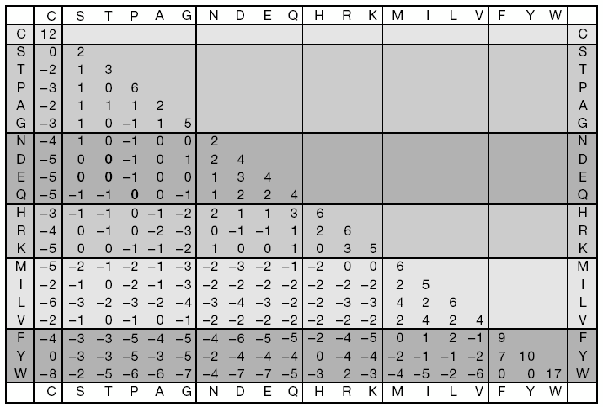
PAM250 matrix

Slide 138
Significance Example
S is in 10 * log₁₀x, so this should be converted to a bit score:
S = 10 log₁₀x
S/10 = log₁₀x
S/10 = log₁₀x * (log₂10/log₂10)
S/10 * log₂10 = log₁₀x / log₂10
S/10 * log₂10 = log₂x
1/3 S ~ log₂x
S’ ~ 1/3S

Slide 139
Significance Example
S’ = 1/3S = 1/3 * 73 = 24.333 bits
The significance cutoff is:
log2(mn) = log2(250 * 250) = 16 bits
Since the alignment score is above the significance cutoff, this is a significant local alignment.

Slide 140
Estimation of E and P
When a PAM250 scoring matrix is being used, K is estimated to be 0.09, while lambda is estimated to be 0.229.
For PAM250, K = 0.09; λ = 0.229
We can convert the score to a bit score as follows:
S’= λS-lnKmn
S’ = 0.229 * 73 – ln 0.09 * 250 * 250
S’ = 16.72 – 8.63 = 8.09 bits
P(S’ >= x) = 1 – e^{(-e-x)}
P(S’ >= 8.09) = 1 – e^{(-e-8.09)} = 3.1* 10⁻⁴
Therefore, we see that the probability of observing an alignment with a bit score greater than 8.09 is about 3 in 1000.

Slide 141
Significance of Gapped Alignments
Gapped alignments make use of the same statistics as ungapped alignments in determining the statistical significance.
However, in gapped alignments, the values for λ and K cannot be easily estimated.
Empirical estimations and gap scores have been determined by looking at the alignments of randomized sequences.

Slide 142
Bayesian Statistics
Bayesian statistics are built upon conditional probabilities,
  which are used to derive the joint probability of two events or conditions.
P(B|A) is the probability of B given condition A is true.
P(B) is the probability of condition B occurring, regardless of conditions A.
P(A, B): Joint probability of A and B occurring simultaneously

Slide 143
Bayesian Statistics
Suppose that A can have two states, A1 and A2, and B can have two states, B1 and B2.
Suppose that P(B1) = 0.3 is known.
Therefore, P(B2) = 1 – 0.3 = 0.7.
These probabilities are known as marginal probabilities.
Now we would like to determine the probability of A1 and B1 occurring together, which is denoted as: P(A1, B1) and is called the joint probability

Slide 144
Joint Probabilities
Note that in this case the marginal probabilities A1 and A2 are missing. Thus, there is not enough information at this point to calculate the marginal probability.
However, if more information about the joint occurrence of A1 and B1 are given, then the joint probabilities may be derived using Bayes Rule:
  P(A1,B1) = P(B1)P(A1|B1)
  P(A1,B1) = P(A1)P(B1|A1)

Slide 145
Bayesian Example
Suppose that we are given P(A1|B1) = 0.8.
Then, since there are only two different possible states for A,
P(A2|B1) = 1 – 0.8 = 0.2.
If we are also given P(A2|B2) = 0.7,
then P(A1|B2) = 0.3.
Using Bayes Rule, the joint probability of having states A1 and B1 occurring at the same time is
P(B1)P(A1|B1) = 0.3 * 0.8 = 0.24 and
P(A2,B2) = P(B2)P(A2|B2) = 0.7 * 0.7 = 0.49.
The other joint probabilities can be calculated from these as well.

Slide 146
Posterior Probabilities
Calculation of joint probabilities results in posterior probabilities
  Not known initially
  Calculated using
    Prior probabilities
    Initial information

Slide 147
Applications of Bayesian Statistics
Evolutionary distance between two sequences
Sequence Alignment
Significance of Alignments
Gibbs Sampling

Slide 148
Pairwise Sequence Alignment Programs
needle
  Global Needleman/Wunsch alignment
water
  Local Smith/Waterman alignment
Blast 2 Sequences
  NCBI
  word based sequence alignment
LALIGN
  FASTA package
  Mult. Local alignments

Slide 149
Various Sequence Alignments
Wise2 -- Genomic to protein
Sim4 -- Aligns expressed DNA to genomic sequence
spidey -- aligns mRNAs to genomic sequence
est2genome -- aligns ESTs to genomic sequence

