Slide 1
Digital Audio and Speech Processing (Sayısal Ses ve Konuşma İşleme)
Prof. Dr. Nizamettin AYDIN
naydin@yildiz.edu.tr
nizamettinaydin@gmail.com
http://www3.yildiz.edu.tr/~naydin
Frequency Domain Methods in Speech Processing

Slide 2
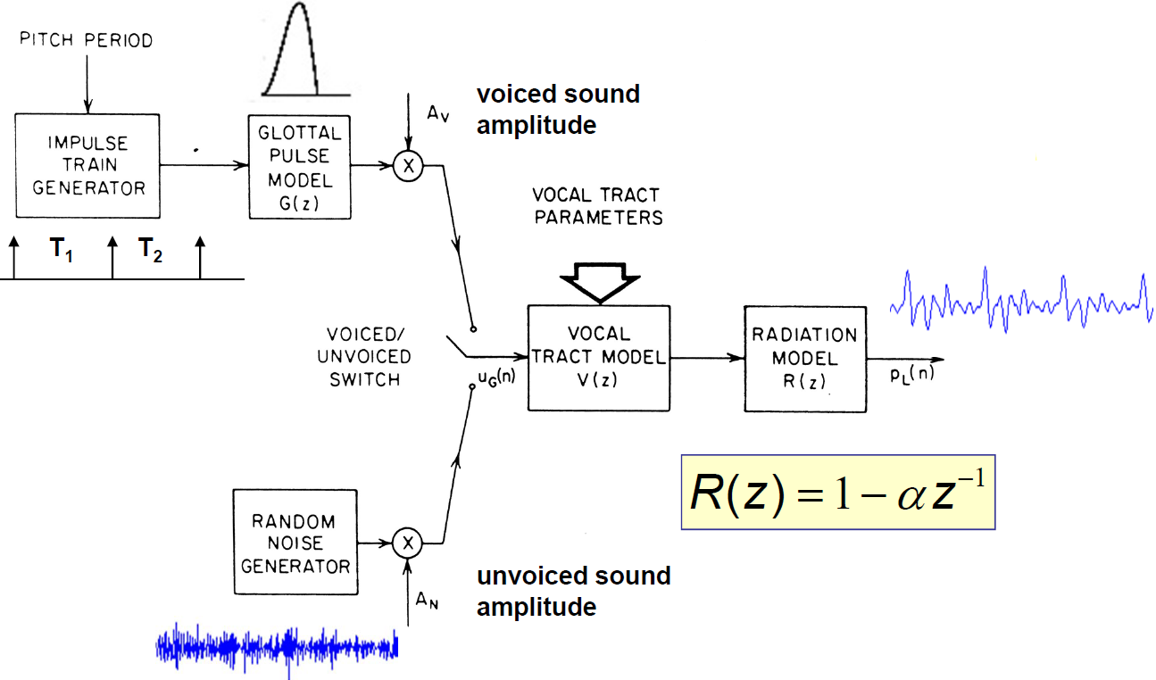
General Synthesis Model
Log Areas, Reflection Coefficients, Formants, Vocal Tract Polynomial, Articulatory Parameters, …
Pitch Detection, Voiced/Unvoiced/Silence Detection, Gain Estimation, Vocal Tract Parameter Estimation, Glottal Pulse Shape, Radiation Model

Slide 3
General Analysis Model
All analysis parameters are time-varying at rates commensurate with information in the parameters;
We need algorithms for estimating the analysis parameters and their variations over time

Slide 4
Overview of Lecture
Define time-varying Fourier transform (STFT) analysis method
Define synthesis method from time-varying FT (filter-bank summation, overlap addition)
Show how time-varying FT can be viewed in terms of a bank of filters model
Computation methods based on using FFT
Application to
vocoders, spectrum displays, format estimation, pitch period estimation

Slide 5
Short-Time Fourier Transform (STFT) Analysis
Represent signal by sum of sinusoids or complex exponentials as it leads to convenient solutions to problems such as
formant estimation,
pitch period estimation,
analysis-by-synthesis methods
Such Fourier representations provide
convenient means to determine response to a sum of sinusoids for linear systems
clear evidence of signal properties that are obscured in the original signal

Slide 6
Why STFT for Speech Signals
Steady state sounds, like vowels, are produced by periodic excitation of a linear system
speech spectrum is the product of the excitation spectrum and the vocal tract frequency response
Speech is a time-varying signal
Need more sophisticated analysis to reflect time varying properties
Changes occur at syllabic rates
~10 times/sec
Over fixed time intervals of 10-30 msec, properties of most speech signals are relatively constant

Slide 7
Frequency Domain Processing
Coding:
Transform, subband, homomorphic, channel vocoders
Restoration/Enhancement/Modification:
Noise and reverberation removal, helium restoration, time-scale modifications (speed-up and slow-down of speech)

Slide 8
Frequency and the DTFT
Sinusoids
$$x\left(n\right)=\cos\left(ω_{0}n\right)=\frac{e^{jωn}+e^{−jωn}}{2}$$
where $ω_{0}$ is the frequency (in radians) of the sinusoid
The Discrete-Time Fourier Transform (DTFT )
$$X\left(e^{jω}\right)=\sum_{n=−∞}^{∞}{x(n)e^{−jωn}}=DTFT\left\{x\left(n\right)\right\}$$
$$x\left(n\right)=\frac{1}{2π}\int_{−π}^{π}{X\left(e^{jω}\right)e^{jωn}dω}={DTFT}^{−1} \{X\left(e^{jω}\right)\}$$
where $ω$is the frequency variable of $X\left(e^{jω}\right)$

Slide 9
DTFT and DFT of Speech
The DTFT and the DFT for the infinite duration signal could be calculated (the DTFT) and approximated (the DFT) by the following:
$$X\left(e^{jω}\right)=\sum_{m=−∞}^{∞}{x(m)e^{−jωm}} (DTFT)$$
$$X\left(k\right)=\sum_{m=0}^{L−1}{{x\left(m\right)w(m)e}^{−j\left(\frac{2π}{L}\right)km}, k=0,1,⋯L−1}$$
$$={\left.X\left(e^{jω}\right)\right|}_{ω=\frac{2πk}{L}} (DFT)$$
Using a value of L=25000 we get the plot given in the next slide

Slide 10
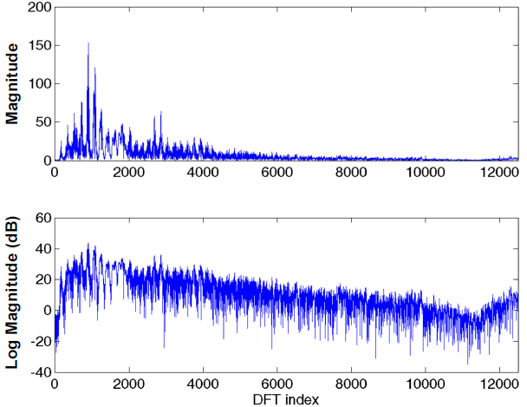
25000-Point DFT of Speech

Slide 11
Short-Time Fourier Transform
Speech is not a stationary signal,
i.e., it has properties that change with time
Thus a single representation based on all the samples of a speech utterance, for the most part, has no meaning
Instead, we define a time-dependent Fourier transform (TDFT or STFT) of speech that changes periodically as the speech properties change over time

Slide 12
Definition of STFT
$$X_{\hat{n}}\left(e^{j\hat{ω}}\right)=\sum_{m=−∞}^{∞}{{x\left(m\right)w(\hat{n}−m)e}^{−j\hat{ω}m}}$$
Both $\hat{n}$ and $\hat{ω}$ are variables
$w(\hat{n}−m)$is a real window which determines the portion of $x\left(\hat{n}\right)$that is used in the computation of $X_{\hat{n}}\left(e^{j\hat{ω}}\right)$

Slide 13
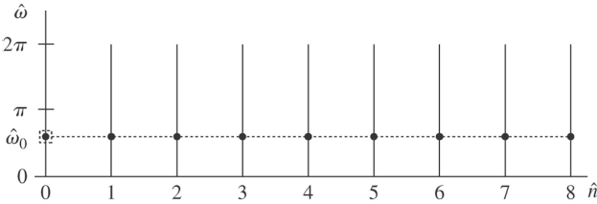
Short Time Fourier Transform
STFT is a function of two variables,
the time index, $\hat{n}$, which is discrete,
the frequency variable, $\hat{ω}$, which is continuous
$$X_{\hat{n}}\left(e^{j\hat{ω}}\right)=\sum_{m=−∞}^{∞}{{x\left(m\right)w(\hat{n}−m)e}^{−j\hat{ω}m}}$$
$$=DTFT\left\{x\left(m\right)w(\hat{n}−m)\right\}$$
where $\hat{n}$ is fixed, $\hat{ω}$ is variable

Slide 14
Fourier Transform Interpretation
Consider $X_{\hat{n}}\left(e^{j\hat{ω}}\right)$ as the normal Fourier transform of the sequence $x\left(m\right)w\left(\hat{n}−m\right), −∞<m<∞$ for fixed $\hat{n}$.
The window $w\left(\hat{n}−m\right)$ slides along the sequence $x\left(m\right)$ and defines a new STFT for every value of $\hat{n}$.
Conditions for the existence of the STFT:
The sequence $x\left(m\right)w\left(\hat{n}−m\right)$ must be absolutely summable for all values of $\hat{n}$
since $\left|x\left(\hat{n}\right)\right|≤L$ (32767 for 16-bit sampling)
since $\left|w\left(\hat{n}\right)\right|≤1$ (normalized window levels)
since window duration is usually finite
$x\left(m\right)w\left(\hat{n}−m\right)$ is absolutely summable for all $\hat{n}$

Slide 15
Signal Recovery from STFT
Since for a given value of $\hat{n}$, $X_{\hat{n}}\left(e^{j\hat{ω}}\right)$ has the same properties as a normal Fourier transform, we can recover the input sequence exactly.
Since $X_{\hat{n}}\left(e^{j\hat{ω}}\right)$ is the normal Fourier transform of the windowed sequnce $x\left(m\right)w\left(\hat{n}−m\right)$, then
$$x\left(m\right)w\left(\hat{n}−m\right)=\frac{1}{2π}\int_{−π}^{π}{X_{\hat{n}}\left(e^{j\hat{ω}}\right)e^{j\hat{ω}m}d\hat{ω}}$$
Assuming the window satisfies the property that $w\left(0\right)≠0$ ( a trivial requirement), then by evaluating the inverse Fourier transform when $m=\hat{n}$, we obtain
$$x\left(\hat{n}\right)=\frac{1}{2πw(0)}\int_{−π}^{π}{X_{\hat{n}}\left(e^{j\hat{ω}}\right)e^{jω\hat{n}}d\hat{ω}}$$

Slide 16
Signal Recovery from STFT
$$x\left(\hat{n}\right)=\frac{1}{2πw(0)}\int_{−π}^{π}{X_{\hat{n}}\left(e^{j\hat{ω}}\right)e^{jω\hat{n}}d\hat{ω}}$$
with the requirement that $w\left(0\right)≠0$, the sequence $x\left(\hat{n}\right)$ can be recovered exactly from $X_{\hat{n}}\left(e^{j\hat{ω}}\right)$, if $X_{\hat{n}}\left(e^{j\hat{ω}}\right)$ is known for all values of $\hat{ω}$ over one complete period.
sample-by-sample recovery process
Since $X_{\hat{n}}\left(e^{j\hat{ω}}\right)$ must be known for every value of $\hat{n}$ and for all $\hat{ω}$ then
Can also recover sequence $x\left(m\right)w\left(\hat{n}−m\right)$ but cannot guarantee that $x\left(m\right)$ can be recovered since $w\left(\hat{n}−m\right)$ can equal to 0

Slide 17
Alternative Forms of STFT
Alternative forms of $X_{\hat{n}}\left(e^{j\hat{ω}}\right)$ :
Real and Imaginary parts
$${ X}_{\hat{n}}\left(e^{j\hat{ω}}\right)=Re\left[X_{\hat{n}}\left(e^{j\hat{ω}}\right)\right]+jIm\left[X_{\hat{n}}\left(e^{j\hat{ω}}\right)\right]$$
$$=a_{\hat{n}}\left(\hat{ω}\right)−jb_{\hat{n}}\left(\hat{ω}\right)$$
$$a_{\hat{n}}\left(\hat{ω}\right)=Re\left[X_{\hat{n}}\left(e^{j\hat{ω}}\right)\right]$$
$$b_{\hat{n}}\left(\hat{ω}\right)=−Im\left[X_{\hat{n}}\left(e^{j\hat{ω}}\right)\right]$$
When $x\left(m\right)$ and $w\left(\hat{n}−m\right)$ are both real can show that $a_{\hat{n}}\left(\hat{ω}\right)$ is symmetric in $\hat{ω}$, and $b_{\hat{n}}\left(\hat{ω}\right)$ is anti-symmetric in $\hat{ω}$
Magnitude and Phase
$$X_{\hat{n}}\left(e^{j\hat{ω}}\right)=\left|X_{\hat{n}}\left(e^{j\hat{ω}}\right)\right|e^{jθ_{\hat{n}}(\hat{ω})}$$
Can relate $\left|X_{\hat{n}}\left(e^{j\hat{ω}}\right)\right|$ and $θ_{\hat{n}}(\hat{ω})$ to $a_{\hat{n}}\left(\hat{ω}\right)$ and $b_{\hat{n}}\left(\hat{ω}\right)$

Slide 18
Role of Window in STFT
The window $w\left(\hat{n}−m\right)$ does the following:
Chooses portion of $x\left(m\right)$ to be analyzed
Window shape determines the nature of $X_{\hat{n}}\left(e^{j\hat{ω}}\right)$
Since $X_{\hat{n}}\left(e^{j\hat{ω}}\right)$ (for fixed $\hat{n}$) is the normal FT of $x\left(m\right)w\left(\hat{n}−m\right)$, then if we consider the normal FT’s of both $x\left(m\right)$ and $w\left(m\right)$ individually, we get
$$X\left(e^{j\hat{ω}}\right)=\sum_{m=−∞}^{∞}{{x\left(m\right)e}^{−j\hat{ω}m}}$$
$$W\left(e^{j\hat{ω}}\right)=\sum_{m=−∞}^{∞}{{w\left(m\right)e}^{−j\hat{ω}m}}$$

Slide 19
Role of Window in STFT
Then for fixed $\hat{n}$, the normal Fourier transform of the product $x\left(m\right)w\left(\hat{n}−m\right)$ is the convolution of the transforms of $x\left(m\right)$ and $w\left(m\right)$
For fixed $\hat{n}$, the FT of $w\left(\hat{n}−m\right)$ is $W\left(e^{−j\hat{ω}}\right)e^{−j\hat{ω}\hat{n}}$, thus
$$X_{\hat{n}}\left(e^{j\hat{ω}}\right)=\frac{1}{2π}\int_{−π}^{π}{W\left(e^{−jθ}\right)e^{−jθ\hat{n}}X\left(e^{j(\hat{ω}−θ)}\right)dθ}$$
And replacing $θ$ by $−θ$ gives
$$X_{\hat{n}}\left(e^{j\hat{ω}}\right)=\frac{1}{2π}\int_{−π}^{π}{W\left(e^{jθ}\right)e^{jθ\hat{n}}X\left(e^{j(\hat{ω}+θ)}\right)dθ}$$

Slide 20
Windows in STFT
For $X_{\hat{n}}\left(e^{j\hat{ω}}\right)$ to represent the short-time spectral properties of $x\left(\hat{n}\right)$ inside the window
$W\left(e^{jθ}\right)$ should be much narrower in frequency than significant spectral regions of $X\left(e^{jθ}\right)$
i.e. Almost an impulse in frequency
Consider Rectangular and Hamming windows, where width of the main spectral lobe is inversely proportional to window length, and side lobe levels are essentially independent of window length
Rectangular Window:
Flat window of length L samples;
First zero in frequency response occurs at F_{S}/L,
with sidelobe levels of -14 dB or lower
Hamming Window:
Raised cosine window of length L samples;
First zero in frequency response occurs at 2F_{S}/L,
with sidelobe levels of -40 dB or lower

Slide 21
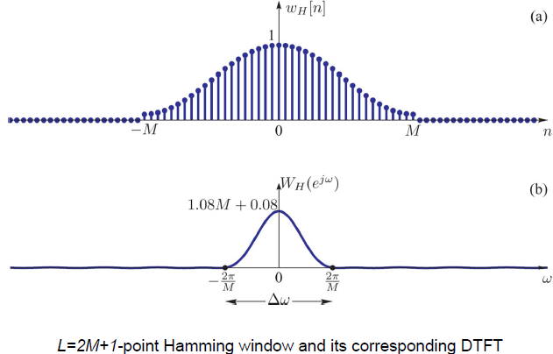
Windows

Slide 22
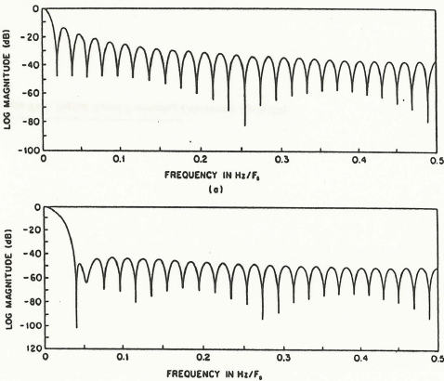
Frequency Responses of Windows

Slide 23
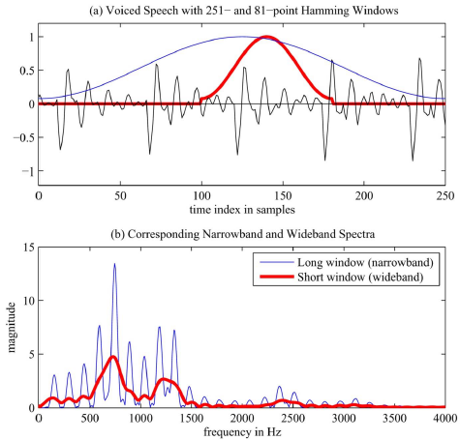
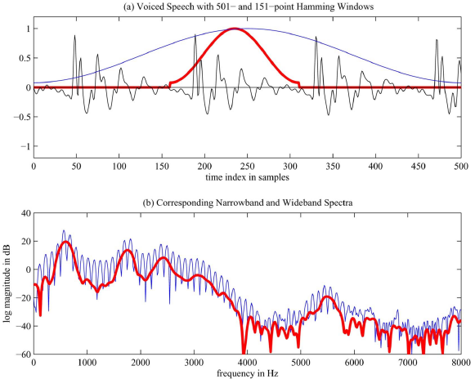
Effect of Window Length

Slide 24
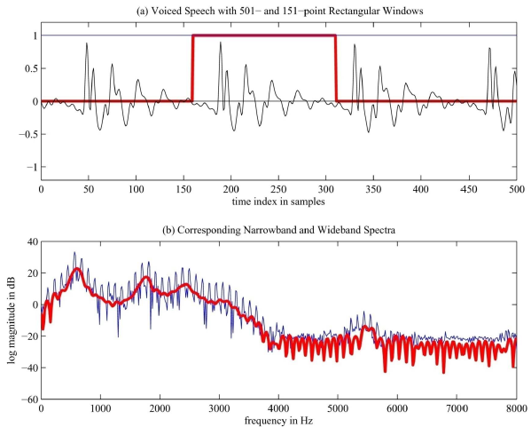
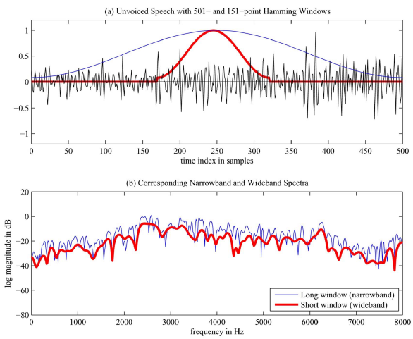
Effect of Window Length

Slide 25
Summary of FT view of STFT
Interpret $X_{\hat{n}}\left(e^{j\hat{ω}}\right)$ as the normal Fourier transform of the sequence $x\left(m\right)w\left(\hat{n}−m\right), −∞<m<∞$
Properties of this Fourier transform depend on the window
Frequency resolution of $X_{\hat{n}}\left(e^{j\hat{ω}}\right)$ varies inversly with the length of the window
Long windows for high frequency resolution
$x\left(n\right)$ should be relatively stationary (non-time-varying) during duration of window for most stable spectrum
Short windows for high temporal resolution
As usual in speech processing, there needs to be a compromise between good temporal resolution (short windows) and good frequency resolution (long windows)

