Slide 1
BLM1612 - Circuit Theory
Prof. Dr. Nizamettin AYDIN
naydin@yildiz.edu.tr
www.yildiz.edu.tr/~naydin
Frequency Response

Slide 2
Frequency Response
Objective of Lecture
  Describe the sinusoidal steady-state behavior of a circuit as a function of frequency.

Slide 3
Frequency Response
If we let the amplitude of the sinusoidal source remain constant and vary the frequency,
  we obtain the circuit’s frequency response.
The frequency response of a circuit is the variation in its behavior with change in signal frequency.
The frequency response of a circuit may also be considered as the variation of the gain and phase with frequency.

Slide 4
Transfer Function
The transfer function H(ω) of a circuit is the frequency-dependent ratio of a phasor output Y(ω) (an element voltage or current) to a phasor input X(ω) (source voltage or current).

Slide 5
Transfer Function
Since the input and output can be either voltage or current at any place in the circuit,
  there are four possible transfer functions:

Slide 6
Transfer Function
The transfer function H(ω) can be expressed in terms of its numerator polynomial N(ω) and denominator polynomial D(ω) as
  The roots of N(ω) = 0 are called the zeros of H(ω) and are usually represented as jω = z₁, z₂, … .
  Similarly, the roots of D(ω) = 0 are the poles of H(ω) and are represented as jω = p₁, p₂, … .
    A zero is a value that results in a zero value of the function.
    A pole is a value for which the function is infinite.

Slide 7
Example 01…
For the following RC circuit,
obtain the transfer function
V_{o} / V_{s} and its frequency response.
  Let v_{s} = V_{m}cosωt .
  The frequency-domain equivalent of the circuit:
  The transfer function

Slide 8
…Example 01…
The magnitude and phase of H(ω)
where ω ₀= 1 / RC
To plot H and φ for 0 < ω < ∞ we obtain their values at some critical points and then sketch.

Slide 9
…Example 01
Frequency response of the RC circuit:
amplitude response phase response

Slide 10
Example 02
For the following RL circuit,
obtain the transfer function
V_{o} / V_{s} and its frequency response.
  Let v_{s} = V_{m}cosωt .
  Answer:

Slide 11
Example 03..
For the following RLC circuit, obtain the current gain I_{o}(ω) / I_{i}(ω) and its poles and zeros.

Slide 12
…Example 03

Slide 13
Example 04
For the following RLC circuit, obtain the transfer function V_{o}(ω) / I_{i}(ω) and its zeros and poles.
Answer:

Slide 14
Example 05…
Plot the amplitude and phase of
the voltage transfer funciton
for this circuit for
  100 Hz < f < 1 kHz (linear)
  Answer:

Slide 15
…Example 05…

Slide 16
…Example 05…

Slide 17
…Example 05…

Slide 18
…Example 05

Slide 19
Example 06…

Slide 20
…Example 06…

Slide 21
…Example 06

Slide 22
Example 07…

Slide 23
…Example 07…

Slide 24
…Example 07

Slide 25
The Decibel Scale
A more systematic way of obtaining the frequency response is to use Bode plots.
  Two important issues in Bode plots :
    The use of logarithms and decibels in expressing gain.
Since Bode plots are based on logarithms, it is important that we keep the following properties of logarithms in mind:
  log P₁P₂ = log P₁ + log P₂
  log P₁/P₂ = log P₁ - log P₂
  log P^{n} = n log P
  log 1 = 0

Slide 26
Logarithms

Slide 27
Logarithms

Slide 28
Logarithms (Arithmetic)

Slide 29
Some Areas of Application
The response of a system can be plotted for a range of values that may otherwise be impossible or unwieldy with a linear scale.
Levels of power, voltage, and the like, can be compared without dealing with very large or very small numbers that often cloud the true impact of the difference in magnitudes.
A number of systems respond to outside stimuli in a nonlinear logarithmic manner.
  The result is a mathematical model that permits a direct calculation of the response of the system to a particular input signal.
The response of a cascaded or compound system can be rapidly determined using logarithms if the gain of each stage is known on a logarithmic basis.

Slide 30
Graphs
Graph paper is available in semilog and log-log varieties.
Example:
  Frequency log scale

Slide 31
Graphs

Slide 32
The Decibel Scale
In communications systems, gain is measured in bels.
  The bel is named after Alexander Graham Bell, the inventor of the telephone.
Historically, the bel is used to measure the ratio of two levels of power or power gain G; that is,

Slide 33
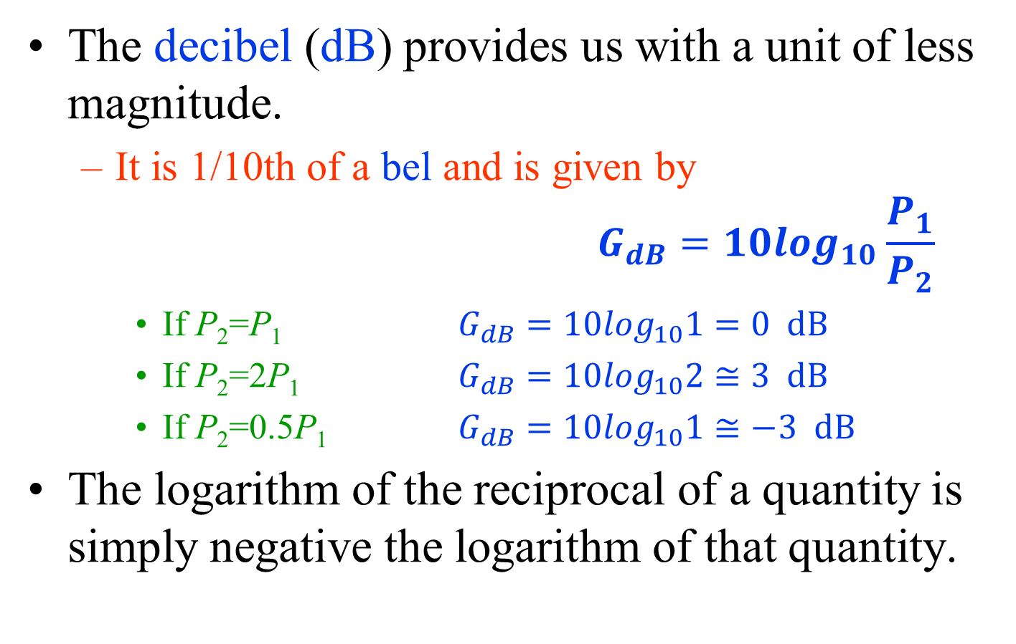
The Decibel Scale
The decibel (dB) provides us with a unit of less magnitude.
  It is 1/10th of a bel and is given by
  $$G_{dB}=10\log_{10}\frac{P_{1}}{P_{2}}$$
    If P₂=P₁ $G_{dB}=10\log_{10}1=0 dB$
    If P₂=2P₁ $G_{dB}=10\log_{10}2≅3 dB$
    If P₂=0.5P₁ $G_{dB}=10\log_{10}1≅−3 dB$
The logarithm of the reciprocal of a quantity is simply negative the logarithm of that quantity.

Slide 34

The Decibel Scale
Alternatively, the gain G can be expressed in terms of voltage or current ratio.
If P₁ is the input power, P₂ is the output (load) power, R₁ is the input resistance, and R₂ is the load resistance, then $P_{1}=0.5V_{1}^{2}/R_{1}$ and $P_{2}=0.5V_{2}^{2}/R_{2}$

Slide 35
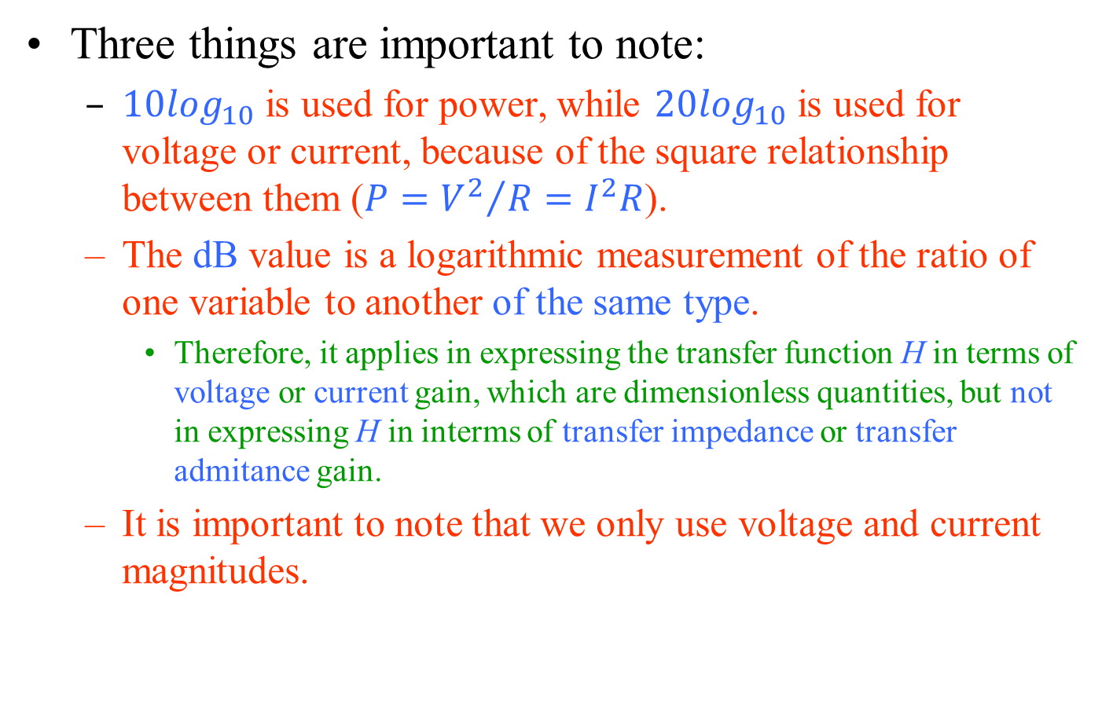
The Decibel Scale
Three things are important to note:
  $10\log_{10}$ is used for power, while $20\log_{10}$ is used for voltage or current, because of the square relationship between them ($P={V^{2}}/R=I^{2}R$).
  The dB value is a logarithmic measurement of the ratio of one variable to another of the same type.
    Therefore, it applies in expressing the transfer function H in terms of voltage or current gain, which are dimensionless quantities, but not in expressing H in interms of transfer impedance or transfer admitance gain.
  It is important to note that we only use voltage and current magnitudes.

Slide 36
The Decibel Scale
Three things are important to note:
  $10\log_{10}$ is used for power, while $20\log_{10}$ is used for voltage or current, because of the square relationship between them ($P={V^{2}}/R=I^{2}R$).
  The dB value is a logarithmic measurement of the ratio of one variable to another of the same type.
    Therefore, it applies in expressing the transfer function H in terms of voltage or current gain, which are dimensionless quantities, but not in expressing H in interms of transfer impedance or transfer admitance gain.
  It is important to note that we only use voltage and current magnitudes.

Slide 37
The Decibel Scale
Specific gain and their decibel values.

Slide 38
Human Auditory Response
One of the most frequent applications of the decibel scale is in the communication and entertainment industries.
The human ear does not respond in a linear fashion to changes in source power level.
  A doubling of the audio power level from 1/2 W to 1 W does not result in a doubling of the loudness level for the human ear.
  In addition, a change from 5 W to 10 W is received by the ear as the same change in sound intensity as experienced from 1/2 W to 1 W.
The ear responds in a logarithmic fashion to changes in audio power levels.

Slide 39
Human Auditory Response
To establish a basis for comparison between audio levels, a reference level of 0.0002 microbar (µbar) was chosen,
  where 1 µbar is equal to the sound pressure of 1 dyne per square centimeter, or about 1 millionth of the normal atmospheric pressure at sea level.
    The 0.0002 µbar level is the threshold level of hearing.
Using this reference level, the sound pressure level in decibels is defined by the following equation:
where P is the sound pressure in microbars.

Slide 40
Typical sound levels and their decibel levels
To double the sound level received by the human ear, the power rating of the acoustical source (in watts) must be increased by a factor of 10.

