Slide 1
BLM1612 - Circuit Theory
Syllabus
The Instructors:
Prof. Dr. Nizamettin AYDIN
naydin@yildiz.edu.tr
Dr. Hamza Osman ILHAN
hamza@yildiz.edu.tr

Slide 2
Course Details
Course Code : BLM1612
Course Name: Circuit Theory (Devre Teorisi)
Instructors : Prof. Dr. Nizamettin AYDIN
Dr. Hamza Osman ILHAN
Lab Assistants:
  Arş. Gör. Hasan Burak Avcı
    http://avesis.yildiz.edu.tr/hbavci/
  Arş. Gör. Kübra Adalı
    http://avesis.yildiz.edu.tr/adalik/
  Arş. Gör. Nihal Altuntaş
    http://avesis.yildiz.edu.tr/nihaltun/

Slide 3
Assesment (for the first-time takers)
Method Quantity (%)
Quiz - -
Homework/Problem Solving 5 10
Laboratory 5 20
Midterm Exam(s) 1(2) 30
Final Exam 1 40
Attendance & participation -

Slide 4
Assesment (for the ones who have taken labs before)
Method Quantity (%)
Quiz - -
Homework/Problem Solving 5 10
Laboratory Midterm 1 20
Midterm Exam(s) 1(2) 30
Final Exam 1 40
Attendance & participation -

Slide 5
Course Outline
1. Introduction.
Lumped circuit elements, Levels of abstraction, What are the circuits?, Course objectives.
2. Basic Concepts.
Units, Charge, Current, Voltage, Power, Conservation of Energy, Circuit Elements, Networks vs. Circuits, Ohm’s Law, .
3. Voltage and Current Laws.
Circuit Terminology, Kirchhoff’s Current Law, Kirchhoff’s Voltage Law, The Single-Loop Circuit, Conservation of Energy, The Single-Node-Pair Circuit, Series Circuits, Parallel Circuits, Voltage Division, Current Division.
4. Nodal and Mesh Analysis.
Nodal (or “Node-Voltage”) Analysis, Nodal Analysis with Supernodes, Mesh (Current) Analysis, Mesh Analysis with Supermeshes, Equivalent Practical Sources.
5. Linearity & Superposition.
Linearity, Superposition, Superposition: Voltage Sources, Superposition: Current Sources, Practical Voltage Sources, Practical Current Sources.
6. Thevenin & Norton Equivalents.
Thevenin Equivalent, Power from a Practical Source, Maximum Power Transfer .
7. The Operational Amplifier.
The Operational Amplifier, Inverting Amplifier, Noninverting Amplifier, Voltage Follower, Summing Amplifier, Difference Amplifier, Op-Amp Cascades, Op-Amp Parameters, Common Mode Rejection, Saturation, An instrumentation amplifier.

Slide 6
Course Outline
8. Capacitors and Inductors.
Capacitance, Capacitor Current & Voltage, Capacitor Characteristics, Inductance, Inductor Current & Voltage, Inductor Characteristics, Inductor Energy Storage, DC Capacitor Circuits, DC Inductor Circuits.
9. Basic RL and RC Circuits.
The Source-Free RL Circuit, The Source-Free RC Circuit, Unit-Step Definition, Driven RL Circuit, Driven RC Circuit.
10. RLC Circuits.
Parallel RLC Circuit, Series RLC Circuit, RLC Solution: Over-damped, RLC Solution: Critically Damped, RLC Solution: Under-damped, The Complete Response Of The RLC Circuit.
11. AC Analysis.
Complex numbers, phasors, impedance, admittance, Sinusoidal steady-state; Ohm’s Law, KVL, KCL for AC circuits, Sinusoidal steady-state: Thevenin, superposition, examples.
12. The Frequency Response.
Frequency response: transfer function, logarithms, Bode plots.
Frequency response: resonance, passive & active filter design
13. Laplace Transform.
Laplace: introduction to transforms, inverse transform.
Laplace: theorems, solving differential equations
14. s-Domain analysis
s-Domain analysis: transfer functions, poles, zeroes.
s-Domain analysis: nodal, mesh, additional techniques

Slide 7
COURSE OBJECTIVES
Students will be able to:
  Analyze wide range of pure resistive DC circuits using the different techniques covered through-out the course.
  Gains hands-on experience in DC circuit problem solving tricks and shortcuts.
  Utilize the Thevenin theorem as a core tool in circuit analysis.
  Analyze RL, RC, and RLC circuits with the proper tools.
  Carry power consumption calculation for different components in a DC circuit.
  Design, simulate, and implement Basic DC circuits.

Slide 8
Suggested Texts
Engineering Circuit Analysis
by William Hayt, Jack Kemmerly, Steven Durbin
ISBN 0073529575
Basic engineering circuit analysis
by J. David Irwin, R. Mark Nelms
ISBN 978-1-118-95598-7
Introductory Circuit Analysis
by Robert L. Boylestad
ISBN 978-0-13-392360-5
…

Slide 9
Rules of the Conduct
No eating /drinking in class
  except water
Cell phones must be kept outside of class or switched-off during class
  If your cell-phone rings during class or you use it in any way, you will be asked to leave and counted as unexcused absent.
No web surfing and/or unrelated use of computers,
  when computers are used in class or lab.

Slide 10
Rules of the Conduct
You are responsible for checking the class web page often for announcements.
Academic dishonesty and cheating will not be tolerated and will be dealt with according to university rules and regulations
  Presenting any work, or a portion thereof, that does not belong to you is considered academic dishonesty.
  University rules and regulations:
    http://www.ogi.yildiz.edu.tr/category.php?id=17
    https://www.yok.gov.tr/content/view/544/230/lang,tr_TR/

Slide 11
Attendance Policy
The requirement for attendance is 70%.
  Hospital reports are not accepted to fulfill the requirement for attendance.
  The students, who fail to fulfill the attendance requirement, will be excluded from the final exams and the grade of F0 will be given.

Slide 12
Electric Circuit
An arrangement into a network of several connected two-terminal electrical components.
  Each type of component will have its own symbol.

Slide 13
What Is Circuit Analysis?
Art of finding out how the unique circuit we are given responds to a particular input.
  The input could be a voltage or a current, or maybe some combination of voltages and currents.
The response of the circuit is the output.

Slide 14
A brief history
Time charts indicating a limited number of major developments
  (a) long-range; (b) expanded

Slide 15
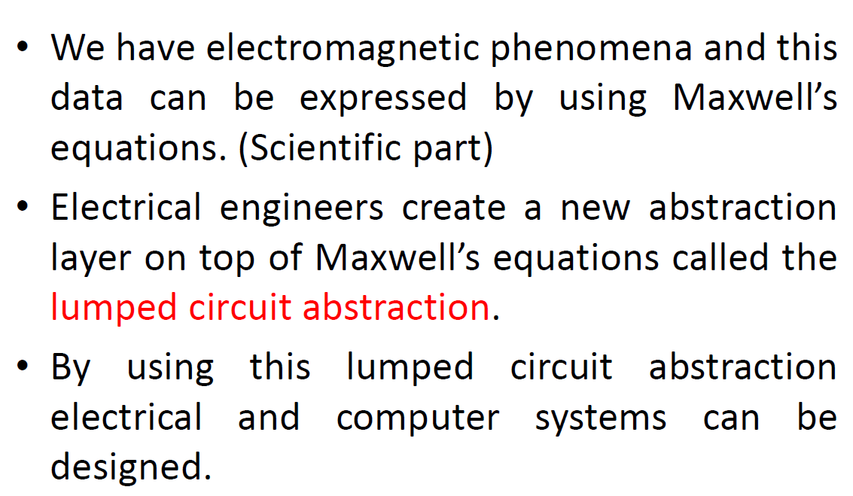
Abstraction

Slide 16
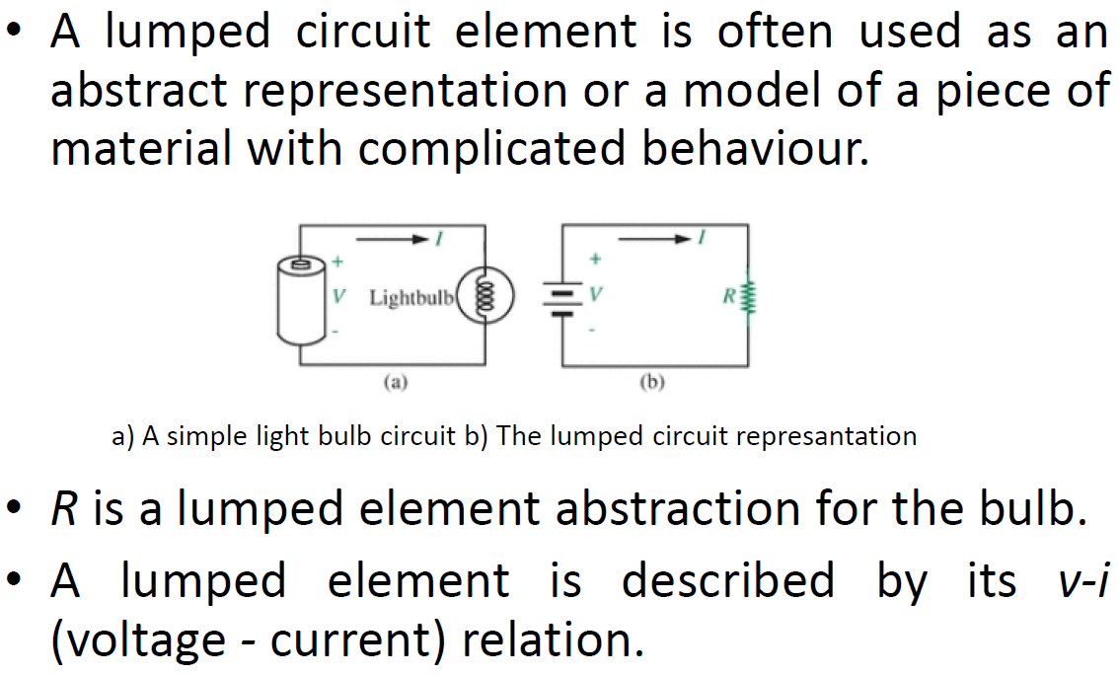
Lumped circuit element

Slide 17
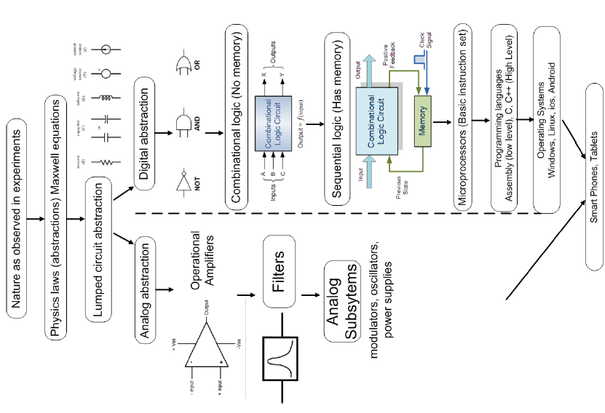
Levels of abstraction

Slide 18
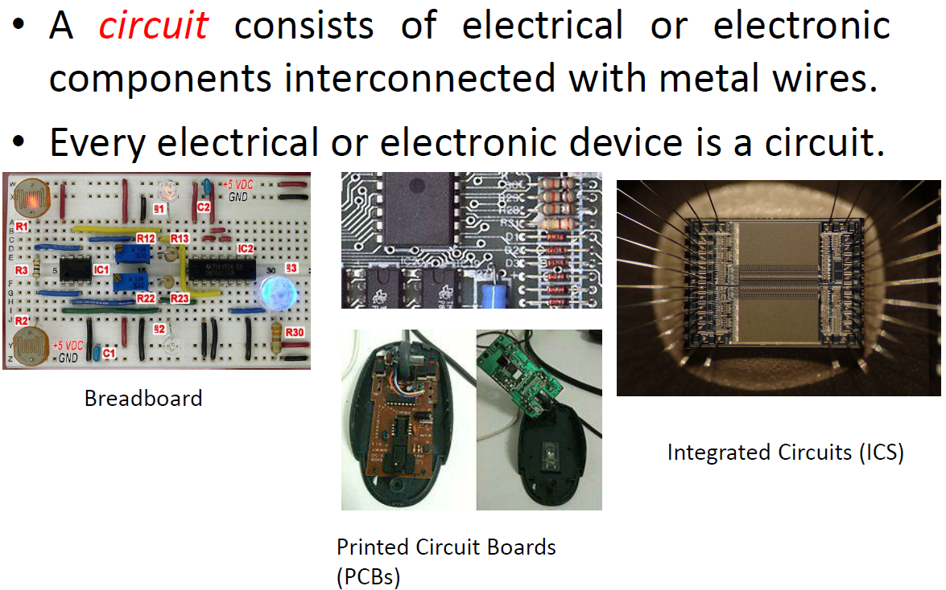
What are the circuits?

Slide 19
What are the circuits?
The schematic diagram for a radio receiver

Slide 20
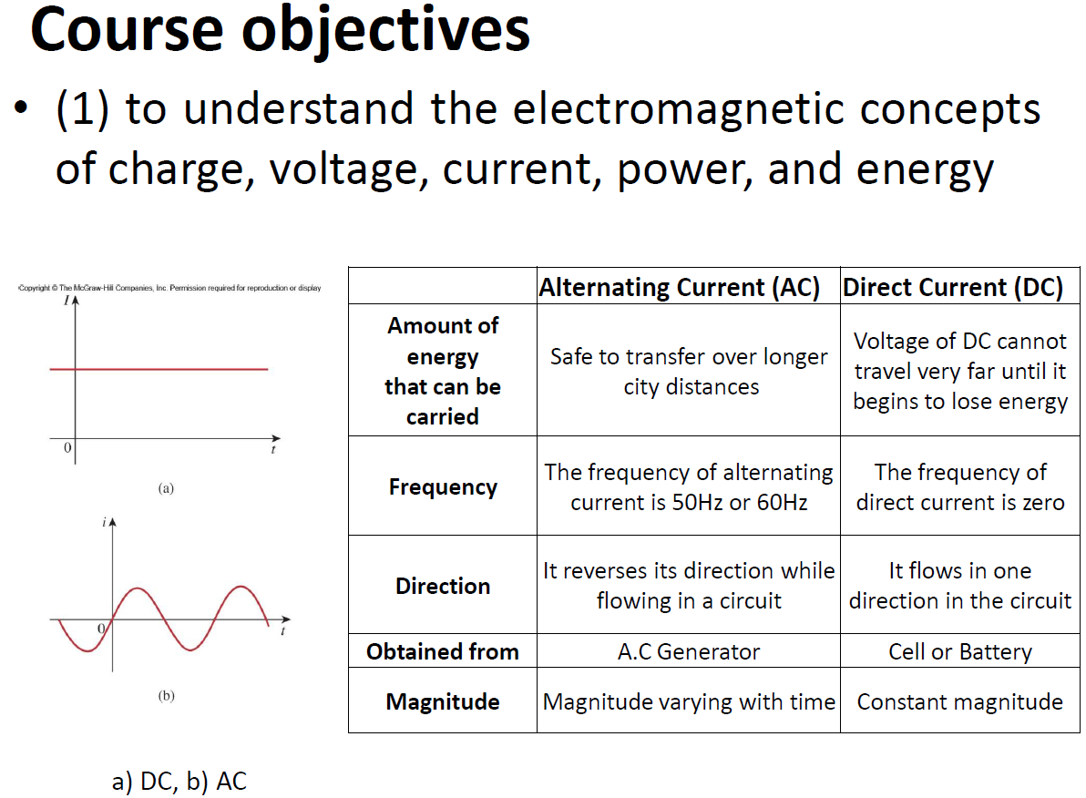
Course objectives

Slide 21
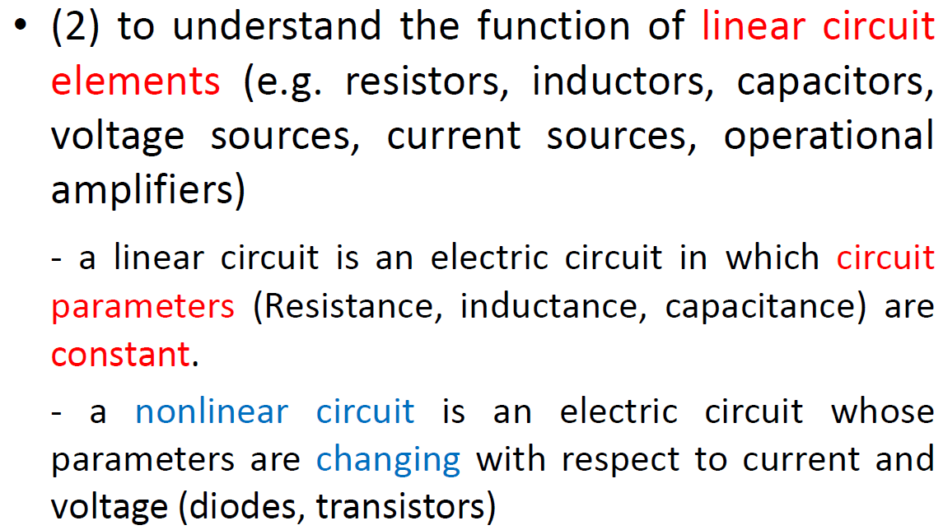
Course objectives

Slide 22
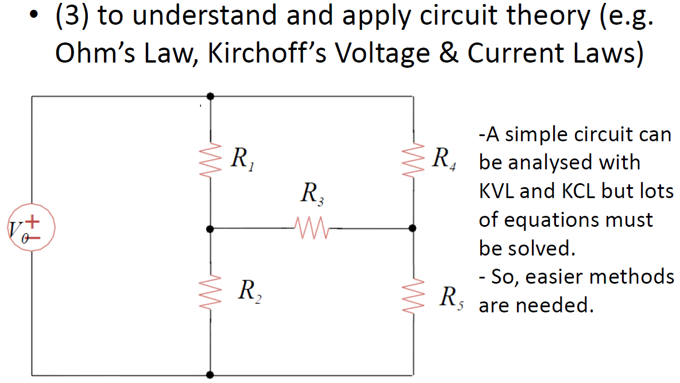
Course objectives

Slide 23
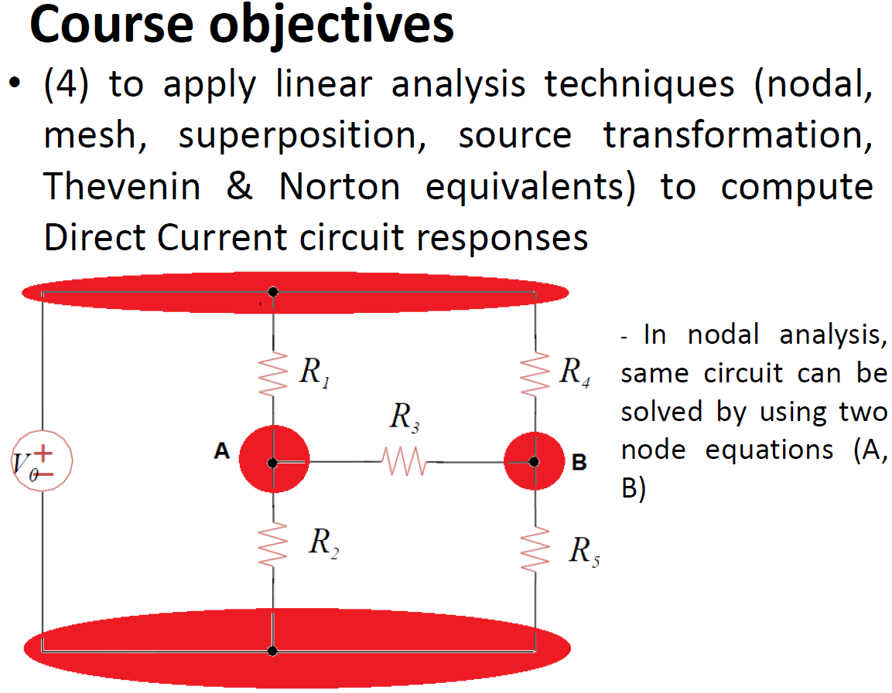
Course objectives

Slide 24
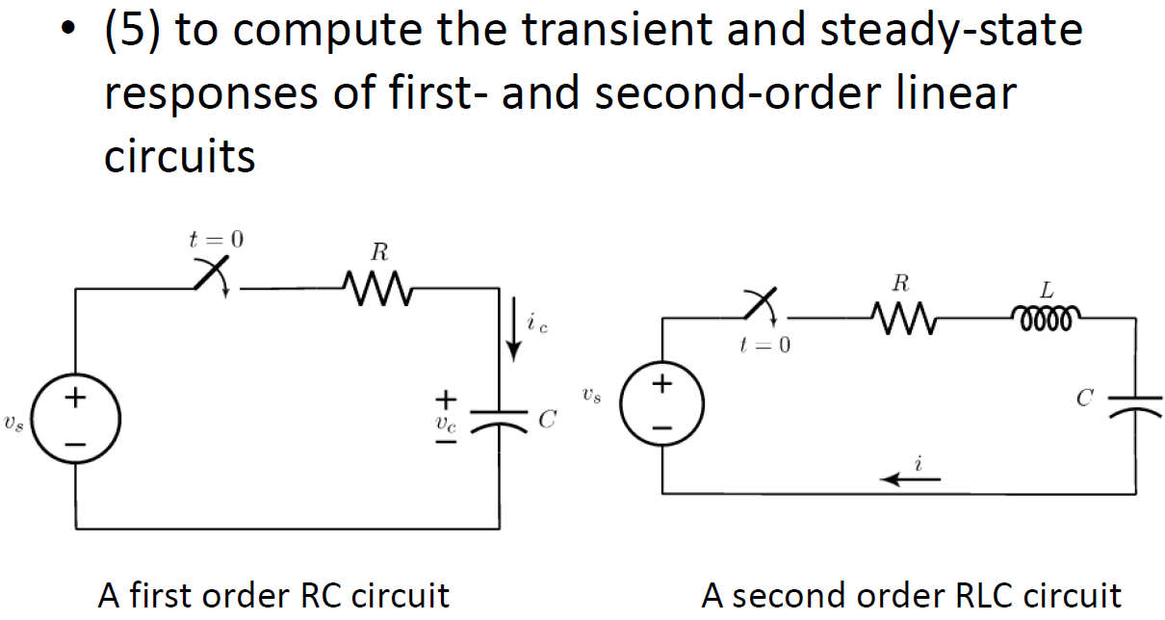
Course objectives

Slide 25
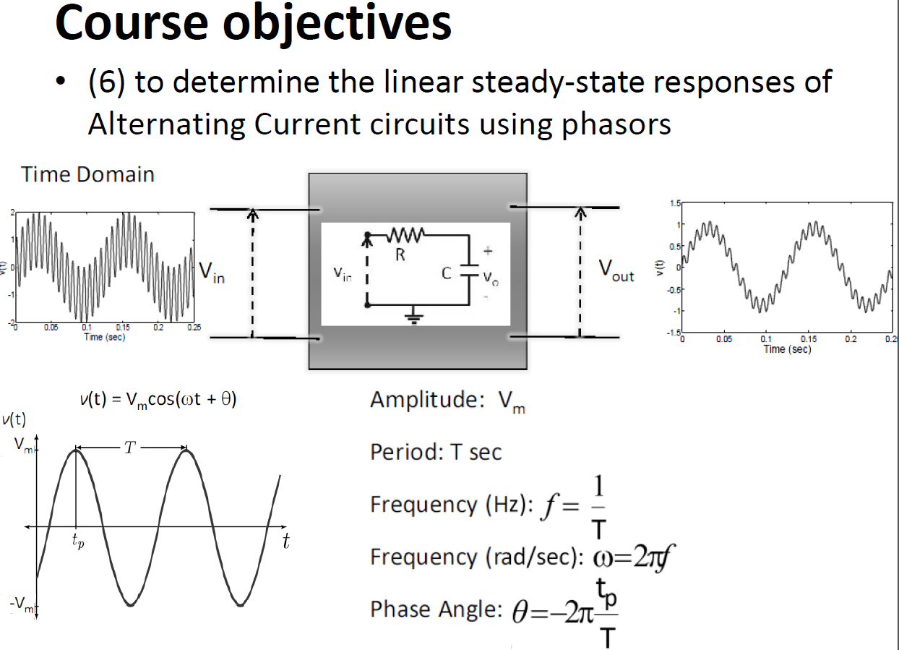
Course objectives

Slide 26
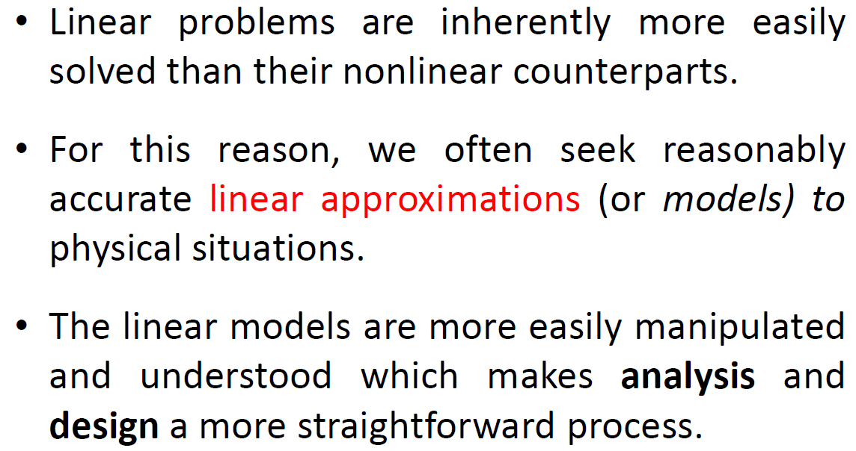
Linear vs. Nonlinear

Slide 27
Linear vs. Nonlinear
Many systems behave in a reasonably linear fashion over a limited range
  allowing us to model them as linear systems if we keep the range limitations in mind.
For example, consider the common function
f (x) = e^{x}
A linear approximation to this function is
f (x) ≈ 1 + x

Slide 28
Linear vs. Nonlinear
Comparison of a Linear Model for e^{x} to Exact Value

Slide 29
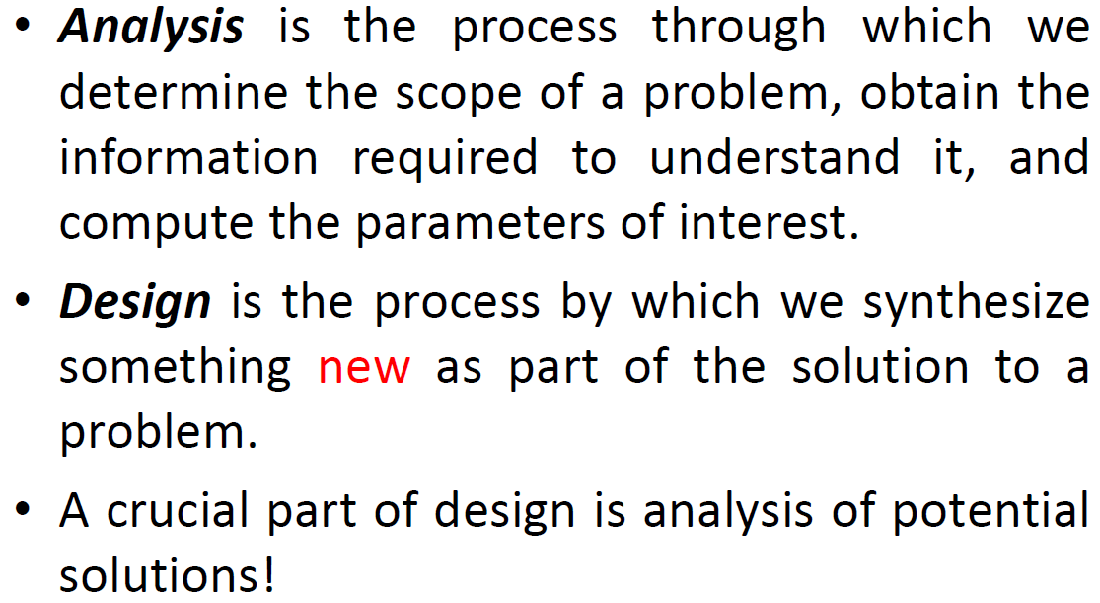
Analysis and Design

Slide 30
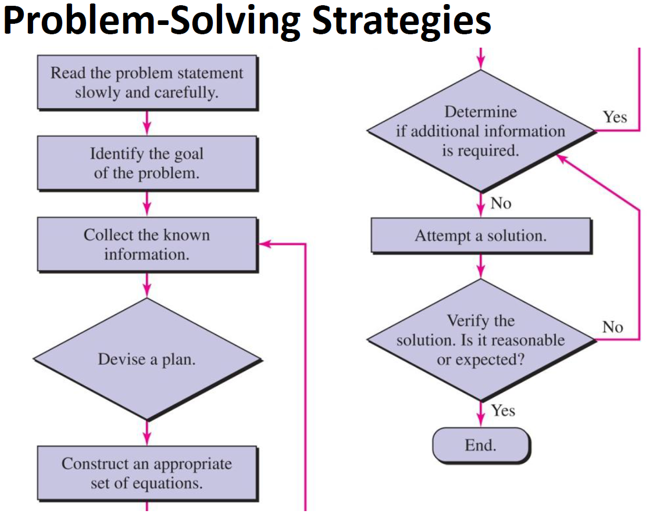
Problem-Solving Strategies

Slide 31
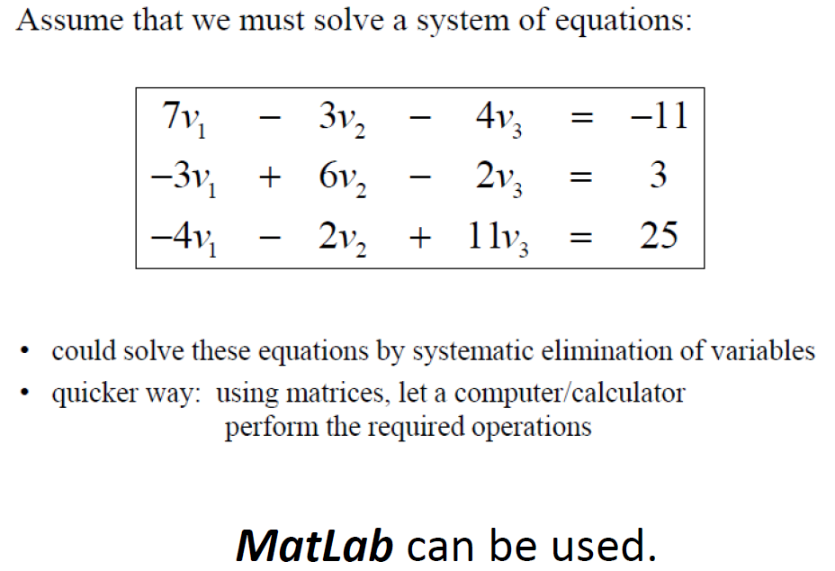
Solving Linear Equations

Slide 32
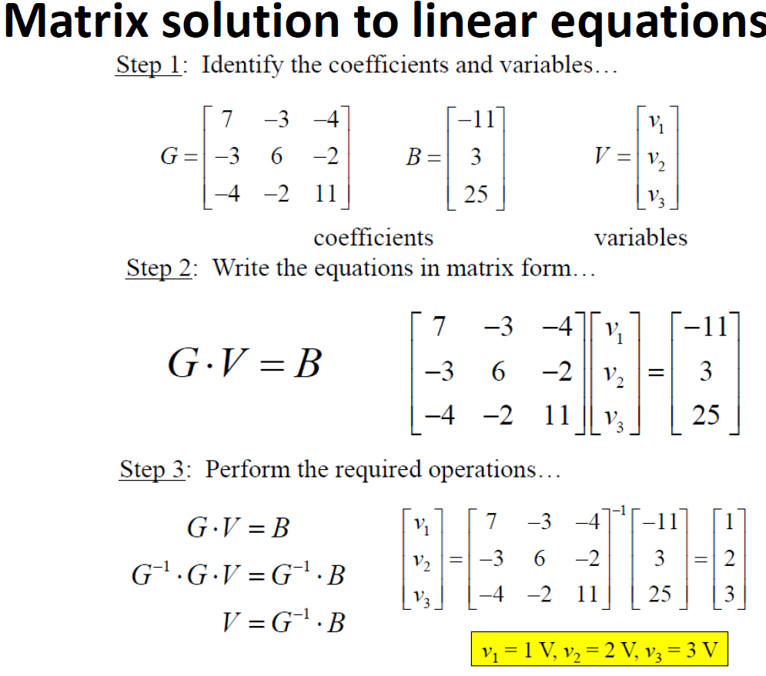
Matrix solution to linear equations

Slide 33
Matrix solution to linear equations

Slide 34
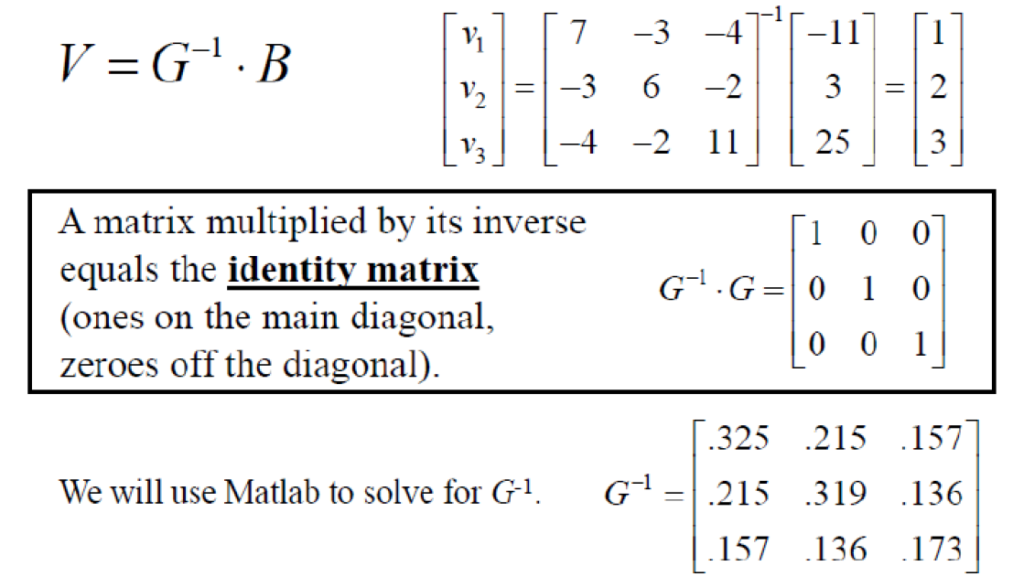
Matrix inversion

Slide 35
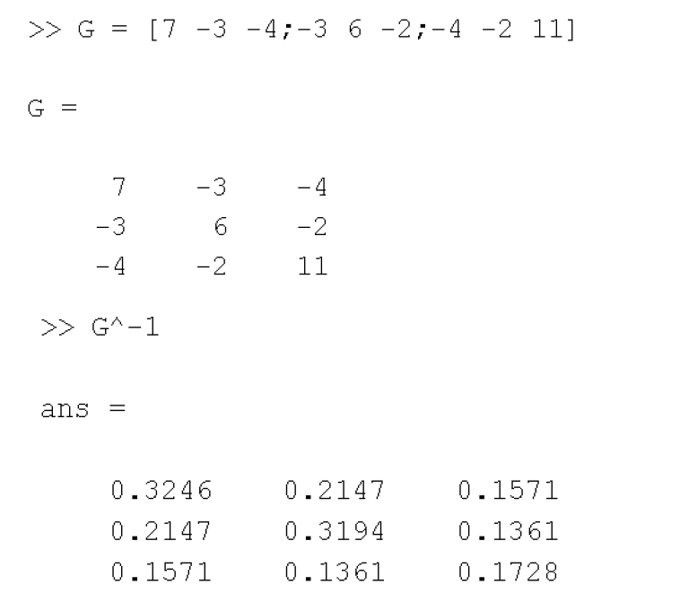
Matlab Procedure

Slide 36
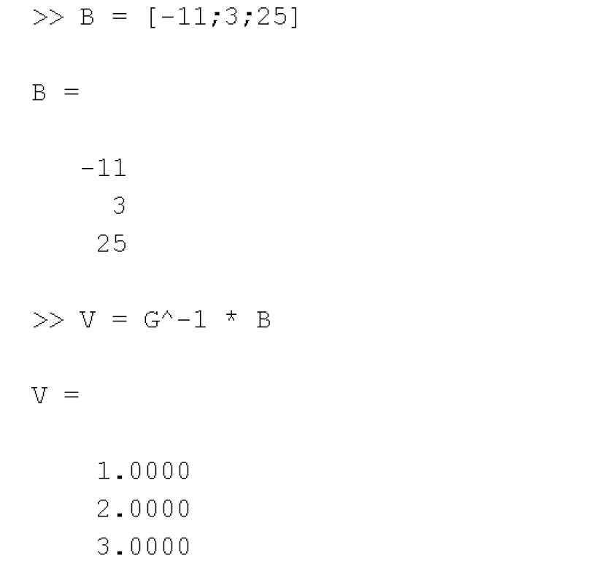
Matlab Procedure

Slide 37
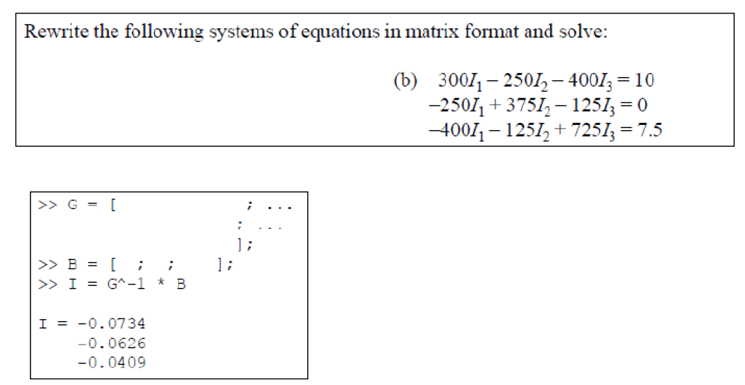
Examples

Slide 38
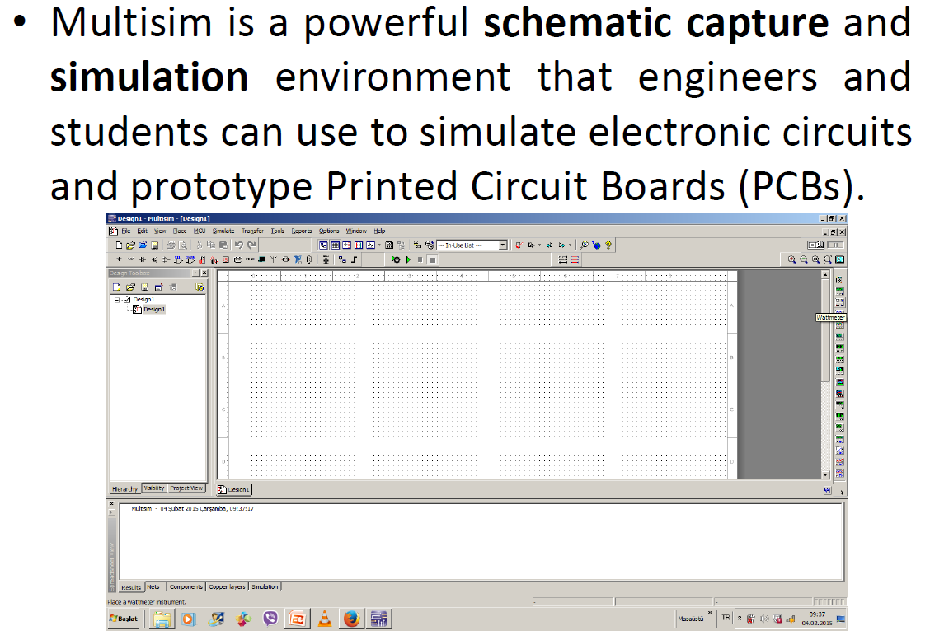
Multisim

Slide 39
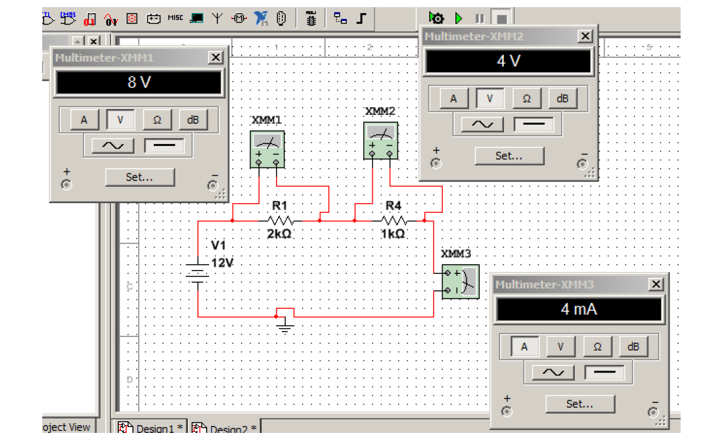
Multisim Examples

Slide 40
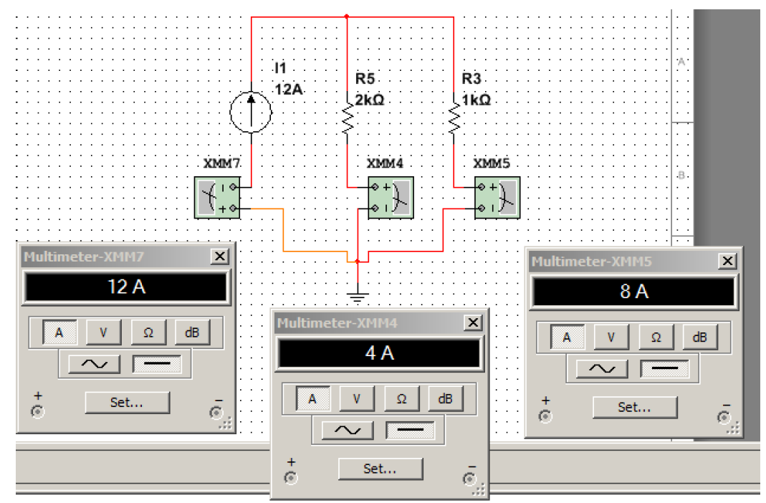
Multisim Examples

