Slide 1
Introduction to Cryptology
22.05.2023, v51
Lecture-15
Identification Protocols
Physical Security

Slide 2
Cryptographic
Identification Mechanisms/Protocols
Secret Key Mechanisms
Public Key Mechanisms
Required for every solid security system!

Slide 3
1. Secret-Key Identification Mechanisms
Require a secret key agreement!

Slide 4
Challenge-Response Identification Mechanisms
Explicit Secret Key Signature
Authenticity without Secrecy
Set up: Agree on a secret key K_{i}
and a One-Way Function F
Prover A
Verifier
K_{i}
K_{i}
Who are you ? : Prove by using R that you know K_{i}
Generate
a random R
(Challenge)
Authentication Request
RES=F(K_{i} , R)
I am A, and this is the proof : RES
(Response)
?
If RES = F(K_{i} , R)
then accept

Slide 5
GSM Challenge-Response Identification
(SIM-Card identification)
Verifier‘s
GSM-HLR
Random Generator
SIM Card
CH(t) 128 bits
CH(t)
H
RES‘’ 32 bits
RES
Ki
Ki
=
H
RES‘=RES?
Accept /
Reject
COMP128
Hash mapping

Slide 6
Improved Symmetric Challenge-Response Identification Mechanism
(Standard usage in modern network protocols)
Set up: Agree on a secret key K_{i}
and a One-Way Function F
Prover A
Verifier
K_{i}
K_{i}
Rv
Rt
Who are you ? : Prove by using Rv that you know K_{i}
Generate
a random Rv
(Challenge)
Authentication Request
RES=F(Rt, K_{i}, Rv)
I am A, and this is the proof : RES, Rt
(Response)
?
If RES = F(K_{i}, Rt, Rv)
then accept

Slide 7
2. Public-Key Identification Protocols
No secret key agreement is necessary!

Slide 8
Identification Protocols/Mechanisms
Zero- Knowledge Iterative Proof (ZKIP)
Authenticity without Secrecy
Prover
Verifier
Who are you ?
Authentication Request
I am A, and this is the proof without revealing secrets
This protocol can be repeated many times for higher security !
The proof is called a Zero-Knowledge proof if:
Prover reveals no secrets (whatever) to the verifier !

Slide 9
Fiat-Shamir Proof-of-Identity Protocol (1986)
A Zero-Knowledge proof protocol !
m = p₁ p₂
p₁ p₂ are secrets
which no body
should know
Security relies on the
Factoring Problem !
public directory
m is RSA type modulus
x_{a} = secret key of A
y_{a} = x_{a}² in Z_{m} (mod m)
Prover A
Verifier
A chooses a unit r, gcd(m,r)=1
in Z_{m} and computes
S = r ²
( I am user A, S )
randomly choose b
b = 1 or 0
x_{a}
b
S y_{a}
t = r. x_{a}^{b}
t
If t² = S . Y_{a}^{b} = r² . (Xa) ^{2b}
then A is authentic
(A knows x_{a} )
Attacker can cheat if he stores earlier verification with the same b sequence!!
Prob. of a successful attack after k random trials = 2^{-k}

Slide 10
Example: Fiat-Shamir Proof-of-Identity Protocol (1986)
A Zero-Knowledge proof protocol !
m = p₁ p₂ = 35
p₁ p₂ are secrets
which no body
should know
public directory
m= 35 is RSA type modulus
x_{a} = secret key of A=8
y_{a} = x_{a}² =29 in Z_{m} (mod m)
Prover A
Verifier
A chooses a unit r=11 , gcd (11,35)=1
in Z_{m} and computes
S = r ² = 11² = 16
( I am user A, S=16 )
randomly choose b
b = 1 or 0
x_{a}
b=1
S y_{a}
If t² = S . y_{a}^{b} =
18² = 16 X 29¹
9 = 9
then A is authentic
(A knows x_{a} )
t =18
t = r. x_{a}^{b} = 11 X 8 = 18

Slide 11
Omura Proof-of-Identity Protocol
public directory
Security relies on the
Discrete Log. Problem !
α is a primitive element in GF(p)
α ^{Xa} = y_{a}
y_{a} = public key of A
Prover A
Verifier
x_{a}
Randomly choose k
compute R = α ^{k}
Who are you?, R
R
R ^{Xa}
I am user A,
R ^{Xa}
check R ^{Xa} = y_{a}^{k} = α ^{k. Xa}
R ^{Xa} = α ^{k. Xa}
Is not Zero knowledge if verifier cheats !

Slide 12
Example: Omura Proof-of-Identity Protocol
Public directory
α = 2
GF(83)
Ya = 56
α ^{Xa} = 2¹¹ = 56 = y_{a}
Prover A
Verifier
x_{a}
Randomly choose k=40
compute R = α ^{k} =41
Who are you?, R=41
R=41
I am user A,
R^{Xa} = 40
check R ^{Xa} = y_{a}^{k}
40 = 56⁴⁰
40 = (2¹¹)⁴⁰=40
=> User is authentic
R ^{Xa} = 41¹¹ = (2⁴⁰)¹¹
= 2^{440 mod 82} = 40

Slide 13
Template of Schnorr’s Identification/signature Scheme
Prover A
Open Directory (as DH public directory)
verifier
GF(p), Element α has order q such that
q is prime which divides p-1
Secret key x_{A}< q
y_{A} : public key of signer A
User A sings a message M:
1
Random
5
A good and strong hash H function is required
6
2
Hash :
Similarity to ElGamal Signature!
7
Verifiecation
3
4
A signed message M is : M, (S,m)
Then, M signed by A is authentic

Slide 14
Physical Security
Why Physical Security
Physical Unclonability

Slide 15
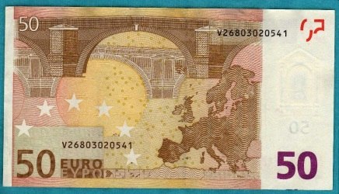
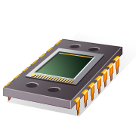



Why Physical Security?
Why unclonable physical units?
Commercial-economic reasons (Cloning)
Identity (Privacy)
Know-How protection (IP-Cores)
Medical
Automotive units
E-Money ….
Smart-Home, -City, -Gouvernement, Consumer, IoT ..

Slide 16
Popular Attack Scenarios
Physical Replacement/Substitution Attack
Intruder
Customer
Legal
Unit
False
Unit
Examples: - False mobile base station attack (GSM Mobile system)
- False Internet host

Slide 17

Popular Attack Scenarios
Tele-service attack: Channel Hijacking Attack
Internet
Legal
Service Access
Diverted/Hijacked channel
Customer
Machine
False Access

Slide 18
Popular Attack Scenarios
Network unit replacement attack
Fake unit
Illegal
Monitor/Node

Slide 19
Popular Attack Scenarios
Replacement Attack- Hardware patch
Manufacturer cheats!
Attacker has successfully cloned the unit!
Gateway in
HW
Gateway out
HW
Fake
HW
FCC
TÜV
cert
cert
Requirements
Unit structure should be unclonable or clone-resistant!
Unit should be unchangeable “Tamper-Proof”!

Slide 20

Two Basic Requirements for Solid Security
Identify and trust each other (Mutual-Authentication)
Establish a secured link (secrecy)
Internet
Machine

Slide 21
Contemporary State of the Art
Identify & Trust (Authentication) Physical Security
Secured link (secrecy)
- Physical uniqueness !! ?
- Unclonable units !! ?
- Electro-Mechanical identity (Mechatronic-Identity) !!?
(Automobile, Production Machines, Robots ….)
Relatively mature technology

Slide 22
State of the Art for
basically clonable Physical Units

Slide 23
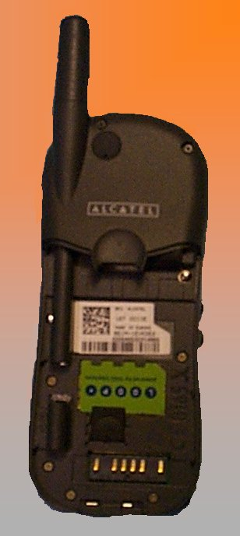
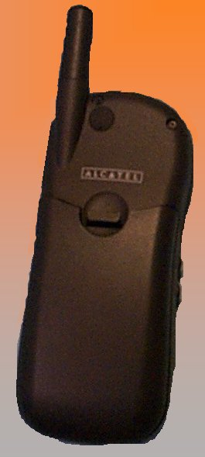

Practical GSM Security Gaps
A5 Cipher Broken 1999
International Mobile Equipment Identity
IMEI (non-secured)
Subscriber Identity Module
SIM (secured)
Cloned for some standard function
(150 000 challenges. Berkeley Univ.)
No collapse. System still solid!

Slide 24
Attack on GSM device Identity IMEI
Mobile serial number IMEI (International Mobile Equipment Identity)
Identity request
Manufacturer Identity
Tamperproof
IMEI
hardware entity
IMEI
Open Identity
System
IMEI
Software
Identity
IMEI (legal response)
Jump
(Soft-Patch)
IMEI‘ (Fake response)!

Slide 25
Physically Unique Units Production
Common technique:
inject
un-removable
and Provable
Identity
Unique objects
Fabricate equal objects

Slide 26
Personalizing Physical Entities : One-Way Injection
Mechanical simulation
Unique
Provable
Identity
Module
- tamperproof
- un-removable
One Way secret-key
injection
One-Way
(One-time)
Injection
Basically clonable
as somebody knows the injected key and can reveal it
Unique object
Neutral objects

Slide 27
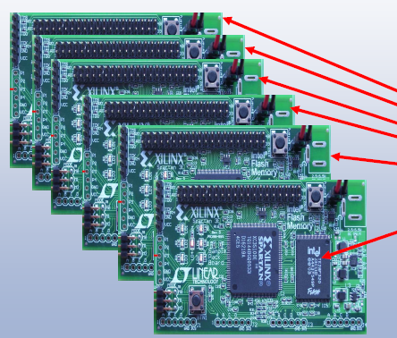
Requirements on Physical Uniqueness
in Production
Personalization requirements:
Uniqueness
- Unclonable, Clone-Resistant
- Remotely and securely Identifiable
- Low cost
- Resilient security if cloned!
(brake-one brake-all impossible!)
Notes:
27

Slide 28
State of the Art in
Unclonable Physical Units
DNA-like
Physically Unclonable Functions
(PUF‘s)
Bio-Inspired Provable Physical Identity
Make use of born uniqueness properties (DNA like)

Slide 29
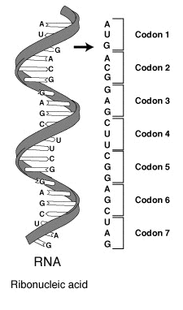
Best physical Identity: As the born DNA-like provable identification
Biological DNA
Select
Markers
Chemical
Extractor
Chemical Markers
Bio DNA: 2⁴⁸ combinations ≈3 · 10¹²
Identification by matching markers
Physical Unclonable Functions PUFs offer DNA like Identification Techniques
Ideal PUFs are: Born unpredictable and unclonable physical VLSI properties.
In other words: PUFs are analogue non-linear, hard to model or to copy, unpredictable huge mapping in a semiconductor VLSI device
PUF
Analogue
Response
Discrete
stimulation
(select marker)
Discrete
Extractor
Unknown
DNA like
Mapping
Discrete
Identification
Response
VLSI
Notes:
29
29

Slide 30
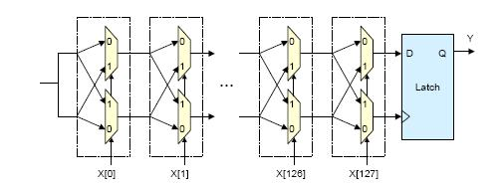
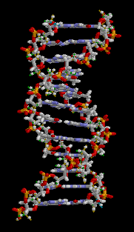
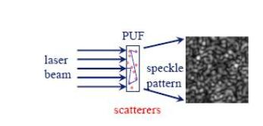
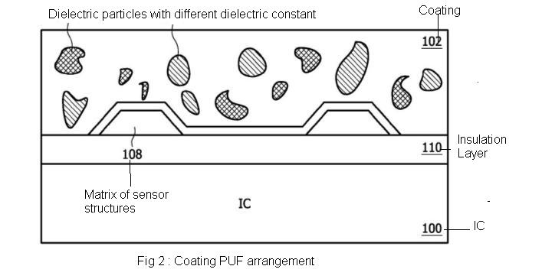
State of the Art: Unclonable Devices by:
Analog Physical Unclonable Functions (PUFs)
Since 2000 many proposals
optical PUF
coating PUF
Silicon PUF
optical fiber PUF
RF COA
LC-PUF
S-RAM PUF
Arbiter PUF
fluorescent PUF
Delay based
Optical
Unclonable
DNA-Chain
Delay PUF
Butterfly PUF
diode breakdown PUF
reconfigurable PUF
acoustic PUF
controlled PUF
phosphor PUF
...
Coating PUF
(Capacity)
So far all have
“Reproducibility”
problems!
Analog functions!!!
Born properties: Similar to the biological DNA

Slide 31
PUFs inconsistency and aging difficulties
*
PUF
pdf_{R}
challenge C
response R
Physical
System
R
“complex interaction”
- Same input =>Different response
“noisy function”
Bad reproducibility due to : Operating conditions, quantization (Metastability) , Aging, …
*
x
PUF
y
Fuzzy
Extractor
K
Crypto
fuzzy
secret
cryptographic
key
Fuzzy Extractors: Complex, Costly (Sign. Proc + ECC)
* Source: Roel Maes, ESAT/COSIC, K.U.Leuven, BCRYPT Workshop:

Slide 32
Fuzzy Extractor for (PUFs)
Fuzzy Extractor: is used to correct errors in reproducing the PUF response by deploying error correcting codes /Helper Data Concept
Enrolment process
Helper Data (HD)
C
PUF
R
Helper Data Extractor
Key
One-Time-Process
Reconstruction
C
PUF
R’
Fuzzy Extractor
Error Correction
Key
Helper Data (HD)
Repeated Action
NOTICE: Helper Data: need not to be secured!

Slide 33
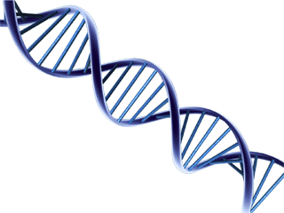
Bio-Inspired Identification Protocol
DNA-Like Marker-Based Identification
DNA-Like Marker-Based Identification
DNA-like Identity chain Carrier/function
P₁
C_{i}
P_{i}
P₂
R_{i}
List generated and kept secret by the proving authority
C₂ – R₂
Secret Pair’s List
C₁ - R₁
C₂ - R₂
…
C_{i} - R_{i}
…
_{Up to ∞}
Same ?
R‘₂
If max | C,R| → ∞, Then unit is unclonable
Tow-way Protocol:
1- send C₂ to the object
2- Object responds with R₂ if authentic
- Cancel the pair C₂ - R₂ from the list and never use it again
If C and R each having n-Bits, Max table size: 2n 2^{n}
(example: for n=128 impossible to store) , that is the unit is unclonable!

Slide 34
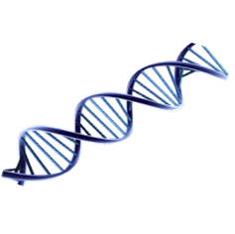

Best physical Identity: the born DNA-like provable identification
Biological DNA
Select
Markers
Chemical
Extractor
Chemical Markers
Bio DNA: 2⁴⁸ combinations ≈3 · 10¹²
Identification by matching markers
Biological DNA Identification (Fatherhood Test):
A
B
C
D
Extract at same marker position
System is unclonable iff:
# markers → ∞
Different entities for Non-equal marker extracts
A’ ≠ B’ ≠ C’ ≠ D’
A’
B’
C’
D’
≠
≠
≠
Notes:
34
34

Slide 35
Selected Proposed
Physical Unclonable Functions PUFs
Device
Few promissing PUF´s
Unique
+
Unclonable
Silicon PUF
Intrinsic PUF
Optical PUF
Coating PUF
Challenge
Response
PUF
Identification module (Function)
Identification by checking challenge-response behavior
Like DNA
Notes:
35

Slide 36
Silicon PUF
MUX Chain or Arbiter PUFs
Principle: Compare delay time in a chain.
Each physical chips exhibits own different delay time behaviour which identifies it
0
1
0
1
0
0
0
0
1
1
1
1
Response
Challenge
1
0
1
1
1
0
1
1
1
1
D
D
Q
Q
1 if top
path is
faster,
else 0
0
0
0
0
0
0
…
…
0
0
0
0
0
Rising
Edge
step
0
G
G
1
1
1
1
1
1
Source [8]
1.
Notes:
36

Slide 37
Silicon PUF
Ring Oscillator Design Procedure
1
MUX
2467MHz
counter
2
Output
2519MHz
>?
0 or 1
N oscillators
counter
N
2453MHz
Input
Compare frequencies of two oscillators.The faster oscillator is randomly determined by manufacturing variations

Slide 38
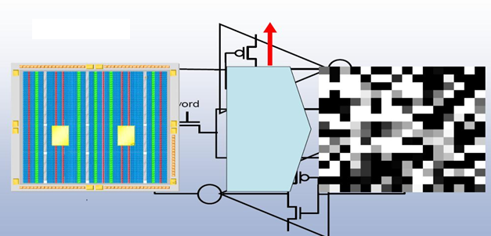
Intrinsic PUF(I-PUF)
S-RAM PUF
S-RAM initial state after power on
Is mostly the same. (re-production !!)
However different from chip to chip
Power up
Source [8]
5.

Slide 39
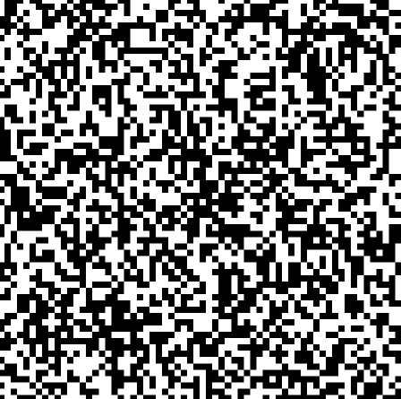
Intrinsic PUF(I-PUF)
SRAM PUF : Intra-Chip Variation
Principle: Read some memory area to identify physical units
S-RAM initial state after power on is mostly the same. (re-production !!)
However different from chip to chip
Source [8]
Notes:
39

Slide 40
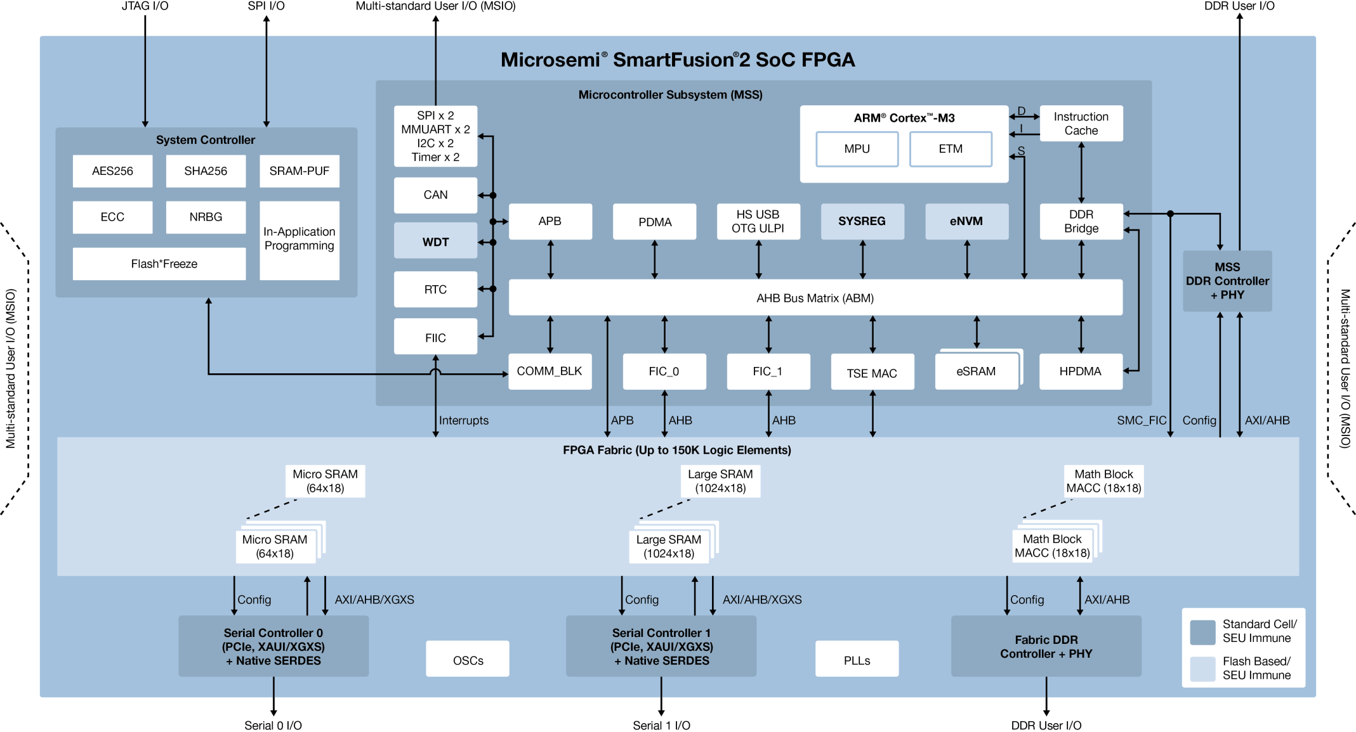
Real-Field SRAM PUF in the Market
Microsemi SmartFusion®2 Techn. SRAM PUF
50-100 K Gate
Manufacturer secrets!
Hard-Core PUF
16 kb RAM
Xilinx FPGA: SRAM PUF many IP-Cores … SRAM, Delay-based, …

Slide 41
Optical PUF
Principle: Difference in reflected and refracted ray of light on a surface
Laser beam
Challenge
Scattered/reflected
beam
Response
Source [8]
3.
Notes:
41

Slide 42
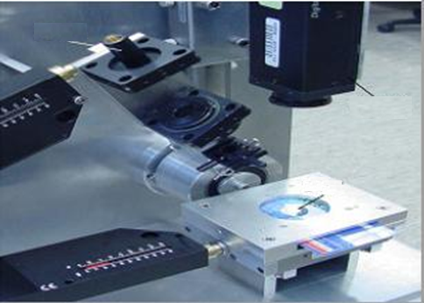
Optical PUF
Practical set-up relatively complex
Laser
Camera
PUF
Source [8]
Notes:
42

Slide 43
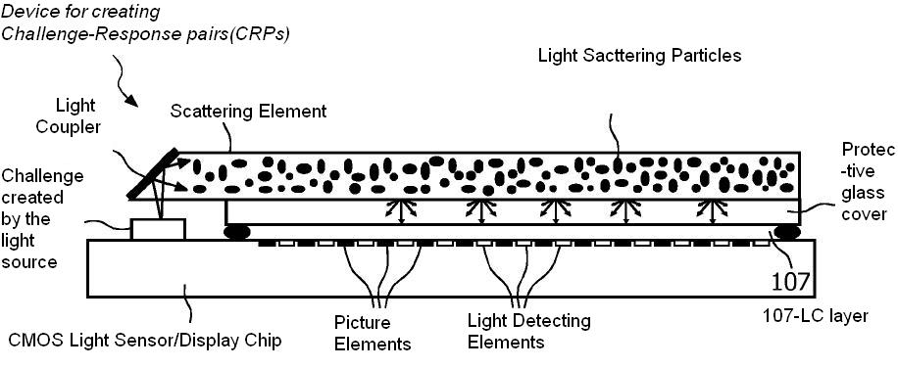
Optical PUF
Possible Integrated PUF
Source [8]
Notes:
43

Slide 44
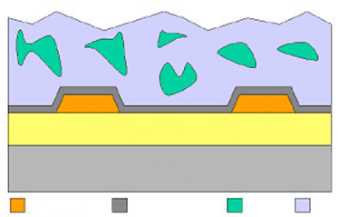

Coating PUF
Principle: Different capacity sensed at by different sensors
dielectric coating material
Capacity sensor grid
Sensor
Sensor
Active layers + lower metal layers
Bulk
top metal
passivation
1
2
Capacity differences
Source [8]
Notes:
44

Slide 45
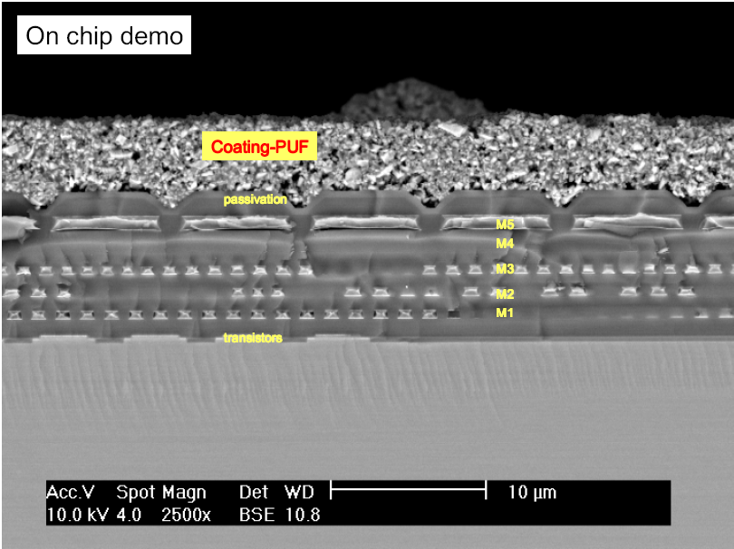
Coating PUF
Source [8]
Notes:
45

Slide 46
Possible attacks on PUFs
- Manufacturer cheats!
Challenge
Response
Fake
PUF
Detectable !
Manufacturer has to be trustable!
Tamper-Proof technology is required!
7.
Notes:
46

Slide 47
All Analog PUFs are however,
Still complex and costly to produce
Sensitive to temperature and supply voltage etc.
Have long-term reproducibility “Aging” issues !
(non-Consistent in the long term!)
Still relatively limited for real field use!
7.
Notes:
47

