Slide 1
Introduction to Cryptology
15.05.2023, v48
Lecture-11
Public-Key Cryptography
ElGamal Public-Key Crypto-System

Slide 2
Lecture Outlines
Public-key Objective
ElGamal Public-Key Encryption System
ElGamal Public-Key Signature System
ElGamal Security considerations
Public Key Signature Standard

Slide 3
The Target of Public Key Cryptography
Sender
Ciphering
De-Ciphering
Receiver
E ( Z,X )
Y = E (Z,X)
X
D ( Z,Y )
X
Message
Channel
Message
Z
Z
Secret Key Channel
Secret Key = Z
Public-Key Register
drops out the need for secret key-
agreement completely

Slide 4
ElGamal Crypto-System, 1985
Taher ElGamal: BsC, EE from Cairo University, MsC and PhD Stanford University advisor M. Hellmann
ElGamal Cryptosystem became a NIST standard called DSA in 1994.
Taher ElGamal
Basic idea: Multiplication instead of exponentiation

Slide 5
ElGamal Crypto-System 1985
Basic idea: Multiplication instead of exponentiation
M
X
M • Z =C
X
M
Z
Z⁻¹
The inverse key Z⁻¹ should not be computable if Z is known
Is that possible?: Yes,
By using groups arithmetic in in GF !

Slide 6
ElGamal Crypto-System 1985
Basic idea: Multiplication instead of exponentiation for encryption
That is possible by using arithmetic in in GF(q) !
Sender
Public directory:
α primitive element in GF(q)
Receiver
y =α ^{X}
Secret Key = x
Open Key y=α ^{X}
M
X
C = M . α ^{X . R}
X
M
α ^{R}
α -^{X . R}
Z = y^{R} = α ^{x·R}
R= Random secret generated ad-hoc by sender
Z⁻¹ = (α^{R}) ^{–x} = α - ^{X . R}
This is actually DH-key!

Slide 7
ElGamal Secrecy-System (1985)
User A encrypts M to B
User B decrypts
α primitive element in GF(p)
Xa = secret key of A
α ^{Xa}
y_{a} = α ^{Xa} public key of A
Xb = secret key of B
α ^{Xb}
y_{b} = α ^{Xb} public key of B
X
C
X
M
C = M . α ^{Xb . R}
/
m
M
y_{b}
Z = α ^{Xb. R}
Z⁻¹ = α - ^{Xb. R}
(y_{b})^{R}
r = α ^{R}
r
- Xb
/
m-bits
(r)^{-Xb} =α - ^{Xb. R}
α ^{R}
R
Random Generator : R = 1 ... p-1
m = log₂ p
- Xb = (p-1) - Xb
Notice 1: a new R is needed for every M! Otherwise, Z can be easily revealed if M is known!
Notice 2: The scheme applies similarly over GF(2^{m}) , with α as a primitive element in GF(2^{m}) .

Slide 8
Example 1: Setup ElGamal Encryption System using GF(11). Send the message M=10 from user A to B. The secret key of B is6and for A is 7
Solution :
Computing order of α =2: 2²=4≠1, 2³=8, 2⁴=5, 2⁵=10 ≠1, => order of 2 is 10 => 2 is a primitive element !.
p=11=2 . 5+1, Possible orders = divisors of p-1=2x5, that is 1,2,5,10.
User A sends M to B
User B receives
α = 2 = primitive element in GF(11)
Xa = secret key of A=7
α ⁷ = 7
y_{a} = α ^{Xa} public key of A = 7
Xb =6= secret key of B
Y_{b}=α ^{Xb}= 2⁶ = 9
y_{b} = α ^{Xb} public key of B = 9
X
C=8
X
M =32 mod 11 =10
M=10
C = M .α ^{Xb . R} = 10 . 3 =8
Z=9 ⁸ = (2 ⁶)⁸ = 2^{48 mod 10} =2⁸ =3
(4)
y_{b}
(9)^{R}
r =2 ⁸ =3
r=3
(3)^{-Xb} = (3)⁴ =4
α ^{R}
- Xb = -6
R=8
Notice : If an attacker knows one message, say M=10
The ecryption key Z can be revealed simply as Z= M⁻¹.C= 10⁻¹.8 mod 11 =3
Xb = (p-1) – Xb
-Xb = (11-1)-6 = 4
Random Generator : R = 1 ... p-1 ,
we select R= 8

Slide 9
ElGamal Crypto-System (1985)
Advantages
Disadvantages
based on discrete logarithm problem
Security is as that of DH system
DL problem needs less key-bits than RSA
for the same security
Asymmetric workload: good for some
applications
ElGamal encryption is probabilistic, meaning that a single plaintext would be encrypted to many possible ciphertexts as a new random R is required for each encrypted block..
The cryptogram needs more bits
than the plaintext (double)
A new random is needed for
every encrypted message
Asymmetric workload: bad for
some applications

Slide 10
ElGamal Signature Scheme
public directory
User A signs M
Verifier
X_{a} = Secret Key of A
α ^{Xa} = y_{a}
α is primitive in GF(p)
y_{a} = public key of A
p, α, y_{a}
If
M
M
S
r
k ⁻¹ ( M - r . X_{a} ) mod (p-1) = S
α ^{M} = y_{a}^{r} . r ^{S} mod p
Then M is authentic.
User A cannot deny having signed message M
k
r = α^{k}
k Random unit in Z_{p-1}
That is: gcd (k, p-1 ) = 1
Signed Message

Slide 11
Digital Signature Standard DSS (1994)
Explicit true signature based on ElGamal Signature System (1985)
Secure Hash Algorithm
(SHA) see later
M
Data digest (compression)
using Hash functions
H(M) 160 bits
Digital Signature Algorithm
(DSA)
k
Random
Source
160 bits 160 bits
M
( r , S )
Signature
Signed Message

Slide 12
Digital Signature Algorithm DSA
Standardized (1994) Based on ElGamal Signature Scheme
public directory
User A signs M
Verifier
α is element in GF(p) with order q
where q = large prime (160 bits)
(q divides p-1 )
X_{a} = Secret Key of A
α ^{Xa} = y_{a}
y_{a} = public key of A
p, q, α, y_{a}
M
or H(M)
If
M
S
r
k ⁻¹ ( H(M) + r . X_{a} ) in GF(q) = S
160 bits
R_{q}(M . S ⁻¹ )
R_{q}(r . S ⁻¹)
R_{p}[α . y_{a} ] = U
k
R_{q} [ R_{p}(α^{k}) ] = r
160 bits
r = R_{q}( U )
k Random unit in GF(q)
For which gcd (q,k)=1 is valid
k = 1 to q-1 (160 bit)
Then M is authentic
Signed Message
- p is a prime with 512 ... 1024 bits, q divides p-1 with a size of 160 bits,
- fresh k is required for every message!

Slide 13
Example 2: 1. Sign the message M=6 by using the Digital Signature Algorithm DSA, Use GF(p)=GF(11).
2. Check the resulting electronic signature
Solution:
Computing order of α =3: 3²=9≠1, 3³=5, 3⁴=4, 3⁵=1 => order of 3 is 5
P=11=2 . 5+1, Possible orders = divisors of p-1=2x5, that is 1,2,5,10. Select q=5
public directory
User A signs M
Verifier
α =3 is element in GF(p=11) with order q=5
where 5 = large prime
X_{a} = Secret Key of A =3
y_{a} =3 ³ = 5 in GF(11)
p, q, α, y_{a}
y_{a} = 5= public key of A
11, 5, 3, 5
M = 6
or H(M)
M=6
S=4
r=4
If
k ⁻¹ ( M + r . X_{a} ) in GF(q)=3(6+4x3) mod 5=4 = S
R_{q}(M . S ⁻¹ )
R_{q}(r . S ⁻¹)
R_{p}[α . y_{a} ] = U
K=2
R₅[ R₁₁(3²) ] = 4 = r
Check if r = R_{q}( U )
4 = R₅( 9 )
4 = 4
K=2 Random invertible mod (q=5)
K⁻¹ = 3 (mod 5)
Signed Message M=6
This true, Thus M is authentic
R₅(6 . 4 )
R₅(4 . 4)
U=R₁₁[3 . 5 ] = 9

Slide 14
ElGamal Signature System (1985), DSS (1994)
Advantages
Disadvantages
A new random is required
to sign every message
more computations than RSA
are needed
DSS may be less secure than RSA as the security in GF(q) with the order of about 160 Bits
Computations on Signer site are
less complex than verifier site
Security is based on the
discrete logarithm problem which is still seen as computationally infeasible.

Slide 15
Security of ElGamal Public Key Crypto-System
(Equivalent to DH system)
Security considerations and known facts:
Based on the assumption/claim that the discrete logarithm is still not efficiently computable according to the public literature
A primitive element α from GF(p) or GF(2^{m}) is used to make exhaustive search algorithms infeasible. If y =α^{t} , only y and α are known. To break the system, we need to find t. To get t , α is repeatedly multiplied by itself i times when α^{i} =y, then t=i.
The order of α (as a primitive element) is p-1 in GF(p) or 2^{m}-1 in GF(2^{m}). Therefore, p is selected as 1000 to 4000 bits prime or m> 1000.
Caution: There is no evidence that no efficient algorithms can be found to break the system.
p-1 should have large prime factor to make the discrete logarithm computation infeasible (p is called a strong prime).

Slide 16
Hash Functions
Hash functions are needed to generate message digest
Iterated Hash Function: generates a digest of the data after being sequentially processed through the so-called Hash function. In general as follows:
Input String
X = (x₁ x₂ ...x_{i} .... x_{n})
Output H is the digest of Input X :
H = Hash(H₀ , X)
Hash
Mapping
H_{i}
x_{i}
N bits: size of hash value (digest)
Non-linear
state machine
H_{i-1}
H₀ Initial value memory
Example: SHA (Secure Hash Algorithm) proposed as a standard with DSA
with N=160 bits (exposed to many attacks !) not more recommended !!!

Slide 17
Few Recommended
“Practical Hash Functions”
by deploying
“Block Ciphers”

Slide 18
Hash Functions
Based on block ciphers
DM Scheme (Davis and Meyer)
Cipher key length = Hash Block length = N
H_{i-1}
Digest of Input X is:
H = Hash(H₀ , X)
x
BC: Block Cipher
Y
/
N
H_{i}
KEY
/ N
Input String
X = (x₁ x₂ ...x_{i} .... x_{n})
H_{i} = E_{xi} (H_{i-1}) ⊕ H_{i-1}

Slide 19
Hash Functions
Based on block ciphers
LM Scheme (Lai and Massey 1992)
Cipher key length = 2 x Cipher block length N
H_{i-1}
Digest of Input X is:
H = E (H₀ , X)
BC: Block Cipher
/
N
H_{i}
KEY
N /
/ N
Input String
X = (x₁ x₂ ...x_{i} .... x_{n})
H_{i} = E (H_{i-1})
H_{i-1}| x_{i}

Slide 20
Traditional Hash Functions
Based on deploying block ciphers (BC)
(well known constellations. See NIST standards)
BC: Block Cipher
state
x_{i}
x_{i}
H_{i-1}
g: key size adapter
X
H_{i-1}
H_{i-1}
x_{i}
BC
BC
BC
g
g
key
Y
H_{i}
H_{i}
H_{i}
Davis-Meyer
Matyas-Meyer-Oseas
Miyaguchi-Preneel

Slide 21
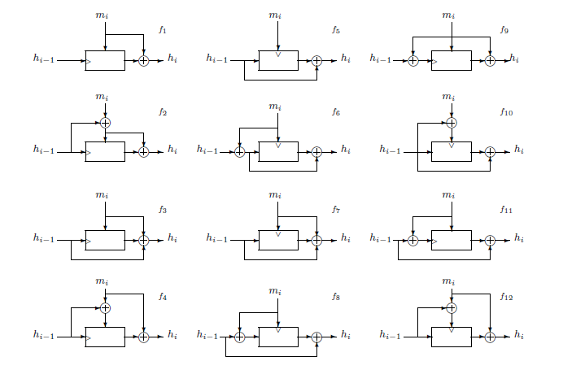
Block-Cipher based Hash Functions alternatives 1/2
Source: Handbook of Applied Cryptography
by Alfred J. Menezes, Paul C. Van Oorschot, Scott A. Vanstone, CRC Press (October 16, 1996) (available free of charge on the WEB)

Slide 22
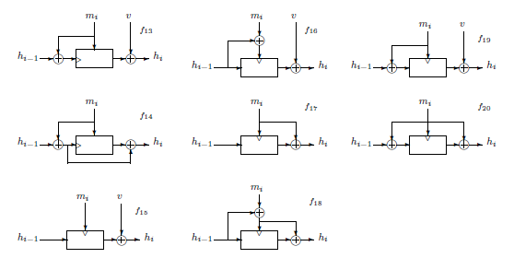
Block-Cipher based Hash Functions alternatives 2/2
Source: Handbook of Applied Cryptography
by Alfred J. Menezes, Paul C. Van Oorschot, Scott A. Vanstone, CRC Press (October 16, 1996) (available free of charge on the WEB)

