Slide 1
Introduction to Cryptology
04.04.2023, v45
Lecture-06
Fundamentals of Secrecy Theory

Slide 2
Secrecy Theory
And Fundamentals of ciphering
Outlines
Historical Overview
Basic Definitions
Shannon’s Secrecy Theorem
Perfect Secrecy „Vernam Cipher“
Unicity Distance
Secret Key Cipher Principle

Slide 3
Two interesting statements around security!
„The only system which is truly secure is one which is switched off , unplugged, locked in a titanium lined safe, buried in a concrete bunker, surrounded by nerve gas and very highly paid armed guards.
Even then, I wouldn't stake my life on it ....“
Gene Spafford - Computer Operations, Audit and Security Technology (COAST), Purdue University
„If I am asked to stake my life on a cryptographic function, I would not trust any function related to known mathematics“
Ulli Maurer – ETH Zürich, Swisserland

Slide 4
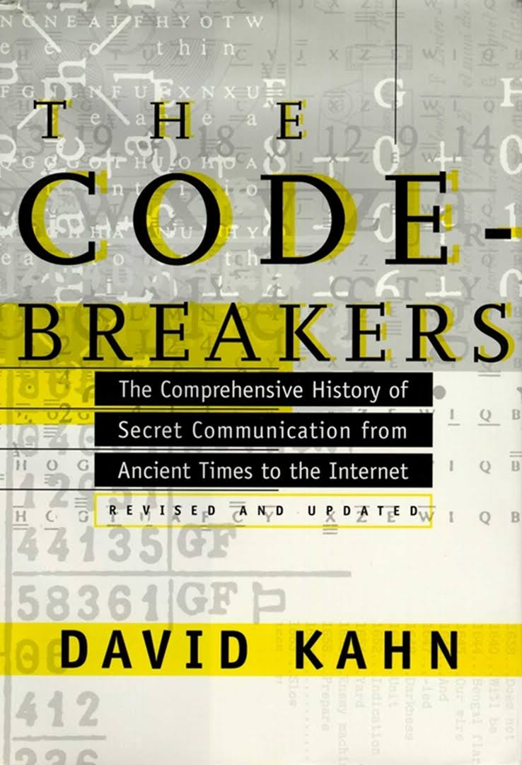
Scientific History of Cryptography
The origin of the word Cryptography (Greek: hidden word):
The scientific story of cryptography has three epochs:
Is Cryptography an Art or or a Science ?
I. Conventional Cryptography as Art till 1949
Julius Caesar Cipher
Kaisiski “ The Art of Deciphering” 1863, ... Gauss
Vernam (AT&T) 1926, first perfect/unbreakable system
II world war 1945, Enigma, Hagelin .... Alan Turing
(1967) Intensive historical treatment on secret communication
Less widely known in convectional public literature:
Jakob Alkindi Bagdad (801–873): "father of Islamic/Arabic philosophy“, Mathematician physician and musician. Presented first mathematical tools for cryptanalysis:
“Treaties on Extracting Cryptograms”, (Doc 4832 Sulaimania Library Istambul Turky)
يقوب بن اسحق الكندي :رسائل في استخراج المعمى
David Khan: "Cryptology was born among the Arabs. They were the first to discover and write down the methods of cryptanalysis.”

Slide 5
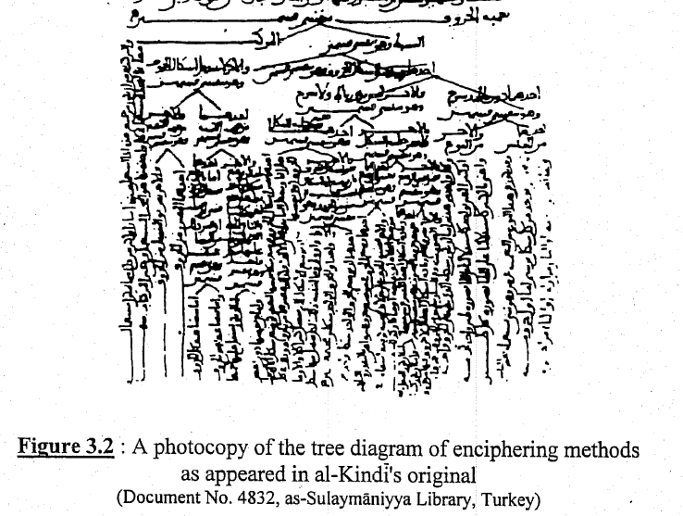
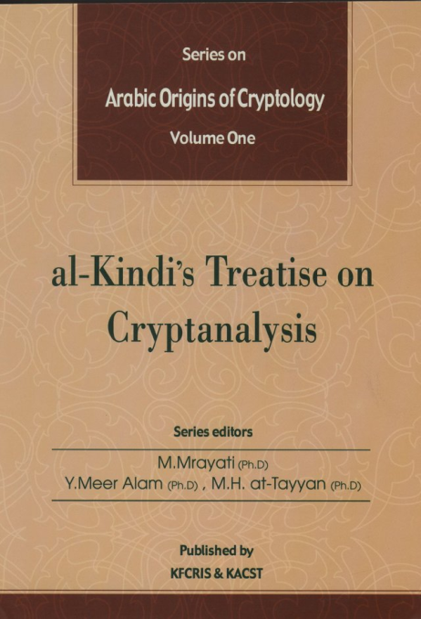
Alkindi’s Treaties on Cryptanalysis (استخراج المعمى) (873 AD)
Classified different ciphering/deciphering techniques using a tree diagram
Translation Published by KACST in 2003
Scholars on history of science:
Orientalist Hellmut Ritter (Istanbul Univ.)
His student PROF. FUAT SEZGIN Uinv. Frankfurt
George Saliba Columbia University
… many others
PPT presentation: At Oxford University (2018) “The Arabic Origins of Cryptology” https://www.google.com/url?sa=t&rct=j&q=&esrc=s&source=web&cd=&ved=2ahUKEwiM4oqJ_pH-AhXySPEDHTDiBI0QFnoECAgQAQ&url=https%3A%2F%2Fmuslimheritage.com%2Fwp-content%2Fuploads%2F2018%2F05%2Fcryptology01.pdf&usg=AOvVaw0ymtbKqj6NzdH0KreCZqhS
Legacy of other old cultures: Chines, Indian … crypto history !

Slide 6
Scientific Epochs and Breakthrough in Cryptography
2. Modern scientific epoch: (1949)
Shannon (AT&T) 1948 “A Mathematical Theory of Communication”
Shannon’s Breakthrough in Communication Technology:
Error-free transmission is possible on noisy channels! C = B log₂ (1 + S/N)
Shannon (AT&T) 1949 “Communication Theory of Secrecy System”
proved mathematically that Vernam cipher is unbreakable
Introduced the first modern scientific methodology in cryptography
NO breakthrough in cryptography!
1916-2001
3. The breakthrough towards the modern Cryptology came in 1976
Diffie and Hellman introduced in 1976 the Public-Key Cryptography (Stanford University)
Diffie Hellman ‘s Breakthrough in Cryptography:
Secured transmission is possible on unsecured channels!
....... Any new Breakthrough expected ? !

Slide 7
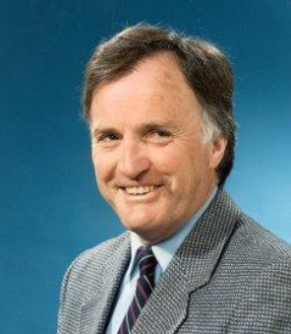
BIG OPEN QUESTIONS
1. Is Security Measurable?
2. Is Security a Science, Art or Magic ?
Question raised by James L. Massey
Cryptography - Science or Magic?
MIT, October 1, 2001, Running Time: 00:57:10
https://techtv.mit.edu/videos/16442-cryptography-science-or-magic

Slide 8
Two Major Security Tasks
Authentication
Securely identify an entity
Secrecy
Keep data safe against illegal users
Security tasks require to deploy Cryptographic mechanisms to be realized
Cryptography is the science dealing with hiding information and data security questions

Slide 9
Conventional
Secret Key Cryptography in Use
Fundamental Concepts

Slide 10
Cryptography : Basic definetions
Cryptogram/Cipher text
Attacker
Crypto-analyser
Receiver
Sender
Ciphering
Deciphering
Clear text
X
Y = E (Z_{e},X)
X
Clear text
E (Z_{e},X)
D (Z_{d},Y)
Message
Channel
Message
Z_{e}
Intruder
Z_{d}
Encryption-Key
Attacker
Decryption Key

Slide 11
Cryptographic Attacks: Basic definetions
Type of attacks:
Cipher text only attack
Known plaintext attack
Chosen plaintext attack
Chosen ciphertext attack
Chosen Cipher/Plain Text Attack: is mostly assumed as a basis to evaluate the quality of a cipher
A Fundamental Principle on Attacks:
Kerckhoff’s Principle: A fundamental security evaluation assumption:
Attacker knows everything but not the key !

Slide 12
Secret Key Crypto-System : mechanical analog
Z
SENDER
Z
RECEIVER
Key = Z Secret key agreement Key = Z
Z
Message
Message
Lock
Z

Slide 13
Conventional Cryptography till 1976 : Secret Key systems
Known locks as Standard Ciphers
Ciphering
De-Ciphering
Sender
Receiver
Y = E (Z,X)
X
E ( Z,X )
D ( Z,Y )
X
Message
Channel
Message
Z
Z
Secret Key Channel
Security rests on the Cipher
Secret Key = Z

Slide 14
Is Cryptographic Security Measurable ?
Yes and No !
Security measures adopted today:
System is unconditionally secure (perfect) :
System impossible to break with any means (whatever)
One not very practical system is known !
Non-sceientific statement
System is practically secure:
System possible to break but with very huge means
All modern practical systems fall under this category!

Slide 15
The Theory of “System Secrecy” is based on the Concept of
Information Entropy : a measure for information contents
Shannon 1949
“Probabilistic Model” of an information source:
Information Source
Output
P : Probability distribution function
Example: two symbole source (binary source):
Includes only two possible outputs for x, that is:
Example for M-symbol source:

Slide 16
Measure of the Amount of Information
(Entropy Unit)
Example for 1-bit information entropy
For instance, 0 denotes Head and 1 denotes Tail : or vice versa
The probability of Head is 0.5 and the probability of Tail is 0.5 too.
The information entropy for that case is = 1 bit
2 Possibilities which are equally probable!
Fair coin flipping
Entropy is measured in BITS
Maximum entropy is attained by equal probabilities!

Slide 17
The Information Entropy Function : Shannon 1949
Amount of information in a message M having n possible combinations is defined by Shannon as “Entropy” H(M) where:
overall n-possible messages M_{i}
Maximum entropy of an information source having n possible symbols is attained if all n combinations are equally probable, that is Prob(M_{i}) = 1/n for any i, Hence:
= n • ( 1/n log₂ n )
= log₂ n
Again, n is the number of all possible combinations
Example 2: A k-bit key vector having 2^{k} equally probable key selections has an entropy of: H(M) = log₂ 2^{k} = k bits
Example 1:
M = 12 months of the year appear equally likely H(M) = log₂ 12 ≈ 3.6 bits

Slide 18
The Theory of Perfect Secrecy Systems
Shannon 1949
If the entropy function for information source X: H (X) = - ∑ p_{r}(x_{i}) . log₂ p_{r}(x_{i})
{x}
Where: 0 ≤ H (X) ≤ log₂ t (for t possibilities for message X),
and If the key entropy is similarly H(Z) , then:
Shannon Condition for Perfect Security is H (Z) ≥ H (X)
If the key is fully randomly selected (usuals practice), then key entropy (H(Z)
(a key having k-bits and all key-combinations are equally likely selected/used:
H(Z) = - 2^{k} [ ( 1/2^{k} ) . Log₂ (1/2^{k}) ]
H (Z) = k
In that case, the necessary condition for Perfect Security is : k ≥ H (X) or k ≥ Information length as H(x) is at most as long as the information block length

Slide 19
Secrecy Theory and Alkindi’s Contribution in Cryptanalysis (استخراج المعمى)
(1000 years old mathematical treatment similar to Shannon’s generalized modern entropy techniques)
Introduced for the first time how to use the probability distribution of letters to break ciphers
Determining the statistical distribution of the frequency of letters in a particular natural language and made use of it to break a cipher by comparing the letter frequency in the cryptogram and natural text (showed an example of a text with 3667 letters) (for comparison: see Shannon’s Entropy Concept and function in page 17-18)
Indicated the importance that cryptogram must be sufficiently long to attain good
accuracy (statistical significance).
Notice : Alkindi’s treatise were dedicated to the central government in Bagdad (Calif Abu Al-abbas)
The use of Cryptography was mainly to transfer confidential reports to the Caliph from the different widespread ruled territories (called “Bareed “ service at that time)
Ref.: http://www.muslimheritage.com/

Slide 20
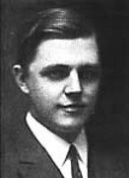
First and only known unbreakable Cipher
One-time-Pad OTP (Vernam Cipher)
Invented by Vernam (AT&T 1926)
Proved later to be impossible to break by Shannon (AT&T 1949)
Gilbert Vernam 1890 – 1960
(AT&T)
Cipher Text X+Z
Clear Text X
+
+
Clear Text X+Z+Z=X
Z
!Addition in GF(2)!
Z
key-tape
key-tape
Use key just one time!!
Random One Time secret Key
Random One Time secret Key
Unconditionally Secrure as : Key length = Clear text length (Shannon 1949)
H(z) > H(X)

Slide 21
Generalised One-Time Pad Cipher
System is also perfect for any Group < G, * >
Cipher Text X*Z
Clear Text X * Z * Z⁻¹ =X
Clear Text X
*
*
Z
Z⁻¹
Key-tape
Key-tape
One Time secret Key
One Time secret Key
Key length = Clear text length !!!
No key is repeatedly used!!

Slide 22
Improving Security by Message Compression
Enhance security by reducing redundancy
Perfect security always possible iff: Key length = Clear text length that is K=N
Natural languages have inherently low entropy as many information sources
if N > K then, try to make K=N by reducing N trough data compression to improve clear test entropy (reduce redundancy)
Low entropy
Clear text X
N Bits
/
N > K
Compressed to k Bits
Ideal
Compressor
K
/
K
/
Cipher
Cipher text
/ K
Unconditionally Secure!
Key

Slide 23
Unicity Distance: Minimum required ciphertext to break a cipher
Key equivocation function: H (Z|y₁, y₂, y₃...y_{n}) for non-randomized cipher
Cipher Unicity Distance
k
k = key size in bits
Information Redundancy
If r → 0, then n_{u} → ∞ => Cipher is perfect
n = number of the sent cryptogram symbols
n_{u}
Unicity Distance n_{u} : is the minimum amount of ciphertext symbols which in principle
can determin the secret key in a ciphertext only attack
Or: Expected minimum amount of ciphertext needed for brute-force to break a cipher

Slide 24
Plain Text Padding technique to improve security
(by increasing the unicity distance)
As larger uniucity distance means higher security, therefore a technique is proposed to increase the unicity distance by appending random unknown clear text as follows:
Original Clear text N-Bits
How to reduce r without compression?
N Bits
L Random Bits
H(X)
Random pattern
New clear text N+L Bits
N‘= N +L
New unicity distance:
′
=
N + L
n
n
u
N
u

Slide 25
Example: A block cipher having a key size of 128 bits is encrypting a clear text with a block length of 128 bits. The clear text redundancy is r=0.8.
Compute the cipher‘s unicity distance n_{u} and the clear text entropy.
The „unicity distance was doubled by appending L random bits to the clear text block. Compute L and the new clear text entropy.
After all the above cipher changes an observer was able to watch 1000 cipher text bits. Would the observer with unlimited resources theoretically be able to uniquely break the cipher in that case ? Give a reasoning for your answer.
SDF2009

Slide 26
Solution:
before
128 bits Data
K= 128 Bits, H(x)=? Bits, r = 0.8
after
128 bits Data
128 random bits
K
r
1. Unicity distance n_{u} = = 128/0.8 = 160 Bits (the cipher can be theoretically broken after 160 cipher bits)
As r = [ N – H(x) ] / N
=> N . r = N – H(x) => entropy H(x) = N · (1-r) => H(x) = 128 · (1-0.8) = 25.6 Bits
Usefull Iformation part of the 128 bits are only 25 bit !
n‘_{u} = [ ( N + L ) / N ] · n_{u}
2 ∙ 160 = [( 128 + L ) / 128] · 160
=> L = 128 Bits
H‘(x) = L + H(x) = 128 + 25,6 = 153.6 bits
3. The observer can theoretically break the cipher as the number of the observed cryptogram bits (1000 bits) is more than the unicity distance (320 bits) of the cipher.
Notes:
26

