Slide 1
Introduction to Cryptology
28.03.2023, v52
Lecture-05
Mathematical Background: Extension Finite Fields

Slide 2
Mathematical Background
In Discrete Mathematics, Number Theory
Outlines
Euclidean Algorithm, Remainder
Greatest Common Divisor (gcd)
Group Theory, Rings, Finite Fields
Element’s Order, Euler Theorem
Prime Numbers
Prime Number Generation
Extension Fields
part 1
part 2
part 3
part 4

Slide 3
Representing information in security systems as “Vectors”
(More flexible and efficient algebraic system for modern cryptography!)
Data representation in Integer algebra:
(1010) ⬄ 10 Element in GF(13)
(1010101) ⬄ 85 Element in GF(89)
Large data blocks require large field modulus and hence more complex arithmetic
Alternatively data may be represented as vectors having entries from GF(13):
(3 2 11 8 10) Vector having components from GF(13) with 5 entries, 4 bits each.
The result is a vector of 20 bits as follows:
Or fully usable binary vectors when using GF(31):
( 10101 00011 01110 … 10110)_{1 x 1000} , 5000 bits, with algebra over GF(31)!
Or simply: (1 0 1 1 0 1 0 1.. 1 0)_{1 x} ₂₅₆ 256 bits block/tuple with algebra over GF(2)
Question: Can we construct a “closed operational algebraic system”
when describing data as such large vectors from a GF ?
The answer is yes, by using what is called Extended Finite Fields (GF)
…
(0011 0010 1011 1000 1010) (not all 4-bit combinations are usable!)
This section treats such data : (1 0 1.. 1 0)_{1 x n} as n-bit tuples/vectors over GF(2)

Slide 4
Vectors Represented as Polynomials over GF(2)
A(x) is a Polynomial over GF(2), a_{i} ∈ GF(2)
A (x) =
Can represent a vector as polynomial A(x) with elements from GF(2)
Corresponding vector ( 1 1 0 1 0 0 1 )
Position 6 5 4 3 2 1 0
Example : Polynomial A(x) = x⁶ + x⁵ + x³ +1 over GF(2)
MSB LSB
And in reversed direction (vector to polynomial)
Example : Position 6 5 4 3 2 1 0
Vector ( 1 1 0 0 0 1 1 )
Corresp. Polynomial A(x) = x⁶ + x⁵ + x + 1

Slide 5
Basic Vectors/Polynomial Arithmetic over GF(2)
Addition:
A(x)
= 1 + x
In binary form
A(x)
⬄
0011
B(x)
= 1 + x + x³
⬄
B(x)
1011
A(x) + B(x) = 2 + 2x + x³
A(x) + B(x)
⬄
1000
A(x) + B(x) = x³
( as 1+1 =2 =0 in GF(2) )
Multiplication:
⬄
B(x)
1011
A(x) B(x)
= (1 + x) (1 + x + x
3
)
In binary form
A(x)
⬄
0011
= 1(1 + x + x
3
) + x(1 + x + x
3
)
1011
= 1 + x + x
3
+ x + x
2
+ x
4
1011
= 1 + x
2
+ x
3
+ x
4
0000
0000
A(x) * B(x)
⬄
0011101
From now on, we will use the term polynomials to designate vectors and vice versa

Slide 6
How to create Algebra between vectors/polynomials?
For creating Finite Fields GF,
non-factoriseable numbers called Prime Numbers
were used as modulus (remainders modulo p)
Similarly:
For creating vector/polynomial-fields called “Extension Fields”,
non-factoriseable polynomials called “Irreducible Polynomials”
are used as modulus (remainders modulo p(x) )
What are “Irreducible Polynomials”

Slide 7
To attain closed field algebra “Irreducible Polynomials” are required!
(Again: such polynomials play a similar role of “prime numbers” as field modulus)
A polynomial g(x) of degree m over GF(2) (2 is a prime!)
( a_{i} ∈ GF(2) )
Is said to be an irreducible polynomial over GF(2) if factorizing g(x) is not possible
g(x) =
Selected fundamental properties of irreducible polynomials
The period e of g(x) is the smallest e such that x^{e} = 1 [mod g(x)]
The period e is actually the multiplicative order of x modulo g(x). e divides 2^{m} -1
If e = 2^{m} -1, then the irreducible polynomial is then called a primitive plynomial
The reciprocal of a polynomial g(x) is defined as g*(x) = x^{m} g(1/x) (mirror polynomial)
The reciprocal g*(x) is also irreducible having the same period as that of g(x)
If g*(x) = g(x), then g(x) is said to be a self-reciprocal irreducible polynomial (symmetric)
(highest possible period is a divisor of 2^{m/2} + 1 )
G(x) =1011
G*(x) =1101
G(x) =101
G*(x)=G(x)=101
Non-trivial Self-reciprocal Polynomial can not be primitive!
- Generating “Irreducible Polynomials” is as difficult as generating prime numbers!
- Polynomial factorization is also an unsolved problem!?

Slide 8
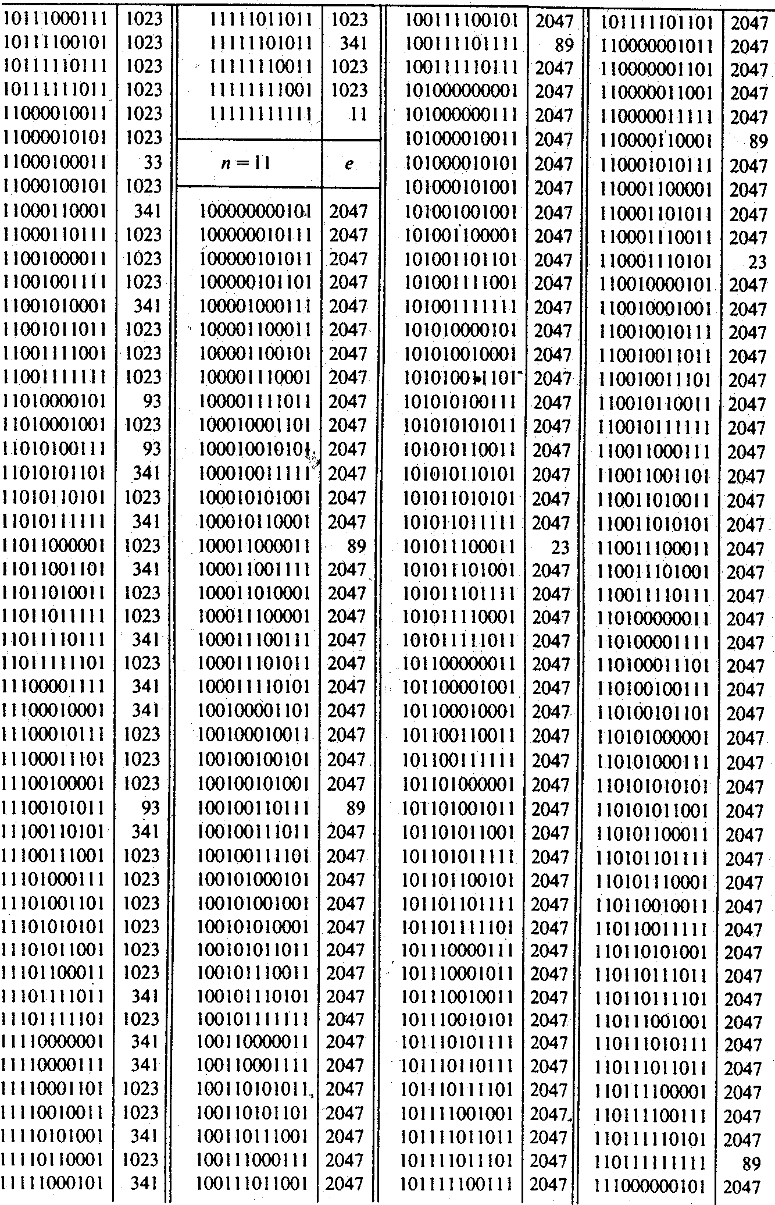
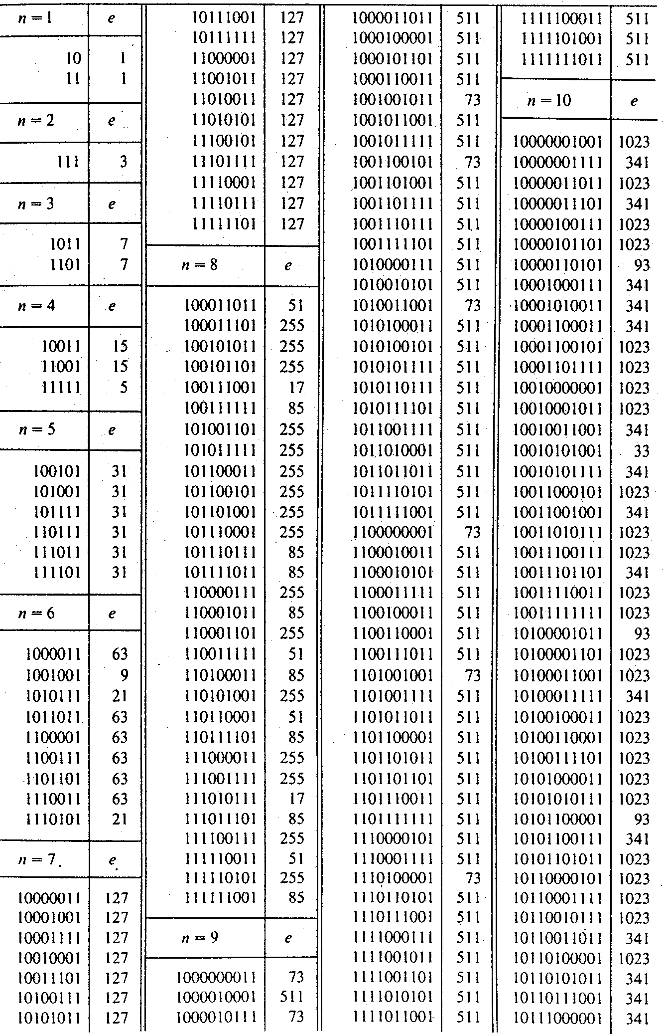
List of all irreducible Polynomials over GF(2 ) up to degree 11 (generated by exhaustive search)
self-reciprocal
Non-primitive ployn.
Periode is a divisor 0f
2^{10/2} +1 = 33
Only self-reciprocal
and primitive ployn.
As 2²-1=2^{2/2} +1 = 3!
Primitive ployn.
(all 1 Polynomial)
self-reciprocal!
Primitive ployn.
Primitive ployn.

Slide 9
! The Use of Irreducible Polynomials !
The ring of polynomials modulo any irreducible g(x)
is designated as Z_{g(x)} and builds an Extension Field
The ring of polynomials Z_{g(x)} modulo any irreducible polynomial g(x) of degree m over GF(2) is an Extension Field with 2^{m} elements of m-bit tuples. This is assigned as GF( 2^{m} ).
How to construct such m-bit closed vectors algebra?
Select g(x) as any irreducible polynomial of degree m and use it as a field modulus. The result is an “extension field” algebraic system on all m-bit vectors
(using prime number modulus in integer algebra. Corresponds to using irreducible polynomial modulus in polynomial algebra)
Finding irreducible polynomials :
There are theories and techniques (similar to those of prime integers but more complex) for testing and generating irreducible polynomial. (this is out of the scope of this lecture).
The table shown before includes a full list of all irreducible polynomials over GF(2) up to degree 11.

Slide 10
Smallest Extension Field GF(2²) :
A full operational algebra on 2-bits vectors/polynomials
  g(x) = x² + x + 1= 111 is irreducible of degree m=2 over GF(2). g(x) is the modulus, therefore x² + x + 1 = 0 => x² = x + 1
  GF(2²) elements are :
  Addition and multiplication tables in GF(2²) are:
00 <=> 0
01 <=> 1
10 <=> x
11 <=> 1+x
⊕
0
1
x
1
+
x
¤
0
1
x
1
+
x
0
0
1
x
1
+
x
0
0
0
0
0
(1+x) (1+x) mod (x² + x + 1 )
= x² + 2x + 1
= x² + 1 = (x+1)+1= x 2=0 over GF(2).
1
1
0
1
+
x
x
1
0
1
x
1
+
x
x
x
1
+
x
0
1
x
0
x
1
+
x
1
1
+
x
1
+
x
x
1
0
1
+
x
0
1
+
x
1
x
or divide:
(x² +2x+1) / (x² + x + 1) = 1 + x / (x² + x + 1)
⊕
00
01
10
11
¤
00
01
10
11
00
00
01
10
11
00
00
00
00
00
01
01
00
11
10
01
00
01
10
11
Remainder of division
10
10
11
00
01
10
00
10
11
01
11
11
10
01
00
11
00
11
01
10

Slide 11
Multiplicative order and primitive elements in GF (2^{m})
Facts:
- Any non-zero element/vector in GF(2^{m}) builds a cyclic group.
- The multiplicative order of any element in GF(2^{m}) is a divisor of 2^{m}-1 .
[ The possible multiplicative orders are only the divisors of (2^{m}-1) ]
A Primitive Element:
- Is the element having the highest possible multiplicative order, that is = 2^{m}-1.
- The exponents of such element generate the whole non-zero group elements
Number of all existing primitive elements: is ϕ (2^{m}-1)
Number of elements having order k: is ϕ (k)

Slide 12
Summary and some extension field properties
The algebra on m-bit vectors/polynomials over GF(2) using an irreducible polynomial g(x)
of degree m as modulus, where g(x) = 1 + g₁x¹ + g₂ x² ...+ g_{m} x^{m .} [all computations are modulo g(x) ]
result with what is called GF(2^{m}) having 2^{m} elements (vectors/polynomials).
In GF(2^{m}) the following relationships hold:
Any non-zero element (multiplicative group element) β in GF(2^{m}) has a multiplicative inverse.
The 2^{m}–1 non-zero elements build a cyclic group under multiplication.
Group’s order is 2^{m}-1. (inverse computation: by using the extended gcd algorithm for polynomials)
The multiplicative order of any element is a divisor of 2^{m}–1 , the number of elements with order t is ϕ(t)
For any non-zero element β ∈ GF(2^{m}) the following holds β = 1
( reason: the order of any element divides the group‘s order 2^{m}-1 )
If α, β ∈ GF(2^{m}) then : (α+β)² = α² + β² or [f(x)]² = f(x²)
(Notice: squaring is a linear operation in GF(2^{m})
2^{m} -1

Slide 13
Example: Element’s order over the extension field GF(2⁴)
Compute the exponents of the element x over GF(2⁴) which is generated by the irreducible polynomial
P(x)= (x⁴+ x +1 )
Solution
If P(x)= x⁴+ x +1 is the modulus then it is equal to zero, that is x⁴ + x +1 = 0, thus x⁴ = x +1.
the exponents of x in GF(2⁴) are:
→
msb lsb
x = x 0010 mod (x⁴+ x +1 )
x²= x² 0100 mod (x⁴+ x +1 )
x³= x³ 1000 mod (x⁴+ x +1 )
x⁴= x⁴ = x + 1 0011 mod (x⁴+ x +1 )
x⁵= x x⁴ = x² +x 0110 mod (x⁴+ x +1 )
x⁶= x (x² +x)= x³ +x² 1100 mod (x⁴+ x +1 )
x⁷= x (x³ +x²) = ( x⁴ +x³ ) = x +1+x³ 1011 mod (x⁴+ x +1 )
x⁸= x⁴ + x² +x = 1+x + x² +x = 1+x² 0101 mod (x⁴+ x +1 )
x⁹ = x³ + x 1010 mod (x⁴+ x +1 )
x¹⁰ = x⁴ + x² = x+1 + x² 0111 mod (x⁴+ x +1 )
x¹¹ = x³ + x² +x 1110 mod (x⁴+ x +1 )
x¹²= x⁴ + x³ + x² = x +1+ x³ + x² 1111 mod (x⁴+ x +1 )
x¹³= x⁴ + x³ + x² +x = x³ + x² + 1 1101 mod (x⁴+ x +1 )
x¹⁴= x⁴ + x³ + x= x+1+x³ + x = x³ +1 1001 mod (x⁴+ x +1 )
x¹⁵= x⁴ + x = x + 1 + x = 1 0001 mod (x⁴+ x +1 )
→
Important notice:
In GF (2⁴): the order of any element Is a divisor of 2⁴-1=15
Divisors of 15 are
1, 3,5,15 !
The order can only be
1 or 3 or 5 or 15 !
→
→
→
The order of the
element x is 15=2⁴-1
=> x is a primitive element
→
→
Ord (α^{i} ) = k / gcd (i,k)
→
Ord (x^{1,2,4,7,8,11,13,14} ) = 15

Slide 14
Why Algebra over GF (2^{m})
for modern Cryptographic Systems
1- Less-complex processing for equivalent security levels
2- Faster running time
3- Lower hardware complexity and costs. Usable in modern smart card
technology at commercially acceptable costs.
Contemporary “Modern Crypto-Systems” are deploying this algebra in practical applications more and more intensively
The basic hardware processing units for the primitive arithmetic operations; addition, multiplication and division over GF(2^{n}) are given in a compact template-form in the following sections

Slide 15
Hardware Architectures for Arithmetic in GF (2^{n})
Addition
Parallel
Sequential
=

Slide 16
Hardware Architectures for Arithmetic in GF (2^{m})
Multiplication
B (x) = H(x) ∙ I(x)
MSB
H(x)
I(x)
⇒
… i(2), i(1), i(0)
h
0
h
1
h
2
h
3
h
m-1
h
m
S
0
S
1
S
S
M-1
S
m
B (x)

Slide 17
Hardware Architectures for Arithmetic in GF (2^{m})
Division
I(x) R(x)
G(x) G(x)
= Q(x) +
g₀
g₁
g₂
g_{m-1}
g₀
NOTE: R(x) is the content of the register after entering all I(x) bits

Slide 18
Hardware Architectures for Arithmetic in GF (2^{m})
Combined Division and Multiplication
Input bits I(x):
i₀ i₁ i₂ …. i_{k-1} i_{k}
h₀
h₁
…
h_{m-1}
h_{m}
…
Clock 2
+
s₀
+
…
+
+
Clock k+1
Clock 1
S_{m-2}
S_{m-1}
g₀
g₁
…
g_{m-1}
Z(x)
Output sequence
Multiplier: H(x) = h₀ + h₁x¹ + h₂x^{2 …} + h_{m}x^{m}
Divisor: G(x) = g₀ + g₁x¹ + g₂x^{2 …} + g_{m}x^{m}
Input: I(x) = i₀ + i₁x¹ + i₂x^{2 …} + i_{k}x^{k}
Remainder: R(x) = r₀ + r₁x¹ + r₂x^{2 …} + r_{m-1}x^{m-1}
R(x)=H(x) • I(x) mod G(x)
= s₀ + s₁x¹ + s₂x^{2 …} + s_{m-1}x^{m-1} after clock k+1

Slide 19
Arithmetic in Z_{p(x)} , size (2¹⁶)
Example: (CRC: Cyclic Redundancy Code/Check)
Simultaneous Division and Multiplication
S(x) = x¹⁶ I(x) mod (1 + x² + x¹⁵ + x¹⁶)
Multiply the data stream I(x) by x¹⁶ and divide it simultaneously by (1 + x² + x¹⁵ + x¹⁶)
S(x) = x¹⁶ I(x) mod (1 + x² + x¹⁵ + x¹⁶)
The contents of the register after entering all I(x) bits is the rest of x¹⁶ I(x) mod (1 + x² + x¹⁵ + x¹⁶)

Slide 20
Example: order of x over an extension field GF(2³) and hardware implementation
Compute the exponents of the element x over GF(2³) which is generated by the irreducible polynomial
P(x)= (x³+ x +1 )
Solution
If P(x)= x³+ x +1 is the modulus then it is equal to zero, that is x³ + x +1 = 0, thus x³ = x +1.
the exponents of x in GF(2³) are:
x = x 010 mod (x³+ x +1 )
x²= x² 100 mod (x³+ x +1 )
x³= x³ = x + 1 011 mod (x³+ x +1 )
x⁴= x x³ = x² + x 110 mod (x³+ x +1 )
x⁵= x x⁴ = x³ +x² =x + 1 + x² 111 mod (x³+ x +1 )
x⁶= (x³)²= (x+1)²=x² +1 101 mod (x³+ x +1 )
x⁷= x (x² +1) = ( x³ +x ) = x+1 + x = 1 001 mod (x³+ x +1 )
msb lsb
Important notice:
In GF (2³): the order of any element Is a divisor of 2³-1=7
Divisors of 7 are
1, 7 !
The order can only be
1 or 7 !
x⁸= x
A possible hardware generator for the exponents of x is as follows:
The order of the
element x is 7=2³-1
=> x is a primitive element
x⁰ x¹ x²
0
+
1
0
x⁰=1 x¹ x³
LSB MSB
Initial state = x = 010

Slide 21
Euclidian gcd Algorithm for Polynomials
Start
P₁(x), P₂(x)
?
PS: [ c⁻¹ is the inverse of the leading
coefficient of P₂(x) ]
yes
R(x)=R
p₂(x)
[ P₁(x)]=0
gcd
c⁻¹ P
no
←
(x)
2
P
1
(x)
←
P
2
(x)
P
(x)
←
2
R(x)
End

Slide 22
Extended gcd Algorithm for Polynomials
Start
gcd [ P₁(x) , P₂(x) ] = A(x) P₁(x) + B(x) P₂(x)
Input: P₁(x), P₂(x), P₂(x) ≠ 0
Initialization:
A₁(x) =1 , B₁(x) =0
A₂(x) =0 , B₂(x) =1
Divide P₁(x) by P₂(x)
P₁(x) / P₂(x) = Q(x) + R(x) / P₂(x)
no
yes
Find the leading coefficient c of P₂(x)

Slide 23
Example: Compute the multiplicative inverse of x³ + x + 1 modulo x⁴ + x + 1
Solution: Compute gcd [ P₁(x) , P₂(x) ] = A(x) P₁(x) + B(x) P₂(x)
if gcd =1, then the inverse is B(x)
Extended gcd Algorithm:
A2 = A1 – q A2
B2 = B1 – q B2
P₁(x)
P₂(x)
A1(x)
A2(x)
B1(x)
B2(x)
Qx)
R(x)
x⁴ + x + 1
x³ + x + 1
1
0
0
1
x
x² + 1
x³ + x + 1
x² + 1
0
1
0 - x . 1=
x
x
1
1
x² + 1
1
1
0 – x . 1 =
x
x
1 – x . x =
x² + 1
x² + 1
0
gcd [ P₁(x) , P₂(x) ] = (x) (x⁴ + x + 1) + (x² + 1) (x³ + x + 1 ) = 1
Operating modulo x⁴ + x + 1 : R [ (x) (x⁴ + x + 1) + (x² + 1) (x³ + x + 1 ) ] = 1
R [ (x² + 1) (x³ + x + 1 ) ] = 1
(x⁴ + x + 1)
(x⁴ + x + 1)
=> (x² + 1) ≡ (x³ + x + 1 ) ⁻¹ modulo (x⁴ + x + 1)
x⁴ + x + 1=0
x⁴ = x + 1
x⁵ = x² + x
Check: (x² + 1) (x³ + x + 1 ) = x⁵+ x³ + x² + x³ + x + 1
≡ (x² + x ) + x² + x + 1 = 1 modulo (x⁴ + x + 1)

Slide 24
GF (2^{m}) as a vector space
Some additional extension field properties of interest
GF(2^{m}) algebra is in general very attractive for implementing modern low-cost crypto systems. The way of representing of data plays a major role in some cases to result with extremely low-cost implementations.
- If α ∈ GF(2^{m}) is a root for g(x)=0, then are the roots of g(x)
- These roots build what is called the Canonical Base for the vector space representing that field.
If ( ) are linearly-independent, then they build what is called
the Normal Base for this GF(2^{m})
The “Normal base “ for a vector space representation of GF(2^{m}) results with extremely simple squaring arithmetic for polynomials/vectors as elements of GF(2^{m}) .
The following example shows one interesting efficient implementing of a squaring operation in GF(2^{m})

Slide 25
Particular Arithmetic cases in GF (2^{m}) are sometimes very attractive
for practical hardware implementations
Example: Squaring in Normal Base representation (Massey-Omura US Patent 1982)
GF(2^{m}) is equivalent to a vector space with the dimension m:
represent a base for a vector space if: = 0
If and only if for b₀= b₁ = b₂ = ... = b_{m-1} = 0, (Base vectors are linearly independent).
If α is a root of the field generating irreducible polynomial g(x) over GF(2), then
α⁰ α¹ α² α^{3 . . .} α^{m-1} build the Canonical Base for GF(2^{m}). (example α=x)
Example of squaring in
a normal base system:
If a = 1 0 1 1
⇒ a² = 1 1 0 1
If however, are linearly independent,
then represent the so called a Normal Base
Squaring is equivalent to a “ring rotation” in normal base representation:
i.e if b = [ b₀ b₁ b₂ ... b_{m-1} ]
then:
Or in normal base representation

Slide 26
Exponentiation for polynomials/vectors by square-and-multiply technique
Example: setup a hardware structure to compute b(x)²⁵ in GF(2⁵)
25 = (11001)₂ = 2⁰ + 2³ + 2⁴ = 1 + 8 + 16
Each ring-rotation clock squares the register contents
21 = ( 1 1 0 0 1 )₂
b(x) = 1 + x + x⁴
= 10011
Nornal base converter
β =00101
0
1
0
1
β¹⁶
β⁸
β⁴
β²
β
β¹⁶
β
β
β⁸
β¹⁶
= β²⁵
Select a normal base
β⁸
*
*
Normal-base multiplier
*
Nornal base to canonical converter
b(x)²⁵
β²⁵

