Slide 1
Computer Architecture
Prof. Dr. Nizamettin AYDIN
naydin@yildiz.edu.tr
nizamettinaydin@gmail.com
http://www.yildiz.edu.tr/~naydin

Slide 2
Computer Architecture
Operating System Support

Slide 3
Outline
Objectives and Functions of OS
Operating System Services
Types of Operating System
Interactive
Batch
Single program
Multi-programming
Scheduling
Long Term Scheduling
Medium Term Scheduling
Short Term Scheduler
Swapping
Partitioning
Relocation
Paging
Virtual Memory
Segmentation

Slide 4
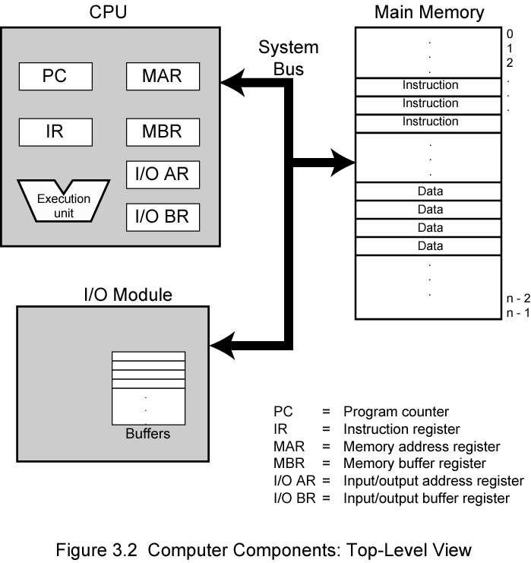
Operating System
A computer consists of modules of three basic types that communicate with each other.
CPU
Memory
Input/Output
Management of these modules is done by OS.

Slide 5
Objectives and Functions of OS
Convenience
An operating system makes a computer easier to use
Efficiency
An operating system allows better use of computer resources

Slide 6
Layers and Views of a Computer System

Slide 7
Operating System Services
Program creation
Program execution
Access to I/O devices
Controlled access to files
System access
Error detection and response
Accounting

Slide 8
O/S as a Resource Manager
A computer is a set of resources for the movement, storage, and processing of data and for the control of these functions
The O/S is responsible for managing these resources
O/S is a program executed by the processor
The O/S frequently relinquishes control and must depend on the processor to allow it to regain control

Slide 9
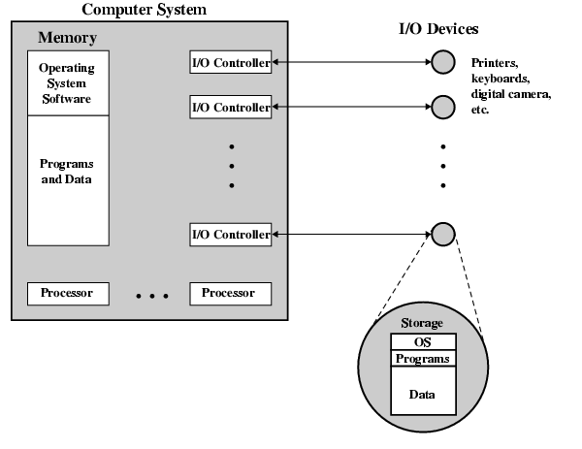
Main Resources managed by the O/S

Slide 10
Types of Operating System
Interactive
User/programmer interacts directly with the computer through a keyboard/display terminal
Batch
Opposite of interactive. Rare
Single program (Uni-programming)
Works only one program at atime
Multi-programming (Multi-tasking)
Processor works on more than one program at a time

Slide 11
Early Systems
Late 1940s to mid 1950s
No Operating System
Programs interact directly with hardware
Two main problems:
Scheduling:
Setup time

Slide 12
Simple Batch Systems
Resident Monitor program
Users submit jobs to operator
Operator batches jobs
Monitor controls sequence of events to process batch
When one job is finished, control returns to Monitor which reads next job
Monitor handles scheduling

Slide 13
Memory Layout for Resident Monitor

Slide 14
Job Control Language
Instructions to Monitor
Usually denoted by $
e.g.
$JOB
$FTN
... Some Fortran instructions
$LOAD
$RUN
... Some data
$END

Slide 15
Desirable Hardware Features
Memory protection
To protect the Monitor
Timer
To prevent a job monopolizing the system
Privileged instructions
Only executed by Monitor
e.g. I/O
Interrupts
Allows for relinquishing and regaining control

Slide 16
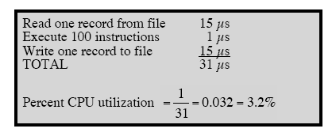
Multi-programmed Batch Systems
I/O devices very slow
When one program is waiting for I/O, another can use the CPU
Following illustrates the problem:
the calculation concerns a program that processes a file of records and performs, on average, 100 processor instructions per record.
In this example the computer spends over 96% of its time waiting for I/O devices to finish transferring data.
System utilization example

Slide 17
Single vs Multi-Programming
Single program
Multi-Programming with two programs

Slide 18
Single vs Multi-Programming
Multi-Programming with Three Programs

Slide 19
Example- benefits of mutiprogramming
Consider a computer with 250 MBytes of memory, a disk, a terminal, and a printer.
The programs JOB1, JOB2, and JOB3 are submitted for execution at the same time with the following attributes:
We assume minimal processor requirements for JOB2 and JOB3 and continuous disk and printer use by JOB3.
For a simple batch environment, these jobs will be executed in sequence

Slide 20
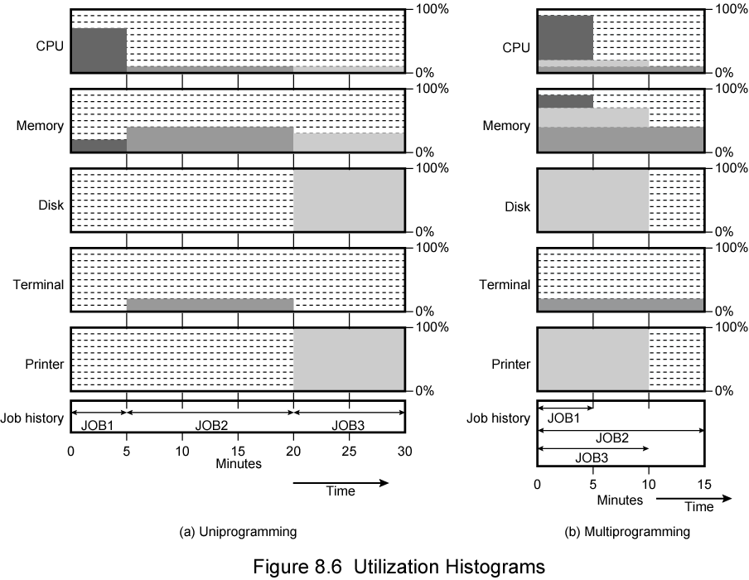
Utilization histograms

Slide 21
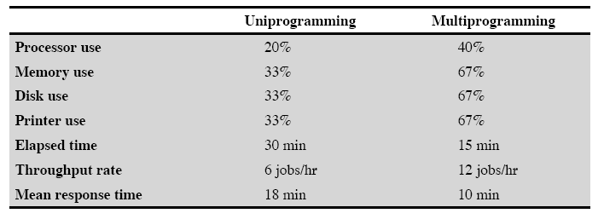
Effects of Multiprogramming on Resource Utilization

Slide 22
Time Sharing Systems
Allow users to interact directly with the computer
i.e. Interactive
Multi-programming allows a number of users to interact with the computer

Slide 23
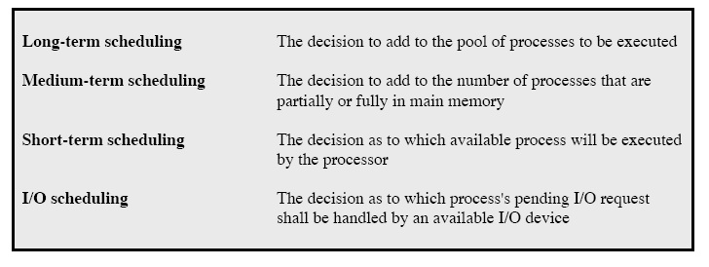
Scheduling
Scheduling is key to multi-programming
A process is:
A program in execution
The “animated spirit” of a program
That entity to which a processor is assigned
Types of scheduling:

Slide 24
Long Term Scheduling
Determines which programs are submitted for processing
i.e. controls the degree of multi-programming
Once submitted, a job becomes a process for the short term scheduler
(or it becomes a swapped out job for the medium term scheduler)

Slide 25
Medium Term Scheduling
Part of the swapping function (later…)
Usually based on the need to manage multi-programming
If no virtual memory, memory management is also an issue

Slide 26
Short Term Scheduler
Also known as Dispatcher, executes frequently and makes the fine grained decisions of which job to execute next
i.e. which job actually gets to use the processor in the next time slot
5 define states in a process state:
New:
A program is admitted by the high-level schedular but is not yet ready to execute
Ready:
The process is ready to execute
Running:
The prcess is being executed
Waiting:
The process is suspended, waiting for some system resources
Halted:
The process has terminated and will be destroyed by the O/S.

Slide 27
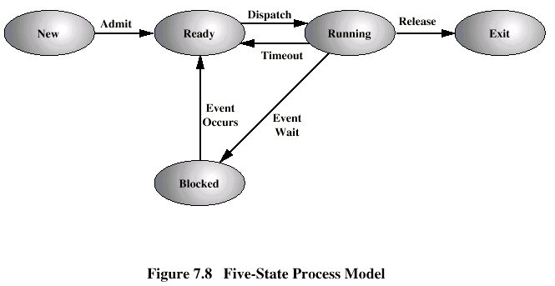
Five State Process Model

Slide 28
Process Control Block

Slide 29
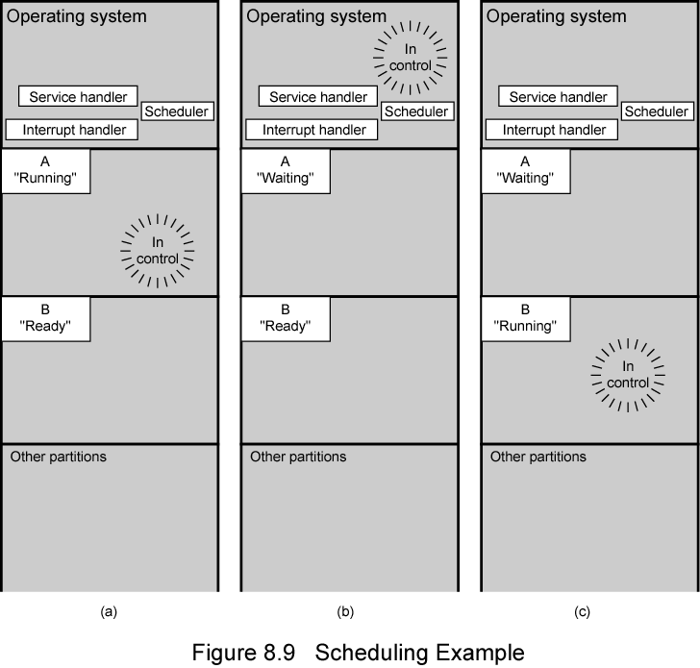
Scheduling Example

Slide 30
Key Elements of O/S for Multiprogramming

Slide 31
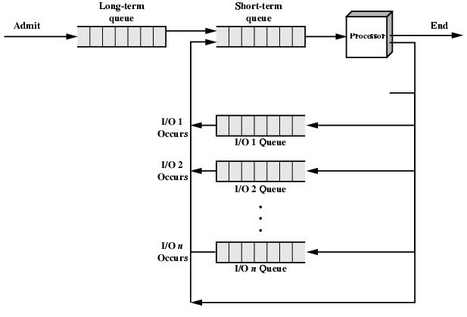
Queuing Diagram Representation of Process Scheduling

Slide 32
Memory Management
Task of dynamically subdivison of memory
Effective memory management is vital in a multiprogramming system
Uni-program
Memory split into two
One for Operating System (monitor)
One for currently executing program
Multi-program
“User” part is sub-divided and shared among active processes

Slide 33
Swapping
Problem:
I/O is so slow compared with CPU that even in multi-programming system, CPU can be idle most of the time
Solutions:
Increase main memory
Expensive
Leads to larger programs
Swapping

Slide 34
What is Swapping?
Long term queue of processes stored on disk
Processes “swapped” in as space becomes available
As a process completes it is moved out of main memory
If none of the processes in memory are ready (i.e. all I/O blocked)
Swap out a blocked process to intermediate queue
Swap in a ready process or a new process
But swapping is an I/O process…

Slide 35
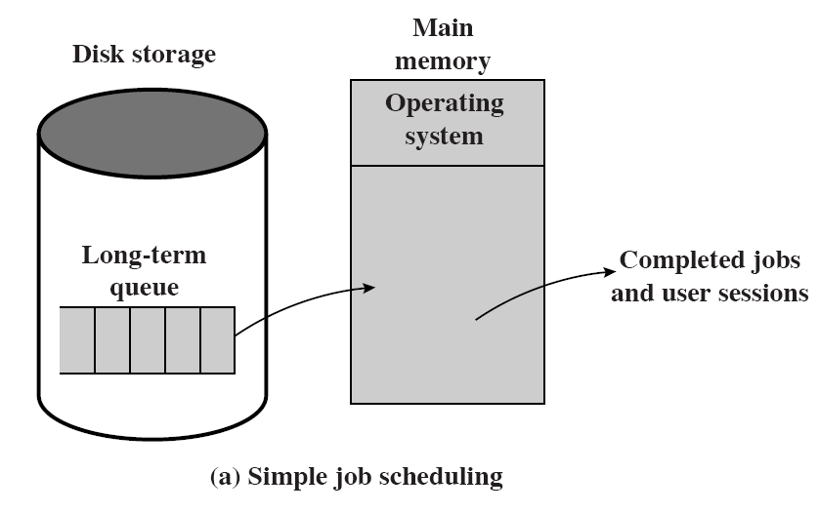
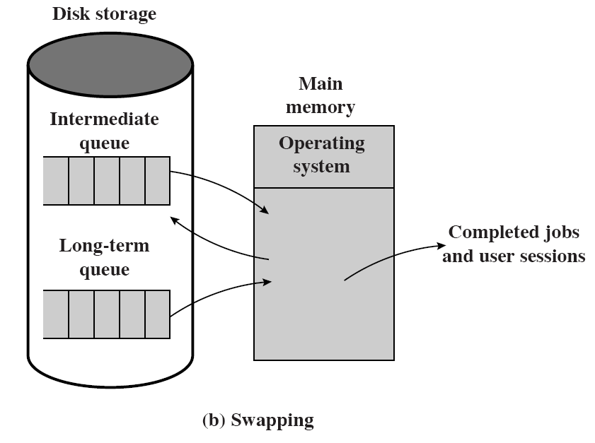
Use of Swapping

Slide 36
Partitioning
Splitting memory into sections to allocate to processes (including Operating System)
Fixed-sized partitions
May not be equal size
Process is fitted into smallest hole that will take it (best fit)
Some wasted memory
Leads to variable sized partitions

Slide 37
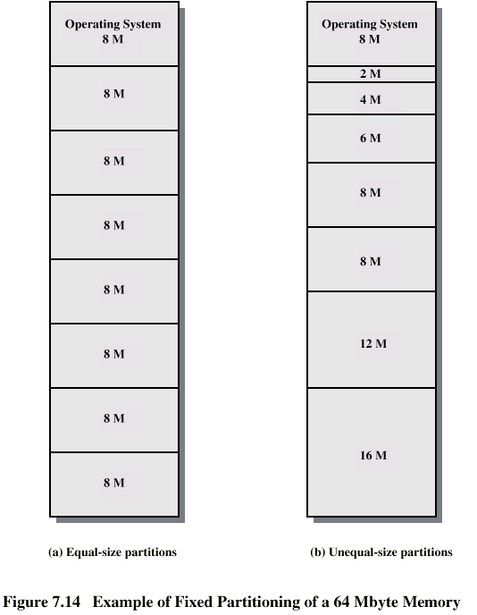
Fixed Partitioning

Slide 38
Variable Sized Partitions (1)
Allocate exactly the required memory to a process
This leads to a hole at the end of memory, too small to use
Only one small hole - less waste
When all processes are blocked, swap out a process and bring in another
New process may be smaller than swapped out process
Another hole

Slide 39
Variable Sized Partitions (2)
Eventually have lots of holes
(fragmentation)
Solutions:
Coalesce
Join adjacent holes into one large hole
Compaction
From time to time go through memory and move all hole into one free block (c.f. disk de-fragmentation)

Slide 40
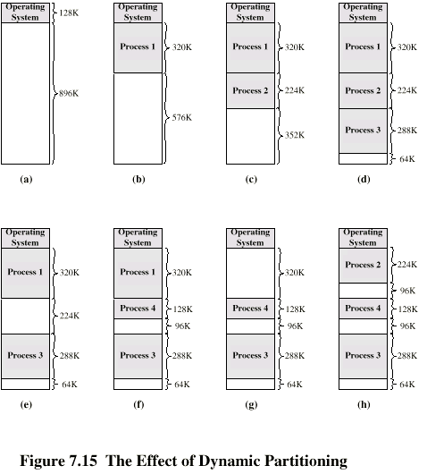
Effect of Dynamic Partitioning

Slide 41
Relocation
No guarantee that process will load into the same place in memory
Instructions contain addresses
Locations of data
Addresses for instructions (branching)
Logical address
relative to beginning of program
Physical address
actual location in memory (this time)
Automatic conversion using base address

Slide 42
Paging
Split memory into equal sized, small chunks -page frames
Split programs (processes) into equal sized small chunks - pages
Allocate the required number page frames to a process
Operating System maintains list of free frames
A process does not require contiguous page frames
Use page table to keep track

Slide 43
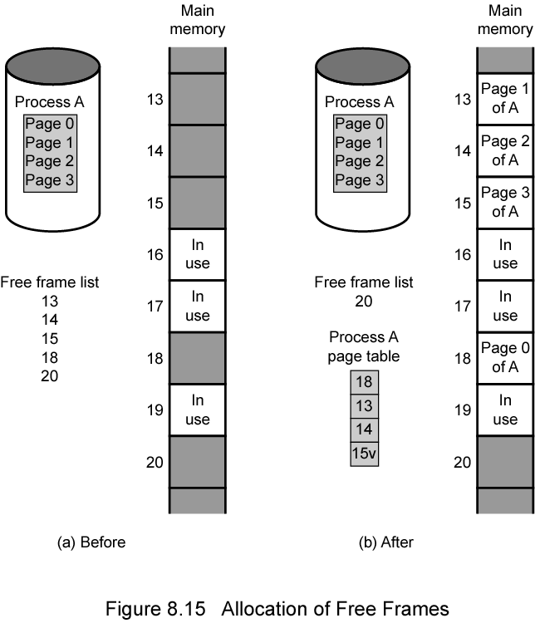
Allocation of Free Frames

Slide 44
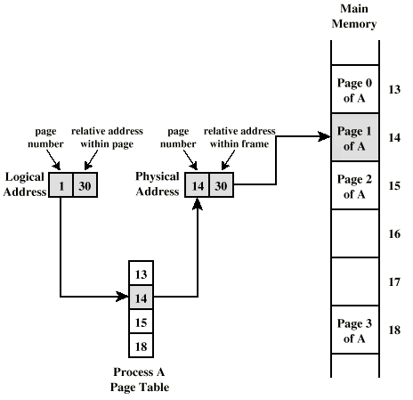
Logical and Physical Addresses - Paging

Slide 45
Virtual Memory
Demand paging
Do not require all pages of a process in memory
Bring in pages as required
Page fault
Required page is not in memory
Operating System must swap in required page
May need to swap out a page to make space
Select page to throw out based on recent history

Slide 46
Thrashing
Too many processes in too little memory
Operating System spends all its time swapping
Little or no real work is done
Disk light is on all the time
Solutions
Good page replacement algorithms
Reduce number of processes running
Fit more memory

Slide 47
Bonus
We do not need all of a process in memory for it to run
We can swap in pages as required
So - we can now run processes that are bigger than total memory available!
Main memory is called real memory
User/programmer sees much bigger memory - virtual memory

Slide 48
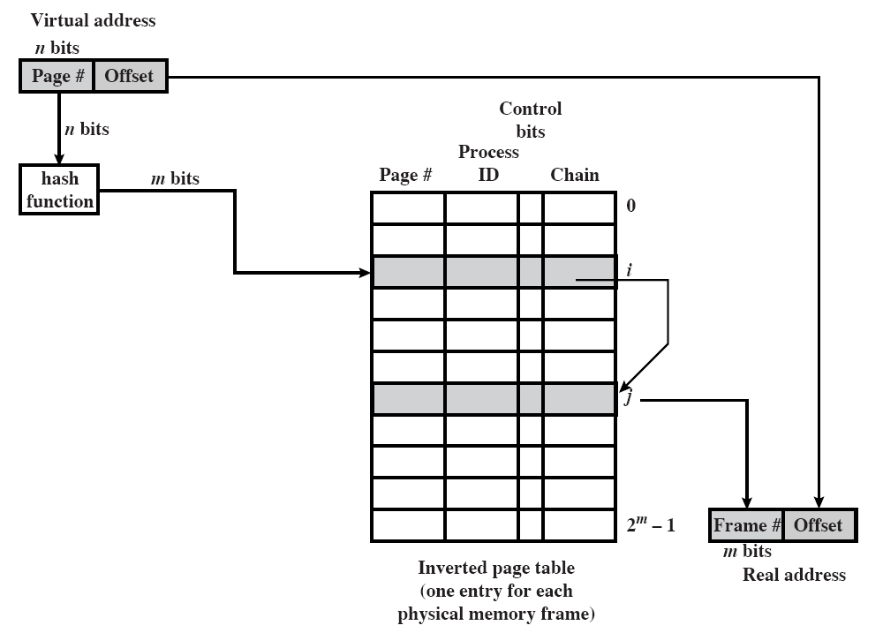
Inverted Page Table Structure

Slide 49
Translation Lookaside Buffer
Every virtual memory reference causes two physical memory access
Fetch page table entry
Fetch data
Use special cache for page table
TLB

Slide 50
TLB Operation

Slide 51
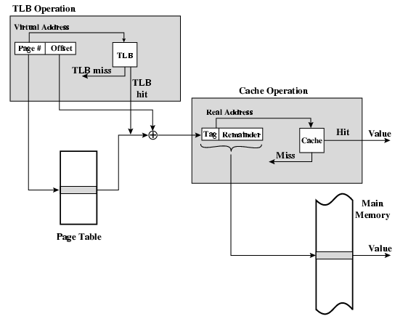
TLB and Cache Operation

Slide 52
Segmentation
Paging is not (usually) visible to the programmer
Segmentation is visible to the programmer
Usually different segments allocated to program and data
May be a number of program and data segments

Slide 53
Advantages of Segmentation
Simplifies handling of growing data structures
Allows programs to be altered and recompiled independently, without re-linking and re-loading
Lends itself to sharing among processes
Lends itself to protection
Some systems combine segmentation with paging

Slide 54
Pentium II
Hardware for segmentation and paging
Unsegmented unpaged
virtual address = physical address
Low complexity
High performance
Unsegmented paged
Memory viewed as paged linear address space
Protection and management via paging
Berkeley UNIX
Segmented unpaged
Collection of local address spaces
Protection to single byte level
Translation table needed is on chip when segment is in memory
Segmented paged
Segmentation used to define logical memory partitions subject to access control
Paging manages allocation of memory within partitions
Unix System V

Slide 55
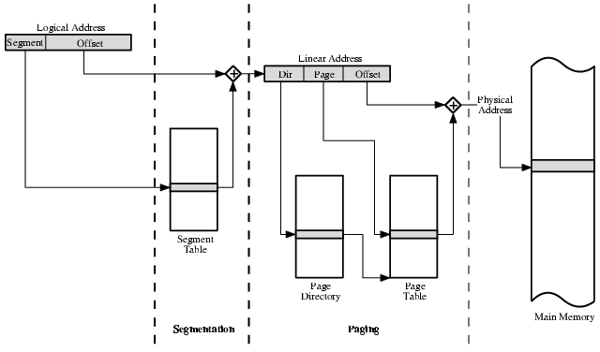
Pentium II Address Translation Mechanism

Slide 56
Pentium II Segmentation
Each virtual address is 16-bit segment and 32-bit offset
2 bits of segment are protection mechanism
14 bits specify segment
Unsegmented virtual memory 2³² = 4 Gbytes
Segmented 2⁴⁶ = 64 terabytes
Can be larger – depends on which process is active
Half (8K segments of 4 Gbytes) is global
Half is local and distinct for each process

Slide 57
Pentium II Protection
Protection bits give 4 levels of privilege
0 most protected, 3 least
Use of levels software dependent
Usually level 3 for applications, level 1 for O/S and level 0 for kernel (level 2 not used)
Level 2 may be used for apps that have internal security e.g. database
Some instructions only work in level 0

Slide 58
Pentium II Paging
Segmentation may be disabled
In which case linear address space is used
Two level page table lookup
First, page directory
1024 entries max
Splits 4G linear memory into 1024 page groups of 4Mbyte
Each page table has 1024 entries corresponding to 4Kbyte pages
Can use one page directory for all processes, one per process or mixture
Page directory for current process always in memory
Use TLB holding 32 page table entries
Two page sizes available 4k or 4M

Slide 59
PowerPC Memory Management Hardware
32 bit – paging with simple segmentation
64 bit paging with more powerful segmentation
Or, both do block address translation
Map 4 large blocks of instructions & 4 of memory to bypass paging
e.g. OS tables or graphics frame buffers
32 bit effective address
12 bit byte selector
=4kbyte pages
16 bit page id
64k pages per segment
4 bits indicate one of 16 segment registers
Segment registers under OS control

Slide 60
PowerPC 32-bit Memory Management Formats

Slide 61
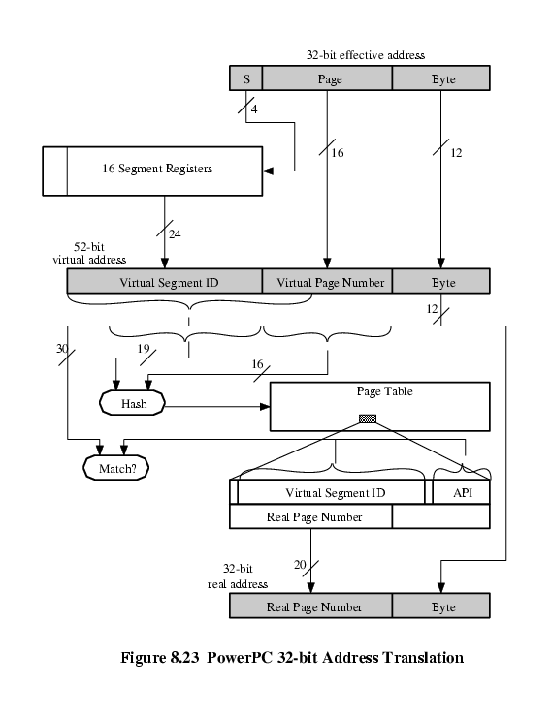
PowerPC 32-bit Address Translation

