Slide 1
Computer Architecture
Prof. Dr. Nizamettin AYDIN
naydin@yildiz.edu.tr
nizamettinaydin@gmail.com
http://www.yildiz.edu.tr/~naydin

Slide 2
Computer Architecture
Input/Output

Slide 3
Outline
Input/Output
  External Devices
  I/O Modules
    Module Function
    I/O Module Structure
  Programmed I/O
  Interrupt-Driven I/O
    Interrupt Processing
    Design Issues
  Direct Memory Access
    DMA Function
  I/O Channels and Processors
    The Evolution of the I/O Function
    Characteristics of I/O Channels
  The External Interface
    Types of Interfaces
    FireWire
    Thunderbolt
    InfiniBand

Slide 4
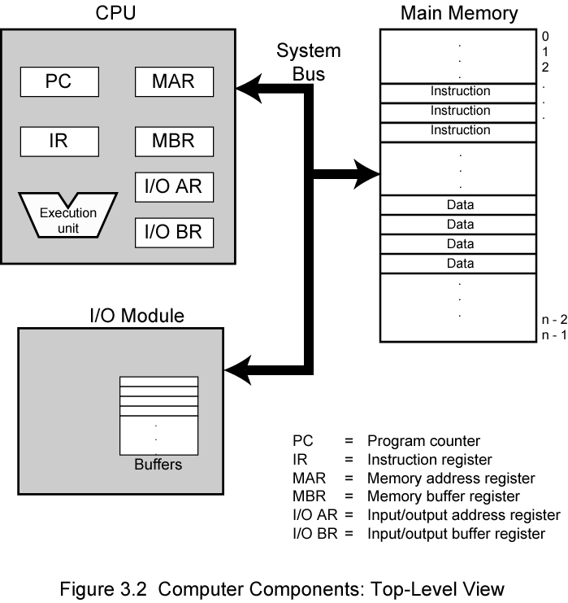
Input/Output
A computer consists of a set of components or modules of three basic types that communicate with each other.
  CPU
  Memory
  Input/Output

Slide 5
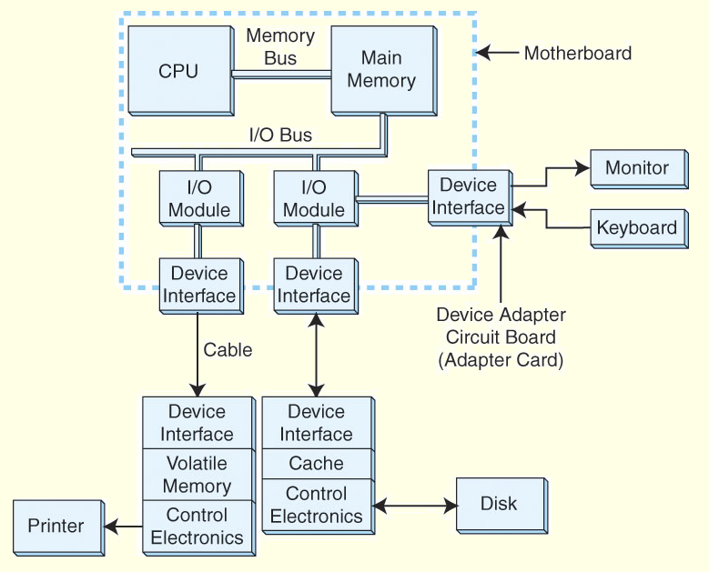
Input/Output Problems
Wide variety of peripherals
  Delivering different amounts of data
  At different speeds
  In different formats
All slower than CPU and RAM
Need I/O modules

Slide 6
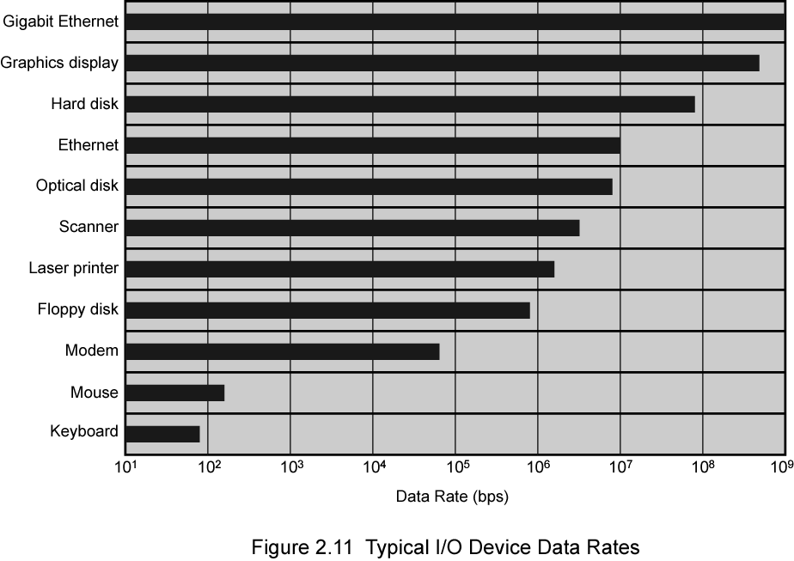
Typical I/O Device Data Rates

Slide 7
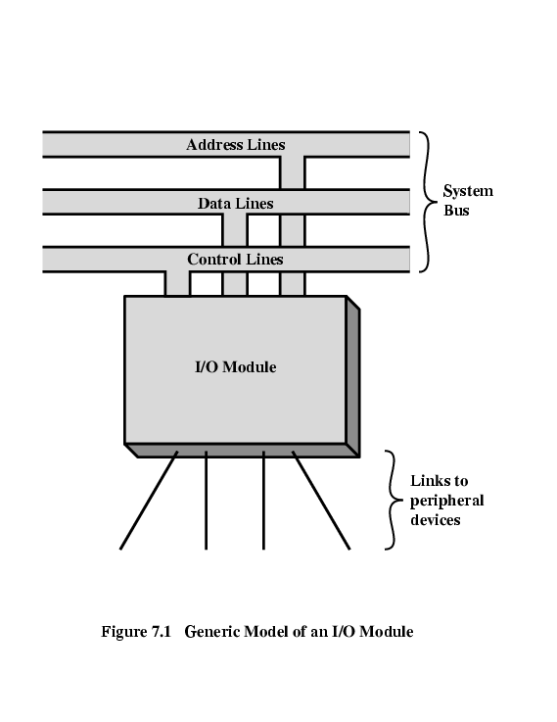
Input/Output Module
Interface to CPU and Memory
Interface to one or more peripherals
I/O Module Functions
  Control & Timing
  CPU Communication
  Device Communication
  Data Buffering
  Error Detection
I/O Steps
  CPU checks I/O module device status
  I/O module returns status
  If ready, CPU requests data transfer
  I/O module gets data from device
  I/O module transfers data to CPU
  Variations for output, DMA, etc.

Slide 8
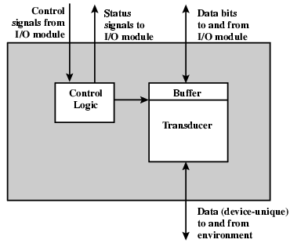
External Devices
Human readable
  Screen, printer, keyboard
Machine readable
  Monitoring and control
Communication
  Modem
  Network Interface Card (NIC)

Slide 9
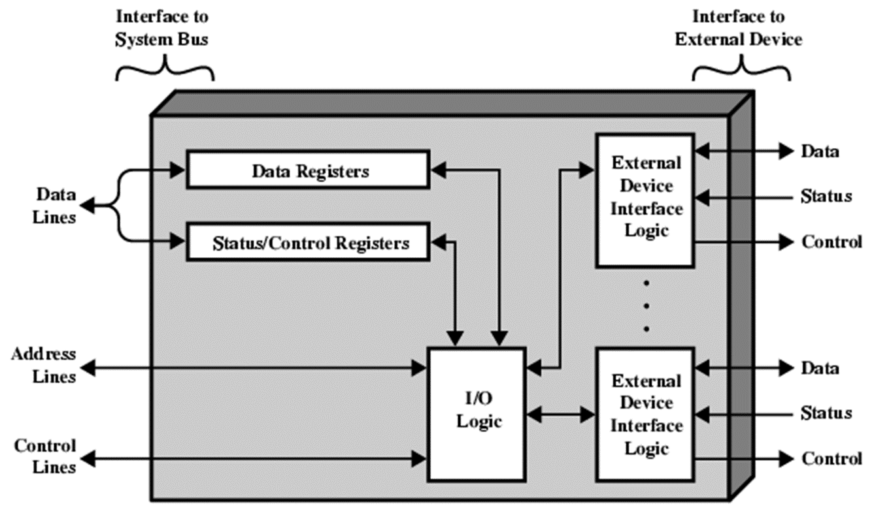
I/O Module Diagram
Hide or reveal device properties to CPU
Support multiple or single device
Control device functions or leave for CPU
Also O/S decisions

Slide 10
I/O Architectures
I/O can be controlled in four general ways.
  Programmed I/O:
    Reserves a register for each I/O device.
    Each register is continually polled to detect data arrival.
  Interrupt-Driven I/O:
    allows the CPU to do other things until I/O is requested.
  Direct Memory Access (DMA):
    offloads I/O processing to a special-purpose chip that takes care of the details.
  Channel I/O:
    uses dedicated I/O processors.

Slide 11
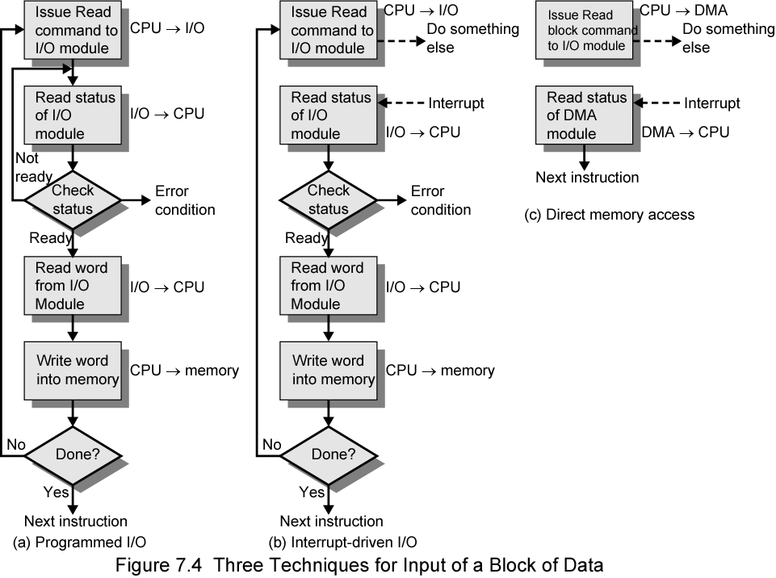
Three Techniques for Input of a Block of Data

Slide 12
Programmed I/O
CPU has direct control over I/O
  Sensing status
  Read/write commands
  Transferring data
CPU waits for I/O module to complete operation
Wastes CPU time

Slide 13
Programmed I/O - detail
CPU requests I/O operation
I/O module performs operation
I/O module sets status bits
CPU checks status bits periodically
I/O module does not inform CPU directly
I/O module does not interrupt CPU
CPU may wait or come back later

Slide 14
I/O Commands & Addressing I/O Devices
Under programmed I/O data transfer is very like memory access (CPU viewpoint)
Each device given unique identifier
CPU commands contain identifier (address)
CPU issues address
  Identifies module (& device if >1 per module)
CPU issues command
  Control - telling module what to do
    e.g. spin up disk
  Test - check status
    e.g. power? Error?
  Read/Write
    Module transfers data via buffer from/to device

Slide 15
I/O Mapping
Memory mapped I/O
  Devices and memory share an address space
  I/O looks just like memory read/write
  No special commands for I/O
    Large selection of memory access commands available
Isolated I/O
  Separate address spaces
  Need I/O or memory select lines
  Special commands for I/O
    Limited set

Slide 16
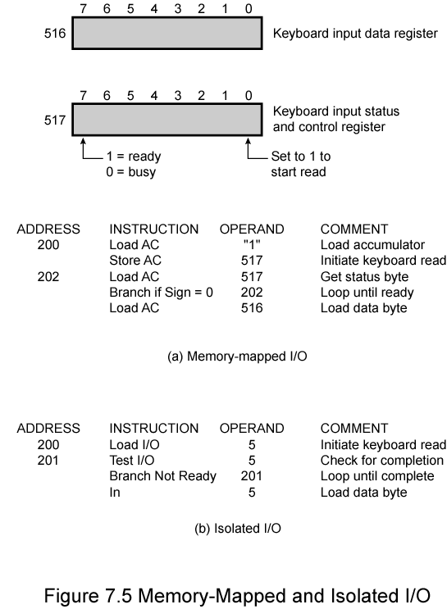
Memory Mapped I/O

Slide 17
Isolated I/O

Slide 18
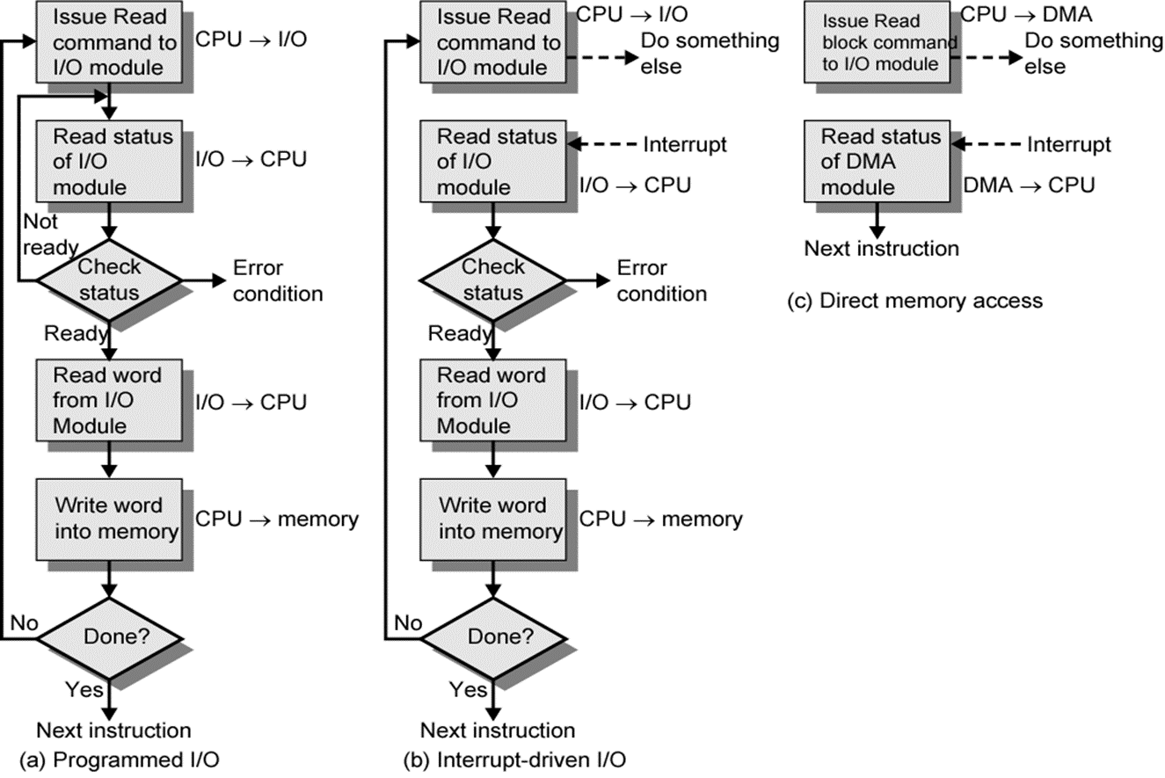
Interrupt Driven I/O
Overcomes CPU waiting
No repeated CPU checking of device
I/O module interrupts when ready
Basic Operation
  CPU issues read command
  I/O module gets data from peripheral whilst CPU does other work
  I/O module interrupts CPU
  CPU requests data
  I/O module transfers data

Slide 19
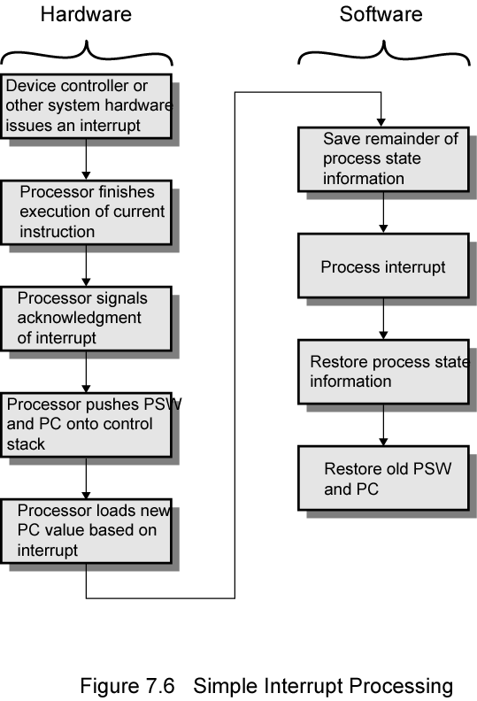
Simple Interrupt Processing

Slide 20
CPU Viewpoint
Issue read command
Do other work
Check for interrupt at the end of each instruction cycle
If interrupted:-
  Save context (registers)
  Process interrupt
    Fetch data & store
See Operating Systems notes

Slide 21
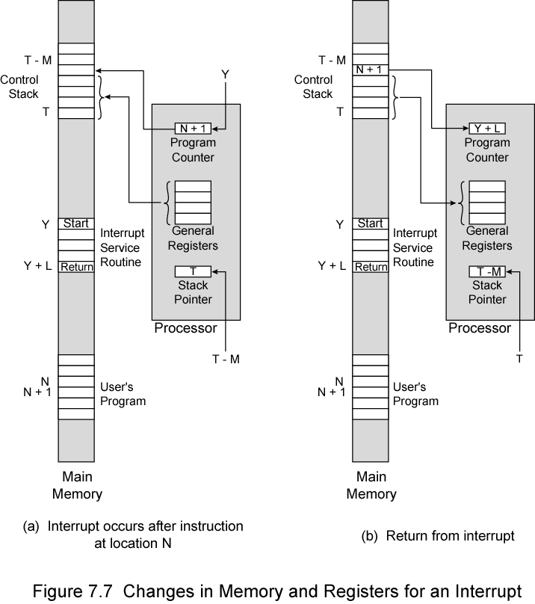
Changes in Memory and Registers for an Interrupt

Slide 22
Design Issues
Two design issues arise in implementing interrupt I/O.
  How do you identify the module issuing the interrupt?
  How do you deal with multiple interrupts?
    i.e. an interrupt handler being interrupted

Slide 23
Identifying Interrupting Module (1)
Different line for each module
  Limits number of devices
Software poll
  CPU asks each module in turn
  Slow
Daisy Chain or Hardware poll
  Interrupt Acknowledge sent down a chain
  Module responsible places vector on bus
  CPU uses vector to identify handler routine
Bus arbitration
  Module must claim the bus before it can raise interrupt
  e.g. PCI & SCSI

Slide 24
Multiple Interrupts
Each interrupt line has a priority
Higher priority lines can interrupt lower priority lines
If bus mastering only current master can interrupt

Slide 25
Example - PC Bus
80x86 has one interrupt line
8086 based systems use one 8259A interrupt controller
8259A has 8 interrupt lines
Sequence of Events
  8259A accepts interrupts
  8259A determines priority
  8259A signals 8086 (raises INTR line)
  CPU Acknowledges
  8259A puts correct vector on data bus
  CPU processes interrupt

Slide 26
ISA Bus Interrupt System
ISA bus chains two 8259As together
Link is via interrupt 2
Gives 15 lines
  16 lines less one for link
IRQ 9 is used to re-route anything trying to use IRQ 2
  Backwards compatibility
Incorporated in chip set

Slide 27
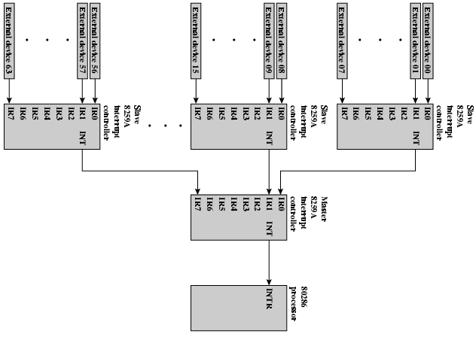
82C59A Interrupt Controller

Slide 28
Intel 82C55A Programmable Peripheral Interface

Slide 29
Keyboard/Display Interfaces to 82C55A

Slide 30
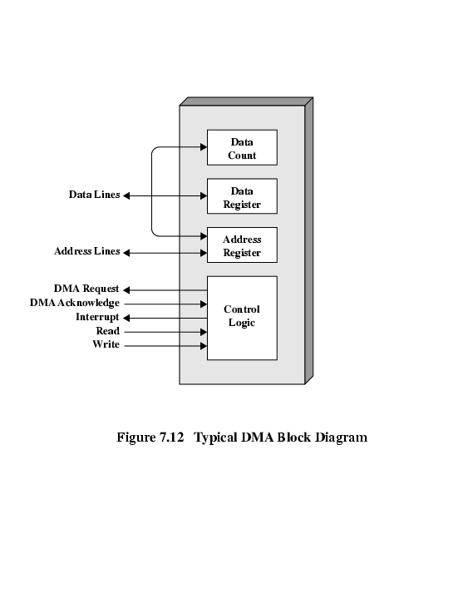
Direct Memory Access
Interrupt driven and programmed I/O require active CPU intervention
  Transfer rate is limited
  CPU is tied up
DMA is the answer
Additional Module (hardware) on bus
  DMA controller takes over from CPU for I/O

Slide 31
DMA Operation
CPU tells DMA controller:-
  Read/Write
  Device address
  Starting address of memory block for data
  Amount of data to be transferred
CPU carries on with other work
DMA controller deals with transfer
DMA controller sends interrupt when finished

Slide 32
DMA Transfer - Cycle Stealing
DMA controller takes over bus for a cycle
Transfer of one word of data
Not an interrupt
  CPU does not switch context
CPU suspended just before it accesses bus
  i.e. before an operand or data fetch or a data write
Slows down CPU but not as much as CPU doing transfer

Slide 33
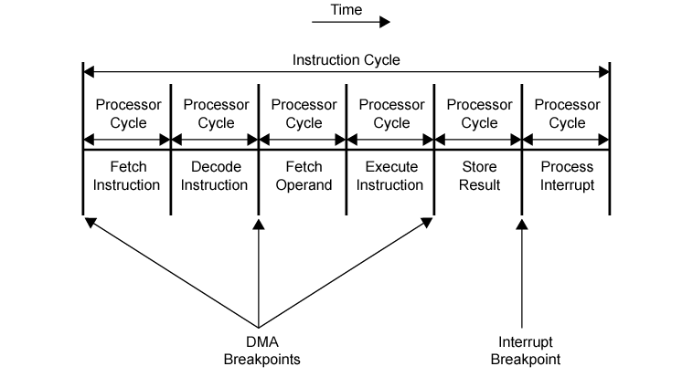
DMA and Interrupt Breakpoints During an Instruction Cycle

Slide 34
DMA Configurations (1)
Single Bus, Detached DMA controller
Each transfer uses bus twice
  I/O to DMA then DMA to memory
CPU is suspended twice

Slide 35
DMA Configurations (2)
Single Bus, Integrated DMA controller
Controller may support >1 device
Each transfer uses bus once
  DMA to memory
CPU is suspended once

Slide 36
DMA Configurations (3)
Separate I/O Bus
Bus supports all DMA enabled devices
Each transfer uses bus once
  DMA to memory
CPU is suspended once

Slide 37
Intel 8237A DMA Controller
Interfaces to 80x86 family and DRAM
When DMA module needs buses it sends HOLD signal to processor
CPU responds HLDA (hold acknowledge)
  DMA module can use buses
E.g. transfer data from memory to disk
  Device requests service of DMA by pulling DREQ (DMA request) high
  DMA puts high on HRQ (hold request),
  CPU finishes present bus cycle (not necessarily present instruction) and puts high on HDLA (hold acknowledge). HOLD remains active for duration of DMA
  DMA activates DACK (DMA acknowledge), telling device to start transfer
  DMA starts transfer by putting address of first byte on address bus and activating MEMR; it then activates IOW to write to peripheral. DMA decrements counter and increments address pointer. Repeat until count reaches zero
  DMA deactivates HRQ, giving bus back to CPU

Slide 38
8237 DMA Usage of Systems Bus

Slide 39
Fly-By
While DMA using buses processor idle
Processor using bus, DMA idle
  Known as fly-by DMA controller
Data does not pass through and is not stored in DMA chip
  DMA only between I/O port and memory
  Not between two I/O ports or two memory locations
Can do memory to memory via register
8237 contains four DMA channels
  Programmed independently
  Any one active
  Numbered 0, 1, 2, and 3

Slide 40
I/O Channels and Processors
Very large systems employ channel I/O.
Channel I/O consists of one or more I/O processors (IOPs) that control various channel paths.
  CPU instructs I/O controller to do transfer
  Improves speed
    Takes load off CPU
    Dedicated processor is faster
Slower devices such as terminals and printers are combined (multiplexed) into a single faster channel.
On IBM mainframes, multiplexed channels are called multiplexor channels, the faster ones are called selector channels.

Slide 41
I/O Channels
Channel I/O is distinguished from DMA by the intelligence of the IOPs.
The IOP negotiates protocols, issues device commands, translates storage coding to memory coding, and can transfer entire files or groups of files independent of the host CPU.
The host has only to create the program instructions for the I/O operation and tell the IOP where to find them.

Slide 42
A selector channel
controls multiple high-speed devices
  at any one time, dedicated to the transfer of data with one of those devices.
Each device, or a small set of devices, is handled by a controller, or I/O module,
Thus, the I/O channel serves in place of the CPU in controlling these I/O controllers.
A multiplexor channel
can handle I/O with multiple devices at the same time.
For low-speed devices, a byte multiplexor accepts or transmits characters as fast as possible to multiple devices.

Slide 43
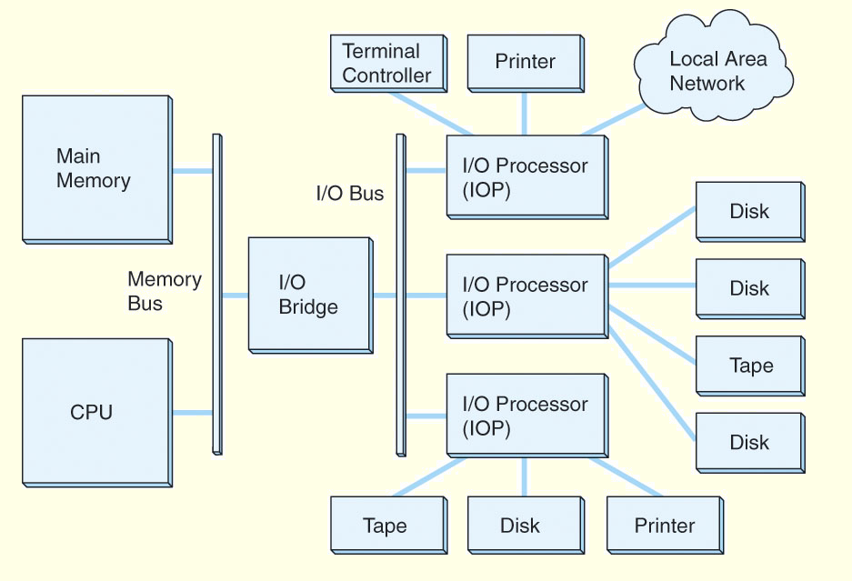
I/O Channels
A typical channel I/O configuration.

Slide 44
The external Interface
The interface to a peripheral from an I/O module must be tailored to the nature and operation of the peripheral.
One major characteristic of the interface is whether it is serial or parallel.
  In a parallel interface, there are multiple lines connecting the I/O module and the peripheral, and multiple bits are transferred simultaneously
  In a serial interface, there is only one line used to transmit data, and bits must be transmitted one at a time.
A parallel interface has traditionally been used for higher-speed peripherals, such as tape and disk, while the serial interface has traditionally been used for printers and terminals.
With a new generation of high-speed serial interfaces, parallel interfaces are becoming much less common.

Slide 45
The external Interface
In either case, the I/O module must engage in a dialogue with the peripheral.
In general terms, the dialogue for a write operation is as follows:
  The I/O module sends a control signal requesting permission to send data.
  The peripheral acknowledges the request.
  The I/O module transfers data (one word or a block depending on the peripheral).
  The peripheral acknowledges receipt of the data.

Slide 46
Point-to-Point and Multipoint Configurations
A point-to-point interface provides a dedicated line between the I/O module and the external device.
  On small systems (PCs, workstations), typical point-to-point links include those to the keyboard, printer, and external modem.
  A typical example of such an interface is the EIA-232 specification
      EIA: Electronics Industry Alliance
    It is originally known as RS-232 i.e. Recommended Standard 232.
      It addresses signal voltages, signal timing, signal function, a protocol for information exchange, and either 25-pin or 9-pin mechanical connectors.

Slide 47
Point-to-Point and Multipoint Configurations
Multipoint external interfaces,
  used to support external mass storage devices (disk and tape drives) and multimedia devices (CD-ROMs, video, audio).
These multipoint interfaces are in effect external buses
Two key examples:
  FireWire
  Thunderbolt
  InfiniBand.

Slide 48
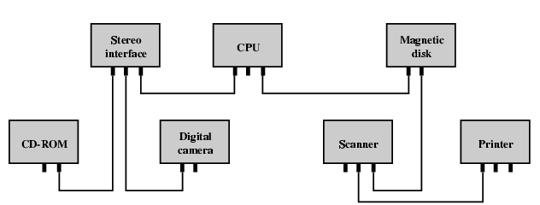
IEEE 1394 FireWire
High performance serial bus
Fast
Low cost
Easy to implement
  Also being used in
  digital cameras,
  VCRs and TV
FireWire Configuration
  Daisy chain
  Up to 63 devices on single port
  Up to 1022 buses can be connected with bridges
  Automatic configuration
  No bus terminators
  May be tree structure

Slide 49
FireWire 3 Layer Stack
Physical
  Transmission medium, electrical and signaling characteristics
Link
  Transmission of data in packets
Transaction
  Request-response protocol

Slide 50
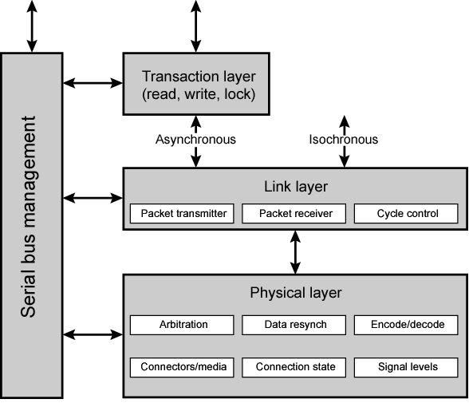
FireWire Protocol Stack

Slide 51
FireWire - Physical Layer
Data rates from 25 to 400Mbps
Two forms of arbitration
  Based on tree structure
  Root acts as arbiter
  First come first served
  Natural priority controls simultaneous requests
    i.e. who is nearest to root
  Fair arbitration
  Urgent arbitration

Slide 52
FireWire - Link Layer
Two transmission types
  Asynchronous
    Variable amount of data and several bytes of transaction data transferred as a packet
    To explicit address
    Acknowledgement returned
  Isochronous
    Variable amount of data in sequence of fixed size packets at regular intervals
    Simplified addressing
    No acknowledgement

Slide 53
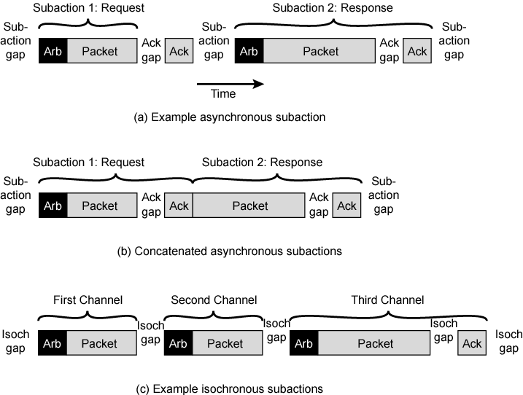
FireWire Subactions

Slide 54
Thunderbolt
The most recent, and fastest, peripheral connection technology for general-purpose use
  developed by Intel with collaboration from Apple.
One Thunderbolt cable can manage the work previously required of multiple cables.
The technology combines data, video, audio, and power into a single high-speed connection for peripherals such as hard drives, RAID arrays, video-capture boxes, and network interfaces.
provides up to 10 Gbps throughput in each direction and up to 10 Watts of power to connected peripherals.

Slide 55
Thunderbolt configuration
central element - the Thunderbolt controller
  high-performance, cross-bar switch.
Each Thunderbolt port on a computer is capable of providing the full data transfer rate of the link in both directions with no sharing of data transmission capacity between ports or between upstream and downstream directions.
For communication internal to the computer, the Thunderbolt controller includes one or more DisplayPort protocol adapter ports.
DisplayPort is a digital display interface standard now widely adopted for computer monitors, laptop displays, and other graphics and video interfaces.
The controller also includes a PCI Express switch with up to four PCI Express protocol adapter ports for internal communication.

Slide 56
Thunderbolt protocol architecture
The cable and connector layer provides transmission medium access.
The Thunderbolt protocol physical layer is responsible for link maintenance including hot-plug detection and data encoding to provide highly efficient data transfer.
The physical layer has been designed to introduce very minimal overhead and provides full-duplex 10 Gbps of usable capacity to the upper layers.
  The common transport layer is the key to the operation of Thunderbolt and what makes it attractive as a high-speed peripheral I/O technology.

Slide 57
Thunderbolt - Some of the features
A high-performance, low-power, switching architecture.
A highly efficient, low-overhead packet format with flexible quality of service (QoS) support that allows multiplexing of bursty PCI Express transactions with DisplayPort communication on the same link.
  The transport layer has the ability to flexibly allocate link bandwidth using priority and bandwidth reservation mechanisms.
The use of small packet sizes to achieve low latency.
The use of credit-based flow control to achieve small buffer sizes.
A symmetric architecture that supports flexible topologies (star, tree, daisy chaining, etc.) and enables peer-to-peer communication (via software) between devices.
A novel time synchronization protocol that allows all the Thunderbolt products connected in a domain to synchronize their time within 8ns of each other.

Slide 58
InfiniBand
I/O specification aimed at high end servers
  Merger of Future I/O (Cisco, HP, Compaq, IBM) and Next Generation I/O (Intel)
Version 1 released early 2001
Architecture and spec. for data flow between processor and intelligent I/O devices
Intended to replace PCI in servers
Increased capacity, expandability, flexibility

Slide 59
InfiniBand Architecture
Remote storage, networking and connection between servers
Attach servers, remote storage, network devices to central fabric of switches and links
Greater server density
Scalable data centre
Independent nodes added as required
I/O distance from server up to
  17m using copper
  300m multimode fibre optic
  10km single mode fibre
Up to 30Gbps

Slide 60
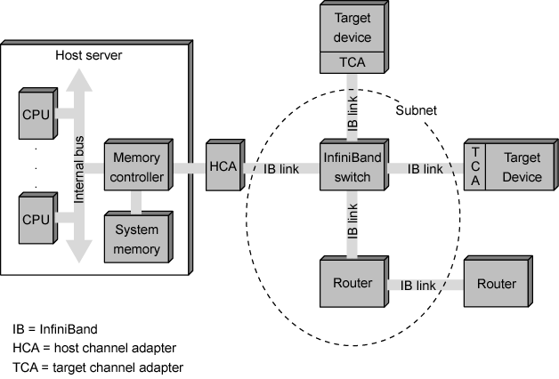
InfiniBand Architecture

Slide 61
InfiniBand Architecture - key elements
Host channel adapter (HCA)
  links the server to an InfiniBand switch
  uses DMA to read and write memory
Target channel adapter (TCA)
  used to connect storage systems, routers, and other peripheral devices to an InfiniBand switch.
InfiniBand switch
  provides point-to-point physical connections to a variety of devices and switches traffic from one link to another
Links
  ink between a switch and a channel adapter, or between two switches
Subnet
  consists of one or more interconnected switches plus the links that connect other devices to those switches
  Router
  Connects InfiniBand subnets, or connects an InfiniBand switch to a network

Slide 62
InfiniBand Operation
16 logical channels (virtual lanes) per physical link
One lane for management, rest for data
Data in stream of packets
Virtual lane dedicated temporarily to end to end transfer
Switch maps traffic from incoming to outgoing lane

Slide 63
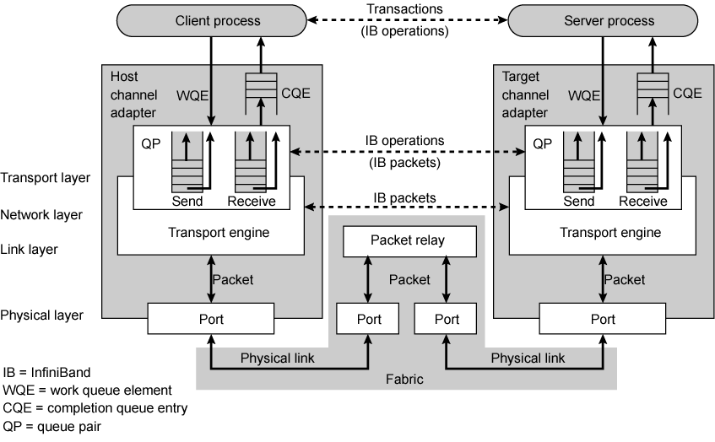
InfiniBand Protocol Stack

Slide 64
Foreground Reading
Check out Universal Serial Bus (USB)
Compare with other communication standards e.g. Ethernet

