Slide 1
Computer Architecture
Prof. Dr. Nizamettin AYDIN
naydin@yildiz.edu.tr
nizamettinaydin@gmail.com
http://www.yildiz.edu.tr/~naydin

Slide 2
Virtual Memory

Slide 3
Virtual Memory
Cache memory enhances performance by providing faster memory access speed.
Virtual memory enhances performance by providing greater memory capacity, without the expense of adding main memory.
Instead, a portion of a disk drive serves as an extension of main memory.
If a system uses paging, virtual memory partitions main memory into individually managed page frames, that are written (or paged) to disk when they are not immediately needed.

Slide 4
Virtual Memory
A physical address is the actual memory address of physical memory.
Programs create virtual addresses that are mapped to physical addresses by the memory manager.
Page faults occur when a logical address requires that a page be brought in from disk.
Memory fragmentation occurs when the paging process results in the creation of small, unusable clusters of memory addresses.

Slide 5
Some frequently used terms for virtual memory
Virtual address
The logical or program address that the process uses.
Whenever the CPU generates an address, it is always in terms of virtual address space.
Physical address
The real address in physical memory.
Mapping
The mechanism by which virtual addresses are translated into physical ones
very similar to cache mapping

Slide 6
Some frequently used terms for virtual memory
Page frames
The equal-size chunks or blocks into which main memory (physical memory) is divided.
Pages
The chunks or blocks into which virtual memory (the logical address space) is divided, each equal in size to a page frame.
Virtual pages are stored on disk until needed.
Paging
The process of copying a virtual page from disk to a page frame in main memory.
Fragmentation
Memory that becomes unusable.
Page fault
An event that occurs when a requested page is not in main memory and must be copied into memory from disk.

Slide 7
Virtual Memory
Main memory and virtual memory are divided into equal sized pages.
The entire address space required by a process need not be in memory at once.
Some parts can be on disk, while others are in main memory.
Further, the pages allocated to a process do not need to be stored contiguously-- either on disk or in memory.
In this way, only the needed pages are in memory at any time, the unnecessary pages are in slower disk storage.

Slide 8
To access data at a given virtual address
Extract the page number from the virtual address.
Extract the offset from the virtual address.
Translate the page number into a physical page frame number by accessing the page table.
Look up the page number in the page table (using the virtual page number as an index).
Check the valid bit for that page.
If the valid bit = 0, the system generates a page fault and the operating system must intervene to
Locate the desired page on disk.
Find a free page frame (this may necessitate removing a “victim” page from memory and copying it back to disk if memory is full).
Copy the desired page into the free page frame in main memory.
Update the page table. (The virtual page just brought in must have its frame number and valid bit in the page table modified. If there was a “victim” page, its valid bit must be set to zero.)
Resume execution of the process causing the page fault, continuing to Step B2.
If the valid bit = 1, the page is in memory.
a. Replace the virtual page number with the actual frame number.
b. Access data at offset in physical page frame by adding the offset to the frame number for the given virtual page.

Slide 9
An example
Suppose that we have a virtual address space of 2⁸ words for a given process (this means the program generates addresses in the range 0 to 255₁₀ which is 00 to FF₁₆), and physical memory of 4 page frames (no cache).
Assume also that pages are 32 words in length.
Virtual addresses contain 8 bits, and physical addresses contain 7 bits
(4 frames of 32 words each is 128 words, or 2⁷).
Suppose, also, that some pages from the process have been brought into main memory.
Next figure illustrates the current state of the system.

Slide 10
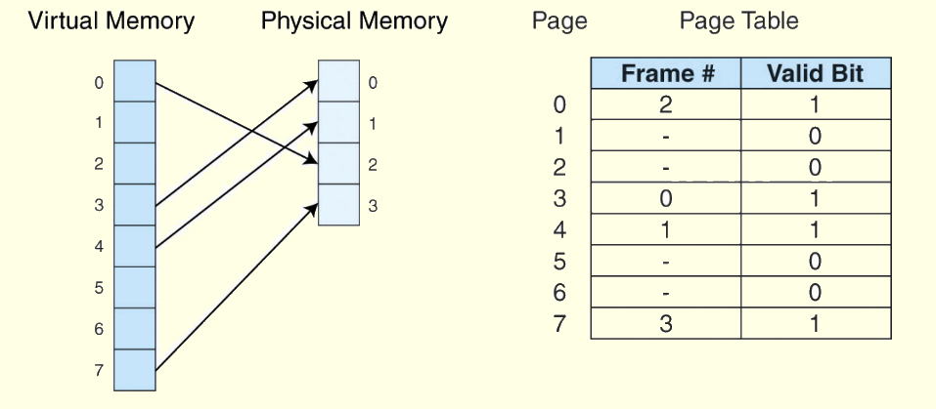
An example
Information concerning the location of each page, whether on disk or in memory, is maintained in a data structure called a page table (shown below).
There is one page table for each active process.

Slide 11
An example
When a process generates a virtual address, the operating system translates it into a physical memory address.
To accomplish this, the virtual address is divided into two fields:
a page field
determines the page location of the address
an offset field
indicates the location of the address within the page
The logical page number is translated into a physical page frame through a lookup in the page table.

Slide 12
An example
Format for an 8-Bit Virtual Address with 2⁵ = 32 Word Page Size
Suppose the system now generates the virtual address 13₁₀ = 0D₁₆ = 00001101₂.
the page field P = 000₂
the offset field = 01101₂
To continue the translation process
use the 000 value of the page field as an index into the page table.
Virtual page 0 maps to physical page frame 2 = 10₂.
Thus the translated physical address becomes
page frame = 2,
offset = 13.

Slide 13
Virtual Memory
If the valid bit is zero in the page table entry for the logical address, this means that the page is not in memory and must be fetched from disk.
This is a page fault.
If necessary, a page is evicted from memory and is replaced by the page retrieved from disk, and the valid bit is set to 1.
If the valid bit is 1, the virtual page number is replaced by the physical frame number.
The data is then accessed by adding the offset to the physical frame number.

Slide 14
Virtual Memory
As an example, suppose a system has a virtual address space of 8K and a physical address space of 4K, and the system uses byte addressing.
The page size is 1024.
We have 2¹³/2¹⁰ = 2³ virtual pages.
A virtual address has 13 bits (8K = 2¹³) with 3 bits for the page field and 10 for the offset,
because the page size is 1024.
A physical memory address requires 12 bits (4K = 2¹²), the first 2 bits for the page frame and the trailing 10 bits the offset.

Slide 15
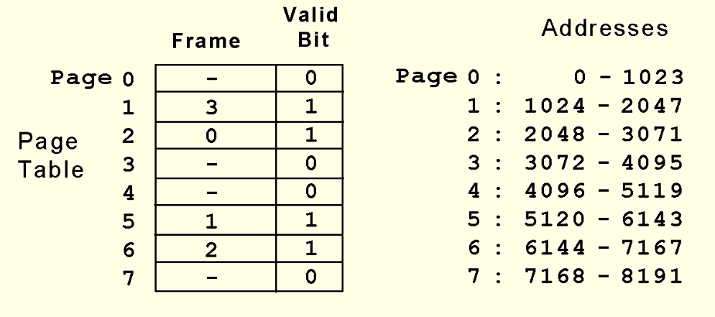
Virtual Memory
Suppose we have the page table shown below.
What happens when CPU generates address 5459₁₀ = 1010101010011₂?

Slide 16
Virtual Memory
The address 1010101010011₂ is converted to physical address 010101010011
because the page field 101 is replaced by frame number 01 through a lookup in the page table.

Slide 17
Virtual Memory
What happens when the CPU generates address 1000000000100₂?
If the valid bit is zero in the page table entry for the logical address, this means that the page is not in memory and must be fetched from disk.
This is a page fault.
If necessary, a page is evicted from memory and is replaced by the page retrieved from disk, and the valid bit is set to 1.

Slide 18
Virtual Memory
Effective access time (EAT) takes all levels of memory into consideration.
Thus, virtual memory is also a factor in the calculation, and we also have to consider page table access time.
Suppose a main memory access takes 200ns, the page fault rate is 1%, and it takes 10ms to load a page from disk.
We have:
EAT = 0.99(200ns + 200ns) + 0.01(10ms) = 100396 ns.

Slide 19
Virtual Memory
Even if we had no page faults, the EAT would be 400ns because memory is always read twice:
First to access the page table, and second to load the page from memory.
Because page tables are read constantly, it makes sense to keep them in a special cache called a translation look-aside buffer (TLB).
TLBs are a special associative cache that stores the mapping of virtual pages to physical pages.
The next slide shows how all the pieces fit together.

Slide 20
Using the TLB

Slide 21
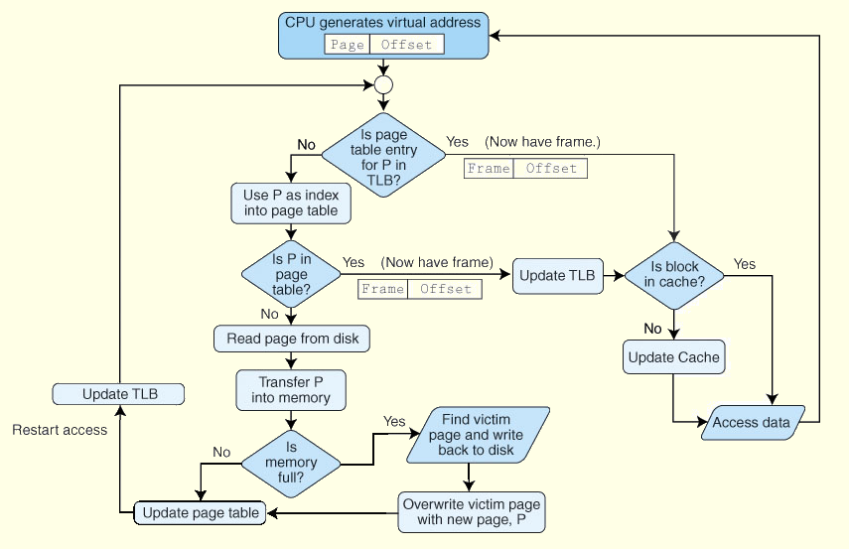
Virtual Memory

Slide 22
Virtual Memory
Another approach to virtual memory is the use of segmentation.
Instead of dividing memory into equal-sized pages, virtual address space is divided into variable-length segments,
often under the control of the programmer.
A segment is located through its entry in a segment table,
which contains the segment’s memory location and a bounds limit that indicates its size.
After a page fault, the operating system searches for a location in memory large enough to hold the segment that is retrieved from disk.

Slide 23
Virtual Memory
Both paging and segmentation can cause fragmentation.
Paging is subject to internal fragmentation because a process may not need the entire range of addresses contained within the page.
Thus, there may be many pages containing unused fragments of memory.
Segmentation is subject to external fragmentation,
which occurs when contiguous chunks of memory become broken up as segments are allocated and deallocated over time.

Slide 24
Virtual Memory
Large page tables are cumbersome and slow, but with its uniform memory mapping, page operations are fast.
Segmentation allows fast access to the segment table, but segment loading is labor-intensive.
Paging and segmentation can be combined to take advantage of the best features of both by assigning fixed-size pages within variable-sized segments.
Each segment has a page table.
This means that a memory address will have three fields,
one for the segment,
another for the page,
a third for the offset.

Slide 25
Cache vs. Virtual Memory
Cache speeds up memory access
Virtual memory increases amount of perceived storage
independence from the configuration and capacity of the memory system
low cost per bit
Notes:
To be useful, the second level of cache must have significantly more memory than the first level; otherwise, the two cache levels would contain the same data, and the secondary cache would serve no purpose. It is also normal to provide a larger cache line in the secondary cache.

Slide 26
Real-World Example
The Pentium architecture supports both paging and segmentation, and they can be used in various combinations including unpaged unsegmented, segmented unpaged, and unsegmented paged.
The processor supports two levels of cache (L1 and L2), both having a block size of 32 bytes.
The L1 cache is next to the processor, and the L2 cache sits between the processor and memory.
The L1 cache is in two parts: and instruction cache (I-cache) and a data cache (D-cache).
The next slide shows this organization schematically.

Slide 27
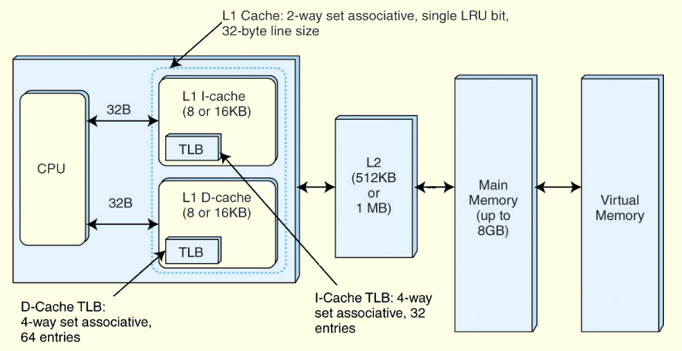
Real-World Example

