Slide 1
Computer Architecture
Prof. Dr. Nizamettin AYDIN
naydin@yildiz.edu.tr
nizamettinaydin@gmail.com
http://www.yildiz.edu.tr/~naydin

Slide 2
Internal Memory

Slide 3
Outline
Semiconductor main memory
Random Access Memory
  Dynamic RAM
  Static RAM
Read Only Memory
Memory Organisation
Error Correction
Advanced DRAM Organization

Slide 4
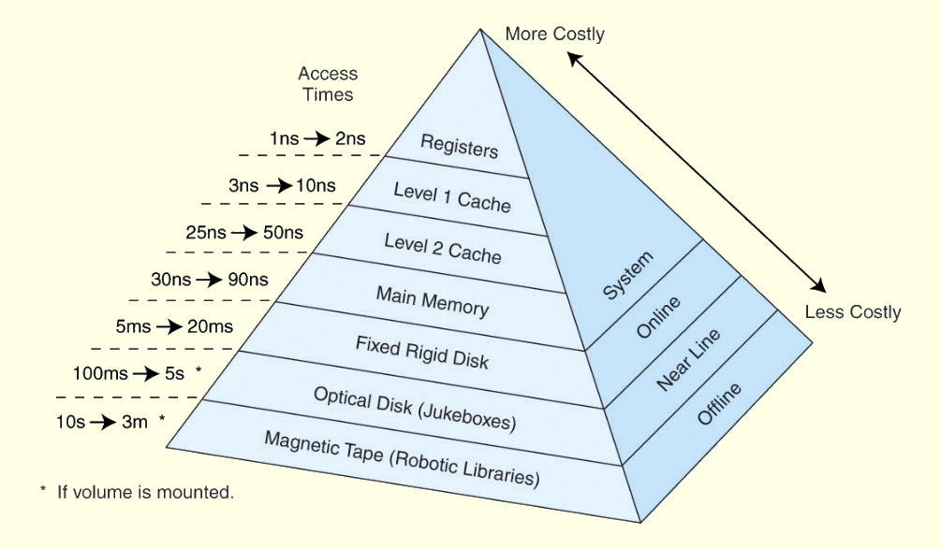
Memory Hierarchy
Registers
L1 Cache
L2 Cache
Main memory
Disk cache
Disk
Optical
Tape

Slide 5
Semiconductor main memory
Basic element is the memory cell
Semiconductor memory cell properties:
  They exhibit two stable states (1 or 0)
  They are capable of being written into, to set the state
  They are capable of being read to sense the state

Slide 6
Semiconductor Memory Types
The major types of semiconductor memory

Slide 7
Random Access Memory
Read/Write
Volatile
Temporary storage
Two types of RAM:
  Dynamic RAM (DRAM)
    Main (Primary) memory uses DRAM for capacity
  Static RAM (SRAM)
    Caches use SRAM for speed

Slide 8
Dynamic RAM
Bits stored as charge in capacitors
Charges leak
Need refreshing even when powered
Simpler construction
Smaller per bit
Less expensive
Need refresh circuits
Slower
Main memory
Essentially analogue
  Level of charge determines value

Slide 9
DRAM Structure and Operation
The address line is activated when the bit value from the cell is to be read or written.
  The transistor acts as a switch that is closed (allowing current to flow) if a voltage is applied to the address line and open (no current flows) if no voltage is present on the address line.
For the write operation,
  a voltage signal is applied to the bit line;
    a high voltage represents 1, and a low voltage represents 0.
  A signal is then applied to the address line, allowing a charge to be transferred to the capacitor.
For the read operation,
  when the address line is selected, the transistor turns on and the charge stored on the capacitor is fed out onto a bit line and to a sense amplifier.
  The sense amplifier compares the capacitor voltage to a reference value and determines if the cell contains a logic 1 or a logic 0.
The readout from the cell discharges the capacitor, which must be restored to complete the operation.
Although the DRAM cell is used to store a single bit (0 or 1), it is essentially an analog device.
  The capacitor can store any charge value within a range; a threshold value determines whether the charge is interpreted as 1 or 0.

Slide 10
Static RAM
Bits stored as on/off switches
No charges to leak
No refreshing needed when powered
More complex construction
Larger per bit
More expensive
Does not need refresh circuits
Faster
Cache
Digital
  Uses flip-flops

Slide 11
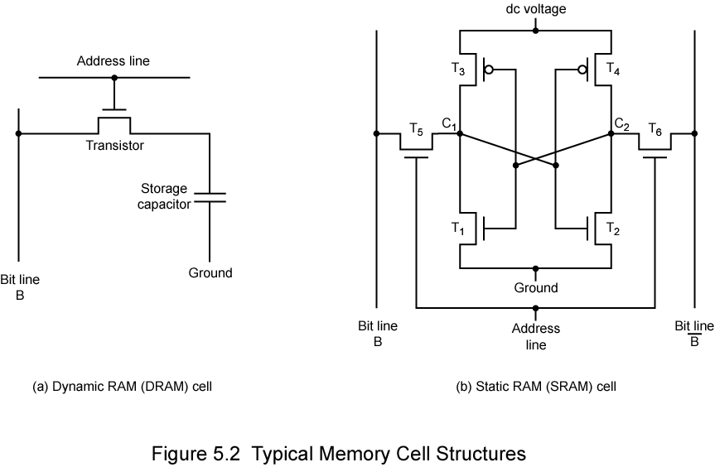
Transistor arrangement gives stable logic state
State 1
  C₁ high, C₂ low
  T₁ T₄ off, T₂ T₃ on
State 0
  C₂ high, C₁ low
  T₂ T₃ off, T₁ T₄ on
Address line transistors T₅ T₆ is switch
Write – apply value to B & compliment to B
Read – value is on line B

Slide 12
SRAM v DRAM
Both volatile
  Power needed to preserve data
Dynamic cell
  Simpler to build, smaller
  More dense
  Less expensive
  Needs refresh
  Larger memory units
Static
  Faster
  Cache

Slide 13
Read Only Memory
Permanent storage
  Nonvolatile
Used in:
  Microprogramming
  Library subroutines
  Systems programs (BIOS)
  Function tables

Slide 14
Types of ROM
Written during manufacture
  Very expensive for small runs
Programmable (once)
  PROM
  Needs special equipment to program
Read “mostly”
  Erasable Programmable (EPROM)
    Erased by UV
  Electrically Erasable (EEPROM)
    Takes much longer to write than read
  Flash memory
    Erase whole memory electrically

Slide 15
Memory Organisation
A 16Mbit chip can be organised as 1M of 16 bit words
A bit per chip system has 16 lots of 1Mbit chip with bit 1 of each word in chip 1 and so on
A 16Mbit chip can be organised as a 2048 x 2048 x 4bit array
  Reduces number of address pins
    Multiplex row address and column address
    11 pins to address (2¹¹=2048)
    Adding one more pin doubles range of values so x4 capacity

Slide 16
DRAM Organization
X8 means each DRAM outputs 8 bits, need 8 chips for DDRx (64 bit)
DIMM, rank, DRAM chip, bank, array, row, column form a hierarchy in DRAM storage organization

Slide 17
DRAM is denser than SRAM

Slide 18
DRAM ARRAY Access in a Bank
Read access sequence:
  Decode row address & drive word-lines
  Selected bits drive bitlines
    Entire row read
  Amplify row data
  Decode column address & select subset of row & send to output
  Precharge bit-lines for next access
Memory is just a big 2D array.
  Access row first and then column.
A DRAM controller must periodically read each row within the allowed refresh time (10s of ms) such that charge is restored.

Slide 19
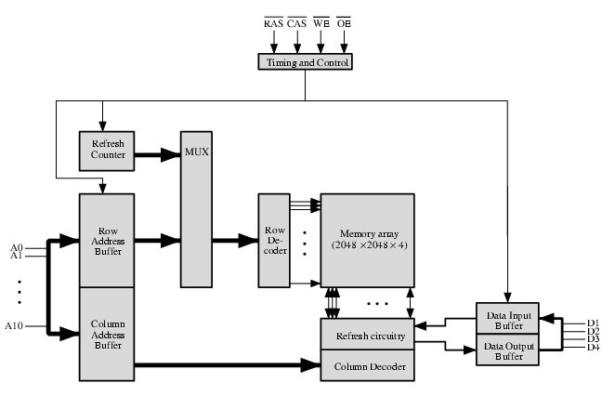
Typical 16 Mb DRAM (4M x 4)

Slide 20
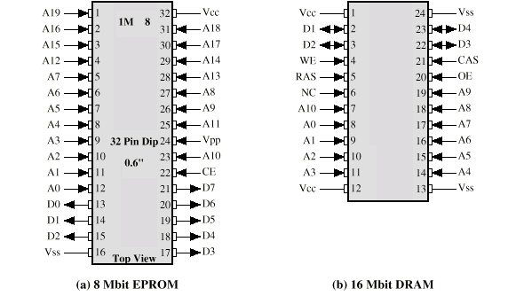
Packaging

Slide 21
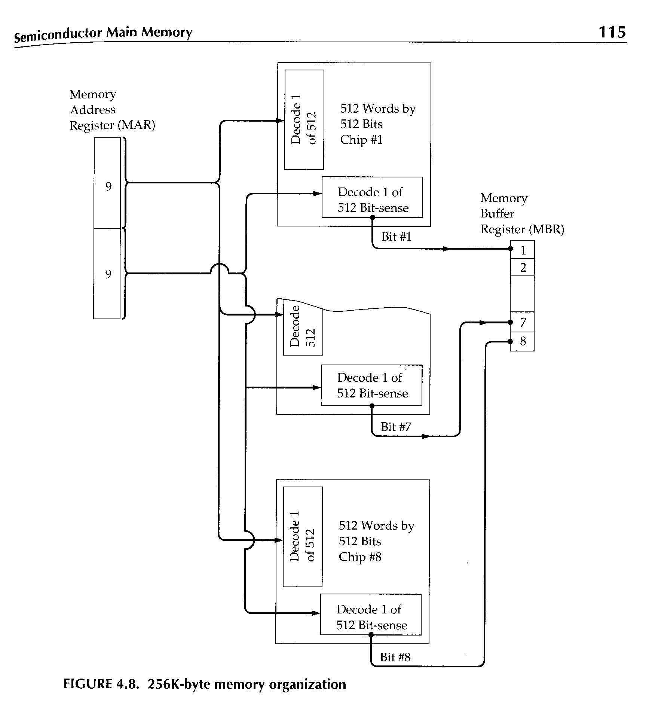
256kByte Module Organisation

Slide 22
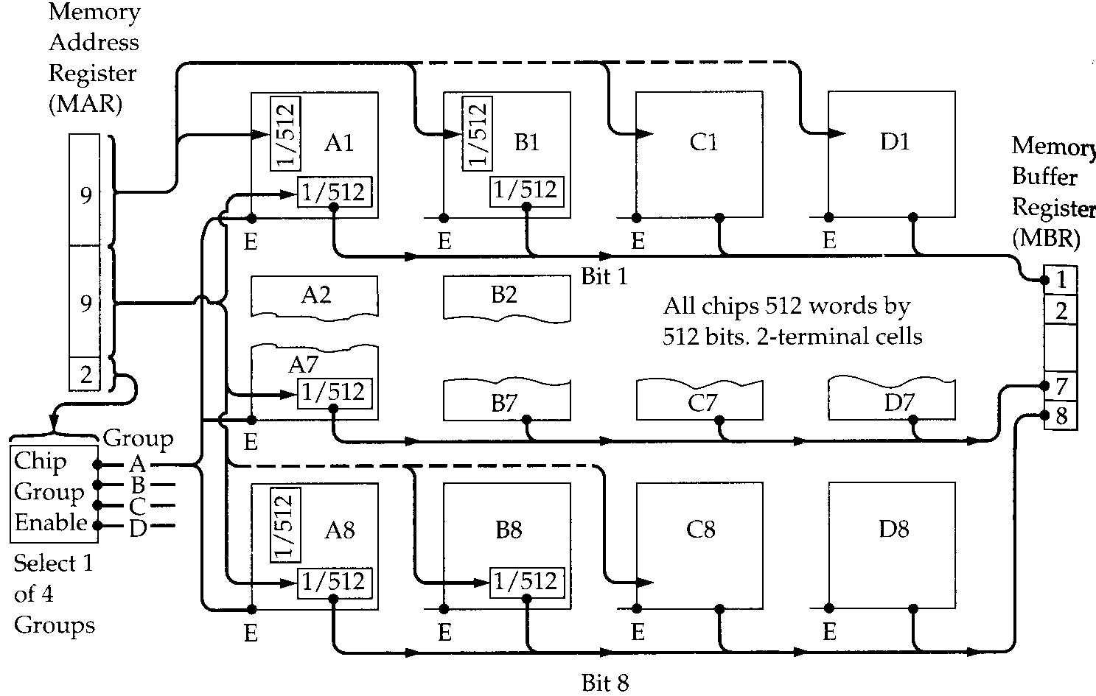
1MByte Module Organisation

Slide 23
Error Correction
Sources of error in computing system
  Hard Failure
    Permanent defect
  Soft Error
    Random, non-destructive
    No permanent damage to memory
Detected using Hamming error correcting code

Slide 24
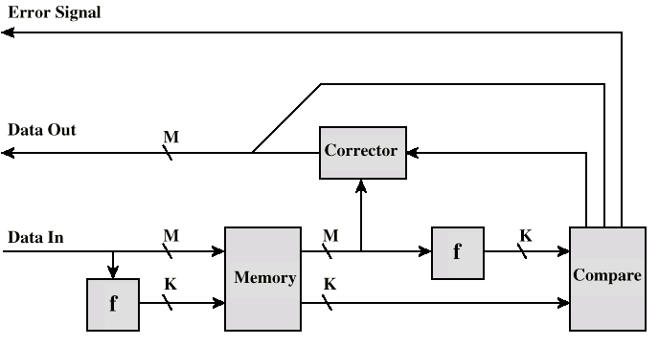
Error Correcting Code Function

Slide 25
Advanced DRAM Organization
Basic DRAM same since first RAM chips
Enhanced DRAM
  Contains small SRAM as well
  SRAM holds last line read
Cache DRAM
  Larger SRAM component
  Use as cache or serial buffer

Slide 26
Synchronous DRAM
Access is synchronized with an external clock
Address is presented to RAM
RAM finds data (CPU waits in conventional DRAM)
Since SDRAM moves data in time with system clock, CPU knows when data will be ready
CPU does not have to wait, it can do something else
Burst mode allows SDRAM to set up stream of data and fire it out in block

Slide 27
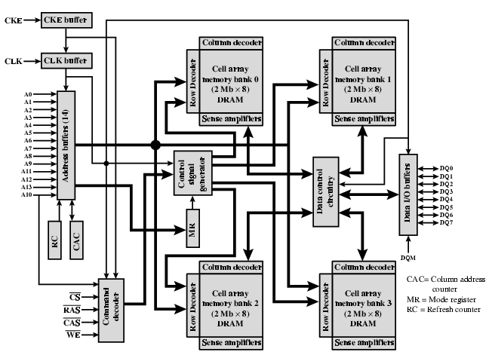
SDRAM

Slide 28
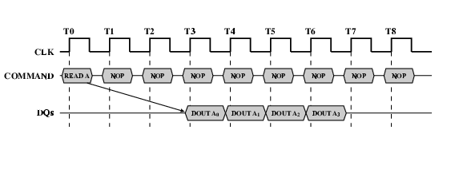
SDRAM Read Timing

Slide 29
RAMBUS
Adopted by Intel for Pentium & Itanium
Main competitor to SDRAM
Vertical package – all pins on one side
Data exchange over 28 wires < cm long
Bus addresses up to 320 RDRAM chips at 1.6Gbps
Asynchronous block protocol
  480ns access time
  Then 1.6 Gbps

Slide 30
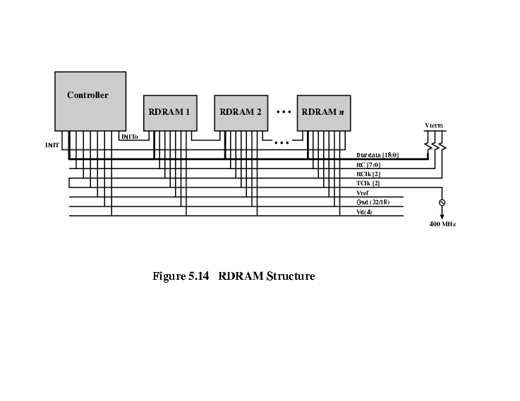
RAMBUS Diagram

Slide 31
DDR SDRAM
SDRAM can only send data once per clock
Double-Data-Rate SDRAM can send data twice per clock cycle
  Rising edge and falling edge

Slide 32
Cache DRAM
Mitsubishi
Integrates small SRAM cache (16 kb) onto generic DRAM chip
Used as true cache
  64-bit lines
  Effective for ordinary random access
To support serial access of block of data
  E.g. refresh bit-mapped screen
    CDRAM can prefetch data from DRAM into SRAM buffer
    Subsequent accesses solely to SRAM

Slide 33
Memory Technology Cost
Bigger is slower
  SRAM, 512 Bytes, sub-nanosec
  SRAM, KByte~MByte, ~nanosec
  DRAM, Gigabyte, ~50 nanosec
  Hard Disk, Terabyte, ~10 millisec
Faster is more expensive (dollars and chip area)
  SRAM, < 10$ per Megabyte
  DRAM, < 1$ per Megabyte
  Hard Disk < 1$ per Gigabyte
  These sample values scale with time
Other technologies have their place as well
  Flash memory, Phase-change memory (not mature yet)

