Slide 1
Computer Architecture
Prof. Dr. Nizamettin AYDIN
naydin@yildiz.edu.tr
nizamettinaydin@gmail.com
http://www.yildiz.edu.tr/~naydin

Slide 2
Arithmetic for Computers

Slide 3
Outline
Arithmetic & Logic Unit
Integer Representation
  Sign-Magnitude
  Two’s Complement
  Integer Arithmetic
    Addition and Subtraction
    Multiplication
    Booth’s Algorithm
    Division
Floating Point
  Floating Point Arithmetic
    Addition and Subtraction
    Multiplication and Division

Slide 4
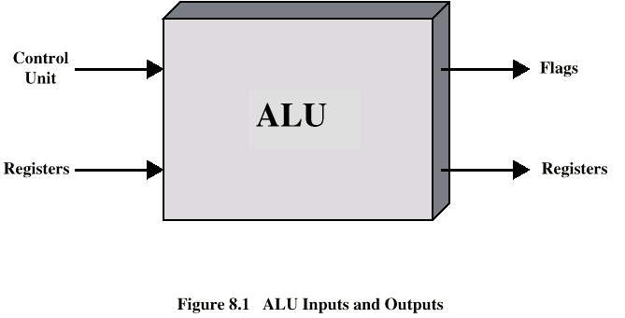
Arithmetic & Logic Unit
Does the calculations
Everything else in the computer is there to service this unit
Handles integers
May handle floating point (real) numbers
May be separate FPU (maths co-processor)
May be on chip separate FPU (486DX +)

Slide 5
Arithmetic & Logic Unit
(Top) A 1-bit ALU that performs AND, OR, and addition on a and b or a' and b'
  includes a direct input that is connected to perform the set on less than operation
(Bottom) a 1-bit ALU for the most significant bit.
  has a direct output from the adder for the less than comparison called Set.

Slide 6
Arithmetic & Logic Unit
A 32-bit ALU constructed from the 31 copies of the 1-bit ALU and one 1-bit ALU in the bottom of the figüre in previous slide.
The Less inputs are connected to 0 except for the least significant bit, which is connected to the Set output of the most significant bit.

Slide 7
Arithmetic & Logic Unit
The final 32-bit ALU with a Zero detector

Slide 8
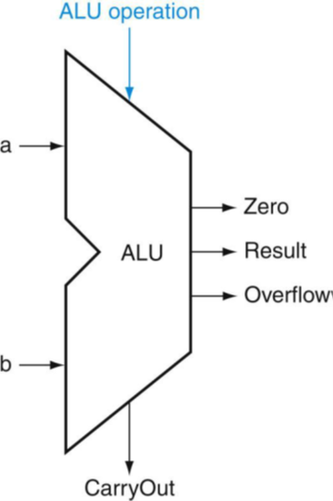
Arithmetic & Logic Unit
The values of the three ALU control lines, Bnegate, and Operation, and the corresponding ALU operations
The symbol commonly used to represent
an ALU

Slide 9
Integer Representation
Only have 0 & 1 to represent everything
Positive numbers stored in binary
  e.g. 41=00101001
No minus sign
No period
Sign-Magnitude
Two’s complement

Slide 10
Sign-Magnitude
Left most bit is sign bit
0 means positive
1 means negative
+18 = 00010010
-18 = 10010010
Problems
  Need to consider both sign and magnitude in arithmetic
  Two representations of zero (+0 and -0)

Slide 11
Two’s Complement
+3 = 00000011
+2 = 00000010
+1 = 00000001
+0 = 00000000
-1 = 11111111
-2 = 11111110
-3 = 11111101

Slide 12
Characteristics of Twos Complement Representation and Arithmetic

Slide 13
Benefits
One representation of zero
Arithmetic works easily
Negating is fairly easy
  3 = 00000011
  Boolean complement gives 11111100
  Add 1 to LSB 11111101

Slide 14
Negation Special Case 1
0 = 00000000
Bitwise not 11111111
Add 1 to LSB +1
Result 1 00000000
Overflow is ignored, so:
- 0 = 0 √

Slide 15
Negation Special Case 2
-128 = 10000000
bitwise not 01111111
Add 1 to LSB +1
Result 10000000
So:
-(-128) = -128
Monitor MSB (sign bit)
It should change during negation

Slide 16
Range of Numbers
8 bit 2s complement
  +127 = 01111111 = 2⁷ -1
  -128 = 10000000 = -2⁷
16 bit 2s complement
  +32767 = 011111111 11111111 = 2¹⁵ - 1
  -32768 = 100000000 00000000 = -2¹⁵

Slide 17
Conversion Between Lengths
Positive number pack with leading zeros
+18 = 00010010
+18 = 00000000 00010010
Negative numbers pack with leading ones
-18 = 10010010
-18 = 11111111 10010010
i.e. pack with MSB (sign bit)

Slide 18
Fixed-Point Representation
Number representation discussed so far also referred as fixed point.
  Because the radix point (binary point) is fixed and assumed to be to the right of the rightmost digit (least significant digit).

Slide 19
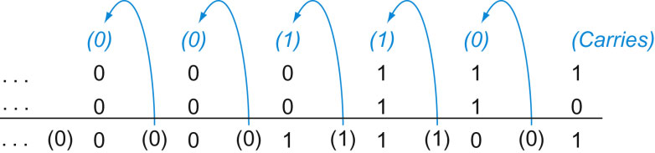
Integer Arithmetic
Binary Addition
Carry in
Carry out
Notes:
Binary addition, showing carries from right to left. The rightmost bit adds 1 to 0, resulting in the sum of this bit being 1 and the carry out from this bit being 0. Hence, the operation for the second digit to the right is 0 1 1 1 1. This generates a 0 for this sum bit and a carry out of 1. The third digit is the sum of 1 1 1 1 1, resulting in a carry out of 1 and a sum bit of 1. The fourth bit is 1 1 0 1 0, yielding a 1 sum and no carry.

Slide 20
Integer Arithmetic
Negation:
  In sign magnitude
    simply invert the sign bit.
  In twos complement:
    apply twos complement operation
Normal binary addition
  Monitor sign bit for overflow
Subtraction
  Take twos complement of subtrahend and add to minuhend
    i.e. a - b = a + (-b)
So we only need addition and complement circuits

Slide 21
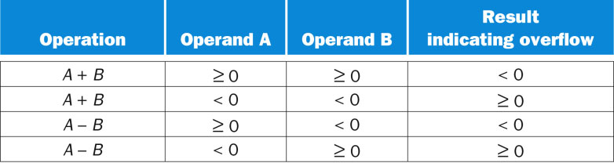
Addition and Subtraction
Overflow rule
  If two numbers are added and they are both positive or both negative, then overflow occurs if and only if the result has the opposite sign

Slide 22
Addition of Numbers in Twos Complement Representation

Slide 23
Subtraction of Numbers in 2s Complement Representation (M – S)

Slide 24
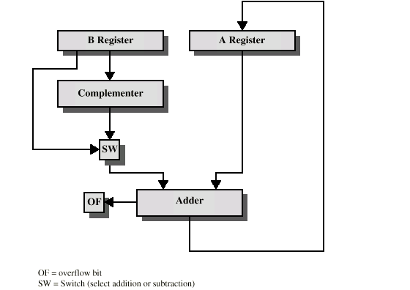
Hardware for Addition and Subtraction

Slide 25
Multiplication
Complex
Work out partial product for each digit
Take care with place value (column)
Add partial products
Example:
1011 Multiplicand (11 dec)
x 1101 Multiplier (13 dec)
1011 Partial products
0000
1011
1011
10001111 Product (143 dec)
Note: need double length result

Slide 26
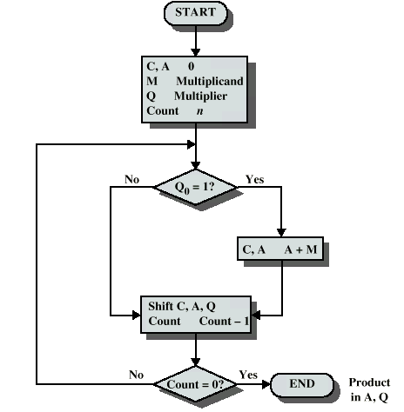
Unsigned Binary Multiplication
Flowchart

Slide 27
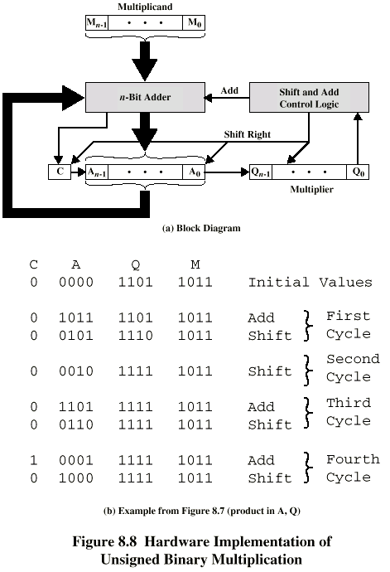
Unsigned Binary Multiplication
Block diagram of ALU circuitry

Slide 28
Execution of Example

Slide 29
Signed Binary Multiplication
This does not work!
Solution 1
  Convert to positive if required
  Multiply as above
  If signs were different, negate answer
Solution 2
  Booth’s algorithm

Slide 30
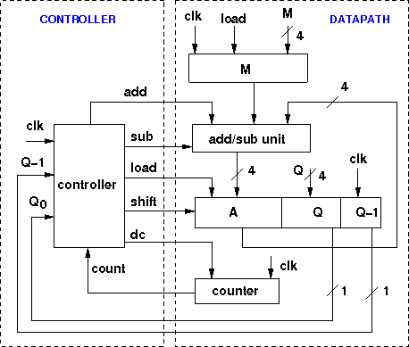
Signed Binary Multiplication
Booth’s Multiplier

Slide 31
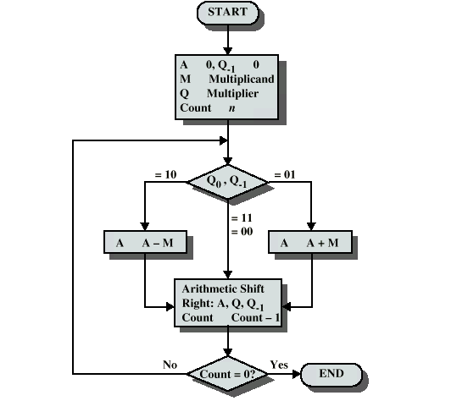
Signed Binary Multiplication
Flowchart of Booth’s Multiplier

Slide 32
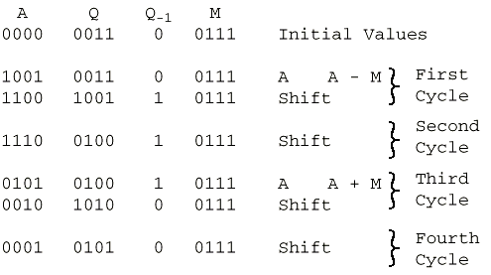
Example of Booth’s Algorithm

Slide 33
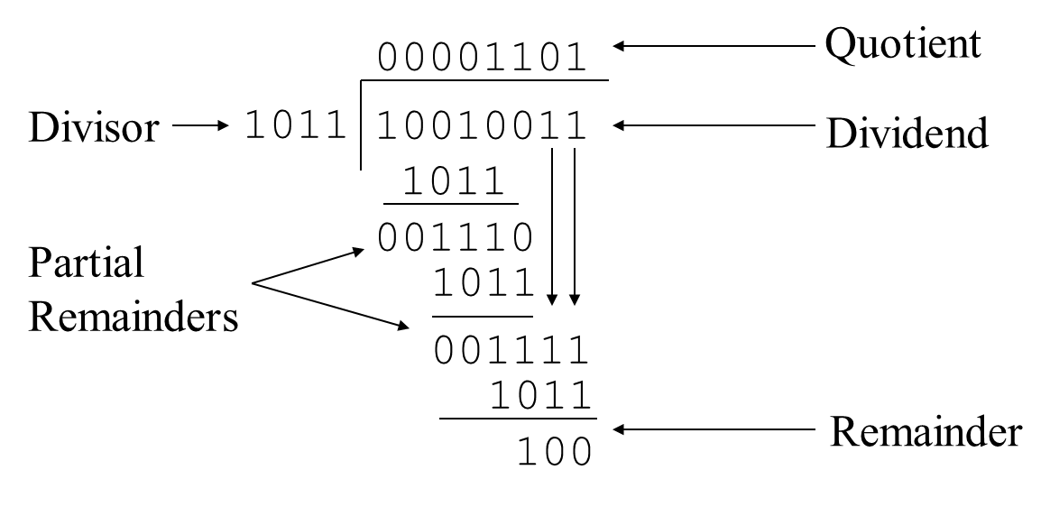
Division of Unsigned Binary Integers
More complex than multiplication
  Negative numbers are really bad!
Based on long division

Slide 34
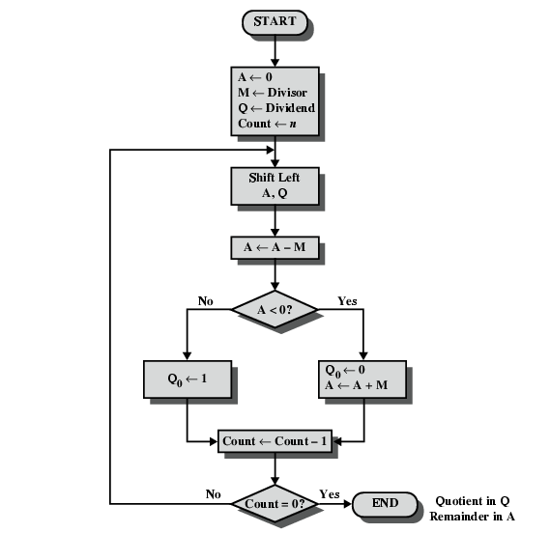
Unsigned Binary Division
Flowchart

Slide 35
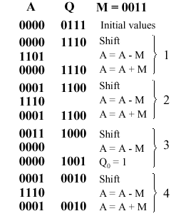
Unsigned Binary Division
Example using division of the unsigned integer 7 by the unsigned integer 3

Slide 36
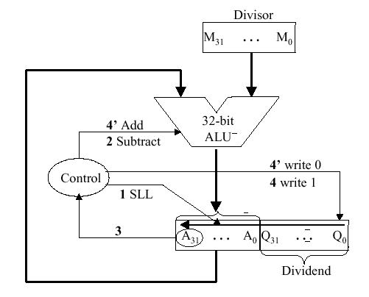
Unsigned Binary Division
Schematic diagram of ALU circuitry

Slide 37
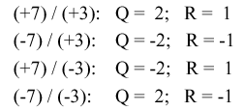
Signed Binary Division
With signed division, we negate the quotient if the signs of the divisor and dividend disagree.
The remainder and the divident must have the same signs.
The governing equation is as follows:
  Remainder = Divident - (Quotient · Divisor) ,
  and the following four cases apply:

Slide 38
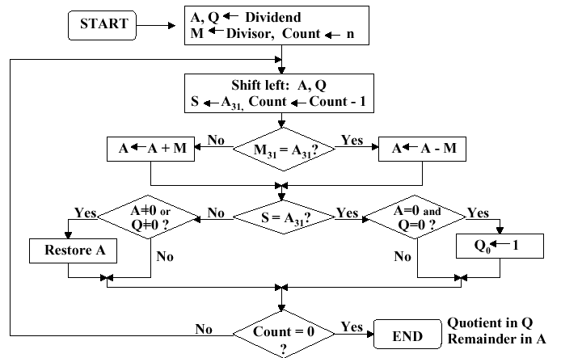
Signed Binary Division
Flowchart

Slide 39
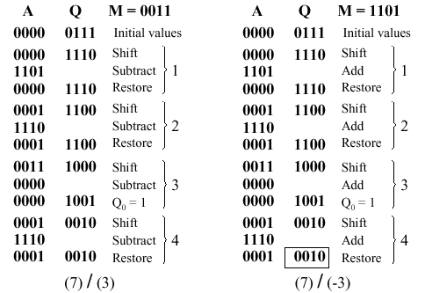
Signed Binary Division
Example using division of +7 by the integer +3 and -3

Slide 40
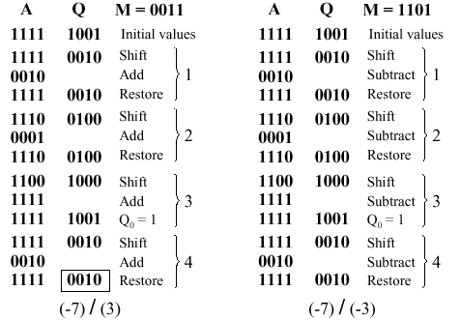
Signed Binary Division
Example using division of -7 by the integer +3 and -3

Slide 41
Division in MIPS
MIPS supports multiplication and division using existing hardware, primarily the ALU and shifter.
  MIPS needs one extra hardware component –
    a 64-bit register able to support sll and sra instructions.
The upper (high) 32 bits of the register contains the remainder resulting from division.
  This is moved into a register in the MIPS register stack (e.g., $t0) by the mfhi command.
The lower 32 bits of the 64-bit register contains the quotient resulting from division.
  This is moved into a register in the MIPS register stack by the mflo command.
In MIPS assembly language code, signed division is supported by the div instruction and unsigned division, by the divu instruction.
MIPS hardware does not check for division by zero.
  Thus, divide-by-zero exception must be detected and handled in system software.
A similar comment holds for overflow or underflow resulting from division.

Slide 42
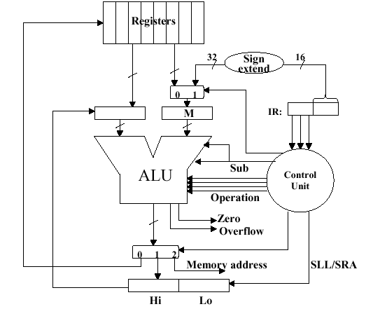
Division in MIPS
MIPS ALU that supports integer arithmetic operations (+,-,x,/)

Slide 43
Real Numbers
Numbers with fractions
Could be done in pure binary
  1001.1010 = 2⁴ + 2⁰ +2⁻¹ + 2⁻³ =9.625
Where is the binary point?
Fixed?
  Very limited
Moving?
  How do you show where it is?

Slide 44
Real Numbers (exponantials)
123 000 000 000 000
        1.23 X 10¹⁴
0.0000000000000123
        1.23 X 10⁻¹⁴

Slide 45
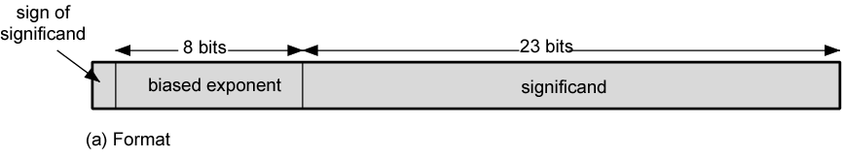
Floating Point
+/- .significand x 2^{exponent}
Point is actually fixed between sign bit and body of mantissa
Exponent indicates place value (point position)

Slide 46
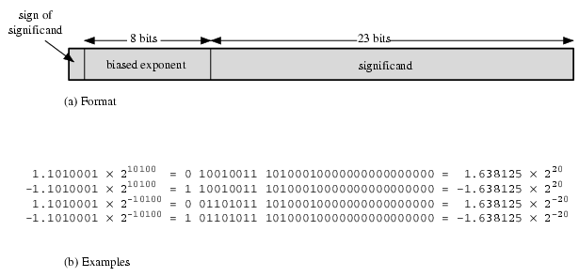
Floating Point Examples

Slide 47
Signs for Floating Point
Mantissa is stored in 2s complement
Exponent is in excess or biased notation
  e.g. Excess (bias) 128 means
  8 bit exponent field
  Pure value range 0-255
  Subtract 128 to get correct value
  Range -128 to +127

Slide 48
Normalization
FP numbers are usually normalized
i.e. exponent is adjusted so that leading bit (MSB) of mantissa is 1
Since it is always 1 there is no need to store it
(c.f. Scientific notation where numbers are normalized to give a single digit before the decimal point
e.g. 3.123 x 10³)

Slide 49
FP Ranges
For a 32 bit number
  8 bit exponent
  +/- 2²⁵⁶ ≈ 1.5 x 10⁷⁷
Accuracy
  The effect of changing lsb of mantissa
  23 bit mantissa 2⁻²³ ≈ 1.2 x 10⁻⁷
  About 6 decimal places

Slide 50
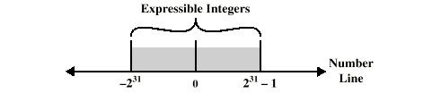
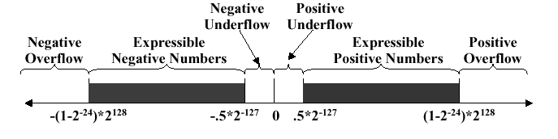
Expressible Numbers
2s complement integer (32 bits)
Floating point

Slide 51
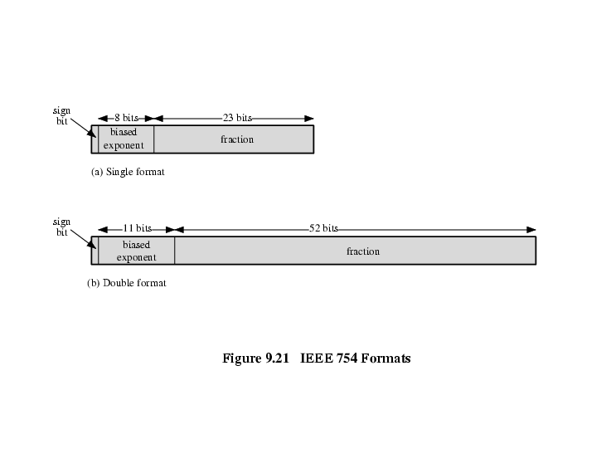
IEEE 754
Standard for floating point storage
32 bit standard (8 bit biased exponent)
  Single format
64 bit standard (11 bit biased exponent)
  Double format

Slide 52
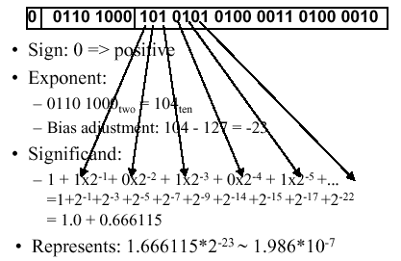
FP example
FPnumber = (-1)S · (1 + Significand) · 2^{(Exponent - Bias)}
Example:

Slide 53
IEEE 754 Format Parameters

Slide 54
Interpretation of IEEE 754 Floating-Point Numbers

Slide 55
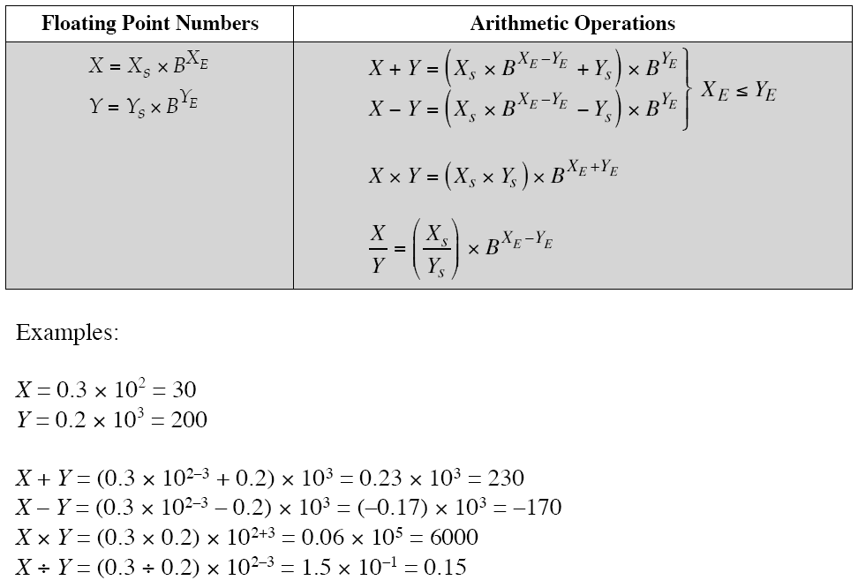
Floating-Point Numbers and Arithmetic Operations

Slide 56
A floating-point operation may produce one of these conditions:
Exponent overflow:
  A positive exponent exceeds the maximum possible expo-nent value.
  In some systems, this may be designated as +∞ or -∞.
Exponent underflow:
  A negative exponent is less than the minimum possible exponent value (e.g., -200 is less than -127).
  This means that the number is too small to be represented, and it may be reported as 0.
Significand underflow:
  In the process of aligning significands, digits may flow off the right end of the significand.
  Some form of rounding is required.
Significand overflow:
  The addition of two significands of the same sign may result in a carry out of the most significant bit.
  This can be fixed by realignment.

Slide 57
FP Arithmetic +/-
Check for zeros
Align significands (adjusting exponents)
Add or subtract significands
Normalize result

Slide 58
FP Arithmetic +/- Phase 1
Zero check
  Because addition and subtraction are identical except for a sign change, the process begins by changing the sign of the subtrahend if it is a subtract operation.
  Next, if either operand is 0, the other is reported as the result.

Slide 59
FP Arithmetic +/- Phase 2
Significand alignment
  Numbers needs to be manipulated so that the two exponents are equal.
  To see the need for aligning exponents, consider the following decimal addition:
    (123 x 10⁰) + (456 x 10⁻²)
  Clearly, we cannot just add the significands.
    The digits must first be set into equivalent positions,
      that is, the 4 of the second number must be aligned with the 3 of the first.
  Under these conditions, the two exponents will be equal,which is the mathematical condition under which two numbers in this form can be added. Thus,
    (123 x 10⁰) + (456 x 10⁻²) = (123 x 10⁰) + (4.56 x 10⁰) = 127.56x10⁰

Slide 60
FP Arithmetic +/- Phase 2
Alignment may be achieved by shifting either the smaller number to the right (increasing its exponent) or shifting the larger number to the left.
  Because either operation may result in the loss of digits, it is the smaller number that is shifted; any digits that are lost are therefore of relatively small significance.
The alignment is achieved by repeatedly shifting the magnitude portion of the significand right 1 digit and incrementing the exponent until the two exponents are equal.
  Note that if the implied base is 16, a shift of 1 digit is a shift of 4 bits.
    If this process results in a 0 value for the significand, then the other number is reported as the result.
  Thus, if two numbers have exponents that differ significantly, the lesser number is lost.

Slide 61
FP Arithmetic +/- Phase 3
Addition
  The two significands are added together, taking into account their signs.
    Because the signs may differ, the result may be 0.
  There is also the possibility of significand overflow by 1 digit.
  If so, the significand of the result is shifted right and the exponent is incremented.
  An exponent overflow could occur as a result;
    this would be reported and the operation halted.

Slide 62
FP Arithmetic +/- Phase 4
Normalization
  Normalization consists of shifting significand digits left until the most significant digit (bit, or 4 bits for base-16 exponent) is nonzero.
  Each shift causes a decrement of the exponent and thus could cause an exponent underflow.
  Finally, the result must be rounded off and then reported.

Slide 63
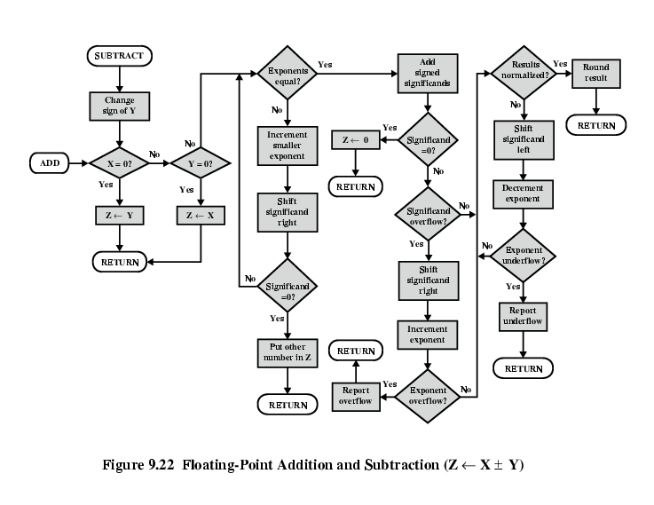
FP Addition & Subtraction Flowchart

Slide 64
FP Arithmetic x/÷
Check for zero
Add/subtract exponents
Multiply/divide significands (watch sign)
Normalize
Round
All intermediate results should be in double length storage

Slide 65
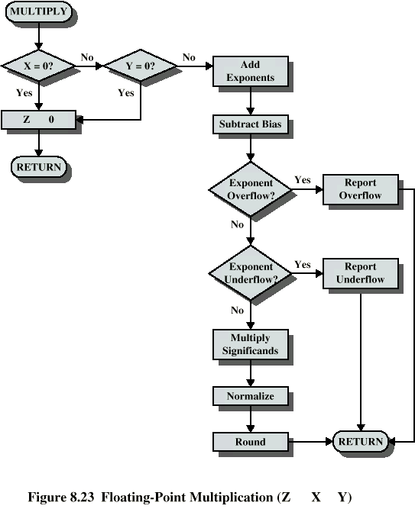
Floating Point Multiplication

Slide 66
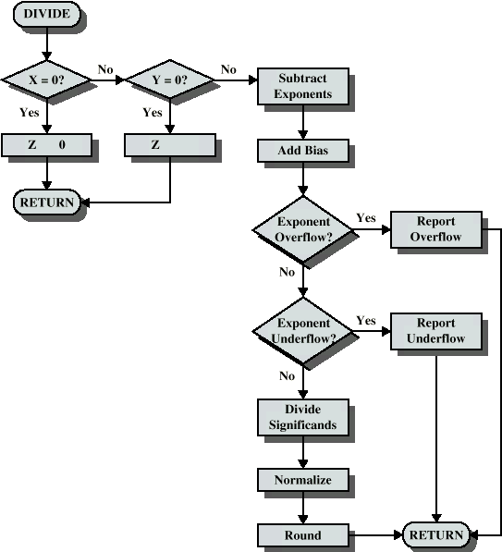
Floating Point Division

