Slide 1
BLM5207 Computer Organization
Prof. Dr. Nizamettin AYDIN
naydin@yildiz.edu.tr
http://www3.yildiz.edu.tr/~naydin
Programming

Slide 2
Solving Problems using a Computer
Methodologies for creating computer programs that perform a desired function.
Problem Solving
How do we figure out what to tell the computer to do?
Convert problem statement into algorithm, using stepwise refinement.
Convert algorithm into machine instructions.
Debugging
How do we figure out why it didn’t work?
Examining registers and memory, setting breakpoints, etc.
Time spent on the first can reduce time spent on the second!

Slide 3
Stepwise Refinement
Also known as systematic decomposition.
Start with problem statement:
“We wish to count the number of occurrences of a character in a file. The character in question is to be input from the keyboard; the result is to be displayed on the monitor.”
Decompose task into a few simpler subtasks.
Decompose each subtask into smaller subtasks, and these into even smaller subtasks, etc.... until you get to the machine instruction level.

Slide 4
Problem Statement
Because problem statements are written in English, they are sometimes ambiguous and/or incomplete.
Where is “file” located?
How big is it, or how do I know when I’ve reached the end?
How should final count be printed? A decimal number?
If the character is a letter, should I count both upper-case and lower-case occurrences?
How do you resolve these issues?
Ask the person who wants the problem solved, or
Make a decision and document it.

Slide 5
Three Basic Constructs
There are three basic ways to decompose a task:
Task
True
Test
False
Test
False
Subtask 1
condition
condition
True
Subtask 1
Subtask 2
Subtask 2
Subtask
Sequential
Conditional
Iterative

Slide 6
Sequential
Do Subtask 1 to completion, then do Subtask 2 to completion, etc.
Get character
input from
keyboard
Count and print the
Examine file and
occurrences of a
count the number
character in a file
of characters that
match
Print number
to the screen

Slide 7
Conditional
If condition is true, do Subtask 1; else, do Subtask 2.

Slide 8
Iterative
Do Subtask over and over, as long as the test condition is true.

Slide 9
Problem Solving Skills
Learn to convert problem statement into step-by-step description of subtasks.
Like a puzzle, or a “word problem” from grammar school math.
What is the starting state of the system?
What is the desired ending state?
How do we move from one state to another?
Recognize English words that correlate to three basic constructs:
“do A then do B” ⇒ sequential
“if G, then do H” ⇒ conditional
“for each X, do Y” ⇒ iterative
“do Z until W” ⇒ iterative

Slide 10
Debugging
You’ve written your program and it doesn’t work.
Now what?
What do you do when you’re lost in a city?
Drive around randomly and hope you find it?
Return to a known point and look at a map?
In debugging, the equivalent to looking at a map is tracing your program.
Examine the sequence of instructions being executed.
Keep track of results being produced.
Compare result from each instruction to the expected result.

Slide 11
Debugging Operations
Any debugging environment should provide means to:
Display values in memory and registers.
Deposit values in memory and registers.
Execute instruction sequence in a program.
Stop execution when desired.
Different programming levels offer different tools.
High-level languages (C, Java, ...) usually have source-code debugging tools.
For debugging at the machine instruction level:
simulators
operating system “monitor” tools
in-circuit emulators (ICE)
plug-in hardware replacements that give instruction-level control

Slide 12
Types of Errors
Syntax Errors
You made a typing error that resulted in an illegal operation.
Not usually an issue with machine language, because almost any bit pattern corresponds to some legal instruction.
In high-level languages, these are often caught during the translation from language to machine code.
Logic Errors
Your program is legal, but wrong, so the results don’t match the problem statement.
Trace the program to see what’s really happening and determine how to get the proper behavior.
Data Errors
Input data is different than what you expected.
Test the program with a wide variety of inputs.

Slide 13
Tracing the Program
Execute the program one piece at a time, examining register and memory to see results at each step.
Single-Stepping
Execute one instruction at a time.
Tedious, but useful to help you verify each step of your program.
Breakpoints
Tell the simulator to stop executing when it reaches a specific instruction.
Check overall results at specific points in the program.
Lets you quickly execute sequences to get a high-level overview of the execution behavior.
Quickly execute sequences that you believe are correct.
Watchpoints
Tell the simulator to stop when a register or memory location changes or when it equals a specific value.
Useful when you don’t know where or when a value is changed.

Slide 14
Debugging: Lessons Learned
Trace program to see what’s going on.
Breakpoints, single-stepping
When tracing, make sure to notice what’s really happening, not what you think should happen.
Test your program using a variety of input data.
Be sure to test extreme cases (all ones, no ones, ...).

Slide 15
The Concept of an Algorithm
Some Algorithms:
Converting from one base to another
Correcting errors in data
Compression
⁝
…
Many researchers believe that every activity of the human mind is the result of an algorithm

Slide 16
Formal Definition of Algorithm
An algorithm is an ordered set of unambiguous, executable steps that defines a terminating process
The steps of an algorithm can be sequenced in different ways
Linear (1, 2, 3, …)
Parallel (multiple processors)
Cause and Effect (circuits)
A Terminating Process
Culminates with a result
Can include systems that run continuously
Hospital systems
Long Division Algorithm
A Non-terminating Process
Does not produce an answer
“Non-deterministic Algorithms”

Slide 17
The Abstract Nature of Algorithms
There is a difference between an algorithm and its representation.
Analogy:
difference between a story and a book
A Program
a representation of an algorithm.
A Process
the activity of executing an algorithm.

Slide 18
Algorithm Representation
Is done formally with well-defined Primitives
A collection of primitives constitutes a programming language.
Is done informally with Pseudocode
Pseudocode is between natural language and a programming language.

Slide 19
Designing a Pseudocode Language
Choose a common programming language
Loosen some of the syntax rules
Allow for some natural language
Use consistent, concise notation
We will use a Python-like Pseudocode

Slide 20
Pseudocode Primitives
Assignment
name = expression
example
RemainingFunds = CheckingBalance +
SavingsBalance
Conditional selection
if (condition):
activity
example
if (sales have decreased):
lower the price by 5%

Slide 21
Pseudocode Primitives
Conditional selection
if (condition):
activity
else:
activity
example
if (year is leap year):
daily total = total / 366
else:
daily total = total / 365

Slide 22
Pseudocode Primitives
Repeated execution
while (condition):
body
example
while (tickets remain to be sold):
sell a ticket
Indentation shows nested conditions
if (not raining):
if (temperature == hot):
go swimming
else:
play golf
else:
watch television

Slide 23
Pseudocode Primitives
Define a function
def name():
example
def ProcessLoan():
Executing a function
if (. . .):
ProcessLoan()
else:
RejectApplication()

Slide 24
The procedure Greetings in pseudocode
def Greetings():
Count = 3
while (Count > 0):
print('Hello')
Count = Count - 1

Slide 25
Pseudocode Primitives
Using parameters
def Sort(List):
.
.
.
Executing Sort on different lists
Sort(the membership list)
Sort(the wedding guest list)

Slide 26
Algorithm Discovery
The first step in developing a program
More of an art than a skill
A challenging task
Polya’s Problem Solving Steps
Understand the problem.
Devise a plan for solving the problem.
Carry out the plan.
Evaluate the solution for accuracy and its potential as a tool for solving other problems.

Slide 27
Getting a Foot in the Door
Try working the problem backwards
Solve an easier related problem
Relax some of the problem constraints
Solve pieces of the problem first
(bottom up methodology)
Stepwise refinement:
Divide the problem into smaller problems
(top-down methodology)

Slide 28
Ages of Children Problem
Person A is charged with the task of determining the ages of B’s three children.
B tells A that the product of the children’s ages is 36.
A replies that another clue is required.
B tells A the sum of the children’s ages.
A replies that another clue is needed.
B tells desired triple must be one whose sum appears at least twice in the table
A replies that another clue is needed.
B tells A that the oldest child plays the piano.
A tells B the ages of the three children.
How old are the three children?

Slide 29
Iterative Structures
A collection of instructions repeated in a looping manner
Examples include:
Sequential Search Algorithm
The sequential search algorithm in pseudocode
def Search (List, TargetValue):
if (List is empty):
Declare search a failure
else:
Select the first entry in List to be TestEntry
while (TargetValue > TestEntry and entries remain):
Select the next entry in List as TestEntry
if (TargetValue == TestEntry):
Declare search a success
else:
Declare search a failure

Slide 30
Iterative Structures
Insertion Sort Algorithm
The insertion sort algorithm expressed in pseudocode
def Sort(List):
N = 2
while (N <= length of List):
Pivot = Nth entry in List
Remove Nth entry leaving a hole in List
while (there is an Entry above the
hole and Entry > Pivot):
Move Entry down into the hole leaving
a hole in the list above the Entry
Move Pivot into the hole
N = N + 1

Slide 31
Components of repetitive control
Initialize:
Establish an initial state that will be modified toward the termination condition
Test:
Compare the current state to the termination condition and terminate the repetition if equal
Modify:
Change the state in such a way that it moves toward the termination condition

Slide 32
Iterative Structures
Pretest loop:
while (condition):
body
Posttest loop:
repeat:
body
until(condition)

Slide 33
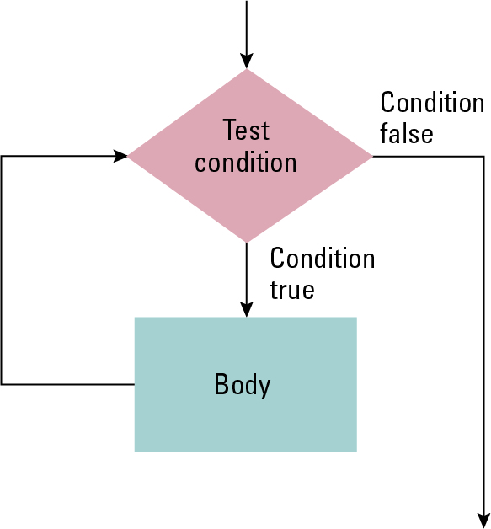
The while loop structure

Slide 34
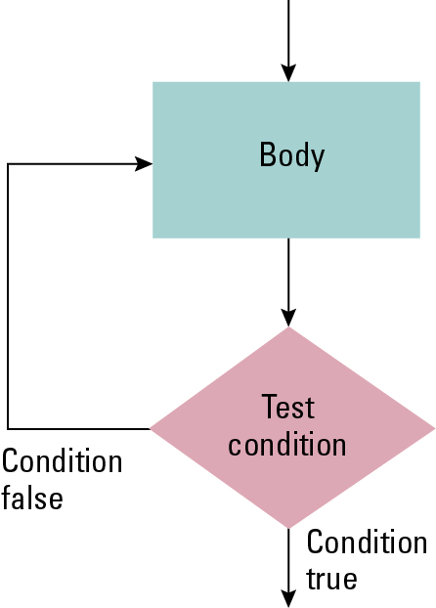
The repeat loop structure

Slide 35
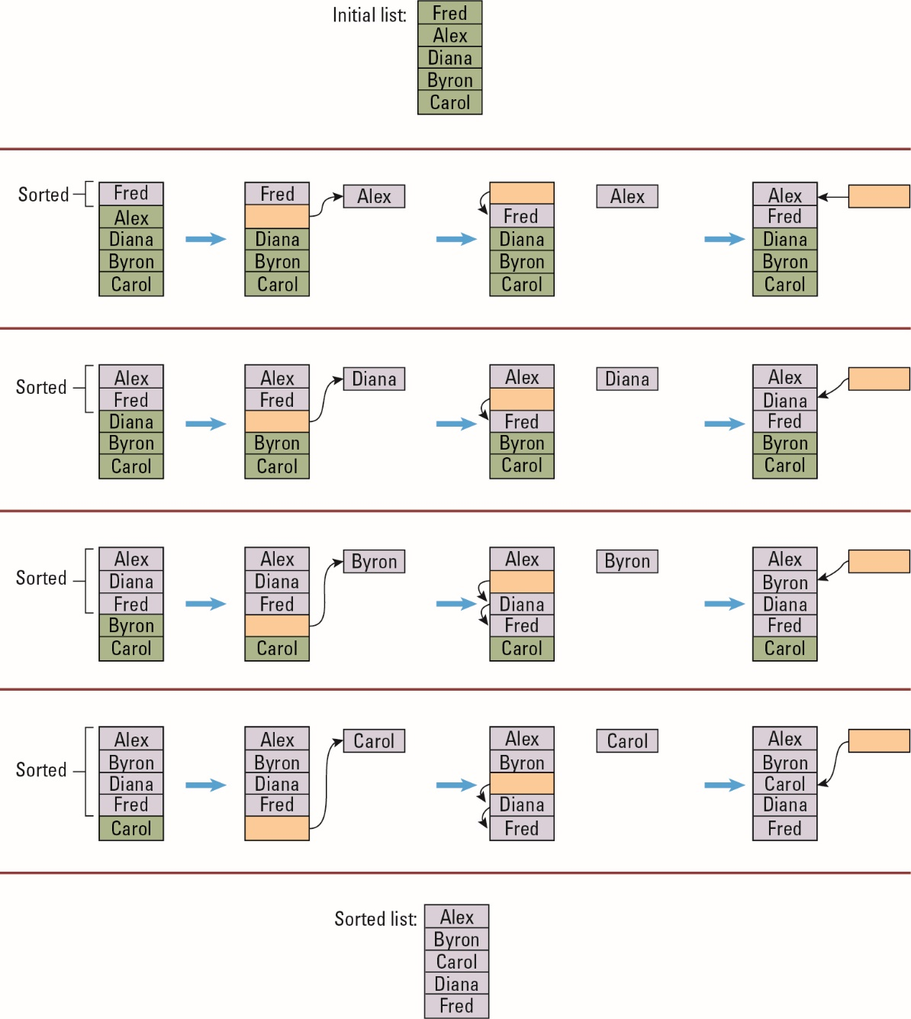
Sorting the list Fred, Alex, Diana, Byron, and Carol alphabetically

Slide 36
The insertion sort algorithm expressed in pseudocode
def Sort(List):
N = 2
while (N <= length of List):
Pivot = Nth entry in List
Remove Nth entry leaving a hole in List
while (there is an Entry above the
hole and Entry > Pivot):
Move Entry down into the hole leaving
a hole in the list above the Entry
Move Pivot into the hole
N = N + 1

Slide 38
Recursive Structures
Repeating the set of instructions as a subtask of itself.
Multiple activations of the procedure are formed, all but one of which are waiting for other activations to complete.
Example:
The Binary Search Algorithm

Slide 39
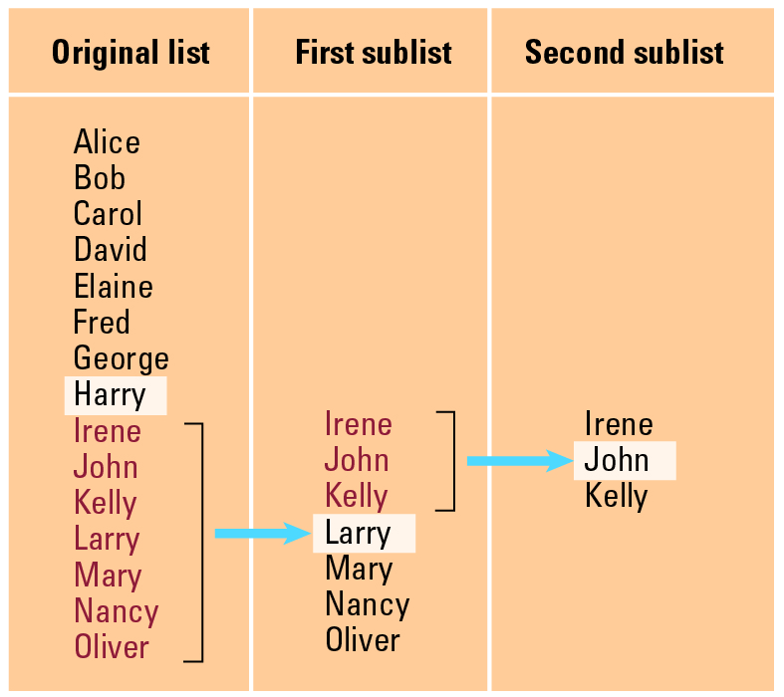
Applying our strategy to search a list for the entry John

Slide 40
A first draft of the binary search technique
if (List is empty):
Report that the search failed
else:
TestEntry = middle entry in the List
if (TargetValue == TestEntry):
Report that the search succeeded
if (TargetValue < TestEntry):
Search the portion of List preceding TestEntry for
TargetValue, and report the result of that search
if (TargetValue > TestEntry):
Search the portion of List following TestEntry for
TargetValue, and report the result of that search

Slide 41
The binary search algorithm in pseudocode
def Search(List, TargetValue):
if (List is empty):
Report that the search failed
else:
TestEntry = middle entry in the List
if (TargetValue == TestEntry):
Report that the search succeeded
if (TargetValue < TestEntry):
Sublist = portion of List preceding TestEntry
Search(Sublist, TargetValue)
if (TargetValue < TestEntry):
Sublist = portion of List following TestEntry
Search(Sublist, TargetValue)

Slide 42
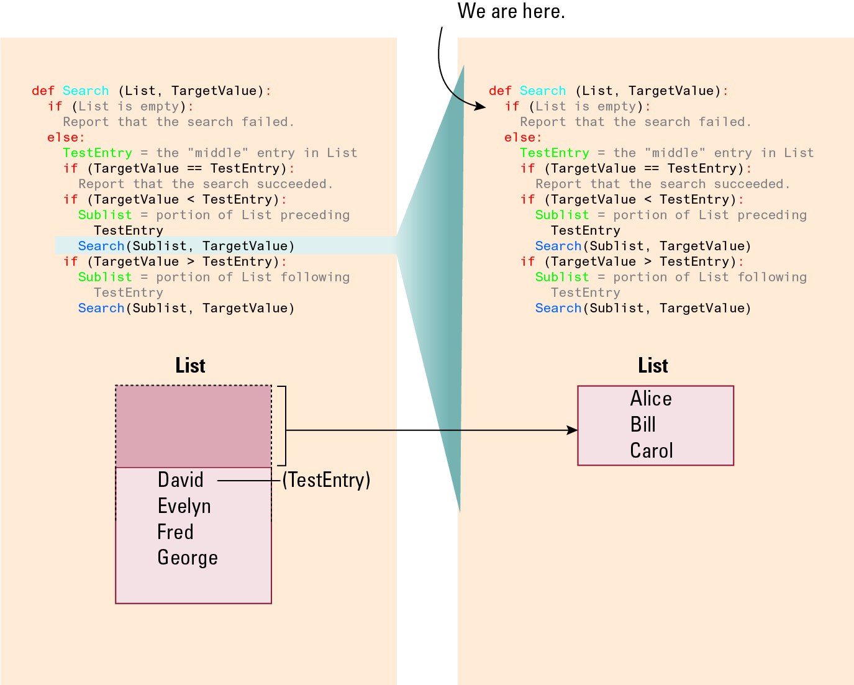
Recursively Searching

Slide 43
Second Recursive Search

Slide 44
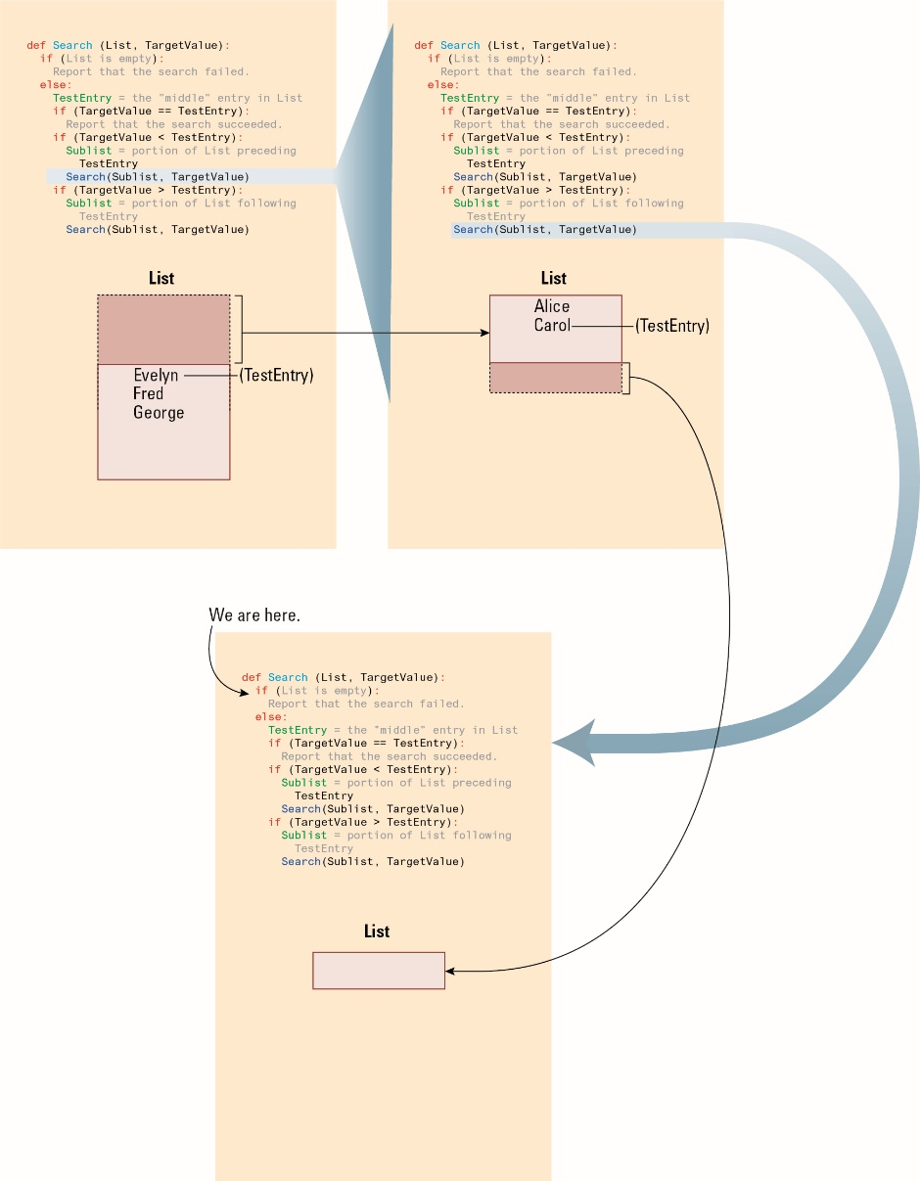
Second Recursive Search, Second Snapshot

Slide 46
Recursive Control
Requires initialization, modification, and a test for termination (base case)
Provides the illusion of multiple copies of the function, created dynamically in a telescoping manner
Only one copy is actually running at a given time, the others are waiting

Slide 47
Correctness and Efficiency
The choice between efficient and inefficient algorithms can make the difference between a practical solution and an impractical one
The correctness of an algorithm is determined by reasoning formally about the algorithm, not by testing its implementation
The efficiency is measured as number of instructions executed
Uses big theta notation:
Example: Insertion sort is in Θ(n²)
Incorporates best, worst, and average case analysis

Slide 48
Applying the insertion sort in a worst-case situation

Slide 49
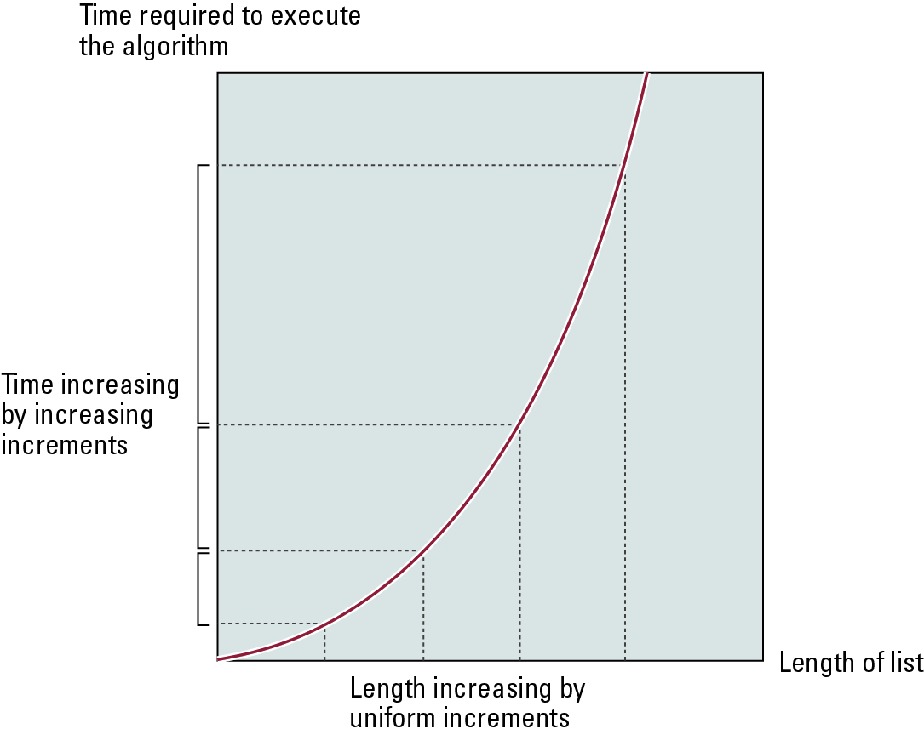
Graph of the worst-case analysis of the insertion sort algorithm

Slide 50
Graph of the worst-case analysis of the binary search algorithm

Slide 51
Software Verification
Proof of correctness (with formal logic)
Assertions
Preconditions
Loop invariants
Testing is more commonly used to verify software
Testing only proves that the program is correct for the test cases used

Slide 52
Chain Separating Problem
A traveler has a gold chain of seven links.
He must stay at an isolated hotel for seven nights.
The rent each night consists of one link from the chain.
What is the fewest number of links that must be cut so that the traveler can pay the hotel one link of the chain each morning without paying for lodging in advance?

Slide 53
Separating the chain using only three cuts

Slide 54
Solving the problem with only one cut

Slide 55
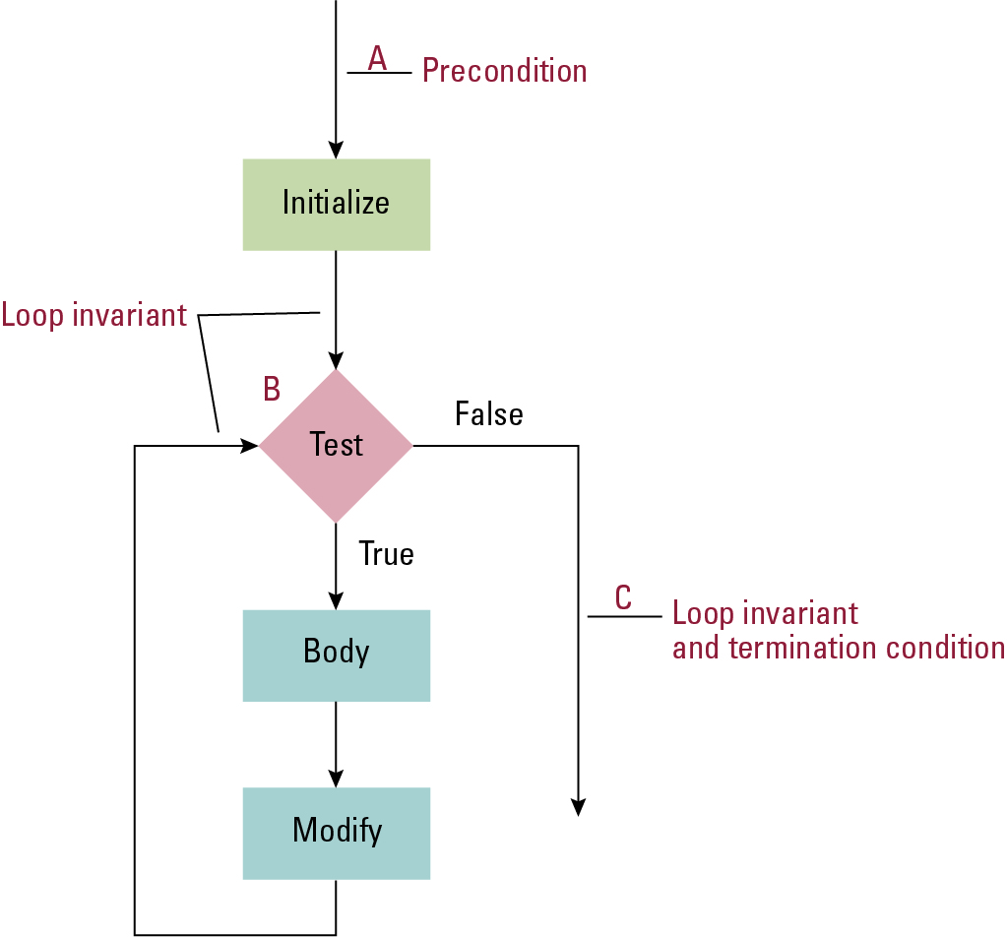
The assertions associated with a typical while structure

