Slide 1
BLM5207
Computer Organization
Prof. Dr. Nizamettin AYDIN
naydin@yildiz.edu.tr
http://www3.yildiz.edu.tr/~naydin
Instruction Set Architecture

Slide 2
Instruction Set Architecture
C
Fortran
Ada
etc.
Basic
Java
Compiler
Compiler
Assembly Language
Byte Code
Assembler
Interpreter
Executable
HW
Implementation 1
HW
Implementation 2
HW
Implementation N

Slide 3
Instruction Set
Instruction: Language of the machine
Instruction set: Vocabulary of the language (Collection of instructions that are understood by a CPU)
  lda, sta, brp, jmp, nop, ... (VVM)
Machine Code
  machine readable
  Binary(example: 1000110010100000)
Usually represented by assembly codes
  Human readable
  Example: VVM code adding a number entered from keyboard and a number in memory location 40
  0 in
  1 sta 30
  2 add 40
  3 sta 50
  4 hlt
Notes:
2

Slide 4
Instruction Types
Data processing
  ADD, SUB
Data storage (main memory)
  STA
Data movement (I/O)
  IN, OUT, LDA
Program flow control
  BRZ
Notes:
6

Slide 5
Elements of an Instruction
Operation code (Op-code)
  Do this
    Example: ADD 30 (VVM code)
Source Operand reference
  To this
    Example: LDA 50 (VVM code)
Result Operand reference
  Put the result here
    Example: STA 60 (VVM code)
Next Instruction Reference
  When you have done that, do this...
    PC points to the next instruction
Notes:
3

Slide 6
Source and Result Operands
Source and Result Operands can be in one of the following areas:
  Main memory
  Virtual memory
  Cache
  CPU register
  I/O device
Notes:
4

Slide 7
Instruction Representation
In machine code each instruction has a unique bit pattern
For human consumption a symbolic representation is used (assembly language)
Opcodes are represented by abbreviations, called mnemonics indicating the operation
  ADD, SUB, LDA, BRP, ...
In an assembly language, operands can also be represented as following
  ADD A,B (add contents of B and A and save the result into A)
Notes:
5

Slide 8
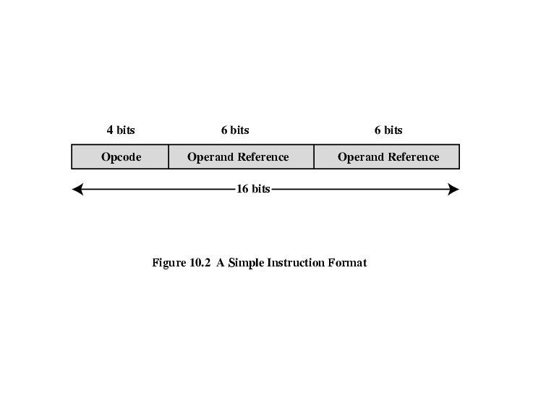
Simple Instruction Format
Following is a 16 bit instruction format
So...
  What is the maximum number of instructions in this processor?
  What is the maximum directly addressable memory size?

Slide 9
Instruction Set Classification
One way for classification:
  Number of operands for typical arithmetic instruction
  add $s1, $s2, $s3
3
  What are the possibilities?
  Will use this C statement as an example:
  a = b + c;
  Assume a, b and c are in memory

Slide 10
Zero Address Machine
a.k.a. Stack Machines
Example: a = b + c;
PUSH b # Push b onto stack
PUSH c # Push c onto stack
ADD # Add top two items
# on stack and replace
# with sum
POP a # Remove top of stack
# and store in a

Slide 11
One Address Machine
a.k.a. Accumulator Machine
One operand is implicitly the accumulator
Example: a = b + c;
LOAD b # ACC ← b
ADD c # ACC ← ACC + c
STORE a # a ← ACC
A good example for such a machine is...
VVM

Slide 12
Two Address Machine (1)
a.k.a. Register-Memory Instruction Set
One operand may be a value from memory
Machine has n general purpose registers
  $0 through $n-1
Example: a = b + c;
LOAD $1, b # $1 ← M[b]
ADD $1, c # $1 ← $1 + M[c]
STORE $1, a # M[a] ← $1

Slide 13
Two Address Machine (2)
a.k.a. Memory-Memory Machine
Another possibility do stuff in memory!
These machines have registers used to compute memory addresses
2 addresses (One address doubles as operand and result)
Example: a = b + c;
MOVE a, b # M[a] ← M[b]
ADD a, c # M[a] ← M[a] + M[c]

Slide 14
Two Address Machine (3)
a.k.a. Load-Store Instruction Set or Register-Register Instruction Set
Typically can only access memory using load/store instructions
Example: a = b + c;
LOAD $1, b # $1 ← M[b]
LOAD $2, c # $2 ← M[c]
ADD $1, $2 # $1 ← $1 + $2
STORE $1, a # M[a] ← $1

Slide 15
Three Address Machine
a.k.a. Load-Store Instruction Set or Register-Register Instruction Set
Typically can only access memory using load/store instructions
3 addresses (Operand 1, Operand 2, Result)
  May be a forth - next instruction (usually implicit)
  Needs very long words to hold everything
Example: a = b + c;
LOAD $1, b # $1 ← M[b]
LOAD $2, c # $2 ← M[c]
ADD $3, $1, $2 # $3 ← $1 + $2
STORE $3, a # M[a] ← $3

Slide 16
Utilization of Instruction Addresses

Slide 17
Types of Operand
Addresses
  Operand is in the address
Numbers (actual operand)
  Integer or fixed point
  floating point
  decimal
Characters (actual operand)
  ASCII etc.
Logical Data (actual operand)
  Bits or flags
Notes:
14

Slide 18
Pentium Data Types
8 bit (byte), 16 bit (word), 32 bit (double word), 64 bit (quad word)
Addressing in Pentium is by 8 bit units
A 32 bit double word is read at addresses divisible by 4:
  0100 1A 22 F1 77
  +0 +1 +2 +3
Notes:
15

Slide 19
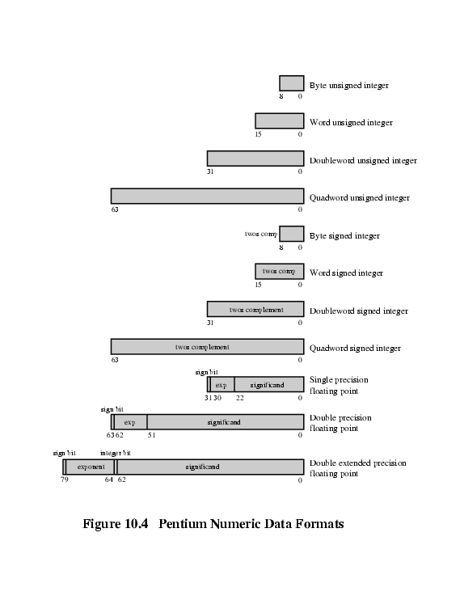
Pentium Numeric Data Formats
Notes:
17

Slide 20
PowerPC Data Types
8 (byte), 16 (halfword), 32 (word) and 64 (doubleword) length data types
Fixed point processor recognises:
  Unsigned byte, unsigned halfword, signed halfword, unsigned word, signed word, unsigned doubleword, byte string (<128 bytes)
Floating point
  IEEE 754
  Single or double precision

Slide 21
Types of Operation
Data Transfer
Arithmetic
Logical
Conversion
I/O
System Control
Transfer of Control
Notes:
18

Slide 22
Data Transfer
Need to specify
  Source
  Destination
  Amount of data
May be different instructions for different movements
Or one instruction and different addresses
Notes:
19

Slide 23
Arithmetic
Basic arithmetic operations are...
  Add
  Subtract
  Multiply
  Divide
  Increment (a++)
  Decrement (a--)
  Negate (-a)
  Absolute
Arithmetic operations are provided for...
  Signed Integer
  Floating point?
  Packed decimal numbers?
Notes:
20

Slide 24
Logical
Bitwise operations
AND, OR, NOT
  Example1: bit masking using AND operation
    (R1) = 10100101
    (R2) = 00001111
    (R1) AND (R2) = 00000101
  Example2: taking ones coplement using XOR operation
    (R1) = 10100101
    (R2) = 11111111
    (R1) XOR (R2) = 01011010
Notes:
21

Slide 25
Basic Logical Operations

Slide 26
Shift and Rotate Operations

Slide 27
Examples of Shift and Rotate Operations

Slide 28
An example - sending two characters in a word
Suppose we wish to transmit characters of data to an I/O device, 1 character at a time.
  If each memory word is 16 bits in length and contains two characters, we must unpack the characters before they can be sent.
To send the left-hand character:
  Load the word into a register
  AND with the value 1111111100000000
    This masks out the character on the right

Slide 29
An example - sending two characters in a word
  Shift to the right eight times
    This shifts the remaining character to the right half of the register
  Perform I/O
    The I/O module reads the lower-order 8 bits from the data bus.
To send the right-hand character:
  Load the word again into the register
  AND with 0000000011111111
  Perform I/O

Slide 30
Conversion
Conversion instructions are those that change the format or operate on the format of data.
For example:
  Binary to Decimal conversion
Notes:
22

Slide 31
Input/Output
May be specific instructions
  IN, OUT
May be done using data movement instructions (memory mapped)
May be done by a separate controller (DMA)
Notes:
23

Slide 32
Systems Control
Privileged instructions
CPU needs to be in specific state
For operating systems use
Notes:
24

Slide 33
Transfer of Control
Branch
  For example: brz 10 (branch to 10 if result is zero)
Skip
  e.g. increment and skip if zero
Subroutine call
  c.f. interrupt call
Notes:
25

Slide 34
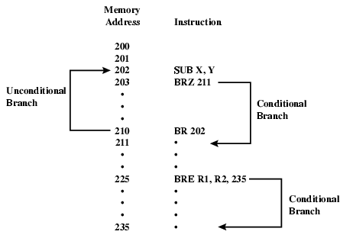
Branch Instruction

Slide 35
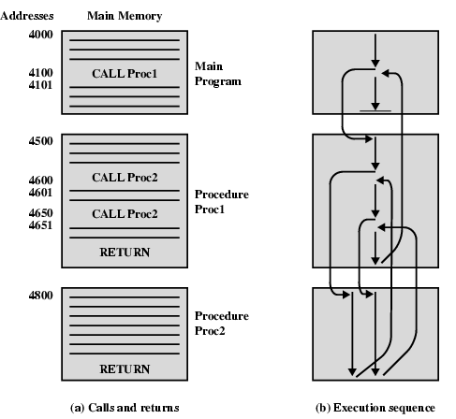
Nested Procedure Calls

Slide 36
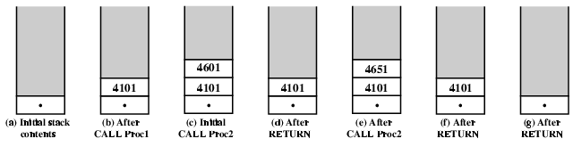
Use of Stack

Slide 37
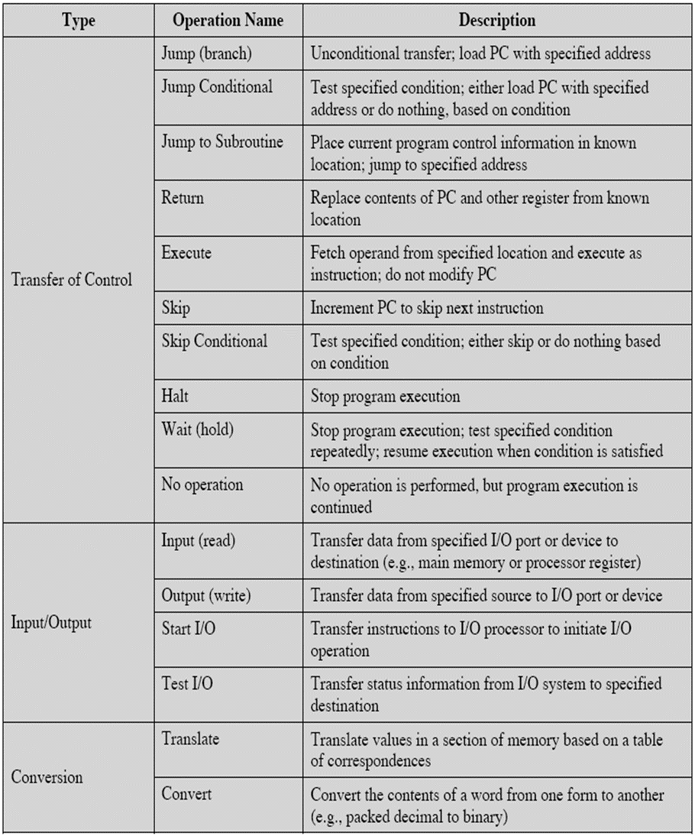
Types of Operation

Slide 38
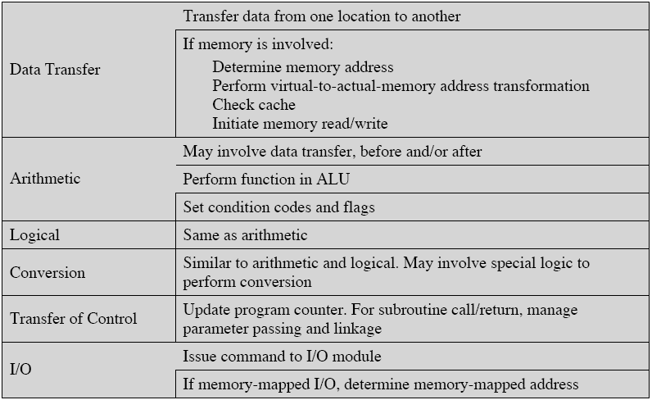
CPU Actions for Various Types of Operations

Slide 39
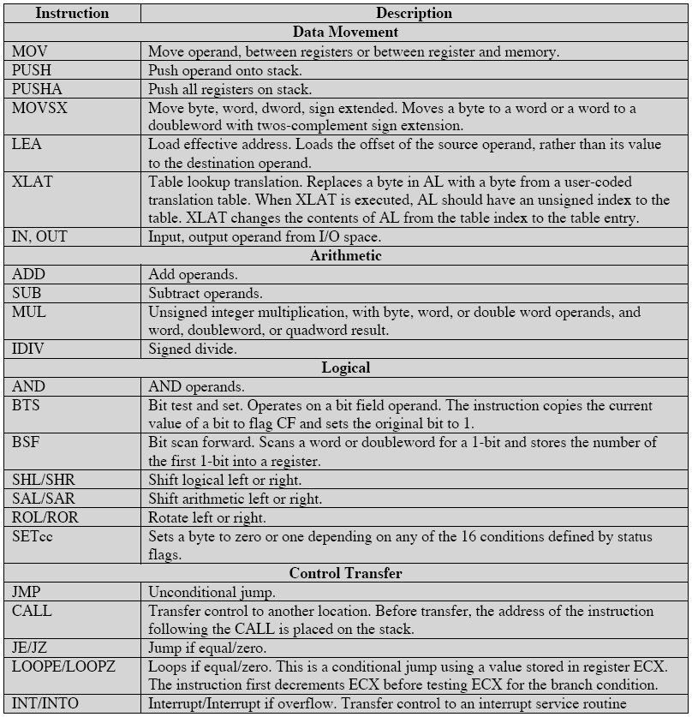
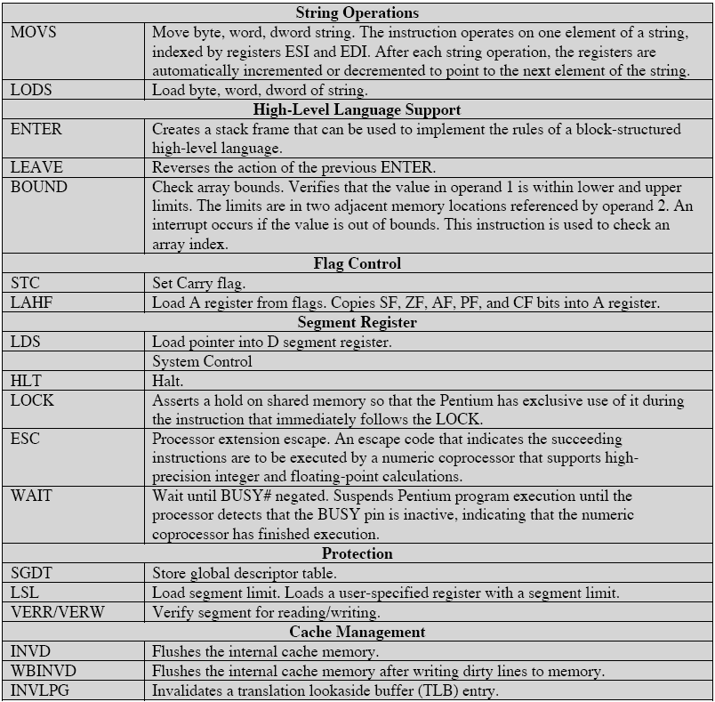
Pentium Operation Types

Slide 40
Pentium Condition Codes

Slide 41
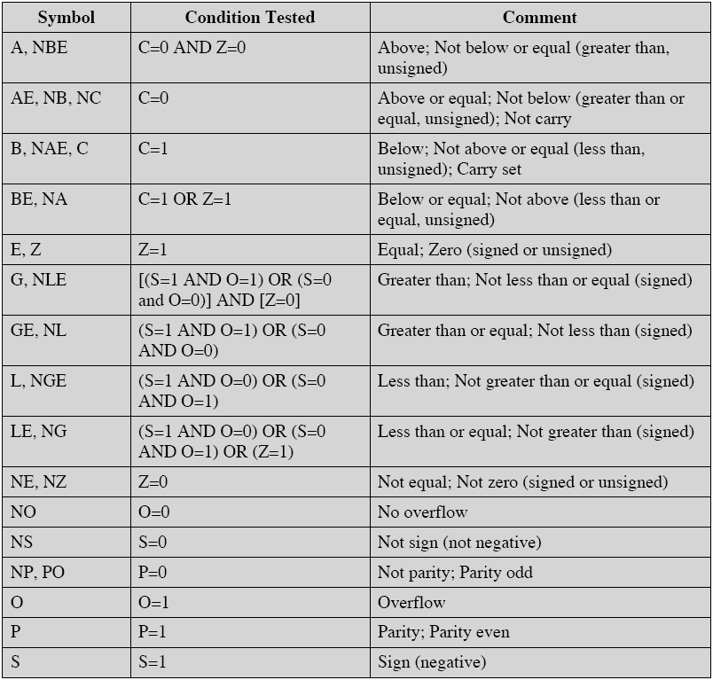
Pentium Conditions for Conditional Jump and SETcc Instructions

Slide 42
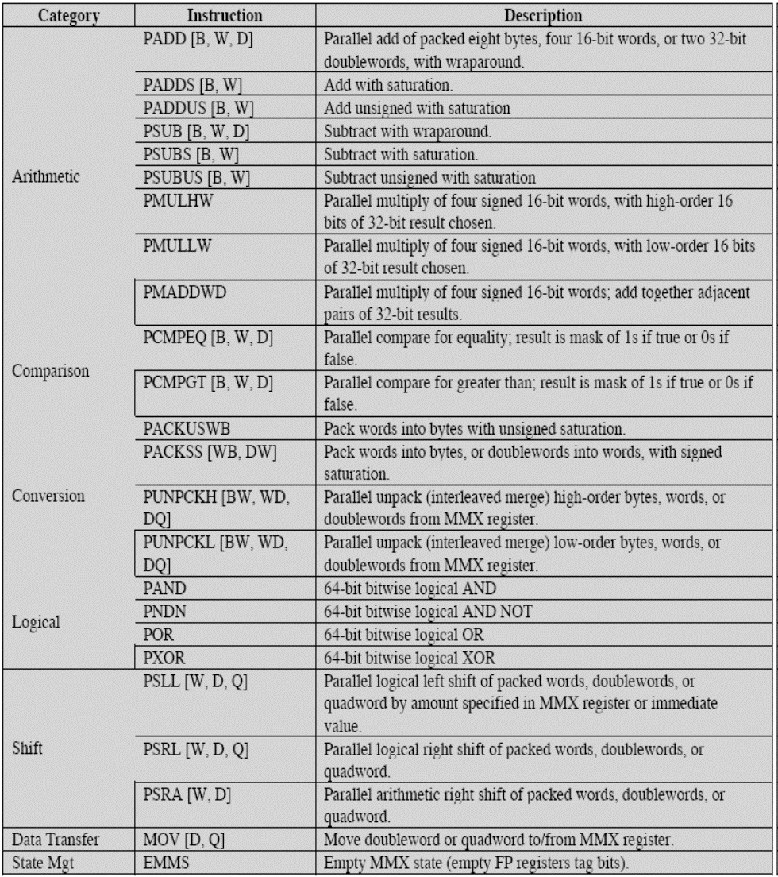
MMX Instruction Set

Slide 43
PowerPC Operation Types

Slide 44
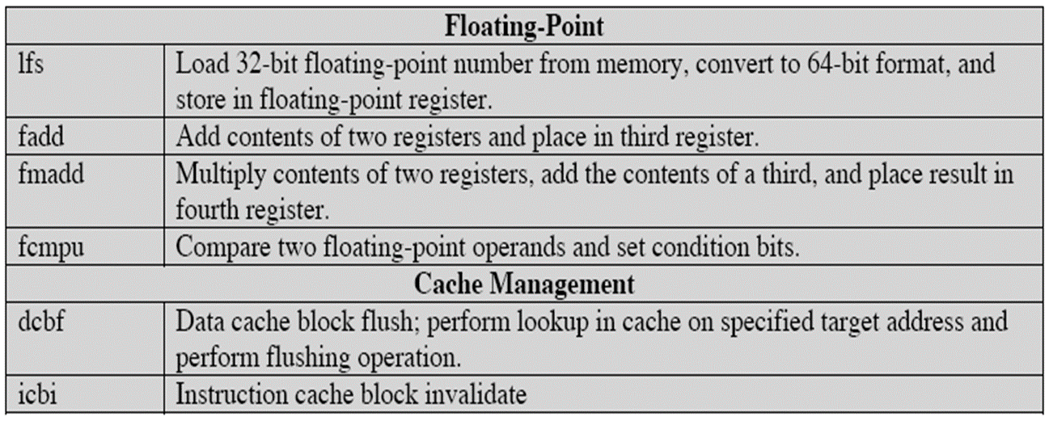
PowerPC Operation Types

Slide 45
Byte Ordering
How should bytes within multi-byte word be ordered in memory?
Some conventions
  Sun’s, Mac’s are “Big Endian” machines
    Least significant byte has highest address
  Alphas, PC’s are “Little Endian” machines
    Least significant byte has lowest address

Slide 46
Byte Ordering Example
Big Endian
  Least significant byte has highest address
Little Endian
  Least significant byte has lowest address
Example
  Variable x has 4-byte representation 0x01234567
  Address given by &x is 0x100
Big Endian
0x100
0x101
0x102
0x103
01
01
23
23
45
45
67
67
Little Endian
0x100
0x101
0x102
0x103
67
67
45
45
23
23
01
01

Slide 47
Representing Integers
Decimal: 15213
Binary: 0011 1011 0110 1101
Hex: 3 B 6 D
int A = 15213;
int B = -15213;
long int C = 15213;
Linux/Alpha A
Sun A
Linux C
Alpha C
Sun C
6D
00
6D
6D
00
3B
00
3B
3B
00
00
3B
00
00
3B
00
6D
00
00
6D
00
Linux/Alpha B
Sun B
00
00
93
FF
00
C4
FF
FF
C4
FF
93
Two’s complement representation

Slide 48
Representing Pointers
int B = -15213;
int *P = &B;
Alpha P
A0
Alpha Address
Hex: 1 F F F F F C A 0
Binary: 0001 1111 1111 1111 1111 1111 1100 1010 0000
FC
FF
FF
01
Sun P
00
Sun Address
Hex: E F F F F B 2 C Binary: 1110 1111 1111 1111 1111 1011 0010 1100
00
EF
00
FF
Linux P
FB
2C
Linux Address
Hex: B F F F F 8 D 4 Binary: 1011 1111 1111 1111 1111 1000 1101 0100
D4
F8
FF
BF
Different compilers & machines assign different locations to objects

Slide 49
Representing Floats
Float F = 15213.0;
Linux/Alpha F
Sun F
00
46
B4
6D
6D
B4
46
00
IEEE Single Precision Floating Point Representation
Hex: 4 6 6 D B 4 0 0 Binary: 0100 0110 0110 1101 1011 0100 0000 0000
15213: 1110 1101 1011 01
IEEE Single Precision Floating Point Representation
Hex: 4 6 6 D B 4 0 0 Binary: 0100 0110 0110 1101 1011 0100 0000 0000
15213: 1110 1101 1011 01
IEEE Single Precision Floating Point Representation
Hex: 4 6 6 D B 4 0 0 Binary: 0100 0110 0110 1101 1011 0100 0000 0000
15213: 1110 1101 1011 01
Not same as integer representation, but consistent across machines
Can see some relation to integer representation, but not obvious

Slide 50
Representing Strings
char S[6] = "15213";
Strings in C
  Represented by array of characters
  Each character encoded in ASCII format
    Standard 7-bit encoding of character set
    Character “0” has code 0x30
      Digit i has code 0x30+i
  String should be null-terminated
    Final character = 0
Compatibility
  Byte ordering is not an issue
    Data are single byte quantities
  Text files generally platform independent
    Except for different conventions of line termination character(s)!
Linux/Alpha S
Sun S
31
31
35
35
32
32
31
31
33
33
00
00

Slide 51
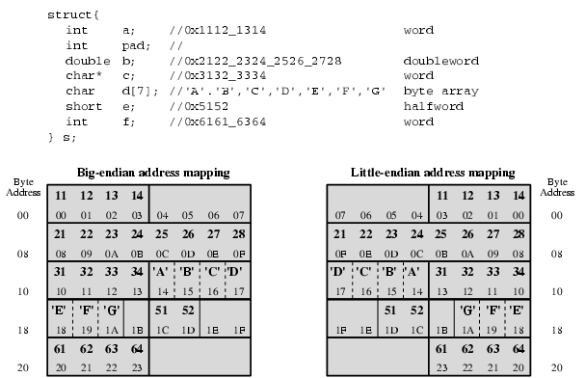
Example of C Data Structure

Slide 52
Common file formats and their endian order
Adobe Photoshop -- Big Endian
BMP (Windows and OS/2 Bitmaps) -- Little Endian
DXF (AutoCad) -- Variable
GIF -- Little Endian
IMG (GEM Raster) -- Big Endian
JPEG -- Big Endian
FLI (Autodesk Animator) -- Little Endian
MacPaint -- Big Endian
PCX (PC Paintbrush) -- Little Endian
PostScript -- Not Applicable (text!)
POV (Persistence of Vision ray-tracer) -- Not Applicable (text!)
QTM (Quicktime Movies) -- Little Endian (on a Mac!)
Microsoft RIFF (.WAV & .AVI) -- Both
Microsoft RTF (Rich Text Format) -- Little Endian
SGI (Silicon Graphics) -- Big Endian
Sun Raster -- Big Endian
TGA (Targa) -- Little Endian
TIFF -- Both, Endian identifier encoded into file
WPG (WordPerfect Graphics Metafile) -- Big Endian (on a PC!)
XWD (X Window Dump) -- Both, Endian identifier encoded into file

