Slide 1
BLM5207
Computer Organization
Prof. Dr. Nizamettin AYDIN
naydin@yildiz.edu.tr
http://www3.yildiz.edu.tr/~naydin
Data Formats

Slide 2
Data Formats
Computers
  Process and store all forms of data in binary format
Human communication
  Includes language, images and sounds
Data formats:
  Specifications for converting data into computer-usable form
  Define the different ways human data may be represented, stored and processed by a computer

Slide 3
Sources of Data
Binary input
  Begins as discrete input
    Example: keyboard input such as A 1+2=3 math
      Keyboard generates a binary number code for each key
Analog
  Continuous data such as sound or images
    Requires hardware to convert data into binary numbers
Computer
Computer representation:
1101000101010101…
Human form:
abcde1453
data
Input device

Slide 4
Common Data Representations
Type of Data | Standard(s)
Alphanumeric | Unicode, ASCII, EDCDIC
Image (bitmapped) | GIF (graphical image format) TIF (tagged image file format) PNG (portable network graphics)
Image (object) | PostScript, JPEG, SWF (Macromedia Flash), SVG
Outline graphics and fonts | PostScript, TrueType
Sound | WAV, AVI, MP3, MIDI, WMA
Page description | PDF (Adobe Portable Document Format), HTML, XML
Video | Quicktime, MPEG-2, RealVideo, WMV

Slide 5
Internal Data Representation
Reflects the
  Complexity of input source
  Type of processing required
Trade-offs
  Accuracy and resolution
    Simple photo vs. painting in an art book
  Compactness (storage and transmission)
    More data required for improved accuracy and resolution
    Compression represents data in a more compact form
    Metadata: data that describes or interprets the meaning of data
Ease of manipulation:
  Processing simple audio vs. high-fidelity sound
Standardization
  Proprietary formats for storing and processing data (WordPerfect vs. Word)
  De facto standards: proprietary standards based on general user acceptance (PostScript)

Slide 6
Data Types
Numeric:
  Used for mathematical manipulation
  Add, subtract, multiply, divide
  Types
    Integer (whole number)
    Real (contains a decimal point)
Alphanumeric:
  Characters: b T
  Number digits: 7 9
  Punctuation marks: ! ;
  Special-purpose characters: $ &
Numeric characters vs. numbers
  Both entered as ordinary characters
  Computer converts into numbers for calculation
    Examples: Variables declared as numbers by the programmer (Salary$ in BASIC)
  Treated as characters if processed as text
    Examples: Phone numbers, ZIP codes

Slide 7
Alphanumeric Codes
Arbitrary choice of bits to represent characters
  Consistency:
    input and output device must recognize same code
Value of binary number representing character corresponds to placement in the alphabet
  Facilitates sorting and searching
Representing Characters
  ASCII:
    most widely used coding scheme
  EBCDIC:
    IBM mainframe (legacy)
  Unicode:
    developed for worldwide use

Slide 8
ASCII
Developed by ANSI (American National Standards Institute)
Represents
  Latin alphabet, Arabic numerals, standard punctuation characters
  Plus small set of accents and other European special characters
ASCII
  7-bit code: 128 characters

Slide 9
ASCII Reference Table
MSD LSD | 0 | 1 | 2 | 3 | 4 | 5 | 6 | 7
0 | NUL | DLE | SP | 0 | @ | P |  | p
1 | SOH | DC1 | ! | 1 | A | Q | a | W
2 | STX | DC2 | “ | 2 | B | R | b | r
3 | ETX | DC3 | # | 3 | C | S | c | s
4 | EOT | DC4 | $ | 4 | D | T | d | t
5 | ENQ | NAK | % | 5 | E | U | e | u
6 | ACJ | SYN | & | 6 | F | V | f | v
7 | BEL | ETB | ‘ | 7 | G | W | g | w
8 | BS | CAN | ( | 8 | H | X | h | x
9 | HT | EM | ) | 9 | I | Y | i | y
A | LF | SUB | * | : | J | Z | j | z
B | VT | ESC | + | ; | K | [ | k | {
C | FF | FS | , | < | L | \ | l | |
D | CR | GS | - | = | M | ] | m | }
E | SO | RS | . | > | N | ^ | n | ~
F | SI | US | / | ? | O | _ | o | DEL
74₁₆
111 0100

Slide 10
EBCDIC
Extended Binary Coded Decimal Interchange Code developed by IBM
  Restricted mainly to IBM or IBM compatible mainframes
  Conversion software to/from ASCII available
  Common in archival data
  Character codes differ from ASCII
 | ASCII | EBCDIC
Space | 20₁₆ | 40₁₆
A | 41₁₆ | C1₁₆
b | 62₁₆ | 82₁₆

Slide 11
Unicode
Most common 16-bit form represents 65,536 characters
ASCII Latin-I subset of Unicode
  Values 0 to 255 in Unicode table
Multilingual: defines codes for
  Nearly every character-based alphabet
  Large set of ideographs for Chinese, Japanese and Korean
  Composite characters for vowels and syllabic clusters required by some languages
Allows software modifications for local-languages

Slide 12
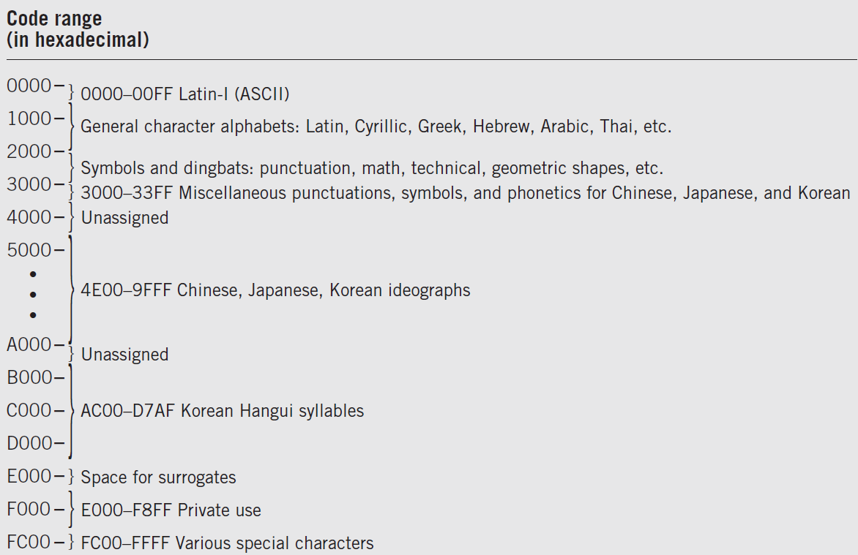
Unicode Assignment Table

Slide 13
2 Classes of Codes
Printing characters
  Produced on the screen or printer
Control characters
  Control position of output on screen or printer
    VT: vertical tab LF: Line feed
  Cause action to occur
    BEL: bell rings DEL: delete current character
  Communicate status between computer and I/O device
    ESC: provides extensions by changing the meaning of a specified number of contiguous following characters

Slide 14
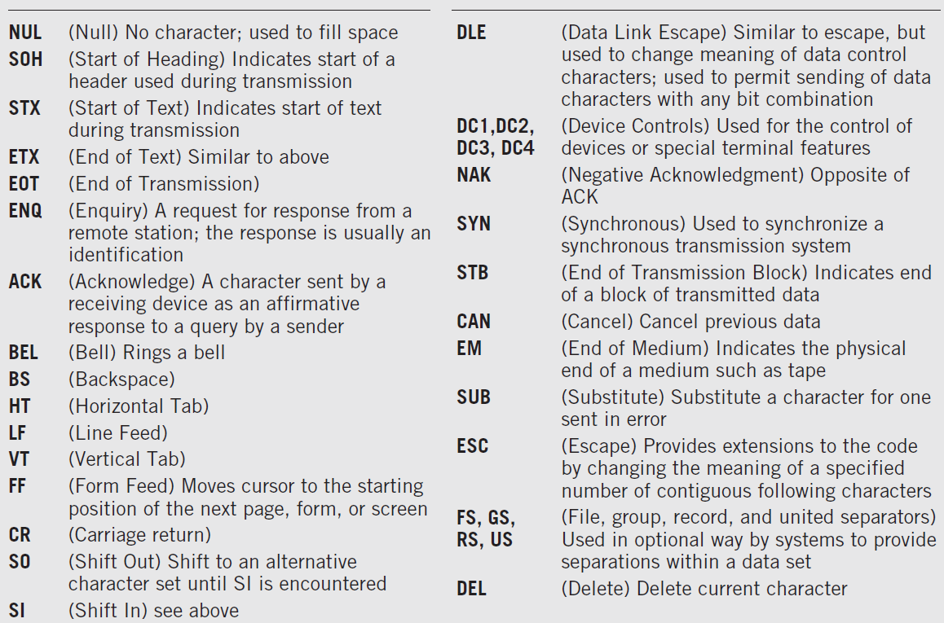
Control Code Definitions

Slide 15
Keyboard Input
Scan code
  Two different scan codes on keyboard
    One generated when key is struck and another when key is released
  Converted to Unicode, ASCII or EBCDIC by software in terminal or PC
Advantage
  Easily adapted to different languages or keyboard layout
  Separate scan codes for key press/release for multiple key combinations
    Examples: shift and control keys

Slide 16
Other Alphanumeric Input
OCR (optical character reader)
  Scans text and inputs it as character data
  Used to read specially encoded characters
    Example: magnetically printed check numbers
  General use limited by high error rate
Bar Code Readers
  Used in applications that require fast, accurate and repetitive input with minimal employee training
    Examples: supermarket checkout counters and inventory control
  Alphanumeric data in bar code read optically using wand
Magnetic stripe reader:
  alphanumeric data from credit cards
Voice
  Digitized audio recording common but conversion to alphanumeric data difficult
    Requires knowledge of sound patterns in a language (phonemes) plus rules for pronunciation, grammar, and syntax

Slide 17
Image Data
Photographs, figures, icons, drawings, charts and graphs
Two approaches:
  Bitmap or raster images of photos and paintings with continuous variation
  Object or vector images composed of graphical objects like lines and curves defined geometrically
Differences include:
  Quality of the image
  Storage space required
  Time to transmit
  Ease of modification

Slide 18
Bitmap Images
Used for realistic images with continuous variations in shading, color, shape and texture
  Examples:
    Scanned photos
    Clip art generated by a paint program
Preferred when image contains large amount of detail and processing requirements are fairly simple
Input devices:
  Scanners
  Digital cameras and video capture devices
  Graphical input devices like mice and pens
Managed by photo editing software or paint software
  Editing tools to make tedious bit by bit process easier

Slide 19
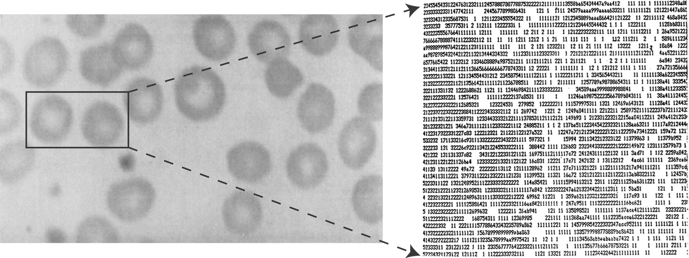
Bitmap Images
Each individual pixel (pi(x)cture element) in a graphic stored as a binary number
  Pixel:
    A small area with associated coordinate location
  Example:
    each point below represented by a 4-bit code corresponding to 1 of 16 shades of gray

Slide 20
Bitmap Display
Monochrome:
  black or white
    1 bit per pixel
Gray scale:
  black, white or 254 shades of gray
    1 byte per pixel
Color graphics:
  16 colors, 256 colors, or 24-bit true color (16.7 million colors)
    4, 8, and 24 bits respectively

Slide 21
Storing Bitmap Images
Frequently large files
  Example: 600 rows of 800 pixels with 1 byte for each of 3 colors ➔ ~1.5MB file
File size affected by
  Resolution (the number of pixels per inch)
    Amount of detail affecting clarity and sharpness of an image
  Levels: number of bits for displaying shades of gray or multiple colors
    Palette: color translation table that uses a code for each pixel rather than actual color value
Data compression

Slide 22
GIF (Graphics Interchange Format)
First developed by CompuServe in 1987
GIF89a enabled animated images
  allows images to be displayed sequentially at fixed time sequences
Color limitation: 256
Image compressed by LZW (Lempel-Zif-Welch) algorithm
Preferred for line drawings, clip art and pictures with large blocks of solid color
Lossless compression

Slide 23
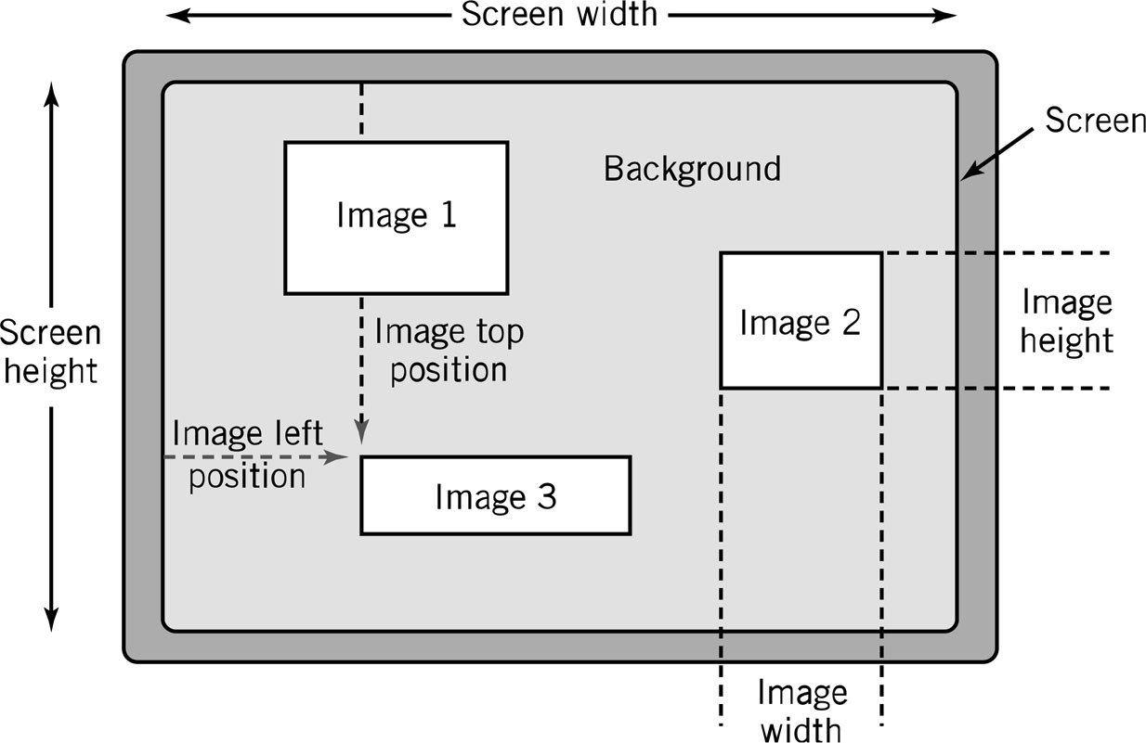
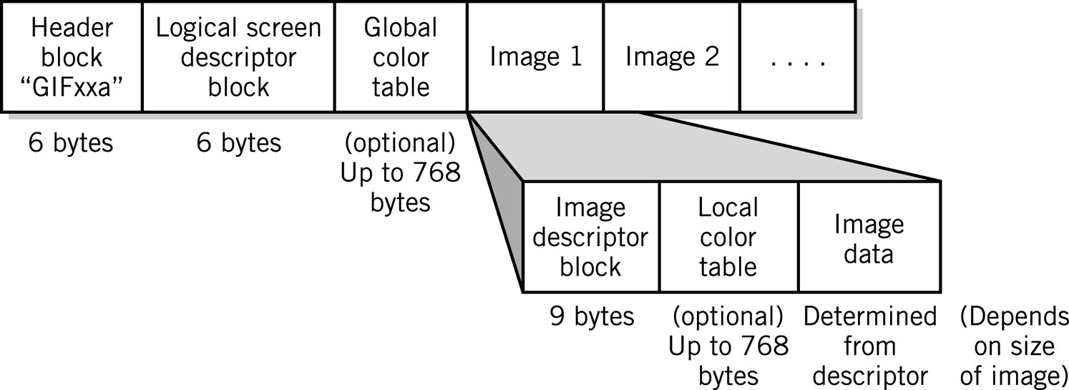
GIF (Graphics Interchange Format)

Slide 24
JPEG (Joint Photographers Expert Group)
Allows more than 16 million colors
Suitable for highly detailed photographs and paintings
Employs lossy compression algorithm that
  Discards data to decreases file size and transmission speed
  May reduce image resolution, tends to distort sharp lines

Slide 25
Other Bitmap Formats
TIFF (Tagged Image File Format): .tif (pronounced tif)
  Used in high-quality image processing, particularly in publishing
BMP (BitMaPped): .bmp (pronounced dot bmp)
  Device-independent format for Microsoft Windows environment:
    pixel colors stored independent of output device
PCX: .pcx (pronounced dot p c x)
  Windows Paintbrush software
PNG: (Portable Network Graphics): .png (pronounced ping)
  Designed to replace GIF and JPEG for Internet applications
  Patent-free
  Improved lossless compression
  No animation support

Slide 26
Object Images
Created by drawing packages or output from spreadsheet data graphs
Composed of lines and shapes in various colors
Computer translates geometric formulas to create the graphic
Storage space depends on image complexity
  number of instructions to create lines, shapes, fill patterns
Movies Shrek and Toy Story use object images

Slide 27
Object Images
Based on mathematical formulas
  Easy to move, scale and rotate without losing shape and identity as bitmap images may
Require less storage space than bitmap images
Cannot represent photos or paintings
Cannot be displayed or printed directly
  Must be converted to bitmap since output devices except plotters are bitmap

Slide 28
Popular Object Graphics Software
Most object image formats are proprietary
  Files extensions include .wmf, .dxf, .mgx, and .cgm
Macromedia Flash: low-bandwidth animation
Micrographx Designer: technical drawings to illustrate products
CorelDraw: vector illustration, layout, bitmap creation, image-editing, painting and animation software
Autodesk AutoCAD: for architects, engineers, drafters, and design-related professionals
W3C SVG (Scalable Vector Graphics) based on XML Web description language
  Not proprietary

Slide 29
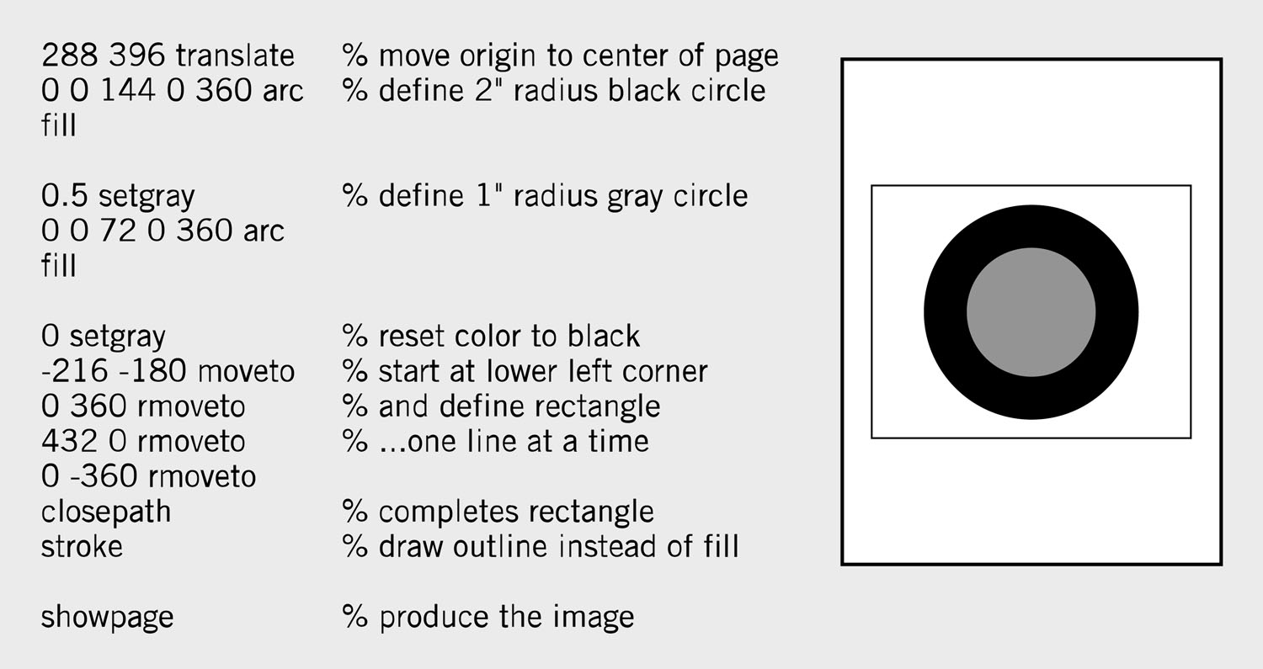
PostScript
Page description language:
  list of procedures and statements that describe each of the objects to be printed on a page
    Stored in ASCII or Unicode text file
    Interpreter program in computer or output device reads PostScript to generate image
  Scalable font support
    Font outline objects specified like other objects

Slide 30
Representing Characters
Characters stored in format like Unicode or ASCII
  Text processed and stored primarily for content
Presentation requirements like font stored with the character
  Text appearance is primary factor
    Example: screen fonts in Windows
Glyphs:
  Macintosh coding scheme that includes both identification and presentation requirement for characters

Slide 31
Bitmap vs. Object Images
Bitmap (Raster) | Object (Vector)
Pixel map | Geometrically defined shapes
Photographic quality | Complex drawings
Paint software | Drawing software
Larger storage requirements | Higher computational requirements
Enlarging images produces jagged edges | Objects scale smoothly
Resolution of output limited by resolution of image | Resolution of output limited by output device

Slide 32
Video Images
Require massive amount of data
  Video camera producing full screen 640 x 480 pixel true color image at 30 frames/sec ➔ 27.65 MB of data/sec
  1-minute film clip ➔ 1.6 GB storage
Options for reducing file size: decrease size of image, limit number of colors, reduce frame rate
Method depends on how video delivered to users
  Streaming video: video displayed as it is downloaded from the Web server
    Example: video conferencing
  Local data (file on DVD or downloaded onto system) for higher quality
    MPEG-2: movie quality images with high compression require substantial processing capability

Slide 33
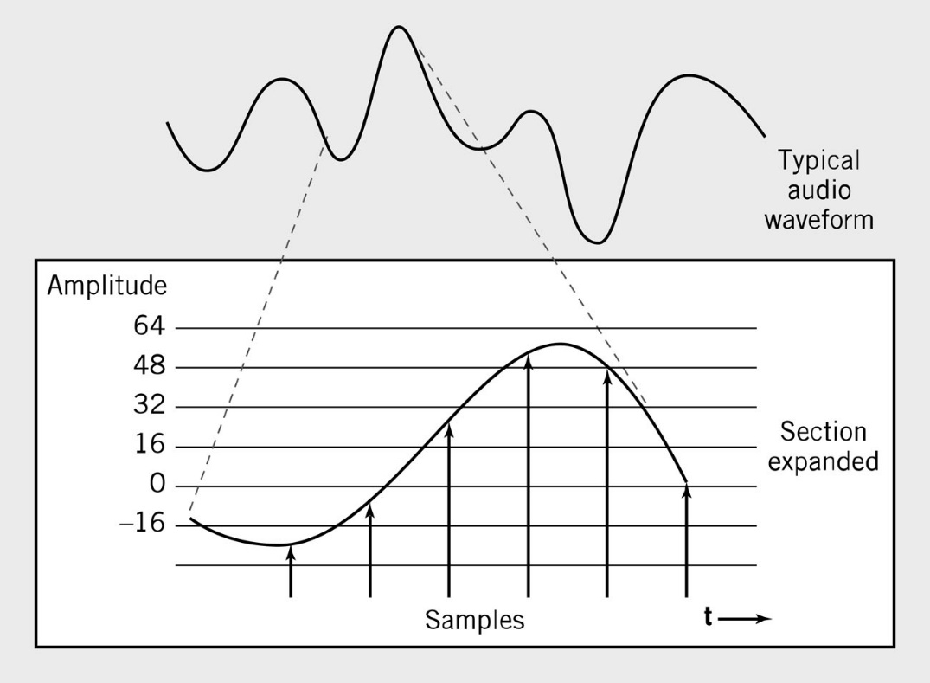
Audio Data
Transmission and processing requirements less demanding than those for video
Waveform audio: digital representation of sound
  Audio CD sampling rate = 44.1KHz
    Height of each sample saved as:
      8-bit number for radio-quality recordings
      16-bit number for high-fidelity recordings
        2 x 16-bits for stereo

Slide 34
MIDI
MIDI (Musical Instrument Digital Interface):
  instructions to recreate or synthesize sounds
    Analog sound converted to digital values by A-to-D converter
  Music notation system that allows computers to communicate with music synthesizers
  Instructions that MIDI instruments and MIDI sound cards use to recreate or synthesize sounds.
    Do not store or recreate speaking or singing voices
    More compact than waveform
      3 minutes = 10 KB

Slide 35
Audio Formats
MP3
  Derivative of MPEG-2 (ISO Moving Picture Experts Group)
  Uses psychoacoustic compression techniques to reduce storage requirements
  Discards sounds outside human hearing range: lossy compression
WAV
  Developed by Microsoft as part of its multimedia specification
  General-purpose format for storing and reproducing small snippets of sound

Slide 36
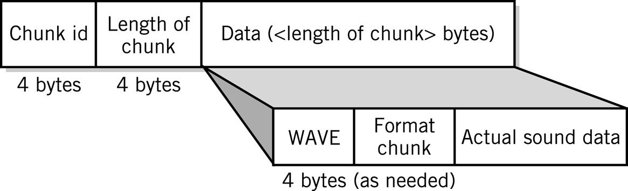
.WAV Sound Format

Slide 37
Data Compression
Compression: recoding data so that it requires fewer bytes of storage space.
Compression ratio: the amount file is shrunk
Lossless: inverse algorithm restores data to exact original form
  Examples: GIF, PCX, TIFF
Lossy: trades off data degradation for file size and download speed
  Much higher compression ratios, often 10 to 1
    Example: JPEG
  Common in multimedia
MPEG-2: uses both forms for ratios of 100:1

Slide 38
Compression Algorithms
Repetition
  0 5 8 7 0 0 0 0 3 4 0 0 0 ➔ 0 1 5 8 7 0 4 3 4 0 3
  Example: large blocks of the same color
Pattern Substitution
  Scans data for patterns
  Substitutes new pattern,
  makes dictionary entry
Example: 45 to 30 bytes plus dictionary
  Peter Piper picked a peck of pickled peppers.
   t ⇨  p ⇨   a   of  l   pp ⇨ s.
 | Pe | ✵ | pi | ❖ | ed
⇨ | er | ◎ | ck |  | pe
✪ | Pi

Slide 39
Internal Computer Data Format
All data stored as binary numbers
  Interpreted based on
    Operations computer can perform
    Data types supported by programming language used to create application
Simple Data Types
  Boolean:
    2-valued variables or constants with values of true or false
  Char:
    Variable or constant that holds alphanumeric character
  Enumerated:
    User-defined data types with possible values listed in definition
      Type DayOfWeek = Mon, Tues, Wed, Thurs, Fri, Sat, Sun
  Integer:
    positive or negative whole numbers
  Real :
    Numbers with a decimal point, whose magnitude (large or small) exceeds computer’s capability to store as an integer

Slide 40
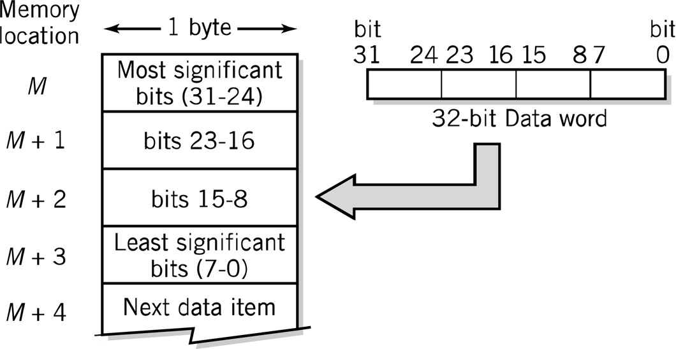
Representing Numbers - 32-bit Data Word

Slide 41
Unsigned Numbers: Integers
Unsigned whole number or integer
Direct binary equivalent of decimal integer
  4 bits: 0 to 9 16 bits: 0 to 9,999
  8 bits: 0 to 99 32 bits: 0 to 99,999,999
Decimal | Binary | BCD
68 | = 0100 0100 | = 0110 1000
 | = 2⁶ + 2² = 64 + 4 = 68 | = 2² + 2¹ = 6 2³ = 8
99 (largest 8-bit BCD) | = 0110 0011 | = 1001 1001
 | = 2⁶ + 2⁵ + 2¹ + 2⁰ = = 64 + 32 + 2 + 1 = 99 | = 2³ + 2⁰ 2³ + 2⁰ = 9 9
255 (largest 8-bit binary) | = 1111 1111 | = 0010 0101 0101
 | = 2⁸ – 1 = 255 | = 2¹ 2² + 2⁰ 2² + 2⁰ = 2 5 5

Slide 42
Value Range: Binary vs. BCD
BCD range of values < conventional binary representation
  Binary: 4 bits can hold 16 different values (0 to 15)
  BCD: 4 bits can hold only 10 different values (0 to 9)
Binary representation generally preferred
  Greater range of value for given number of bits
  Calculations easier
BCD often used in business applications to maintain decimal rounding and decimal precision
No. of Bits | BCD Range |  | Binary Range
4 | 0-9 | 1 digit | 0-15 | 1+ digit
8 | 0-99 | 2 digits | 0-255 | 2+ digits
12 | 0-999 | 3 digits | 0-4,095 | 3+ digits
16 | 0-9,999 | 4 digits | 0-65,535 | 4+ digits
20 | 0-99,999 | 5 digits | 0-1 million | 6 digits
24 | 0-999,999 | 6 digits | 0-16 million | 7+ digits
32 | 0-99,999,999 | 8 digits | 0-4 billion | 9+ digits
64 | 0-(10¹⁶-1) | 16 digits | 0-16 quintillion | 19+ digits

Slide 43
Signed-Integer Representation
2’s Complement
  +3 = 00000011 +2 = 00000010
  +1 = 00000001 +0 = 00000000
  -1 = 11111111 -2 = 11111110 -3 = 11111101

Slide 44
Floating Point Representation (IEEE-754 fp)
s
biased exp.
fraction
32 bits:
1
8 bits
23 bits
N = (-1)^{s} x 1.fraction x 2^{(biased exp. – 127)}
Sign: 1 bit
Mantissa: 23 bits
  We “normalize” the mantissa by dropping the leading 1 and recording only its fractional part
Exponent: 8 bits
  In order to handle both +ve and -ve exponents, we add 127 to the actual exponent to create a “biased exponent”:
    2⁻¹²⁷ => biased exponent = 0000 0000 (= 0)
    2⁰ => biased exponent = 0111 1111 (= 127)
    2⁺¹²⁷ => biased exponent = 1111 1110 (= 254)

