Slide 1
Computer Architecture Some questions & answers
Prof. Nizamettin AYDIN, PhD
naydin@yildiz.edu.tr
http://www3.yildiz.edu.tr/~naydin

Slide 2
AcA-00-Introduction
What is Computer Organization?
What is Computer Architecture?
Brief history of computing systems
What are the classes of computers?
What are the constituents of a computer?
What are the constituents of a CPU?
What are the constituents of a Control Unit?
What are the levels of program code?
What is a program?
How do you describe The Computer Level Hierarchy?

Slide 3
AcA-01-Fundamentals
What is informatics?
What is data?
What is information?
What is knowledge?
What is a system?
What is an information system?
What are to components that implement information system?
What is a computing system?
What is a digital system?
What is a signal?

Slide 4
AcA-01-Fundamentals
Compare analog and digital signals
Why do we sample a signal?
Why do we quantize a signal?
Describe continuous, discrete, and digital signals.
Describe the process of obtaining digital signals
What is sampling theorem?
What are the fundamental data types represented in a computing system?
Boolean algebra, digital circuit functions

Slide 5
AcA-02-InstructionSet-rev
What is an instruction?
What is instruction set?
What is meant by Instruction Set Architecture? Explain
What are the general instruction types in a computing system?
What are the elements of an instruction?
Classify instruction set in terms of number of operands.
What types of operand an instruction can take?
What is Big/Little Endian?

Slide 6
AcA-03-Performance
List common performance metrics used in a computing system.
Describe the Forces on Computer Architecture.
What type of parallelisms exist in a computing system?
What are the classes of computers?
What is Flynn’s Taxonomy?
Power consumption in a processor
How to reduce power consumption?
What are the basic performance metrics?
What are the measurement tools?
What is Amdahl’ law?

Slide 7
AcA-04-MemoryHierarchy
What is Memory Hierarchy?
What is the Principle of Locality?
What is a Cache?
Why a Cache Memory is used?
How many cash types exist?
What is Main Memory
What is Virtual Memory
Why a Virtual Memory is used?
Classify memory types
Differences between SRAM and DRAM?
Memory organization
Virtual machines

Slide 8
AcA-05-Instruction-Level Parallelism
Explain Instruction-Level Parallelism
What is pipelining?
What is main constraint in paralellism?
How many dependences exist?
What are data hazards?
What techniques exist to avoid dependences
What is purpose of Tomasulo’s algorithm?
Compare the processors interms of pipelining

Slide 9
AcA-06-Data-Level Parallelism
What are the classes of parallelizm? Briefly explain
Classify computers in terms of the Data-Level Parallelism
Brifly describe Vector Architecture
How Vector Processors work? Explain with an example
Brifly describe Graphics Processing Units Architecture
What is heterogen computing system?

Slide 10
AcA-06-Data-Level Parallelism
Brifly describe NVIDIA Instruction Set Architecture
What are the Challenges for the GPU programmer
Compare Graphics Processing Units and vector Architectures
Dependences in Loop Level Parallelism
How to find dependences in Loop Level Parallelism

Slide 11
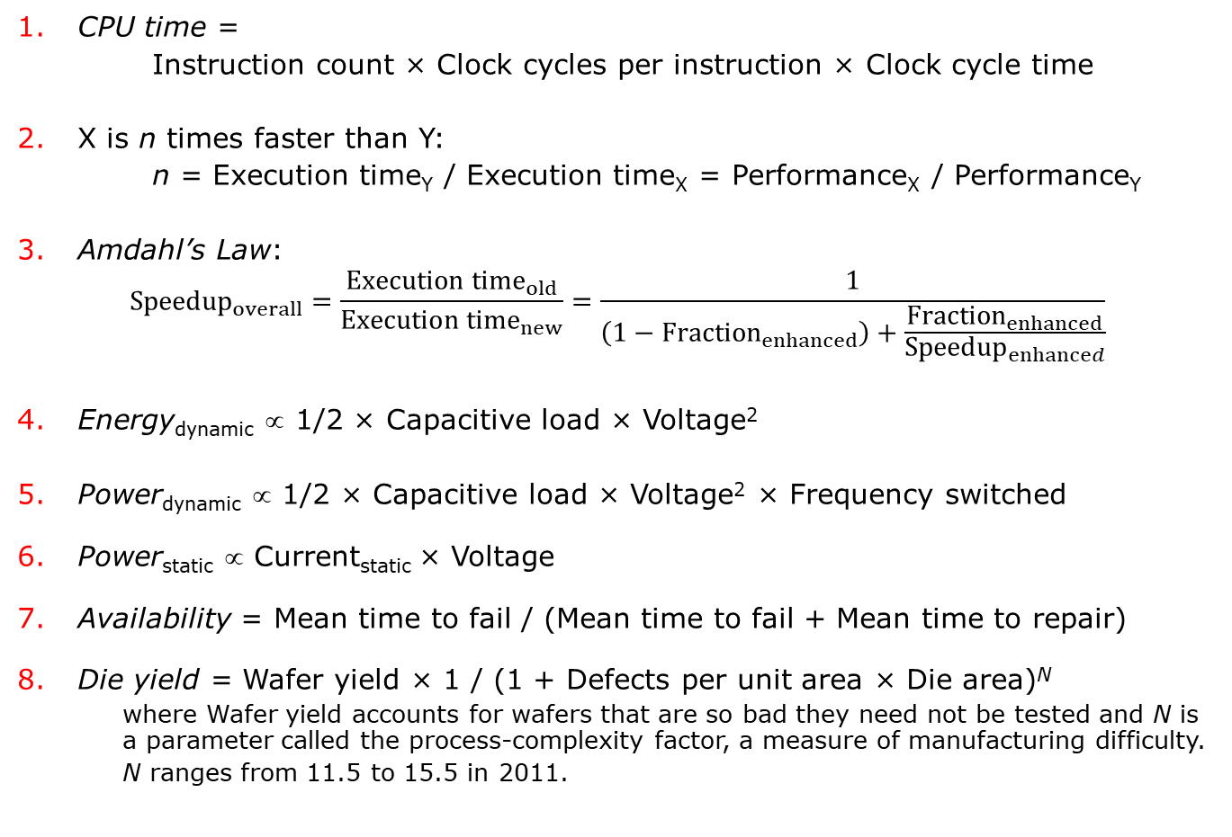
Computer Architecture Formulas
CPU time =
Instruction count × Clock cycles per instruction × Clock cycle time
X is n times faster than Y:
n = Execution time_{Y} / Execution time_{X} = Performance_{X} / Performance_{Y}
Amdahl’s Law:
$${Speedup}_{overall}=\frac{{Execution time}_{old}}{{Execution time}_{new}}=\frac{1}{\left(1−{Fraction}_{enhanced}\right)+\frac{{Fraction}_{enhanced}}{{Speedup}_{enhanced}}}$$
Energy_{dynamic} ∝ 1/2 × Capacitive load × Voltage²
Power_{dynamic} ∝ 1/2 × Capacitive load × Voltage² × Frequency switched
Power_{static} ∝ Current_{static} × Voltage
Availability = Mean time to fail / (Mean time to fail + Mean time to repair)
Die yield = Wafer yield × 1 / (1 + Defects per unit area × Die area)^{N}
where Wafer yield accounts for wafers that are so bad they need not be tested and N is a parameter called the process-complexity factor, a measure of manufacturing difficulty.
N ranges from 11.5 to 15.5 in 2011.

Slide 12
Computer Architecture Formulas
Means—arithmetic (AM), weighted arithmetic (WAM), and geometric (GM):
$$AM=\frac{1}{n}\sum_{i=1}^{n}{{Time}_{i}}, WAM=\sum_{i=1}^{n}{{{Weight}_{i}×Time}_{i}} , GM=\sqrt[n]{\prod_{i=1}^{n}{{Time}_{i}}}$$
where Time_{i} is the execution time for the ith program of a total of n in the workload, Weight_{i} is the weighting of the ith program in the workload.
Average memory-access time = Hit time + Miss rate × Miss penalty
Misses per instruction = Miss rate × Memory access per instruction
Cache index size: 2^{index} = Cache size /(Block size × Set associativity)
$Power Utilization Effectiveness (PUE) of a Warehouse Scale Computer=\frac{Total Faciliy Power}{IT Equipment Power}$

Slide 13
Rules of Thumb
Amdahl/Case Rule:
A balanced computer system needs about 1 MB of main memory capacity and 1 megabit per second of I/O bandwidth per MIPS of CPU performance.
90/10 Locality Rule:
A program executes about 90% of its instructions in 10% of its code.
Bandwidth Rule:
Bandwidth grows by at least the square of the improvement in latency.

Slide 14
Rules of Thumb
2:1 Cache Rule:
The miss rate of a direct-mapped cache of size N is about the same as a two-way set-associative cache of size N/2.
Dependability Rule:
Design with no single point of failure.
Watt-Year Rule:
The fully burdened cost of a Watt per year in a Warehouse Scale Computer in North America in 2011, including the cost of amortizing the power and cooling infrastructure, is about $2.

