Slide 1
BLM6112
Advanced Computer Architecture
Fundamentals of Quantitative Design and Analysis
Prof. Dr. Nizamettin AYDIN
naydin@yildiz.edu.tr
http://www3.yildiz.edu.tr/~naydin

Slide 2
Performance Metrics
Objectives
  How can we meaningfully measure and compare computer performance?
  Understand why program performance varies
    Understand how applications and the compiler impact performance
    Understand how CPU impacts performance
    What trade-offs are involved in designing a CPU?
  Purchasing perspective vs design perspective

Slide 3
Outline
Latency, delay, time
Throughput
Cost
Power
Energy
Reliability

Slide 4
Forces on Computer Architecture
Technology
Programming
Languages
Applications
Computer
Architecture
Operating
Systems
History
Notes:
History/Applications matters because
1) People buy computers to run programs
2) Most people don;’t write own programs
3) Documented IDA interface means people ship binary machine code

Slide 5
What is Computer Architecture?
Application
Operating
System
Compiler
Firmware
Instruction Set
Architecture
Instr. Set Proc.
I/O system
Datapath & Control
Digital Design
Circuit Design
Layout
Coordination of many levels of abstraction
  Under a rapidly changing set of forces
Design, Measurement, and Evaluation

Slide 6
Computer Architecture is
The attributes of a [computing] system as seen by the programmer, i.e., the conceptual structure and functional behavior, as distinct from the organization of the data flows and controls the logic design, and the physical implementation.
Amdahl, Blaaw, and Brooks, 1964
SOFTWARE

Slide 7
A Changing Definition
1950s to 1960s: Computer Architecture Course
  Computer Arithmetic
1970s to mid 1980s: Computer Architecture Course
  Instruction Set Design, especially ISA appropriate for compilers
1990s: Computer Architecture Course
  Design of CPU, memory system, I/O system, Multiprocessors

Slide 8
The Instruction Set: a Critical Interface
Software
instruction set
Hardware

Slide 9
Instruction Set Architecture
Organization of Programmable Storage
Data Types & Data Structures Encodings & Representations
Instruction Formats
Instruction (or Operation Code) Set
Modes of Addressing and Accessing Data Items and Instructions
Exceptional Conditions
SOFTWARE

Slide 10
Computer Organization
Capabilities & Performance Characteristics of Principal Functional Units
  (e.g., Registers, ALU, Shifters, Logic Units, ...)
Ways in which these components are interconnected
Information flows between components
Logic and means by which such information flow is controlled.
Choreography of FUs to realize the ISA
Register Transfer Level (RTL)
hardware design
Notes:
Design state of art organization in 1990

Slide 11
Computer Technology
Performance improvements:
  Improvements in semiconductor technology
    Feature size, clock speed
  Improvements in computer architectures
    Enabled by HLL compilers, UNIX
    Lead to RISC architectures
  Together have enabled:
    Lightweight computers
    Productivity-based managed/interpreted programming languages

Slide 12
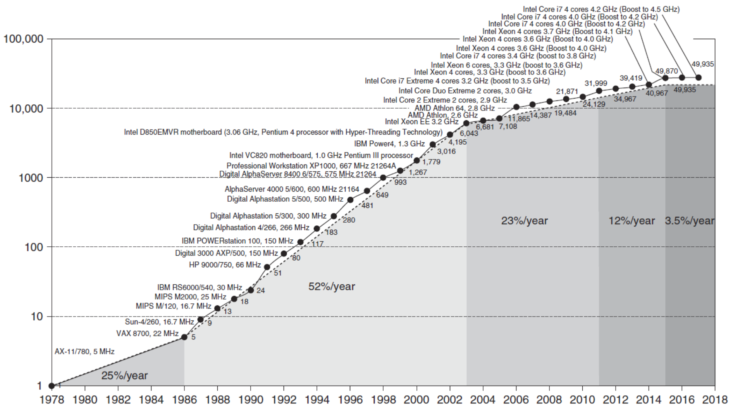
Growth in processor performance over 40 years

Slide 13
Current Trends in Architecture
Cannot continue to leverage Instruction-Level Parallelism (ILP)
  Single processor performance improvement ended in 2003
New models for performance:
  Data-Level Parallelism (DLP)
  Thread-Level Parallelism (TLP)
  Request-Level Parallelism (RLP)
These require explicit restructuring of the application

Slide 14
Classes of Computers
Personal Mobile Device (PMD)
  e.g. start phones, tablet computers
  Emphasis on energy efficiency and real-time
Desktop Computing
  Emphasis on price-performance
Servers
  Emphasis on availability, scalability, throughput
Clusters / Warehouse Scale Computers
  Used for “Software as a Service (SaaS)”
  Emphasis on availability and price-performance
  Sub-class: Supercomputers, emphasis: floating-point performance and fast internal networks
Internet of Things/Embedded Computers
  Emphasis: price

Slide 15
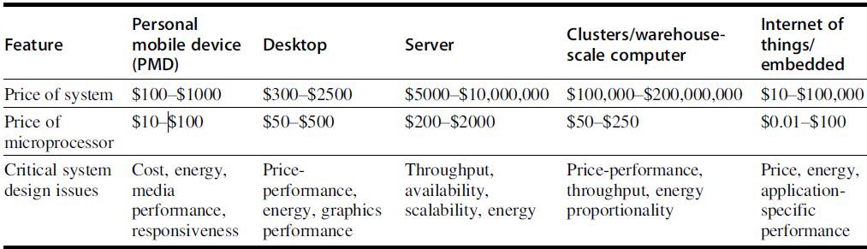
A summary of the five mainstream computing classes and their system characteristics
Sales in 2015 included about
  1.6 billion PMDs (90% cell phones),
  275 million desktop PCs,
  15 million servers.
  19 billion embedded processors.
In total, 14.8 billion ARM-technology-based chips were shipped in 2015

Slide 16
Parallelism
Parallelism at multiple levels is now the driving force of computer design across all four classes of computers,
  with energy and cost being the primary constraints.
Classes of parallelism in applications:
  Data-Level Parallelism (DLP)
    arises because there are many data items that can be operated on at the same time.
  Task-Level Parallelism (TLP)
    arises because tasks of work are created that can operate independently and largely in parallel.

Slide 17
Parallelism
Computer hardware in turn can exploit these two kinds of application parallelism in four major ways:
  Instruction-Level Parallelism (ILP)
    exploits data-level parallelism at modest levels with compiler help using ideas like pipelining and at medium levels using ideas like speculative execution.
  Vector architectures/Graphic Processor Units (GPUs) and multimedia instruction sets
    exploit data-level parallelism by applying a single instruction to a collection of data in parallel.

Slide 18
Parallelism
  Thread-Level Parallelism (TLP)
    exploits either data-level parallelism or task-level parallelism in a tightly coupled hardware model that allows for interaction between parallel threads.
  Request-Level Parallelism (RLP)
    exploits parallelism among largely decoupled tasks specified by the programmer or the operating system.
When Flynn (1966) studied the parallel computing efforts in the 1960s, he found a simple classification whose abbreviations we still use today.
  He looked at the parallelism in the instruction and data streams called for by the instructions at the most constrained component of the multiprocessor and placed all computers in one of four categories:

Slide 19
Flynn’s Taxonomy
Single instruction stream, single data stream (SISD)
  the uniprocessor
  it can exploit ILP
Single instruction stream, multiple data streams (SIMD)
  The same instruction is executed by multiple processors using different data streams
  exploit DLP by applying the same operations to multiple items of data in parallel
    Vector architectures
    Multimedia extensions
    Graphics processor units

Slide 20
Flynn’s Taxonomy
Multiple instruction streams, single data stream (MISD)
  No commercial implementation
Multiple instruction streams, multiple data streams (MIMD)
  Each processor fetches its own instructions and operates on its own data, and it targets TLP
  can also exploit DLP
  more flexible than SIMD and thus more generally applicable, but it is inherently more expensive than SIMD
    Tightly-coupled MIMD
    Loosely-coupled MIMD

Slide 21
Defining Computer Architecture
“Old” view of computer architecture:
  Instruction Set Architecture (ISA) design
  i.e. decisions regarding:
    registers, memory addressing, addressing modes, instruction operands, available operations, control flow instructions, instruction encoding
“Real” computer architecture:
  Specific requirements of the target machine
  Design to maximize performance within constraints:
    cost, power, and availability
  Includes ISA, microarchitecture, hardware

Slide 22
Instruction Set Architecture
Class of ISA
  General-purpose registers
  Register-memory vs load-store
RISC-V registers
  32 g.p., 32 f.p.
Register | Name | Use | Saver
x9 | s1 | Saved | callee
x10-x17 | a0-a7 | Arguments | caller
x18-x27 | s2-s11 | Saved | callee
x28-x31 | t3-t6 | Temporaries | caller
f0-f7 | ft0-ft7 | FP temps | caller
f8-f9 | fs0-fs1 | FP saved | callee
f10-f17 | fa0-fa7 | FP arguments | callee
f18-f27 | fs2-fs21 | FP saved | callee
f28-f31 | ft8-ft11 | FP temps | caller
Register | Name | Use | Saver
x0 | zero | constant 0 | n/a
x1 | ra | return addr | caller
x2 | sp | stack ptr | callee
x3 | gp | gbl ptr
x4 | tp | thread ptr
x5-x7 | t0-t2 | temporaries | caller
x8 | s0/fp | saved/ frame ptr | callee

Slide 23
Instruction Set Architecture
Memory addressing
  RISC-V: byte addressed, aligned accesses faster
Addressing modes
  RISC-V: Register, immediate, displacement (base+offset)
  Other examples: autoincrement, indexed, PC-relative
Types and size of operands
  RISC-V: 8-bit, 32-bit, 64-bit

Slide 24
Instruction Set Architecture
Operations
  RISC-V: data transfer, arithmetic, logical, control, floating point
    See Fig. 1.5 in text, or The RISC-V Instruction Set Manual
Control flow instructions
  Use content of registers (RISC-V) vs. status bits (x86, ARMv7, ARMv8)
  Return address in register (RISC-V, ARMv7, ARMv8) vs. on stack (x86)
Encoding
  Fixed (RISC-V, ARMv7/v8 except compact instruction set) vs. variable length (x86)

Slide 25
Trends in Technology
Integrated circuit technology (Moore’s Law)
  Transistor density: 35%/year
  Die size: 10-20%/year
  Integration overall: 40-55%/year
DRAM capacity: 25-40%/year (slowing)
  8 Gb (2014), 16 Gb (2019), possibly no 32 Gb
Flash capacity: 50-60%/year
  8-10X cheaper/bit than DRAM
Magnetic disk capacity: recently slowed to 5%/year
  Density increases may no longer be possible,
    may be increase from 7 to 9 platters
  8-10X cheaper/bit then Flash
  200-300X cheaper/bit than DRAM

Slide 26
Bandwidth and Latency
Bandwidth or throughput
  Total work done in a given time
  32,000-40,000X improvement for processors
  300-1200X improvement for memory and disks
Latency or response time
  Time between start and completion of an event
  50-90X improvement for processors
  6-8X improvement for memory and disks

Slide 27
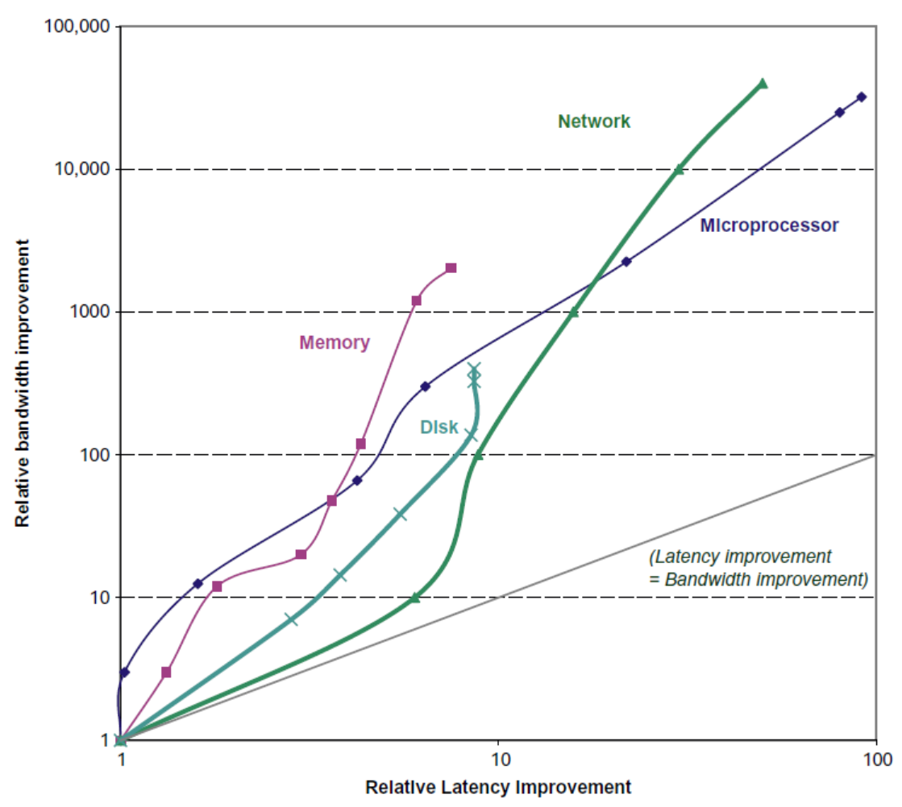
Bandwidth and Latency
Log-log plot of bandwidth and latency milestones

Slide 28
Transistors and Wires
Feature size
  Minimum size of transistor or wire in x or y dimension
    10 µm in 1971
    0.011 µm in 2017
    0.003 µm in 2021
  Transistor performance scales linearly
    Wire delay does not improve with feature size!
  Integration density scales quadratically

Slide 29
Power and Energy
Problem:
  Get power in, get power out
Thermal Design Power (TDP)
  Characterizes sustained power consumption
  Used as target for power supply and cooling system
  Lower than peak power (1.5X higher), higher than average power consumption
Clock rate can be reduced dynamically to limit power consumption
Energy per task is often a better measurement

Slide 30
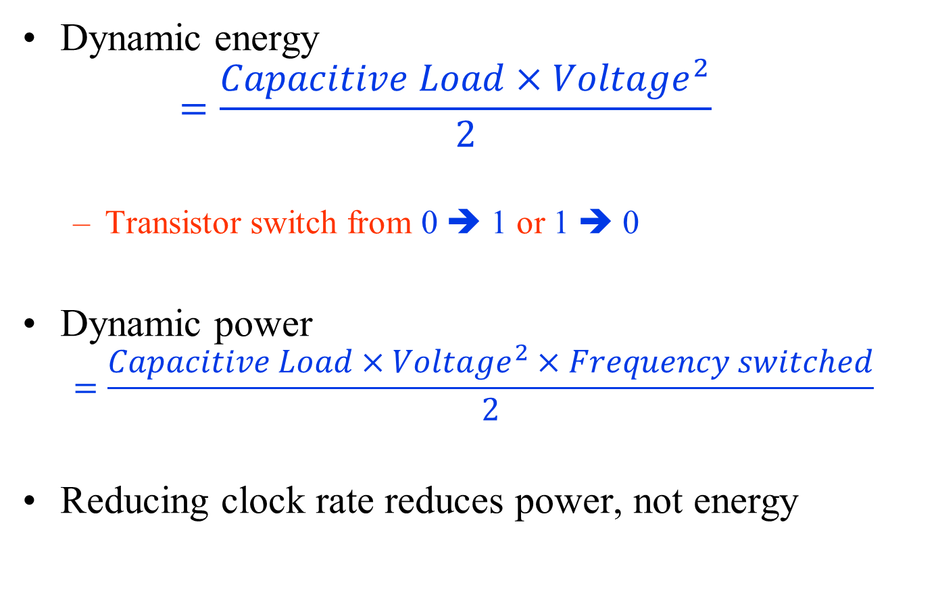
Dynamic Energy and Power
Dynamic energy
  $$=\frac{Capacitive Load×{Voltage}^{2}}{2}$$
  Transistor switch from 0 ➔ 1 or 1 ➔ 0
Dynamic power
  $$=\frac{Capacitive Load×{Voltage}^{2}×Frequency switched}{2}$$
Reducing clock rate reduces power, not energy

Slide 31
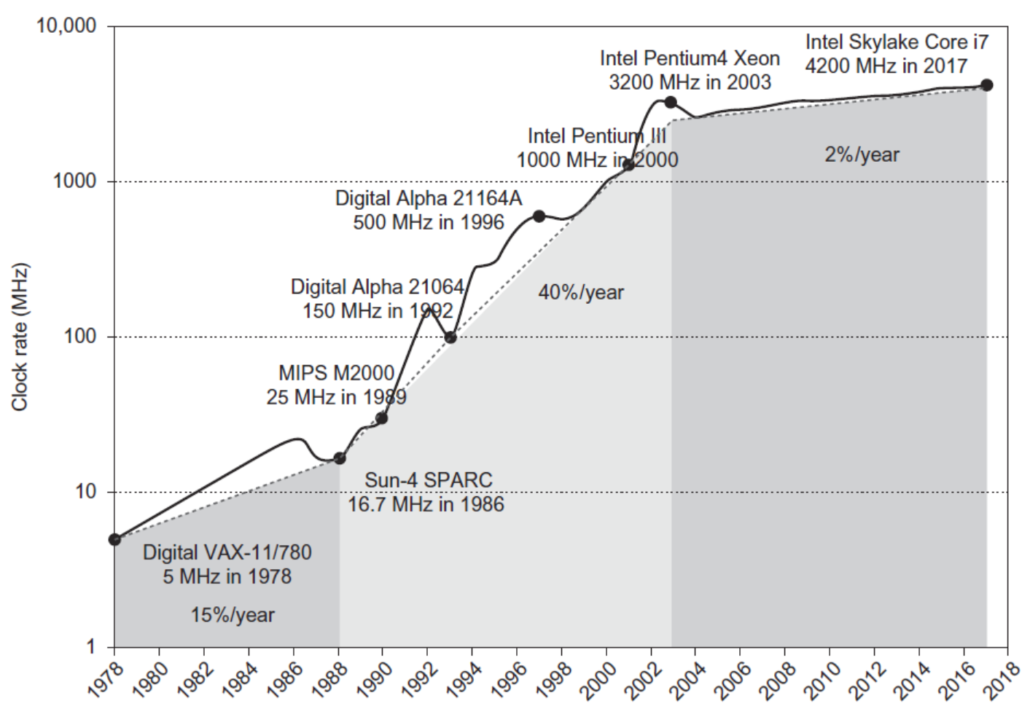
Power
Intel 80386 consumed ~ 2 W
3.3 GHz Intel Core i7 consumes 130 W
Heat must be dissipated from 1.5 x 1.5 cm chip
This is the limit of what can be cooled by air

Slide 32
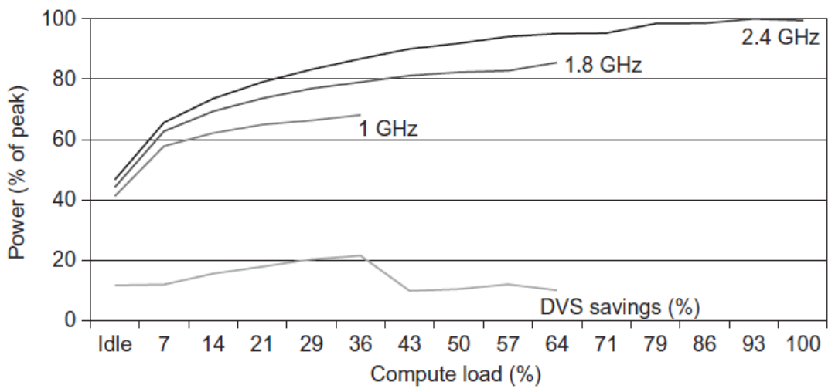
Reducing Power
Techniques for reducing power:
  Do nothing well
  Dynamic Voltage-Frequency Scaling
  Low power state for DRAM, disks
  Overclocking, turning off cores

Slide 33
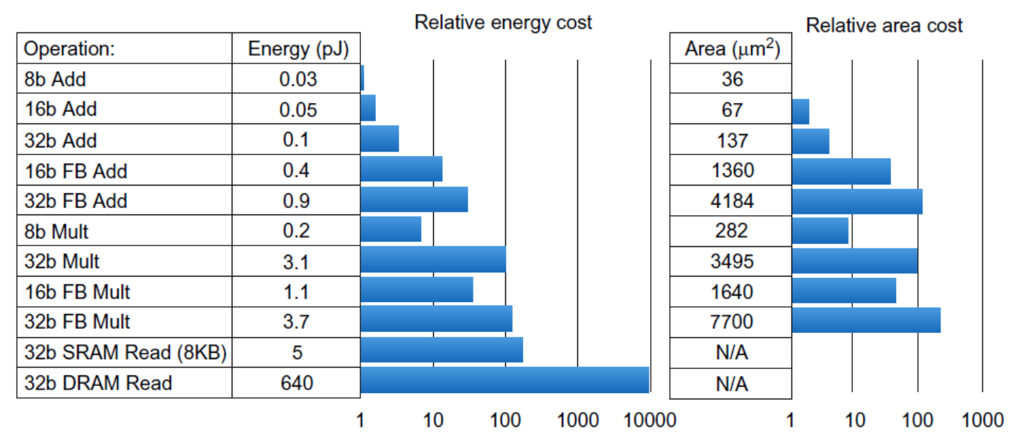

Static Power
Static power consumption
  $${=Current}_{static}×Voltage$$
  25-50% of total power
  Scales with number of transistors
  To reduce:
  power gating

Slide 34
Trends in Cost
Cost driven down by learning curve
  Yield
DRAM:
  price closely tracks cost
Microprocessors:
  price depends on volume
    10% less for each doubling of volume

Slide 35

Integrated Circuit Cost
Integrated circuit
Bose-Einstein formula:
Defects per unit area = 0.016-0.057 defects per square cm (2010)
N = process-complexity factor = 11.5-15.5 (40 nm, 2010)

Slide 36
Dependability
Module reliability
  Mean time to failure (MTTF)
  Mean time to repair (MTTR)
  Mean time between failures (MTBF) = MTTF + MTTR
  Availability = MTTF / MTBF

Slide 37
Measuring Performance
Typical performance metrics:
  Response time
  Throughput
Speedup of X relative to Y
  Execution time_{Y} / Execution time_{X}
Execution time
  Wall clock time: includes all system overheads
  CPU time: only computation time
Benchmarks
  Kernels (e.g. matrix multiply)
  Toy programs (e.g. sorting)
  Synthetic benchmarks (e.g. Dhrystone)
  Benchmark suites (e.g. SPEC06fp, TPC-C)

Slide 38
Basic Performance Metrics
Latency, delay, time
  Lower is better
    Complete a task as soon as possible
  Measured in sec, μs, ns
Throughput (bandwith)
  Higher is better
    Complete as many tasks per time as possible
  Measured in bytes/sec, instructions/sec
Cost
  Lower is better
    Complete tasks for as little money as possible
  Measured in $, TL, etc.

Slide 39
Basic Performance Metrics
Power
  Lower is better
    Complete tasks while dissipating as few joules/sec as possible
Energy
  Lower is better
    Complete tasks using as few joules as possible
  Measured in Joules, Joules/instruction
Reliability
  Higher is better
    Complete tasks with low probability of failure
  Measured in Mean time to failure (MTTF)
    MTTF: the average time until a failure occurs

Slide 40
Bandwidth and Latency
Bandwidth or throughput
  Total work done in a given time
    32,000-40,000X improvement for processors
    300-1200X improvement for memory and disks
Latency or response time
  Time between start and completion of an event
    50-90X improvement for processors
    6-8X improvement for memory and disks

Slide 41
Latency vs Throughput
Madrid to Istanbul is about 3600 km
Time:
  Aircraft 1 is faster than Aircraft 2
    900/750 = 1.2 times or 20% faster
Throughput:
  Aircraft 2 has a higher throughput
    (750*600)/(900*400) = 1.25 times the throughput or 25% more throughput

Slide 42
Response Time vs Throughput
Response time (latency)
  the time between the start and the completion of a task
    Important to individual users ( passengers)
Throughput (bandwidth)
  the total amount of work done in a given time
    Important to data center managers (airline)
Different performance metrics are required
  to benchmark embedded and desktop computers,
    which are more focused on response time,
  to benchmark servers,
    which are more focused on throughput

Slide 43

Principles of Computer Design
Take Advantage of Parallelism
  e.g. multiple processors, disks, memory banks, pipelining, multiple functional units
Principle of Locality
  Reuse of data and instructions
Focus on the Common Case
  Amdahl’s Law

Slide 44


Principles of Computer Design
The Processor Performance Equation

Slide 45


Principles of Computer Design
Different instruction types having different CPIs

Slide 46
What is Performance?
Purchasing perspective
  given a collection of machines, which has the
    best performance ?
    least cost ?
    best performance / cost ?
Design perspective
  faced with design options, which has the
    best performance improvement ?
    least cost ?
    best performance / cost ?
Both require
  basis for comparison
  metric for evaluation
Our goal is to understand cost & performance implications of architectural choices

Slide 47
Measurement and Evaluation
Architecture is an iterative process
-- searching the space of possible designs
-- at all levels of computer systems
Design
Analysis
Creativity
Cost /
Performance
Analysis
Good Ideas
Mediocre Ideas
Bad Ideas

Slide 48
Levels of Representation
temp = v[k];
v[k] = v[k+1];
v[k+1] = temp;
High Level Language
Program
Compiler
lw $15, 0($2)
lw $16, 4($2)
sw $16, 0($2)
sw $15, 4($2)
Assembly Language Program
Assembler
0000 1001 1100 0110 1010 1111 0101 1000
1010 1111 0101 1000 0000 1001 1100 0110
1100 0110 1010 1111 0101 1000 0000 1001
0101 1000 0000 1001 1100 0110 1010 1111
Machine Language Program
Machine Interpretation
Control Signal Specification
ALUOP[0:3] <= InstReg[9:11] & MASK
°
°

Slide 49
Metrics of Performance
Application
Answers per month
Operations per second
Programming
Language
Compiler
(millions) of Instructions per second: MIPS
(millions) of (FP) operations per second: MFLOP/s
ISA
Datapath
Control
Megabytes per second
Function Units
Cycles per second (clock rate)
Transistors
Wires
Pins
Each metric has a place and a purpose, and each can be misused

Slide 50
Basis of Evaluation
Pros
Cons
very specific
non-portable
difficult to run/measure
hard to identify cause
representative
Actual Target Workload
portable
widely used
improvements
useful in reality
Full Application Benchmarks
less representative
easy to run, early
in design cycle
Small “Kernel”
Benchmarks
easy to “fool”
identify peak
capability and
potential bottlenecks
“peak” may be a long way from application performance
Microbenchmarks

Slide 51
Measurement Tools
Benchmarks, Traces, Mixes
Hardware:
  Cost, delay, area, power estimation
Simulation (many levels)
  ISA, RT, Gate, Circuit
Queuing Theory
Rules of Thumb
Fundamental “Laws”/Principles

Slide 52
Which has Higher Performance?
Plane
DC to Paris
Speed
Passengers
Throughput (pmph)
Boeing 747
6.5 hours
610 mph
470
286,700
Concorde
3 hours
1350 mph
132
178,200
Time to run the task (Execution Time)
  Execution time, response time, latency
Tasks per day, hour, week, sec, ns … (Performance)
  Throughput, bandwidth
Notes:
Fastest for 1 person?
Which takes less time to transport 470 passengers?

Slide 53
Performance Definition
Performance is in units of things per sec (bigger is better)
If we are primarily concerned with response time
  " X is n times faster than Y" means
Speed of Concorde vs. Boeing 747
Throughput of Boeing 747 vs. Concorde

Slide 54
Performance: Example
Time of Concorde vs. Boeing 747?
  Concorde is 1350 mph / 610 mph = 2.2 times faster
  = 6.5 hours / 3 hours
Throughput of Concorde vs. Boeing 747 ?
  Concorde is 178,200 pmph / 286,700 pmph = 0.62 “times faster”
  Boeing is 286,700 pmph / 178,200 pmph = 1.6 “times faster”
Boeing is 1.6 times (“60%”) faster in terms of throughput
Concorde is 2.2 times (“120%”) faster in terms of flying time
We will focus primarily on execution time for a single job

Slide 55
Amdahl’s Law
The performance gain that can be obtained by improving some portion of a computer can be calculated using Amdahl’s Law.
Amdahl’s Law states that the performance improvement to be gained from using some faster mode of execution is limited by the fraction of the time the faster mode can be used.
Amdahl’s Law defines the speedup that can be gained by using a particular feature.

Slide 56
Amdahl’s Law
What is speedup?
Suppose that we can make an enhancement to a computer that will improve performance when it is used.
Speedup is the ratio
Alternatively

Slide 57
Amdahl's Law
Speedup due to enhancement E:
Suppose that enhancement E accelerates a fraction F of the task by a factor S, and the remainder of the task is unaffected
ExTime(w/E) = (1-F) x ExTime(w/o E) + F/S x ExTime(w/E)

Slide 58
Amdahl’s Law
ExTime_{new} = ExTime_{old} x (1 - Fraction_{enhanced}) +
Fraction_{enhanced}
Speedup_{enhanced}
ExTime_{old}
ExTime_{new}
1
Speedup_{overall} =
=
Fraction_{enhanced}
Speedup_{enhanced}
(1 - Fraction_{enhanced}) +

Slide 59
Amdahl’s Law: Example 1
Suppose that Floating point instructions are improved to run 2X; but only 10% of actual instructions are FP. What’s the overall speedup gained?
F = 0.1 S = 2
ExTime_{new} =
Speedup_{overall}=

Slide 60
Amdahl’s Law: Example 1
Suppose that Floating point instructions are improved to run 2X; but only 10% of actual instructions are FP. What’s the overall speedup gained?
F = 0.1 S = 2
ExTime_{new} = ExTime_{old} x (0.9 + 0.1/2) = 0.95 x ExTime_{old}
1
Speedup_{overall}=
=
1.053
0.95

Slide 61
Amdahl’s Law: Example 2
Suppose that we are considering an enhancement to the processor of a server system used for web serving. The new CPU is 10 times faster on computation in web serving application than the original processor. Assuming that the original CPU is busy with computation 40% of the time and is waiting for I/0 60% of time. What’s the overall speedup gained by incorporating the enhancement?
F = 0.4 S = 10
Speedup(E) = 1/((1-0.4) + 0.4/10)
= 1.56

Slide 62
Amdahl’s law: Example 2
Suppose we want to design a processor for graphic applications. Suppose that FP square root (FPSQR) computation is responsible for 20% of execution time and all FP instructions are responsible for 50% of execution time.
  Alternative 1: Enhance FPSQR hardware by a factor of 10.
  Speedup(FPSQR) = 1/((1-0.2)+ 0.2/10) = 1.22
  Alternative 2: Enhance the speedup of all FP operations by a factor of 1.6.
  Speedup(FP) = 1/((1-0.5) + 0.5/1.6) = 1.28
Improving the performance of the FP operations overall
is slightly better because of the higher frequency!

Slide 63
CPU Equation
CPI
inst count
Cycle time
Inst. Count CPI Clock Rate
Program X
Compiler X (X)
Inst. Set. X X
Organization X X
Technology X

Slide 64
CPI: Cycles Per Instruction
Average Cycles per Instruction
CPI = (CPU Time * Clock Rate) / Instruction Count
  = Cycles / Instruction Count
Instruction Frequency F_{j}

Slide 65
CPU Equation: Example 1
Reg-Reg Architecture
Op Freq Cycles CPI(i) % Time
ALU 50% 1 0.5 23%
Load 20% 5 1.0 45%
Store 10% 3 0.3 14%
Branch 20% 2 0.4 18%
2.2
Typical Mix
How much faster would the machine be if a better data cache reduced the average load time to 2 cycles?
How does this compare with using branch prediction to save a cycle off the branch time?
What if two ALU instructions could be executed at once?

Slide 66
CPU Equation: Example 2
Suppose we have the following measurements:
  Frequency of FP operations (others than FPSQR) = 25%
  Average CPI of FP operations = 4
  Average CPI of others instructions = 1.33
  Frequency of FPSQR = 2%
  CPI of FPSQR = 20
Assume:
  Alternative 1: decrease the CPI of FPSQR to 2
  Alternative 2: decrease the average CPI of all operations to 2.5
Compare the two design alternatives using CPU
performance equation.

Slide 67
CPU Equation: Example 2 (cont’d)
CPI_original = 75% * 1.33 + 25% * 4 = 2
CPI_newFPSQR = CPI_original – 2%*(CPI_oldFPSQR –
CPI_newFPSQR)
= 2 – 0.02*(20 – 2) = 1.64
CPI_newFP = 75% * 1.33 + 25% * 2.5 = 1.625
Speedup_newFP = CPU time original/CPU time new FP
= CPU_original / CPI_newFP
= 2.00/1.625 = 1.23
Speedup_newFPSQR = 2.00 / 1.64 = 1.22

Slide 68
CPU Equation: Example 3
Assume CPI = 1.0 ignoring branches (ideal)
Assume branch solution was delaying for 3 cycles
If 30% branch, delay 3 cycles on 30%
Op Freq Cycles CPI(i) (% Time)
Other 70% 1 0.7 (37%)
Branch 30% 4 1.2 (63%)
 new CPI = 1.9
New machine is 1/1.9 = 0.52 times faster (i.e. slow!)

Slide 69
SPEC: System Performance Evaluation Cooperative
First Round 1989
  10 programs yielding a single number (“SPECmarks”)
Second Round 1992
  SPECInt92 (6 integer programs) and SPECfp92 (14 floating point programs)
    Compiler Flags unlimited. March 93 of DEC 4000 Model 610:
  spice: unix.c:/def=(sysv,has_bcopy,”bcopy(a,b,c)= memcpy(b,a,c)”
  wave5: /ali=(all,dcom=nat)/ag=a/ur=4/ur=200
  nasa7: /norecu/ag=a/ur=4/ur2=200/lc=blas
Third Round 1995
  new set of programs: SPECint95 (8 integer programs) and SPECfp95 (10 floating point)
  “benchmarks useful for 3 years”
  Single flag setting for all programs: SPECint_base95, SPECfp_base95

Slide 70
SPEC First Round
One program: 99% of time in single line of code
New front-end compiler could improve dramatically

Slide 71
More Performance Metrics
Arithmetic mean (weighted arithmetic mean) tracks execution time: ∑(T_{i})/n or ∑(W_{i}*T_{i})
Harmonic mean (weighted harmonic mean) of rates (e.g., MFLOPS) tracks execution time:
n/∑(1/R_{i}) or n/∑(W_{i}/R_{i})
Normalized execution time is handy for scaling performance (e.g., X times faster than SPARCstation 10)
But do not take the arithmetic mean of normalized execution time, use the geometric mean (∏(R_{i})^1/n)

Slide 72
Impact of Means on SPECmark89 for IBM 550
Ratio to VAX Time Weighted Time
Program Before After Before After Before After
gcc 30 29 49 51 8.91 9.22
espresso 35 34 65 67 7.64 7.86
spice 47 47 510 510 5.69 5.69
doduc 46 49 41 38 5.81 5.45
nasa7 78 144 258 140 3.43 1.86
li 34 34 183 183 7.86 7.86
eqntott 40 40 28 28 6.68 6.68
matrix300 78 730 58 6 3.43 0.37
fpppp 90 87 34 35 2.97 3.07
tomcatv 33 138 20 19 2.01 1.94
Mean 54 72 124 108 54.42 49.99
Geometric Arithmetic Weighted Arith.
Ratio 1.33 Ratio 1.16 Ratio 1.09

Slide 73
SPEC Performance: Summary
“For better or worse, benchmarks shape a field”
Good products created when have:
  Good benchmarks
  Good ways to summarize performance
Given sales is a function in part of performance relative to competition, investment in improving product as reported by performance summary
If benchmarks/summary inadequate, then choose between improving product for real programs vs. improving product to get more sales;
Sales almost always wins!
Execution time is the measure of computer performance!

Slide 74
Performance Metrics: Summary
Design-time metrics:
  Can it be implemented, in how long, at what cost?
  Can it be programmed? Ease of compilation?
Static metrics:
  How many bytes does the program occupy in memory?
Dynamic metrics:
  How many instructions are executed?
  How many bytes does the processor fetch to execute the program?
  How many clocks are required per instruction?
  How "lean" a clock is practical?
Best Metric: Time to execute the program!
Depends on instructions set, processor organization, and compiler
CPI
Inst. Count
Cycle Time

Slide 75
Fallacies and Pitfalls
All exponential laws must come to an end
  Dennard scaling (constant power density)
    Stopped by threshold voltage
  Disk capacity
    30-100% per year to 5% per year
  Moore’s Law
    Most visible with DRAM capacity
    ITRS disbanded
    Only four foundries left producing state-of-the-art logic chips
    11 nm, 3 nm might be the limit

Slide 76
Fallacies and Pitfalls
Microprocessors are a silver bullet
  Performance is now a programmer’s burden
Falling prey to Amdahl’s Law
A single point of failure
Hardware enhancements that increase performance also improve energy efficiency, or are at worst energy neutral
Benchmarks remain valid indefinitely
  Compiler optimizations target benchmarks

Slide 77
Fallacies and Pitfalls
The rated mean time to failure of disks is 1,200,000 hours or almost 140 years, so disks practically never fail
  MTTF value from manufacturers assume regular replacement
Peak performance tracks observed performance
Fault detection can lower availability
  Not all operations are needed for correct execution

Slide 78
A Relative Performance Example
If computer A runs a program in 10 seconds and computer B runs the same program in 15 seconds,
  Which computer is faster?
  How much faster?
We know that A is n times faster than B if
  performance of A execution_time of B
  --------------------- = -------------------------- = n
  performance of B execution_time of A
The performance ratio n is 15/10 =1.5
So A is 1.5 times (50%) faster than B

Slide 79
Ratios of Measure: Side Note
For bigger-is-better metrics,
  improved means increase
    V_{new} = 2.5 * V_{old}
      A metric increased by 2.5 times (sometimes written 2.5x)
      A metric increased by 150% (x% increase == 0.01*x+1 times increase)
For smaller-is-better metrics,
  improved means decrease
    e.g., Latency improved by 2x, means latency decreased by 2x (i.e., dropped by 50%)
    e.g., Battery life worsened by 50%, means battery life decrease by 50%.

Slide 80
Examples
Bigger-is-better examples
  Bandwidth per dollar (e.g., in networking (GB/s)/$)
  BW/Watt (e.g., in memory systems (GB/s)/W)
  Work/Joule (e.g., instructions/joule)
  In general
    Multiply by big-is-better metrics, divide by smaller-is-better metrics
Smaller-is-better examples
  Cycles/Instruction (i.e., Time per work)
  Latency * Energy -- Energy Delay Product
  In general:
    Multiply by smaller-is-better metrics, divide by bigger-is-better metrics

Slide 81
Clock Cycle and Clock Rate
A clock cycle is a single electronic pulse of a CPU
  To synchronize different parts of the circuit
  To determine when events take place in the hardware
  Processor runs at a constant clock rate
  Clock cycle or tick or cycle = Discrete time interval
Clock rate (frequency)
  Number of clock cycles per second in hertz
    1 nsec (10⁻⁹) clock cycle => 1 GHz (10⁹) clock rate
    0.5 nsec clock cycle => 2 GHz clock rate

Slide 82
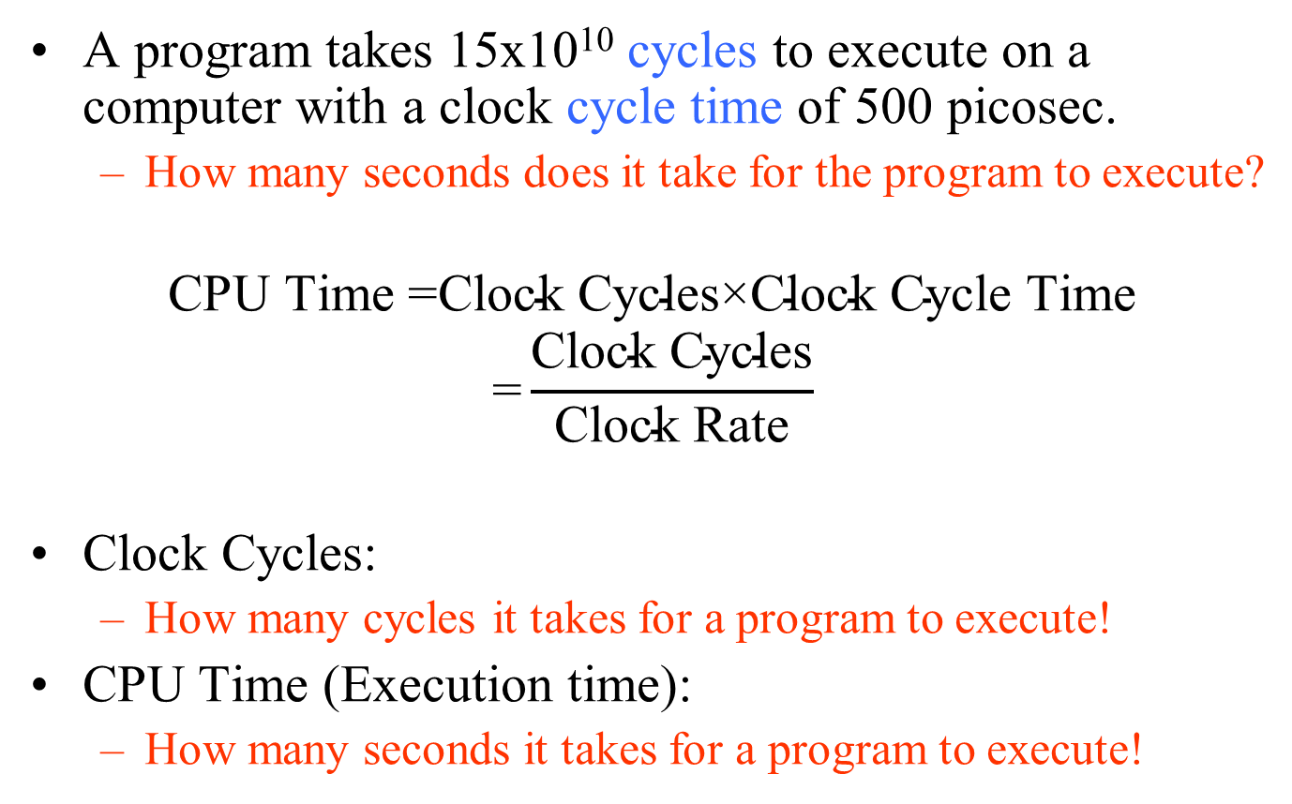
CPU Time (Execution Time)
A program takes 15x10¹⁰ cycles to execute on a computer with a clock cycle time of 500 picosec.
  How many seconds does it take for the program to execute?
$$\text{CPU} \text{Time}\text{ =}\text{Clock} \text{Cycles}\text{×}\text{Clock} \text{Cycle} \text{Time}$$
$$\text{=}\frac{\text{Clock} \text{Cycles}}{\text{Clock} \text{Rate}}$$
Clock Cycles:
  How many cycles it takes for a program to execute!
CPU Time (Execution time):
  How many seconds it takes for a program to execute!

Slide 83
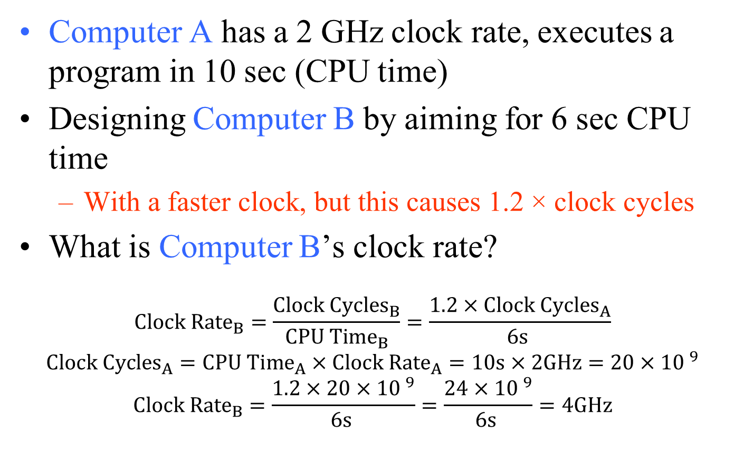
CPU Time Example
Computer A has a 2 GHz clock rate, executes a program in 10 sec (CPU time)
Designing Computer B by aiming for 6 sec CPU time
  With a faster clock, but this causes 1.2 × clock cycles
What is Computer B’s clock rate?
$${\text{Clock} \text{Rate}}_{B}=\frac{{Clock Cycles}_{B}}{{CPU Time}_{B}}=\frac{1.2×{Clock Cycles}_{A}}{6s }$$
$${Clock Cycles}_{A}={CPU Time}_{A}×{Clock Rate}_{A}=10s×2GHz=20×{10 }^{9}$$
$${\text{Clock} \text{Rate}}_{B}=\frac{1.2×20×{10 }^{9}}{6s }=\frac{24×{10 }^{9}}{6s }=4GHz$$

Slide 84
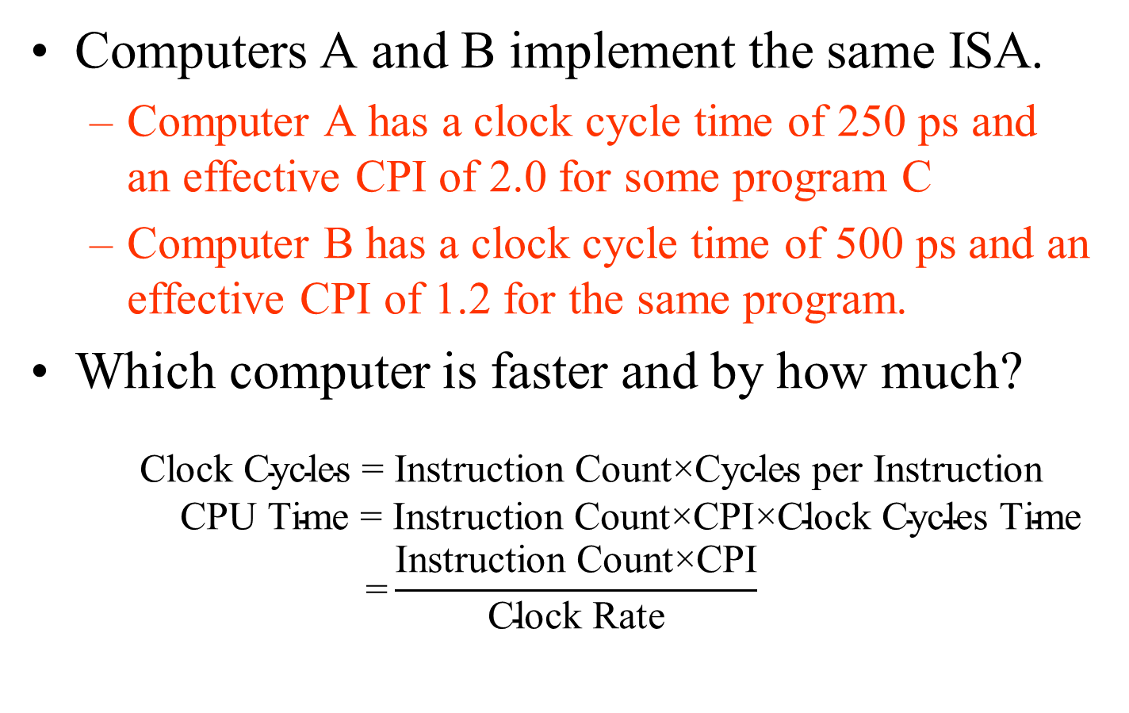
Comparing Computers
Computers A and B implement the same ISA.
  Computer A has a clock cycle time of 250 ps and an effective CPI of 2.0 for some program C
  Computer B has a clock cycle time of 500 ps and an effective CPI of 1.2 for the same program.
Which computer is faster and by how much?
$$\text{Clock} \text{Cycles} \text{=} \text{Instruction} \text{Count}\text{×}\text{Cycle}\text{s} \text{per} \text{Instruction}$$
$$\text{CPU} \text{Time} \text{=} \text{Instruction} \text{Count}\text{×}\text{CPI}\text{×}\text{Clock} \text{Cycle}\text{s} \text{Time}$$
$$\text{=}\frac{\text{Instruction} \text{Count}\text{×}\text{CPI}}{\text{Clock} \text{Rate}}$$

Slide 85
Comparing Computers
Clock Cycles = Instruction Count×Cycles per Instruction
CPU Time = Instruction Count×CPI×Clock Cycle Time
Each computer executes the same number of instructions, I, so
  CPU time_{A} = I × 2.0 × 250 ps = 500 × Ips
  CPU time_{B} = I × 1.2 × 500 ps = 600 × Ips
Clearly, A is faster than B by the ratio of execution times
performance_{A} execution_time_{B} 600 x Ips
------------------- = --------------------- = ---------------- = 1.2
performance_{B} execution_time_{A} 500 x Ips

