Slide 1
Computer Architecture
Prof. Dr. Nizamettin AYDIN
naydin@yildiz.edu.tr
http://www.yildiz.edu.tr/~naydin

Slide 2
The Von Neumann Model/Architecture
Also called stored program computer (instructions in memory).
Two key properties:
  Stored program
    Instructions stored in a linear memory array
    Memory is unified between instructions and data
      The interpretation of a stored value depends on the control signals
        When is a value interpreted as an instruction?
  Sequential instruction processing
    One instruction processed (fetched, executed, and completed) at a time

Slide 3
A computing System (Reminder)
What is a computer?
  in terms of what?
    Functional
    Structural
Functional definition
  Data processing
  Data storage
  Data movement
  Control
Structural definition
  Central processing unit
  Main memory
  Input/Output
  System interconnection

Slide 4
Structure - Top Level
Peripherals
Computer
Central
Processing
Unit
Main
Memory
Computer
Systems
Interconnection
Input
Output
Communication
lines

Slide 5
Structure - The CPU
CPU
Computer
Arithmetic
and
Logic Unit
I/O
Registers
System
Bus
CPU
Internal CPU
Interconnection
Memory
Control
Unit

Slide 6
Structure - The Control Unit
Control Unit
CPU
ALU
Sequencing
Logic
Internal
Bus
Control
Unit
Control Unit
Registers and
Decoders
Registers
Control
Memory

Slide 7
The Stored Program Computer
1943: ENIAC
  Presper Eckert and John Mauchly -- first general electronic computer.
  (or was it John V. Atanasoff in 1939?)
  Hard-wired program -- settings of dials and switches.
1944: Beginnings of EDVAC
  among other improvements, includes program stored in memory
1945: John von Neumann
  wrote a report on the stored program concept,
  known as the First Draft of a Report on EDVAC
The basic structure proposed in the draft became known
as the “von Neumann machine” (or model).
  a memory, containing instructions and data
  a processing unit, for performing arithmetic and logical operations
  a control unit, for interpreting instructions

Slide 8
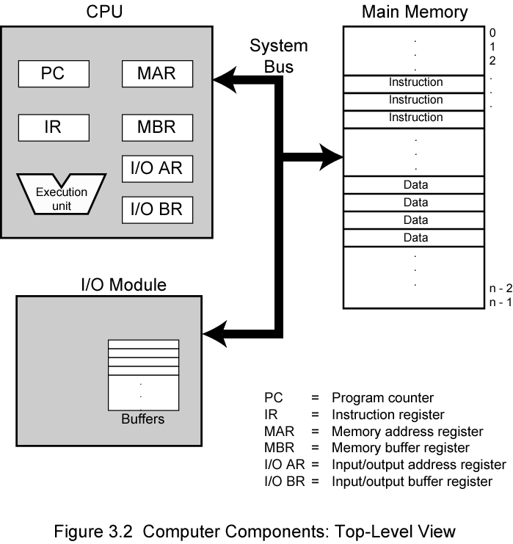
Von Neumann Model

Slide 9
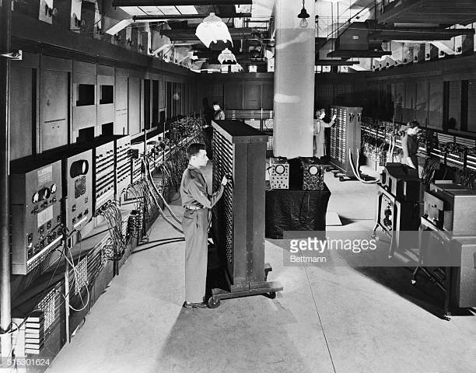
ENIAC - details
Decimal (not binary)
20 accumulators of 10 digits
Programmed manually by switches
18,000 vacuum tubes
30 tons
15,000 square feet
140 kW power consumption
5,000 additions per second
http://www.seas.upenn.edu/~museum/

Slide 10
Interface to Memory
How does processing unit get data to/from memory?
MAR: Memory Address Register
MBR (MDR): Memory Buffer (Data) Register
To LOAD a memory location (A):
  Write the address (A) into the MAR.
  Send a “read” signal to the memory.
  Read the data from MBR.
To STORE a value (X) to a location (A):
  Write the data (X) to the MBR.
  Write the address (A) into the MAR.
  Send a “write” signal to the memory.

Slide 11
Processing Unit
Functional Units (Execution unit)
  ALU = Arithmetic and Logic Unit
  could have many functional units.
  some of them special-purpose
  (multiply, square root, …)
Registers
  Small, temporary storage
  Operands and results of functional units
Word Size
  number of bits normally processed by ALU in one instruction
  also width of registers

Slide 12
Input and Output
Devices for getting data into and out of computer memory
Each device has its own interface,
usually a set of registers (I/OAR and I/OBR)
Some devices provide both input and output
  disk, network
Program that controls access to a device is usually called a driver.

Slide 13
Control Unit
Orchestrates execution of the program
Instruction Register (IR) contains the current instruction.
Program Counter (PC) contains the address of the next instruction to be executed.
Control unit:
  reads an instruction from memory
    the instruction’s address is in the PC
  interprets the instruction, generating signals that tell the other components what to do
    an instruction may take many machine cycles to complete

Slide 14
Program Concept
Hardwired systems are inflexible
General purpose hardware can do different tasks, given correct control signals
Instead of re-wiring, supply a new set of control signals

Slide 15
What is a program?
A sequence of steps
For each step, an arithmetic or logical operation is done
For each operation, a different set of control signals is needed

Slide 16
Instruction Processing
Fetch instruction from memory
Decode instruction
Evaluate Address
fetch OPerands from memory
EXecute operation
Store result

Slide 17
Instruction
The instruction is the fundamental unit of work.
Specifies two things:
  opcode: operation to be performed
  operands: data/locations to be used for operation
An instruction is encoded as a sequence of bits.
(Just like data!)
  Often, but not always, instructions have a fixed length,
  such as 16 or 32 bits.
  Control unit interprets instruction:
  generates sequence of control signals to carry out operation.
  Operation is either executed completely, or not at all.
A computer’s instructions and their formats is known as its
Instruction Set Architecture (ISA).

Slide 18
Instruction Processing: FETCH
Load next instruction (at address stored in PC)
from memory
into Instruction Register (IR).
  Copy contents of PC into MAR.
  Send “read” signal to memory.
  Copy contents of MBR into IR.
Then increment PC, so that it points to
the next instruction in sequence.
  PC becomes PC+1.
F
D
EA
OP
EX
S

Slide 19
Instruction Processing: DECODE
First identify the opcode.
  A n-to-2^{n} decoder asserts a control line corresponding to the desired opcode.
Depending on opcode, identify other operands
from the remaining bits.
F
D
EA
OP
EX
S

Slide 20
Instruction Processing: EVALUATE ADDRESS
For instructions that require memory access,
compute address used for access.
Examples:
  add offset to base register
  add offset to PC
  add offset to zero
F
D
EA
OP
EX
S

Slide 21
Instruction Processing: FETCH OPERANDS
Obtain source operands needed to
perform operation.
Examples:
  load data from memory (LDA)
  read data from register file (ADD)
F
D
EA
OP
EX
S

Slide 22
Instruction Processing: EXECUTE
Perform the operation,
using the source operands.
Examples:
  send operands to ALU and assert ADD signal
  do nothing (e.g., for loads and stores)
F
D
EA
OP
EX
S

Slide 23
Instruction Processing: STORE RESULT
Write results to destination.
(register or memory)
Examples:
  result of ADD is placed in destination register
  result of memory load is placed in destination register
  for store instruction, data is stored to memory
    write address to MAR, data to MBR
    assert WRITE signal to memory
F
D
EA
OP
EX
S

Slide 24
Changing the Sequence of Instructions
In the FETCH phase, we increment the Program Counter by 1.
What if we don’t want to always execute the instruction that follows this one?
  examples: loop, if-then, function call
Need special instructions that change the contents of the PC.
These are called control instructions.
  jumps are unconditional -- they always change the PC
  branches are conditional -- they change the PC only if
  some condition is true (e.g., the result of an ADD is zero)

Slide 25
Instruction Processing Summary
Instructions look just like data -- it’s all interpretation.
Four basic kinds of instructions:
  Data processing instructions
    Arithmetic and logic instructions (ADD, AND, …)
  Data storage instructions
    Memory instructions (LDA, STA)
  Data movement instructions
    I/O instructions (IN, OUT, …)
  Program flow control instructions
    Test and branch instructions (JMP, BRP, …)
Six basic phases of instruction processing:
F → D → EA → OP → EX → S
  not all phases are needed by every instruction
  phases may take variable number of machine cycles

Slide 26
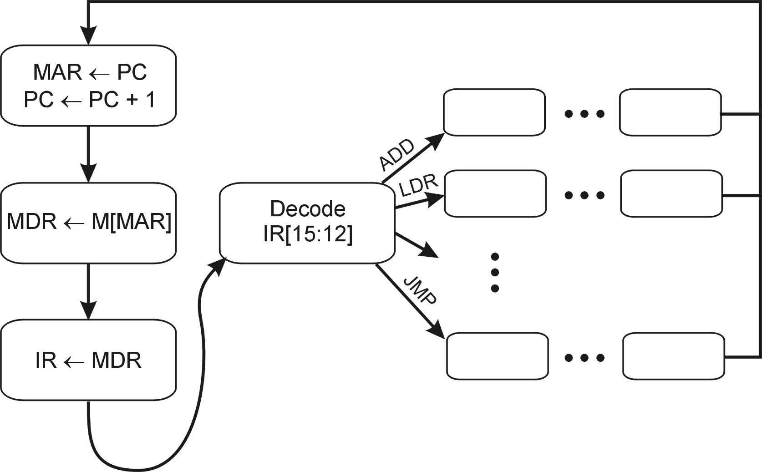
Control Unit State Diagram
The control unit is a state machine.
Here is part of a simplified state diagram:

Slide 27
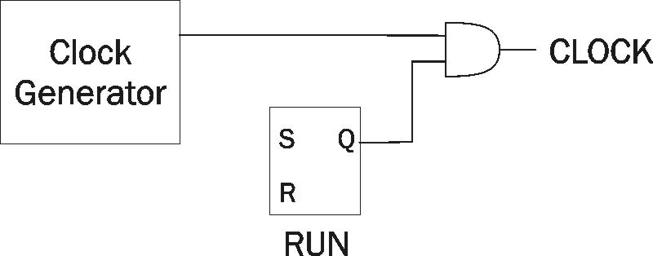
Stopping the Clock
Control unit will repeat instruction processing sequence
as long as clock is running.
  If not processing instructions from your application,
  then it is processing instructions from the Operating System (OS).
  The OS is a special program that manages processor
  and other resources.
To stop the computer:
  AND the clock generator signal with ZERO
  When control unit stops seeing the CLOCK signal, it stops processing.

Slide 28
Dataflow Model of a Computer
Von Neumann model
Dataflow model
An instruction is fetched and executed in control flow order
  As specified by the instruction pointer
  Sequential unless explicit control flow instructio
An instruction is fetched and executed in data flow order
  i.e., when its operands are ready
  i.e., there is no instruction pointer
  Instruction ordering specified by data flow dependence
    Each instruction specifies “who” should receive the result
    An instruction can “fire” whenever all operands are received
  Potentially many instructions can execute at the same time
  Inherently more parallel

Slide 29
von Neumann vs Dataflow
Consider a von Neumann program (sequential) vs dataflow execution
Which model is more natural to you as a programmer?
All major instruction set architectures today use von Neumann
  x86, ARM, MIPS, SPARC, Alpha, POWER PC

Slide 30
Fundamental Computer Elements

Slide 31
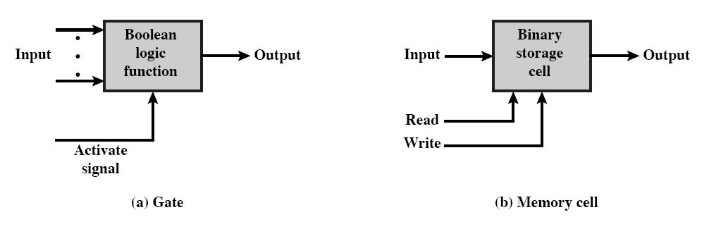
Fundamental computer elements
Data processing
  Provided by gates
Data storage
  Provided by memory cells
Data movement
  The paths between components are used to move data from/to memory
Control
  The paths between components can carry control signals

Slide 32
Levels of Representation
High Level Language Program
temp = v[k];
v[k] = v[k+1];
v[k+1] = temp;
Compiler
lw $15, 0($2)
lw $16, 4($2)
sw $16, 0($2)
sw $15, 4($2)
Assembly Language Program
Assembler
0000 1001 1100 0110 1010 1111 0101 1000
1010 1111 0101 1000 0000 1001 1100 0110
1100 0110 1010 1111 0101 1000 0000 1001
0101 1000 0000 1001 1100 0110 1010 1111
Machine Language Program
Machine Interpretation
Control Signal Specification
ALUOP[0:3] <= InstReg[9:11] & MASK
°
°

Slide 33
Computer Components-CPU

Slide 34
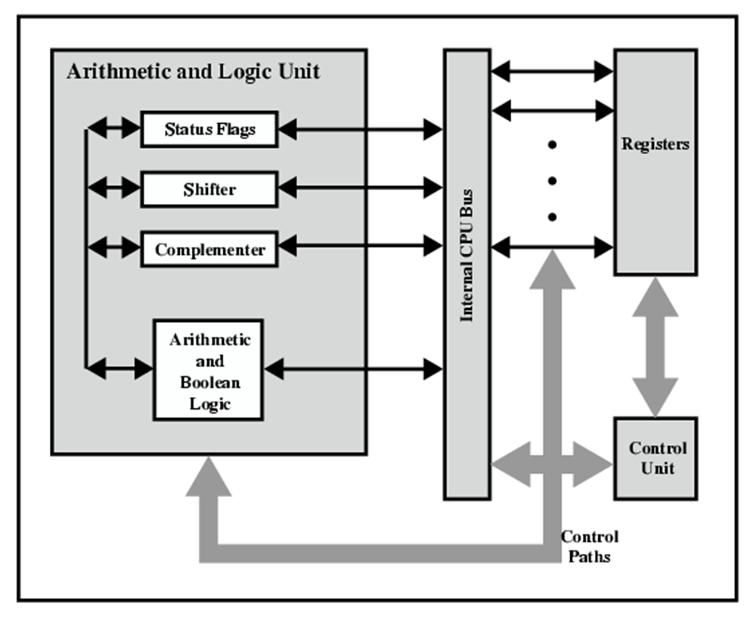
CPU Structure
CPU must:
  Fetch instructions
  Interpret instructions
  Fetch data
  Process data
  Write data
Notes:
22

Slide 35
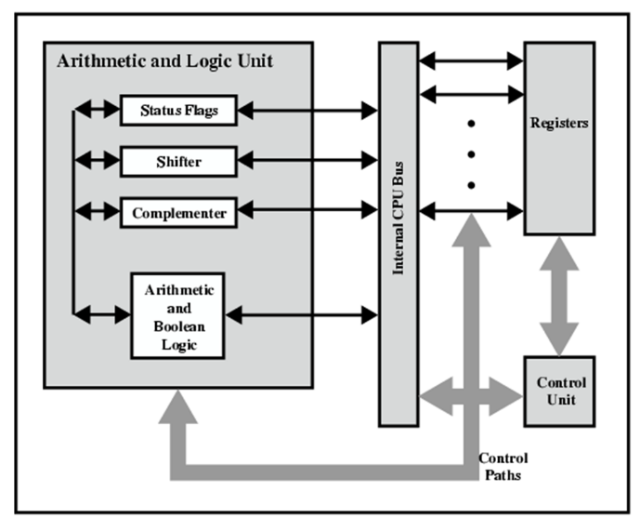
Registers
CPU must have some working space (temporary storage)
  Called registers
Number and function vary between processor designs
One of the major design decisions
Top level of memory hierarchy
Notes:
23

Slide 36
Registers in the μP perform two roles:
User-visible registers
  Enable the machine- or assembly language programmer to minimize main memory references by optimizing use of registers
Control and status registers
  Used by the control unit to control the operation of the processor and by priviliged, operating system programs to control the execution of programs

Slide 37
User Visible Registers
General Purpose registers
Data registers
Address registers
Condition Codes (flags)
Notes:
24

Slide 38
Condition Code Registers
Sets of individual bits
  e.g. result of last operation was zero
Can be read (implicitly) by programs
  e.g. Jump if zero
Can not (usually) be set by programs
Notes:
29

Slide 39
Control & Status Registers
Program Counter (PC)
  Contains the address of an instruction to be fetched
Instruction Decoding Register (IR)
  Contains the instruction most recently fetched
Memory Address Register (MAR)
  Contains the addres of location in memory
Memory Buffer Register (MBR)
  Contains a word or data to be written to memory or the word most recently read
Notes:
30

Slide 40
Program Status Word
A set of bits containing status information
Includes Condition Codes (flags)
  Sign
    sign of last result
  Zero
    set when the result is 0
  Carry
    set if an operation resulted in a carry (addition) into or borrow (subtraction) out of a high order bit
  Equal
    set if a logical compare result is equality
  Overflow
    used to indicate arithmetic overflow
  Interrupt enable/disable
    used to enable or disable interrupts
Notes:
31

Slide 41
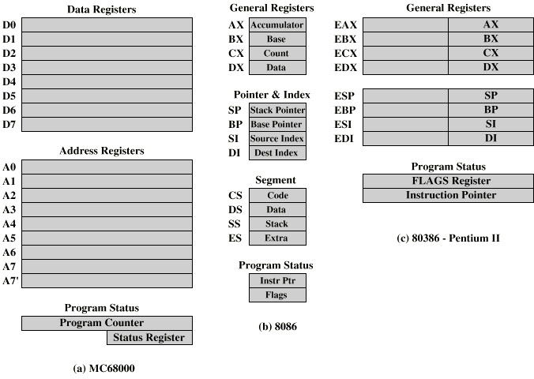
Example Register Organizations

Slide 42
Computer Components-Memory

Slide 43
Operation of Memory
Each memory location has a unique address
Address from an instruction is copied to the MAR which finds the location in memory
CPU determines if it is a store or retrieval
Transfer takes place between the MBR and memory
  MBR is a two way register

Slide 44
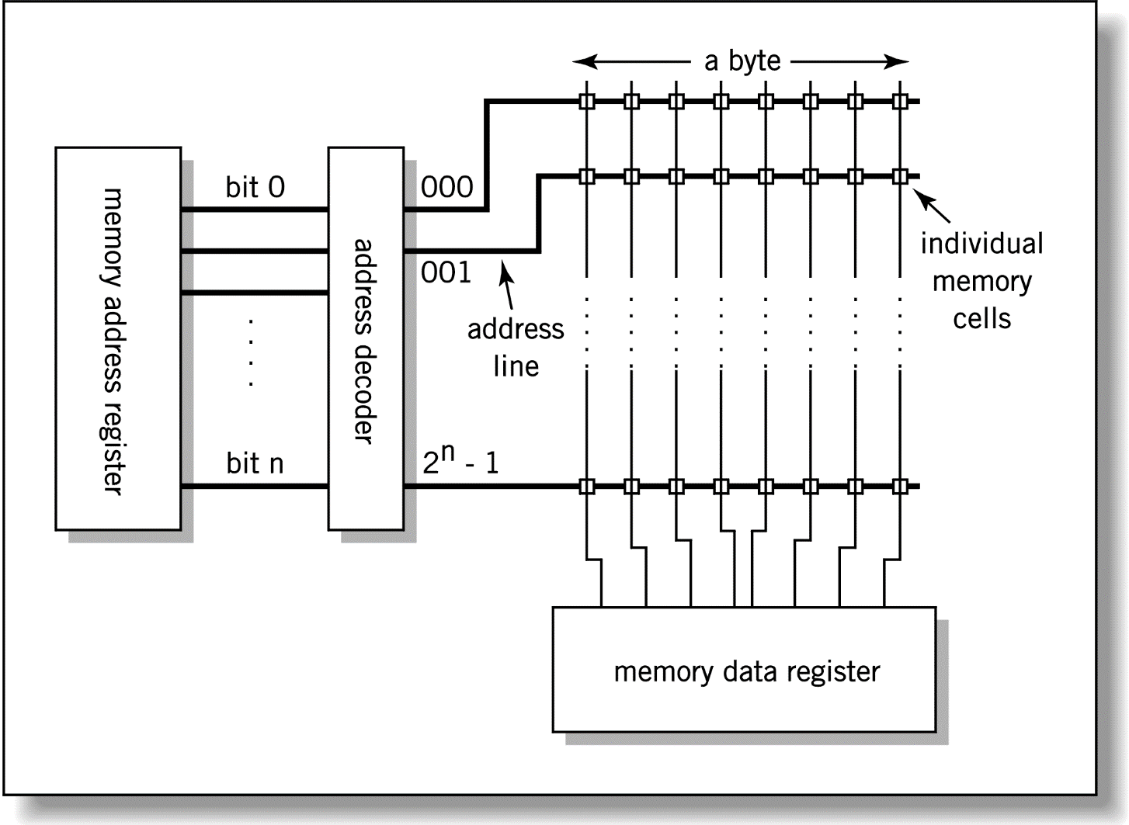
Relationship between MAR, MBR and Memory
Address
Data

Slide 45
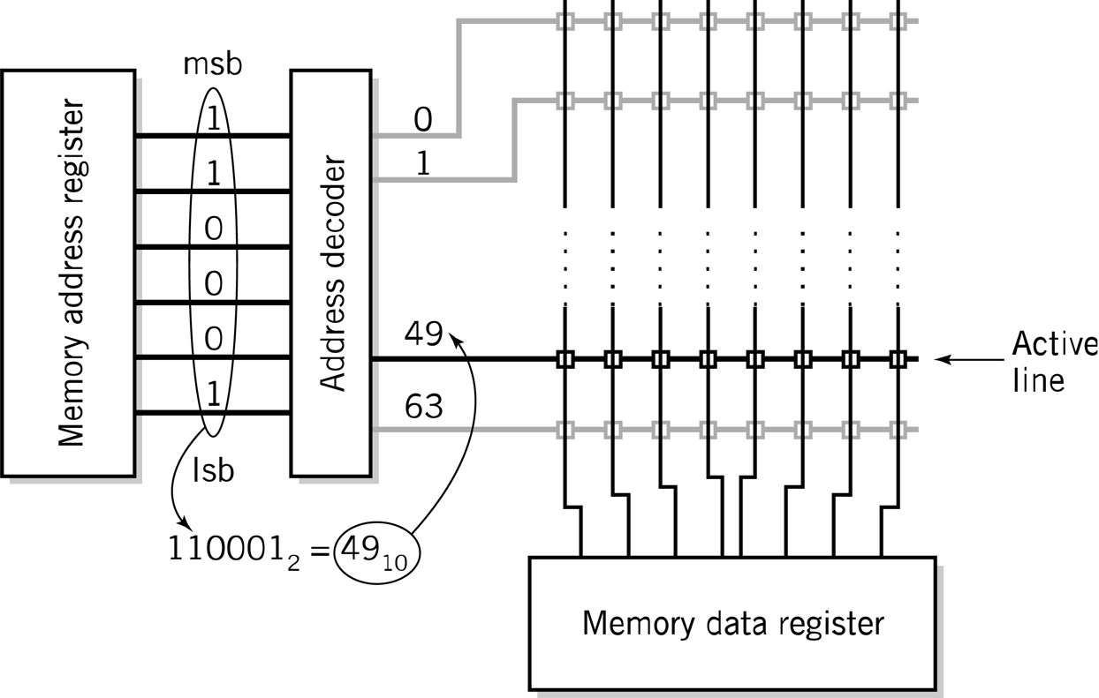
MAR-MBR Example

Slide 46
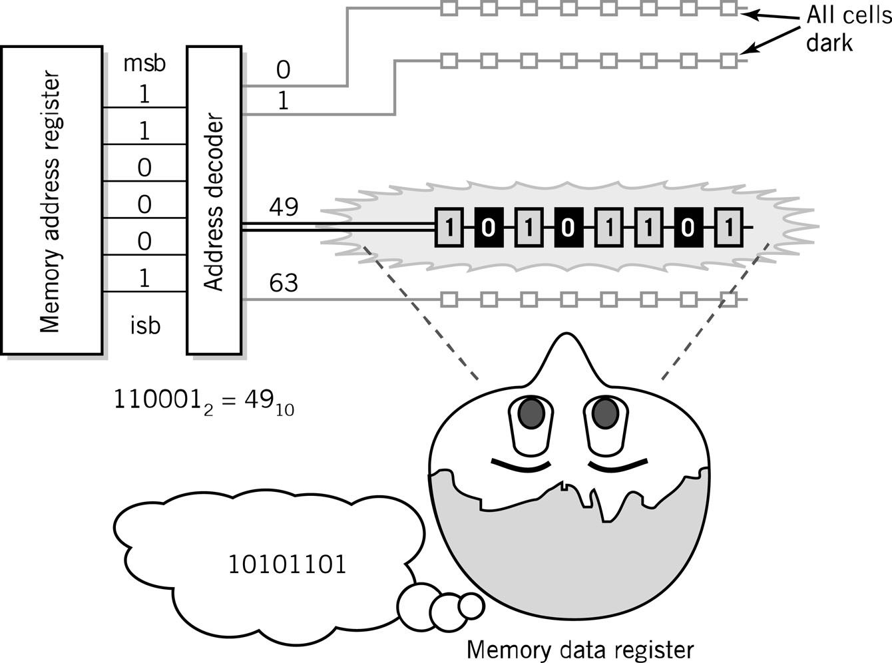
Visual Analogy of Memory

Slide 47
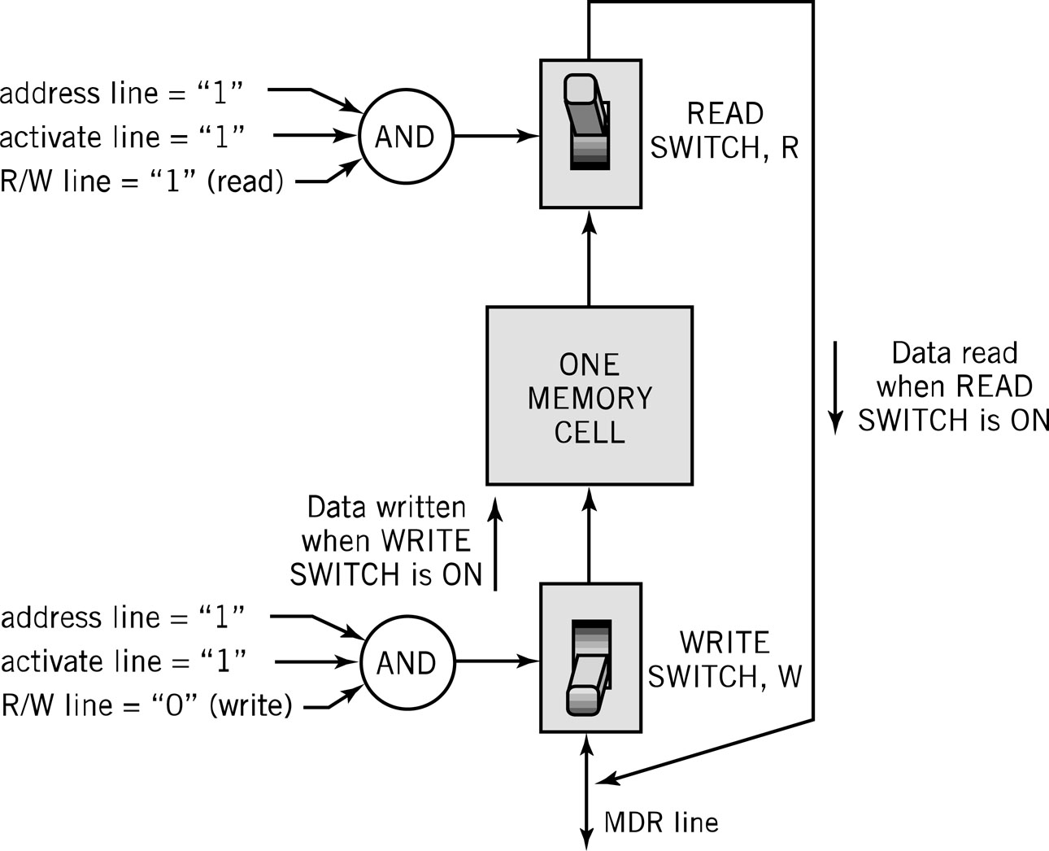
Individual Memory Cell

Slide 48
Memory Capacity
Determined by two factors
  Number of bits in the MAR
    2^{K} where K = width of the register in bits
  Size of the address portion of the instruction
    4 bits allows 16 locations
    8 bits allows 256 locations
    32 bits allows 4,294,967,296 or 4 GB
Important for performance
  Insufficient memory can cause a processor to work at 50% below performance

Slide 49
Memory Hierarchy
Registers
  In CPU
Internal or Main memory
  May include one or more levels of cache
  “RAM”
External memory
  Backing store

Slide 50
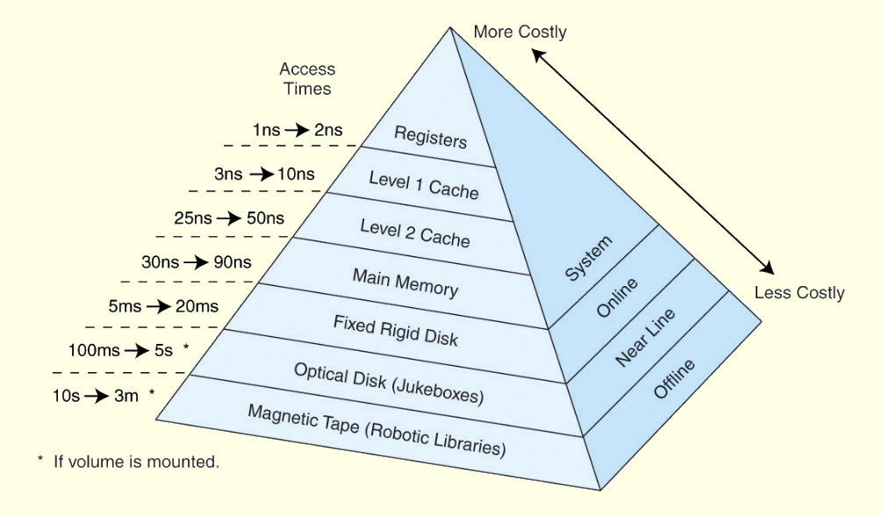
Memory Hierarchy
This storage organization can be thought of as a pyramid:

Slide 51
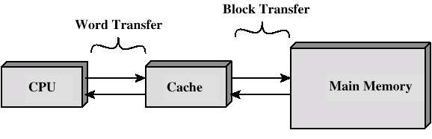
Cache
Small amount of fast memory
Sits between normal main memory and CPU
May be located on CPU chip or module

Slide 52
Virtual Memory
Cache memory enhances performance by providing faster memory access speed.
Virtual memory enhances performance by providing greater memory capacity, without the expense of adding main memory.
Instead, a portion of a disk drive serves as an extension of main memory.
If a system uses paging, virtual memory partitions main memory into individually managed page frames, that are written (or paged) to disk when they are not immediately needed.

Slide 53
RAM: Random Access Memory
DRAM (Dynamic RAM)
  Most common, cheap
  Volatile: must be refreshed (recharged with power) 1000’s of times each second
SRAM (static RAM)
  Faster than DRAM and more expensive than DRAM
  Volatile
  Frequently small amount used in cache memory for high-speed access used

Slide 54
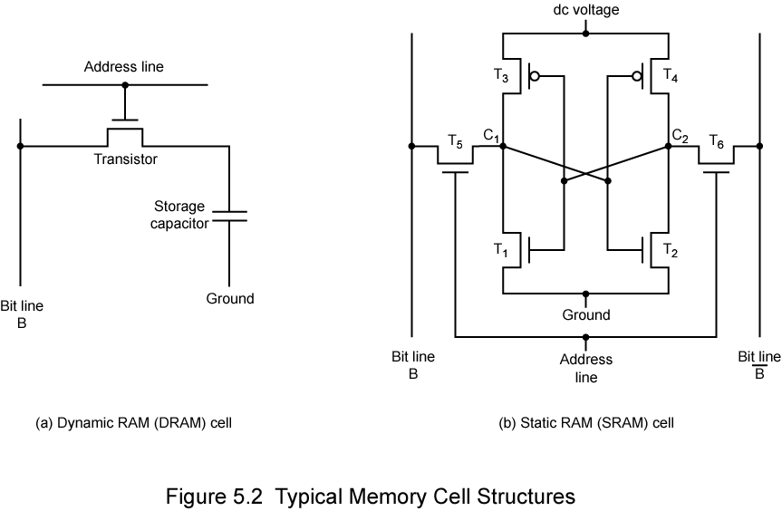
Dynamic RAM Structure

Slide 55
Stating RAM Structure

Slide 56
Read Only Memory (ROM)
Permanent storage
  Nonvolatile
Used in...
  Microprogramming
  Library subroutines
  Systems programs (BIOS)
  Function tables

Slide 57
Types of ROM
Written during manufacture
  Very expensive for small runs
Programmable (once)
  PROM
  Needs special equipment to program
Read “mostly”
  Erasable Programmable (EPROM)
    Erased by UV
  Electrically Erasable (EEPROM)
    Takes much longer to write than read
  Flash memory
    Erase whole memory electrically

Slide 58
Types of External Memory
SSD
  Fast
  Expensive (relatively)
Magnetic Disk
  RAID
  Removable
Optical
  CD-ROM
  CD-Recordable (CD-R)
  CD-R/W
  DVD
Magnetic Tape

Slide 59
Computer Components-I/O

Slide 60
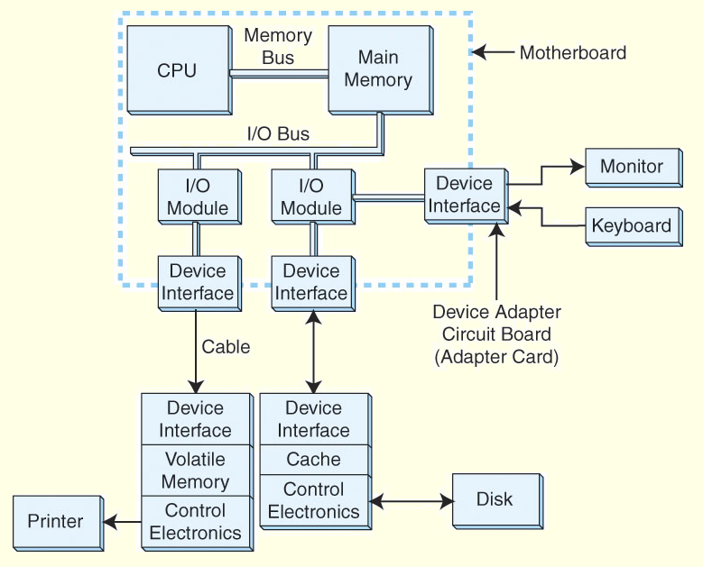
Input/Output Problems
Wide variety of peripherals
  Delivering different amounts of data
  At different speeds
  In different formats
All slower than CPU and RAM
Need I/O modules

Slide 61
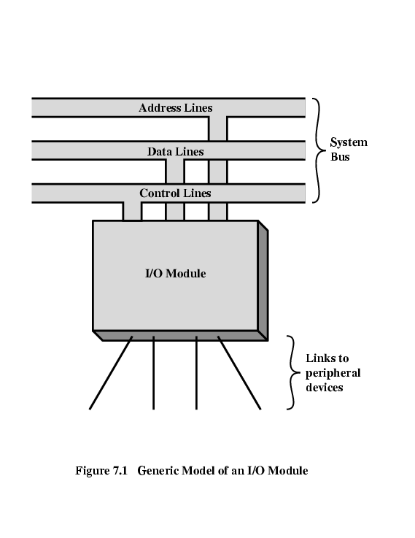
Input/Output Module
I/O Module Block Diagram
Interface to CPU and Memory
Interface to one or more peripherals
I/O Module Function:
  Control & Timing
  CPU Communication
  Device Communication
  Data Buffering
  Error Detection

Slide 62
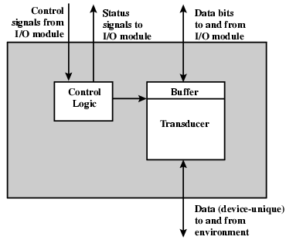
External Devices
External Device Block Diagram
External Devices:
  Human readable
    Screen, printer, keyboard
  Machine readable
    Monitoring and control
  Communication
    Modem
    Network Interface Card (NIC)

Slide 63
I/O Steps
CPU checks I/O module device status
I/O module returns status
If ready, CPU requests data transfer
I/O module gets data from device
I/O module transfers data to CPU
Variations for output, DMA, etc.

Slide 64
I/O Architectures
I/O can be controlled in four general ways:
  Programmed I/O
    Reserves a register for each I/O device.
    Each register is continually polled to detect data arrival.
  Interrupt-Driven I/O
    Allows the CPU to do other things until I/O is requested.
  Direct Memory Access (DMA)
    Offloads I/O processing to a special-purpose chip that takes care of the details.
  Channel I/O
    Uses dedicated I/O processors.

Slide 65
Computer Components- Bus

Slide 66
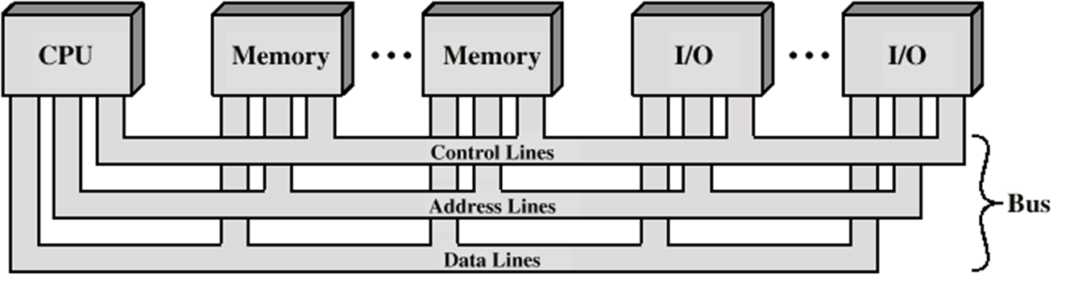
Bus
The physical connection that makes it possible to transfer data from one location in the computer system to another
Group of electrical conductors for carrying signals from one location to another
4 kinds of signals
  Data
    Alphanumeric
    Numerical
    instructions
  Addresses
  Control signals
  Power (sometimes)

Slide 67
Bus
Connects CPU and Memory
I/O peripherals: on the same bus as CPU/memory or separate bus
Physical packaging commonly called backplane
  Also called system bus or external bus
  Example of broadcast bus (address bus)
  Part of printed circuit board called motherboard that holds CPU and related components

Slide 68
Bus Characteristics
Protocol
  Documented agreement for communication
  Specification that spells out the meaning of each line and each signal on each line
Throughput, i.e., data transfer rate in bits per second
Data width in bits carried simultaneously

Slide 69
Bus types
Data Bus
  Carries data
  Width is a key determinant of performance
    8, 16, 32, 64 bit
  Address bus
  Identify the source or destination of data
  Bus width determines maximum memory capacity of system
    e.g. 8080 has 16 bit address bus giving 64k address space
  Control Bus
  Control and timing information
    Memory read/write; I/O read/write; Transfer acknowledge; Bus request; Bus grant; Interrupt request; Interrupt acknowledge; Clock; Reset

Slide 70
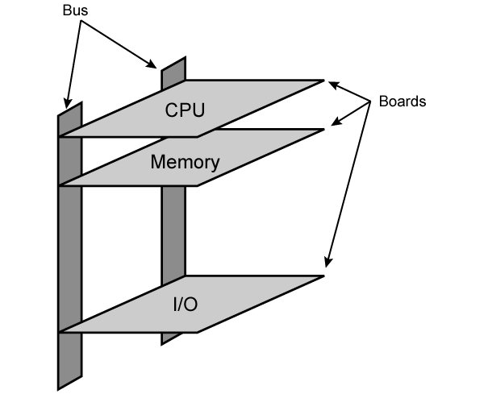
What do buses look like?
  Parallel lines on circuit boards
  Ribbon cables
  Strip connectors on mother boards
    e.g. PCI
  Sets of wires
Physical Realization of
Bus Architecture

Slide 71
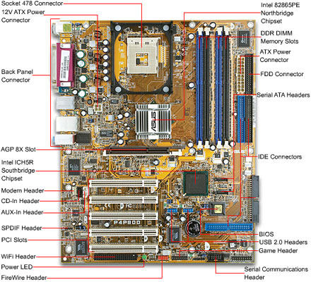
Motherboard
Printed circuit board that holds CPU and related components including backplane

Slide 72
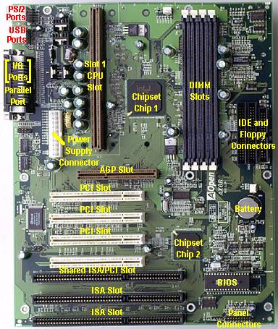
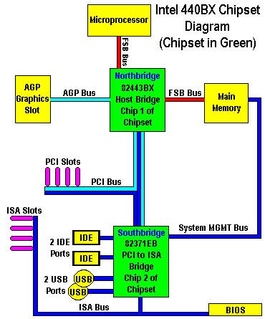

Slide 73
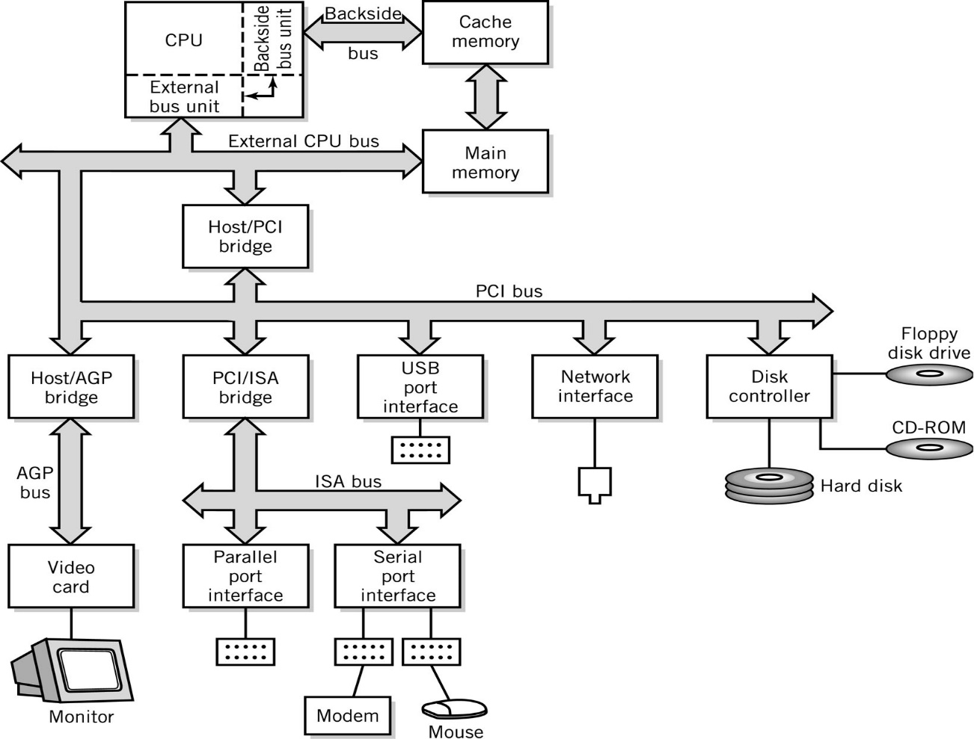
Typical PC Interconnections
Bus interface bridges connect different bus types

Slide 74
Instructions
Instruction:
  Direction given to a computer
  Causes electrical signals to be sent through specific circuits for processing
The operation of the processor is determined by the instructions it executes,
  which is referrred as machine instructions or computer instructions
The collection of different instructions that the processor execute is referred as the processor’s instruction set.

Slide 75
What is an Instruction Set?
The complete collection of instructions that are understood by a CPU
  Machine Code
  Binary
Usually represented by assembly codes
Differentiates computer architecture by the
  Number of instructions
  Complexity of operations performed by individual instructions
  Data types supported
  Format (layout, fixed vs. variable length)
  Use of registers
  Addressing (size, modes)
Notes:
2

Slide 76
Instruction Elements
Source
OPERAND
Result
OPERAND
OPCODE
Operation code (OPCODE): task
  Do this
Source OPERAND reference(s)
  To this
Result OPERAND reference
  Put the answer here
Next Instruction Reference
  When you have done that, do this...
Addresses

Slide 77
Instruction Elements
Source and Result Operands can be in one of the following areas:
  Main memory
  Virtual memory
  Cache
  CPU register
  I/O device
Notes:
4

Slide 78
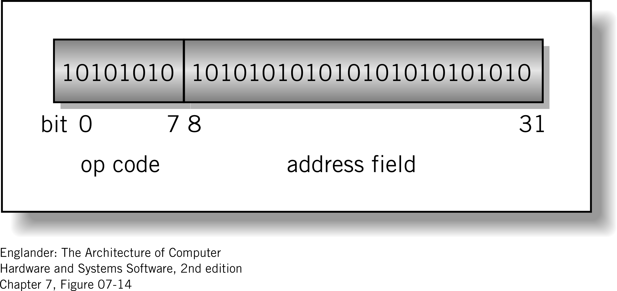
Instruction Format
Machine-specific template that specifies
  Length of the op code
  Number of operands
  Length of operands
Simple
32-bit Instruction Format

Slide 79
Instruction Types
Data Transfer (load, store)
  Most common, greatest flexibility
  Involve memory and registers
  What’s a word ? 16? 32? 64 bits?
Arithmetic
  Operators + - / * ^
  Integers and floating point
Logical or Boolean
  Relational operators: > < =
  Boolean operators AND, OR, XOR, NOR, and NOT
Single operand manipulation instructions
  Negating, decrementing, incrementing

Slide 80
More Instruction Types
Bit manipulation instructions
  Flags to test for conditions
Shift and rotate
Program control
Stack instructions
Multiple data instructions
I/O and machine control

Slide 81
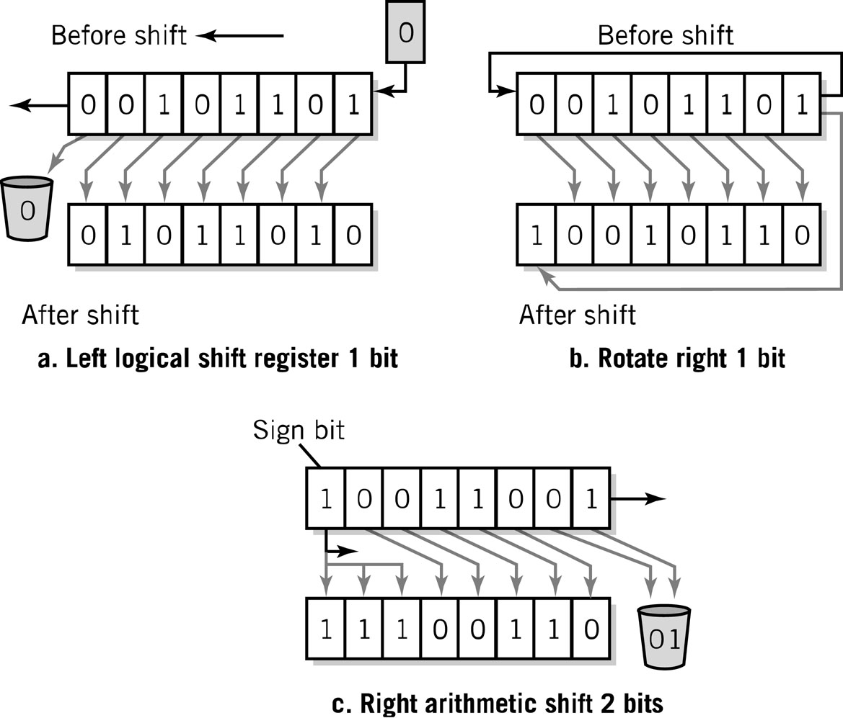
Register Shifts and Rotates

Slide 82
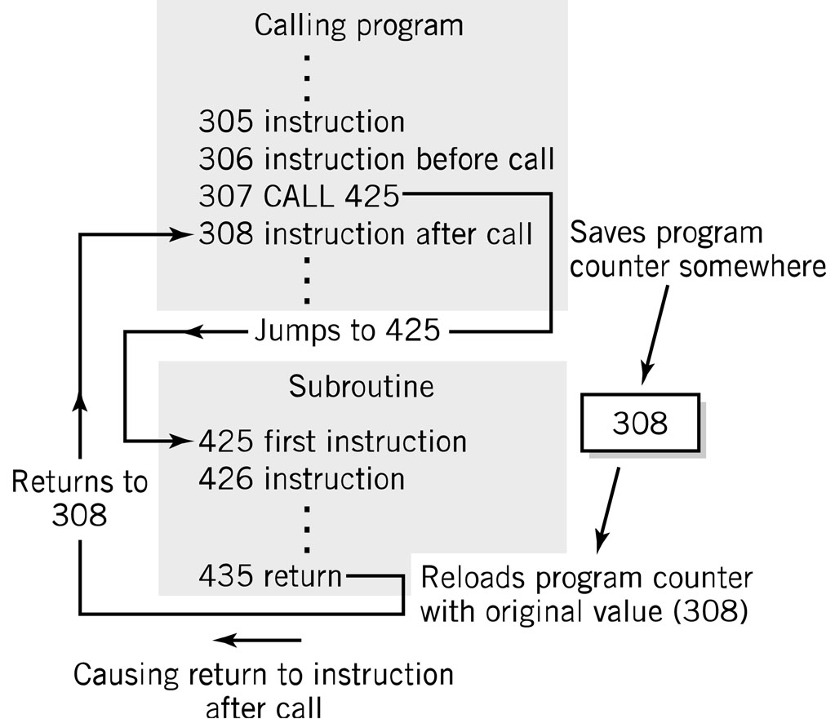
Program Control Instructions
Program control
  Jump and branch
  Subroutine call
  and return

Slide 83
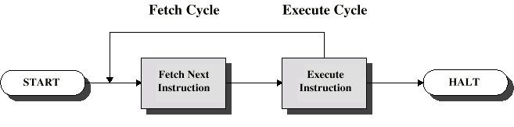
Instruction Cycle
Two steps:
  Fetch
  Execute

Slide 84
Fetch Cycle
Program Counter (PC) holds address of next instruction to fetch
Processor fetches instruction from memory location pointed to by PC
Increment PC
  Unless told otherwise
Instruction loaded into Instruction Register (IR)
Processor interprets instruction and performs required actions

Slide 85
Execute Cycle
Processor-memory
  data transfer between CPU and main memory
Processor I/O
  Data transfer between CPU and I/O module
Data processing
  Some arithmetic or logical operation on data
Control
  Alteration of sequence of operations
  e.g. jump
Combination of above

Slide 86
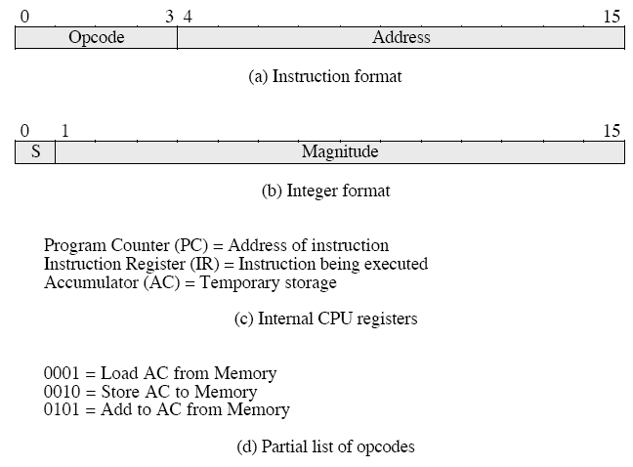
A simple example – A hypotetical machine

Slide 87
A simple example –
Next figure illustrates a partial program execution.
It adds the contents of the memory word at address 940 to the contents of the memory word at address 941 and stores the result in the address 941.
Here 3 instructions (3 fetch and 3 execute cycles) are required

Slide 88
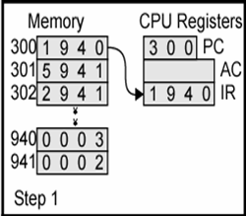
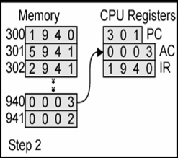
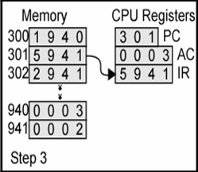
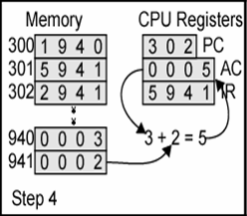
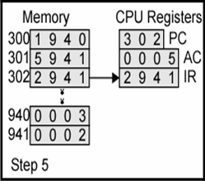
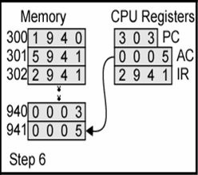
Example of Program Execution

Slide 89
A virtual processor for understanding instruction cycle
The Visible Virtual Machine (VVM)

Slide 90
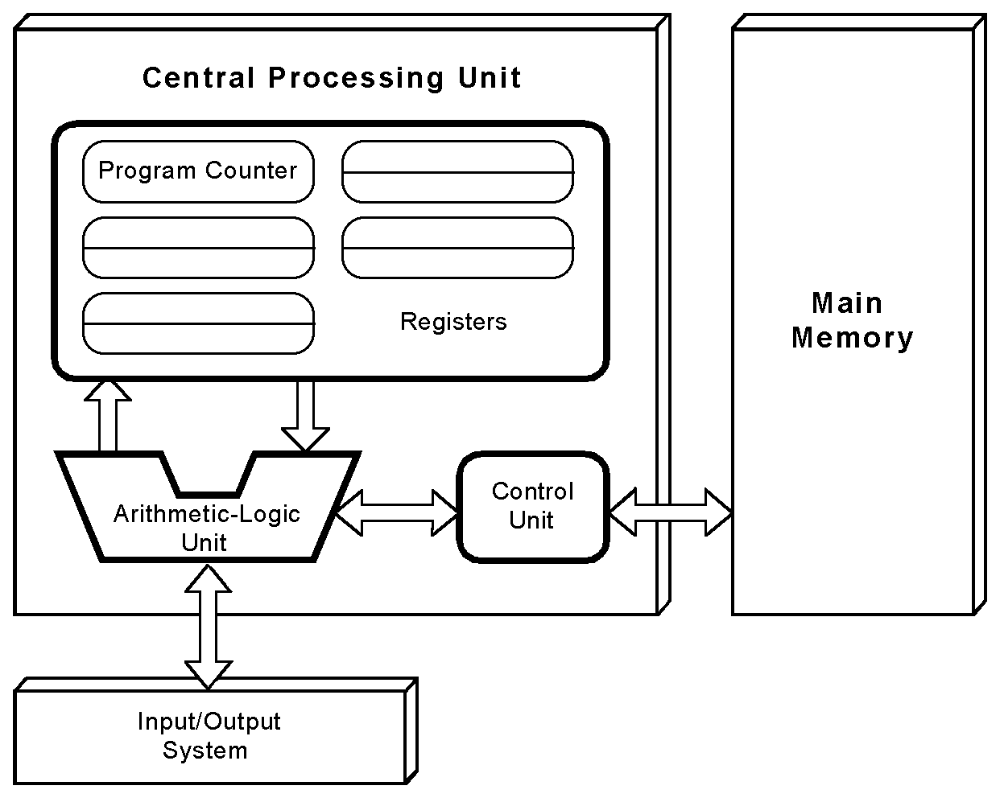
The von Neumann Model
This is a general depiction of a von Neumann system:
These computers employ a fetch-decode-execute cycle to run programs as follows . . .

Slide 91
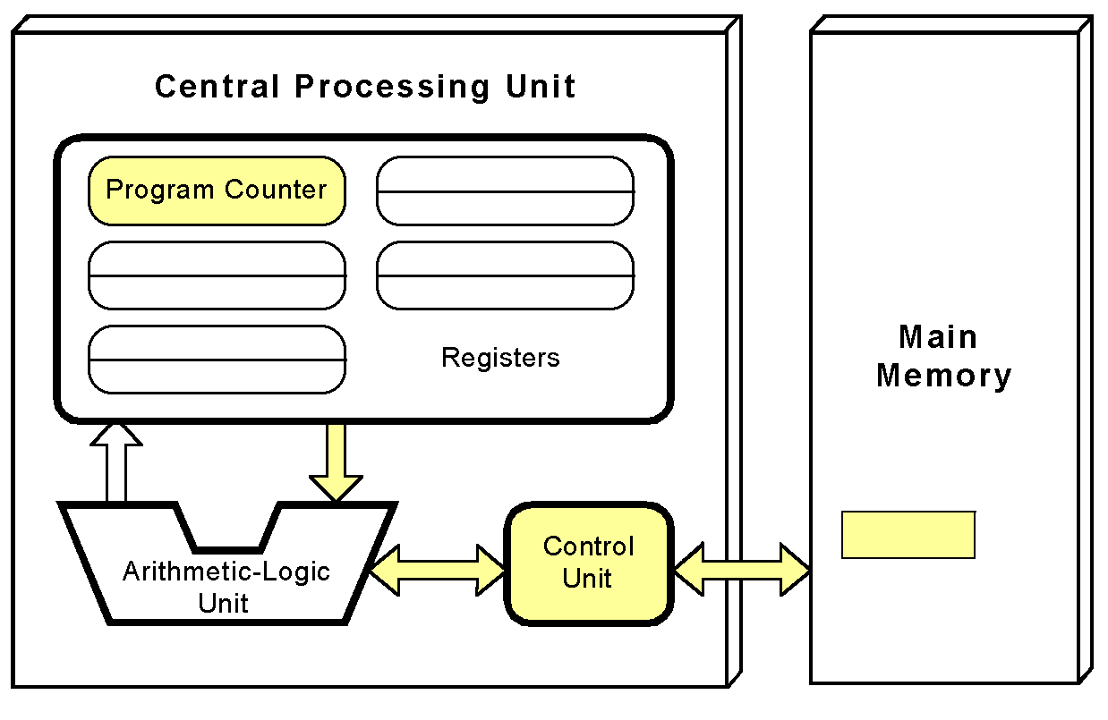
The control unit fetches the next instruction from memory using the program counter to determine where the instruction is located.

Slide 92
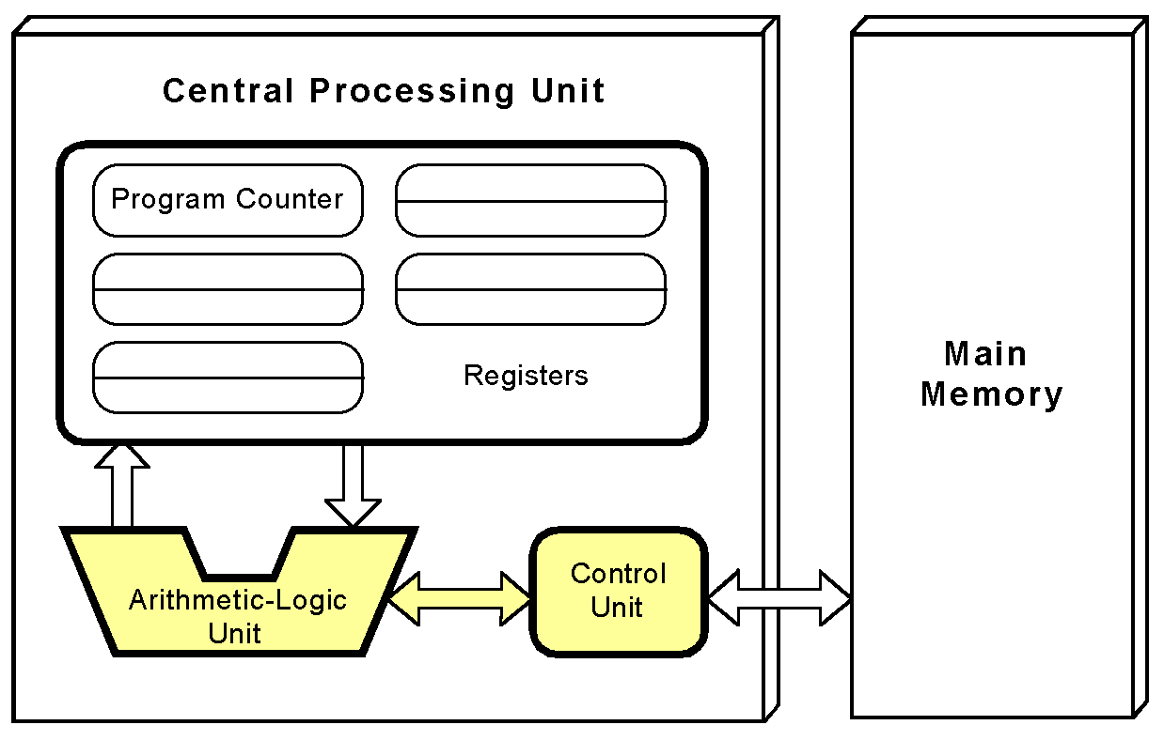
The instruction is decoded into a language that the ALU can understand.

Slide 93
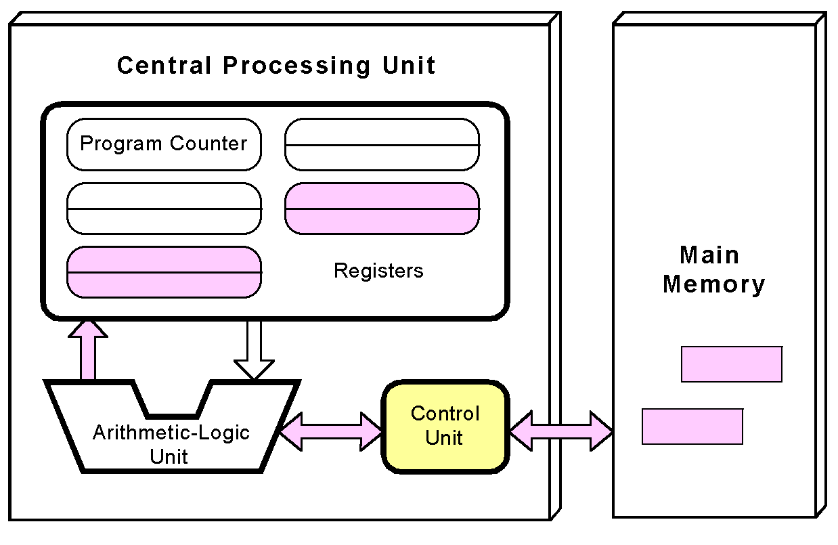
Any data operands required to execute the instruction are fetched from memory and placed into registers within the CPU.

Slide 94
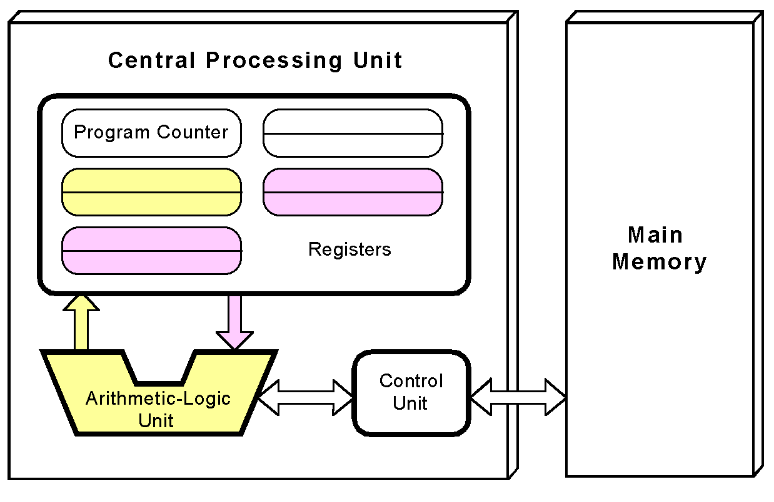
The ALU executes the instruction and places results in registers or memory.

Slide 95
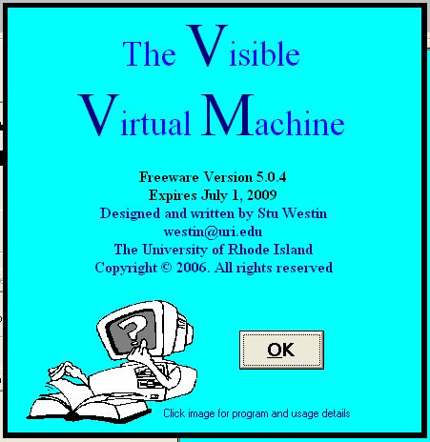
A virtual processor for understanding instruction cycle

Slide 96
The VVM Machine
The Visible Virtual Machine (VVM) is based on a model of a simple computer device called the Little Man Computer which was originally developed by Stuart Madnick in 1965, and revised in 1979.
The VVM is a virtual machine because it only appears to be a functioning hardware device.
In reality, the VVM "hardware" is created through a software simulation. One important simplifying feature of this machine is that it works in decimal rather than in the traditional binary number system.
Also, the VVM works with only one form of data - decimal integers.

Slide 97
Hardware Components of VVM
I/O Log. This represents the system console which shows the details of relevant events in the execution of the program. Examples of events are the program begins, the program aborts, or input or output is generated.
Accumulator Register (Accum). This register holds the values used in arithmetic and logical computations. It also serves as a buffer between input/output and memory. Legitimate values are any integer between -999 and +999. Values outside of this range will cause a fatal VVM Machine error. Non integer values are converted to integers before being loaded into the register.
Instruction Cycle Display. This shows the number of instructions that have been executed since the current program execution began.

Slide 98
Hardware Components of VVM
Instruction Register (Instr. Reg.). This register holds the next instruction to be executed. The register is divided into two parts: a one-digit operation code, and a two digit operand. The Assembly Language mnemonic code for the operation code is displayed below the register.
Program Counter Register (Prog. Ctr.). The two-digit integer value in this register "points" to the next instruction to be fetched from RAM. Most instructions increment this register during the execute phase of the instruction cycle. Legitimate values range from 00 to 99. A value beyond this range causes a fatal VVM Machine error.
RAM. The 100 data-word Random Access Storage is shown as a matrix of ten rows and ten columns. The two-digit memory addresses increase sequentially across the rows and run from 00 to 99. Each storage location can hold a three-digit integer value between -999 and +999.

Slide 99
Data and Addresses
All data and address values are maintained as decimal integers.
The 100 data-word memory is addresses with two-digit addressed in the range 00-99.
Each memory location holds one data-word which is a decimal integer in the range -999 - +999.
Data values beyond this range cause a data overflow condition and trigger a VVM system error.

Slide 100
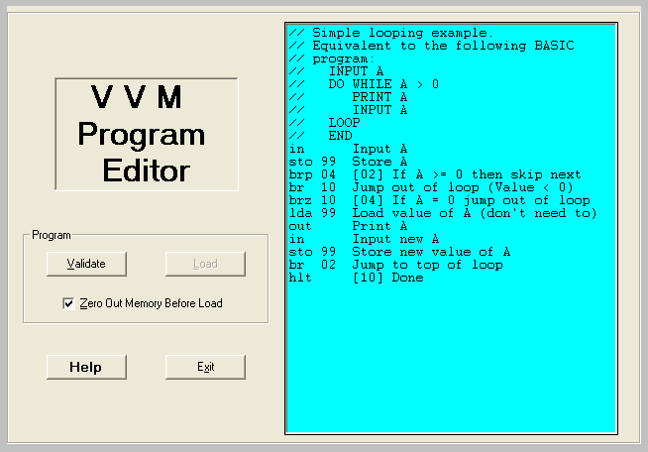
VVM Program Editor

Slide 101
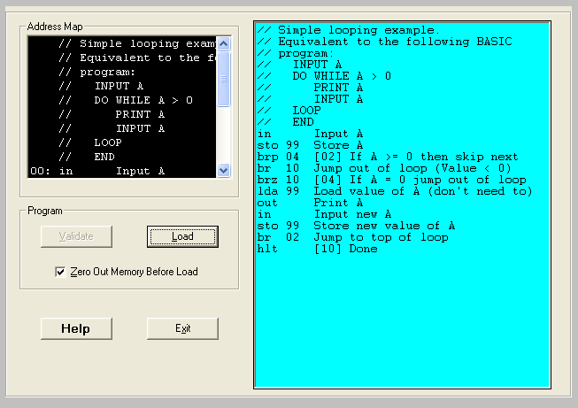
VVM Program Editor

Slide 102
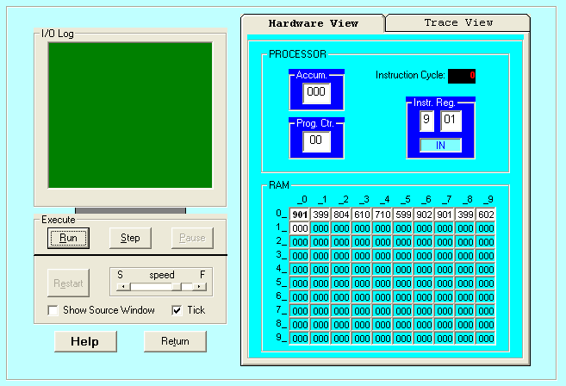
VVM Structure and User Interface

Slide 103
VVM System Errors
Data value out of range. This condition occurs when a data value exceeds the legitimate range -999 - +999. The condition will be detected while the data resides in the Accumulator Register. Probable causes are an improper addition or subtraction operation, or invalid user input.
Undefined instruction. This occurs when the machine attempts to execute a three-digit value in the Instruction Register which can not be interpreted as a valid instruction code. See the help topic "VVM Language" for valid instruction codes and their meaning. Probable causes of this error are attempting to use a data value as an instruction, an improper Branch instruction, or failure to provide a Halt instruction in your program.
Program counter out of range. This occurs when the Program Counter Register is incremented beyond the limit of 99. The likely cause is failure to include a Halt instruction in your program, or a branch to a high memory address.
User cancel. The user pressed the "Cancel" button during an Input or Output operation.

Slide 104
The Language Instructions
Load Accumulator (5nn) [LDA nn] The content of RAM address nn is copied to the Accumulator Register, replacing the current content of the register. The content of RAM address nn remains unchanged. The Program Counter Register is incremented by one.
Store Accumulator (3nn) [STO nn] or [STA nn] The content of the Accumulator Register is copied to RAM address nn, replacing the current content of the address. The content of the Accumulator Register remains unchanged. The Program Counter Register is incremented by one.
Add (1nn) [ADD nn] The content of RAM address nn is added to the content of the Accumulator Register, replacing the current content of the register. The content of RAM address nn remains unchanged. The Program Counter Register is incremented by one.

Slide 105
The Language Instructions
Subtract (2nn) [SUB nn] The content of RAM address nn is subtracted from the content of the Accumulator Register, replacing the current content of the register. The content of RAM address nn remains unchanged. The Program Counter Register is incremented by one.
Input (901) [IN] or [INP] A value input by the user is stored in the Accumulator Register, replacing the current content of the register. Note that the two-digit operand does not represent an address in this instruction, but rather specifies the particulars of the I/O operation (see Output). The operand value can be omitted in the Assembly Language format. The Program Counter Register is incremented by one with this instruction.
Output (902) [OUT] or [PRN] The content of the Accumulator Register is output to the user. The current content of the register remains unchanged. Note that the two-digit operand does not represent an address in this instruction, but rather specifies the particulars of the I/O operation (see Input). The operand value can be omitted in the Assembly Language format. The Program Counter Register is incremented by one with this instruction.

Slide 106
The Language Instructions
Branch if Zero (7nn) [BRZ nn] This is a conditional branch instruction. If the value in the Accumulator Register is zero, then the current value of the Program Counter Register is replaced by the operand value nn (the result is that the next instruction to be executed will be taken from address nn rather than from the next sequential address). Otherwise (Accumulator >< 0), the Program Counter Register is incremented by one (thus the next instruction to be executed will be taken from the next sequential address).
Branch if Positive or Zero (8nn) [BRP nn] This is a conditional branch instruction. If the value in the Accumulator Register is nonnegative (i.e., >= 0), then the current value of the Program Counter Register is replaced by the operand value nn (the result is that the next instruction to be executed will be taken from address nn rather than from the next sequential address). Otherwise (Accumulator < 0), the Program Counter Register is incremented by one (thus the next instruction to be executed will be taken from the next sequential address).
Branch (6nn) [BR nn] or[BRU nn] or [JMP nn] This is an unconditional branch instruction. The current value of the Program Counter Register is replaced by the operand value nn. The result is that the next instruction to be executed will be taken from address nn rather than from the next sequential address. The value of the Program Counter Register is not incremented with this instruction.

Slide 107
The Language Instructions
No Operation (4nn) [NOP] or [NUL] This instruction does nothing other than increment the Program Counter Register by one. The operand value nn is ignored in this instruction and can be omitted in the Assembly Language format. (This instruction is unique to the VVM and is not part of the Little Man Model.)
Halt (0nn) [HLT] or [COB] Program execution is terminated. The operand value nn is ignored in this instruction and can be omitted in the Assembly Language format.
Embedding Data in Programs
Data values used by a program can be loaded into memory along with the program. In Machine or Assembly Language form simply use the format "snnn" where s is an optional sign, and nnn is the three-digit data value. In Assembly Language, you can specify "DAT snnn" for clarity.

Slide 108
Assembly Language
Specific to a CPU
1 to 1 correspondence between assembly language instruction and binary (machine) language instruction
Mnemonics (short character sequence) represent instructions
Used when programmer needs precise control over hardware, e.g., device drivers

Slide 109
Example - Add 2 Numbers
Input a #
Assume data is stored
in mailbox address 90
Let us write instructions (using Mnemonics)
  00 IN; input 1st Number
  01 STO 90; store data in memory location 90
  02 IN; input 2nd Number
  03 ADD 90; add 1st # to 2nd #
  04 OUT; output result
  05 COB; stop
  90 DAT 00; data
Store the #
Input a #
Add
Output the
number

Slide 110
Example - Add 2 Numbers (Using Machine code)
Mailbox | Code | Instruction Description
00 | 901 | ;input 1st Number
01 | 390 | ;store data in memory location 90
02 | 901 | ;input 2nd Number
03 | 190 | ;add 1st # to 2nd #
04 | 902 | ;output result
05 | 000 | ;stop
90 | 000 | ;data

Slide 111
Program Control
Branching (executing an instruction out of sequence)
  Changes the address in the counter
Halt
 |  | Content
 |  | Op Code | Operand (address)
BR (Jump) |  | 6 | xx
BRZ (Branch on 0) |  | 7 | xx
BRP (Branch on +) |  | 8 | xx
COB (stop) |  | 0 | (ignore)

Slide 112
Instruction Set
ADD | 1xx | ADD
SUB | 2xx | SUB
STA or STO | 3xx | STORE
LDA | 5xx | LOAD
BR or BRU or JMP | 6xx | JUMP
BRZ | 7xx | BRANC ON 0
BRP | 8xx | BRANCH ON +
IN or INP | 901 | INPUT
OUT or PRN | 902 | OUTPUT
NOP or NUL | 400 | No Operation
HLT or COB | 000 | HALT (coffee break)

Slide 113
Example - Find Positive Difference of 2 Numbers
00 | IN | 901 | ;input 1st Number
01 | STO 10 | 310 | ;store data in memory location 10
02 | IN | 901 | ;input 2nd Number
03 | STO 11 | 311 | ;store data in memory location 11
04 | SUB 10 | 210 | ;subtract 1st # from the 2nd #
05 | BRP 08 | 808 | ;test
06 | LDA 10 | 510 | ;if negative, reverse order
07 | SUB 11 | 211 | ;subtract 2nd # from the 1st #
08 | OUT | 902 | ;print result and
09 | HLT | 000 | ;stop
10 | DAT 00 | 000 | ;used for data
11 | DAT 00 | 000 | ;used for data

